Slide 1
Phishing Website Detection
Yifan Liu

Slide 2
Website Phishing Data Set
Number of instances: 1353
Attributes:
SFH {1,-1,0}, popUpWidnow {-1,0,1}, SSLfinal_State {1,-1,0}
Request_URL {-1,0,1,} URL_of_Anchor {-1,0,1}, web_traffic {1,0,-1}
URL_Length {1,-1,0}, age_of_domain {1,-1}, having_IP_Address {0,1}
Result: Phishing/ Suspicious/ Legitimate
Source:
Neda Abdelhamid from Auckland Institute of Studies
Phishtank data archive, Yahoo

Slide 3
Previous Work and Results
Neural network with an error rate equals to 7.5%
SVM and random-forest with an error rate equals to 8.5%
daboost with 9.0%
J48 with 10.5%
Naïve Bayes gave the worst result with a 22.5 % error rate

Slide 4
Problem: Learn from labeled samples to classify three classes
Algorithms:
DNN(Deep Neural Networks)
KNN(k-Nearest Neighbor)

Slide 5
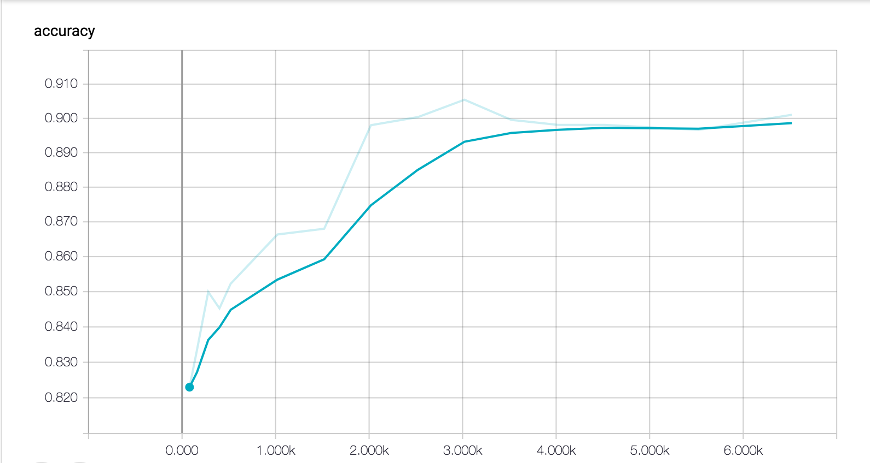
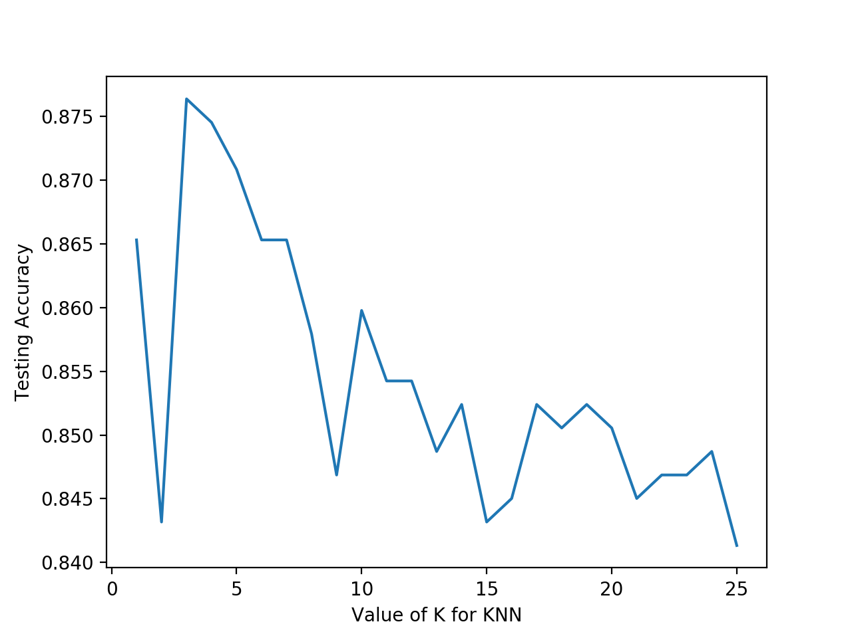
Results

Slide 6
Conclusion
Choose algorithms based on the features and the purpose of learning
Visualization to see trend
Only one algorithm is not enough
Study impacts of the data involved

