Slide 1
LA City Health Prediction
Yifan Liu

Slide 2
Dataset
MyLA311 Service Request Data 2016
Number of instances: 9527600
Attributes: 33 (request created date, request type, and location……)
by City of Los Angeles, Information Technology Agency
Physical health not good for ≥14 days among adults aged ≥18 years 2014
Number of instances: 1005
Attributes: 24 (population, data value, and geolocation……)
By CDC Behavioral Risk Factor Surveillance System
Notes:
1. Mean of the integrated profile. 2. Standard deviation of the integrated profile. 3. Excess kurtosis of the integrated profile. 4. Skewness of the integrated profile. 5. Mean of the DM-SNR curve. 6. Standard deviation of the DM-SNR curve. 7. Excess kurtosis of the DM-SNR curve. 8. Skewness of the DM-SNR curve.

Slide 3
Data Pre-process
Determine areas and their geolocation:
Aggregate dataset based on neighborhood areas
Normalization

Slide 4
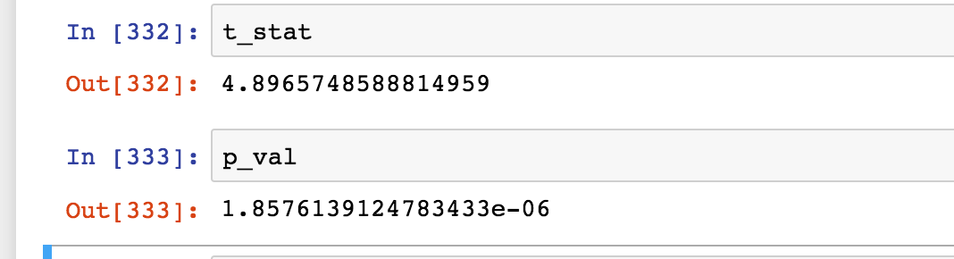
Hypothesis
Health rate is higher for the area with less requests than the area with more requests
Dependent variable: requests
Independent variable: health rate
H₀: Health rate is the same for more-request area and less-request area
H₁: Health rate is higher for less-request area than more-request area
T-Test:
P-value

Slide 5
KNN:
<|"folds_scores" -> {0.602941, 0.617647, 0.617647, 0.654412, 0.617647, 0.566176, 0.610294, 0.632353, 0.573529, 0.595588}, "avg_scores" -> 0.608824|>
SVM:
<|"folds_scores" -> {0.610294, 0.566176, 0.669118, 0.558824, 0.632353, 0.661765, 0.617647, 0.595588, 0.595588, 0.669118}, "avg_scores" -> 0.617647|>
Random Forest:
<|"folds_scores" -> {0.867647, 0.897059, 0.897059, 0.852941, 0.882353, 0.838235, 0.816176, 0.860294, 0.823529, 0.852941}, "avg_scores" -> 0.858824|>

Slide 6
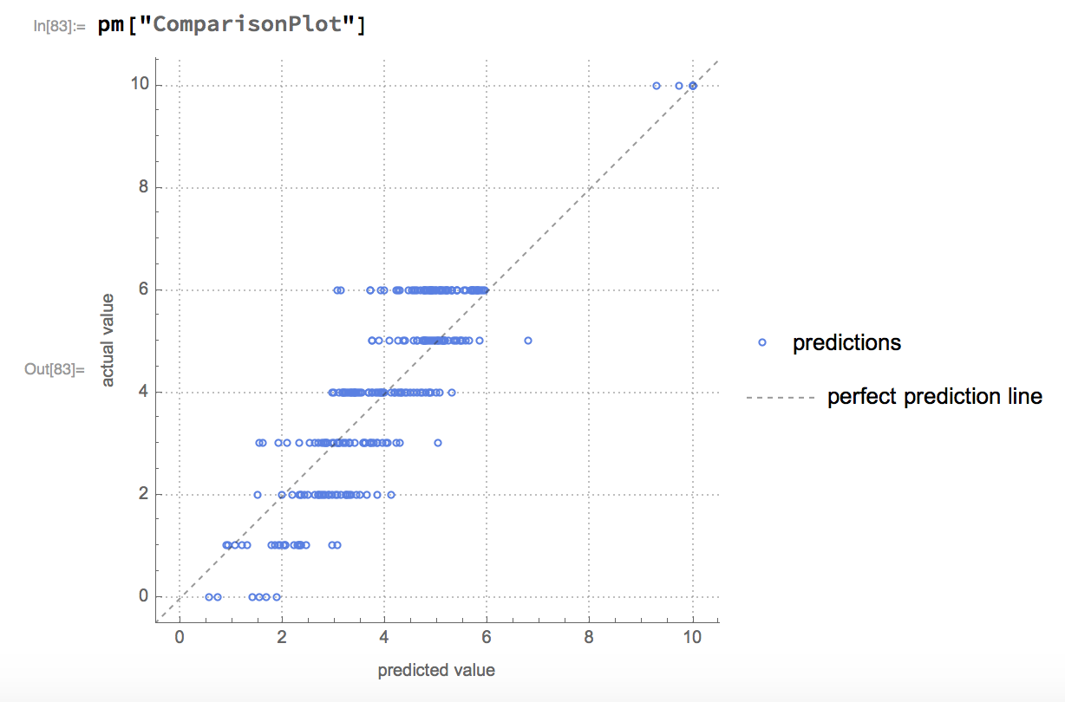
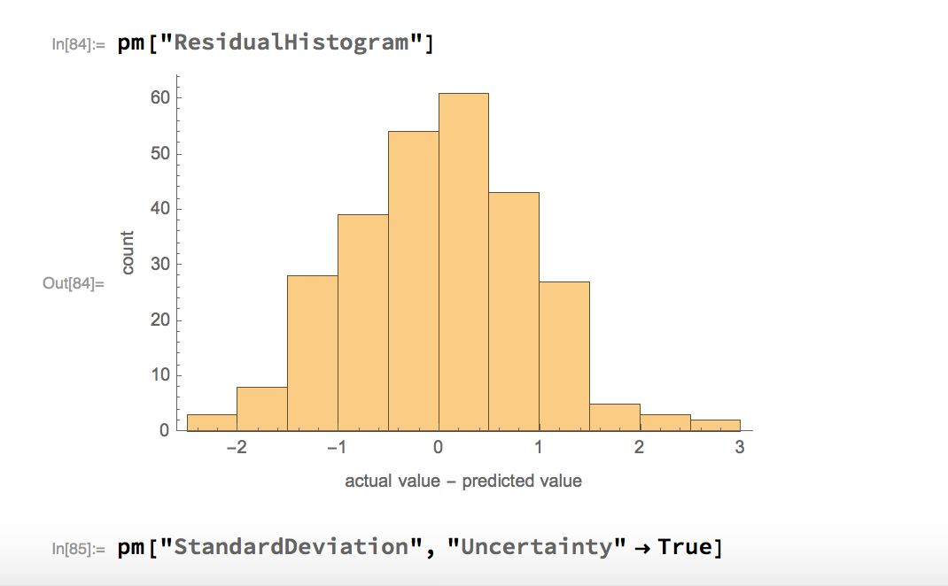

Slide 7
