Slide 1
Pulsar Candidates Classification
Yifan Liu

Slide 2
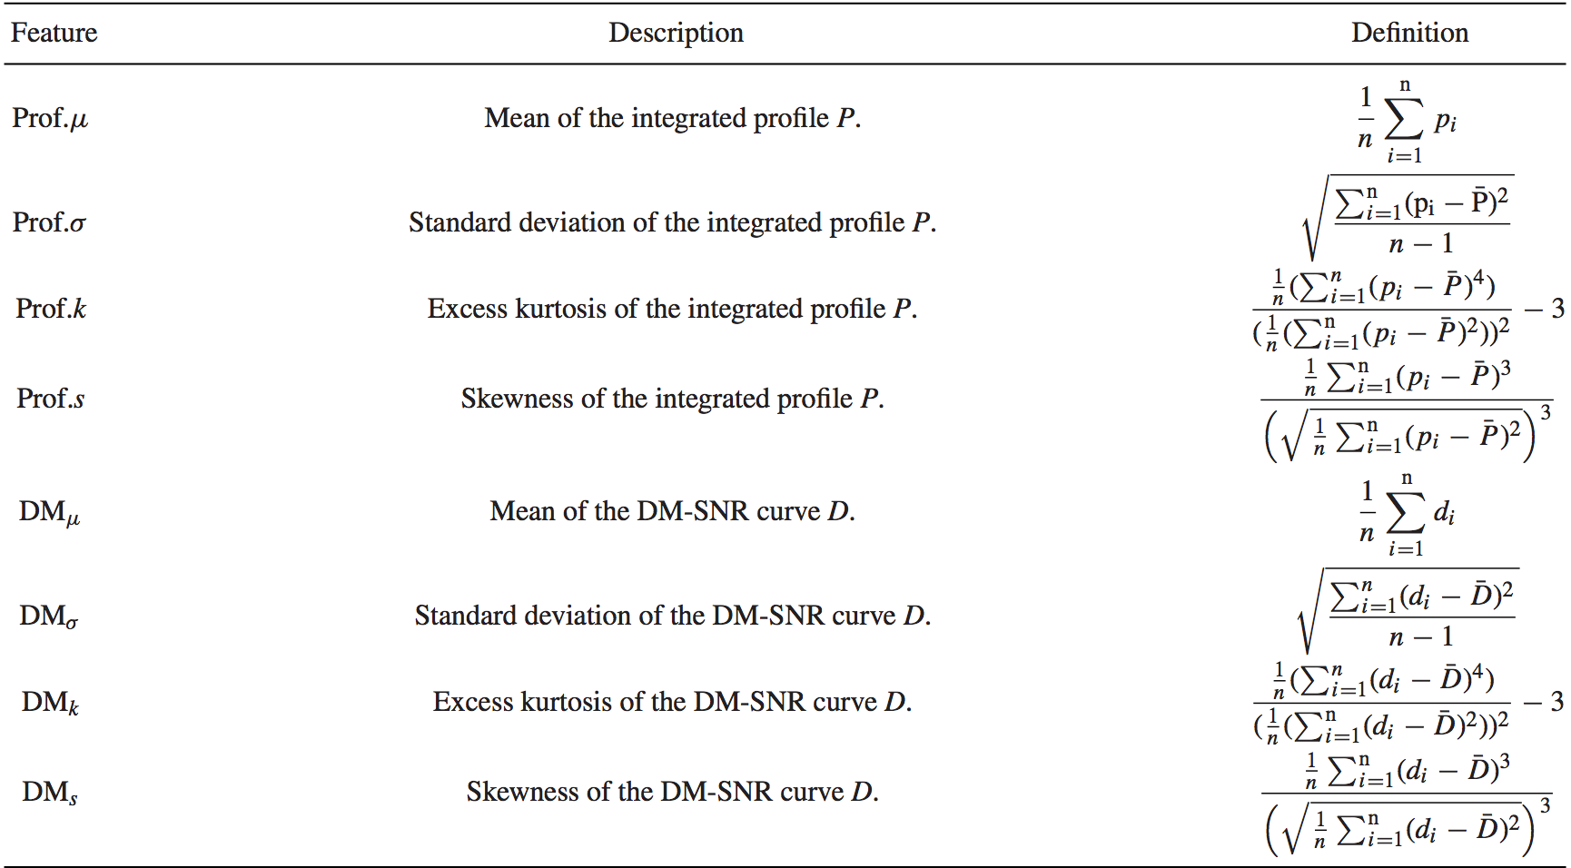
HTRU2 Dataset
Number of instances: 17898(1,639 pulsar / 16,259 non-pulsar)
Attributes:
Source:
Dr Robert Lyon, University of Manchester

Slide 3
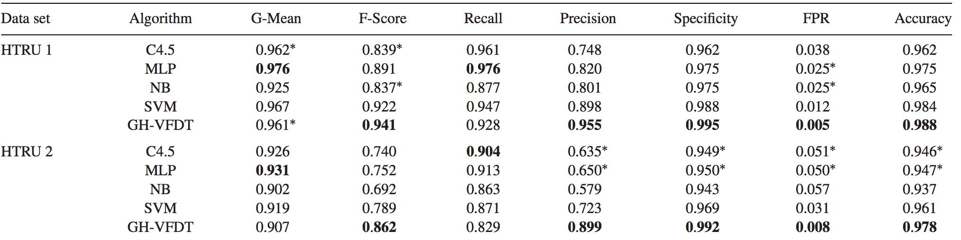
Previous Work and Results

Slide 4
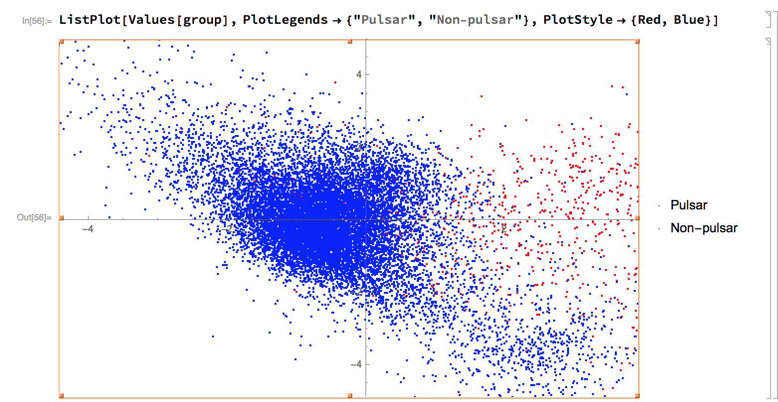
Problem: pulsar and non-pulsar classification
Algorithms: SVM(support vector machine)
Result:
<|"folds_scores" -> {0.976523, 0.977641, 0.986585, 0.979318, 0.979318, 0.974287, 0.9782, 0.979318, 0.974287, 0.973169}, "avg_scores" -> 0.977865|>

