Slide 1
Chapter 11 Sandwiching
Chapter 12 Propp-Wilson with read-once randomness
Chapter 13 Simulated annealing
Wei Liu
2019/04/03

Slide 2
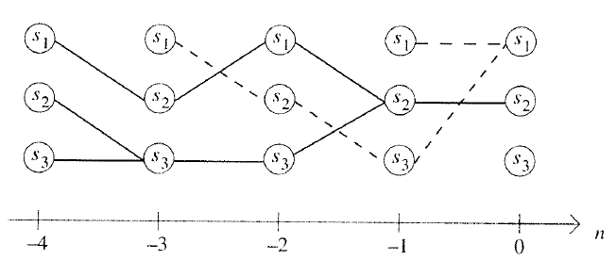
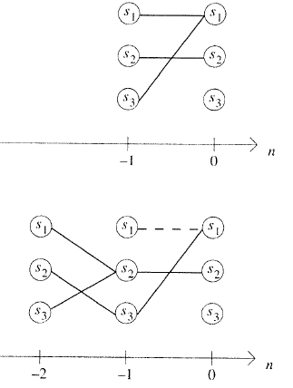
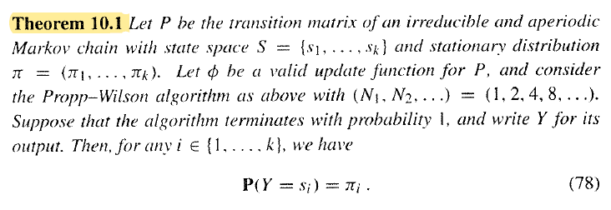
Chapter 11 Sandwiching
Recall the Propp-Wilson algorithm.

Slide 3
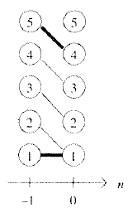
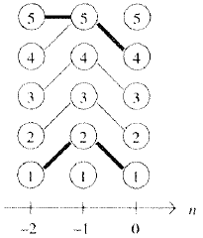
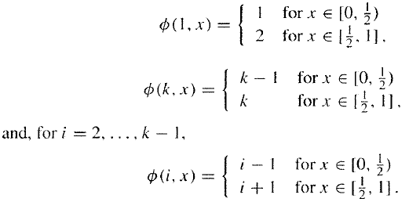
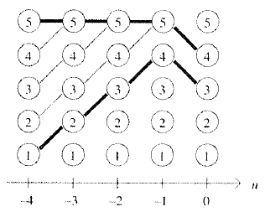
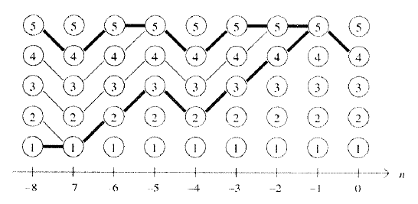
Chapter 11 Sandwiching
Sandwiching is an idea for making the Propp-Wilson algorithm work on large state spaces. This idea works for Markov chains obeying certain monotonicity properties with respect to some ordering of the state space.
Ladder walk

Slide 4
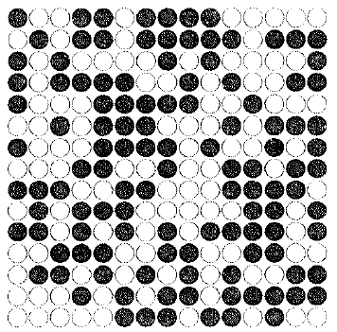










Chapter 11 Sandwiching
Ising model
Low energy of a configuration corresponds to a large amount of agreement between neighboring vertices
every spin configuration has the same probability
the model favors configurations with low energy
“all plus” configuration and the “all minus” configuration.

Slide 5
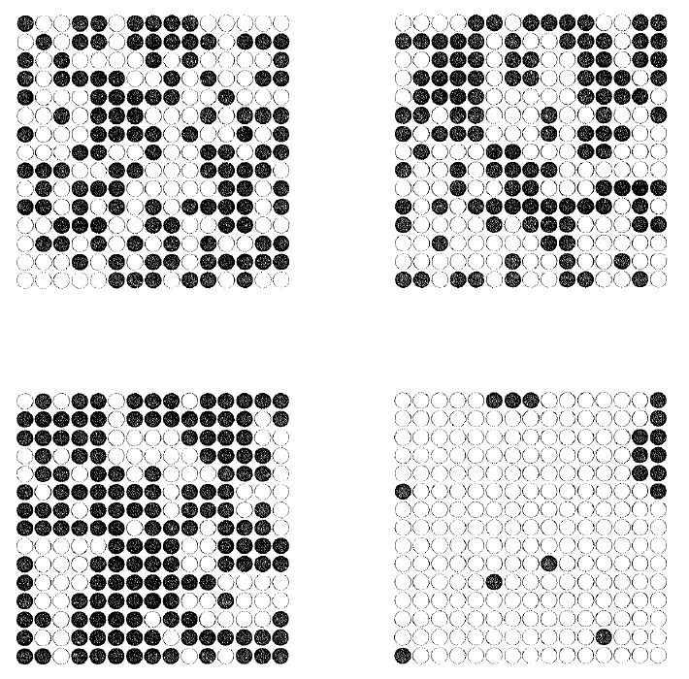





Chapter 11 Sandwiching
Simulation algorithms for the Ising model
Gibbs sampler:

Slide 6








Chapter 11 Sandwiching

Slide 7
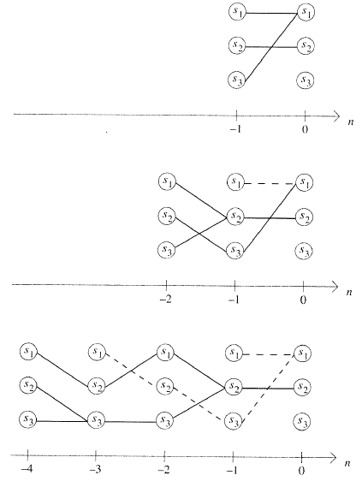
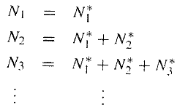
Chapter 12 Propp-Wilson with read-once randomness
Original Propp-Wilson algorithm: need to read all the random numbers in the previous steps.
Modified Propp-Wilson algorithm: avoid storage and reuse of random numbers.

Slide 8

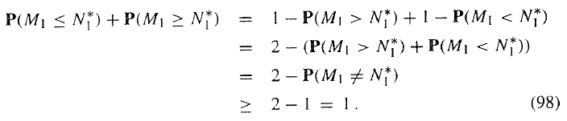

Chapter 12 Propp-Wilson with read-once randomness
an unknown probability

Slide 9


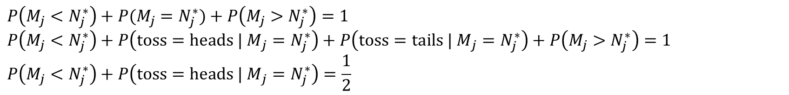
Chapter 12 Propp-Wilson with read-once randomness
$$P\left(M_{j}<N_{j}^{∗}\right)+P(M_{j}=N_{j}^{∗})+P\left(M_{j}>N_{j}^{∗}\right)=1$$
$$P\left(M_{j}<N_{j}^{∗}\right)+P\left({toss=heads | M}_{j}=N_{j}^{∗}\right)+P\left({toss=tails | M}_{j}=N_{j}^{∗}\right)+P\left(M_{j}>N_{j}^{∗}\right)=1$$
$$P\left(M_{j}<N_{j}^{∗}\right)+P\left({toss=heads | M}_{j}=N_{j}^{∗}\right)=\frac{1}{2}$$

Slide 10
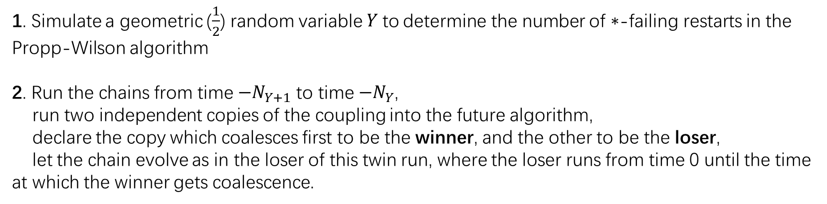
Chapter 12 Propp-Wilson with read-once randomness
1. Simulate a geometric ($\frac{1}{2}$) random variable$Y$to determine the number of $∗$-failing restarts in the Propp-Wilson algorithm
2. Run the chains from time $−N_{Y+1}$ to time $−N_{Y}$,
run two independent copies of the coupling into the future algorithm,
declare the copy which coalesces first to be the winner, and the other to be the loser,
let the chain evolve as in the loser of this twin run, where the loser runs from time 0 until the time at which the winner gets coalescence.
3. $Y=Y−1$, repeat step 2, until $Y=1$.

Slide 11

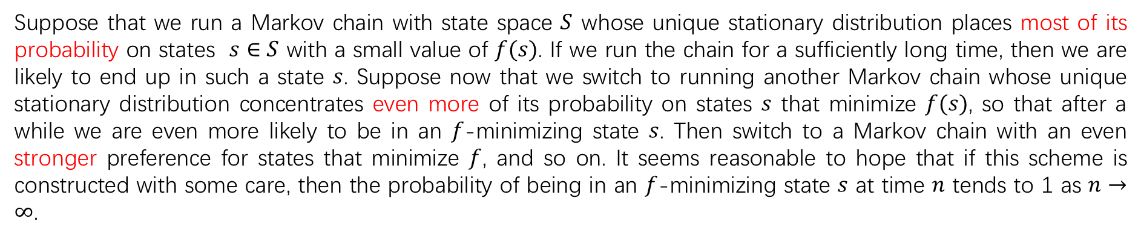
Chapter 13 Simulated annealing
We have a set and a function . The objective is to find an which minimizes (or, sometimes, maximizes .
Suppose that we run a Markov chain with state space $S$ whose unique stationary distribution places most of its probability on states $s∈S$ with a small value of $f(s)$. If we run the chain for a sufficiently long time, then we are likely to end up in such a state $s$. Suppose now that we switch to running another Markov chain whose unique stationary distribution concentrates even more of its probability on states $s$ that minimize $f(s)$, so that after a while we are even more likely to be in an $f$-minimizing state $s$. Then switch to a Markov chain with an even stronger preference for states that minimize $f$, and so on. It seems reasonable to hope that if this scheme is constructed with some care, then the probability of being in an $f$-minimizing state $s$ at time $n$ tends to 1 as $n→∞$.

Slide 12
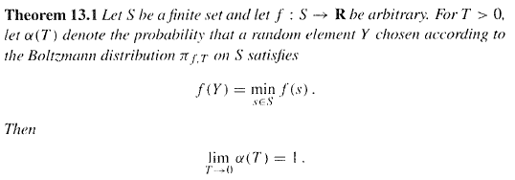
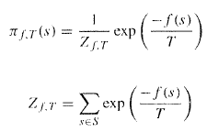

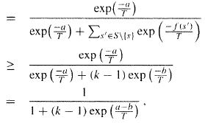
Chapter 13 Simulated annealing
Boltzmann distribution

Slide 13
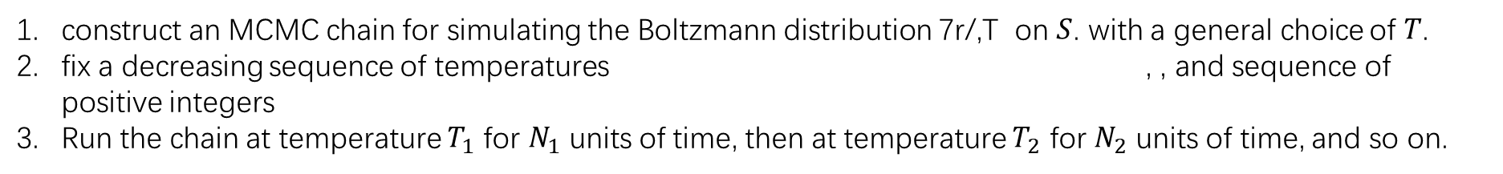
Chapter 13 Simulated annealing
Simulated annealing algorithm
construct an MCMC chain for simulating the Boltzmann distribution 7r/,T on $S$. with a general choice of $T$.
fix a decreasing sequence of temperatures , , and sequence of positive integers
Run the chain at temperature $T_{1}$ for $N_{1}$ units of time, then at temperature $T_{2}$ for $N_{2}$ units of time, and so on.
The choice of annealing schedule in practice is therefore a highly delicate balance: On the one hand, we want it to be fast enough to get convergence in reasonable time, and on the other hand, we want it to be slow enough to avoid converging to an element which is not an $f$-minimizer. This often requires quite a bit of experimentation

Slide 14

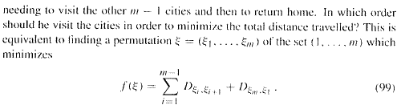
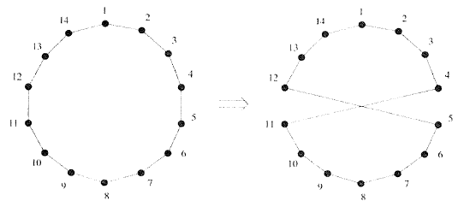
Chapter 13 Simulated annealing

Slide 15
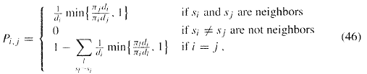
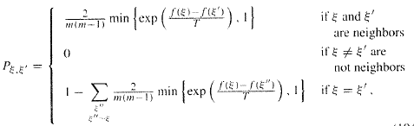



Chapter 13 Simulated annealing
The Metropolis chain corresponding to a given choice of $G$ has transition matrix:
Inserting the stationary distribution to (46), we can get:
First pick $i,j∈\left\{1,…, m\right\}$ uniformly from the set of all choices such that $i<j$. Then switch from the
present permutation $ξ$ to the permutation $ξ′$ defined with probability

Slide 16
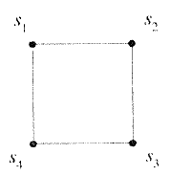
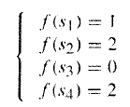

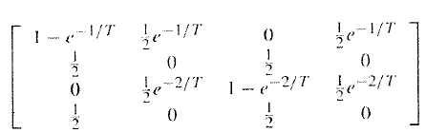
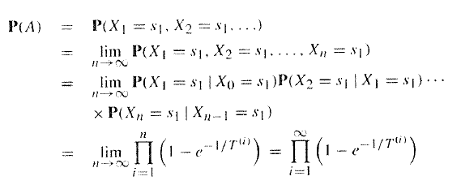



Chapter 13 Simulated annealing
Example 13.4: The hazard of using a fast annealing schedule.
$P(A)>0$,fails

