Slide 1
Perceptual-Sensitive GAN for Generating Adversarial Patches
Aishan Liu¹, Xianglong Liu^{1*}, Jiaxin Fan¹, Yuqing Ma¹, Anlan Zhang¹
Huiyuan Xie² and Dacheng Tao³
¹State Key Laboratory of Software Development Environment, Beihang University, China
{liuaishan, xlliu, jxfan, mayuqing, zal1506}@buaa.edu.cn
²Department of Computer Science and Technology, University of Cambridge, UK
hx255@cam.ac.uk
³UBTECH Sydney AI Centre, SIT, FEIT, University of Sydney, Australia
dacheng.tao@sydney.edu.au

Slide 2
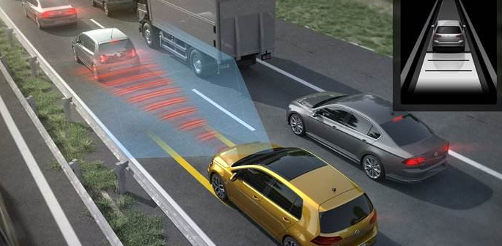
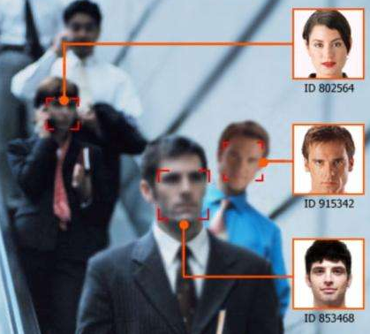
Introduction
Artificial Intelligence Safety
Widely used AI techniques
AI safety needs to be improved
Auto Driving
Face Recognition
$

Slide 3
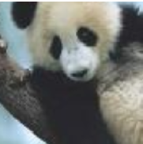
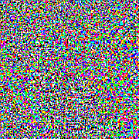
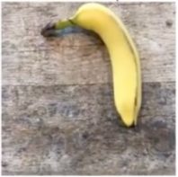
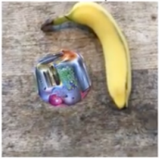

Introduction
Adversarial Example
An elaborately designed example that can mislead deep learning models:
Imperceptible to human
Misleading deep learning models
Clean Example
Human：Panda
DNN：Panda
Noise
Adversarial Example
Human：Panda
DNN：Gibbon
Adversarial Patch
An visible noise that is localized to a small area of the image that can mislead deep learning models ：
Input-Independent
Scene-Independent
Clean Example
Human：Banana
DNN：Banana
Adversarial
Patch
Adversarial Example
Human：Banana
DNN：Toaster

Slide 4
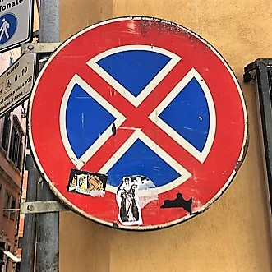
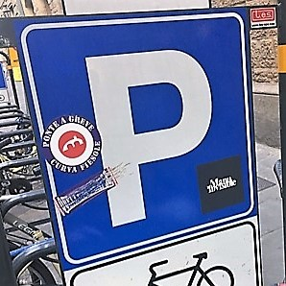
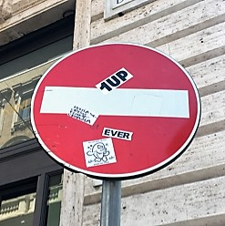
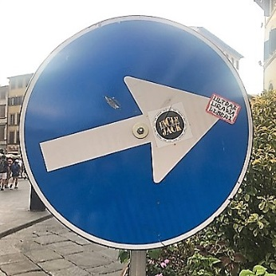
Introduction
An Interesting & Valuable Scenario
Real world traffic signs with scrawls and patches are quite common. Photos taken in downtown of Rome.
Current Dilemma
Our Motivation
Meaningless adversarial patch
Lack perceptual correlation
Weak visual-fidelity
Unstable attack ability
Generate visually natural adversarial patch
High perceptual correlation with image context
Visual-fidelity
Strong attack ability

Slide 5
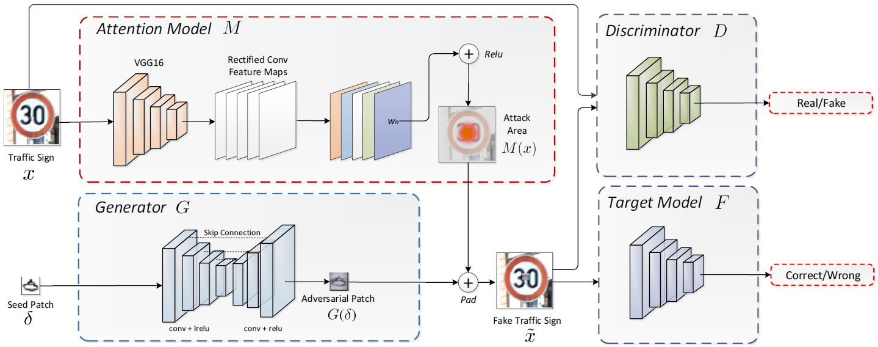
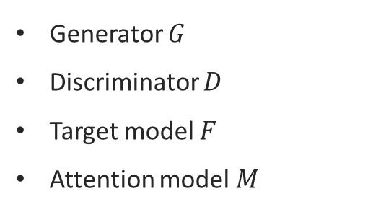
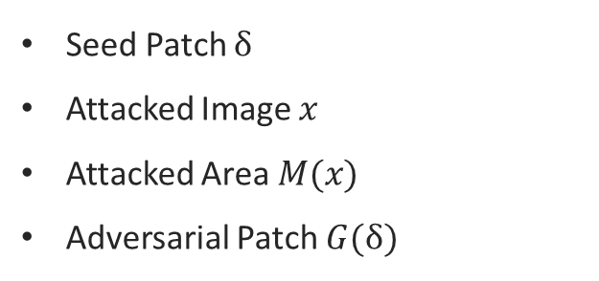
Perceptual-Sensitive GAN
Overview
Patch-to-Patch Translation
Generator $G$
Discriminator $D$
Target model $F$
Attention model $M$
Seed Patch $δ$
Attacked Image $x$
Attacked Area $M(x)$
Adversarial Patch $G(δ)$

Slide 6
Perceptual-Sensitive GAN
Overview
Patch-to-Patch Translation
Generator $G$
Discriminator $D$
Target model $F$
Attention model $M$
Seed Patch $δ$
Attacked Image $x$
Attacked Area $M(x)$
Adversarial Patch $G(δ)$

Slide 7
Perceptual-Sensitive GAN
Overview
Patch-to-Patch Translation
Generator $G$
Discriminator $D$
Target model $F$
Attention model $M$
Seed Patch $δ$
Attacked Image $x$
Attacked Area $M(x)$
Adversarial Patch $G(δ)$

Slide 8
Perceptual-Sensitive GAN
Overview
Patch-to-Patch Translation
Generator $G$
Discriminator $D$
Target model $F$
Attention model $M$
Seed Patch $δ$
Attacked Image $x$
Attacked Area $M(x)$
Adversarial Patch $G(δ)$

Slide 9
Perceptual-Sensitive GAN
Overview
Patch-to-Patch Translation
Generator $G$
Discriminator $D$
Target model $F$
Attention model $M$
Seed Patch $δ$
Attacked Image $x$
Attacked Area $M(x)$
Adversarial Patch $G(δ)$

Slide 10


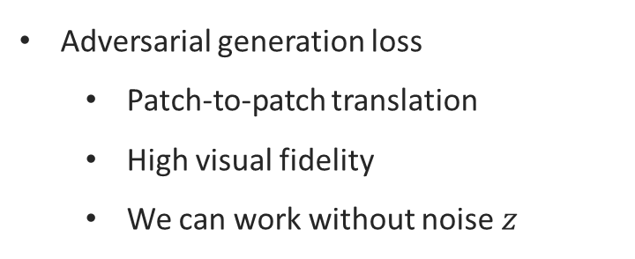
Formulation
Visual Fidelity & Perceptual Correlation
Adversarial generation loss
Patch-to-patch translation
High visual fidelity
We can work without noise $z$
Patch loss
High perceptual correlation
Constrain distortion

Slide 11


Formulation
Attention Sensitivity & Attacking Ability
Adversarial attacking loss
Attacking ability
Untargeted
Also can be targeted
Attention sensitivity
Critical attacking area leading to better performance
Grad-CAM
Overall Loss

Slide 12
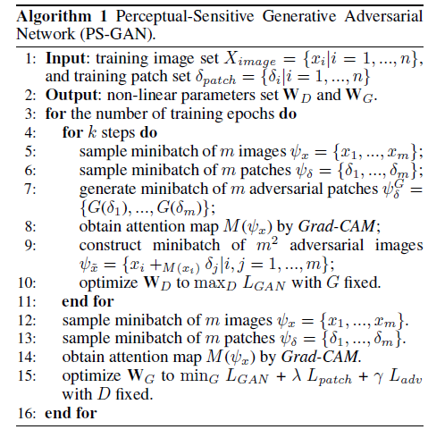
Perceptual-Sensitive GAN
Training Process

Slide 13
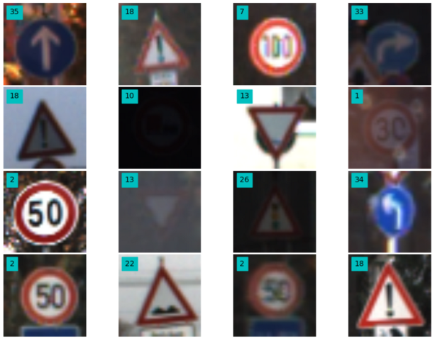
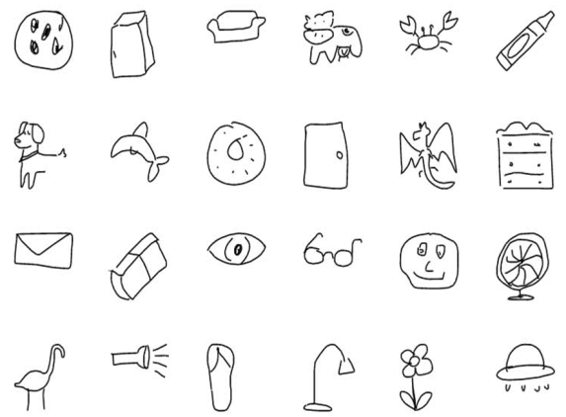
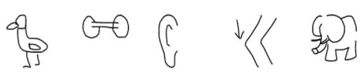

Experiments
Image dataset - GTSRB
Dataset
GTSRB
ImageNet
Attack Type
White-box attack
Black-box attack
Patch dataset - QuickDraw
Experiment Type
Digital world
Physical world

Slide 14
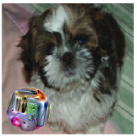
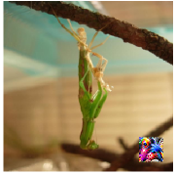
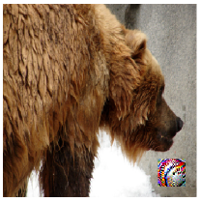
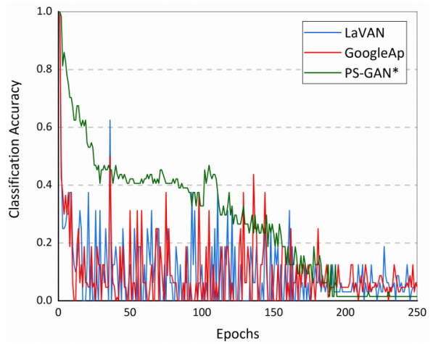
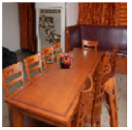
Experiments
Attacking Algos
GoogleAp
LaVAN
Implementation
Tensorflow
NVIDIA Tesla K80 GPU cluster
Converge at epoch 200

Slide 15

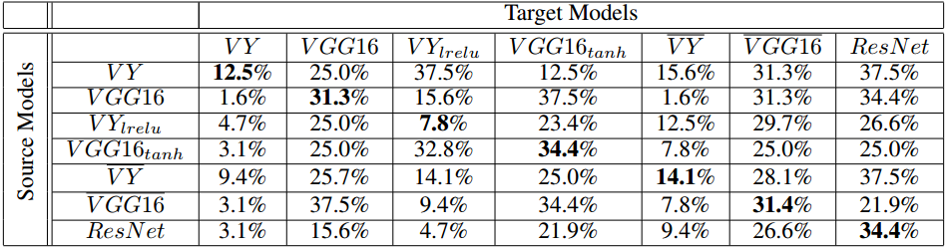
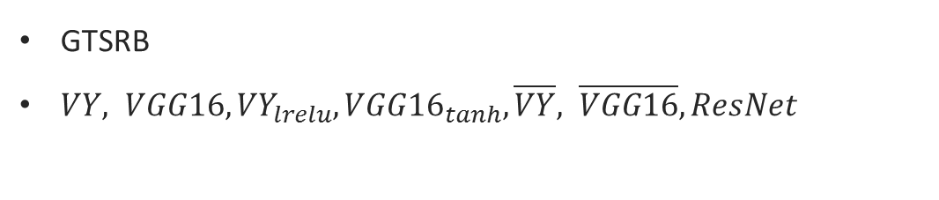
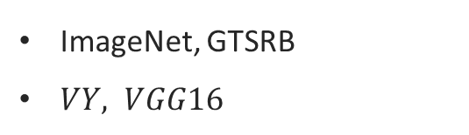
Experiments
Digital World Attack
Semi-Whitebox Attack
ImageNet, GTSRB
$VY, VGG16$
Transferability & Blackbox Attack
GTSRB
$VY, VGG16,{VY}_{lrelu}, {VGG16}_{tanh},\overline{VY}, \overline{VGG16}, ResNet$

Slide 16
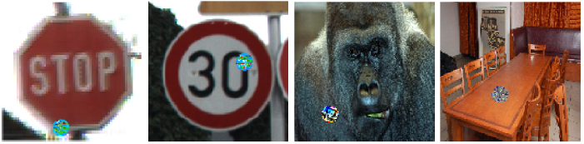
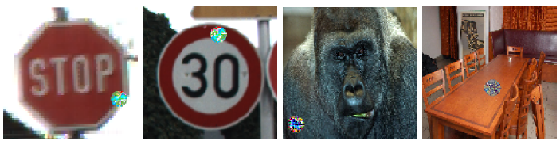
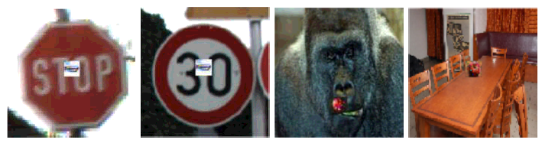
Experiments
Digital World Attack
Advantages
Visual Fidelity
GoogleAp
Noise-like patch
Good-looking patch
Perceptual Correlation
Meaningless
Natural and Harmonious
LaVAN
PsGAN

Slide 17
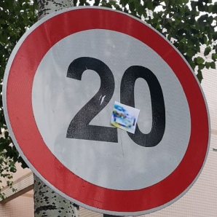
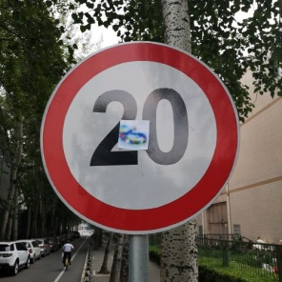
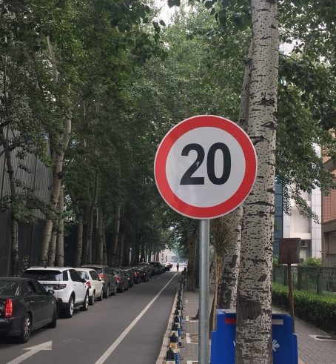
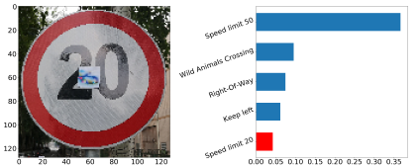
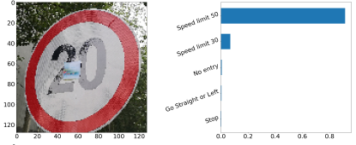
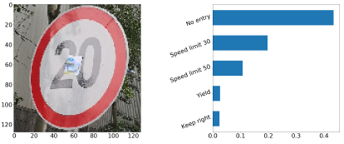
Experiments
Traffic Signs with Patch
Physical World Attack
Classification Result
Real-world traffic sign
Beihang University Campus
Various angles and distances
4 adversarial patches
Print & Stick & Photo
86.7% --> 17.2%

Slide 18
References
[1] Athalye, A., and Sutskever, I. 2017. Synthesizing robust adversarial examples. arXiv preprint arXiv:1707.07397.
[2] Brown, T. B.; Mane, D.; Roy, A.; Abadi, M.; and Gilmer, J. 2017. Adversarial patch. arXiv preprint arXiv:1712.09665.
[3] Evtimov, I.; Eykholt, K.; Fernandes, E.; Kohno, T.; Li, B.; Prakash, A.; Rahmati, A.; and Song, D. 2017. Robust physical-world attacks on deep learning models. arXiv preprint arXiv:1707.08945
[4] Goodfellow, I. J.; Pouget-Abadie, J.; Mirza, M.; Xu, B.; Warde-Farley, D.; Ozair, S.; Courville, A.; and Bengio, Y. 2014. Generative adversarial nets. Advances in Neural Information Processing Systems, 2672–2680.
[5] Goodfellow, I. J.; Shlens, J.; and Szegedy, C. Explaining and harnessing adversarial examples (2014). arXiv preprint arXiv:1412.6572.
[6] Houben, S.; Stallkamp, J.; Salmen, J.; Schlipsing, M.; and Igel, C. 2008. Detection of traffic signs in real-world images: The german traffic sign detection benchmark. In International Joint Conference on Neural Networks, 1–8.
[7] Isola, P.; Zhu, J. Y.; Zhou, T.; and Efros, A. A. 2017. Imageto-image translation with conditional adversarial networks. In IEEE Conference on Computer Vision and Pattern Recognition, 5967–5976.
[8] Johnson, J.; Alahi, A.; and Li, F. F. 2016. Perceptual losses for real-time style transfer and super-resolution. In European Conference on Computer Vision, 694–711.
[9] Karmon, D.; Zoran, D.; and Goldberg, Y. 2018. Lavan: Localized and visible adversarial noise. arXiv preprint arXiv:1801.02608.
[10] Kurakin, A.; Goodfellow, I.; and Bengio, S. 2016. Adversarial examples in the physical world. arXiv preprint arXiv:1607.02533.
[11] Pathak, D.; Krahenbuhl, P.; Donahue, J.; Darrell, T.; and Efros, A. A. 2016. Context encoders: Feature learning by inpainting. In The IEEE Conference on Computer Vision and Pattern Recognition, 2536–2544.
[12] Selvaraju, R. R.; Das, A.; Vedantam, R.; Cogswell, M.; Parikh, D.; and Batra, D. 2016. Grad-cam: Why did you say that? visual explanations from deep networks via gradientbased localization. CoRR, abs/1610.02391, 7.
[13] Szegedy, C.; Zaremba, W.; Sutskever, I.; Bruna, J.; Erhan, D.; Goodfellow, I.; and Fergus, R. 2013. Intriguing properties of neural networks. arXiv preprint arXiv:1312.6199.
[14] Xiao, C.; Li, B.; Zhu, J.-Y.; He, W.; Liu, M.; and Song, D. 2018. Generating adversarial examples with adversarial networks. arXiv preprint arXiv:1801.02610.

Slide 19
Thanks!

