Slide 1
Chapter 16
Web Engineering

Slide 2
16.1 Attributes of WebApps
Attributes
Network intensiveness. A WebApp resides on a network and must serve the needs of a diverse community of clients (Internet, Intranet or Extranet).
Concurrency. A large number of users may access the WebApp at one time; patterns of usage among end-users will vary greatly.
Unpredictable load. The number of users of the WebApp may vary by orders of magnitude from day to day.
Performance. If a WebApp user must wait too long (for access, for server-side processing, for client-side formatting and display), he or she may decide to go elsewhere.
1/10

Slide 3
16.1 Attributes of WebApps
Attributes
Availability. Although expectation of 100 percent availability is unreasonable, users of popular WebApps often demand access on a “24/7/365” basis.
Data driven. The primary function of many WebApps is to use hypermedia to present text, graphics, audio, and video content to the end-user.
Content sensitive. The quality and aesthetic nature of content remains an important determinant of the quality of a WebApp.
Continuous evolution. Unlike conventional application software that evolves over a series of planned, chronologically-spaced releases, Web applications evolve continuously.
2/10

Slide 4
16.1 Attributes of WebApps
Attributes
Immediacy. WebApps often exhibit a time to market that can be a matter of a few days or weeks.
Security. In order to protect sensitive content and provide secure modes of data transmission, strong security measures must be implemented throughout the infrastructure that supports a WebApp and within the application itself.
Aesthetics. When an application has been designed to market or sell products or ideas, aesthetics may have as much to do with success as technical design.
3/10

Slide 5
16.1 Attributes of WebApps
Categories
Informational — read-only content is provided with simple navigation and links
Download — a user downloads information from the appropriate server
Customizable — the user customizes content to specific needs
Interaction — communication among a community of users occurs via chatroom, bulletin boards, or instant messaging
User input — forms-based input is the primary mechanism for communicating need
Transaction-oriented — the user makes a request (e.g., places an order) that is fulfilled by the WebApp
4/10

Slide 6
16.1 Attributes of WebApps
Categories
Service-oriented — the application provides a service to the user, e.g., assists the user in determining a mortgage payment
Portal — the application channels the user to other Web content or services outside the domain of the portal application
Database access — the user queries a large database and extracts information
Data warehousing — the user queries a collection of large databases and extracts information
5/10

Slide 7
16.2 WebApp Engineering Layers
Languages: HTML, XML, VRML…
Programming Languages: Java…
Resources: CORBA, COM, ActiveX, .NET …
Communication
Requirements analysis
Design Testing
Agile
tools
methods
process model
a “quality” focus
6/10

Slide 8
16.3 The WebE Process
Must accommodate:
  Incremental delivery
  Frequent changes
  Short timeline
An incremental process model should be used in virtually all situations
An agile process model is appropriate in many situations
7/10

Slide 9
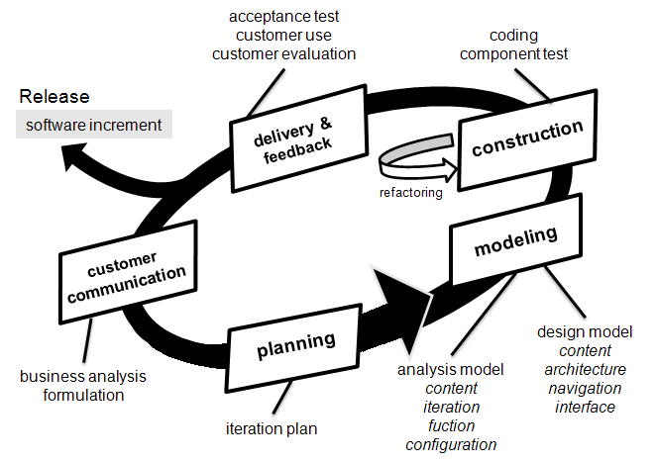
16.3 The WebE Process
8/10

Slide 10
16.3 The WebE Process
Basic Questions
How important is a Web site home page?
What is the most effective page layout (e.g., menu on top, on the right or left?) and does it vary depending upon the type of WebApp being developed?
Which media options have the most impact?
How much work can we expect a user to do when he or she is looking for information?
How important are navigational aids when WebApps are complex?
How complex can forms input be before it becomes irritating for the user? How can forms input be expedited?
How important are search capabilities?
Will the WebApp be designed in a manner that makes it accessible to those who have physical or other disabilities?
9/10

Slide 11
16.4 WebE Best Practices
Take the time to understand the business needs and product objectives, even if the details of the WebApp are vague.
Describe how users will interact with the WebApp using a scenario-based approach
Develop a project plan, even if it is very brief.
Spend some time modeling what it is that you’re going to build.
Review the models for consistency and quality.
Use tools and technology that enable you to construct the system with as many reusable components as possible.
Don’t rely on early users to debug the WebApp — design comprehensive tests and execute them before releasing the system.
10/10

