Slide 1
Chapter 19
Design Model for WebApps

Slide 2
19.1 Design Issues for Web Engineering
Design and WebApps Quality
  Security
    Rebuff external attacks
    Exclude unauthorized access
    Ensure the privacy of users/customers
  Availability
    the measure of the percentage of time that a WebApp is available for use
  Scalability
    Can the WebApp and the systems with which it is interfaced handle significant variation in user or transaction volume
  Time to Market
1/19
Notes:
What are the most important quality issues?

Slide 3
19.1 Design Issues for Web Engineering
Design Goals
  Simplicity
  Consistency: content, aesthetics, architectural design, interface design, navigation mechanisms
  Identity: domain image
  Robustness
  Navigability: move around without help
  Visual appeal
  Compatibility: hardware, Internet connection types, OS, browsers…
2/19

Slide 4
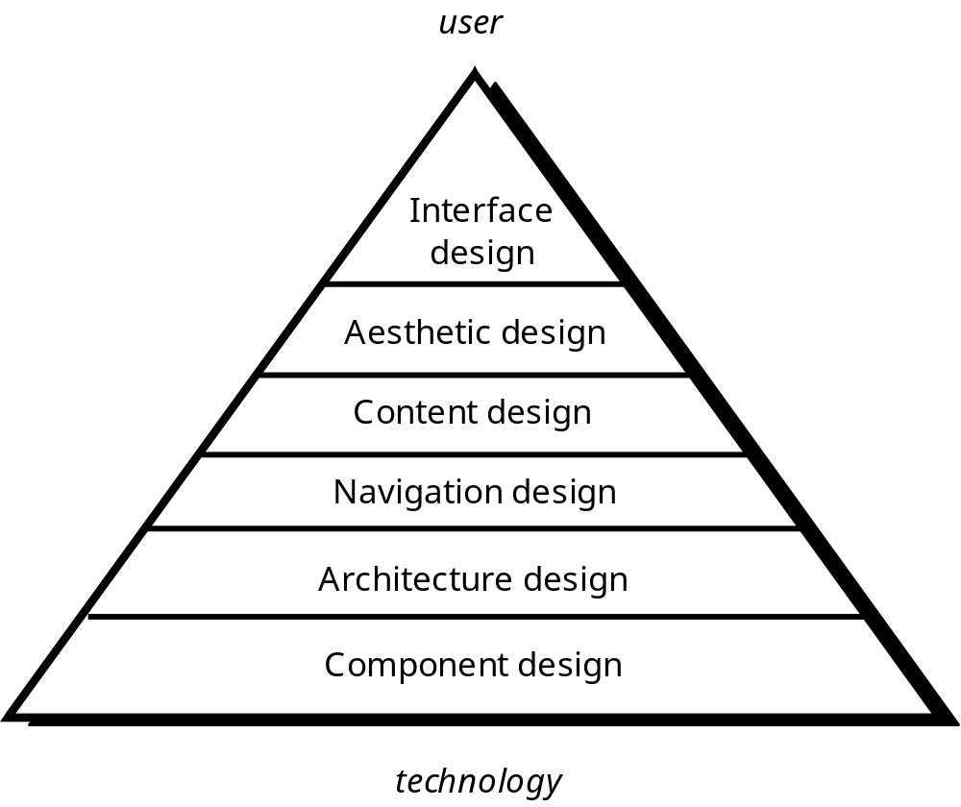
19.2 WebE Design Pyramid
3/19

Slide 5
19.3 WebApp Interface Design
Primary Questions
  Where am I?
    provide an indication of the WebApp that has been accessed
    inform the user of her location in the content hierarchy
  What can I do now?
    what functions are available?
    what links are live?
    what content is relevant?
  Where have I been, where am I going?
    Provide a map
4/19

Slide 6
19.3 WebApp Interface Design
Fundamental Characteristics
  Effective interfaces are visually apparent and forgiving, instilling in their users a sense of control. Users quickly see the breadth of their options, grasp how to achieve their goals, and do their work.
  Effective interfaces do not concern the user with the inner workings of the system. Work is carefully and continuously saved, with full option for the user to undo any activity at any time.
  Effective applications and services perform a maximum of work, while requiring a minimum of information from users.
Please read 19.3.1 for
Design Principles and Guidelines
5/19
Notes:
Apparent明显的

Slide 7
19.3 WebApp Interface Design
Interface Control Mechanisms
  Navigation menues
  Graphic icons
  Graphic images
6/19

Slide 8
19.3 WebApp Interface Design
Workflow
  Review information contained in the analysis model and refine as required.
  Develop a rough sketch of the WebApp interface layout.
  Map user objectives into specific interface actions.
  Define a set of user tasks that are associated with each action.
  Storyboard screen images for each interface action.
  Refine interface layout and storyboards using input from aesthetic design.
7/19
Notes:
3. Objective对应页面上哪个点击
4. 点击对应一系列动作完成objective

Slide 9
19.3 WebApp Interface Design
Workflow
  Identify user interface objects that are required to implement the interface.
  Develop a procedural representation of the user’s interaction with the interface.
  Develop a behavioral representation of the interface.
  Describe the interface layout for each state.
  Refine and review the interface design model.
8/19

Slide 10
19.4 Aesthetic Design
Don’t be afraid of white space.
Emphasize content.
Organize layout elements from top-left to bottom right.
Group navigation, content, and function geographically within the page.
Don’t extend your real estate with the scrolling bar.
Consider resolution and browser window size when designing layout.
9/19
Notes:
Geographically：有规律地排列

Slide 11
19.5 Content Design
Design Issues
  Develops a design representation for content objects
  Represents the mechanisms required to instantiate their relationships to one another
UML
10/19

Slide 12
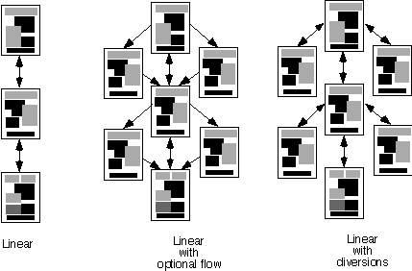
19.6 Architecture Design
Content Architecture focuses on the manner in which content objects (or composite objects such as Web pages) are structured for presentation and navigation.
Linear Structure
11/19

Slide 13
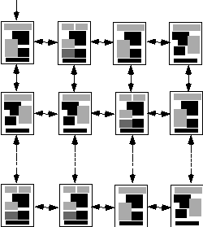
19.6 Architecture Design
Content Architecture
Grid Structure
12/19

Slide 14
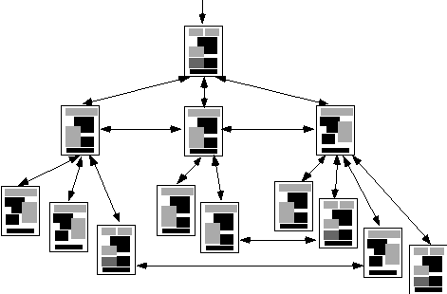
19.6 Architecture Design
Content Architecture
Hierarchical Structure
13/19

Slide 15
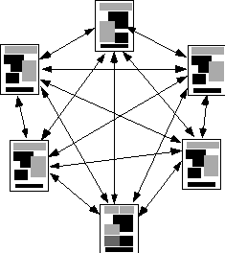
19.6 Architecture Design
Content Architecture
Network Structure
14/19

Slide 16
19.6 Architecture Design
WebApp Architecture describes an infrastructure that enables a Web-based system to achieve its business objectives.
The Model-View-Controller (MVC) architecture
  The model contains all application specific content and processing logic
  The view contains all interface specific functions
  The controller manages access to the model and the view and coordinates the flow of data between them
15/19
Notes:
Infrastructure：基础设施

Slide 17
19.7 Navigation Design
Navigation Semantic Units (NSUs)
  a set of information and related navigation structures that collaborate in the fulfillment of a subset of related user requirements
  One NSU for each use-case associated with each user role
16/19

Slide 18
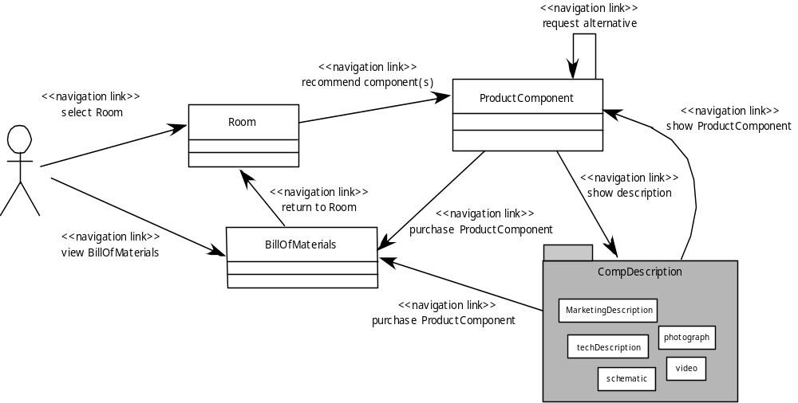
19.7 Navigation Design
17/19

Slide 19
19.7 Navigation Design
Syntax
  Individual navigation link —text-based links, icons, buttons and switches, and graphical metaphors..
  Horizontal navigation bar —lists major content or functional categories in a bar containing appropriate links. In general, between 4 and 7 categories are listed.
  Vertical navigation column
    lists major content or functional categories
    lists virtually all major content objects within the WebApp.
  Tabs —a metaphor that is nothing more than a variation of the navigation bar or column, representing content or functional categories as tab sheets that are selected when a link is required.
  Site maps —provide an all-inclusive tab of contents for navigation to all content objects and functionality contained within the WebApp.
18/19

Slide 20
19.8 Component-Level Design
WebApp components implement the following functionality
  perform localized processing to generate content and navigation capability in a dynamic fashion
  provide computation or data processing capability that are appropriate for the WebApp’s business domain
  provide sophisticated database query and access
  establish data interfaces with external corporate systems
19/19

