Slide 1
Ch.33 Estimation

Slide 2
Software Project Planning
The overall goal of project planning is to establish a pragmatic strategy for controlling, tracking, and monitoring a complex technical project.
Why ?
So the end result gets done on time, with quality!

Slide 3
Project Planning Task Set-I
Establish project scope
Determine feasibility
Analyze risks
  Risk analysis is considered in detail in Chapter 25.
Define required resources
  Determine require human resources
  Define reusable software resources
  Identify environmental resources

Slide 4
Project Planning Task Set-II
Estimate cost and effort
  Decompose the problem
  Develop two or more estimates using size, function points, process tasks or use-cases
  Reconcile the estimates
Develop a project schedule
  Scheduling is considered in detail in Chapter 34.
        Establish a meaningful task set
        Define a task network
        Use scheduling tools to develop a timeline chart
        Define schedule tracking mechanisms

Slide 5
Estimation
Estimation of resources, cost, and schedule for a software engineering effort requires
  experience
  access to good historical information (metrics)
  the courage to commit to quantitative predictions when qualitative information is all that exists
Estimation carries inherent risk and this risk leads to uncertainty

Slide 6
Write it Down!
Project Scope
Estimates
Risks
Schedule
Control strategy
Software
Project
Plan

Slide 7
To Understand Scope ...
Understand the customers needs
understand the business context
understand the project boundaries
understand the customer’s motivation
understand the likely paths for change
understand that ...
Even when you understand,
nothing is guaranteed!

Slide 8
What is Scope?
Software scope describes
  the functions and features that are to be delivered to end-users
  the data that are input and output
  the “content” that is presented to users as a consequence of using the software
  the performance, constraints, interfaces, and reliability that bound the system.
Scope is defined using one of two techniques:
  A narrative description of software scope is developed after communication with all stakeholders.
  A set of use-cases is developed by end-users.

Slide 9
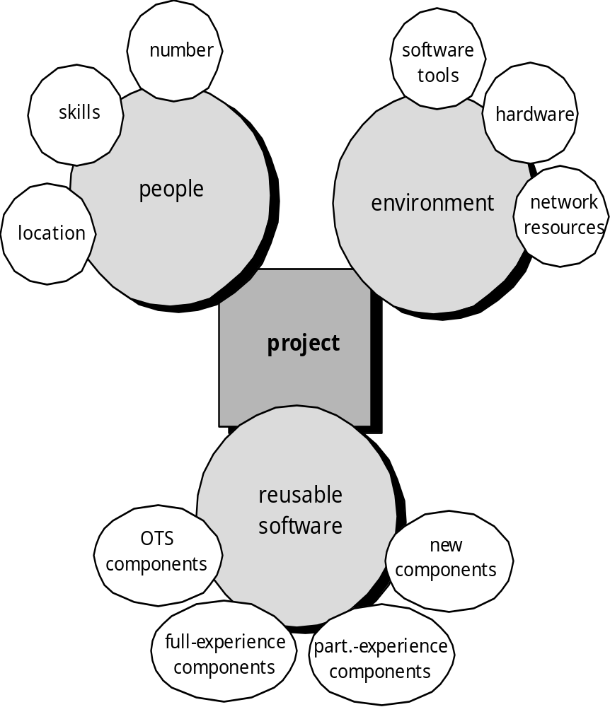
Resources

Slide 10

Project Estimation
Project scope must be understood
Elaboration (decomposition) is necessary
Historical metrics are very helpful
At least two different techniques should be used
Uncertainty is inherent in the process

Slide 11

Estimation Techniques
Past (similar) project experience
Conventional estimation techniques
  task breakdown and effort estimates
  size (e.g., FP) estimates
Empirical models
Automated tools

Slide 12
Estimation Accuracy
Predicated on …
  the degree to which the planner has properly estimated the size of the product to be built
  the ability to translate the size estimate into human effort, calendar time, and dollars (a function of the availability of reliable software metrics from past projects)
  the degree to which the project plan reflects the abilities of the software team
  the stability of product requirements and the environment that supports the software engineering effort.

Slide 13
Functional Decomposition
Statement
of
Scope
functional
decomposition
Perform a Grammatical “parse”

Slide 14
Conventional Methods: LOC/FP Approach
compute LOC/FP using estimates of information domain values
use historical data to build estimates for the project

Slide 15
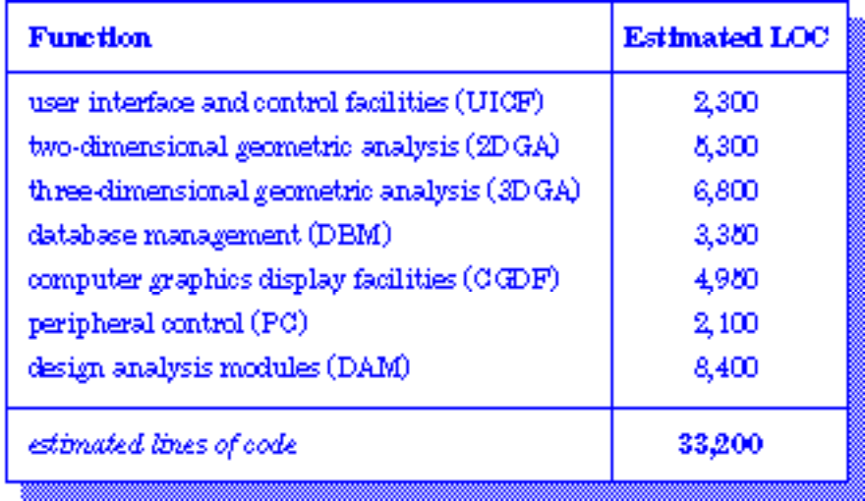
Example: LOC Approach
Average productivity for systems of this type = 620 LOC/pm.
Burdened labor rate =$8000 per month, the cost per line of code is approximately $13.
Based on the LOC estimate and the historical productivity data, the total estimated project cost is $431,000 and the estimated effort is 54 person-months.

Slide 16
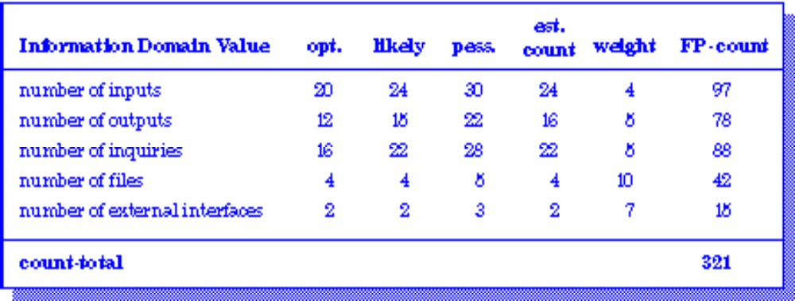
Example: FP Approach
The estimated number of FP is derived:
FP_{estimated} = count-total 3 [0.65 + 0.01 3 S (Fi)]
FP_{estimated} = 375
organizational average productivity = 6.5 FP/pm.
burdened labor rate = $8000 per month, approximately $1230/FP.
Based on the FP estimate and the historical productivity data, total estimated project cost is $461,000 and estimated effort is 58 person-months.

Slide 17
Process-Based Estimation
Obtained from “process framework”
framework activities
application
functions
Effort required to accomplish
each framework activity for each application function

Slide 18
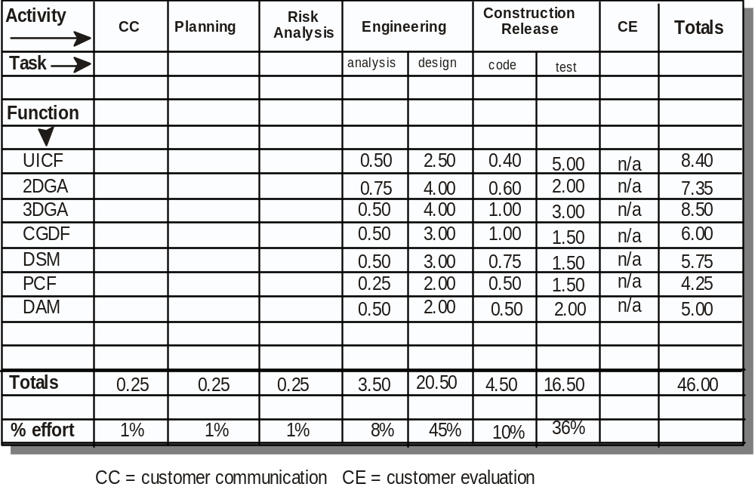
Process-Based Estimation Example
Based on an average burdened labor rate of $8,000 per month, the total estimated project cost is $368,000 and the estimated effort is 46 person-months.

Slide 19

Tool-Based Estimation
project characteristics
calibration factors
LOC/FP data

Slide 20
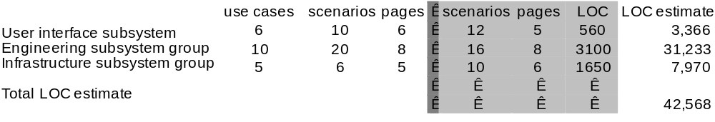
Estimation with Use-Cases
Using 620 LOC/pm as the average productivity for systems of this type and a burdened labor rate of $8000 per month, the cost per line of code is approximately $13. Based on the use-case estimate and the historical productivity data, the total estimated project cost is $552,000 and the estimated effort is 68 person-months.

Slide 21
Empirical Estimation Models
General form:
exponent
effort = tuning coefficient * size
usually derived
empirically
as person-months
derived
of effort required
usually LOC but
may also be
either a constant or
function point
a number derived based
on complexity of project

Slide 22
COCOMO-II
COCOMO II is actually a hierarchy of estimation models that address the following areas:
  Application composition model. Used during the early stages of software engineering, when prototyping of user interfaces, consideration of software and system interaction, assessment of performance, and evaluation of technology maturity are paramount.
  Early design stage model. Used once requirements have been stabilized and basic software architecture has been established.
  Post-architecture-stage model. Used during the construction of the software.

Slide 23
The Software Equation
A dynamic multivariable model
where
E = effort in person-months or person-years
t = project duration in months or years
B = “special skills factor”
P = “productivity parameter”
E = [LOC x B^{0.333}/P]³ x (1/t⁴)

Slide 24
Estimation for OO Projects-I
Develop estimates using effort decomposition, FP analysis, and any other method that is applicable for conventional applications.
Using object-oriented requirements modeling (Chapter 6), develop use-cases and determine a count.
From the analysis model, determine the number of key classes (called analysis classes in Chapter 6).
Categorize the type of interface for the application and develop a multiplier for support classes:
  Interface type Multiplier
  No GUI 2.0
  Text-based user interface 2.25
  GUI 2.5
  Complex GUI 3.0

Slide 25
Estimation for OO Projects-II
Multiply the number of key classes (step 3) by the multiplier to obtain an estimate for the number of support classes.
Multiply the total number of classes (key + support) by the average number of work-units per class. Lorenz and Kidd suggest 15 to 20 person-days per class.
Cross check the class-based estimate by multiplying the average number of work-units per use-case

Slide 26
Estimation for Agile Projects
Each user scenario (a mini-use-case) is considered separately for estimation purposes.
The scenario is decomposed into the set of software engineering tasks that will be required to develop it.
Each task is estimated separately. Note: estimation can be based on historical data, an empirical model, or “experience.”
  Alternatively, the ‘volume’ of the scenario can be estimated in LOC, FP or some other volume-oriented measure (e.g., use-case count).
Estimates for each task are summed to create an estimate for the scenario.
  Alternatively, the volume estimate for the scenario is translated into effort using historical data.
The effort estimates for all scenarios that are to be implemented for a given software increment are summed to develop the effort estimate for the increment.

Slide 27
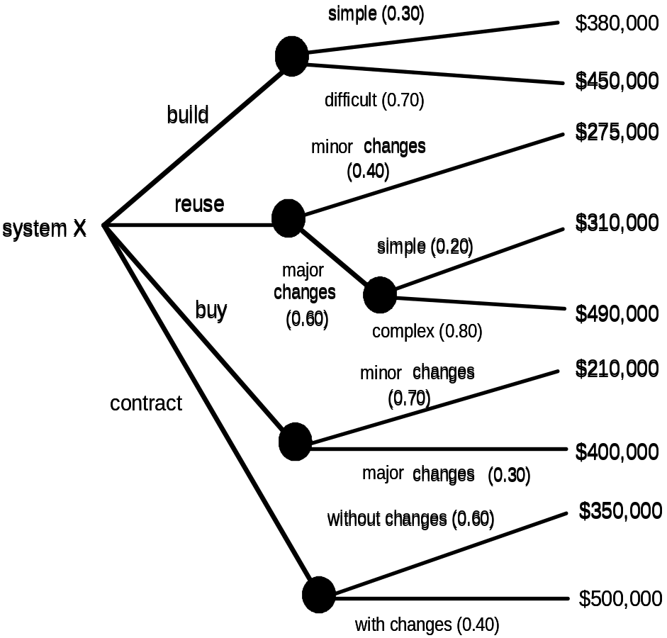
The Make-Buy Decision

Slide 28
Computing Expected Cost
expected cost =
(path probability) x (estimated path cost)
i
i
For example, the expected cost to build is:
expected cost_{build} = 0.30 ($380K) + 0.70 ($450K) = $429 K
similarly,
expected cost_{reuse} = $382K
expected cost_{buy} = $267K
expected cost_{contr} = $410K

