Slide 1
Chapter 24
Project Scheduling and Tracking

Slide 2
24.1 Basic Concepts
Why are we late?
  an unrealistic deadline established by someone outside the software development group
  changing customer requirements that are not reflected in schedule changes
  an honest underestimate of the amount of effort and/or the number of resources that will be required to do the job
  predictable and/or unpredictable risks that were not considered when the project commenced
  technical difficulties that could not have been foreseen in advance
  human difficulties that could not have been foreseen in advance
  miscommunication among project staff that results in delays
  a failure by project management to recognize that the project is falling behind schedule and a lack of action to correct the problem
1/12

Slide 3
24.1 Basic Concepts
What to do?
  Perform a detailed estimate using historical data. Determine the estimated effort and duration for the project.
  Using an incremental process model. Deliver critical functionality by the imposed deadline, but delay others. Document the plan.
  Meet with the customer and explain with detailed estimate why the deadline is unrealistic.
  Offer the incremental development strategy as an alternative.
2/12

Slide 4
24.2 Project Scheduling
Basic Principles
  Compartmentalization —define distinct tasks
  Interdependency —indicate task interrelationship
  Time allocation —start date and completion date of each task
  Effort validation —be sure resources are available
  Defined responsibilities —people must be assigned
  Defined outcomes —each task must have an output
  Defined milestones —review for quality
3/12

Slide 5
24.2 Project Scheduling
The Relationship Between People and Effort
Effort
cost
4
4
E
a
= m (
t
d
/
t
a
)
Impossible
E
= effort in person-months
a
region
t
= nominal delivery time for schedule
d
t
= optimal development time (in terms of cost)
o
t
= actual delivery time desired
E
d
a
E
o
t
d
t
o
Development time
T
min
=
0.75T
d
The Putnam-Norden-Rayleigh (PNR) Curve
4/12

Slide 6
24.2 Project Scheduling
Effort Distribution
Front end activities
  customer communication
  analysis
  design
  review and modification
Construction activities
  coding or code generation
Testing and installation
  unit, integration
  white-box, black-box
  regression
40-50%
15-20%
30-40%
5/12

Slide 7
24.3 Defining a Task Set for the Software Project
Strategy
  Determine the type of the project: no single task set is appropriate for all projects
  Assess the degree of rigor with which the team decides to do its work
  Identify adaptation criteria
  Select appropriate software engineering tasks
Please read 24.3.1-2 for
a task set example
6/12

Slide 8
24.4 Defining a Task Network
I
.
3
a
I
.
5
a
T
e
c
h
C
o
n
c
e
p
t
.
R
i
s
k
I
m
p
A
s
s
e
s
s
m
e
n
t
l
e
m
e
n
t
.
I
.
1
I
.
2
I
.
3
b
I
.
4
I
.
5
b
I
.
6
C
o
n
c
e
p
t
C
o
n
c
e
p
t
P
r
o
o
f
o
f
C
o
n
c
e
p
t
I
n
t
e
g
r
a
t
e
C
u
s
t
o
m
e
r
T
e
c
h
.
R
i
s
k
a
,
b
I
m
p
,
c
s
c
o
p
C
o
n
c
e
p
t
l
e
m
e
n
t
.
R
e
a
c
t
i
o
n
i
n
g
p
l
a
n
n
i
n
g
A
s
s
e
s
s
m
e
n
t
I
.
3
c
I
.
5
c
T
e
c
h
.
R
i
s
k
C
o
n
c
e
p
t
A
s
s
e
s
s
m
e
n
t
I
m
p
l
e
m
e
n
t
.
Critical Path Analysis
Three I.5 tasks are
applied in parallel to
3 different concept
functions
7/12

Slide 9
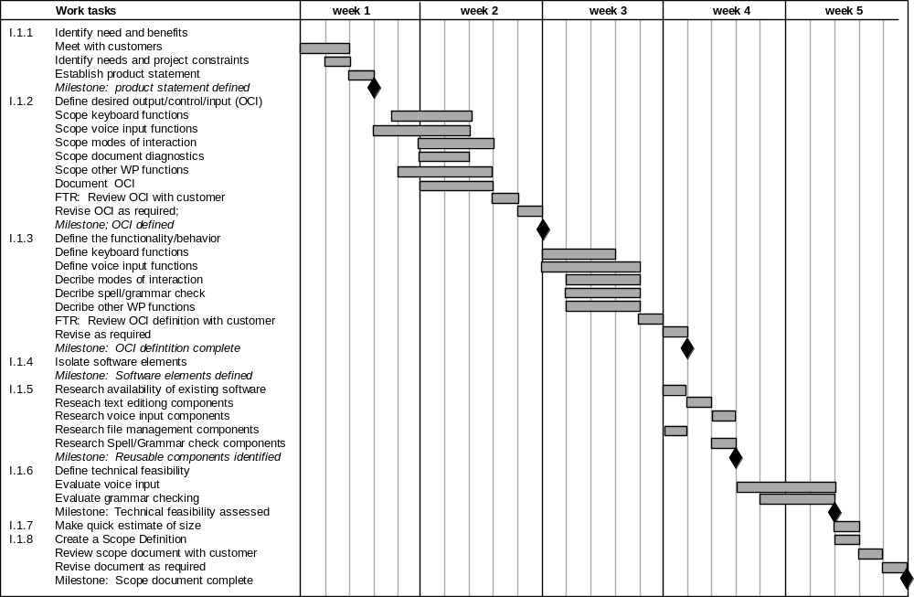
24.5 Scheduling
Timeline Charts
Milestone
8/12

Slide 10
24.5 Scheduling
Tracking the Schedule
  Conduct periodic project status meetings in which each team member reports progress and problems.
  Evaluate the results of all reviews conducted throughout the software engineering process.
  Determine whether formal project milestones have been accomplished by the scheduled date.
  Compare actual start-date to planned start-date for each project task listed in the resource table.
  Meet informally with practitioners to obtain their subjective assessment of progress to date and problems on the horizon.
  Use earned value analysis to assess progress quantitatively.
9/12

Slide 11
24.6 Earned Value Analysis (EVA)
Earned value
  is a measure of progress
  enables us to assess the percent of completeness of a project using quantitative analysis rather than rely on a gut feeling
  “provides accurate and reliable readings of performance from as early as 15 percent into the project.” [FLE98]
10/12

Slide 12
24.6 Earned Value Analysis (EVA)
Determine the Earned Value
  The budgeted cost of work scheduled (BCWS) is determined for each work task represented in the schedule.
    BCWS_{i} : the effort planned for work task i.
    BCWS = ∑ (BCWS_{i}) for all tasks i that should have been completed by that point in time
  The BCWS values for all work tasks are summed to derive the budget at completion (BAC). Hence,
  BAC = ∑ (BCWS_{k}) for all tasks k
  Compute the value for budgeted cost of work performed (BCWP): BCWP = ∑ (BCWS_{j}) for all tasks j that have actually been completed by that point in time
11/12

Slide 13
24.6 Earned Value Analysis (EVA)
Actual cost of work performed (ACWP)
BCWS₁
CV
BCWS₂
BCWS₃
SV
BC of work performed (BCWP)
Budgeted cost of work scheduled (BCWS)
Budget at completion (BAC)
  Schedule performance index: SPI = BCWP / BCWS ∼ 1.0
  Schedule variance: SV = BCWP – BCWS
  Percent scheduled for completion = BCWS / BAC
  Percent complete = BCWP / BAC
  Cost performance index: CPI = BCWP / ACWP ∼ 1.0
  Cost variance: CV = BCWP – ACWP
12/12

Slide 14
Chapter 25
Risk Management

Slide 15
25.1 Reactive vs. Proactive Risk Strategies
What can go wrong?
What is the likelihood?
What will the damage be?
What can we do about it?
1/8

Slide 16
25.1 Reactive vs. Proactive Risk Strategies
Reactive Risk Management
  Project team reacts to risks when they occur
  Mitigation—plan for additional resources in anticipation of fire fighting
  Fix on failure—resource are found and applied when the risk strikes
  Crisis management—failure does not respond to applied resources and project is in jeopardy
2/8

Slide 17
25.1 Reactive vs. Proactive Risk Strategies
Proactive Risk Management
  Formal risk analysis is performed
  Organization corrects the root causes of risk
    statistical SQA
    examining risk sources that lie beyond the bounds of the software
    developing the skill to manage change
3/8

Slide 18
25.2 Software Risks
Characteristics
  Uncertainty – the risk may or may not happen
  Loss – if the risk becomes a reality, unwanted consequences or losses will occur
Categories of Risks
  Project risks: schedule, cost …
  Technical risks: quality, timeliness…
  Business risks: validity – market, strategic, sales, management, and budget risks
  And more…
Level of uncertainty
Degree of loss
4/8

Slide 19
25.3 Risk Identification
Risk Item Checklist: risks associated with …
  Product size
  Business impact
  Customer characteristics
  Process definition
  Development environment
  Technology to be built
  Staff size and experience
5/8

Slide 20
25.3 Risk Identification
Risk Components and Drivers
  Components
    performance risk
    cost risk
    support risk
    schedule risk
  Impact degrees of each driver on each component
    Negligible
    Marginal
    Critical
    Catastrophic
6/8

Slide 21
25.4 Risk Projection
Risk projection, also called risk estimation, attempts to rate each risk in two ways
  the likelihood or probability that the risk is real
  the consequences of the problems associated with the risk, should it occur.
Risk projection steps:
  Establish a scale that reflects the perceived likelihood of a risk
  Delineate the consequences of the risk
  Estimate the impact of the risk on the project and the product
  Note the overall accuracy of the risk projection so that there will be no misunderstandings
prioritization
7/8

Slide 22
25.6 Risk Mitigation, Monitoring, and Management
Mitigation — how can we avoid the risk?
Monitoring — what factors can we track that will enable us to determine if the risk is becoming more or less likely?
Management — what contingency plans do we have if the risk becomes a reality?
8/8

