Slide 1
Chapter 5
Software Engineering Practice

Slide 2
The Essence of Practice
Understand the problem (communication and analysis).
Plan a solution (modeling and software design).
Carry out the plan (code generation).
Examine the result for accuracy (testing and quality assurance).
1/3

Slide 3
Core Principles
Provide value to the customer and the user
KISS — Keep It Simple, Stupid!
Maintain the product and project “vision”
What you produce, others will consume
Be open to the future
Plan ahead for reuse
Think!
2/3

Slide 4
Software Engineering Practices
Communication Practices
Planning Practices
Modeling Practices
Analysis
Design
Construction Practices
Coding
Testing
Deployment
3/3

Slide 5
Chapter 6
System Engineering

Slide 6
6.2 The System Engineering Hierarchy
Business or
Product Domain
World view
Domain of interest
Domain view
Software, hardware, people, database, documentation, procedures
System element
Element view
Detailed view
1/11

Slide 7
6.3 Business Process Engineering
Goal: define architecture that will enable a business to use information effectively
Architectures to be analyzed and designed within the context of business objectives and goals:
  data architecture provides a framework for the information needs of a business or business function
  application architecture encompasses those elements of a system that transform objects within the data architecture for some business purpose
  technology infrastructure provides the foundation for the data and application architectures
2/11

Slide 8
6.3 Business Process Engineering
The enterprise
Information strategy planning (ISP)
Business area analysis (BAA)
Business system design
Construction and integration
3/11

Slide 9
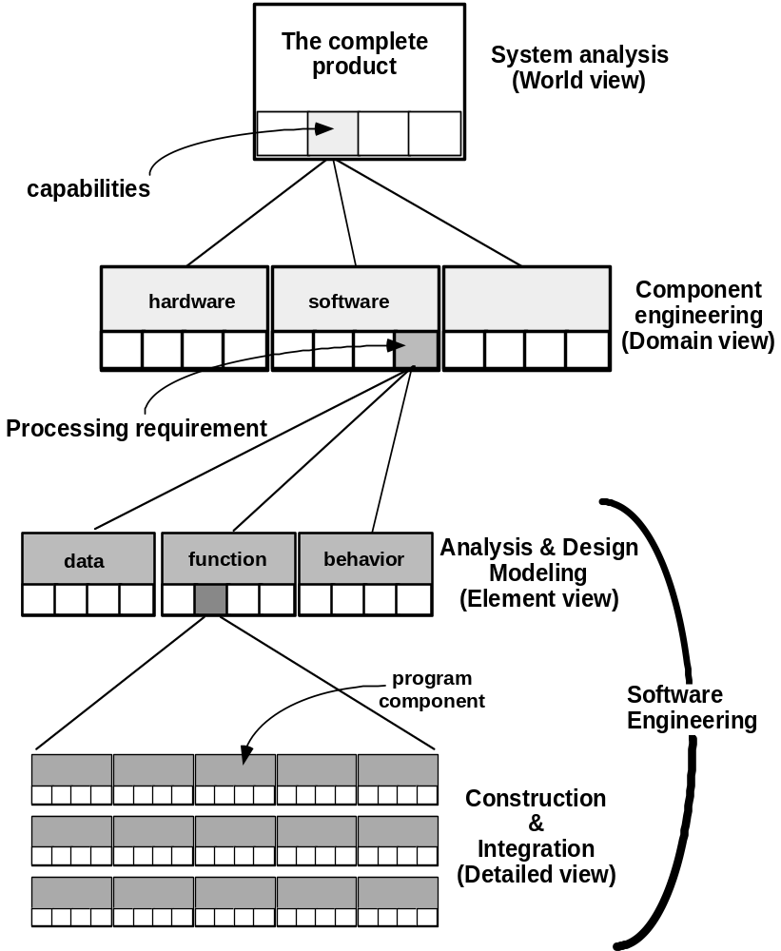
6.4 Product
Engineering
Goal: translate the customer’s desire for a set of defined capabilities into a working product.
4/11

Slide 10
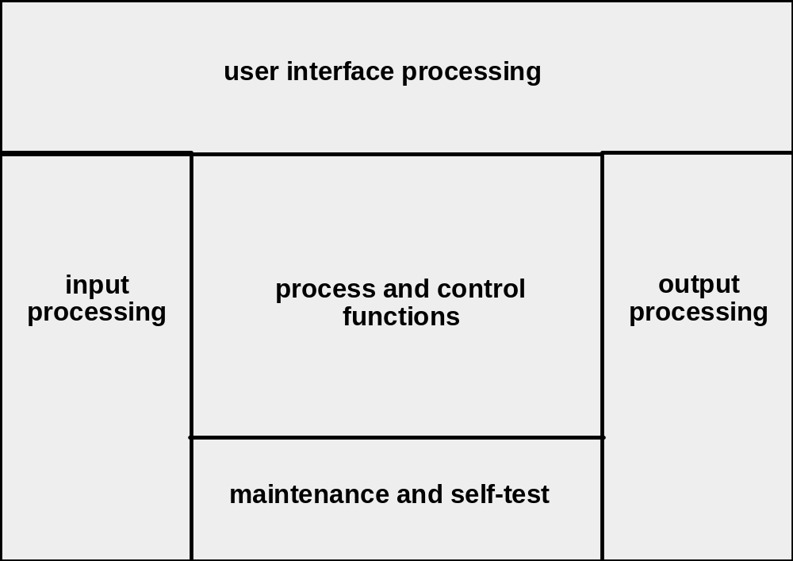
6.5 System Modeling
Every computer-based system can be modeled as an information transform using an input-processing-output template.
5/11

Slide 11
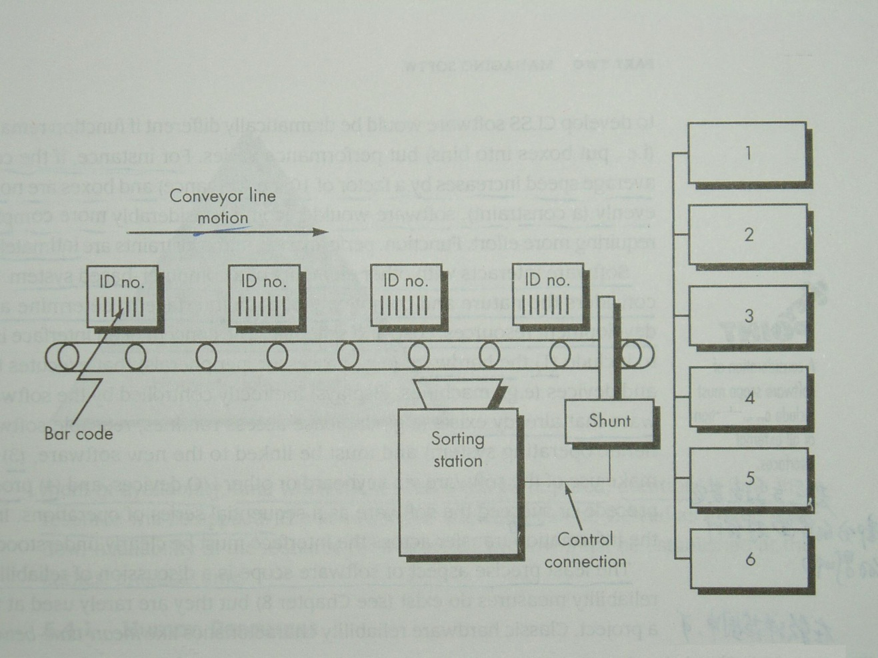
Example: Conveyor Line Sorting System
Read bar code input
Read pulse tachometer
Decode part code data
Do database look-up
Determine bin location
Produce control signal for shunt
Maintain record of box destinations
6/11

Slide 12
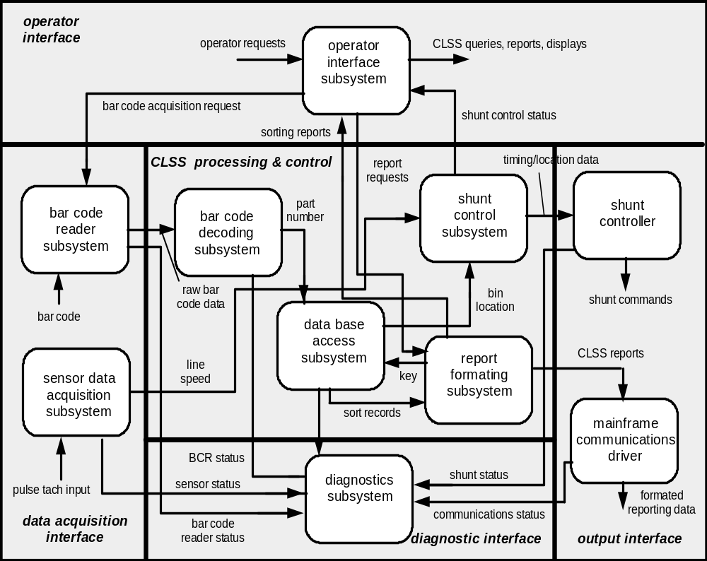
Architecture Flow Diagram
7/11

Slide 13
6.5 System Modeling
UML – Unified Modeling Language
Deployment diagram for CLSS hardware
CLSS processor
Sorting subsystem
Operator display
Sensor data
acquisition subsystem
Shunt controller
Conveyor
pulse tach
Bar code
reader
Shunt
actuator
8/11

Slide 14
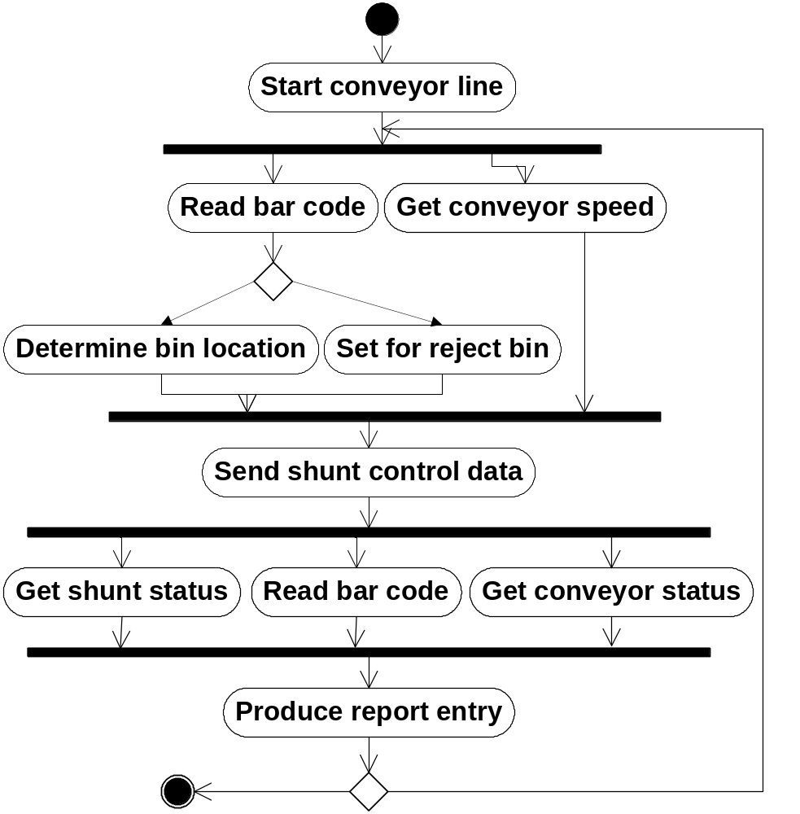
Activity diagram for procedural aspects of CLSS software
Valid
bar code
Invalid
bar code
Conveyor
stopped
Conveyor in motion
9/11

Slide 15
UML Class diagram for Box class
Box
Class name
barcode
forwardSpeed
conveyorLocation
height
width
depth
weight
contents
Attributes
Operations (parentheses at end of name indicate the list of attributes that the operation requires)
readBarcode()
updateSpeed()
readSpeed()
updateLocation()
readLocation()
getDimensions()
getWeight()
checkContents()
10/11

Slide 16
Use-case diagram for CLSS operator
Request bar code
Request shunt
control status
Request box
processing report
Update product
database
CLSS operator
Run system
diagnostics
11/11

