Slide 1
Chapter 7
Requirements Engineering

Slide 2
7.1 A Bridge to Design and Construction
Case 1: Our real-time example is based on the embedded software in the Ariane-5, a space rocket belonging to the European Space Agency (ESA). On June 4, 1996, on its maiden flight, the Ariane-5 was launched and performed perfectly for approximately 40 seconds. Then, it began to veer off course. At the direction of an Ariane ground controller, the rocket was destroyed by remote control. The destruction of the uninsured rocket was a loss not only of the rocket itself, but also of the four satellites it contained; the total cost of the disaster was $500 million (Newsbytes home page 1996; Lions et al. 1996).
The reason: there was no discussion in the requirements documents of the ways in which the Ariane-5 trajectory would be different from Ariane-4.
1/15

Slide 3
7.1 A Bridge to Design and Construction
In 1994, the Standish Group surveyed over 350 companies about their over 8000 software projects to find out how well they were faring. The results are sobering. Thirty-one percent of the software projects were canceled before they were completed. Moreover, in large companies, only 9% of the projects were delivered on time and cost what they were budgeted, and 16% met those criteria in small companies (Standish 1994).
To understand why, Standish (1995) asked the survey respondents to explain the causes of the failed projects. The top factors were reported to be
incomplete requirements (13.1%)
lack of user involvement (12.4%)
lack of resources (10.6%)
unrealistic expectations (9.9%)
lack of executive support (9.3%)
changing requirements and specifications (8.7%)
lack of planning (8.1%)
system no longer needed (7.5%)
2/15

Slide 4
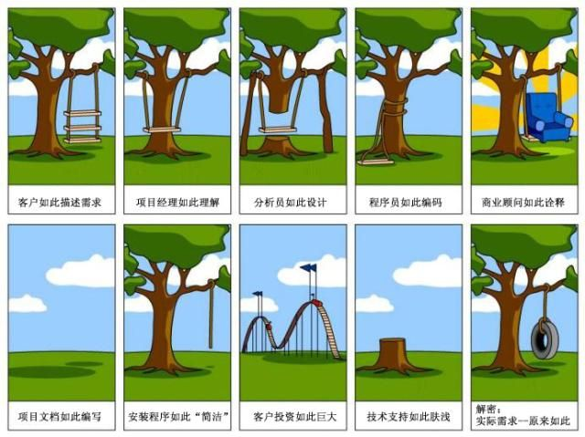
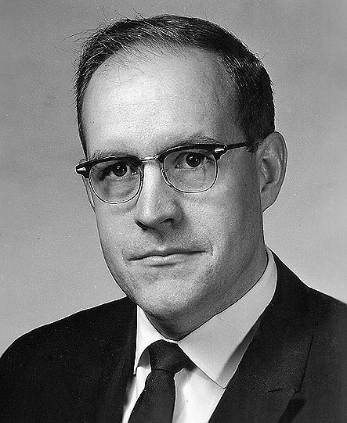
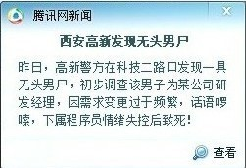
7.1 A Bridge to Design and Construction
The hardest single part of building a software system is deciding WHAT to build. No part of the work so cripples the resulting system if done wrong. No other part is more difficult to rectify later.
3/15

Slide 5
7.2 Requirements Engineering Tasks
Inception — ask a set of questions that establish
  basic understanding of the problem
  the people who want a solution
  the nature of the solution that is desired, and
  the effectiveness of preliminary communication and collaboration between the customer and the developer
Elicitation — elicit requirements from all stakeholders
Elaboration — create an analysis model that identifies data, function and behavioral requirements
Negotiation — agree on a deliverable system that is realistic for developers and customers
4/15
Notes:
小问题：What are the tasks?

Slide 6
7.2 Requirements Engineering Tasks
Specification — can be any one (or more) of the following
  A written document
  A set of models
  A formal mathematical
  A collection of user scenarios (use-cases)
  A prototype
Validation — a review mechanism that looks for
  errors in content or interpretation
  areas where clarification may be required
  missing information
  inconsistencies (a major problem when large products or systems are engineered)
  conflicting or unrealistic (unachievable) requirements.
Requirements management — identify, control, and track requirements and changes to requirements at any time
5/15

Slide 7
7.3 Inception
Identify stakeholders
  “who else do you think I should talk to?”
Recognize multiple points of view
Working toward collaboration
The first set of context-free questions
  Who is behind the request for this work?
  Who will use the solution?
  What will be the economic benefit of a successful solution?
  Is there another source for the solution that you need?
The next set of questions – customer’s perceptions about a solution
The final set of questions – effectiveness of the communication activity itself
6/15

Slide 8
7.4 Eliciting Requirements
Collaborative Requirements Gathering
Goal:
Identify the problem
Propose elements
of the solution
Negotiate different
approaches
Specify a preliminary set of solution requirements
7/15

Slide 9
7.4 Eliciting Requirements
Meetings are conducted and attended by both software engineers and customers
Rules for preparation and participation are established
An agenda is suggested
A facilitator (can be a customer, a developer, or an outsider) controls the meeting
A definition mechanism (can be work sheets, flip charts, or wall stickers or an electronic bulletin board, chat room or virtual forum) is used
8/15
Notes:
问题：How to organize the meeting?

Slide 10
7.4 Eliciting Requirements
Quality Function Deployment (QFD)
— Translate the needs of the customer into technical requirements for software. Maximize customer satisfaction from the software engineering process.
Function deployment determines the value of each function required of the system
Information deployment identifies data objects and events
Task deployment examines the behavior of the system
Value analysis determines the relative priority of requirements
Normal, Expected, and Exciting requirements
9/15

Slide 11
7.4 Eliciting Requirements
User Scenarios (Use-cases) — identify a thread of usage
Elicitation Work Products
a statement of need and feasibility.
a bounded statement of scope for the system or product
a list of customers, users, and other stakeholders who participated in requirements elicitation
a description of the system’s technical environment
a list of requirements (preferably organized by function) and the domain constraints that apply to each
a set of usage scenarios that provide insight into the use of the system or product under different operating conditions.
any prototypes developed to better define requirements
10/15

Slide 12
7.5 Developing Use-Cases
Actor — a person or device that interacts with the software
Each scenario answers the following questions:
  Who is the primary actor, the secondary actor(s)?
  What are the actor’s goals?
  What preconditions should exist before the story begins?
  What main tasks or functions are performed by the actor?
  What exceptions might be considered as the story is described?
  What variations in the actor’s interaction are possible?
  What system information will the actor acquire, produce, or change?
  Will the actor have to inform the system about changes in the external environment?
  What information does the actor desire from the system?
  Does the actor wish to be informed about unexpected changes?
Please read the SafeHome example
on how to develop a high-level
use-case diagram
11/15

Slide 13
7.6 Building the Analysis Model
Elements of the analysis model
  Scenario-based elements
    Use-case and user-case diagram
    Sequence of activities within certain context
  Class-based elements
    Class diagram
  Behavioral elements
    State diagram
  Flow-oriented elements
    Data flow diagram
Analysis Patterns — for reuse
12/15

Slide 14
7.7 Negotiating Requirements
Identify the key stakeholders
  These are the people who will be involved in the negotiation
Determine each of the stakeholders’ win conditions
  Win conditions are not always obvious
Negotiate
  Work toward a set of requirements that lead to win-win
If different customers/users cannot agree on requirements, the risk of failure is very high.
13/15

Slide 15

7.7 Negotiating Requirements
The Art of Negotiation
It is not a competition
Map out a strategy
Listen
Focus on the other party’s interest
Don’t let it get personal
Be creative
Be ready to commit
14/15

Slide 16
7.8 Validating Requirements
Consistency
Omissions
Ambiguity
15/15

