Slide 1


PEORL: Integrating Symbolic Planning and Hierarchical Reinforcement Learning for Robust Decision Making
Fangkai Yang¹, Daoming Lyu², Bo Liu², Steven Gustafson¹
¹ Maana Inc, Bellevue, WA, USA
² Auburn University, AL, USA
27th International Joint Conference on Artificial Intelligence (IJCAI-18), July 13-19, Stockholm, Sweden

Slide 2
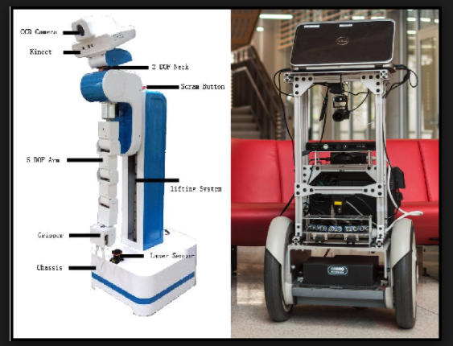
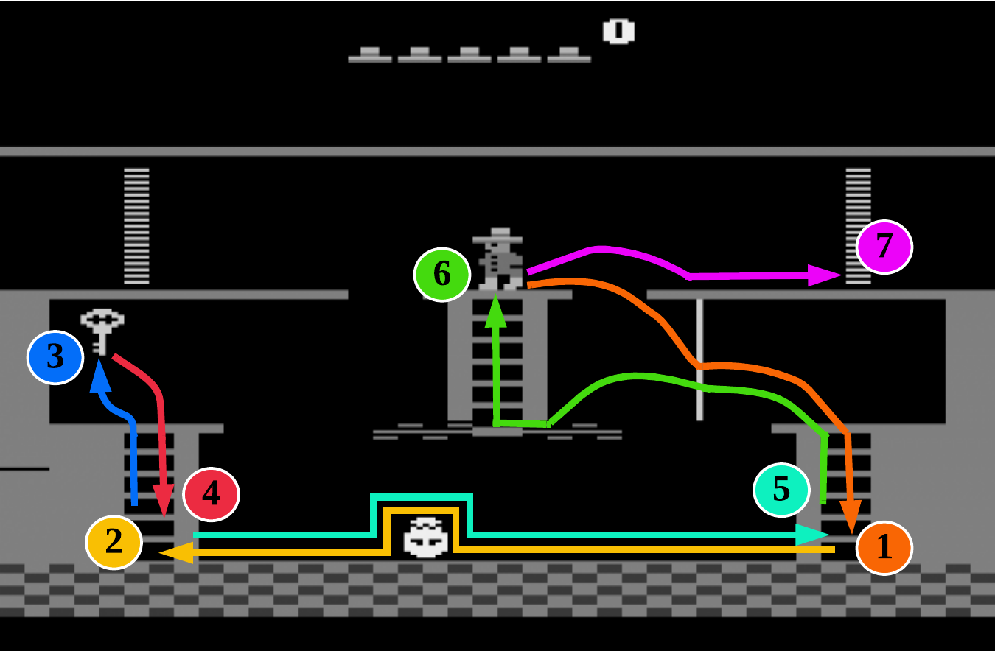
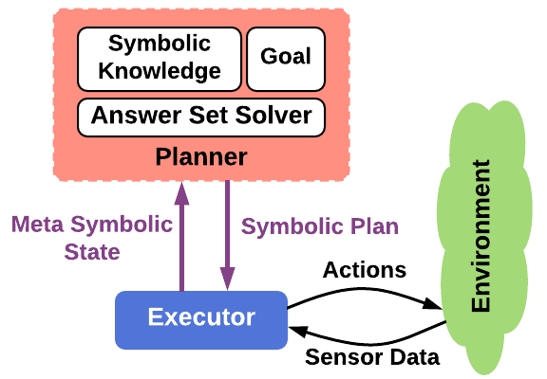

Planning Agent and Learning Agent
Symbolic Planning and Reinforcement Learning are two important paradigms to build intelligent agents
planning-agent
require prior knowledge
does not rely on trail-end-error
brittle to domain change and uncertainty
RL-agent
don’t require prior knowledge
Relies on trail-and-error from huge amount of experience
Highly adaptive and robust to domain uncertainty

Slide 3
Motivation
Symbolic planning can help RL to explore a meaningful part of state space, through a one-shot plan generation and compilation [Parr and Russell, 1998; Ryan, 2002; Leonetti et al., 2012, 2016].
Learning method is also used to improve robustness and adaptiveness of symbolic plans [Khandewal, et.al, 2014].
Can we have an integration of symbolic planning and RL such that they mutually benefit each other?
Symbolic planning uses domain knowledge to guide RL for efficient exploration and rapid convergence
RL helps symbolic planning to generate adaptive and robust plan to handle domain uncertainty and change

Slide 4
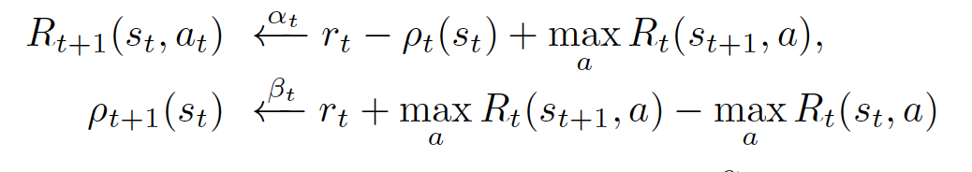
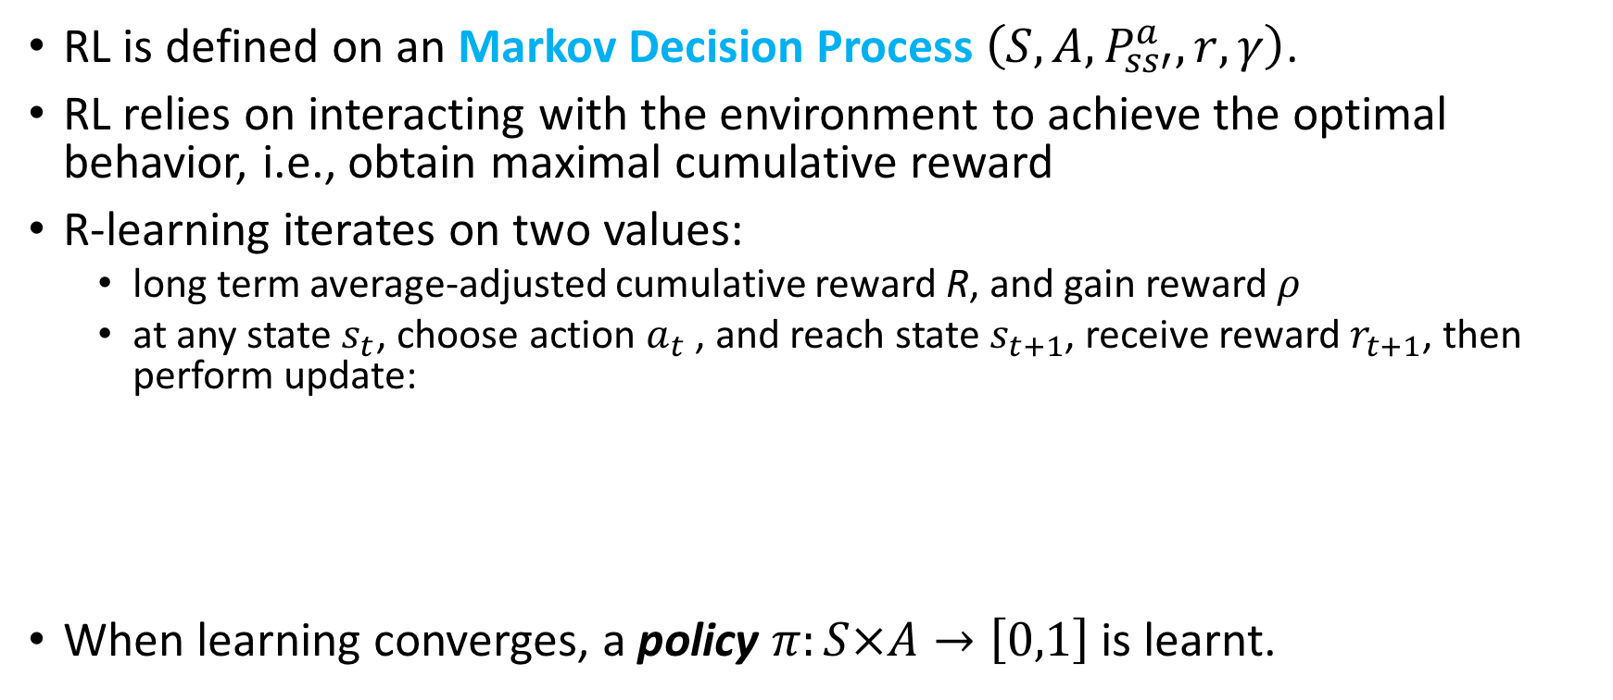
Reinforcement Learning (RL)
RL is defined on an Markov Decision Process $\left(S,A,P_{ss′}^{a},r,γ\right)$.
RL relies on interacting with the environment to achieve the optimal behavior, i.e., obtain maximal cumulative reward
R-learning iterates on two values:
long term average-adjusted cumulative reward R, and gain reward 𝜌
at any state $s_{t}$, choose action $a_{t}$ , and reach state $s_{t+1}$, receive reward $r_{t+1}$, then perform update:
When learning converges, a policy $π:S×A→\left[0,1\right]$ is learnt.

Slide 5
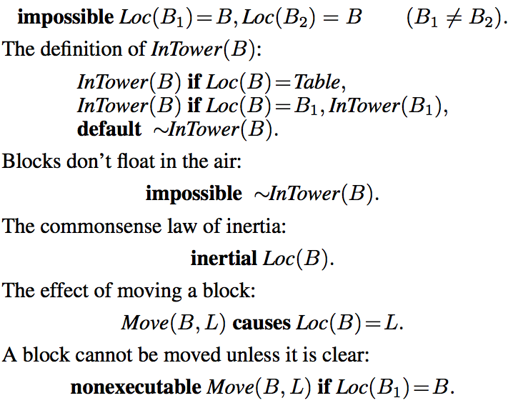
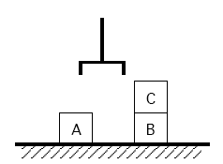
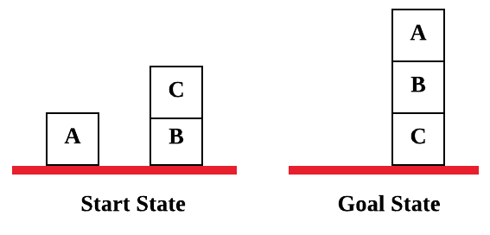
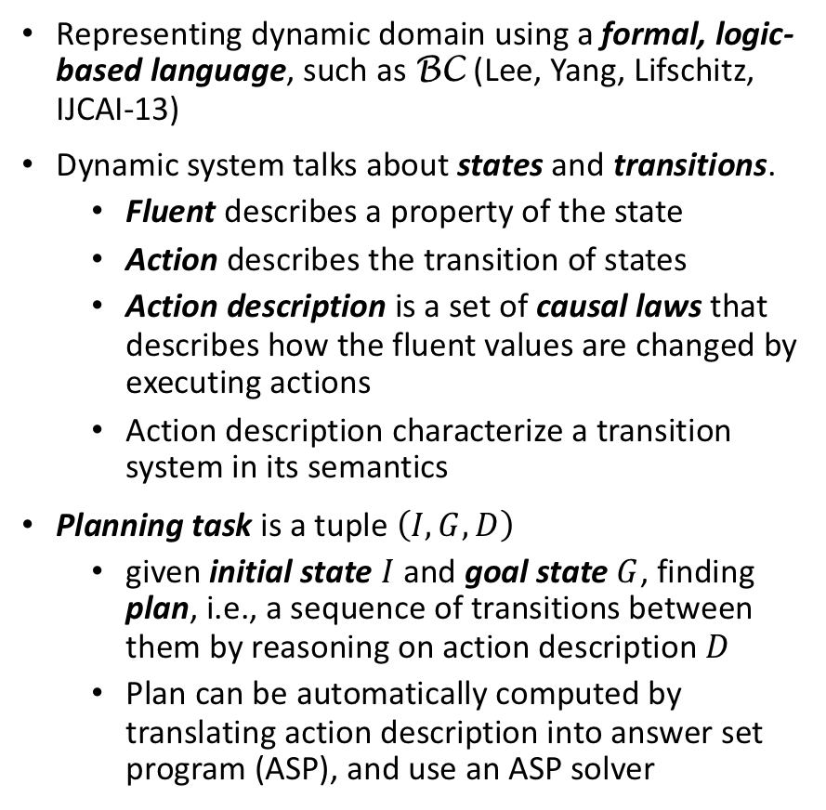
Symbolic Planning
Representing dynamic domain using a formal, logic-based language, such as BC (Lee, Yang, Lifschitz, IJCAI-13)
Dynamic system talks about states and transitions.
Fluent describes a property of the state
Action describes the transition of states
Action description is a set of causal laws that describes how the fluent values are changed by executing actions
Action description characterize a transition system in its semantics
Planning task is a tuple $\left(I,G,D\right)$
given initial state $I$ and goal state $G$, finding plan, i.e., a sequence of transitions between them by reasoning on action description $D$
Plan can be automatically computed by translating action description into answer set program (ASP), and use an ASP solver
On(A,table),on(C,B),
on(B,table)
On(A,B),on(B,C),
on(C,table)
Plan: 1:Move(C,table), 2:Move(B,C), 3:Move(A,B)

Slide 6
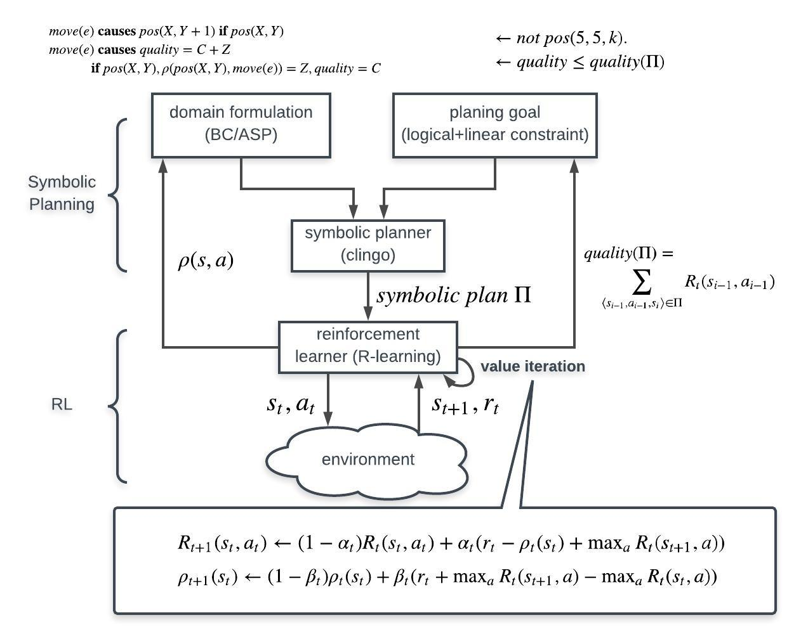
PEORL
framework
Planning
Execution
Observation
Reinforcement
Learning

Slide 7
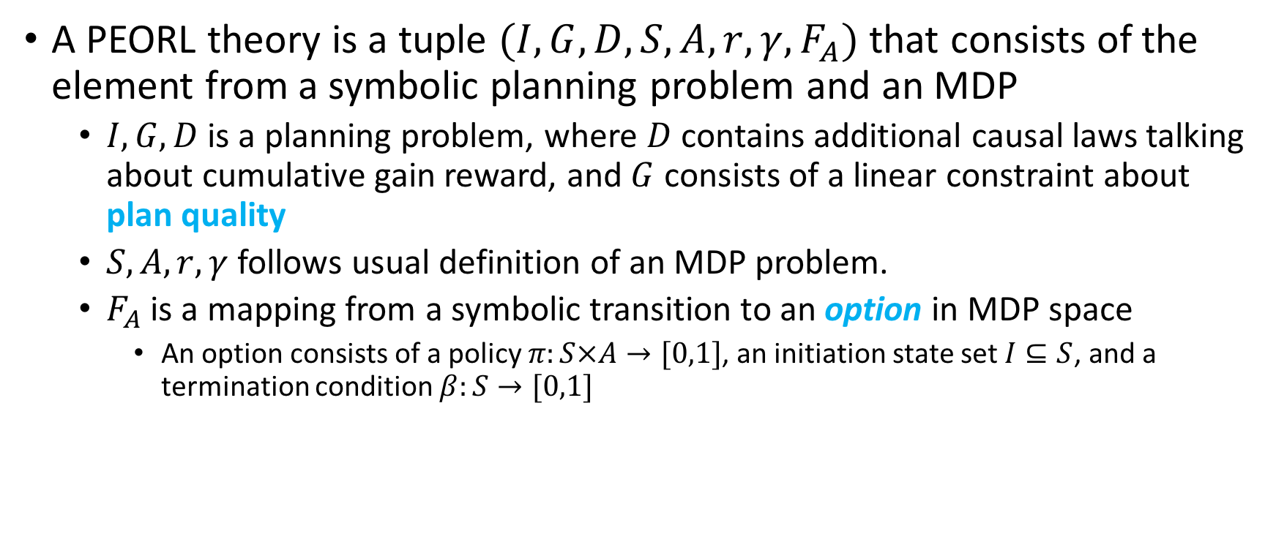
PEORL: Integrating Symbolic Planning with Reinforcement Learning
A PEORL theory is a tuple $(I,G,D,S,A,r,γ,F_{A})$ that consists of the element from a symbolic planning problem and an MDP
$I,G,D$ is a planning problem, where $D$ contains additional causal laws talking about cumulative gain reward, and $G$ consists of a linear constraint about plan quality
$S,A,r,γ$ follows usual definition of an MDP problem.
$F_{A}$ is a mapping from a symbolic transition to an option in MDP space
An option consists of a policy $π:S×A→[0,1]$, an initiation state set $I⊆S$, and a termination condition $β:S→[0,1]$

Slide 8
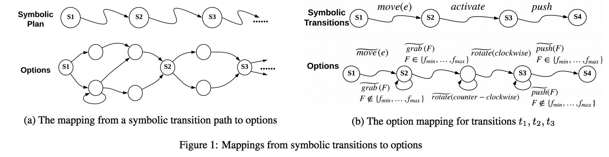
Mapping from Symbolic Transition to Option

Slide 9



Interaction between Planning and Learning
Executing action increases cumulative quality, summed over cumulative gain reward
Linear constraint in planning goal on cumulative gain reward
where
R-learning is used to compute cumulative gain reward for symbolic actions:
Notes:
Action description: Explain if condition, and action is taken, then what result will happen.

Slide 10
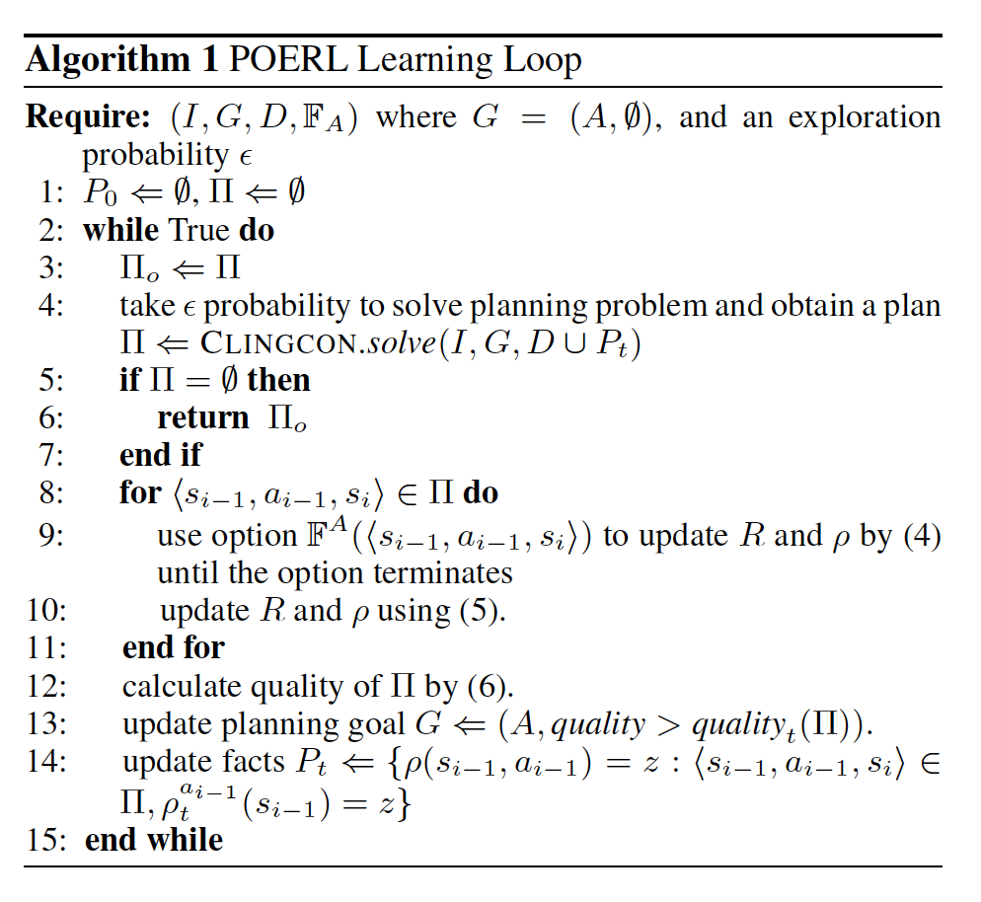
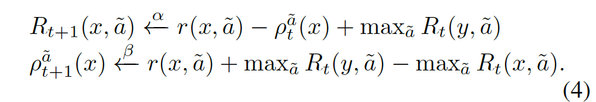
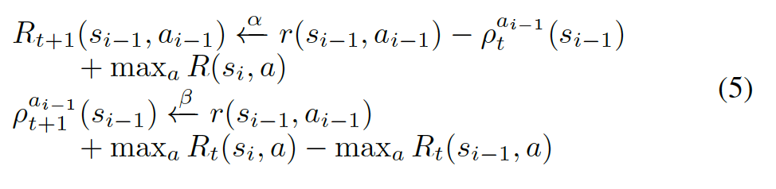
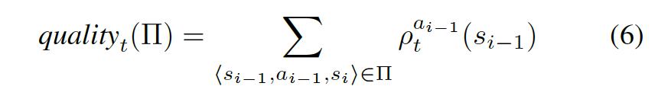
Complete Algorithm

Slide 11
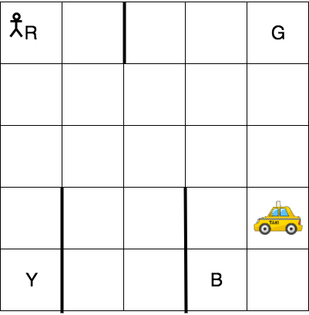
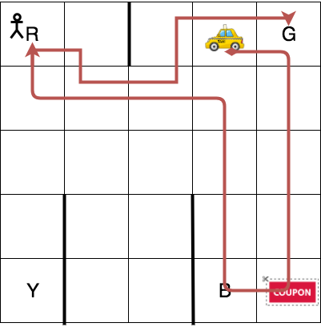
Taxi domain
Taxi domain (navigate, pick-up, drop-off)
Every movement (north, south, west, east) receives -1 reward
Successful drop off: +10
Improper pickup or drop off: -10
We consider two scenarios:
Scenario 1: original setting
Scenario 2: original setting with extra reward at (4,4), leads to a +10 extra reward
Taxi domain (original setting)
A solution to taxi domain with extra reward (coupon)

Slide 12
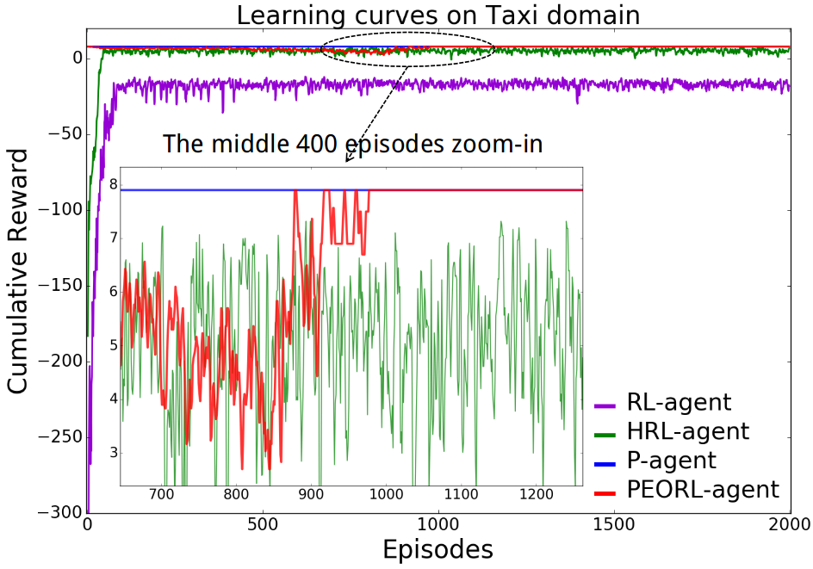
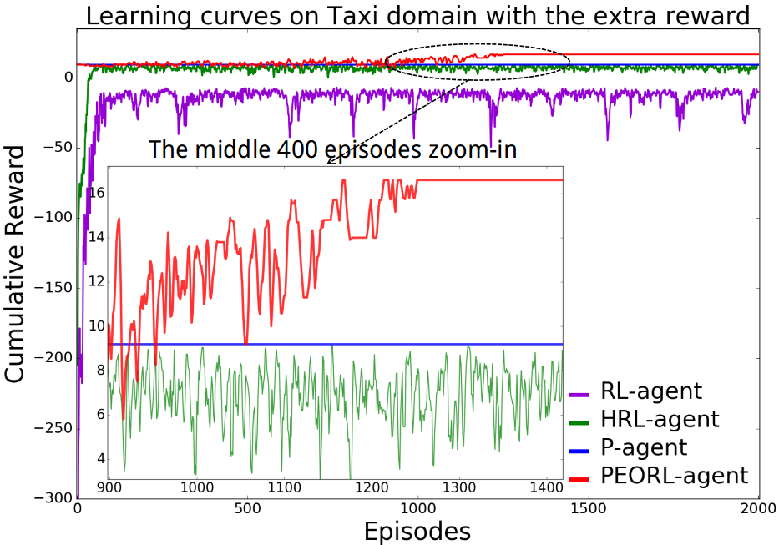
Experiment Result
Learning curves on taxi domain (original setting)
Learning curves on taxi domain with extra reward (coupon)
Notes:
2nd figure, P-agent cannot deal with model change.
Why Pagent best on left?
P is NOT reward driven,but goal driven. Thus favors shortest plan, and in left, the shortest happens == the most rewarding one. But things are different with the coupon case

Slide 13
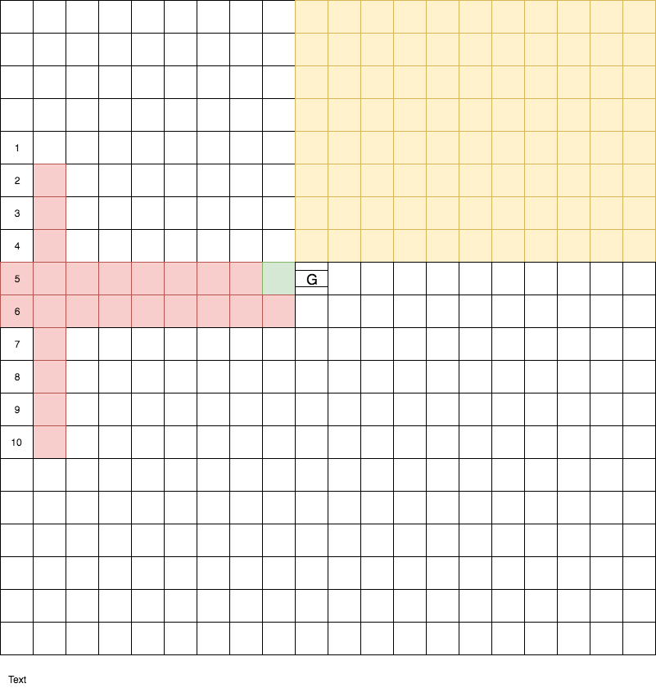
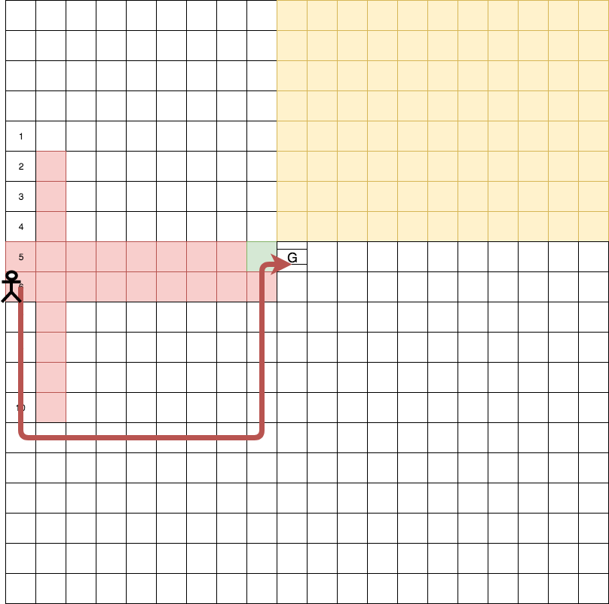
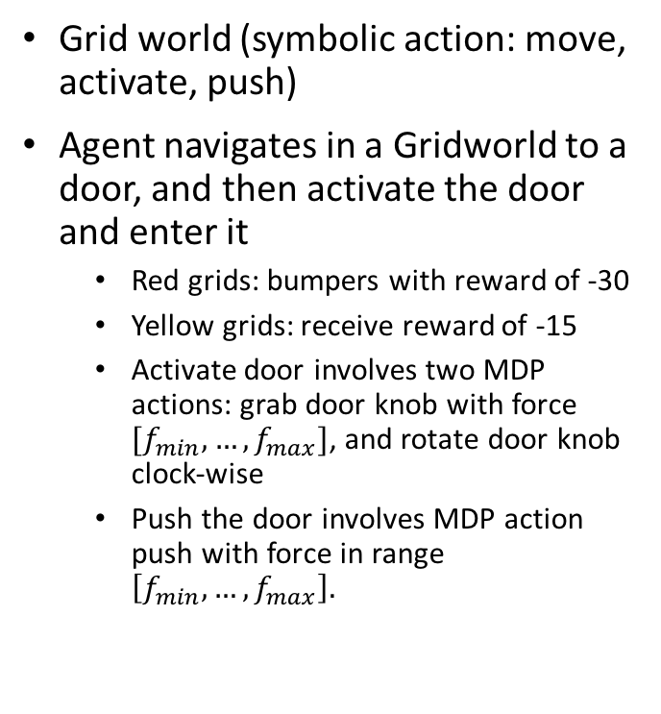
Grid World
Grid world (symbolic action: move, activate, push)
Agent navigates in a Gridworld to a door, and then activate the door and enter it
Red grids: bumpers with reward of -30
Yellow grids: receive reward of -15
Activate door involves two MDP actions: grab door knob with force $[f_{min},…,f_{max}]$, and rotate door knob clock-wise
Push the door involves MDP action push with force in range $\left[f_{min},…,f_{max}\right].$
Grid world
A solution to grid world

Slide 14
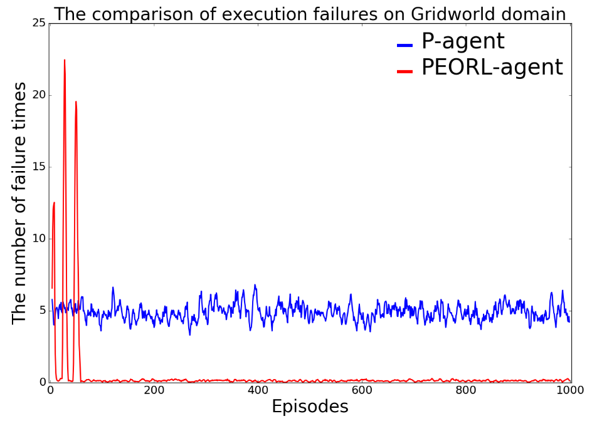
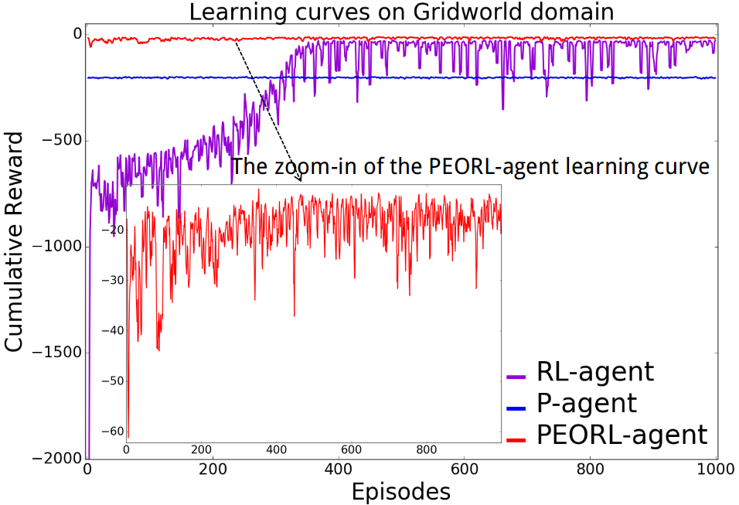
Experiment Result
The comparison of execution failure
Learning curves on grid world domain

Slide 15
Conclusion
PEORL framework integrates symbolic planning and reinforcement learning to achieve rapid policy search and robust symbolic plan
Symbolic plan can adapt to domain uncertainty leveraging learning result
Reinforcement learning can leverage symbolic plan to learn policy faster and better
Future work:
Improve transferability of PEORL architecture
Generalize to continuous space by integrating with deep reinforcement learning
Automatically discover useful/learnable subtasks in complex domain

