Slide 1

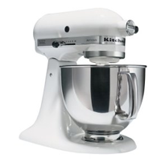
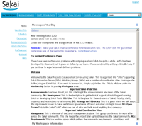
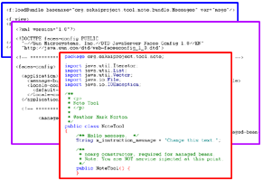
An Overview of Presentation Technologies
Mark J. Norton – Nolaria Consulting
Aaron Zeckoski – Virginia Tech

Slide 2
Introduction
MN
AZ
Why are we doing this?
  Provide more insight into UI solutions
  Compare the strengths
  Point out the weaknesses
  Develop an understanding that will lead to better Sakai practices and standards

Slide 3
The Theory
Basic HTTP Request Cycle
Presentation Technology
MVC Pattern
JSF as an MVC Example
Notes:
What is the goal of this slide? -AZ

Slide 4
How Tomcat Works
AZ
Tomcat serves as a web application container that invokes a known Servlet identified by a URL
Tomcat
An HTTP request comes from the user, packaged as a request object.
Servlet
The response is a stream of data (often HTML) that is sent back to the user’s browser.
Request
Object
Response
Object
Services
Database
etc.
doGet()
doPost()
etc.

Slide 5
Java Servlet Problems
The main problem with using Servlets to write web apps is that the HTML is embedded in the Java code
Changes are very difficult
Designers can’t easily contribute
Components are not shared
Internationalization is difficult

Slide 6
Presentation Technology
Over time, many solutions have emerged to address the limitations of Servlets
The main concept is to separate the representation of a user interface from the code that manages it
This has lead to the Model-View-Controller design pattern and 3-tier architectures

Slide 7
The MVC Pattern
The controller responds to user events and updates the model based on user actions
Controller
The view renders the model information into a format for user interaction (often HTML)
View
Model
The Presentation layer (UI), from 3-tier architecture, consists of the Controller and View. The model is basically the logic and data access together.
The model manages application data (includes render logic and uses data access layer)
URL: http://en.wikipedia.org/wiki/Model-view-controller

Slide 8
MVC in Tomcat
A Servlet acts as the CONTROLLER, set up in the web.xml file of this tool
Servlet
Template
Backing Beans
Templates (description pages) define how the user VIEWS the application information
The backing bean MODELS the data and handles events

Slide 9
Sakai UI
MN

Slide 10
The Sakai Style Guide
Standard definitions of commonly used UI layouts and gadgets
Defines Sakai navigation
Formatting of text
Provides support for accessibility
Fairly out of date

Slide 11
Why Is It a Good Thing?
Sakai tags implement standard UI elements.
Support for skinning – free!
Support for accessibility – free!
Consistent look and feel across Sakai installations.
UI can be tweaked without substantial code changes.
Support for I18N – not quite free.
Notes:
I think this might be the theory behind this, but the truth is not really the same as that in this case. -AZ

Slide 12
Tag Library Definitions
Three sets of taglibs are available:
  <sakai:>: use these where possible
  <h:> (html): use these as needed
  <f:> (faces): use these if necessary
New tags can be defined, but use existing tags if possible.
JSF discourages the use of standard html tags in the jsf template (.jsp)
Notes:
JSF discourages the use of normal html in the page. Ideally you should never use html tags when using JSF (if using it correctly)
It is better to refer to these as tag libraries or taglibs

Slide 13
Documentation
JSF faces and html tags are covered in the JSF documentation and several books that are now available
Sakai Style Guide has been uploaded to the TDE resource tool
The Resource Tool on collab largely conforms to the Style Guide
Notes:
TDE resource tool is what again?

Slide 14
Sakai taglibs
sakai:button_bar
sakai:button_bar_item
sakai:comment
sakai:commentII
sakai:date_input
sakai:date_output
sakai:doc_properties
sakai:doc_section
sakai:doc_section_title
sakai:flat_list
sakai:group_box
sakai:instruction_message
sakai:panel_edit
sakai:title_bar
sakai:tool_bar
sakai:tool_bar_item
sakai:tool_bar_message
sakai:tool_bar_spacer
sakai:view_container
sakai:view_content

Slide 15
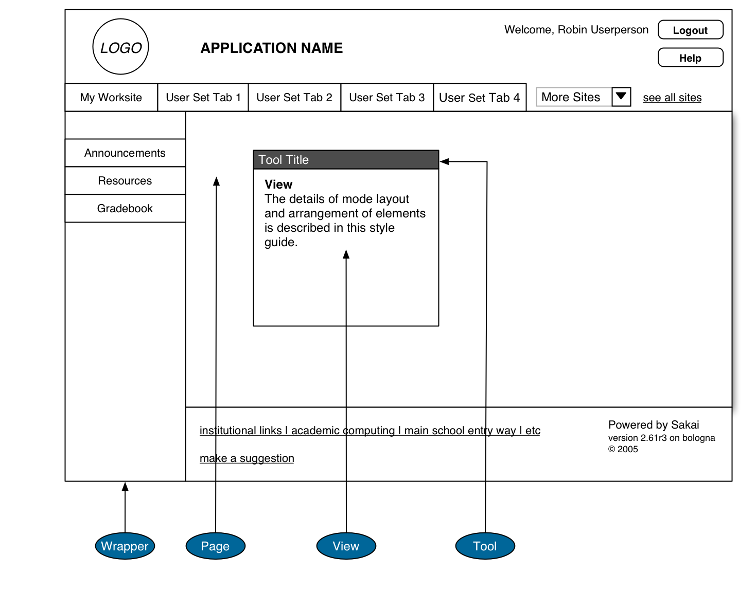
The Sakai Window Layout

Slide 16
Window Layout
Implemented by the Charon portal
  Uses JSF as the technology
Allows tools to be defined and registered
Supports skinning
Navigation via site tabs and tool bar
Tools appear in a iframe

Slide 17
Kinds of Views
Hierarchical View
Flat Actionable List View
Item Summary View
Forms View
Wizard View
Message View
Compound View
Notes:
What is this talking about? On the previous slide you say tools appear in a view but this is not the same kind of view, we need to change the terminology on one slide or the other

Slide 18
Style Guide Examples
Each entry in the Sakai Style Guide includes:
  A description
  An illustration
  HTML example
  Tag description
Let’s look at a few illustrations…

Slide 19
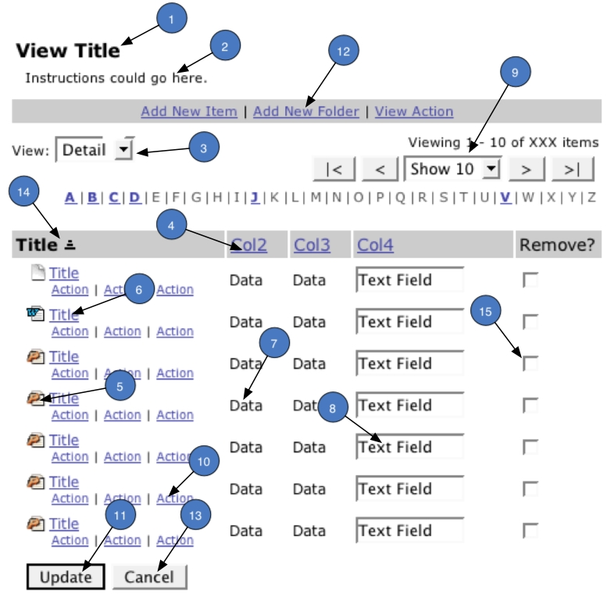
Flat Actionable List View

Slide 20
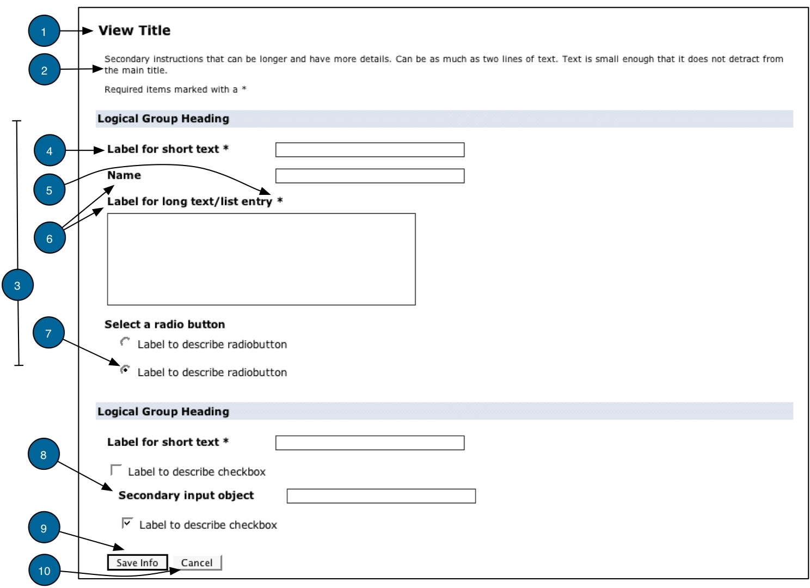
Forms View

Slide 21
Technology Review
MN

Slide 22
Technology Review
Let’s have a look at some of the presentation technologies available in Java.
Each of these will include:
  Description
  Strengths and Weaknesses
  Sakai Examples (if they exist)
Notes:
Need to define each of the 6 parts of the “score card” here

Slide 23
Servlet
Modules of Java code that run in a server application to answer client requests
Request parameters are passed to a response method along with an output stream
Response is written to the stream as HTML (typically)

Slide 24

Servlet Review
Pro
  Simple java object
  Fast and efficient execution
  Extensible in web.xml file
  Most other Java techs built on them
  Well documented
Con
  Brittle: UI is embedded in the code
  No component support
  Slow to develop in
  Asymetric
Notes:
Asymetric? What does that mean?

Slide 25
Servlet Score Card
Easy for Designer | Poor
Easy for Developer | Good
Separation of Code and UI | Poor
Integration with Sakai | Full
Expressibility | Fair
Maturity | Very good

Slide 26
Servlet Examples
Training examples
Minimal Sakai tool from cafe
Notes:
SU tool is written in JSF

Slide 27
JSF
A Java based set of APIs for managing state, handling events, and defining navigation
Two main implementations: Sun RI and MyFaces (Apache)
  Sakai supports both
Includes a custom set of tag libraries
Includes error handling, input validation, and internationalization support

Slide 28
JSF Review
Pro
  Symmetric
  Component support
  Configurable render
  IoC
  Good documentation
Con
  Large learning curve
  Restrictive
  Slow
  Event model in memory
  Poor separation of UI and render logic
Notes:
What does Symmetric mean here? JSF does not have spring integration

Slide 29
JSF Score Card
Easy for Designer | Poor
Easy for Developer | Poor
Separation of Code and UI | Fair
Integration with Sakai | Full (both)
Expressibility | Fair
Maturity | Fair

Slide 30
JSF Examples
Many of the newer tools in Sakai have been written in JSF:
  Gradebook
  Calendar
  Scheduling
  Samigo
  Melete
  Help
  Etc.
<f:view> <!-- From SimpleTool training example. -->
<sakai:view title="Tag Usage Demos">
<h2>Note Tool<h2>
<sakai:instruction_message value="#{msgs.pt_title_main}"/>
<sakai:instruction_message value="#{NoteTool.instructionMessage}"/>
</sakai:view>
</f:view>

Slide 31
Velocity
AZ
Velocity is an Apache project
Template based presentation system
Uses an MVC approach to separate code from UI description
Can generate output including HTML, SQL, Postscript, and XML
Uses “references” to place dynamic content in template pages

Slide 32

Velocity Review
Pro
  Easy to use
  Some designer support
  Powerful, Flexible
  Widely used
  Well documented
  MVC pattern
Con
  Sakai is tied to an older version
  Mixes render logic and template
  No component support
Notes:
No component support means what?

Slide 33
Velocity Score Card
Easy for Designer | Average
Easy for Developer | Good
Separation of Code and UI | Fair
Integration with Sakai | Full
Expressibility | Fair
Maturity | Very Good

Slide 34
Velocity Examples
Velocity is used in many of the legacy tools including:
  Resources
  Chat
  Discussion
  Drop Box
  Email Archive
  Etc.
<HTML>
<HEAD><title>Velocity Sample</title></HEAD>
<BODY>
<h1>Hello $user.name</h1>
<table>
#foreach( $item in $items )
#if ( $itemCheck($item) )
<tr>
<td> $item.value </td>
</tr>
#end
#end
</table>
</BODY>
</HTML>
Notes:
This example has no velocity elements in it, that is just javascript

Slide 35
RSF
Pure html templating allows for clean separation of template and render logic
Full spring framework integration
Full scope control via RSAC
Component bindings from UI to model
Created by Antranig Basman at Cambridge University

Slide 36

RSF Review
Pro
  Supports pure html templates
  Component support
  Very fast
  Integrated with Spring
  Support for AJAX
  Good scoping
  Simpler
Con
  Young and unproven
  No published documentation
  Limited Sakai integration

Slide 37
RSF Score Card
Easy for Designer | Very good
Easy for Developer | Good
Separation of Code and UI | Very good
Integration with Sakai | Evolving
Expressibility | Very good
Maturity | Poor

Slide 38
RSF Examples
Large: Evaluation System
Small: Sakai Config Viewer, Resource Viewer, etc…
Sample: RSF Gallery, Tasklist RSF, CRUD
Others in Sakai contrib
<html>
<head><title>RSF sample</title></head>
<body>
<h1>Hello <span rsf:id=“user-name”>User Name</span></h1>
Today is <span rsf:id=“current-date”>1/1/2006</span><br/>
<table>
<tr rsf:id=“items:”>
<td rsf:id=“item-value”>item value here</td>
</tr>
</table>
</body>
</html>

Slide 39
Struts
MN
Struts is a retired Jakarta project
While some work is being done on it, largely replaced by JSF
Early versions of Samigo were written in Struts
MVC based, supports components.
Asymmetric

Slide 40

Struts Review
Pro
  Widely used
  Well documented
  Components
  Good libraries
Con
  Complicated
  Asymmetric
  Performance issues

Slide 41
Struts Score Card
Easy for Designer | Poor
Easy for Developer | Good
Separation of Code and UI | Poor
Integration with Sakai | Poor
Expressibility | Fair
Maturity | Good
Notes:
How is integration in Sakai good? There are no widgets or helpers.

Slide 42
Struts Examples
Many of the UNISA applications are written in Struts.
<%@ page language="java" %>
<%@ taglib uri="/WEB-INF/struts-tiles.tld" prefix="tiles" %>
<html>
<head>
<title><tiles:getAsString name="title" ignore="true"/></title>
</head>
<body>
<table border="1" cellpadding="0" cellspacing="0" width="100%" bordercolor="#000000" bgcolor="#E7FDFE">
<tr>
<td width="100%" colspan="2" valign="top"><tiles:insert attribute="header"/></td>
</tr>
</table>
</body>
</html>

Slide 43
XSLT
XSLT (Extensible Stylesheet Language Transformations) is a way to describe XML transformations
In a presentation context, this means describing the UI with XML and transforming it into XHTML
URL: http://en.wikipedia.org/wiki/XSLT
Notes:
XSLT (XML Style Language Transforms) <== this is wrong

Slide 44
XSLT Review
Pro
  Fairly easy to use
  Allows different kinds of transforms to be defined
  Well documented
  Mature
Con
  Requires data in XML format
  Limited use of loop constructs
  No variables (only constants)
  Poor separation between template and render logic

Slide 45
XSLT Score Card
Easy for Designer | Fair
Easy for Developer | Good
Separation of Code and UI | Fair
Integration with Sakai | Fair
Expressibility | Fair
Maturity | Good

Slide 46

XSLT Examples
Sakai uses of XSLT
  OSP uses XSLT extensively
  Help, Rwiki, Samigo, Calendar, etc. make use of XSLT
    not as primary renderer
  Several tools in MIT’s Stellar CMS use XSLT
Notes:
There are no Sakai tools that use XSLT purely for UI description. (this is wrong)
XSLT used for RSS (this is also wrong, though there are some implementations that may handle xslt it is not true across the board)

Slide 47
JSP
AZ
Dynamic Java web content scripting language
JSP pages are compiled into Servlets when accessed
Allows Java code to be embedded in the HTML pages similar to PHP
Easy for developers, but is brittle since code is placed into the web pages

Slide 48
JSP Review
Pro
  Very flexible
  Powerful
  Integrated into Tomcat
  Easy to learn
  Uses standard tag library (JSTL) and EL
Con
  Too easy to write bad applications
  Poor separation of UI and render code
  Not well supported in Sakai

Slide 49
JSP Score Card
Easy for Designer | Fair
Easy for Developer | Very good
Separation of Code and UI | Poor
Integration with Sakai | Adapter
Expressibility | Fair
Maturity | Very good

Slide 50
JSP Examples
RWiki
Jforum
Search
<HTML>
<HEAD><title>JSP Sample</title></HEAD>
<BODY>
<h1>Hello <%= user.getName() %></h1>
Today is <%= new Date() %><br/>
<ul>
<% for (int i=0; i<items.size(); i++) { %>
<li><%= ((Item)items.get(i)).getValue() %></li>
<% } %>
</ul>
</BODY>
</HTML>

Slide 51
Spring MVC
Spring’s abstraction of the lowest common denominator of “render-only” frameworks such as JSP, Struts, Velocity, etc.
  Uses JSP, Velocity, Freemarker, etc.
A complete MVC model for generating user interfaces including portlets
Has its own tag library
Well integrated with the rest of the Spring framework (naturally)

Slide 52

Spring MVC Review
Pro
  Full MVC model
  Easy to learn
  Portlet support
  Spring integration
  Flexible
  Mature
Con
  Poor abstraction
  Poor portability
  Componentization via taglibs
  Have to use another template processor

Slide 53
Spring MVC Score Card
Easy for Designer | Fair
Easy for Developer | Good
Separation of Code and UI | Fair
Integration with Sakai | Adapter
Expressibility | Fair
Maturity | Good

Slide 54
Spring MVC Examples
OSP makes heavy use of Spring MVC
<%@ attribute name="property" required="true" %>
<%@ attribute name="size" required="false" type="java.lang.Integer" %>
<%@ attribute name="max" required="false" type="java.lang.Integer" %>
<%@ taglib prefix="c" uri="http://java.sun.com/jsp/jstl/core" %>
<%@ taglib prefix="spring" uri="/spring" %>
<c:if test="${size==null}">
<c:set var="size" value="14"/>
</c:if>
<spring:bind path="${property}">
<input type="text" name="${status.expression}" value="${status.value}" size="${size}" maxlength="${max}" />
</spring:bind>

Slide 55
Facelets
MN
Adds capability over JSF:
  Templating
  Composition components
  Custom logic tags
  More designer friendly
  Better support for component libraries

Slide 56

Facelets Review
Pro
  HTML templating
  Components
  Uses JSF
Con
  Relatively immature
  Not widely used
  Worse performance
  Most of the negatives of JSF

Slide 57
Facelets Score Card
Easy for Designer | Good
Easy for Developer | Poor
Separation of Code and UI | Good
Integration with Sakai | Good
Expressibility | Fair
Maturity | Fair

Slide 58
Facelets Examples
There are no examples of Sakai tools that use facelets at this time
  Maybe in contrib?
<!DOCTYPE html PUBLIC "-//W3C//DTD XHTML 1.0 Transitional//EN"
"http://www.w3.org/TR/xhtml1/DTD/xhtml1-transitional.dtd">
<html xmlns="http://www.w3.org/1999/xhtml"
xmlns:ui="http://java.sun.com/jsf/facelets">
<head>
<title><ui:insert name="title">Default title</ui:insert></title>
<link rel="stylesheet" type="text/css" href="./css/main.css"/>
</head>
...

Slide 59
Non-Java Adapters
Cambridge University has created a servlet that allows non-Java applications to be accessed from Sakai.
This allows applications based on other presentation technologies to be used and integrated via web services.

Slide 60
Guidelines to Selection
Consider your own skill set first
Sakai recommends some over others – previously JSF and more recently RSF
Consider design flexibility – separation of description and code
Maturity and documentation matter to ramp up the learning curve

Slide 61
Towards Sakai UI Standards
Improvements to the Sakai Style Guide
Portable components – JSF to RSF
Keep in mind support for Transformable
Participate in the Sakai user experience discussions and make your needs known

Slide 62
Technology Evolution
Technology will continue to advance in this area
There is no perfect solution for presentation in all tools at this point
Until there is, Sakai must remain flexible and open to new developments like RSF

Slide 63
Conclusions
There are a lot of choices out there
Sakai supports some more than others
Your skills and experience will guide you, but consider what others are using
Participate in the on-going discussions and make your feelings known

Slide 64
References
Mark and Aaron have collected many notes and references on these pages:
  Presentation technologies in Sakai
  http://issues.sakaiproject.org/confluence/x/3XQ
  Mark’s Comparing Presentation Technologies
  http://issues.sakaiproject.org/confluence/x/vUc
See Sakai Cafe for self paced training on developing Sakai tools
  http://bugs.sakaiproject.org/confluence/display/BOOT/Home

Slide 65
Questions ?
AZ
MN

