Slide 1

Sakai WebApp
Structure
Aaron Zeckoski
azeckoski@gmail.com

Slide 2
What are we talking about?
Let’s review some basics about web applications (to get on the same page)
  3-tier architecture (or n-tier where n=3)
Look at the basics of Sakai webapps
Go over some Sakai app file structure conventions
Talk about some package naming conventions

Slide 3
3-tier Application Architecture
3-tier architecture
External
Presentation
User
Business Logic
Other Apps
Database
Data Access

Slide 4
Presentation Layer
3-tier architecture
This is what the user sees and interacts with
Sometimes called the GUI or client view
Should not contain business logic or data access code
Presentation
Business Logic
Data Access

Slide 5
Logic (Business) Layer
3-tier architecture
The set of rules for processing business information
Sometimes called middle tier or backend
Should not contain presentation or data access code
Presentation
Business Logic
Data Access

Slide 6
Data Access Layer
3-tier architecture
The physical storage layer for data persistence
Manages access to DB or file system
Should not contain presentation or business logic code
Presentation
Business Logic
Data Access

Slide 7
The 3-tier keys
3-tier architecture
Each tier should be independent and should not expose dependencies related to the implementation
Unconnected tiers should not communicate
Presentation
Business Logic
Data Access

Slide 8
Application Structure and Dependencies
Implementing the 3-tier structure in Sakai requires use of 3 deployment areas
  Shared - Tomcat shared library space
    More things than you would think will have to go here for your app to work
  Components - Sakai application context
    This is how Sakai maintains its collection of beans
  WebApp - Tomcat webapps (for your app/tool)
    Anything specific to your app gets deployed the same way it would if it were outside Sakai
Note: Deployment areas do not map to tiers
URL: http://issues.sakaiproject.org/confluence/x/BGo

Slide 9
More about Shared and Components
Shared
  Spring framework
  Hibernate
  Some commons libraries
  Almost all APIs
Components
  Framework
  Services
  All other service level libraries

Slide 10
More about the Webapp
Should contain your presentation framework (RSF, JSF, etc.)
  This should not be in shared!
No direct access to the Sakai database
  Use a logic/dao layer for this
Move business logic out of here
  Put it in the logic service layer

Slide 11
Application Structure Diagram
Shared
Model
Logic-api
(business logic)
Public-api
(service)
Dao-api
(data access)
Components
Logic-impl
(business logic)
Webapps
Dao-impl
(data access)
Tool
(presentation)
URL: http://issues.sakaiproject.org/confluence/x/BGo

Slide 12
Sakai App File Structure
4 main directories (can be separate eclipse projects)
  Api (interfaces)
    Logic - business logic and dao apis
    Model - POJOs (value/data objects)
    Public - Service API (if you have one)
    Hbm - Hibernate HBM files (if using hibernate)
  Impl (implementations)
    Dao - data access implementation
    Logic - business logic implementation
    Tests - programmatic tests (unit/integration)
  Pack (component definitions)
    spring config files (Sakai components.xml)
  Tool (webapp)
    src/java - java classes used by your tool only
    src/webapp - xml, jsp, html, other meta files
URL: http://issues.sakaiproject.org/confluence/x/BGo

Slide 13
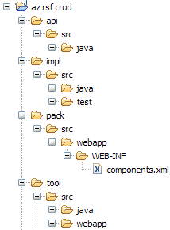
File Structure Diagram
Don’t try to memorize this, use the café app structure reference instead
Don’t build this manually, use the Sakai AppBuilder plugin for Eclipse
URL: http://issues.sakaiproject.org/confluence/x/BGo

Slide 14
Sakai App Package Structure
org.sakaiproject - base package prefix
  You could also use your local prefix (e.g. uk.ac.cam.caret)
org.sakaiproject.app-name
    Use something unique for app-name, long is good
  dao - data access
  hbm - hibernate mapping files
  logic - business logic
  model - value/data objects
  service - public api
  tool - webapp
Add impl to represent implementations
URL: http://issues.sakaiproject.org/confluence/x/BGo

Slide 15
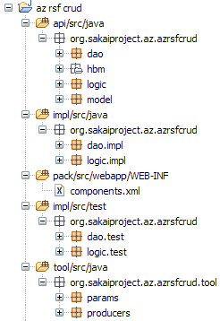
Package Structure Diagram
As before, don’t try to memorize this, use the café app structure reference instead
Don’t build this manually, use the Sakai AppBuilder plugin for Eclipse
URL: http://issues.sakaiproject.org/confluence/x/BGo

Slide 16
Reference Materials
Refer to the Programmers Café
Use the café app structure reference
Try out the Sakai AppBuilder plugin
Take advantage of the power of Eclipse to auto-complete and organize
  Use the Package Explorer Java view

Slide 17
Questions?

