Slide 1
Sakai
Course Management
Service
Ray Davis
(most slides by Josh Holtzman & Duffy Gillman)
University of California, Berkeley

Slide 2
Why CM API?
We needed our LMS/CLE to associate
Courses, sections, departments with sites
Courses, sections with groups
Instructors, students, TAs with permissions
Site data with registrar data
Notes:
The legacy approach was to bulk load Sakai’s own DB as deemed appropriate by the installation’

Slide 3
Who we?
MIT
Stanford University
University of Arizona
University of California, Berkeley
University of California, Davis
A cast of dozens

Slide 4
CM Project Goals
Bring enrollment and course data into Sakai
  Flexible enough to support many different course structures
  Concrete enough to build tools and services upon
Solve course-site mismatch issue
  Courses are not sites
  Sites are not courses
  More later…
Deliver new site admin tools…?

Slide 5
Why a new API?
IMS Enterprise?
OKI OSID?

Slide 6
Course Data
Three problems to solve
  Definitions vary widely among institutions
  Structures vary widely within institutions!
  Business rules vary widely

Slide 7
Problem #1: Definitions vary widely among institutions
Semester = Quarter = Term = Session
Section = Class = Course = Course Offering
Our Solution: Use vague terms
(with help from OKI OSID)

Slide 8
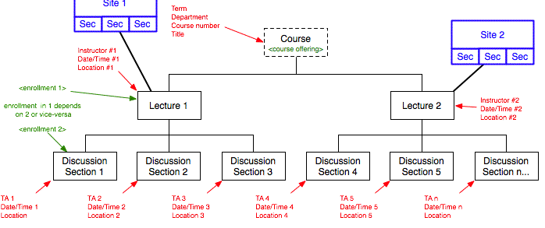
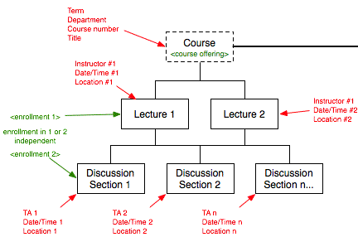
Problem #2: Structures vary widely within institutions
Our Solution: (Hopefully) Flexible API

Slide 9
Problem #3: Business rules vary widely
Our Solution: Punt

Slide 10
Added to Sakai
Integration with Authz
Integration with Section Management
Integration with Site Management
Integration with Roster

Slide 11
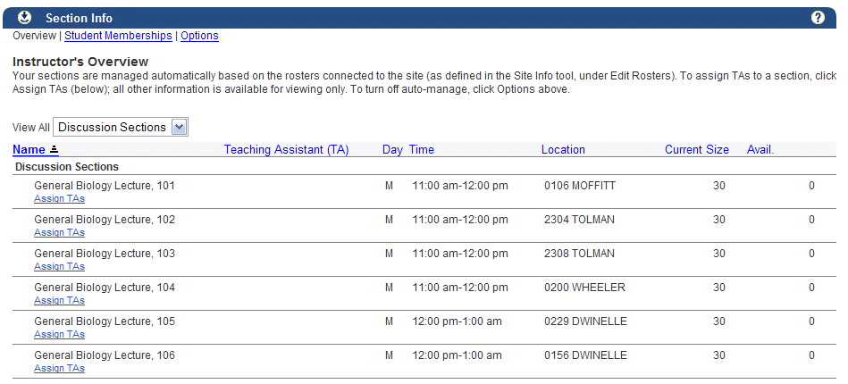
Automated Section Creation

Slide 12
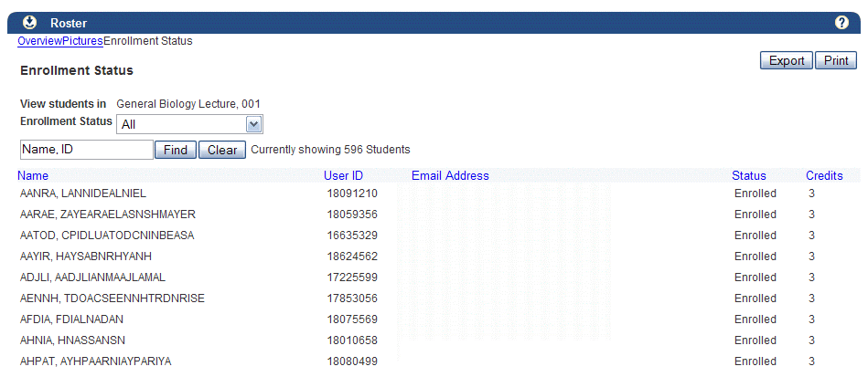
Student enrollment data

Slide 13
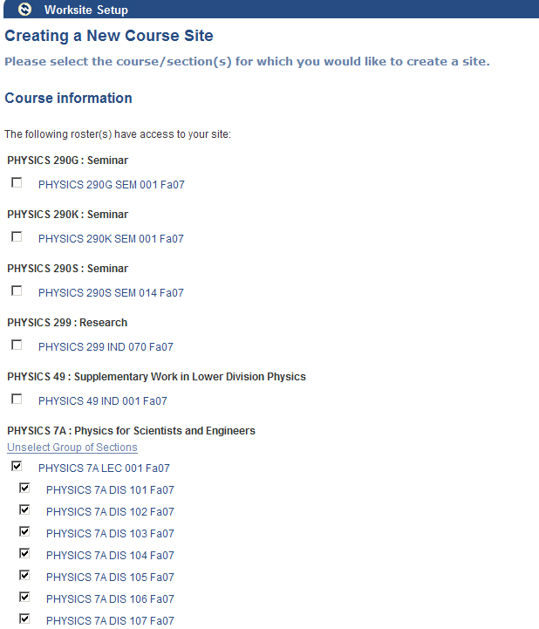
Site creation with CM

Slide 14
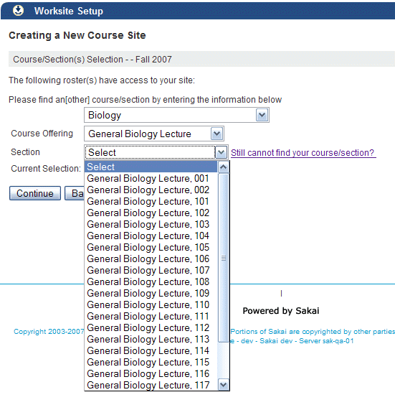
Institutional Structures in the UI

Slide 15
Don’t thank us yet
Complex API
Unfamiliar terminology
Documentation lacking
Sample implementations lacking
Inconsistent OOTB authorizations
Legacy code still hard to customize
Didn’t replace Site admin tools

Slide 16
Decide integration strategy
Understand CM object model
Understand your institution’s model
Understand what your users want out of an LMS / CME
See what data you can get from where

Slide 17
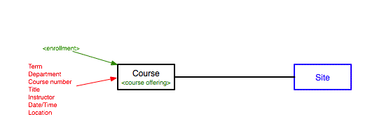
Use Case: Simple Course

Slide 18
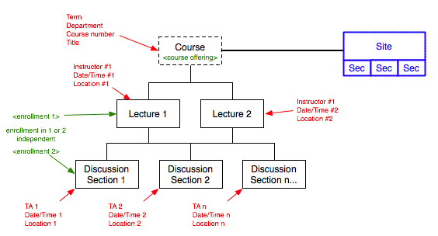
Use Case: Large Lecture (multiple lectures and sections)

Slide 19
Institutional Decisions
Sites managed by central admin? By instructors?
Course Site & Section Creation
  Automated, based on institutional structures
    Requires either CM or some custom data feed
  Manual (custom), as required by Instructors
    Requires a CM implementation
    Requires a SectionFieldManager implementation
    May require other customizations to Site Manage / Authz

Slide 20
Development approach
Decide mappings between institutional data & CM
Start from demo DB or from scratch
WRITE INTEGRATION TESTS!
Configure the GroupProvider
  How do institutional roles map to Sakai roles
  How does enrollment status affect Sakai roles
  Which Sakai roles take precedence over others
Implement SectionFieldManager for Site Manage
Fork legacy code as needed :(

Slide 21
Group Provider
Exposes enterprise defined groups in Sakai
  Map getGroupRolesForUser(String userId);
  Map getUserRolesForGroup(String id);
  String preferredRole(String one, String other);
Defines how to do compound group IDs
  String packId(String[] ids);
  String[] unpackId(String id);

Slide 22
Group Provider (continued)
OOTB Implementation (in “providers”) maps hierarchical enterprise memberships to flat Sakai site & group memberships
  Resolves roles in higher level structures
  Resolves roles based on enrollment status
  Resolves roles based on instructor status
You might not have to customize

Slide 23
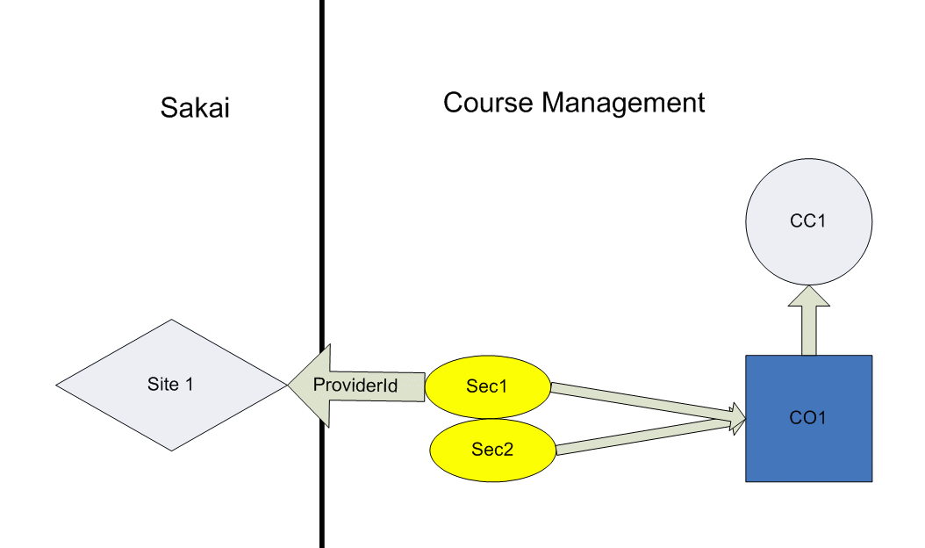
CM impl. of the Group Provider (continued)

Slide 24
CM impl. of the Group Provider (continued)
From https://source.sakaiproject.org/svn/providers/branches/sakai_2-4-x/component/src/webapp/WEB-INF/components.xml
<bean class=“...SectionRoleResolver">
  <property name="roleMap">
<map>
<entry key="I" value="Instructor" />
<entry key="S" value="Student" />
<entry key="GSI" value="Teaching Assistant"/>
</map>
</property>
<property name="officialInstructorRole" value="Instructor" />
<property name="enrollmentStatusRoleMap">
<map>
<entry key="enrolled" value="Student" />
<entry key="waitlisted" value="Student" />
</map>
</property>
</bean>

Slide 25
Section Info integration
Instructors can switch between SIS and self-managed Sections
System Admins can choose among 4 configuration options
  A) Exclusively manual. Sections are never automatically created for a site.
  B) Manual by default. Sections are not automatically created for a site.
  C) Automatic by default. Sections are automatically created for a site.
  D) Exclusively automatic. Sections are always automatically created for a site.

Slide 26
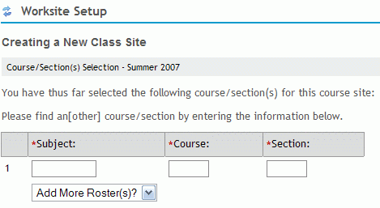
SectionFieldManager
Simple provider that translates from user input to Section EIDs in Site Manage

Slide 27
Course Management API
Seeks a common abstraction for course data across institutions
Essential data:
  Enrollment in institutionally recognized units
Design Abstraction
  Avoiding model lock-in before enough community input is gathered
  Intentionally anemic model

Slide 28
Course Management API (continued)
Parts
  Two service interfaces
    Read-only
    Writable
  Business objects
Anemic model by design
  Factoring “for the wire”
  Cross-service dependencies
  Simplification of persistence layer caching/session management

Slide 29
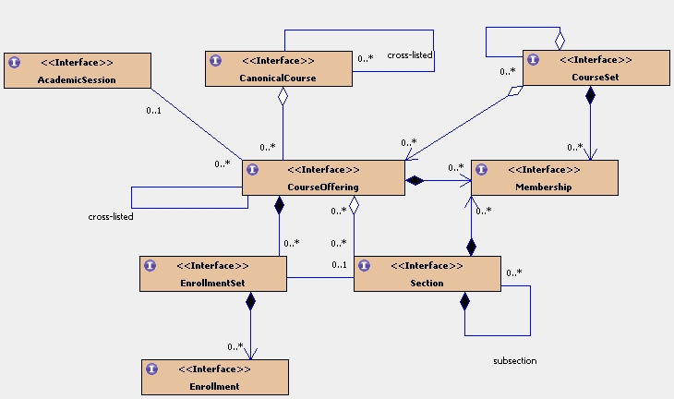
Course Management Service Business Objects

Slide 30
AcademicSession
Read-only properties:
Eid
Title
Description
StartDate
EndDate
Provides a time-based context for CourseOfferings within a CanonicalCourse. This will generally reflect semesters or terms (e.g. Fall and Spring), but may be used to represent any time-based ordering of CourseOfferings
Used for time-based ordering and determining which course data is current

Slide 31
CanonicalCourse
Read-only properties:
Eid
Title
Description
Reflects a curriculum or academic program that is offered repeatedly.

Slide 32
CourseOffering
Read-only properties:
Eid
Title
Description
AcademicSession
StartDate
EndDate
Represents an instance of a CanonicalCourse offered during an AcademicSession.
Enables CourseOfferings to have unique schedule.*
*Roadmap plans to abstract dates into Schedule object where AcademicSession and CourseOffering would each have a Schedule.

Slide 33
CourseSet
Read-only properties:
Eid
Title
Description
Category
Parent
Model a related group of CanonicalCourse or CourseOffering objects. Used in API to group child course objects. [hierarchy]
Institution-specific metadata for filtering/searching

Slide 34
Enrollment
Represents the enrollment of a single student in a single CourseOffering or Section.
Read-only properties:
UserId
EnrollmentStatus
Credits
GradingScheme

Slide 35
Membership
Relates a user to a particular role within a course data unit.
e.g .
Department Admin (CourseSet),
T.A. (CourseOffering),
lecturer (CourseOffering),
Default Instructor (CanonicalCourse)
Read-only properties:
UserId
Role

Slide 36
EnrollmentSet
Read-only properties:
Eid
Title
Description
Category
DefaultEnrollmentCredits
OfficialInstructors
Contains Enrollments for a particular Section or CourseOffering and metadata about enrollment in general. Separated from Section as some institutions have Sections that do not carry credit themselves.
Institution-specific metadata (e.g. lab, lecture, …)
Some registrars provide this data in aggregate; this applies to all contained enrollments.

Slide 37
Section
Read-only properties:
Eid
Title
Description
Category
Parent
EnrollmentSet
Represents a cohort or group within a CourseOffering. There may be multiple Sections related to a CourseOffering. Sections may also contain other Sections as subsections.

Slide 38
Service Management Interfaces
Contain semantic ‘glue’ of the APIs
Two interfaces
  CourseManagementService (read-only)
  CourseManagementAdministration (writeable)

Slide 39
CourseManagementService
Set getChildCourseSets(String parentEid);
Set getCourseSets();
Set getCourseSetMemberships(String eid);
CanonicalCourse getCanonicalCourse(String eid);
Set getEquivalentCanonicalCourses(String canonicalCourseEid);
Set getCanonicalCourses(String courseSetEid;
List getAcademicSessions();
List getCurrentAcademicSessions();
AcademicSession getAcademicSession(String eid);
CourseOffering getCourseOffering(String eid);
Set getEquivalentCourseOfferings(String courseOfferingEid);
Set getCourseOfferingMemberships(String courseOfferingEid);
Set getCourseOfferings(String courseSetEid);
Set findCourseOfferings(String courseSetEid, String academicSessionEid);

Slide 40
CourseManagementService (continued)
Set findCurrentlyEnrolledEnrollmentSets(String userId);
Set findCurrentlyInstructingEnrollmentSets (String userId);
Set findInstructingSections(String userId);
Set findInstructingSections(String userId, String academicSessionEid);
Set findCurrentSectionsWithMember(String userId);

Slide 41
CourseManagementService (continued)
List findCourseSets(String category);
boolean isEmpty(String courseSetEid);
Section getSection(String eid);
Set getSections(String courseOfferingEid);
Set getChildSections(String parentSectionEid);
Set getSectionMemberships(String sectionEid);
String getSectionRole(String sectionEid, String userId);
EnrollmentSet getEnrollmentSet(String eid);
Set getEnrollmentSets(String courseOfferingEid);
Set getEnrollments(String enrollmentSetEid);
Set getInstructorsOfRecordIds(String enrollmentSetEid);
boolean isEnrolled(String userId, Set enrollmentSetEids);
boolean isEnrolled(String userId, String eid);
Enrollment findEnrollment(String userId, String eid);

Slide 42
CourseManagementAdministration
boolean removeCourseOfferingFromCourseSet(String csEid, String coEid);
void createEnrollmentSet(String eid, String title, String description, String category, …);
void updateEnrollmentSet(EnrollmentSet enrollmentSet);
void addOrUpdateEnrollment(String userId, String enrollmentSetEid, String enrollmentStatus, String credits, String gradingScheme);
boolean removeEnrollment(String userId, String enrollmentSetEid);
public void createSection(String eid, String title, String description, String category, String parentSectionEid, String …);
public void updateSection(Section section);
void addOrUpdateCourseSetMembership(String userId, String role, String courseSetEid);
boolean removeCourseSetMembership(String userId, String courseSetEid);
void addOrUpdateCourseOfferingMembership (String userId, String role, String courseOfferingEid);

Slide 43
CourseManagementAdministration (continued)
public boolean removeCourseOfferingMembership(String userId, String courseOfferingEid);
public void addOrUpdateSectionMembership(String userId, String role, String sectionEid);
public boolean removeSectionMembership(String userId, String sectionEid);
void createAcademicSession(String eid, String title, String description, Date startDate, Date endDate);
void updateAcademicSession(AcademicSession academicSession);
void createCourseSet(String eid, String title, String description, String category, String parentCourseSetEid);
void updateCourseSet(CourseSet courseSet);
void createCanonicalCourse(String eid, String title, String description);
void updateCanonicalCourse(CanonicalCourse canonicalCourse);
void addCanonicalCourseToCourseSet(String courseSetEid,
String canonicalCourseEid);
boolean removeCanonicalCourseFromCourseSet(String courseSetEid, String canonicalCourseEid);

Slide 44
CourseManagementAdministration (continued)
void setEquivalentCanonicalCourses(Set canonicalCourses);
boolean removeEquivalency(CanonicalCourse canonicalCourse);
void createCourseOffering(String eid, String title, String description, String academicSessionEid, String canonicalCourseEid, Date startDate, Date endDate);
void updateCourseOffering(CourseOffering courseOffering);
void setEquivalentCourseOfferings(Set courseOfferings);
boolean removeEquivalency(CourseOffering courseOffering);
void addCourseOfferingToCourseSet(String courseSetEid, String courseOfferingEid);

Slide 45
Course Management Implementation
Sakai 2.4 comes with a Hibernate-based reference implementation
Institutions may:
  Use the RI, populating the hibernate tables with the CourseManagementAdministration API
  Use the RI, customizing the hibernate mappings to your custom DB schema
  Write a custom implementation of the CM API

Slide 46
CM Implementations
UC Berkeley
  Spring JDBC against Oracle Views from SIS
Stanford
  RI, loading tables via XML feeds from SIS
UC Davis
  RI against Oracle views from SIS
Others, see http://confluence.sakaiproject.org/confluence/x/Apc

Slide 47
Resources
Production Working Group
http://bugs.sakaiproject.org/confluence/display/PROD/Production+Work+Group
Old CM Project home
http://bugs.sakaiproject.org/confluence/display/CM/Home
UC Davis sample
https://source.sakaiproject.org/contrib/ucd/cm-ucd-impl
UC Berkeley sample
https://source.sakaiproject.org/contrib/ucb/ucb-integration-samples
Stanford description
http://bugs.sakaiproject.org/confluence/display/~caseyd/Stanford_Integration

