Slide 1
Sakai Technical Overview
Charles Severance
Sakai Chief Architect
December 1, 2005
http://www.dr-chuck.com/talks.php?id=62
Notes:
Abstract: This presentation gives ahigh level overview of the technical aspects of Sakai. The presentation covers the goals of the Sakai Technical architecture and describes how the Sakai architecture has been designed and developed to meet those goals. Topics covered include: building Sakai tools and services, Sakai presentation technology, Sakai’s portal integration approaches, Sakai web services, expanding Sakai without using Java, the IMS Tool Interoberability specification, configuring and running Sakai in production and a look forward to some features coming in future releases.

Slide 2
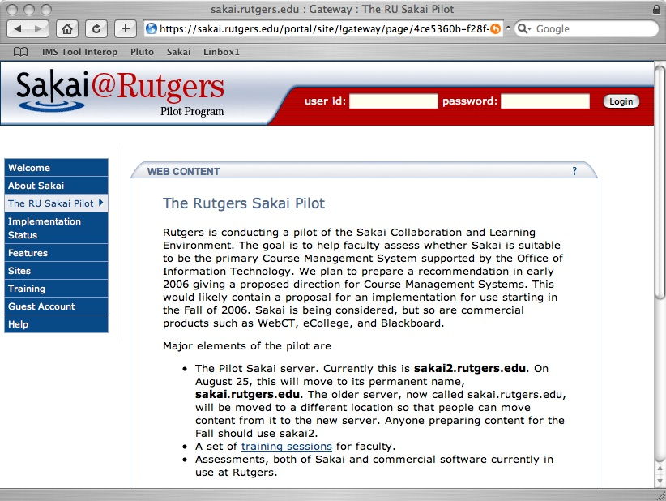
The Ideal Sakai Deployment
Take an empty Sakai system
  Choose a set of 10-15 tools for your needs
  Choose a set of Services (web services, etc)
  Add some local customizations, look feel, language etc
And you have a production ready system
Tools and capabilities written by many different groups or individuals
Sakai
Tool
Library
Sakai
Framework
Sakai
Service
Library
Local
Customization

Slide 3
Sakai Goals
Component based expandability
Appearance of a single well-integrated application
Flexible Presentation (HTML, Portals)
Support for Web Services
Flexibility in Expansion including non-Java
Production-ready

Slide 4
Framework, Tools and Services
Tools
  Cannot do any type of persistence
  Responsible for presentation (GUI)
Services
  Must provide documented API
  Cannot do any presentation (not aware of HTML at all)
  Must access other services through service APIs (not data models)
Framework
  Provides registration for tools and service
  Provides common capabilities
  Knows nothing of domain objects

Slide 5
Component Based Expansion

Slide 6
Sakai Service Rules
Tool A
Tool B
Tools can access Service APIs
Services can access Service APIs
We must be able to swap Service implementations
X API
Y API
Service X
Impl
Service Y
Impl
X Data
Model
Y Data
Model

Slide 7
Substituting Service Implementations
Tool A
Tool B
If a deployment chooses to implement Service X is using web services, there is no data model and any implementation-X specific access is no longer available.
X API
Y API
Service X
WS Impl
Service Y
Impl
X Web
Service
Y Data
Model

Slide 8
Sakai Framework
Registration of tools and services
Provides portability between environments where possible
  HTML / Web Services
Framework includes presentation elements as well to support tools
The Sakai Framework
Sakai
TPP Tool
Sakai
TPP Tool
Sakai
Service
Sakai
Service

Slide 9
Functionality Flow
Goal: no replication of code
Code trends toward the broadest and most reusable are of the system
  Framework
  Service
  Tools
As long as it does not break the “rules”
The Sakai Framework
Sakai
TPP Tool
Sakai
TPP Tool
Sakai
Service
Sakai
Service

Slide 10
Goal: Appear as Single Integrated Application

Slide 11
Why Build A Sakai Tool?
Want your website under a button in Sakai?
Want your PHP app to know the current logged in Sakai User?
Want a servlet “in Sakai” but with a minimum of rework?
Full blown Sakai tool - released separately?
An optional part of the Sakai release?
A core part of the Sakai release?
Notes:
There is a significant difference between these options.

Slide 12
Sakai Goals (may conflict)
A collaborative application
  Reusable objects (Quiz Questions) across many tools
  Component based - any component can be removed without harming the system
Extremely easy to expand - reduce barriers to adding a new tool
Notes:
To be fully integrated a tool must follow many rules. These rules are still evolving.
However to encourage innovation, we also want to allow simple expansion.
Question: Would you rather have a Quizzing tool that does not export automatically or no Quizzing tool at all?
First we cover the “highly integrated case” (Tools written in Java which want to look like they are “part of Sakai”.

Slide 13
Current
Reuse in 2.0
Anouncements
Resources
Presentation
Samigo
Melete
Notes:
Announcements can attach from resources
Presentations are uploaded into resources.
Melete and Samigo store their content in their own tables or files.

Slide 14
Better
Reuse
Anouncements
Resources
Presentation
Samigo
Melete
Notes:
We want new attachments for announcements to show up in resources… We want to use TwinPeaks for announcement attachments. Presentation needs an upload mode so you don’t have to figure out how to use Resources by reading the Presentation help.
Samigo and Melete need to be modified to store and use files, etc from resources.
During authoring, Melete needs to be able search for questions and quizzes stored in Samigo, add them to a Melete module, and then while the student is “taking” the Melete module, Melete will temporarily use Samigo to display the answer and then get it back so as to decide what to do next.

Slide 15
Flexibility in reuse
Anouncements
Resources
Presentation
Samigo
Melete
Scorm
Authoring
Notes:
What if UC Davis wants to write a SCORM authoring environment. Now it needs to talk to Samigo and the resources tool. Perhaps Melete will want to include a SCORM module as a step in a Melete module. And perhaps the SCORM authoring environment will want a full and ocmplete export of everything including the quizzes and questions from Samigo.
Yikes.

Slide 16
So you want to write a new tool?
Anouncements
Resources
Presentation
Samigo
Language
Module
Melete
Scorm
Authoring
Notes:
Say you are the Yale Language Learning Center and you want to write a Template Authoring system which will provide little lesssons for Melete and elsewhere.
What do you have to do? You have to support Melete during authoring with searching capabilties and hand out handles to your templates. When Melete is playing a model you will be handed back the handl to your object and then expected to play it. There may be a neede to import or export your object.

Slide 17
Building Tools
To meet the goals of Sakai it is not sufficient to simply build a stovepipe tool
While much of what is described here is “optional”, the more “integrated” a tool intends to be, the more “required” these elements become
Notes:
A stovepipe is a tool that stands alone and does a single function with no interaction with the rest of the system or any other tools.

Slide 18
Two Layer Architecture
Task
Tool
Task
Tool
Presentation
Public Abstraction
Task API
Task
API
Impl.
Persistence,
Business Logic,
ORM, etc…
Task DB
Task DB

Slide 19
To fully integrate into “Sakai
Task
Tool
Helper
Other
Tools
Web
Services
Task API
Task
API
Impl.
Internationalization
AutoDDL
Import/export
Authorization
Sakai DB
Placement
Components
Notes:
With great power comes great responsibility.
We are building a component based collaborative application not a portal which shows a bunch of stove pipes in a single web page.
Everything is “optional” but not optional to fully play in Sakai. The question is whether or not you are building a tool that fully plays in Sakak.

Slide 20
Flexible Presentation

Slide 21
Abstract Architecture
Client
To render a Sakai response, the tools, and services work with other elements
  Presentation Support
  Aggregation
The Abstract Sakai Environment
Aggregator
Presentation
Tools
Services
System

Slide 22
External
Aggregator
Writing a Tool
The Sakai Framework
Internal
Aggregator
Each tool describes its presentation needs in a generic fashion - the framework provides mechanisms to render the tool’s presentation
The tool is unaware of any aggregation or final presentation
Tools may produce “application” services related to the tools (chat tool / chat service)
A service built for a particular tool should still operate through an API and be available to other tools
Presentation
Support
The Sakai Tool Environment
Sakai Tool
Presentation
Sakai
Tool Code
Application
Services
Framework
Services
System

Slide 23
uPortal via
WSRP
An Example
The Sakai Framework
HTML Based
Aggregator
This is a tool written using the Sakai JSF widget set
The tool builds its own API (Schedule)
The tool makes use of framework APIs.
The tool is rendered in HTML and displayed within uPortal via the Web Services for Remote Portlets (WSRP) protocol
Outside the tool, there is great flexibility which is hidden to the tool
Sakai JSF
Widget Set
The Sakai Tool Environment
GUI layout
(JSF/JSP)
Schedule
Tool (Java)
Schedule
API (Java)
OSID Id
API
System

Slide 24
Rendering Flexibility
Sakai
iframe
Portals via
iframe
Sakai
Non iframe
Portals via
WSRP
uPortal via
JSR-168
The Sakai Framework
Servlet/HTML
Renderer
WSRP
Renderer
JSR-168
Renderer
Sakai JSF
Widget Set
The Sakai Tool Environment
Java Server
Faces in JSP
Java Tool Logic
Java Beans
Sakai Application
Services
Sakai and/or OKI
APIs
Notes:
There are many rendering options within Sakai, but the tool code does not have to change. Because presentation is delegated to the JSF widget set, all of this flexibility is hidden from the application.

Slide 25
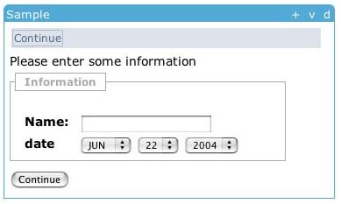
Tool Display in JSF
<sakai:view_container title="#{msgs.sample_title}">
<sakai:tool_bar> <sakai:tool_bar_item/> </sakai:tool_bar>
<sakai:instruction_message
value="#{msgs.sample_one_instructions}" />
<sakai:group_box
title="#{msgs.sample_one_groupbox}">
<h:inputText
value="#{MyTool.userName}" />
<sakai:date_input
value="#{MyTool.date}" />
<sakai:button_bar> <sakai:button_bar_item action="#{MyTool.processActionDoIt} value="#{msgs.sample_one_cmd_go}" />
</sakai:button_bar>
Notes:
Showing the separation between the “within tool” presentation and “within framework” presentation details. The tools use Sakai Widgets to express their layout needs and the framework renders the tags as appropriate for the different presentation approaches.
The variable values are populated from Java bean getter methods provided by the Java tool code in the display backing bean.

Slide 26
Describing Actions in JSF
<h:inputText
value="#{MyTool.userName}" />
MyTool.userName() {
}
<sakai:date_input
value="#{MyTool.date}" />
MyTool.date() {
}
<sakai:button_bar> <sakai:button_bar_item action="#{MyTool.processActionDoIt} value="#{msgs.sample_one_cmd_go}" />
</sakai:button_bar>
MyTool.processActionDoIt() {
}
Notes:
Similarly, the presentation in JSF links actions in the presentation to methods in the Java code which is the backing bean..

Slide 27
Support For Velocity Tools
Sakai
Stand-Alone
uPortal via
iframe
The Sakai Framework
HTML Based
Aggregator
Sakai Velocity
Support Layer
Sakai JSF
Widget Set
The Sakai Legacy Environment
The Sakai Tool Environment
Velocity
Templates
Java Server
Faces in JSP
Sakai Legacy
Tools
Java Tool Logic
Java Beans
Sakai Legacy
Services
OKI OSID
Legacy Covers
Sakai Application
Services
Sakai
Framework APIs
Hibernate
OKI OSIDs
Notes:
In addition to support for JSF tools, there is an environment to support the tools developed for the precursor to Sakai (CHEF). This compatibility layer allows all of the CHEF tools to fully operate in Sakai.

Slide 28
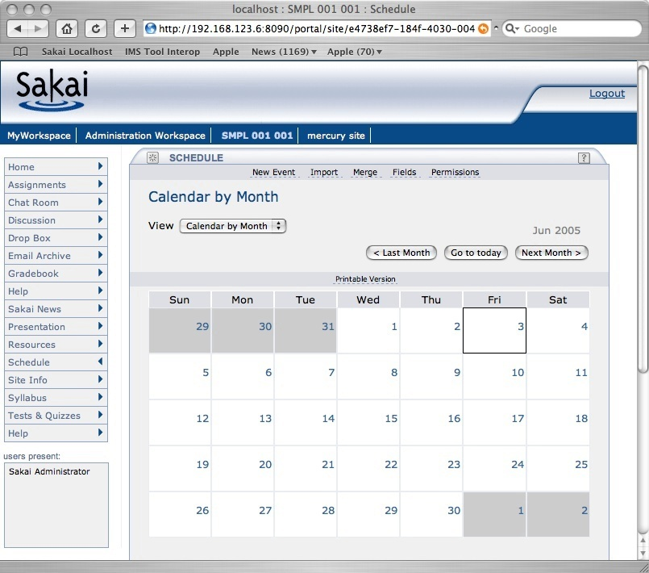
HTML Aggregator - Charon
Login
Branding
Site
Selection
Tool
Selection
Tool Area
Presence
Notes:
There are multiple ways to display Sakai tools - the basic and default portal is called “Charon”. Charon is used when Sakai is operating stand-alone and uses iframes to assemble the tools into an application.

Slide 29
Charon - Rendering Subsets
http://sakai.edu/portal/gallery
http://sakai.edu/portal/page/<id>
http://sakai.edu/portal/tool/<id>
http://sakai.edu/portal/site/<id>
Notes:
Charon provides access to various subsets of the interface. This allows flexible re-presentations of the pages and tools within Sakai.

Slide 30
Charon
Portal
Sakai Sites
Charon
Kernel Tool Registry
Request Filter
Tool A
Tool B
Tool C
Notes:
End user built in portal - Sakai site aware.
Produces new iFrame naming convention. Se documents up on sakai-dev on collab.sakaiproject.org.
Charon is pure servlet (no Velocity)

Slide 31
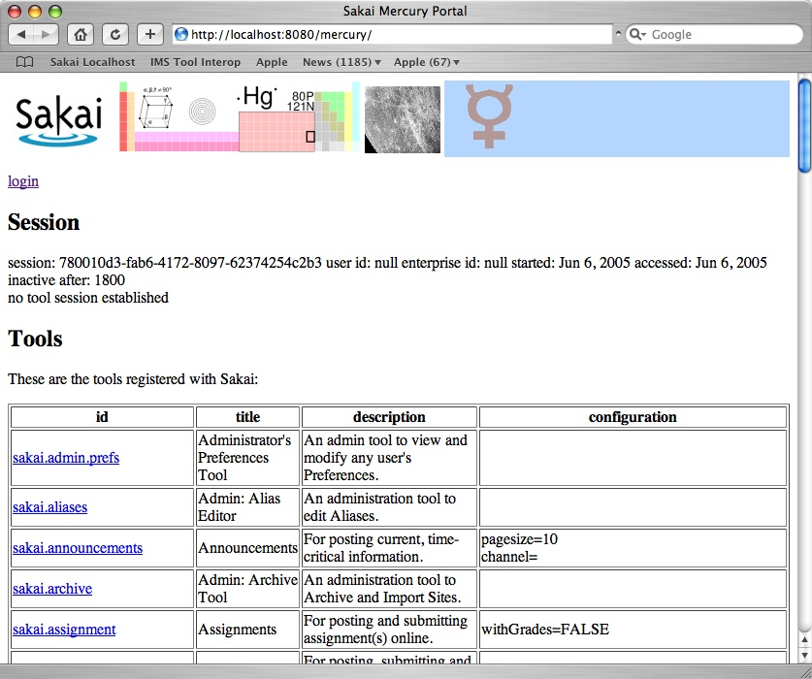
Mercury

Slide 32
Mercury
Portal
User’s
Browser
Mercury
Kernel Tool Registry
Request Filter
Tool A
Tool B
Tool C
Notes:
Has no layout nor placement - excellent for quick testing of tools. All tools live in one context “mercury”.

Slide 33
Sakai Portal Integration Steps
Use iFrames and Charon
  Highly Portable - manual configuration - separate rendering
Sakai JSR-168 Web Service Portlet
  Highly portable - automatic configuration - separate rendering
Web Services for Remote Portlets (WSRP)
  Highly portable - manual configuration - coordinated rendering
Sakai integrated into uPortal 3.0
  Not portable - automatic configuration - coordinated rendering

Slide 34
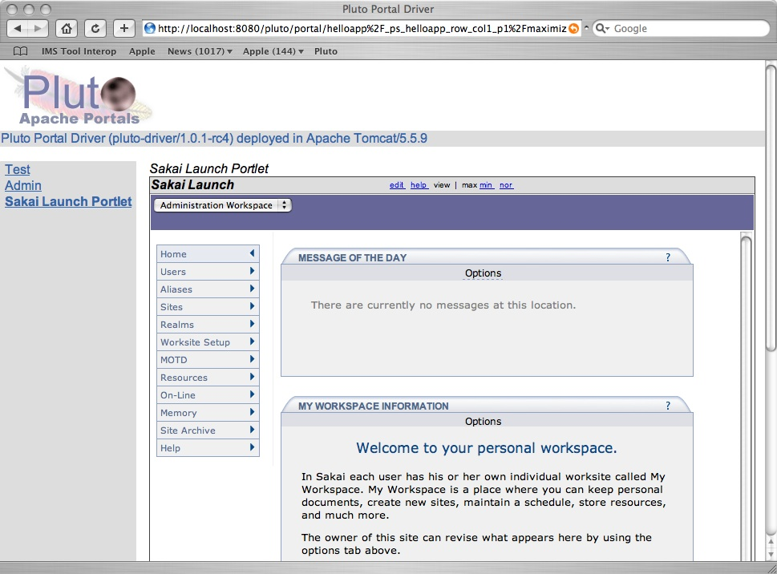
Sakai Portlet
JSR-168 Portlet
iFrame
Notes:
Two Clicks For animation. (1) Portlet Boundary (2) iFrame Boundary

Slide 35
How it Works
Charon
Portal
Sakai
uPortal, Pluto, or GridSphere
SiteList
Sakai
Portlet
Web Svcs
Login
Notes:
Four Clicks for animation.
When the Portlet Starts, it puts up a login screen or auto-logs in depending on configuration. The login is done with a web service. Once the session is established, the site list is retrieved and the portlet is displayed. As a site is selected, the portlet generates an appropriate iFrame with the Charon URL to the site. This uses session based launch to bypass Sakai’s login process.

Slide 36
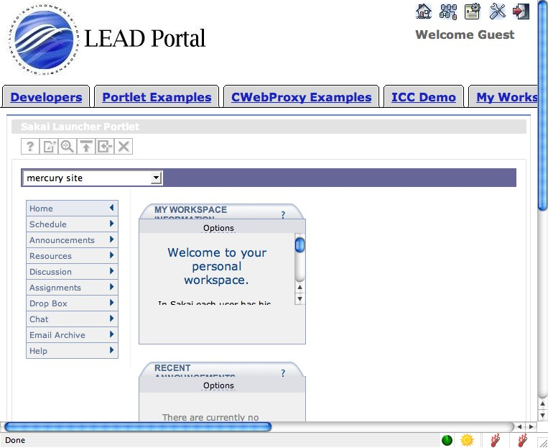
uPortal
Thanks to Marcus Christie, Indiana University for the uPortal screen shot

Slide 37
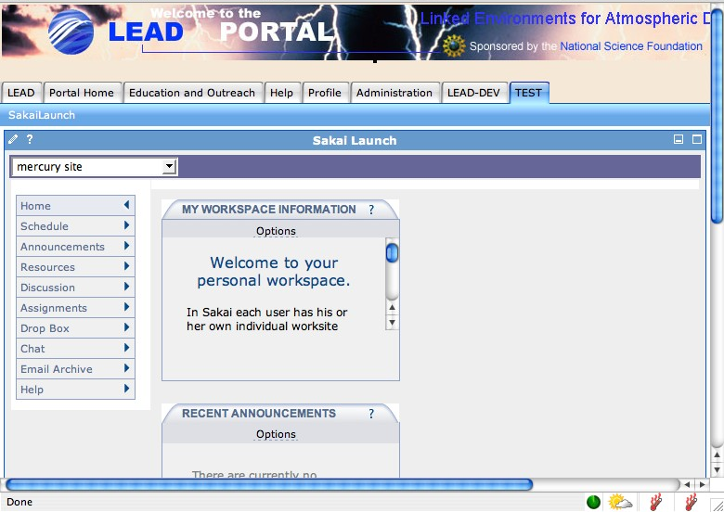
GridSphere
Thanks to Marcus Christie, Indiana University for the GridSphere screen shot

Slide 38

WSRP Activities
SunGard-led and funded: Vishal Goenka
Working with uPortal in their WSRP 3.0 effort
As we really try to use WSRP, we identify issues in the standard and WSRP4J implementation
Sakai and uPortal are becoming involved in WSRP standards activities and WSRP4J

Slide 39
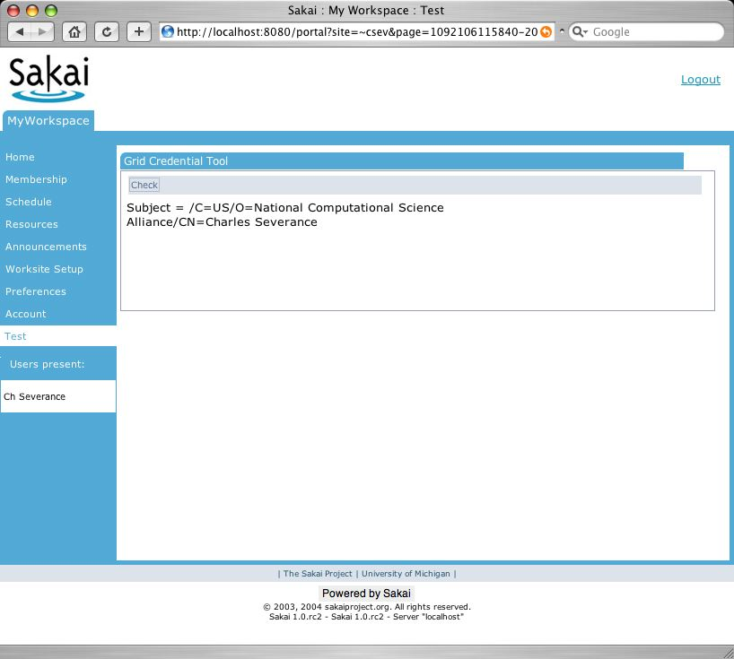
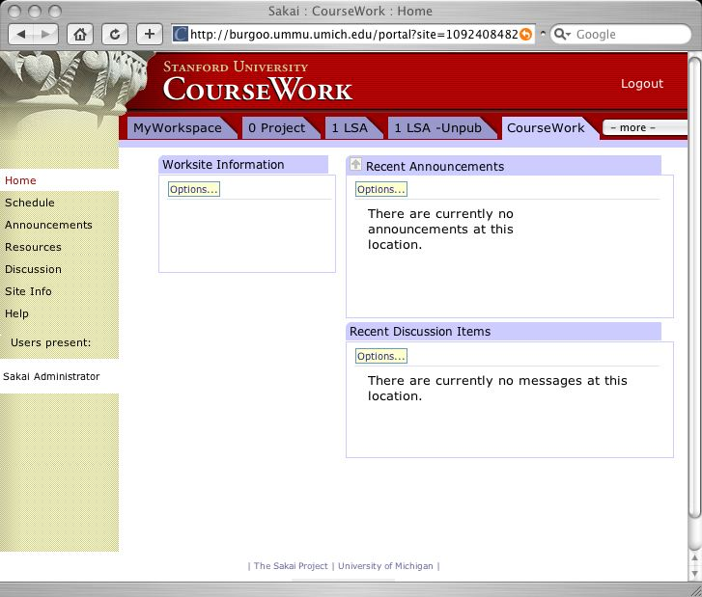
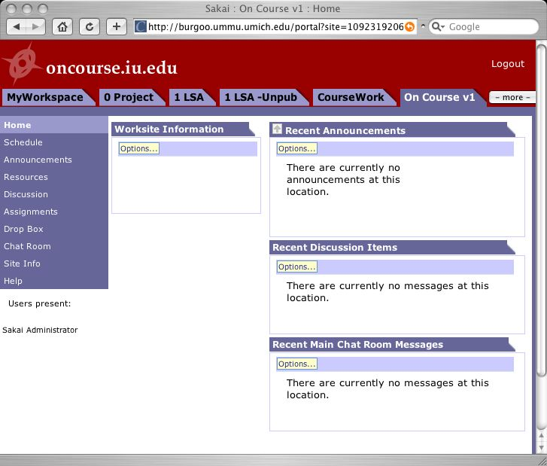
WSRP Use Case
Portal
Non-Sakai
Tool
Non-Sakai
Non-Java Tools
tool
tool
WSRP
WSRP
WSRP
WSRP
HTTP
HTTP
HTTP
Sakai
Sakai
Sakai
tool
tool
tool
tool
tool
tool

Slide 40
WSRP
“Portal”
WSRP Consumer
Portal
WSRP
Placements
Apache WSRP4J
Sakai Sites
Sakai WSRP
Kernel Tool Registry
Request Filter
Tool A
Tool B
Tool C
Web Services
Notes:
WSRP Portal was produced by Vishal Goenka of SunGard SCT over the past six months. It uses the kernel’s tool registry and tool dispatch just like every other portal. The Sakai WSRP portal satisfies the Apache WSRP4J producer API.

Slide 41
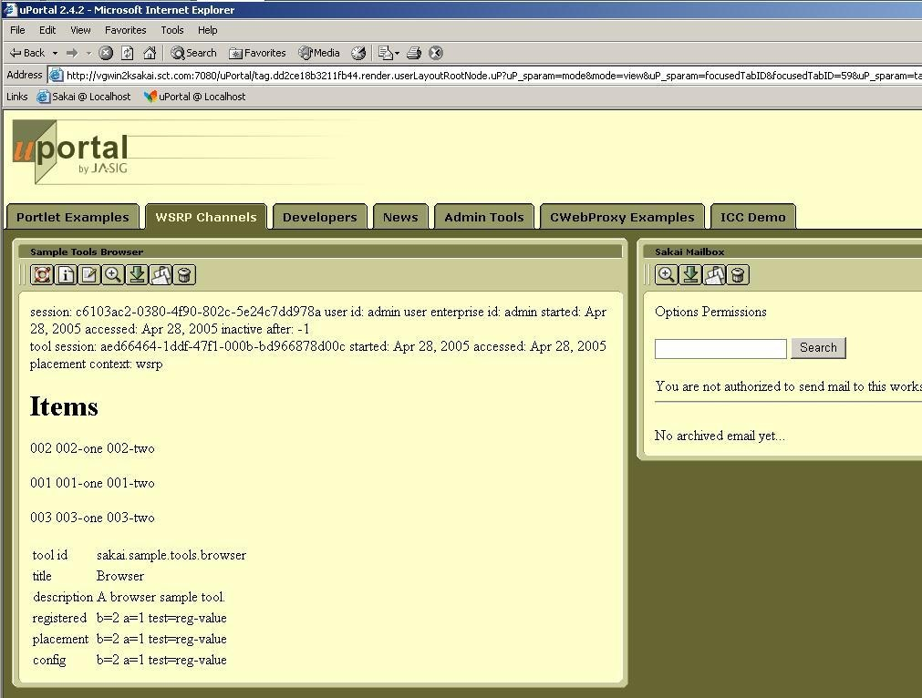
WSRP Image

Slide 42
Rendering Flexibility
Sakai
iframe
Portals via
iframe
Sakai
Non iframe
Portals via
WSRP
uPortal via
JSR-168
The Sakai Framework
Servlet/HTML
Renderer
WSRP
Renderer
JSR-168
Renderer
Sakai JSF
Widget Set
The Sakai Tool Environment
Java Server
Faces in JSP
Java Tool Logic
Java Beans
Sakai Application
Services
Sakai and/or OKI
APIs
Notes:
There are many rendering options within Sakai, but the tool code does not have to change. Because presentation is delegated to the JSF widget set, all of this flexibility is hidden from the application.

Slide 43
Web Services

Slide 44
Web Services
Web Services allow flexible reuse of API and services in contexts beyond the Sakai interfaces
  WSRP presentation
  SOAP - RPC
Web Services Issues
  Security
  Performance
  API needs to tend towards document-style rather than RPC-style
Notes:
APIs need to be reengineered.

Slide 45
Web Services
Web Services
Client
Web Services shipped in Sakai 2.0
Based on Axis 1.2
Release 2.0 includes sample PHP client
Jakarta Axis
WS End Point
Sakai Kernel
Sakai APIs
Available in Sakai 2.0
Samples Only
Notes:
Sakai 2.0 ships with a fully integrates web services capability - the particular WSDL and web services are not yet defined - this is there to enable the development of new applications, uses, and ways to integrate with Sakai.

Slide 46
Ease of Expansion Including non-Java Tools

Slide 47
Why Build A Sakai Tool?
Want your website under a button in Sakai?
Want your PHP app to know the current logged in Sakai User?
Want a servlet “in Sakai” but with a minimum of rework?
Full blown Sakai tool - released separately?
An optional part of the Sakai release?
A core part of the Sakai release?
(Review)
Notes:
There is a significant difference between these options.

Slide 48
Sakai Goals (may conflict)
A collaborative application
  Reusable objects (Quiz Questions) across many tools
  Component based - any component can be removed without harming the system
Extremely easy to expand - reduce barriers to adding a new tool
Notes:
To be fully integrated a tool must follow many rules. These rules are still evolving.
However to encourage innovation, we also want to allow simple expansion.
Question: Would you rather have a Quizzing tool that does not export automatically or no Quizzing tool at all?
First we cover the “highly integrated case” (Tools written in Java which want to look like they are “part of Sakai”.

Slide 49
Simpler Routes to New Tools
May want to write in PHP, or some other language other than java
May not want to comply with “Sakai” rules such as import/export, accessibility, or internationalization
May just want very small distribution (I.e. not part of the Sakai release)
Perhaps a very innovative early concept

Slide 50
Integrating A Servlet
Sakai
Stand-Alone
uPortal via
iframe
JVM
The Sakai Framework
HTTML Based
Aggregator
Sakai JSF
Widget Set
Sakai Request
Filter
Non-Sakai Web Application
The Sakai Tool Environment
Java Server
Faces in JSP
Presentation
Java Tool Logic
Java Beans
Sakai Commponents
Java Tool Logic
Sakai Application
Services
Application
Services
Sakai/OKI
APIs

Slide 51
Sakai Request Filter
Web Application Container (Tomcat)
Group
Provider
Group
Provider
Presentation
Presentation
Java Tool Logic
Java Tool Logic
Application
Services
Application
Services
Group
Provider
Group
Provider
AUTHN
Provider
AUTHZ
Provider
Group
Provider
AUTHN
Provider
AUTHZ
Provider
Group
Provider
Sakai Components
Storage
Storage
Stand Alone Operation
Operating Within Sakai

Slide 52
Current Servlet Integration
Samigo and Gradebook - Hybrid JSF
Spring MVC - OSP 2.0
Struts - UNISA
These are not long term approaches and gently discouraged in releases
Notes:
These are supported and viewed as a way to get existing code into Sakai quickly - often for a small community of folks for a short term.
At some level, the Sakai JSF framework is still evolving, we are pragmatic about “compliance”.

Slide 53
IMS Tool Portability Group
Focus is on making tools portable between systems (Sakai, WebCT, and Blackboard)
Established to further the discussion with commercial and other CMS/CLE providers
Uses web services and IFRAMES
Does not require tools to be written in Java
Working demonstration at the July 2005 Alt-I-lab with Samigo in Sakai, WebCT, and Blackboard
Will be released as part of Sakai 2.1
Notes:
Describe what IMS is.

Slide 54
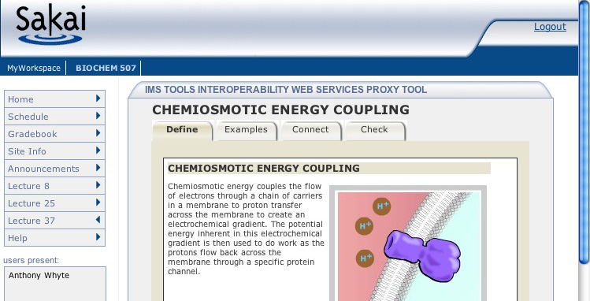
How IMS TI Works
1
6
JVM
Samigo, ConceptTutor, Etc
Sakai
7
Application
Code
Sakai Web
Services
Outcome
Sakai APIs
4
Session
And Services
Bootstrap
5
3
Sakai
IMS Proxy
Launch
2

Slide 55
Local Configuration

Slide 56
Providers in
Sakai
Sakai Velocity
Support
Sakai JSF
Support
Sakai Velocity
Tools
Sakai JSF
Tools
Sakai Servlet
Tools
Sakai
Application
Services
Sakai
Framework
Services
Enterprise Data
Sakai
Common
Services
User
Provider
Role
Provider
Course/Site
Provider
Sakai Kernel and RequestFilter
Notes:
Everything in Sakai is highly abstracted across interfaces. Integrators are *not* ever supposed to mess with Sakai tables. All enterprise integration is done using very clean APIs which Sakai consults as Sakai needs information.
Green is application domain and blue is framework domain.

Slide 57
User Directory Provider
Very mature - since Sakai 1.0
User type is controlled by provider - this controls the user template when the user is created
Can provide fully populated User objects or just answer ID/PW queries
Consulted at log-in
Supports special “properties” known to the provider
Sample providers in release 2.0: JLDAP, OpenLDAP, Kerberos, and IMS Enterprise in a database
Notes:
User type is system-wide - guest, kerberos, faculty, etc. For each type a template is needed. Controls the (relatively few

Slide 58
Course Provider
Does not auto-populate courses
Provides the course list when instructor is making a new worksite
Consulted during “New Site” operation
More work needed here
  Need to make into a Site provider
  Need to be able to set site type from provider
  Need to come up with auto population mechanism
Notes:
Early design choice in Sakai was not to pre-load every single course at the beginning of the semester, but to give the instructor a tool to make new sites (course or otherwise). The Course Provider simply populates the list of courses available to the instructor.
WorkSite Setup graphic up next.

Slide 59
Realm Provider (Role)
Consulted at login
What are the sites and roles within each site for this user
If the system is using many different roles throughout, this code must feed the proper site the proper role
Sakai internal tables are updated as changes from the provider are noticed.

Slide 60
Production Configurations

Slide 61
Important Production Choices
Operating System
  Linux (*), Solaris, X/Serve, AIX, Windows
Data Base
  Oracle (*), MySql, HSQL
Configuration
  One System
  Separate DB Server
  Clustered application servers (*)
Notes:
When choosing an environment it is important to “follow the crowd” - you will get the best support from the community if many others are using the same configuration choices as you.

Slide 62
Deployment Configurations
Developer/Demo - Hypersonic SQL
MySql
  Medium sized systems
Oracle
  Large systems
Clustered
  Multiple application servers

Slide 63
Developer Environment
HSQL database
  In memory
  On file
Easy to use/configure
HSQL is Open Source so it can be included with Sakai’s distribution
Sometimes runs “too fast” because it is in memory
Developer WorkStation
Sakai
HSQL
Database
Notes:
Sometimes it is important to performance test applications where the database connection is over a network to get a better sense of real, production performance.

Slide 64
Small/Medium Production System
MySql database
Application and database can be on same server
Placing on same server simplifies some performance tuning
Pair of fast 2-CPU systems or one 4-CPU system should support 200+ simultaneous users
Server
Sakai
MySql
Database
Application
Server
Database
Server
Sakai
MySql
Database
Notes:
When choosing a database for production, check to see what other sites are running. Most large systems run Oracle so more tuning happens on Oracle.
Separate servers allow greater scaling, but database tuning is more important. One approach is to start on the same system and then migrate to the dual-CPU configuration.

Slide 65
Large Production Environment
Sakai
IP Sprayer
Sakai
Database
Server
Oracle
Database
Sakai
Application
Server Cluster
Sakai
Notes:
Sakai is set up to cluster to scale application servers. Sakai 2.0 supports about 200 simultaneous users per application server. Database performance needs to be scaled up as well. Generally a large multiprocessor database server with a large amount of RAM is necessary.
Oracle is the recommended database as most of the large sites (except Rutgers so far) use Oracle. As the MySql experience grows, this configuration will be feasible with Oracle as well.
University of Michigan Fall 2005 - 2500 simultaneous users, IU 2000 simultaneous users. 2.0.1 + performance patches.

Slide 66
Going Forward

Slide 67
Sakai 2.1
Expected December 1, 2005
Performance improvements and bug fixes
Sections and Groups within a Site
  Section Tool, Announcements, Gradebook, Samigo
Provisional Tools
  SU Tool, Roster Tool, Wiki, WSRP, TwinPeaks

Slide 68
Sakai 2.2 (best guess)
Second Quarter 2006
Hierarchy
Open Source Portfolio
More tools Section Aware
IMS Content Packaging Import and Export
Provisional Tools (initial list)
  Mail Tool, IU Discussion Tool, Melete, JSR-168 Portlet, IMS Tool Portability, Blog, JForums

Slide 69
Way Long Term
Sakai / uPortal tightly integrated
  JSR-168, WSRP Consumer, WSRP Producer
JSR-170 - Java Content Repository
IMS Common Cartridge
All domain objects fully modeled with published Data models and RDF/OWL support

Slide 70
Summary / Questions
Thank you for your time

