Slide 1

The Simplest Possible Tool - Iteration 1
Vancouver Bootcamp
Mike Osterman
Ostermmg@whitman.edu

Slide 2
Goals of the Bootcamp
NOT the "one and only way" to do tool development
Factor out and demystify Sakai technologies
Iterative learning model

Slide 3
What we’ll cover
Tool registration
Maven
Spring
Hooking in to the Sakai framework
JSF for Sakai
Hibernate
Unit Testing

Slide 4
What we won’t cover
Providers (Thur, 10:15, Gulf A)
Writing a service for Sakai
Load testing
UI Testing (Selenium)
Web Services

Slide 5
Iteration 1 concepts
Sakai tool registration
Intro to Maven

Slide 6
The components
A Java Servlet (class and web.xml)
Sakai Tool Registration XML file
Maven project.xml file (for building and deploying your tool)

Slide 7
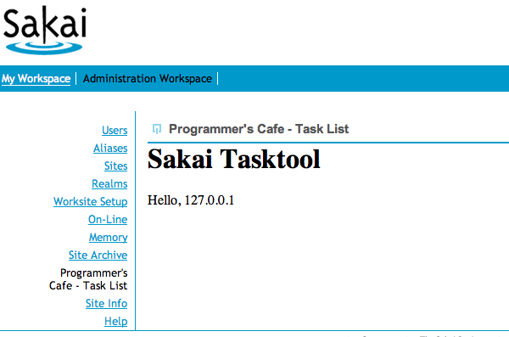

Slide 8
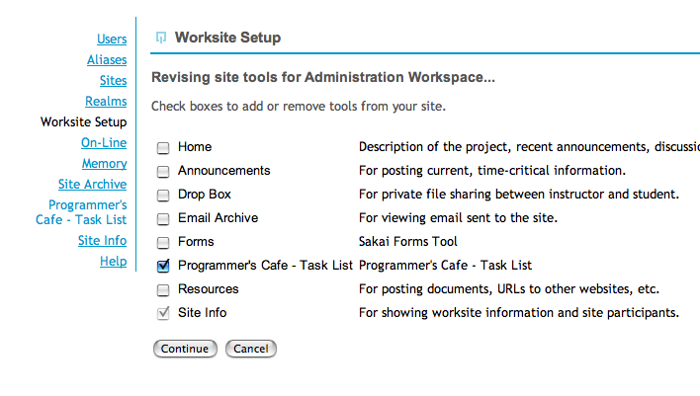

Slide 9
Creating the Servlet
_x001a_New source folder “tool/src/java”
New package “org.sakaiproject.tool.tasklist”
Extend MAVEN_REPO - servletapi-2.4
New Class “TasklistTool”
  Superclass “javax.servlet.http.HttpServlet”

Slide 10
TasklistTool.java
package org.sakaiproject.tool.tasklist;
import javax.servlet.http.HttpServlet;
public class TasklistTool extends HttpServlet {}

Slide 11
TasklistTool.java - packages
import javax.servlet.http.HttpServlet;
import javax.servlet.http.HttpServletRequest;
import javax.servlet.http.HttpServletResponse;
import javax.servlet.ServletException;
import java.io.PrintWriter;
import java.io.IOException;

Slide 12
TasklistTool.java
public class TasklistTool extends HttpServlet {
void doGet(HttpServletRequest req, HttpServletResponse res) throws ServletException, IOException {
res.setContentType("text/html; charset=UTF-8");
PrintWriter out = res.getWriter();
out.println("<h1>Sakai Tasktool</h1>");
out.println("Hello, "+ req.getRemoteAddr());
}
}

Slide 13
tool/src/webapp/WEB-INF/web.xml
<servlet>
<servlet-name>sakai.tasklist</servlet-name>
<servlet-class>
org.sakaiproject.tool.tasklist.TasklistTool
</servlet-class>
<load-on-startup>1</load-on-startup>
</servlet>

Slide 14
tool/src/webapp/WEB-INF/web.xml
<!-- Sakai request filter -->
<filter>
<filter-name>sakai.request</filter-name> <filter-class>
org.sakaiproject.util.RequestFilter
</filter-class>
</filter>

Slide 15
tool/src/webapp/WEB-INF/web.xml
<filter-mapping>
<filter-name>sakai.request</filter-name>
<servlet-name>sakai.tasklist</servlet-name>
<dispatcher>REQUEST</dispatcher>
<dispatcher>FORWARD</dispatcher>
<dispatcher>INCLUDE</dispatcher>
</filter-mapping>

Slide 16
tool/src/webapp/WEB-INF/web.xml
<!-- tool listener is required -->
<listener>
<listener-class>
org.sakaiproject.util.ToolListener
</listener-class>
</listener>

Slide 17
tool/src/webapp/tools/sakai.cafe.tool.xml
<?xml version="1.0" encoding="UTF-8"?>
<registration>
<tool
id="sakai.tasklist”
title="Programmer's Cafe - Task List”
description="Programmer's Cafe - Task List">
<category name="course" />
<category name="project" />
</tool>
</registration>

Slide 18
tool/project.xml
<pomVersion>3</pomVersion>
<name>Cafe Iteration 1 - Sakai Hello</name>
<groupId>sakaiproject</groupId>
<id>sakai-cafe-iteration1-tool</id>
<currentVersion>0.1</currentVersion>
<organization>
<name>Sakai Foundation</name>
<url>http://sakaiproject.org/</url>
</organization>
<inceptionYear>2004</inceptionYear>
<properties>
<deploy.type>war</deploy.type>
</properties>

Slide 19
tool/project.xml
<dependencies>
<!-- Java Servlets -->
<dependency>
<groupId>servletapi</groupId>
<artifactId>servletapi</artifactId>
<version>2.4</version>
</dependency>
</dependencies>
<build>
<sourceDirectory>src/java</sourceDirectory>
</build>

