Slide 1


High precision positioning system
Security monitoring solutions
Changsha Minghang Intelligent Technology Co. , Ltd

Slide 2
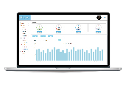
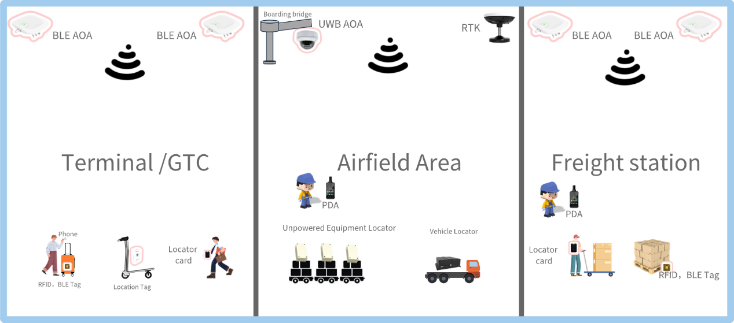
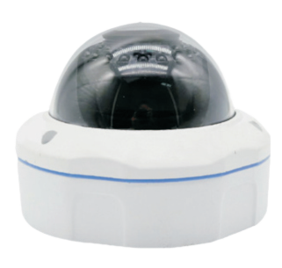
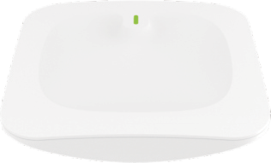


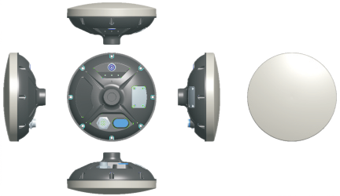
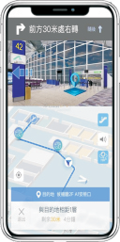

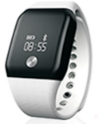


System Composition
Positioning service system
Terminal display
Cloud server
Current display
Through the positioning engine and positioning base station，the high-precision positioning system provides airport managers with real-time positioning of people, vehicles and objects. Meanwhile, it can be connected to other security systems to achieve a higher level of security at airports.
Positioning engine
Engine server
Network link
Core switching and routing
Access switch
POE switch
Locators
UWB AoA Locator
BEL AoA Locator
BLE slave Locator
BLE Beacon
Differential positioner Locator
Positioning equipment

Slide 3
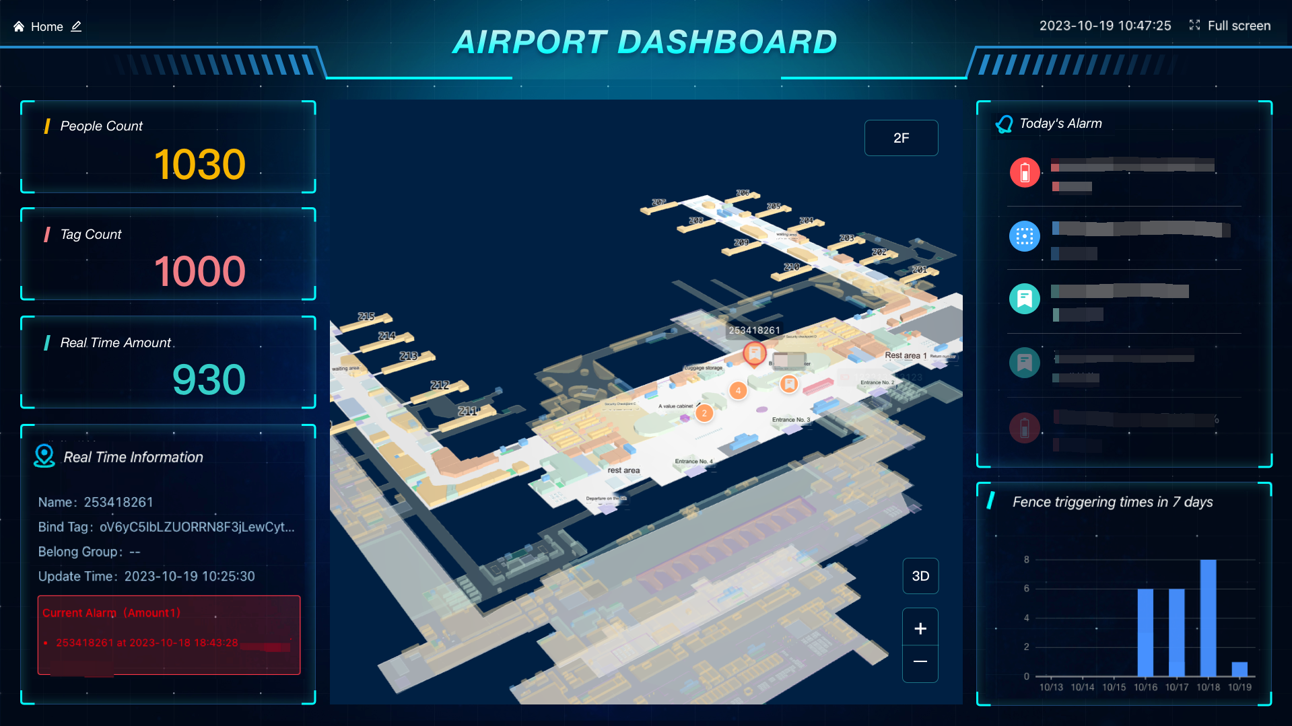
Use Case - Passenger Flow Analysis
Through the heat map based on high-precision location data analysis, the system visually displays the activity area and personnel density of travellers, and analyses the travellers' patterns by combining the heat maps of different time periods, so as to prevent security risks in key areas.

Slide 4
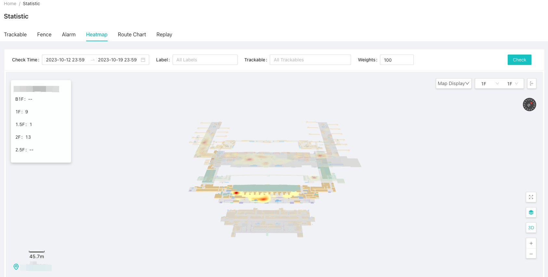
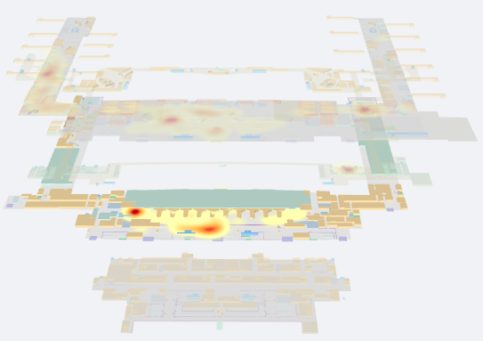
Use Case - Heat Map Analysis
Heat maps analyzed by high-precision location data visualize the activity areas and personnel density of travelers, and analyze traveler patterns in combination with heat maps at different times of the day to prevent security risks in key areas.

Slide 5
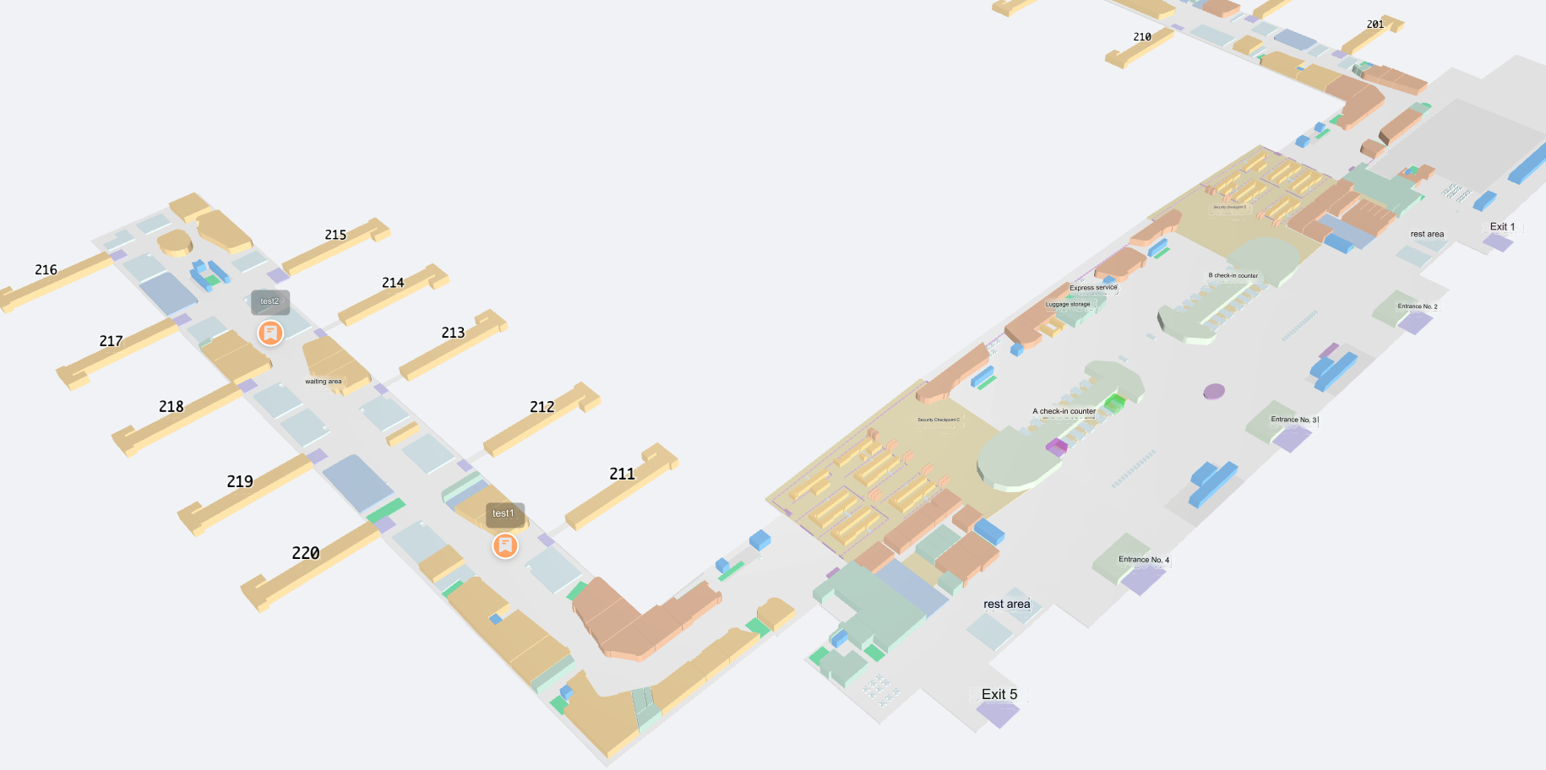
Use Case - Gate Analysis
By monitoring the status and behaviour of passengers at the gate in real time, the system can analyse the accumulation of people at the gate, thus avoiding the creation of safety hazards and optimising the arrangement and efficiency of gate usage.

Slide 6
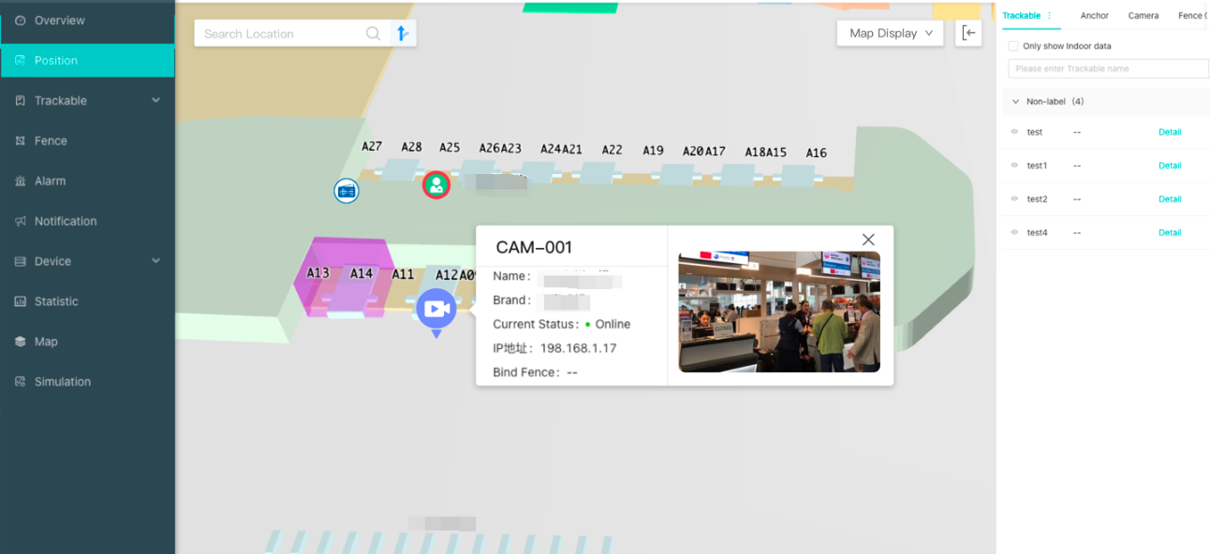
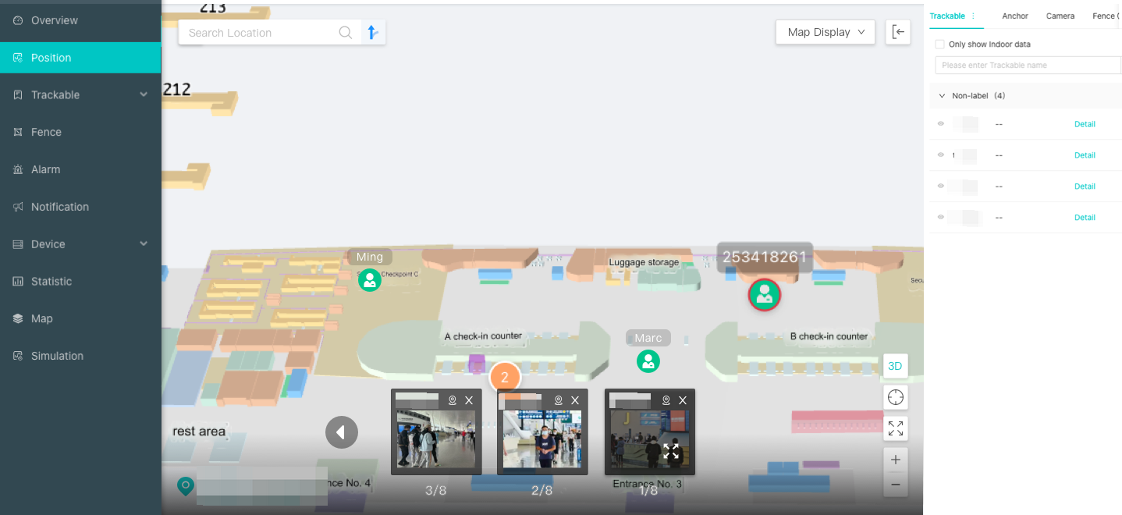
Use Case - Security Queue Monitoring
The joint monitoring of surveillance video and high-precision positioning enables real-time analysis of passenger dynamics and behaviour, timely detection of security risks and other issues, so as to adjust the settings of security facilities, increase or reduce the number of security channels, adjust the speed of security checks and so on. As a whole, it improves the level of security supervision at airports and the travelling experience of passengers.

Slide 7
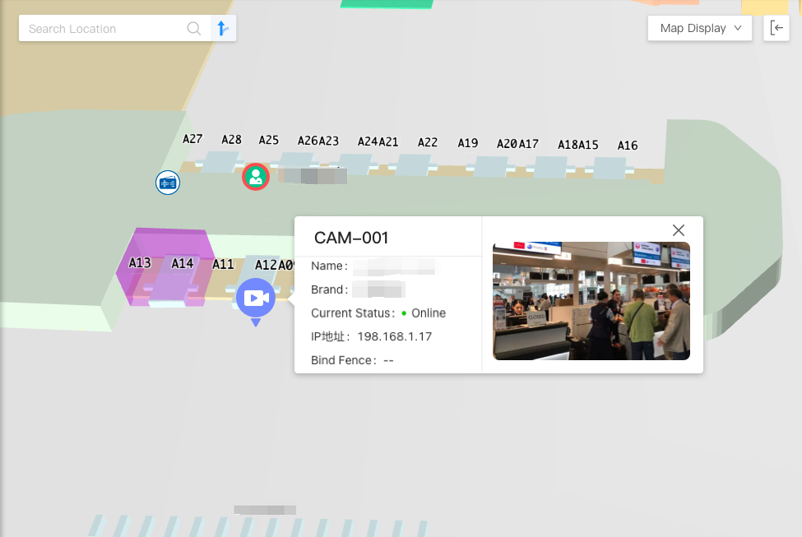
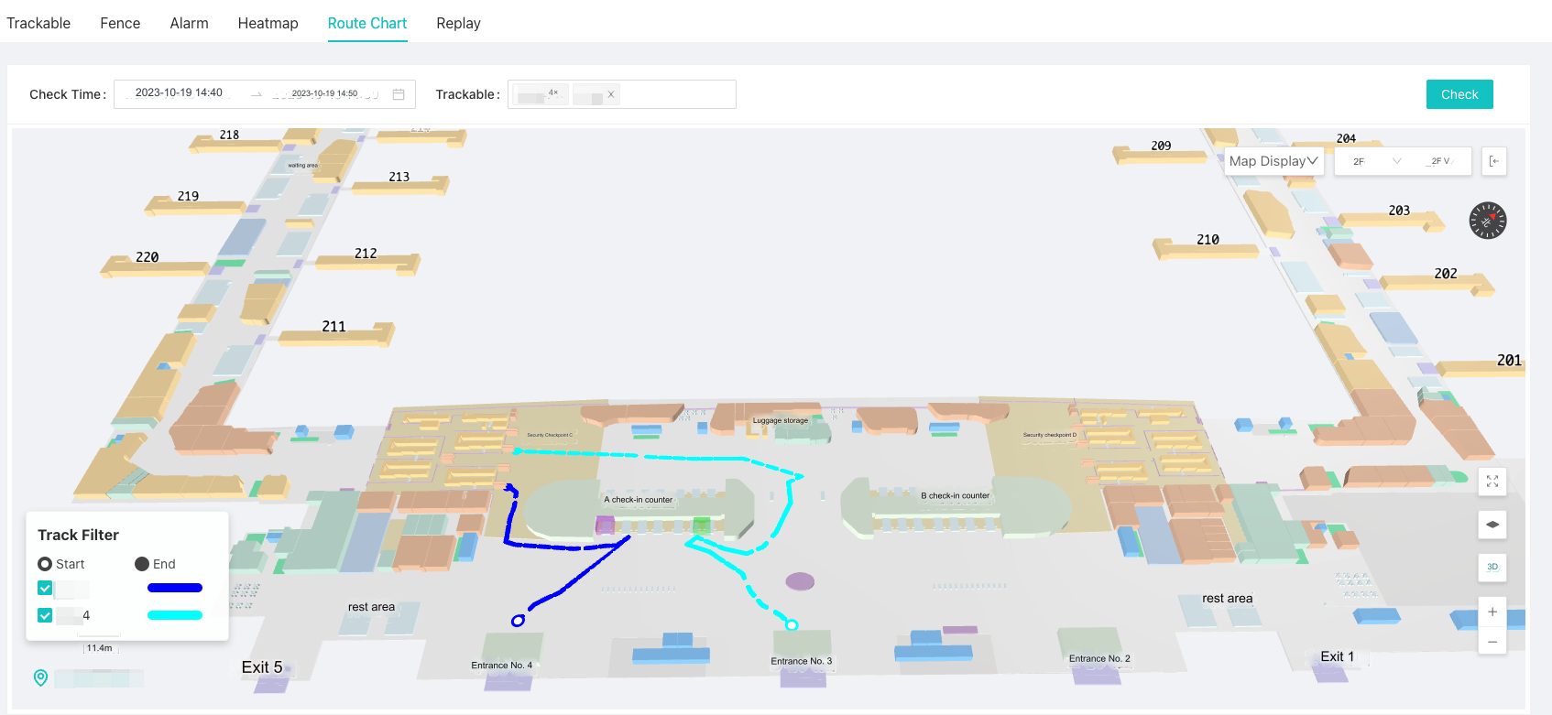
Use Case – Check in Counter Monitoring
The joint monitoring of surveillance video and high-precision positioning can realize monitoring of the status of passengers around the check-in counters, which can balance resource allocation, manage check-in efficiency, so that we can reduce potential security risks.

Slide 8
Thanks for watching

