Slide 1
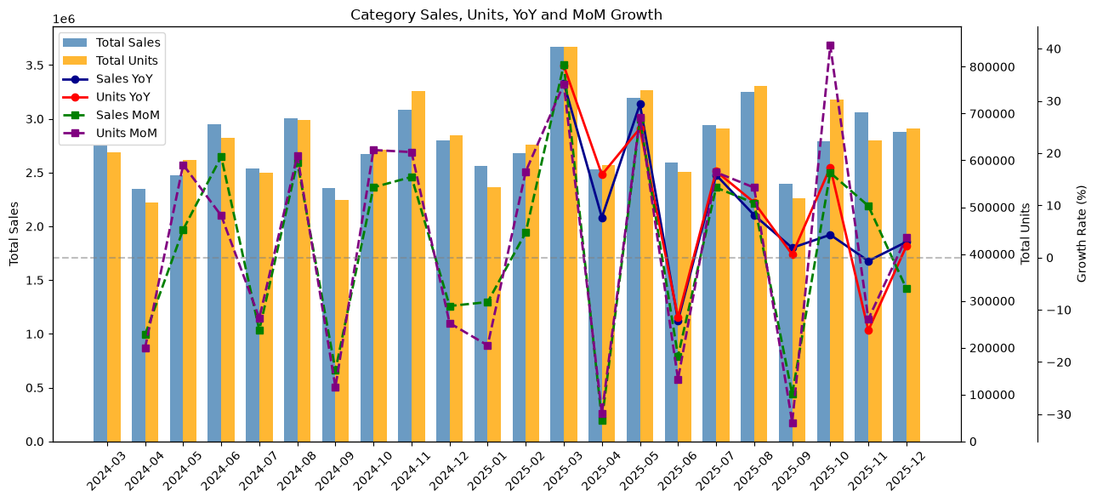
Part 1. What is happening in the category -- Category Growth
Cat Treat Sales Grew 8.7%, with Units Outpacing Value
+ 8.67%
+ 9.23%
- 0.51%
Sales Growth
Unit Growth
ASP Change
Monthly Category Sales Trend:
Business Implication:
Cat treats category growth suggests a potential opportunity for us, but need further evaluation is needed before making an entry decision.
Notes:
This analysis compares sales from March to December in 2024 and 2025, as these are the months covered in both years.
Sales growth does not necessarily mean higher profits.
Units represent selling units, not weight.
Source: Cat Treats dataset; Notebook In[9], In[39] and In[44]. Period totals and growth KPIs calculated from notebook outputs.
PPT produced by Chang
2026/10/22

Slide 2
Part 1. What is happening in the category -- Competitive Landscape
Two Brands Control 76% of Category Sales, but Market Shares are Shifting
FELIX and TEMPTATIONS gained share, while DINE and FUSSY CAT lost share.
Business Implication:
With TEMPTATIONS and DINE holding nearly 76% of the market, we would face strong competition from existing brands. To take more market share, we would need a clear point of difference (product format, pricing, etc.).
Notes:
Market shares are from December 2025. Share changes are averages of available monthly YoY comparisons and may cover different months across brands.
Source: brand_share and brand_share_yoy (Notebook In[41]–In[42]).
PPT produced by Chang
2026/10/22

Slide 3
Part 1. What is happening in the category -- Channel & Segment Trend
Online Sales are Growing Faster, while Crunch Remains the Largest Segment
Channel Dynamics
Product Segment Dynamics
Dec 2025 YoY Sales Growth
Sales Share, Mar-Dec Comparison
Online Sale Share
7.44% → 9.28%
Crunchy continued to account for most of sales.
Dec 2024 → Dec 2025 (+1.84 pp)
Online grew in every comparable month, but Instore is still the main channel.
Business Implication:
We should assess opportunities in the growing online channel, while keep in mind that most sales still come from instore and Crunchy segment remain the most popular.
Notes:
Channel growth compares December 2024 with December 2025, uses December YoY.
Segment shares compare March-December periods.
Very limited data for Functional and Freeze-dried products prevent a reliable growth assessment.
Source: Notebook In[13], In[51] and Structural Shifts analysis.
PPT produced by Chang
2026/10/22

Slide 4

Part 2. Why it is happening – Growth Drivers
Higher Unit Sales Drove Growth, While Price and Mix Had a Small Negative Effect
Sales Growth Breakdown
Potential Promotion Signal
Mar-Dec 2024 vs 2025
- 17.33%
+ 40.60%
+ 16.23%
ASP MoM, Oct 2025
Units MoM, Oct 2025
Sales MoM, Oct 2025
Promotions could explain part of this pattern, but the data cannot confirm this.
Higher-Priced SKU Growth (%)
Volume contributed 106.41% of net growth, while price/mix offset 6.41%.
Higher-priced existing products grew faster, although pack sizes may affect the comparison.
Business Implication:
We should focus on products that can attract more buyers, while carefully considering pricing and competition, as well as the effect of promotion activities.
Notes:
Price/mix includes changes in product mix.
Lower ASP cannot exactly prove promotions.
Higher-priced SKU analysis excludes products which are newly observed in 2025 .
Source: Notebook In[44], In[45], Premiumization analysis and Structural Shifts parts.
PPT produced by Chang
2026/10/22

Slide 5
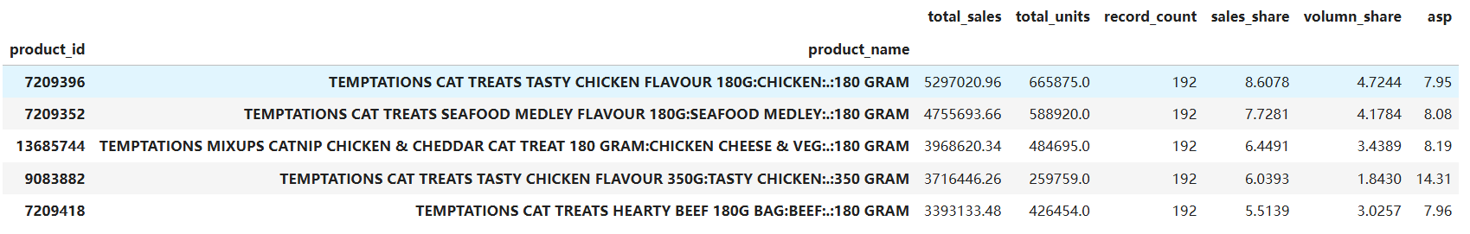
Part 2. Why it is happening – Product Winners & Losers
Major TEMPTATIONS Products Gained Sales and Shares while Some DINE Products Declined
Sales Change
Top 5 Products with Largest Sales Shares
Mar-Dec 2025 vs 2024
All time
Business Implication:
We should focus on products with strong sales and growing market share. Chicken and beef based treats are a promising starting point as several leading products have both high sales and strong growth. We should consider testing chicken flavors when developing its first products. Meanwhile, the declining market share of selected DINE tuna-based products suggests that we should be more cautious about launching similar products.
Category Share
2024 → 2025
DINE Tuna & Prawn
-0.68 pp
4.48% → 3.80%
DINE Tuna & Salmon
-0.59 pp
4.70% → 4.11%
TEMPTATIONS Tasty Chicken 350g
+0.48 pp
5.91% → 6.39%
TEMPTATIONS Tasty Chicken 180g
+0.95 pp
Source: Notebook In[14]–[16] and In[43]. Product shares calculated from comparable-period category sales (Mar–Dec 2025 vs 2024).
8.00% → 8.95%
TEMPTATIONS Mixups 180g
+1.64 pp
5.55% → 7.19%
PPT produced by Chang
2026/10/22

Slide 6
Part 2. Why it is happening – The Role of New Product Development (NPD)
Total Sales of 4 New Products
Monthly Category Share (%)
First seen in Sep 2025
Of four new products, Sep-Dec 2025
15.86% of Mar–Dec Net Category Sales Growth
Business Implication:
We should consider Creamy/Purée products for its initial launch, given the recent growth in sales share. Chicken flavors could be a good starting point, but we should also test other flavors and see which one customers prefer. Repeat purchases will be important in deciding whether these products are worth expanding.
Notes:
First observed does not exactly represent the actual launch date. These sales figures do not absolutely prove that the products brought new demand into the category.
Source: Notebook In[14]–[16] and In[43]. Category shares calculated for Mar–Dec 2024 and 2025.
PPT produced by Chang
2026/10/22

Slide 7
Part 3. What should we do about it
Entry Decision
Product Focus
Start with a small pilot
Creamy/Purée treats
Decision | Recommendation
Product Format | Focus mainly on Creamy/Purée products, as recently observed SKUs have gained market share quickly. Crunchy products should also be tested, as they remain the largest category by sales share. However, the limited data on Functional and Freeze-dried products is not enough to support investment in these formats, so we should approach them cautiously.
Positioning | Start with an affordable, everyday cat treat and focus on flavours and product features that customers already show interest in (like chicken and beef based products). Test whether we can offer something different from existing brands meanwhile.
Pricing | Use existing market prices as a reference, while also considering the potential benefits of higher pricing, given the evidence that higher-priced products show stronger sales growth.
Next Step | Start with a small product test to see which flavours customers like, whether the price is right, and whether they would buy again. Use the results to decide whether to launch on a larger scale.
Recommendations are based on analysis findings and need further testing. For positioning and pricing, we should take the relationship between pack size and price into consideration as well.
PPT produced by Chang
2026/10/22

Slide 8
Part 3. What should we do about it
How would we win
Steps before a full launch
Better Products
Offer flavours and textures that customers prefer over existing brands.
Test the Product
Find out the right product, flavor, pack size, price and position that customers prefer.
Right Price & Position
Give customers a good reason to choose our brand and products.
Start Small
Sell through selected channels, always be cautious about product profitability and feedback from customers.
Right Channel
Catch the opportunities of online sales, while make the most of offline store.
Decide if to Expand or Quit
Expand if customers buy again and the product is profitable enough. Quit otherwise.
PPT produced by Chang
2026/10/22

Slide 9
Part 4. What could change the decision
Main Conclusion: The sales data show market trends, but some important questions still need to be answered before we makes a major investment.
Limitation | Why it matters | What we should check
Missing Data | Some products or sales may not be included. | Check whether the dataset covers the full market.
Product Categories | Some product types may not be classified correctly. | Check product details, especially Functional and Freeze-dried treats.
Price and Promotions | Price changes do not necessarily mean promotions. | Check actual promotions and compare similar pack sizes.
New Products | The first recorded sale may not be the actual launch date. | Check the actual date the products entered the market.
Market Share | Share changes alone do not explain why brands gained or lost sales. | Compare sales over the same periods.
Costs and Customer Behavior | Sales data cannot show profitability or repeat purchases by customers. | Test customer behaviors and check costs before expanding.
Takeaway: The data shows an opportunity for us, but more testing is needed before a full launch.
PPT produced by Chang
2026/10/22

