Slide 1
ACID, CAP, 2PC, and all that
Jeff Chase
Fall 2015

Slide 2
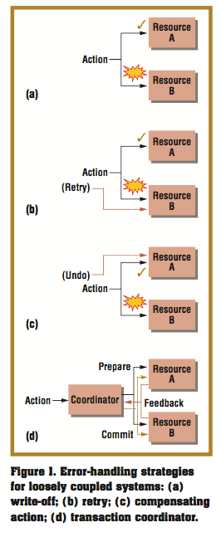

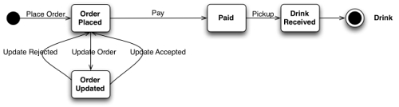

We can think of message-based distributed systems as interacting state machines. They have many analogues in the real world. But what to do when things go wrong?
[http://www.infoq.com/articles/webber-rest-workflow]

Slide 3
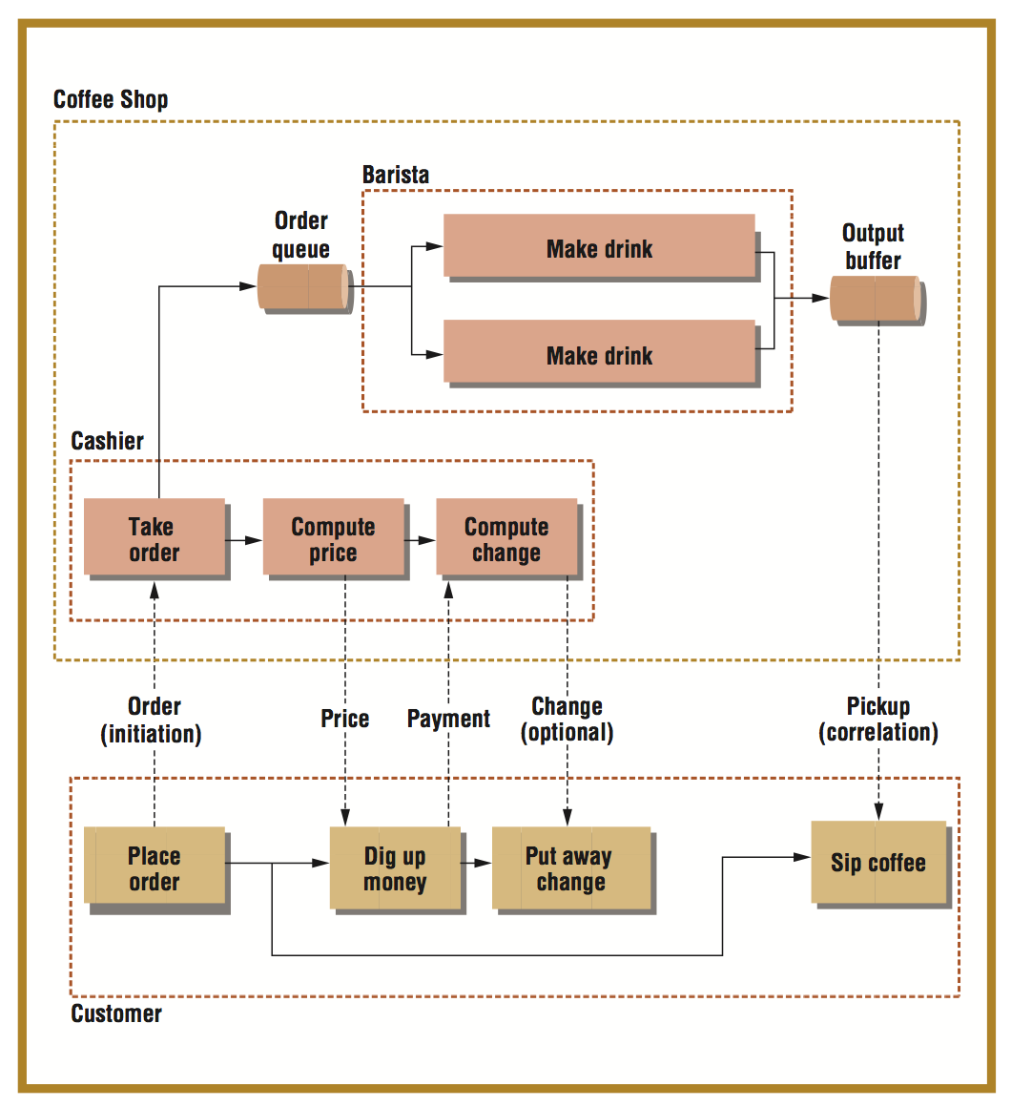
Points:
Correlation ID
Retry → idempotence
Compensating actions

Slide 4
Reliable messaging…almost
client
server
Tag each request with a unique ID, e.g., a correlation ID or reqID.
Log/cache each reqID and response. If a duplicate arrives, discard it and replay response.
request
Retry/resend if no response (or ack) before timeout.
Idempotent: an op has the same effect even if requested/executed more than once.
Use reqID to match call and response.
reply
At-most-once semantics: a message, request, or op is never duplicated, but it may be lost.

Slide 5
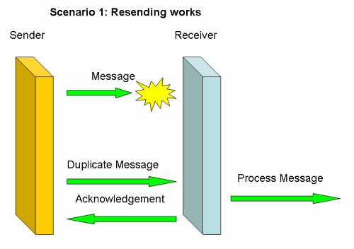
The basic problem: if I send a message, say I order a book, and through some netwok glitch the message never arrives, I get no book. Simply resending the message would solve this:
http://www.infoq.com/articles/no-reliable-messaging

Slide 6
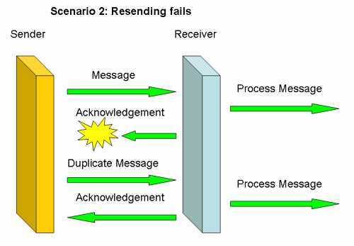
However, if the message arrives, but the response is lost, resending will not work: if I've ordered a book, I'll receive two books:
http://www.infoq.com/articles/no-reliable-messaging

Slide 7
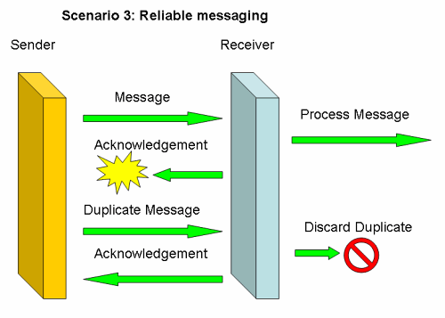
Reliable messaging solutions usually solve this problem through acknowledgements, duplicate detection and duplicate removal, as scenario 3 shows.
http://www.infoq.com/articles/no-reliable-messaging

Slide 8

Instantiating Akka actors
object RingStore {
def props(): Props = {
Props(classOf[RingStore])
}
}
// Storage tier: create K/V store servers
val stores = for (i <- 0 until numNodes)
yield system.actorOf(RingStore.props(), "RingStore" + i)

Slide 9

A key-value store in Akka/Scala (?)
sealed trait RingStoreAPI
case class Put(key: BigInt, cell: RingCell)
case class Get(key: BigInt)
class RingStore extends Actor {
private val store = new scala.collection.mutable.HashMap[BigInt, RingCell]
override def receive = {
case Put(key, cell) =>
sender ! store.put(key,cell)
case Get(key) =>
sender ! store.get(key)
}
}

Slide 10

Key-value stores
Distributed application
put(key, data)
get (key)
data
[image adapted from Morris, Stoica, Shenker, etc.]
Distributed hash table
lookup(key)
node
node
….
node
Web Tier
Storage Tier
A-F
G-L
M-R
S-Z
[image adapted from Lloyd, etc., Don’t Settle for Eventual]

Slide 11

Looking up a value named by a string
private def hashForKey(anything: String): BigInt =
{
val md: MessageDigest = MessageDigest.getInstance("MD5")
val digest: Array[Byte] = md.digest(string.getBytes)
BigInt(1, digest)
}
private def route(key: BigInt): ActorRef = {
stores((key % stores.length).toInt)
}

Slide 12
An “RPC call” in Akka
implicit val timeout = Timeout(5 seconds)
import scala.concurrent.ExecutionContext.Implicits.global
def read(key: BigInt): Option[RingCell] = {
val future = ask(route(key), Get(key)).mapTo[Option[RingCell]]
val optValue = Await.result(future, timeout.duration)
}
if (optValue.isDefined)
optValue.get
else…

Slide 13

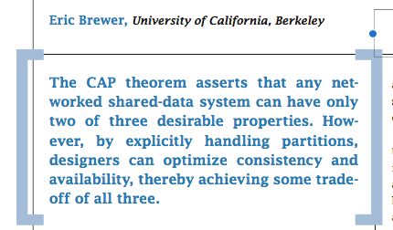
Topics mentioned, to discuss later in the semester:
  Quorum
  Version vectors
  Causal dependencies
  Bayou’s tentative updates and rollback
  CRDTs
  …
Published by the IEEE Computer Society FEBRUARY 2012

Slide 14

“CAP theorem”
consistency
C
C-A-P “choose two”
Dr. Eric Brewer
CA: available, and consistent, unless there is a partition.
CP: always consistent, even in a partition, but a reachable replica may deny service if it is unable to agree with the others (e.g., quorum).
A
P
AP: a reachable replica provides service even in a partition, but may be inconsistent.
Availability
Partition-resilience

Slide 15
“The easiest way to understand CAP is to think of two nodes on opposite sides of a partition. Allowing at least one node to update state will cause the nodes to become inconsistent, thus forfeiting C. Likewise, if the choice is to preserve consistency, one side of the partition must act as if it is unavailable, thus forfeiting A. Only when nodes communicate is it possible to preserve both consistency and availability, thereby forfeiting P.”
“In its classic interpretation, the CAP theorem ignores latency, although in practice, latency and partitions are deeply related. Operationally, the essence of CAP takes place during a timeout, a period when the program must make a fundamental decision—the partition decision:
• cancel the operation and thus decrease availability,
^{or}
• proceed with the operation and thus risk inconsistency.”
Published by the IEEE Computer Society FEBRUARY 2012

Slide 16
Safety and Liveness
We want distributed systems to be safe and live.
Agreement or “consistency” is a safety property.
  “Nothing bad ever happens”.
Termination is a liveness property.
  “Something good eventually happens.”
  Note that we can think of availability as a liveness property (unbounded response time → not available).
FLP: “An asynchronous distributed system can be safe or live, but not both.” → CAP
Which would you choose?

Slide 17
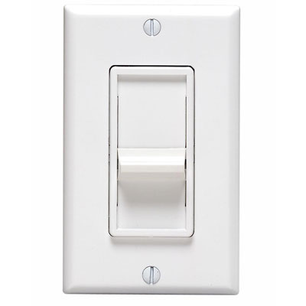
Theme: C vs. A is a “knob”, not a “switch”.
Expose (limited) inconsistencies and fix them (or try to) after the partition heals.
How to fix them? Log intentions and retry the ops on recovery. Apologize! Compensate!
This is an argument for loose coupling.
Published by the IEEE Computer Society FEBRUARY 2012

Slide 18
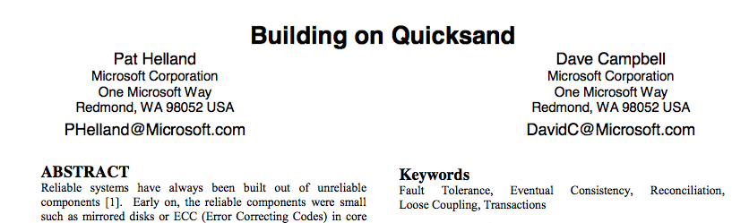
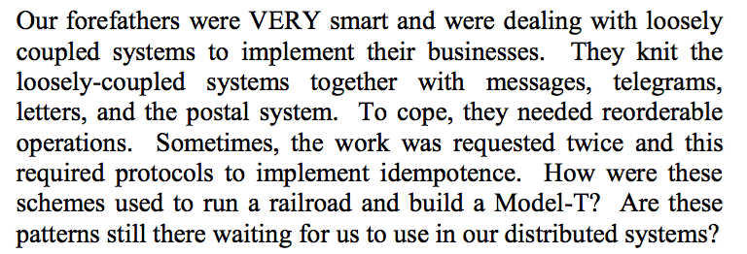
One source of these ideas

Slide 19
WHY “2 OF 3” IS MISLEADING
The first version of this consistency-versus-availability argument appeared as ACID versus BASE, which was not well received at the time, primarily because people love the ACID properties and are hesitant to give them up.
Published by the IEEE Computer Society FEBRUARY 2012

Slide 20

ACID vs. BASE
Jim Gray
ACM Turing Award 1998
Eric Brewer
ACM SIGOPS
Mark Weiser Award
2009

Slide 21
ACID vs. BASE
BASE
Weak consistency
  stale data OK
Availability first
Best effort
Approximate answers OK
Aggressive (optimistic)
“Simpler” and faster
Easier evolution (XML)
“wide” Invariant Boundary
Outside consistency boundary
ACID
Strong consistency
Isolation
Focus on “commit”
Nested transactions
Availability?
Conservative (pessimistic)
Difficult evolution
(e.g. schema)
“small” Invariant Boundary
The “inside”
but it’s a spectrum

Slide 22
ACID Transactions
Database systems etc. use a programming construct called atomic transactions (“ACID”) to represent a group of related reads/writes, often on different data items.
BEGIN T1
read X
read Y
…
write X
END
Atomic
Consistent
Independent
Durable
BEGIN T2
read X
write Y
…
write X
END
Transactions appear to commit atomically in a serial order.

Slide 23
Transaction states
Abort
Begin
Run
Commit
The program or system may choose to abort (or restart) T.
e.g., due to an error, deadlock, conflict, failure…
Else T ends with a commit

Slide 24
A-C-I-D
Atomic: a transaction T is an atomic/indivisible unit. It either commits or aborts: all of T’s ops complete, and are all seen by subsequent transactions, or none of them complete, “like it never happened”.
Durable: if a transaction T commits, then its effects survive a(ny) subsequent failure.
C: “Each T does something reasonable.”
I: “Transactions don’t interfere with one another”

Slide 25
Serial schedule
  One-copy serializability (1SR): Transactions observe the effects of their predecessors, and not of their successors.
T1
T2
Tn
S0
S1
S2
Sn
The data is in a “good” state “between” transactions.
Transaction bodies must be coded correctly!

Slide 26
Transactions: logging
Begin transaction
Append info about modifications to a log
Append “commit” to log to end x-action
Write new data to normal database
Single-sector write commits x-action (3)
Begin
Transaction Complete
Write1
…
WriteN
Commit
Invariant: append new data to log before applying to DB
Called “write-ahead logging”

Slide 27
Transactions: logging
Begin transaction
Append info about modifications to a log
Append “commit” to log to end x-action
Write new data to normal database
Single-sector write commits x-action (3)
Begin
Write1
…
WriteN
Commit
What if we crash here (between 3,4)?
On reboot, reapply committed updates in log order.

Slide 28
Transactions: logging
Begin transaction
Append info about modifications to a log
Append “commit” to log to end x-action
Write new data to normal database
Single-sector write commits x-action (3)
Begin
Write1
…
WriteN
What if we crash here?
On reboot, discard uncommitted updates.

Slide 29
Anatomy of a Log
(old)
...
A log is a sequence of records (entries) on recoverable storage.
Each entry is associated with some transaction T (given by T’s XID).
Create log entries for T’s operations, to record progress of T.
Atomic operations:
  Append/write entry to log
  Truncate older entries up to time t
  Read/scan entries
Log writes are atomic and durable, and complete detectably in order.
Log
Sequence
Number
(LSN)
LSN 11
XID 18
LSN 12
XID 18
Transaction
ID (XID)
LSN 13
XID 19
commit
record
LSN 14
XID 18
commit
(new)
(tail)

Slide 30
Redo: one way to use a Log
(old)
...
Log
Sequence
Number
(LSN)
LSN 11
XID 18
Entries for T record the writes by T (or operations in T).
  Redo logging
To recover, read the checkpoint and replay committed log entries.
  “Redo” by reissuing writes or reinvoking the methods.
  Redo in order (old to new)
  Skip the records of uncommitted Ts
No T can be allowed to affect the database until T commits.
  Technique: write-ahead logging
LSN 12
XID 18
Transaction
ID (XID)
LSN 13
XID 19
commit
record
LSN 14
XID 18
commit
(new)

Slide 31
Log grows forever?
(old)
...
Checkpoint “old” transactions.
On checkpoint, truncate the log head
  No longer need those entries to recover
Checkpoint how often? Tradeoff:
  Checkpoints are expensive, BUT
  Long logs take up space
  Long logs increase recovery time
Checkpoint+truncate is “atomic”
  Is it safe to redo/replay records whose effect is already in the checkpoint?
  Checkpoint “between” transactions, so checkpoint records a consistent state.
  Lots of approaches (see: ARIES)
Log
Sequence
Number
(LSN)
LSN 11
XID 18
LSN 12
XID 18
Transaction
ID (XID)
LSN 13
XID 19
commit
record
LSN 14
XID 18
commit
(new)

Slide 32

Transactions: References
Gold standard
Jim Gray and Andreas Reuter
Transaction Processing:
Concepts and Techniques
Comprehensive Tutorial
Michael J. Franklin
Concurrency Control and Recovery
1997
Industrial Strength
C. Mohan, D. Haderle, B. Lindsay, H. Pirahesh
ARIES: a transaction recovery method supporting fine-granularity locking and partial rollbacks using write-ahead logging
ACM Transactions on Database Systems, March 1992

Slide 33
Commit is a Consensus Problem
If a transaction runs at more than one site, then the sites must agree to commit or abort.
  E.g., think about the key-value store example.
Sites (Resource Managers or RMs) manage their own data, but coordinate commit/abort.
  “Log locally, commit globally.”
  We’ll call the RMs participants.
Each transaction commit is led by a coordinator (Transaction Manager or TM).

Slide 34
2PC: Two-Phase Commit
If unanimous to commit
decide to commit
else decide to abort
“commit or abort?”
“here’s my vote”
“commit/abort!”
TM/C
RM/P
precommit
or prepare
vote
decide
notify
RMs validate Tx and prepare by logging their local updates and decisions
TM logs commit/abort (commit point)

Slide 35
2PC: Phase 1
Tx requests commit, by notifying the coordinator (C).
Coordinator C requests each participant (P) to prepare.
Each P validates, prepares, and votes.
  Prepare: each P validates the request, logs updates locally, ensure log is durable. → enter prepared state.
  Vote: respond to C with a vote to commit or abort.
  If P votes to commit, Tx is said to be “prepared” at P.

Slide 36
2PC: Phase 2
4. Coordinator (TM) commits.
    Iff all P votes are unanimous to commit
      C writes a commit record to its log.
      Tx is committed.
    Else abort.
5. Coordinator notifies participants (asynchronously)
    C notifies each P of the outcome for Tx.
    Each P logs the outcome locally
    Each P releases any resources held for Tx.

Slide 37
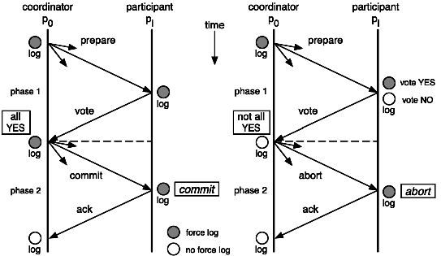
Middleware Architecture with Patterns and Frameworks
Chapter 9 Transactions
[© 2003-2009 S. Krakowiak, Creative Commons license]
[http://sardes.inrialpes.fr/~krakowia/MW-Book/Chapters/Transact/transact-body.html]

Slide 38
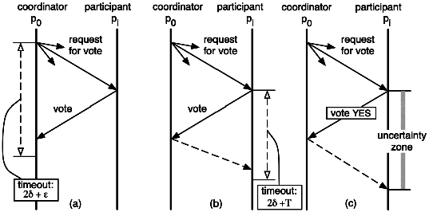
Middleware Architecture with Patterns and Frameworks
Chapter 9 Transactions
[© 2003-2009 S. Krakowiak, Creative Commons license]
[http://sardes.inrialpes.fr/~krakowia/MW-Book/Chapters/Transact/transact-body.html]

Slide 39
Handling Failures in 2PC
How to ensure consensus if a site fails during the 2PC protocol?
Case 1. A participant P fails before preparing.
  Either P recovers and votes to abort, or C times out and aborts.
Case 2. Each P votes to commit, but C fails before committing.
  Participants wait until C recovers and notifies them of the decision to abort. The outcome is uncertain until C recovers.

Slide 40
Handling Failures in 2PC, continued
Case 3: P or C fails during phase 2, after the outcome is determined.
  Carry out the decision by reinitiating the 2PC protocol on recovery.
  Note: this is an important general technique: log intentions and restart the protocol on recovery.
  If C fails, outcome is uncertain until C recovers.
    What if C never recovers?
2PC is safe, but not live.

Slide 41
Notes on 2PC
Requires persistent state, to restart the protocol after recovery.
3N-1 messages, some of which may be local.
Any RM (participant) can enter the prepared state at any time. “The TM’s prepare message can be viewed as an optional suggestion that now would be a good time to do so. Other events, including real-time deadlines, might cause working RMs to prepare. This observation is the basis for variants of the 2PC protocol that use fewer messages.” Lamport and Gray.
Still needed: non-blocking commit, for which “failure of a single process does not prevent other processes from deciding if the transaction is committed or aborted.”

Slide 42
Paxos: voting among groups of nodes
Self-appoint
Wait for majority
Wait for majority
“Can I lead b?”
“OK, but”
“v?”
“OK”
“v!”
L
N
1a
1b
2a
2b
3
log
log
safe
Propose
Promise
Accept
Ack
Commit
You will see references to Paxos state machine: it refers to a group of nodes that cooperate using the Paxos algorithm to keep the system safe and available (to the extent possible under prevailing conditions). We will discuss it later.
Notes:
Consensus point of no return occurs when a majority of agents accept v and log it. At that point it’s done, the round has succeeded and consensus has been reached, and nobody can ever be permitted to choose a new/different value. However, it may take more rounds to recognize the success.

Slide 43
Paxos: Properties
Paxos is an asynchronous consensus algorithm.
Paxos (like 2PC) is guaranteed safe.
  Consensus is a stable property: once reached it is never violated; the agreed value is not changed.
Paxos (like 2PC) is not guaranteed live.
  Consensus is reached if “a large enough subnetwork...is nonfaulty for a long enough time.”
  Otherwise Paxos might never terminate.
  Paxos is more robust than 2PC, which is vulnerable to failure of the leader.
Equivalent: RAFT, Viewstamped Replication (VR)

Slide 44
Getting precise about CAP #1
  What does consistency mean?
  Consistency → Ability to implement an atomic data object served by multiple nodes.
  Requires linearizability of ops on the object.
  Total order for all operations, consistent with causal order, observed by all nodes
  Also called one-copy serializability (1SR): object behaves as if there is only one copy, with operations executing in sequence.
  Also called atomic consistency (“atomic”)
Brewer’s Conjecture and the Feasibility of Consistent, Available, Partition-Tolerant Web Services. Seth Gilbert, Nancy Lynch. MIT manuscript.

Slide 45
Getting precise about CAP #2
Availability → Every request received by a node must result in a response.
  Every algorithm used by the service must terminate.
Network partition → Network loses or delays arbitrary runs of messages between arbitrary pairs of nodes.
  Asynchronous network model assumed
  Service consists of at least two nodes
Brewer’s Conjecture and the Feasibility of Consistent, Available, Partition-Tolerant Web Services. Seth Gilbert, Nancy Lynch. MIT manuscript.

Slide 46
Getting precise about CAP #3
Theorem. It is impossible to implement an atomic data object that is available in all executions.
  Proof. Partition the network. A write on one side is not seen by a read on the other side, but the read must return a response.
Corollary. Applies even if messages are delayed arbitrarily, but no message is lost.
  Proof. The service cannot tell the difference.
Brewer’s Conjecture and the Feasibility of Consistent, Available, Partition-Tolerant Web Services. Seth Gilbert, Nancy Lynch. MIT manuscript.

Slide 47
Getting precise about CAP #4
Atomic and partition-tolerant
  Trivial: ignore all requests.
  Or: pick a primary to execute all requests
Atomic and available.
  Multi-node case not discussed.
  But use the primary approach.
  Need a terminating algorithm to select the primary. Does not require a quorum if no partition can occur. Left as an exercise.
Brewer’s Conjecture and the Feasibility of Consistent, Available, Partition-Tolerant Web Services. Seth Gilbert, Nancy Lynch. MIT manuscript.

Slide 48
Getting precise about CAP #5
Available and partition-tolerant
  Trivial: ignore writes; return initial value for reads.
  Or: make a best effort to propagate writes among the replicas; reads return any value at hand.
Brewer’s Conjecture and the Feasibility of Consistent, Available, Partition-Tolerant Web Services. Seth Gilbert, Nancy Lynch. MIT manuscript.

Slide 49
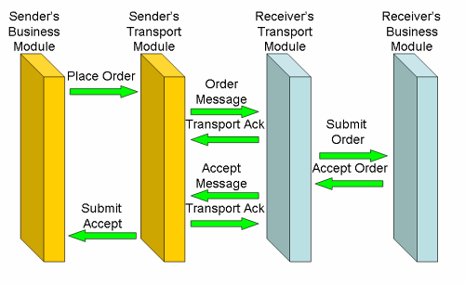
An end-to-end argument against exactly-once messaging semantics.
Say I have a book order: I don't want to receive the same title twice, nor do I want it not at all. Now, if it's important to us, on a business level, that I get my book exactly once, what does the assurance that my message has been received exactly once really bring me? I want to know that your book ordering system has received it. If the WS-Reliable Messaging bus accepts it, and subsequently the book system rejects it because I've entered a wrong client number or a non-existent catalog item, knowing the message has been received brings me preciously little assurance. And even when the message is syntactically and semantically correct, it's no good if the title is out of stock: I want my book, not just the certainty my message has been received well. If the processing of my message once, and exactly once, is important on a business level, I need to confirm the exactly-once processing on a business level. As the figure below shows, the transport acks are pretty meaningless on a business level: we need the business ack.
http://www.infoq.com/articles/no-reliable-messaging

Slide 50
To prevent visibility and reordering problems on actors, Akka guarantees the following two “happens before” rules:
• The actor send rule: the send of the message to an actor happens before the receive of that message by the same actor.
• The actor subsequent processing rule: processing of one message happens before processing of the next message by the same actor.
Note: In layman’s terms this means that changes to internal fields of the actore are visible when the next message is processed by that actor. So fields in your actor need not be volatile or equivalent.
Both rules only apply for the same actor instance and are not valid if different actors are used.

Slide 51
What message ordering rules do we really need?
e.g., preserve program order, even if retransmit?
causal messages?
To prevent visibility and reordering problems on actors, What messageAkka guarantees the following two “happens before” rules:
• The actor send rule: the send of the message to

Slide 52
The completion of a Future “happens before” the invocation of any callbacks registered to it are executed.
We recommend not to close over non-final fields (final in Java and val in Scala), and if you do choose to close over non-final fields, they must be marked volatile in order for the current value of the field to be visible to the callback.
If you close over a reference, you must also ensure that the instance that is referred to is thread safe. We highly recommend staying away from objects that use locking, since it can introduce performance problems and in the worst case, deadlocks. Such are the perils of synchronized.

Slide 53
Please note, that the ordering guarantees discussed above only hold for user messages between actors.
Failure of a child of an actor is communicated by special system messages that are not ordered relative to ordinary user messages. In particular:
- Child actor C sends message M to its parent P
- Child actor fails with failure F
Parent actor P might receive the two events either in order M, F or F, M

Slide 54
local sends can fail in Akka-specific ways:
• if the mailbox does not accept the message (e.g. full BoundedMailbox)
• if the receiving actor fails while processing the message or is already terminated
While the first is clearly a matter of configuration the second deserves some thought: the sender of a message does not get feedback if there was an exception while processing, that notification goes to the supervisor instead.

Slide 55
The rule more specifically is that for a given pair of actors, messages sent directly from the first to the second will not be received out-of-order. The word directly emphasizes that this guarantee only applies when sending with the tell operator to the final destination

