Slide 1
Chubby: A Consensus Service
Jeff Chase
Duke University
http://www.cs.duke.edu/~chase/cps512

Slide 2
Chubby: the big picture
Shared consensus service
(e.g., Chubby)
paxos inside
Your scalable application service
What are the “right” abstractions for this API?
Can we factor the “hard parts” of consensus out of the application? Can we hide the messiness of consensus from the app? How to make the consensus service scalable?

Slide 3
Chubby in a nutshell
Chubby generalizes leased locks
More efficient: session-grained leases/timeout
No need to keep track of time states for every lock
More robust: primary/backup replication with failover
More general: multiple consistent abstractions
Locks with mutually assured exclusion and callbacks
Strongly consistent files, ephemeral files
Safe caching with guaranteed change notifications
General notion of jeopardy if consistency cannot be maintained

Slide 4
A Chubby cell
Chubby itself usually has five replicas in each cell, of which three must be running for the cell to be up.
paxos inside
Synchronous primary/backup replication
N replicas per cell with leader election through Paxos.
Primary accepts/sequences all client client requests.
Backups accept/execute requests in primary’s order.
Primary replies to request after backups accept it.
Replace a failed replica after a few hours.

Slide 5
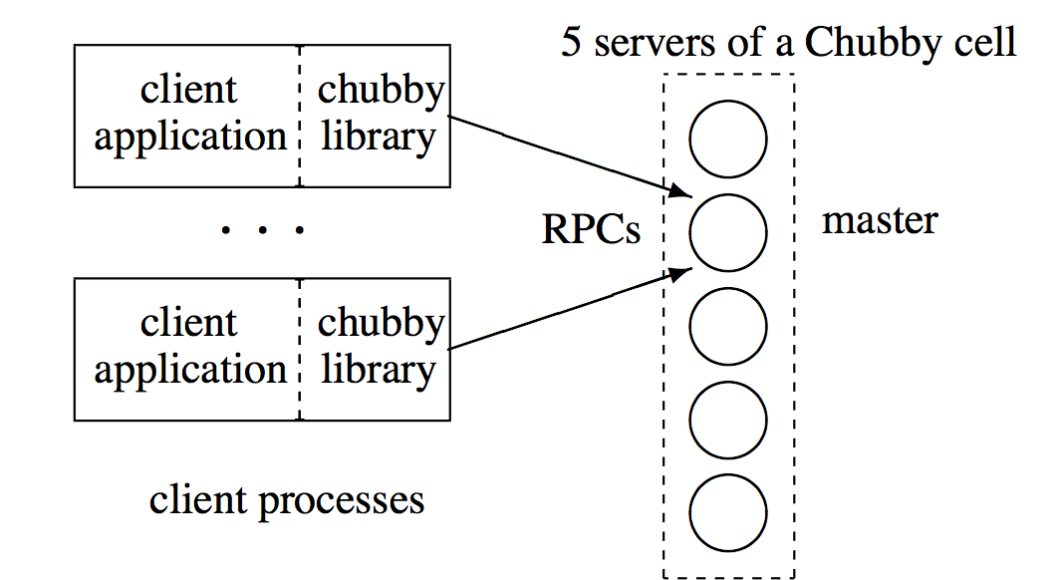
Chubby and its library
Chubby API boundary
The application uses the Chubby API, and does not care that part of the implementation is in a library local to the process.

Slide 6
Developers are …
Human ☹
Despite attempts at education, our developers regularly write loops that retry indefinitely when a file is not present, or poll a file by opening it and closing it repeatedly when one might expect they would open the file just once.
Our developers sometimes do not plan for high availability in the way one would wish.
However, mistakes, misunderstanding and the differing expectations of our developers lead to efforts that are similar to attacks.
Our developers are confused by non-intuitive caching semantics, so we prefer consistent caching.
Developers also fail to appreciate the difference between a service being up, and that service being available to their applications.
A lock-based interface is more familiar to our programmers.
Slide courtesy of Mosharaf Chowdhury

Slide 7
Why a lock service?
It becomes “easy” to retrofit consensus functions onto app services that start as little toys and then grow organically into production mega-services.
First, our developers sometimes do not plan for high availability in the way one would wish. Often their systems start as prototypes with little load and loose availability guarantees; invariably the code has not been specially structured for use with a consensus protocol. As the service matures and gains clients, availability becomes more important; replication and primary election are then added to an existing design…a lock server makes it easier to maintain existing program structure and communication patterns.

Slide 8
Lock service → name service
A lock service helps to configure an app service, e.g., to select a primary or master. But then how to advertise/share the resulting configuration within the app service? Add files in a name space, with consistent sharing and caching: the lock service already has the core functions needed to do it.
Second, many of our services that elect a primary or that partition data between their components need a mechanism for advertising the results. This suggests that we should allow clients to store and fetch small quantities of data—that is, to read and write small files. This could be done with a name service, but our experience has been that the lock service itself is well-suited for this task…because the consistency features of the protocol are shared. Chubby’s success as a name server owes much to its use of consistent client caching….

Slide 9
Why locks? Why not?
Third, a lock-based interface is more familiar to our programmers…exclusive locks can provide the programmer with the illusion of sequential programming. However, many programmers have come across locks before, and think they know to use them. Ironically, such programmers are usually wrong, especially when they use locks in a distributed system; few consider the effects of independent machine fail- ures on locks in a system with asynchronous communications. Nevertheless, the apparent familiarity of locks overcomes a hurdle in persuading programmers to use a reliable mechanism for distributed decision making.
What is he saying here?
Programmers know how to use locks, or think they do, or at least are willing to try. So sell what they are buying.
Programmers don’t know what to do when their locks fail. Many don’t consider this case. But they will later.

Slide 10
Why consensus as a service?
Last, distributed consensus algorithms use quorums to make decisions, so they use several replicas to achieve high availability….if a client system uses a lock service, even a single client can obtain a lock and make progress safely. Thus, a lock service reduces the number of servers needed for a reliable client system to make progress. In a loose sense, one can view the lock service as a way of providing a generic electorate that allows a client system to make decisions correctly when less than a majority of its own members are up.
Do it once, do it right, share it among client applications large and small.

Slide 11
Consensus service: functions
Allow app servers to:
claim roles, functions, or data, with mutual exclusion
advertise their liveness and roles to peers
share configuration data with strong consistency
e.g., DNS bindings of peers, master/coordinator roles
coordinate their accesses to other services (r/w locking)
Notify app servers if/when:
configuration changes occur elsewhere in the application
consensus properties cannot be assured (“jeopardy”)
e.g., updates lost, exclusion compromised

Slide 12

Abstractions, scale, and confusion
Some decisions follow from our expected use and from our environment:
• A service advertising its primary via a Chubby file may have thousands of clients. Therefore, we must allow thousands of clients to observe this file, preferably without needing many servers.
• Clients and replicas of a replicated service may wish to know when the service’s primary changes. This suggests that an event notification mechanism would be useful to avoid polling.
• Even if clients need not poll files periodically, many will; this is a consequence of supporting many developers. Thus, caching of files is desirable.
• Our developers are confused by non-intuitive caching semantics, so we prefer consistent caching.

Slide 13
Chubby Abstraction(s)
Objects (“nodes”) exist in a hierarchical name space.
create/destroy/open/close/read/write
operations protected by access control: one lookup/check per op
open returns an “unforgeable” handle for ops
open handles are reference-counted
ephemeral files disappear when no longer open
Nodes may act as locks or files or both.
read/write atomically and in their entirety, w/ consistent caching
lock Acquire, tryAcquire, Release, w/ shared/exclusive lock modes
Client may monitor specified nodes for update events.

Slide 14
Caching and scale
paxos inside
Clients cache aggressively within their sessions:
Locks
Open file handles and file contents
Name entries
Chubby records client cache contents, and invalidates client cache entries synchronously on any update.

Slide 15
Chubby failure: app view
If an app server loses its session, bad things happen:
All handles are invalidated.
All locks are lost.
Ephemeral files disappear: you become invisible.
How should an application server respond?
What causes a server to lose its session with Chubby?
Chubby fails completely: not enough surviving replicas.
Server is on the minority side of a partitioned network.

Slide 16
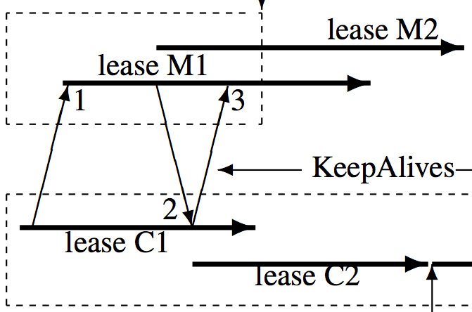
Session KeepAlive
Client issues KeepAlive RPC (1). Master responds (2) when it wants another (3). Master response extends session lease by “advance amount” (master’s choice).

Slide 17
Piggybacking
Master may generate a KeepAlive response whenever it wants.
E.g., respond early if there is an event or invalidation to deliver. Piggyback events (e.g., invalidations) on master responses. Or, maybe the KeepAlive responses piggyback on the events? The point is that any message from the master may reset the session lease.

Slide 18
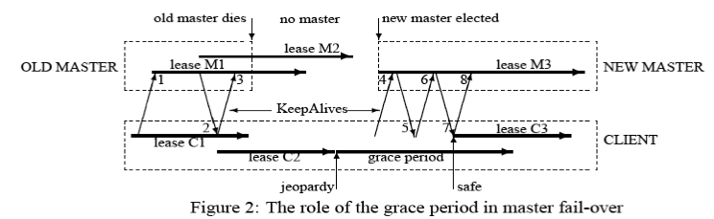
“Jeopardy”
If master does not respond to KeepAlive by deadline, then the client’s session and cache are in “jeopardy”.
- Block API calls until we figure out what is going on.
- Expose jeopardy/safe events to the application if it subscribes.
- Wait a “grace period” until expiring the session.
- Poison all handles to disable API if the session expires.
18

Slide 19
Locks: coarse-grain vs. fine-grain
We expect coarse-grained use. For example, an application might use a lock to elect a primary, which would then handle all access to that data for a consider- able time, perhaps hours or days.
Chubby is intended to provide only coarse-grained locking. Fortunately, it is straightforward for clients to implement their own fine-grained locks tailored to their application. An application might partition its locks into groups and use Chubby’s coarse-grained locks to allocate these lock groups to application-specific lock servers. Little state is needed to maintain these fine-grain locks; the servers need only keep a non-volatile, monotonically increasing acquisition counter that is rarely updated.
What is he saying here?

Slide 20
Points to discuss
Advisory vs. mandatory locks
Sequencers: why needed? vs. lock delay
Epoch number
Per-node counters

