Slide 1
A peek at consistency models, and transactional 2PL
Jeff Chase
Duke University
http://www.cs.duke.edu/~chase/cps512

Slide 2
Thinking about data consistency
Let us choose a total (sequential) ordering of data accesses across an entire system.
Sequential schedules are easy to reason about, e.g., we know how reads and writes should behave.
R(x) returns the “last” W(x)=v in the schedule
A data consistency model defines required safety and liveness properties of the ordering we choose.
E.g., we require the total order to be consistent with some “natural” partial order (→).
Application might perceive an inconsistency if the ordering violates →, otherwise not detectable.
Some orders are legal in a given consistency model, and some orders are not.

Slide 3
Choosing a schedule/ordering
W(x)=v
e3a
A
e1a
e2
External witness
e5
e1b
e4
B
R(x)
e3b
R(x)
This is a total order of events.
Also called a sequential schedule.
It allows us to say “before” and “after”, etc.
But it is arbitrary.

Slide 4

Sequential consistency
W(x)=v
OK
W(y)=u
OK
P1
ordered
M
P2
R(x)
v
Sequential consistency model [Lamport79]:
- Memory/SS chooses a global total order for each cell.
- All operations from a given P are in program order.

Slide 5
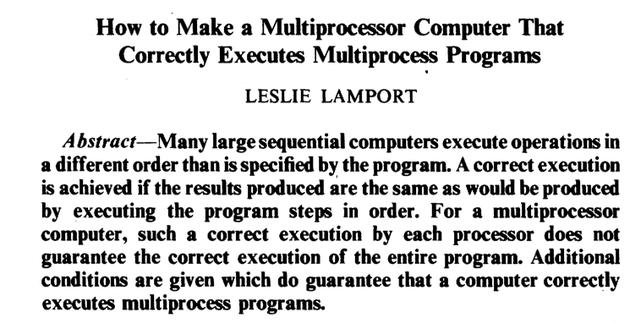
1979: An early understanding of data consistency.

Slide 6
Sequential consistency
No sequentially consistent execution can produce this result:
W(x)=1
OK
R(y)
0??
To produce this result:
4<2 (4 happens-before 2) and 3<1. No such schedule can exist unless it also reorders the accesses from T1 or T2. Then the reordered accesses are out of program order.
T1
2
3
M
1
4
T2
W(y)=1
OK
R(x)
0??
It turns out that sequential consistency is sufficiently strong to implement locking “above” the memory system, using flag values.

Slide 7
Q: Data consistency
What properties can we assume for:
A cache-consistent file store? (Using per-file locks.)
Chubby file accesses?
“RingCell” accesses in the KVStore?
What about Akka message ordering?
Is there a “stronger” model than sequential consistency?
Is there a “weaker” model than sequential consistency?

Slide 8
File caching with leases
A read lease ensures that no other client is writing the data. Holder is free to read from its cache.
A write lease ensures that no other client is reading or writing the data. Holder is free to read/write from cache.
Writer must push modified (dirty) cached data to the server before relinquishing write lease.
Must ensure that another client can see all updates before it is able to acquire a lease allowing it to read or write.
If some client requests a conflicting lock, server may recall or evict on existing leases.
Callback RPC from server to lock holder: “please release now.”
Writers get a grace period to push cached writes and release.

Slide 9
Chubby: caching and scale
paxos inside
Clients cache aggressively within their sessions:
Locks
Open file handles and file contents
Name entries
Chubby records client cache contents, and invalidates client cache entries synchronously on any update.

Slide 10
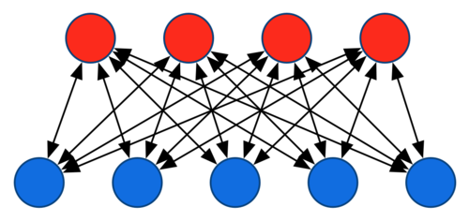

KVStore
class KVStore extends Actor { private val store = new scala.collection.mutable.HashMap[BigInt, Any] override def receive = { case Put(key, cell) => sender ! store.put(key,cell) case Get(key) => sender ! store.get(key) } }
[Pic courtesy of Alex Smola]

Slide 11
What “RingService” does
private def touchCell() = { stats.touches += 1 val key = chooseActiveCell val cell = directRead(key) if (cell.isEmpty) { stats.misses += 1 } else { val r = cell.get
<check and modify contents of cell r> directWrite(key, r) } }
What happens if two RingServers try to touch the same cell “at the same time”?

Slide 12
Akka message ordering
For a given pair of actors, messages sent directly from the first to the second will not be received out-of-order. The word directly emphasizes that this guarantee only applies when sending with the tell operator to the final destination [not through intermediaries]. Suppose:
Actor A1 sends messages M1, M2, M3 to A2
Actor A3 sends messages M4, M5, M6 to A2
Then:
If M1 is delivered it must be delivered before M2 and M3
If M2 is delivered it must be delivered before M3
If M4 is delivered it must be delivered before M5 and M6
If M5 is delivered it must be delivered before M6
But:
A2 can see messages from A1 interleaved with messages from A3
Any of the messages may be dropped, i.e. not arrive at A2

Slide 13
Transactions: ACID Properties
ACID guarantees four intertwined properties:
Atomicity. Transactions can never “partly commit”; their updates are applied “all or nothing”.
Consistency. Each transaction T transitions the dataset from one semantically consistent state to another.
Independence/Isolation. All updates by T1 are either entirely visible to T2, or are not visible at all.
(→serializability)
Durability. Updates made by T are “never” lost once T commits.

Slide 14
Serial schedule
One-copy serializability (1SR): Transactions observe the effects of their predecessors, and not of their successors.
T1
T2
Tn
S0
S1
S2
Sn
The data is in a “good” state “between” transactions.
Transaction bodies must be coded correctly!

Slide 15
Transactions: ACID Properties
Atomicity. The system guarantees atomicity using logging, shadowing, distributed commit.
Consistency. The application guarantees consistency by correctly marking transaction boundaries.
Independence/Isolation. Guaranteed through locking or timestamp-based concurrency control.
Durability. The system guarantees durability by writing updates to stable storage (e.g., logging again).

Slide 16
“A small database”
[Birrell/Jones/Wobber, SOSP 87]
Your favorite data structures in memory
Your favorite programming language
volatile memory
non-volatile memory
Log transaction events as they occur, and push log ahead of commit →WAL
Push a “pickled” checkpoint to a file periodically
snapshot
log
Notes:
WAL is write-ahead logging

Slide 17
Q1
How to ensure serializability?
What if we fail when writing a snapshot?
How to ensure snapshot is a consistent state?
How to restore state if transaction aborts?

Slide 18
Q1: the [BJW87] answers
How to ensure serializability?
One big lock: single shot transactions
What if we fail when writing a snapshot?
Atomic snapshots using filesystem (link/rename)
How to ensure snapshot is consistent state?
Stop executing transactions while snapshot is in progress.
What if transaction chooses to abort?
No support for programmed aborts: program must validate transaction before starting it.

Slide 19
Q2
What if I want more concurrency/throughput?
That’s harder…
What if my data is too big to fit in memory?
That’s harder…
What if my program must abort a transaction?
That’s harder…
What if my program/structures change?
That’s harder…
What if I don’t want to stop for a checkpoint?
That’s harder…

Slide 20
Isolation and Serializability
“I” means that actions are serializable.
A schedule for a group of transactions is serializable iff its effect is the same as if they had executed in some serial order.
Obvious approach: execute them in a serial order (slow).
Transactions may be interleaved for concurrency, but this requirement constrains the allowable schedules:
A transaction must not affect another that commits before it.
T₁ and T₂ may be arbitrarily interleaved only if there are no conflicts among their operations.
Concurrent operations conflict if they access the same data item and at least one of them is a write.
Conflicts matter: “I” property says that intermediate effects of T must be invisible to other transactions unless/until T commits.

Slide 21
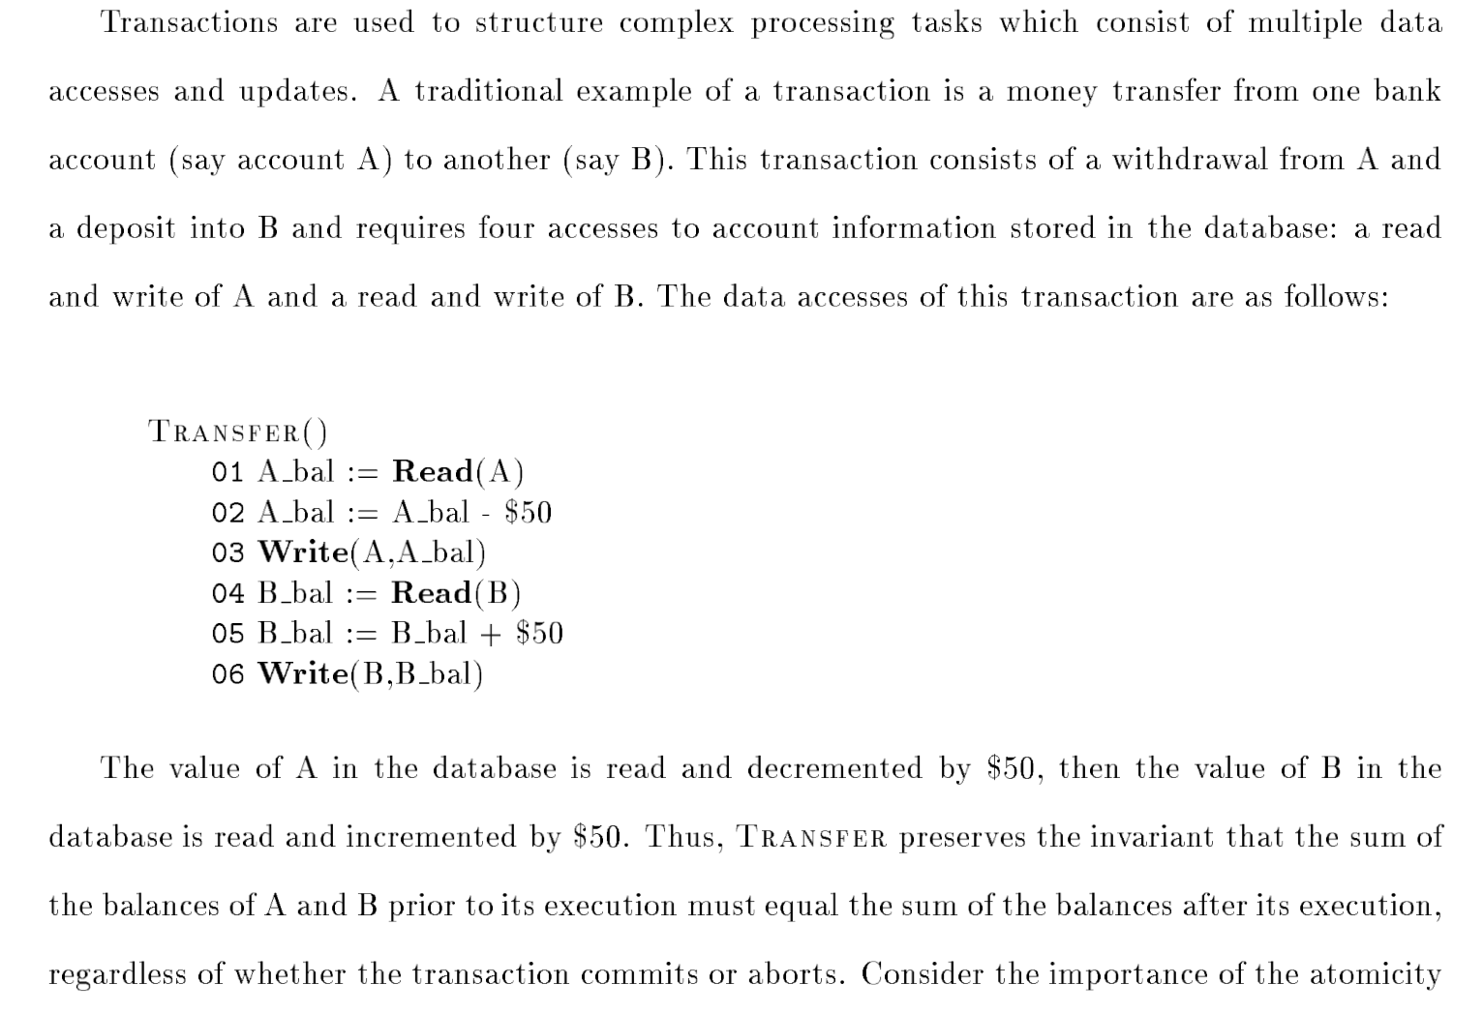
from
Concurrency Control and Recovery
Mike Franklin

Slide 22
Some examples of conflicts
1. lost updates
T: transfer $100 from A to C: R(A) W(A) R(C) W(C)
S: transfer $100 from B to C: R(B) W(B) R(C) W(C)
2. inconsistent retrievals (dirty reads violate consistency)
T: transfer $100 from A to C: R(A) W(A) R(C) W(C)
S: compute total balance for A and C: R(A) R(C)
3. nonrepeatable reads
T: transfer $100 from A to C: R(A) W(A) R(C) W(C)
S: check balance,withdraw $100 from A: R(A) R(A) W(A)

Slide 23
Serializable schedules
A schedule is a partial ordering of operations for a set of transactions {T,S,...}, such that:
The operations of each xaction execute serially.
The schedule specifies an order for conflicting operations.
Any two schedules for {T,S,...} that order the conflicting operations in the same way are equivalent.
A schedule for {T,S,...} is serializable if it is equivalent to some serial schedule on {T,S,...}.
There may be other serializable schedules on {T,S,...} that do not meet this condition, but schedules that meet it are safe.
Conflict serializability: detect conflicting operations and enforce a serial-equivalent order.

Slide 24
Legal interleaved schedules: examples
T < S
1. avoid lost update problem
T: transfer $100 from A to C: R(A) W(A) R(C) W(C)
S: transfer $100 from B to C: R(B) W(B) R(C) W(C)
2. avoid inconsistent retrievals problem
T: transfer $100 from A to C: R(A) W(A) R(C) W(C)
S: compute total balance for A and C: R(A) R(C)
3. avoid nonrepeatable reads
T: transfer $100 from A to C R(A) W(A) R(C) W(C)
S: check balance and withdraw $100 from A: R(A) R(A) W(A)

Slide 25
Defining the legal schedules
1. To be serializable, the conflicting operations of T and S must be ordered as if either T or S had executed first.
We only care about the conflicting operations: everything else will take care of itself.
2. Suppose T and S conflict over some shared item(s) x.
3. In a serial schedule, T’s operations on x would appear before S’s, or vice versa....for every shared item x.
4. A legal (conflict-serializable) interleaved schedule of T and S must exhibit the same property for all conflicting accesses.
Either T or S “wins” in the race to x; serializability dictates that the “winner take all”.

Slide 26
The graph test for serializability
To determine if a schedule is serializable, make a directed graph:
Add a node for each committed transaction.
Add an arc from T to S if any equivalent serial schedule must order T before S (T must commit before S).
T must commit before S iff the schedule orders some operation of T before some operation of S.
The schedule is conflict-serializable if the graph has no cycles.
(winner take all)
A
T
S
C

Slide 27
The graph test: example
Consider two transactions T and S:
T: transfer $100 from A to C: R(A) W(A) R(C) W(C)
S: compute total balance for A and C: R(A) R(C)
T: R(A) W(A) R(C) W(C)
S: R(A) R(C)
T: R(A) W(A) R(C) W(C)
S: R(A) R(C)
A
A
T
S
T
S
C
C
(S total balance gains $100.)
(S total balance loses $100.)

Slide 28
Transactional Concurrency Control
Three ways to ensure serial-equivalent order on conflicts:
Option 1, execute transactions serially.
Option 2, pessimistic concurrency control: block T until transactions with conflicting operations are done.
use locks for mutual exclusion
two-phase locking (2PL) required for strict isolation
Option 3, optimistic concurrency control: proceed as if no conflicts will occur, and recover if wrong.
Repair the damage by rolling back (aborting) one of the conflicting transactions.

Slide 29
Pessimistic Concurrency Control
Pessimistic concurrency control uses locking to prevent illegal conflict orderings.
Well-formed: acquire lock before accessing each item.
Concurrent transactions T and S race for locks on conflicting data items (say x and y)....
Locks are often implicit, e.g., on first access to an item.
No acquires after release: hold all locks at least until all needed locks have been acquired (2PL).
growing phase vs. shrinking phase
Problem: possible deadlock.
prevention vs. detection and recovery

Slide 30
Why 2PL?
If transactions are well-formed, then an arc from T to S in the indicates that T beat S to some lock.
Neither could access the item x without holding its lock.
Read the arc as “T holds a resource needed by S”.
2PL guarantees that the “winning” transaction T holds all its locks at some point during its execution.
Thus 2PL guarantees that T “won the race” for all the locks...
...or else a deadlock would have resulted.
T: R(A) W(A) R(C) W(C)
S: R(A) R(C)
A
T
S
C

Slide 31
Why 2PL: Examples
Consider our two transactions T and S:
T: transfer $100 from A to C: R(A) W(A) R(C) W(C)
S: compute total balance for A and C: R(A) R(C)
Non-two-phased locking might not prevent the illegal schedules.
T: R(A) W(A) R(C) W(C)
S: R(A) R(C)
T: R(A) W(A) R(C) W(C)
S: R(A) R(C)
A
A
T
S
T
S
C
C

Slide 32


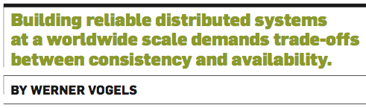
Dr. Werner Vogels is Vice President & Chief Technology Officer at Amazon.com.
Prior to joining Amazon, he worked as a researcher at Cornell University.

Slide 33

Vogels on consistency
The scenario
A updates a “data object” in a “storage system”.
Consistency “has to do with how observers see these updates”.
Strong consistency: “After the update completes, any subsequent access will return the updated value.”
Eventual consistency: “If no new updates are made to the object, eventually all accesses will return the last updated value.”

