Slide 1
Leases and cache consistency
Jeff Chase
Fall 2015

Slide 2

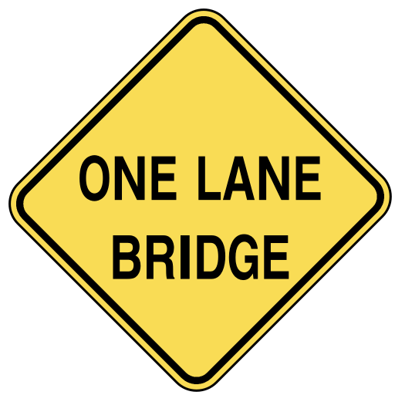
Distributed mutual exclusion
It is often necessary to grant some node/process the “right” to “own” some given data or function.
Ownership rights often must be mutually exclusive.
At most one owner at any given time.
How to coordinate ownership?

Slide 3



One solution: lock service
acquire
acquire
grant
x=x+1
release
A
grant
x=x+1
release
B
lock service

Slide 4
Definition of a lock (mutex)
Acquire + release ops on L are strictly paired.
After acquire completes, the caller holds (owns) the lock L until the matching release.
Acquire + release pairs on each L are ordered.
Total order: each lock L has at most one holder.
That property is mutual exclusion; L is a mutex.
Some lock variants weaken mutual exclusion in useful and well-defined ways.
Reader/writer or SharedLock: see OS notes (later).

Slide 5

A lock service in the real world
acquire
acquire
grant
X
???
???
x=x+1
A
B
B

Slide 6


Leases (leased locks)
A lease is a grant of ownership or control for a limited time.
The owner/holder can renew or extend the lease.
If the owner fails, the lease expires and is free again.
The lease might end early.
lock service may recall or evict
holder may release or relinquish

Slide 7

A lease service in the real world
acquire
acquire
grant
X
x=x+1
A
grant
x=x+1
release
B

Slide 8

A network partition
A network partition is any event that blocks all message traffic between subsets of nodes.

Slide 9
Two kings?
acquire
acquire
grant
X?
x=x+1
A
grant
x=x+1
release
release
B

Slide 10
Never two kings at once
acquire
acquire
grant
x=x+1
???
A
grant
x=x+1
release
B

Slide 11
Leases and time
The lease holder and lease service must agree when a lease has expired.
i.e., that its expiration time is in the past
Even if they can’t communicate!
We all have our clocks, but do they agree?
synchronized clocks
For leases, it is sufficient for the clocks to have a known bound on clock drift.
|T(C_{i}) – T(C_{j})| < ε
Build in slack time > ε into the lease protocols as a safety margin.

Slide 12
Using locks to coordinate data access
Ownership transfers on a lock are serialized.
W(x)=v
OK
A
release
SS
grant
B
R(x)
v
W(x)=u
OK

Slide 13
Coordinating data access
Thought question: must the storage service integrate with the lock service?
- or – Does my memory system need to see synchronization accesses by the processors?
W(x)=v
OK
A
release
SS
grant
B
R(x)
v
W(x)=u
OK

Slide 14
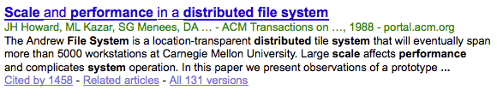
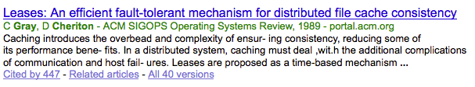
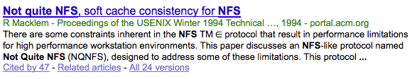
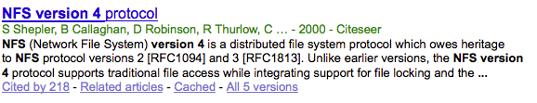
History

Slide 15
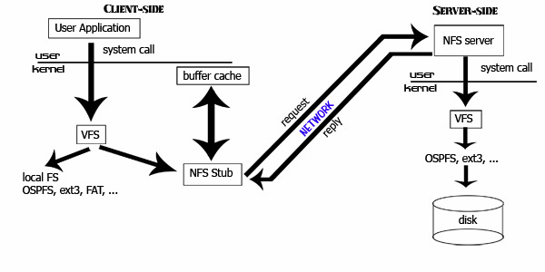
Network File System (NFS, 1985)
Remote Procedure Call (RPC)
External Data Representation (XDR)
[ucla.edu]

Slide 16
NFS: revised picture
Applications
FS
Client
BufferCache
FS
File server
BufferCache

Slide 17
Multiple clients
Applications
Applications
Applications
FS
FS
FS
BufferCache
BufferCache
BufferCache
FS
File server
BufferCache

Slide 18
Multiple clients
Read(server=xx.xx…, inode=i27412, blockID=27, …)
Applications
Applications
Applications
FS
FS
FS
BufferCache
BufferCache
BufferCache

Slide 19
Multiple clients
Write(server=xx.xx…, inode=i27412, blockID=27, …)
Applications
Applications
Applications
FS
FS
FS
BufferCache
BufferCache
BufferCache

Slide 20
Multiple clients
What if another client reads that block?
Will it get the right data? What is the “right” data?
Will it get the “last” version of the block written?
How to coordinate reads/writes and caching on multiple clients?
How to keep the copies “in sync”?
Applications
Applications
Applications
FS
FS
FS
BufferCache
BufferCache
BufferCache

Slide 21
Cache consistency
How to ensure that each read sees the value stored by the most recent write? (Or some reasonable value)?
This problem also appears in multi-core architecture.
It appears in distributed data systems of various kinds.
DNS, Web
Various solutions are available.
It may be OK for clients to read data that is “a little bit stale”.
In some cases, the clients themselves don’t change the data.
But for “strong” consistency (single copy semantics) we can use leased locks….but we have to integrate them with the cache.

Slide 22
Lease example: network file cache
A read lease ensures that no other client is writing the data. Holder is free to read from its cache.
A write lease ensures that no other client is reading or writing the data. Holder is free to read/write from cache.
Writer must push modified (dirty) cached data to the server before relinquishing write lease.
Must ensure that another client can see all updates before it is able to acquire a lease allowing it to read or write.
If some client requests a conflicting lock, server may recall or evict on existing leases.
Callback RPC from server to lock holder: “please release now.”
Writers get a grace period to push cached writes and release.

Slide 23
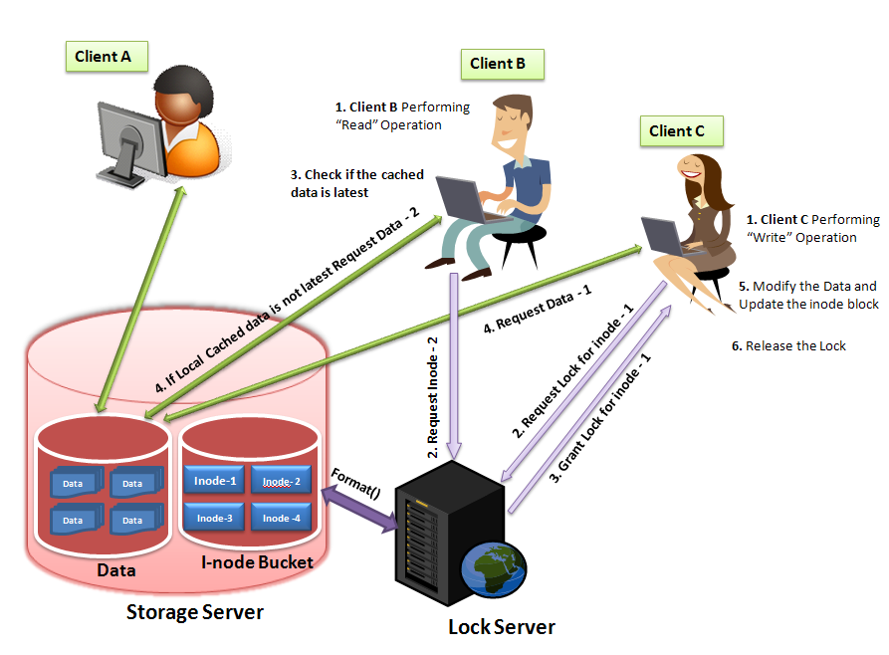

Lease example network file cache consistency
This approach is used in NFS and various other networked data services.

Slide 24
A few points about leases
Classical leases for cache consistency are in essence a distributed reader/writer lock.
Add in callbacks and some push and purge operations on the local cache, and you are done.
These techniques are used in essentially all scalable/parallel file systems.
But what is the performance? Would you use it for a shared database? How to reduce lock contention?
The basic technique is ubiquitous in distributed systems.
Timeout-based failure detection with synchronized clock rates
E.g., designate a leader or primary replica.

Slide 25
SharedLock: Reader/Writer Lock
A reader/write lock or SharedLock is a new kind of “lock” that is similar to our old definition:
supports Acquire and Release primitives
assures mutual exclusion for writes to shared state
But: a SharedLock provides better concurrency for readers when no writer is present.
class SharedLock {
AcquireRead(); /* shared mode */
AcquireWrite(); /* exclusive mode */
ReleaseRead();
ReleaseWrite();
}

Slide 26
Reader/Writer Lock Illustrated
If each thread acquires the lock in exclusive (*write) mode, SharedLock functions exactly as an ordinary mutex.
Multiple readers may hold
the lock concurrently in shared mode.
A_{r}
A_{r}
A_{w}
R_{r}
R_{r}
Writers always hold the lock in exclusive mode, and must wait for all readers or writer to exit.
R_{w}
mode read write max allowed
shared yes no many
exclusive yes yes one
not holder no no many

Slide 27
Google File System (GFS)
Similar: Hadoop HDFS, p-NFS, many other parallel file systems.
A master server stores metadata (names, file maps) and acts as lock server.
Clients call master to open file, acquire locks, and obtain metadata. Then they
read/write directly to a scalable array of data servers for the actual data. File data may be spread across many data servers: the maps say where it is.

Slide 28
GFS: leases
Primary must hold a “lock” on its chunks.
Use leased locks to tolerate primary failures.
We use leases to maintain a consistent mutation order across replicas. The master grants a chunk lease to one of the replicas, which we call the primary. The primary picks a serial order for all mutations to the chunk. All replicas follow this order when applying mutations. Thus, the global mutation order is defined first by the lease grant order chosen by the master, and within a lease by the serial numbers assigned by the primary.
The lease mechanism is designed to minimize management overhead at the master. A lease has an initial timeout of 60 seconds. However, as long as the chunk is being mutated, the primary can request and typically receive extensions from the master indefinitely. These extension requests and grants are piggybacked on the HeartBeat messages regularly exchanged between the master and all chunkservers. …Even if the master loses communication with a primary, it can safely grant a new lease to another replica after the old lease expires.

Slide 29
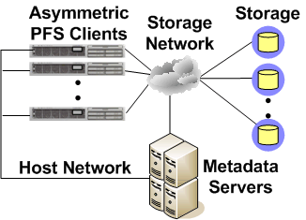
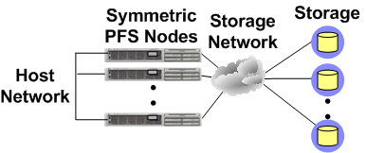
Parallel File Systems 101
Manage data sharing in large data stores
Asymmetric
E.g., PVFS2, Lustre, High Road
Ceph, GFS
Symmetric
E.g., GPFS, Polyserve
Classical: Frangipani
[Renu Tewari, IBM]
Notes:
This slide helps us get a common naming system
To now zoom in on how parallel file systems are used in HPC.
Two major types, asym and sym
PFS’s stripe data over several if not hundreds of storage nodes.
Either way, most important feature is that they provide direct storage access.
Asymmetric file systems can be file, object, or block based.
Symmetric file systems are generally block based, examples of which are gpfs, gfs, and polyserve.
They provide very high I/O throughput rates and can scale to meet the demands of 10s of thousands of clients
They are Homogenous, lack a strong security model and are not satisfactory WAN performance
Say there are different types of “Access methods”
Say there are two different types of storage, scsi disk arrays and clusters of nodes
Limited security
Highly specialized
Lack heterogeneous data access since limited to a singe OS and HW platform

Slide 30



Parallel NFS (pNFS)
data
metadata
Block (FC) /
Object (OSD) /
File (NFS)
Storage
pNFS
Clients
control
NFSv4+ Server
Modifications to standard NFS protocol (v4.1, 2005-2010) to offload bulk data storage to a scalable cluster of block servers or OSDs. Based on an asymmetric structure similar to GFS and Ceph.
[David Black, SNIA]

Slide 31
pNFS architecture
data
metadata
Block (FC) /
Object (OSD) /
File (NFS)
Storage
pNFS
Clients
control
NFSv4+ Server
Only this is covered by the pNFS protocol
Client-to-storage data path and server-to-storage control path are specified elsewhere, e.g.
SCSI Block Commands (SBC) over Fibre Channel (FC)
SCSI Object-based Storage Device (OSD) over iSCSI
Network File System (NFS)
[David Black, SNIA]

Slide 32
pNFS basic operation
Client gets a layout from the NFS Server
The layout maps the file onto storage devices and addresses
The client uses the layout to perform direct I/O to storage
At any time the server can recall the layout (leases/delegations)
Client commits changes and returns the layout when it’s done
pNFS is optional, the client can always use regular NFSv4 I/O
layout
Storage
Clients
NFSv4+ Server
[David Black, SNIA]

