Slide 1

Multi-turn Inference Matching Network for Natural Language Inference
Chunhua Liu, Shan Jiang, Hainan Yu, Dong Yu
Beijing Language and Culture University
Notes:
Good afternoon, everybody. I’ Chunahua Liu from Beijing Language and Culture University. It’s very glad to be here to introduce our work: Multi-turn inference matching network for natural language inference for you. 【13s】

Slide 2
Introduction
Natural Language Inference (Recognizing Textual Entailment)：
It defines is a directional relation between a premise text sequence and a hypothesis text sequence.
The relations includes entailment, contradiction, and neutral.
Premise: Children going home from school.
entailment
Hypothesis1: The school children head home.
Notes:
First, let me introduce the task of natural language inference, it’s also called recognizing textual entailment. It defines a directional relation between a premise and a hypothesis. The relations includes entailment, contradiction, and neutral. Given a premise and a hypothesis, the model aims to decide that the hypothesis entails the premise, or the hypothesis contradicts with the premise, or the hypothesis cann’t be inferenced from the premise.
For example, if the premise is “Children going home from school” and the hypothesis is “The school children head home”, obviously, we can see that the the hypothesis can be inferenced from the premise. In this case, we say their relationship is entailment. 【59s】

Slide 3
Introduction
Premise: Children going home from school.
contradiction
Hypothesis2: The children are at the library.
going
neutral
Hypothesis3: The children are walking in the afternoon.
Notes:
But, if we replace hypothesis as“The children are at the library”, which is contradicts with the premise. Because if the children are going home, they cann’t stay at the library simultaneously. So their relationship is contradiction.
In the third example, the hypothesis is “The children are walking in the afternoon”. Based on the information provided in the premise, we don’t know the children are walking to home or riding to home, or by some other ways. Hence, the hypothesis is neutral to the premise. 【38s】

Slide 4
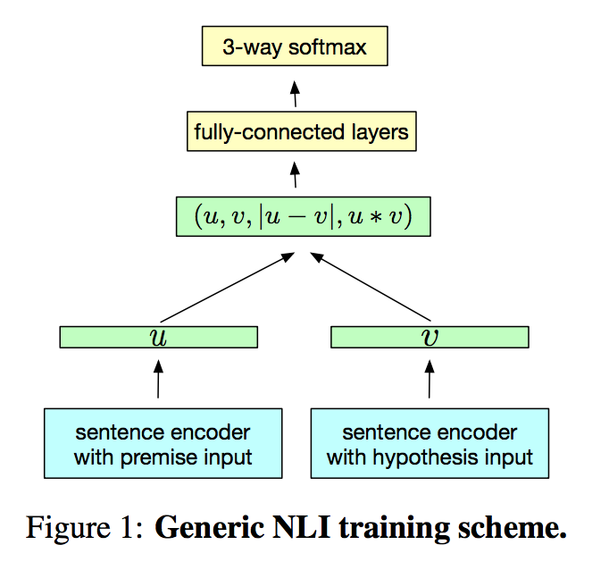
Previous Approaches
Sentence Encoding-based Models
Focus on sentence encoding
Cross Attention-based Models
Utilize the interactions between premise and hypothesis
“compare-aggregation” network works pretty well
Notes:
Previous neural network based approaches on NLI task can be divided into two categories: the sentence encoding-based models and the cross-attention based models.
In the first kind of approach, the models focus on sentence encoding, which means that the premise and the hypothesis are projected into sentence vectors respectively by a sentence encoder， such as RNN/SAN. The final relation prediction is based on the combination of the two vectors. In the model picture, the ‘u’ and ‘v’ are the sentence vectors, this is their combinations for final prediction. This approach is usually lightweight and easy to transform.【55s】
The second kind of approach utilizes the interactions between the premise and the hypothesis to assist the modeling. Interaction means information exchange, on NLI task, exchange the message between the premise and the hypothesis is usually a better choice. In the second kind of approach, ”compare-aggregation” related models gains excellent performance. 【30s】

Slide 5
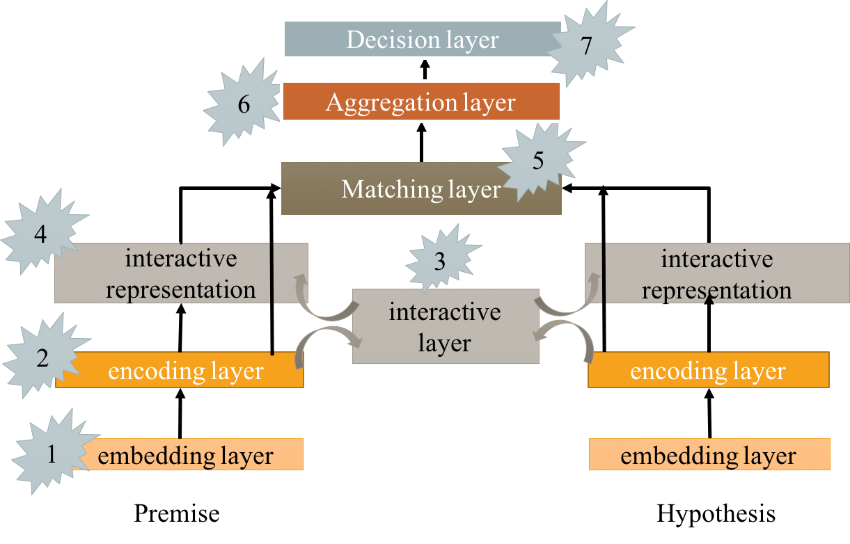
Previous Approaches
“compare-aggregation” network
Matching the premise
and the hypothesis
in word level
Notes:
The “compare-aggregation” network works as follows: The bottom embedding layer and the encoding layer are used to enrich the word representations of the premise and the hypothesis. Based on the outputs of the encoding layer, an interactive layer is used for information exchanging and it output the interactive representations.
Next, a matching layer is employed to compare the original encoding representations with the interactive representations. The matching process is word-by-word to obtain more details.
Then an aggregation layer is used for integrating the matching sequences.
Finally is the decision layer.【54s】
Our work is under the “compare-aggregation” framework.

Slide 6
Motivation
How do human do inferences given a premise sentence and a hypothesis sentence?
1. Read the two sentences
2. Find their similarity, think about and remember
3. Find their differences, think about and remember
Can machine imitate this process?
Reading
Encoder
Find the similarity and difference
Matching Functions
P: Children going home from school.
Memory Mechanism
Remember
H: The children are at the library.
Notes:
The motivation of our work comes from the behavior of how a human judge the relation between the premise and the hypothesis. Take 5 seconds to think about how you will make such a decision on the example we have mentioned before? The P is ”Children going home from school” and the H is ”The children are at the library”. For me, I would first read the two sequences. Then I would find their similarities and remember them, like the “Children”. Next I would find the differences and remember them, like the “school” and the “library”. After that, I would aggregate the information I have collected and give the final prediction that their relationship is contradiction.
We can see the inference process are conducted in multiple turns, one turn process one feature.
Based on this motivation, we are thinking about if the machine can imitate this thinking trajectory？ We can treat the input encoding as the reading process, both the premise and the hypothesis are projected into context-aware embeddings, using encoder like RNN.
And we can use the matching functions to find the similarities and the differences.
As for the remember behavior, we can use the memory mechanism to store the important information we have read.【2:00s】

Slide 7
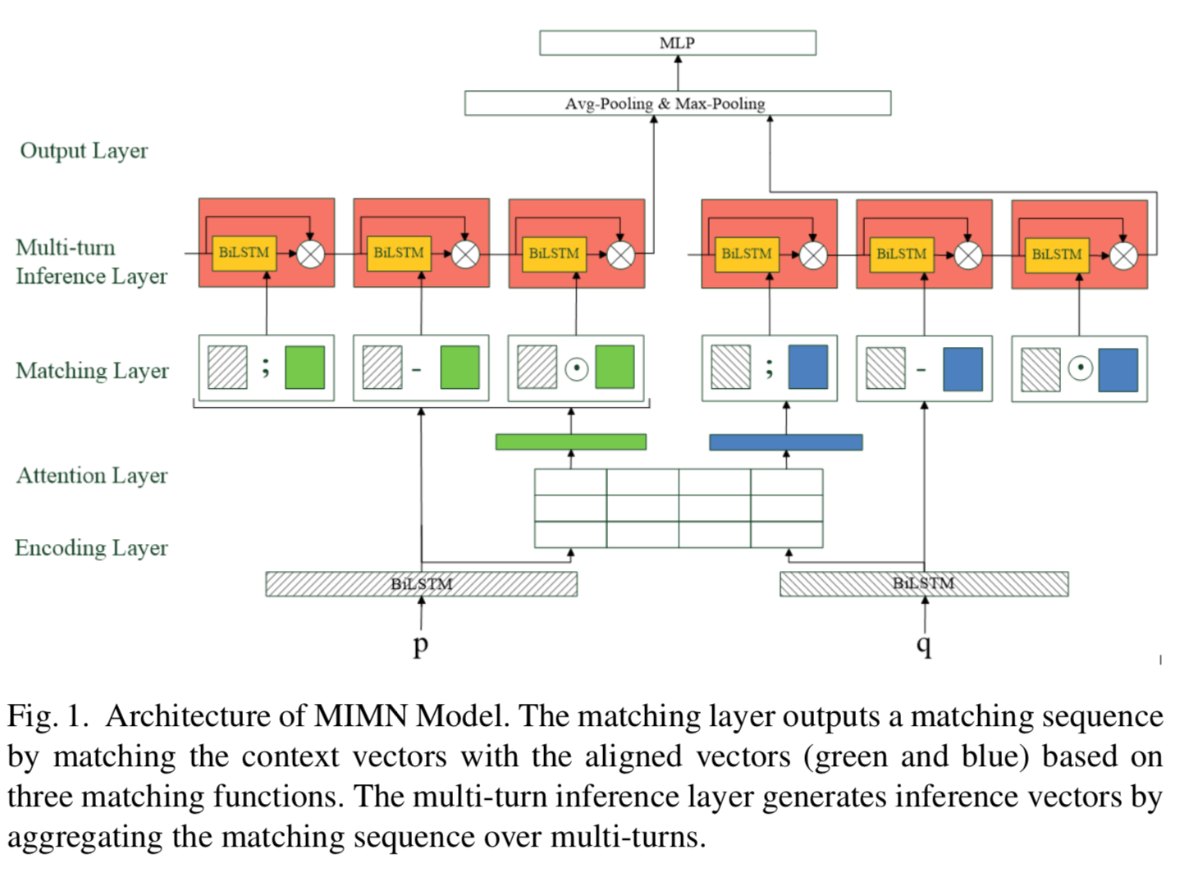
Methodology
Notes:
Inspired by this motivation, we proposed a multi-turn inference matching network to model the relation of the premise and the hypothesis, which includes five layers as shown on the left side of the model figure.
The Encoding layer employs a bidirectional LSTM to transform the word embeddings into context-aware word embeddings.
Then inter-attention based on the hidden outputs of the BiLSTM is used to capture the interactive representations.
Next the matching layer use three matching functions to match the original hidden outputs and the attentive representations to extract the similarities and the differences between two sequences. And this layer forms a list of matching sequences and delivers it to the next layer.
The next layer is multi-turn inference layer, which is our key component. This layer is responsible processing the matching sequences in multiple turns to obtain a deeper inference sequence.【1:30】

Slide 8
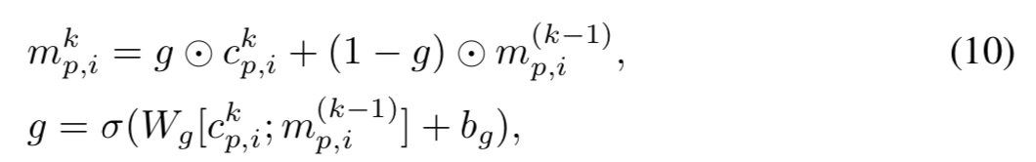
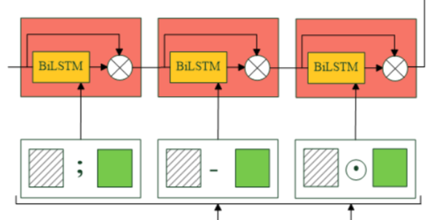
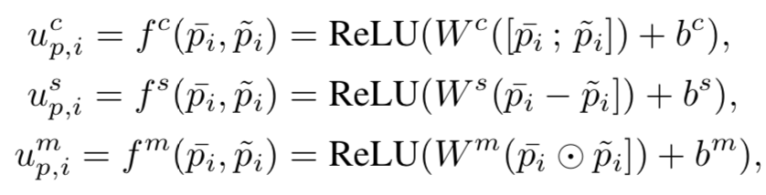
Methodology
Multi-turn
Inference Layer
Matching Layer
Notes:
In this slide, I will describe the details about the matching layer and the multi-turn inference layer in our model.
The matching layer constructs three matching sequences using three functions fc, fs, and fm. The input of the functions are the original hidden outputs like (pi bar) and the attentive representations(like pi tilde), where the pi tilde is the summarization sequence of the hypothesis.
The three functions are the FNN with relu activation based on the operations on two inputs, such as: concatenation, element-wise multiplication, and element-wise subtraction. The matching layer form three matching sequences and store in a list up.【1:30】
This layer takes up as input and inference one matching sequence in one turn. To enhance the information interaction between matching features, a memory component is employed to store the history information. So, the inference of each turn is based on the current matching feature and the memory of previous turn. The multi-turn inference layer compromises two subcomponents: aggregating the current matching sequence and update the memory. The final output is the memory of the last turn.
The memory is updated by combining the current aggregation vector ckp,i with the memory vector of last turn c(k−1)i .
An update gate is used to control the ratio of current information and history information adaptively. In this way, the model can also filter the useless content.
【备选】
The initial values of all the memory vectors are all zeros.
The ucp can be considered as a joint-feature of combing the context vectors p ̄ with aligned vectors p ̃, which preserves all the information. And the usp can be seen as a diff-feature of the p ̄ and p ̃, which preserves the different parts and removes the similar parts. And the ump can be regarded as a sim-feature of p and p ̄, which emphasizes on the similar parts and neglects the different parts between barp and p ̃. Each feature helps us focus on particular parts between the context vectors and the aligned vectors. These matching features are vector representations with low dimension, but containing high- order semantic information.

Slide 9
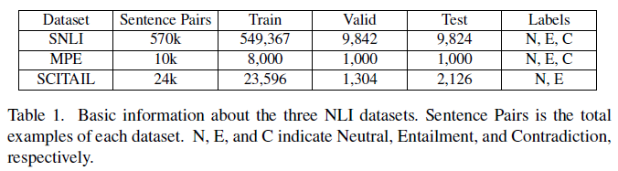
Experiment - Dataset
Three datasets: SNLI, SCITIAL, MPE,
Notes:
To investigate the effectiveness of our model, we conduct experiments on three datasets. The SNLI, which is a benchmark large-scale dataset released by Bowman in 2015.
And the Scitail dataset, which about science question answering domain.
The Multiple Premise Entailment (MPE) dataset, which is different from the other two datasets. The premise is 4 sentences instead of one sentence, and the hypothesis is one sentence. The system needs to combine multiple sentences to inference the relation with the hypothesis. 【45s】

Slide 10
Experiment - Dataset
MPE example
Four Premises
P1: A brown dog with its mouth open and ears in the air running on a grassy surface.
P2: A yellow Labrador running with its ears flopping.
P3: This dog is running along the path.
P4: The brown dog is running.
entailment
Hypothesis: A tan dog runs through a field.
Notes:
For example, there are four premises describe a same picture. This dataset faces the two challenges:
First, the system requires to collect several fragments from multiple sentences and compose them to inference with the hypothesis （the orange and the bule fragments).
Second, some of the information are irrelevant, the system requires to filter them.(the second premise)【40s】

Slide 11
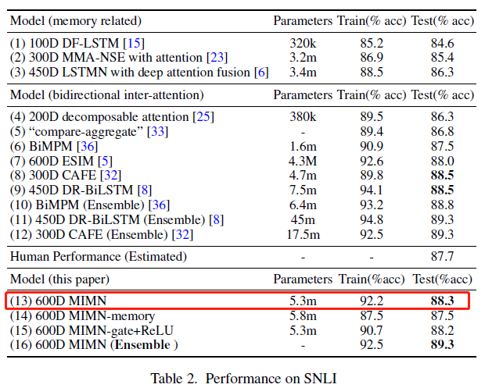
Results
Notes:
The experimental results on the SNLI dataset are shown in Table2. The ESIM is our major compare model, which aggregate all the matching features in one pass instead of multi-turn. This model is also a strong baseline model on SNLI dataset, with the accuracy of 88.0%.
As we can see, our single MIMN model achieving an accuracy of 88.3% in terms of accuracy, surpassing the ESIM model.
Our ensemble model achieving an accuracy of 89.3%, which is comparable with the CAFÉ and the DR-BILSTM. 【60s】

Slide 12
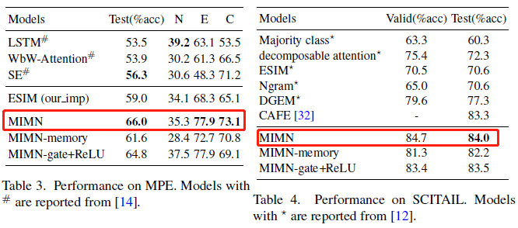
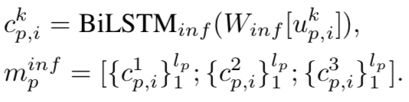

Results
MIMN-memory
MIMN-gate+Relu
Notes:
The experimental results show that our model gains a significant improvement on the MPE dataset. To compared with the ESIM, we re-implement it and test it on the MPE dataset. We get the 59.0% in accuracy， while our MIMN model is 66%, which is obviously much higher than the ESIM. This prove that the multi-turn inference mechanism is effectiveness.
The results on the Scitail dataset also prove that our model works very well.
To analysis the effectiveness of our major memory component and update gate. We did ablation analysis on the MIMN model. The MIMN-memory indicates remove the memory from the multi-turn inference layer. In each turn, the model just aggregate the current matching sequence, the final output is the concatenation of the three turns.
To verify if the gate can help the model, we remove the gate and replace it with a feed-forward function with relu activation.
Both experiments on the MPE and the Scitail show that the memory and the update gate are useful, and the memory is much more important than the gate.

Slide 13
Conclusion
We propose a new model called Multi-turn Inference Matching Network (MIMN) to perform multi-turn inference on different matching features.
We conduct experiments on three different NLI datasets. The experimental results show that our model outperforms or achieves the state-of-the-art performance on all the three datasets.

Slide 14
THANKS!
Any question?

