Slide 1

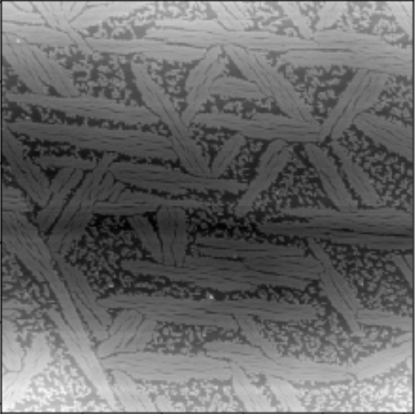
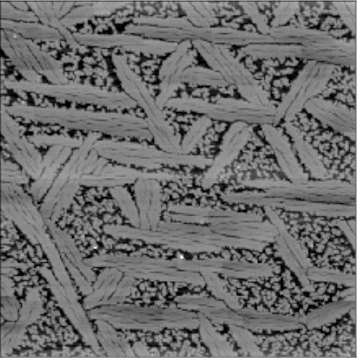
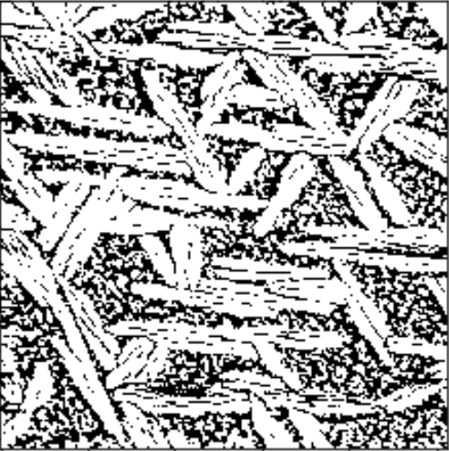
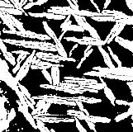
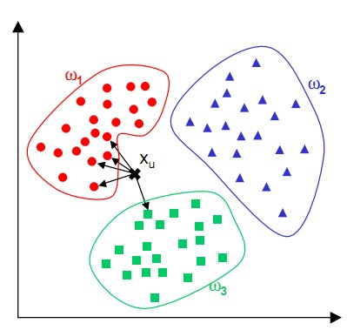





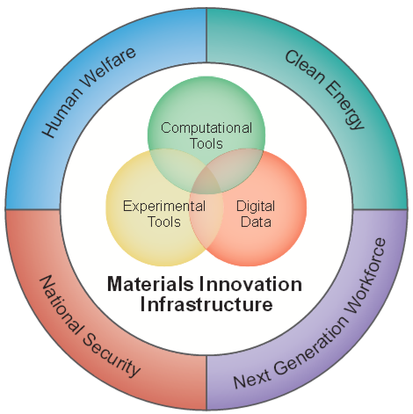
SAFMIs: Segmented Atomic Force Microscope Images
Demi Liu^{1,4}, Sarthak P. Jariwala^{2,4}, Christopher Nyambura³, Sid Rath^{2,5}
1. Chemistry 2. Material Science and Engineering 3. Chemical Engineering 4. CEI 5. GEMSEC
Background Subtraction
Image Segmentation: Random Walk
The background approximation and subtraction function uses Morphological Filtering from scikit-image. It returns all bright spots in the image that are smaller than the structuring element that the user defines (rectangular, square or ellipsoidal/circular). It outputs a foreground with some threshold, deletes the background, while preserving the relative height values to use later.
Random walker segmentation from scikit-image was employed for this step. Random walk solves an anisotropic diffusion equation with tracers starting from a pre-determined pixel with a certain label (initial marker position). Diffusivity is high, if neighboring pixels have similar values, whereas widely varying pixels values results in low diffusion. Thus, diffusion has a inverse relationship to the gradient height.
Prediction of Bio/Nano Interface Parameters using KNN Clustering and Regression
Generation of Image Descriptors from Segmented Images
K-Nearest Neighbor Clustering was performed on 50 images where a random test/train split was performed. Images were clustered based on pH and concentration of the peptide solution used to create the bio-interface observed under AFM. Next, regression was used to predict order/disorder ratio and percent coverage for a given input AFM image with the same clustering parameters.
Percentile Filter from scikit-ndimage module allowed for separation of ordered and disordered ratios. Furthermore, a percent coverage was calculated; these two parameters are image descriptors that are specific to the experimental conditions of the surface under the microscope
Images provided by:
David Starkebaum (affiliation: GEMSEC)
Tyler Dean Jorgenson (affiliation: GEMSEC)
Special Thanks to:
Prof Mehmet Sarikaya
PI: GEMSEC (NSF-MGI Program)
Acknowledgments:
Dr. David Beck
Nicholas Montoni
Arushi Prakash
Moke Mao

