Slide 1
A Comprehensive and Subjective Job Search Recommendation System
Presenter: Di Liu
Ph.D. in Mechanical Engineering
Virginia Commonwealth University, Richmond, Virginia
2019/2/14

Slide 2
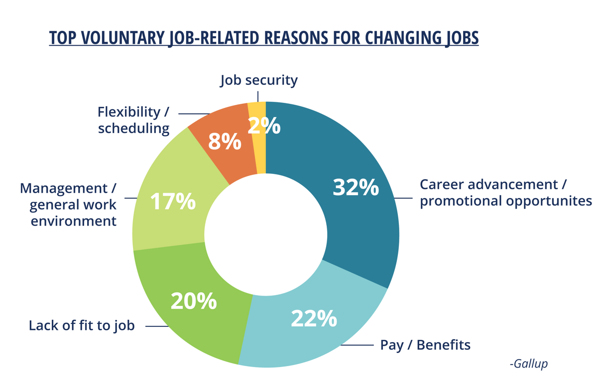
Motivation
Frequently changing jobs has adverse effects on both employers and employees themselves.
Unlike ‘Pay/benefit’, about 80% reason for people changing jobs are not quantifiable.
Comprehensive and subjective understanding of the companies during the job searching process is important.
Source: Gallup
(http://myaliat.com/news/employees-mentally-checked-out/top-voluntary-job-related-reasons-changing-jobs-gallup-aliat/)
Notes:
According to some research report, people are changing jobs more frequently than before.
Figure here shows the reasons why people changing jobs.
These 80% reason can be concluded as “mis-match” between employees and employers.
https://news.gallup.com/businessjournal/106912/turning-around-your-turnover-problem.aspx
Source:http://myaliat.com/news/employees-mentally-checked-out/top-voluntary-job-related-reasons-changing-jobs-gallup-aliat/

Slide 3
System Design
Data Collection
Data Analysis
Recommendation Algorithm
Term Frequency – Inversed Document Frequency (TF-IDF)
Web Crawling
Data Exploration
Word2Vec
Similarity Calculation
Information including: reviewers’ information, ratings and comments.
Extract the most meaningful keywords from the review comments for each company.
Convert keywords of companies and jobhunters’ input into vector space;
Compute the similarity between these two vectors;
Recommend companies by similarity score.
Investigate correlation among the rating scores (i.e., overall, work-balance, culture-values, career-opportunities, comp-benefit, management ratings)

Slide 4
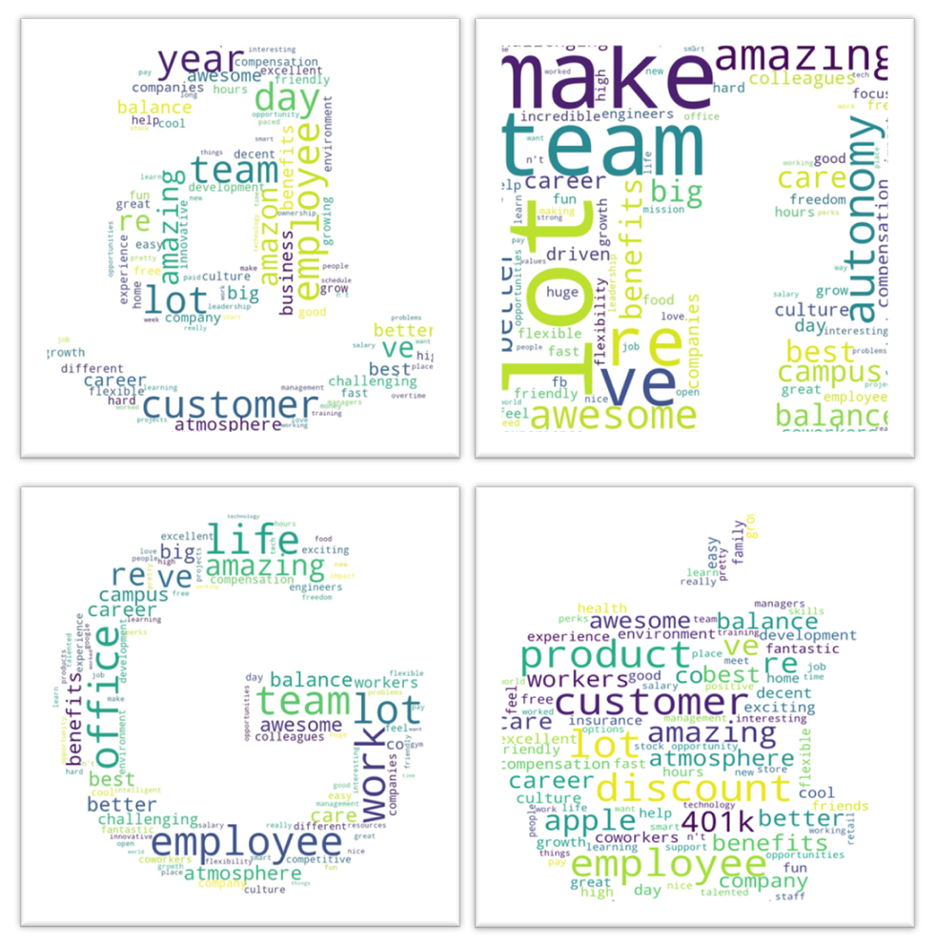
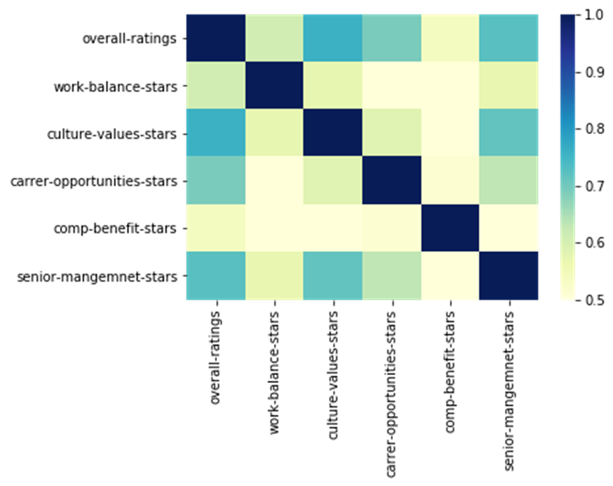
Takeaway so far…
Term Frequency – Inversed Document Frequency (TF-IDF)
web crawling
Data Exploration
Word2Vec
Similarity Calculation
The overall ratings are more related to the company culture and management rather than ‘money’.
Wordclouds including the keywords have been plotted for companies.
* Darker color represents that the two factors are more co-related.

Slide 5
To Do List
Term Frequency – Inversed Document Frequency (TF-IDF)
Web Crawling
Data Exploration
Word2Vec
Similarity Calculation
Write Python program for crawling information from glassdoor or indeed, etc.
Increase stop-words pool for better extracting significant keyword for each company.
Improve algorithm to make the recommendation system more robust. (i.e., Doc2Vec, Word2Vec with weighted input.)

Slide 6

There is no Mr.Wrong,
but Mr.Right in the WRONG place!
Thank you!
& Question?
* For more information, please refer to my github link: https://github.com/liudi1025/TDI

