Slide 1

A Prudent Framework for Understanding Risk-Awareness in Demand Response
-------Group meeting
Original title: Prudent Price-Responsive Demands
Liudong Chen
Earth and Environmental Engineering
Columbia University
Jun. 25. 2025

Slide 2


Prudent
Prudent Price-Responsive Demands
Price-Responsive
Demands
Economic: seeing ahead, sagacity
If uncertain events happen, prudent decision-makers will do sth. to respond to the event
Demand
Time-dependent system:
Uncertainty
Decision makers do sth. ahead of time
Time
Time
2|

Slide 3

Toy example:
Suppose you have a battery and participate in the real-time market with price uncertainty.
You need to decide on charge or discharge starting now until the price is realized
Now, I told you future price variance increase, but the expectation is the same.
Price pdf
Future price
Time
What will you do?
3|

Slide 4
Background
Problem formulation
Main Results
Case Study and Conclusion
4|

Slide 5
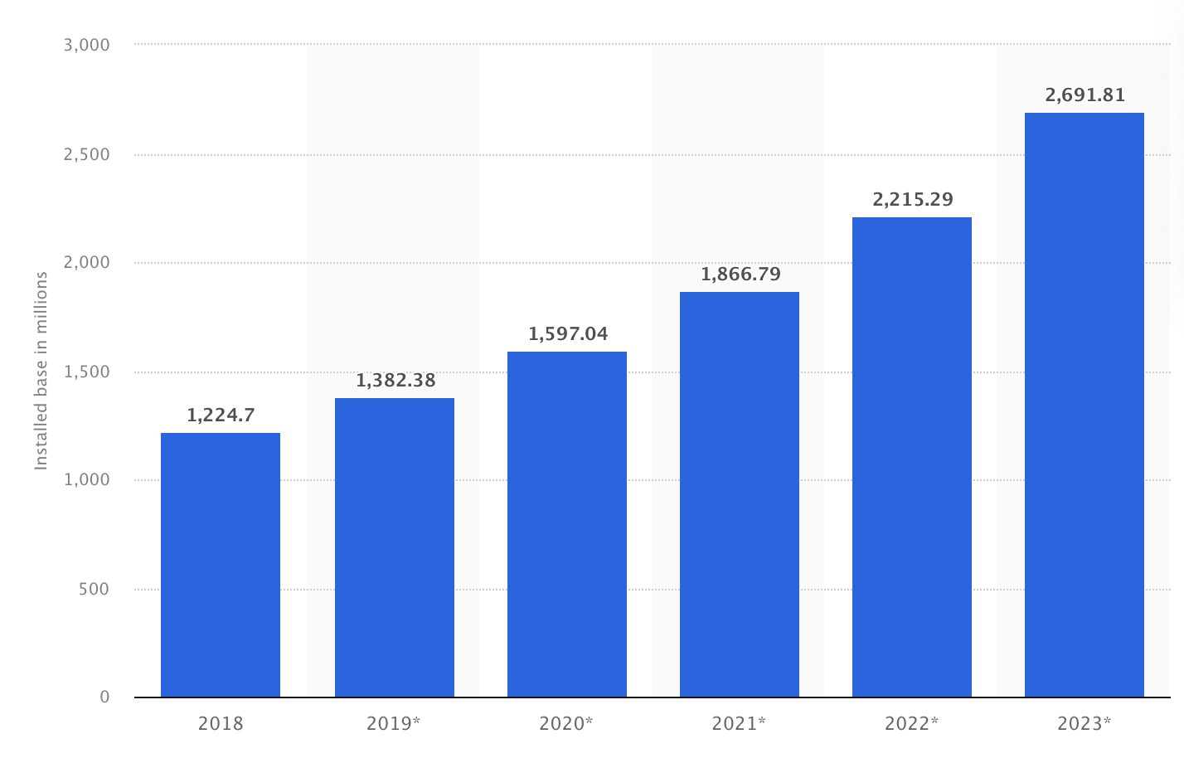
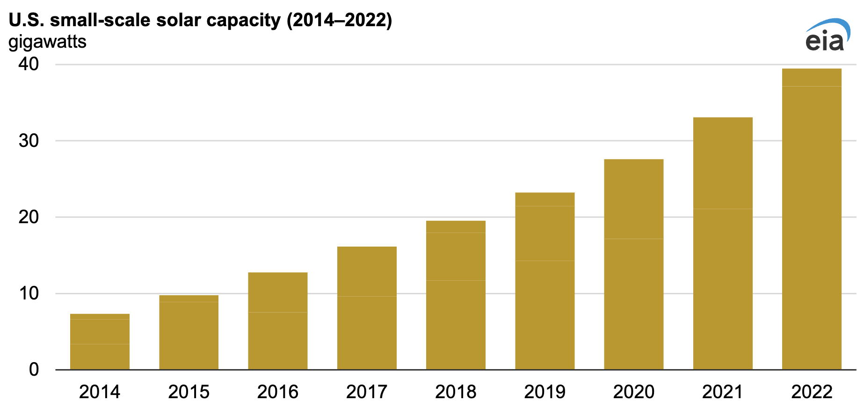
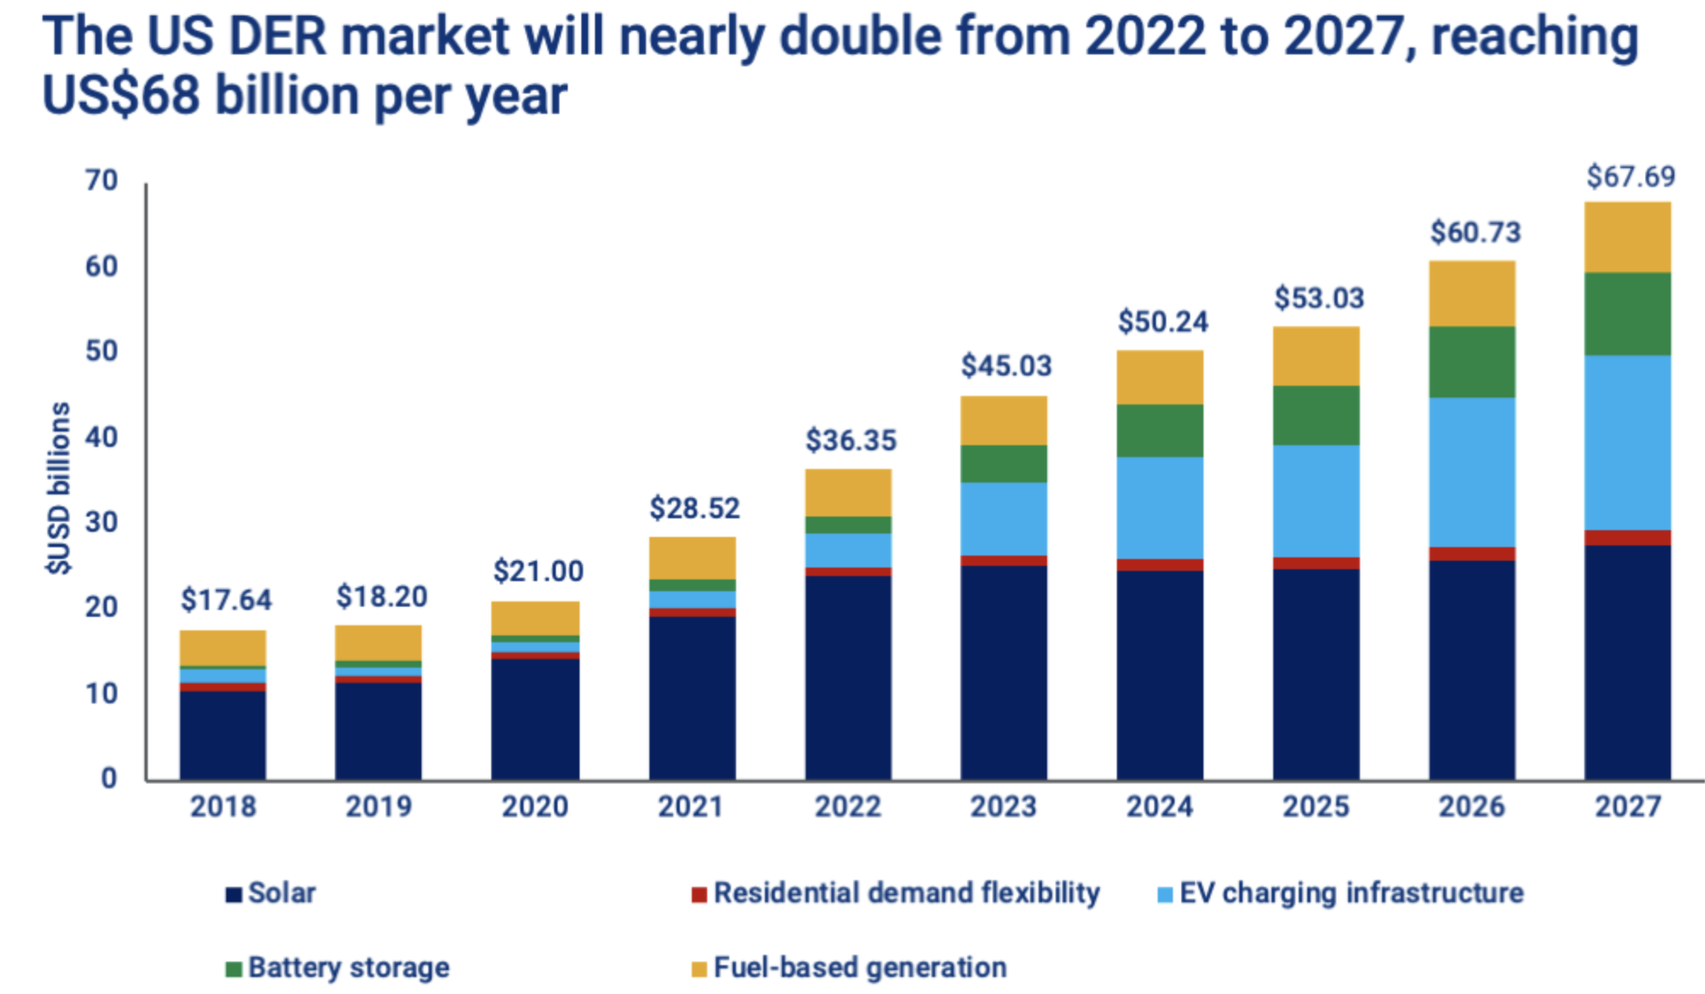
Background
Motivation
United States DER integration increase
Consumers installed more smart home devices
179 GW solar capacity until 2023
22% are distributed
2.8 Billion
40GW
https://en.wikipedia.org/wiki/Solar_power_in_the_United_States
https://www.eia.gov/todayinenergy/detail.php?id=60341
https://www.woodmac.com/news/opinion/transformation-distributed-energy-resource-market/
https://www.statista.com/statistics/1075749/united-states-installed-base-of-smart-home-systems/#statisticContainer
https://www.techtarget.com/iotagenda/definition/smart-home-or-building
Consumers become more responsive
5| Background
Notes:
Small scale – aks distributed solar
EIA - US energy information administration
Smart TV, smart lighting, easy to control and align with user preference, more flexible,

Slide 6
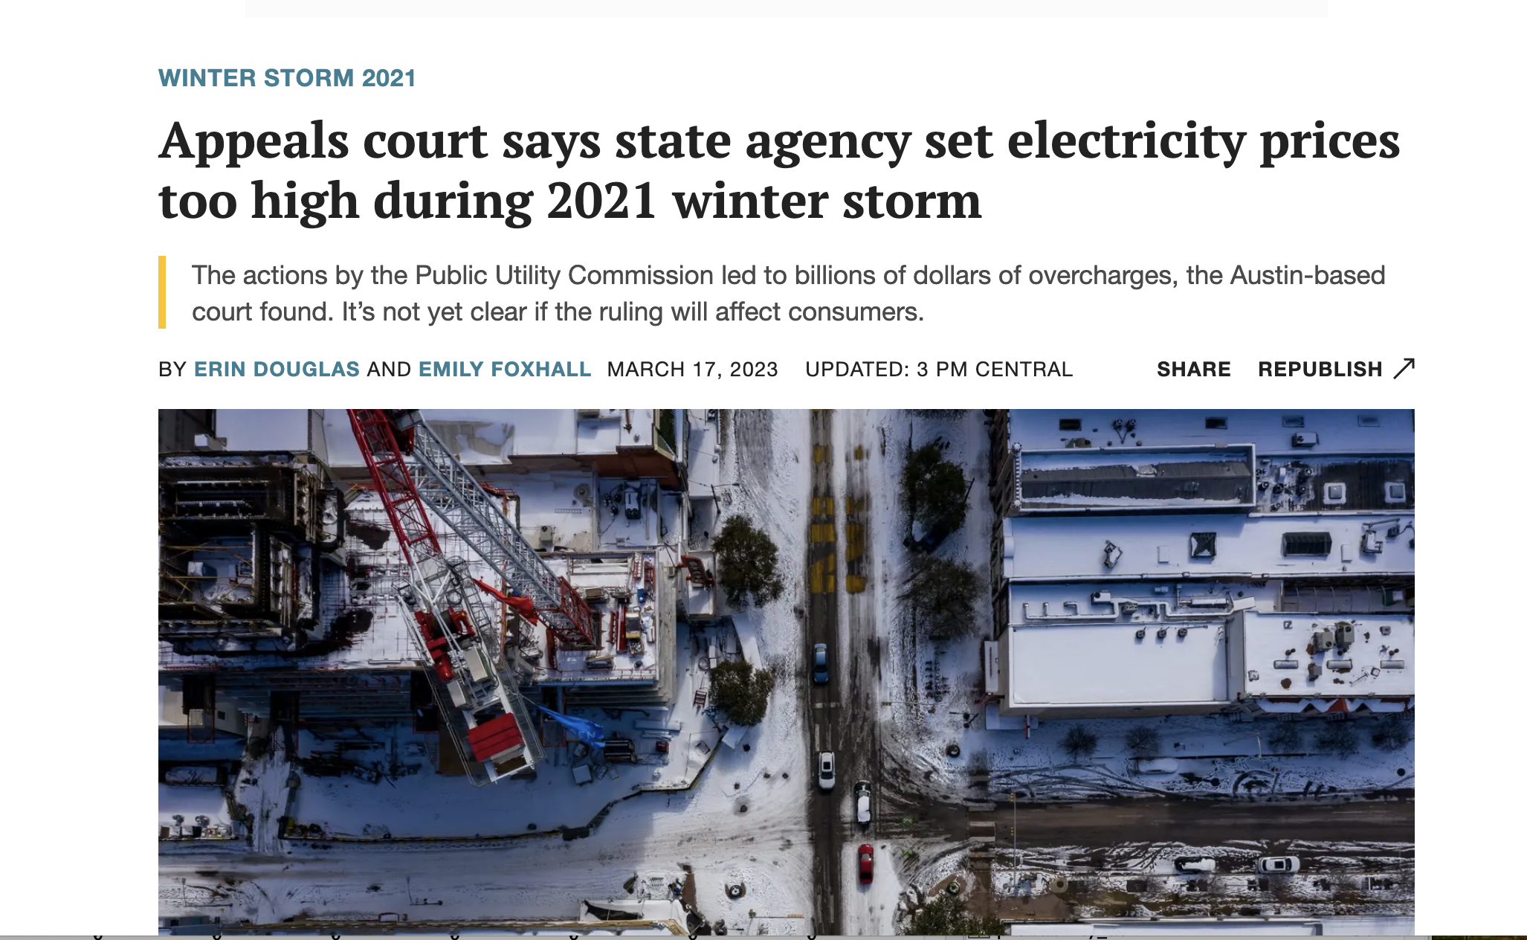
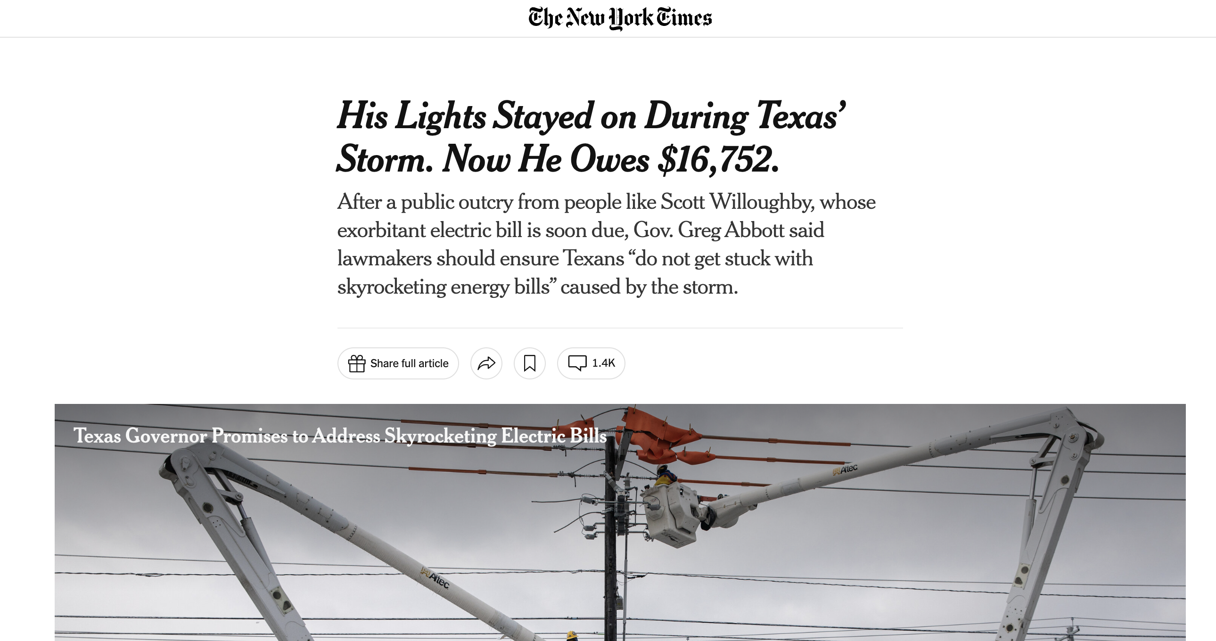
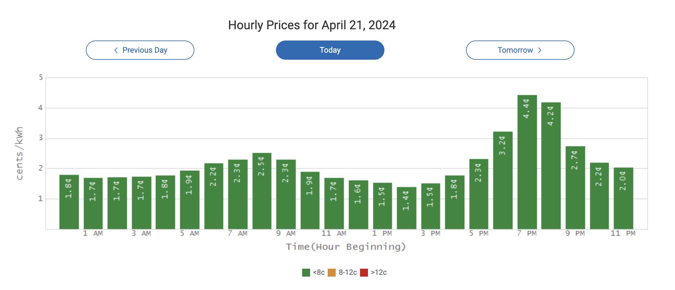
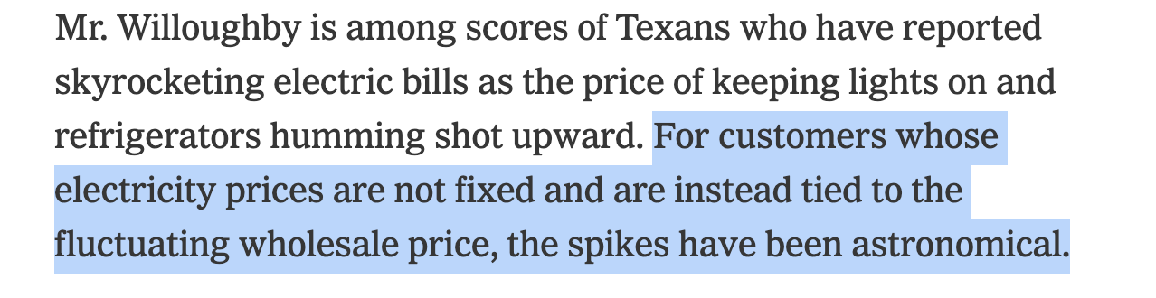
Background
Dynamic prices incentivize consumers’ responsiveness – uncertainty
Wholesale markets are inherently uncertain.
Utility companies adopt dynamic tariffs to incentivize demand responses.
Ameren Power Smart Pricing in Illinois
Wholesale consumers bear huge uncertainty
Retail consumer bear huge uncertainty
https://en.wikipedia.org/wiki/Solar_power_in_the_United_States
https://www.eia.gov/todayinenergy/detail.php?id=60341
https://www.woodmac.com/news/opinion/transformation-distributed-energy-resource-market/
https://www.coned.com/en/accounts-billing/your-bill/time-of-use
https://www.srpnet.com/price-plans/residential-electric/time-of-use
https://www.oge.com/wps/portal/ord/residential/pricing-options/smart-hours
https://www.ameren.com/illinois/account/customer-service/bill/power-smart-pricing/
Understand complex risk-aware behaviors facing (price) uncertainty
6| Background

Slide 7


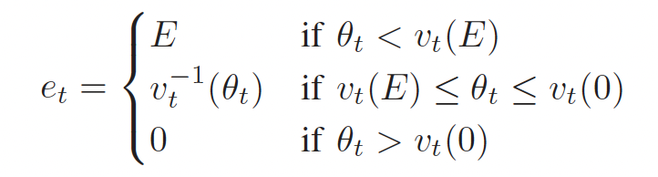

Background
Literature
Data-driven
Model-driven: Adopt decision-making models with utility functions to represent consumers’ decision-making process
Infrastructure
Quadratic
Piecewise linear
Privacy
https://www.javatpoint.com/group-discussion
Less data-driven previous works
Face limited application problem
Conditional value at risk (CVaR) or robust
Consumers naturally have high-dimensional and non-linear behavior
Lack of first-principle understanding of risk-aversion motivations
Highlight the need for a more sophisticated utility function formulation
7| Background
Notes:
So, how literature do?
Generally, if you want to know human behavior, behavior economic people will design experiments and collect data, then do some data analysis and combine with statistical tools to reveal the general behavior.
But, due to the infrastructure constraints and concerns about privacy and affordability, it is very difficult to conduct controlled real-world experiments. At least right now, only very few utility company start using smart pricing scheme, such as Ameille mention before, but all the data are private.
So, Consumers’ responses to uncertain prices are less understood in literature. Thus, we need model based formulation.
For example, thermal comfort does not decrease linearly with temperature adjustments or change in a purely quadratic manner. it is influenced
by individual, high-dimensional, non-linear preferences. Also, batteries and many home devices need to operate within strict capacity and ramp rate limits

Slide 8
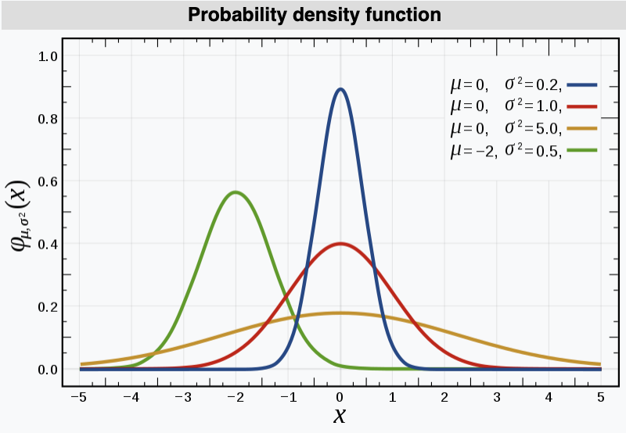
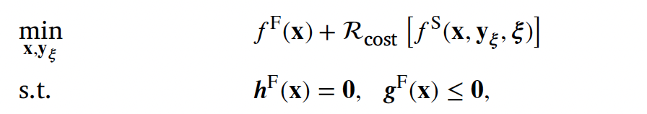
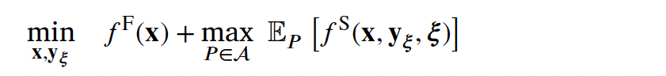

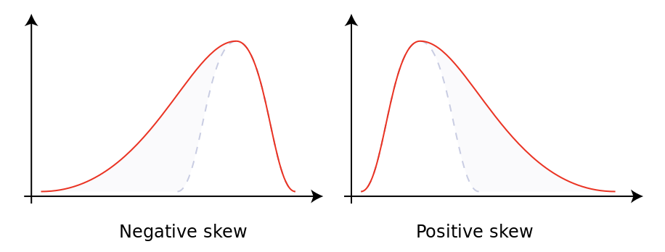

Background
What do we do
Normal distribution – mean, variance
Risk operator
Expectation
https://en.wikipedia.org/wiki/Normal_distribution
+ Risk term
Other practical distribution – mean, variance, skewness, etc. - shape
Intentionally
future
How does the future uncertainty distribution affect the risk-neutral decision-making process?
https://en.wikipedia.org/wiki/Skewness
8| Background

Slide 9
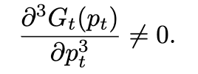
Background
Contribution
We establish a theoretical framework to model demand behavior to future volatile electricity prices We model demand with a risk-neutral cost-saving objective in a sequential decision-making context;
Same expectation
pdf
We found that demand models with quadratic cost functions are distribution-insensitive;
Price
English: Current demand pattern affected by future uncertainty distribution
Math-wise: third-order derivative of the utility function
We prove that super-quadratic cost functions (higher order than two) result in prudent demands;
prudent demands
We use a simulation with a real-world case to verify our results.
9| Background
Notes:
CVAR it is prudent, but it is add intentionally, so the model called risk-averse model, but our model here is risk-netural, but is reflect risk-averse behavior.

Slide 10
Background
Problem formulation
Main Results
Case Study and Conclusion
10|

Slide 11
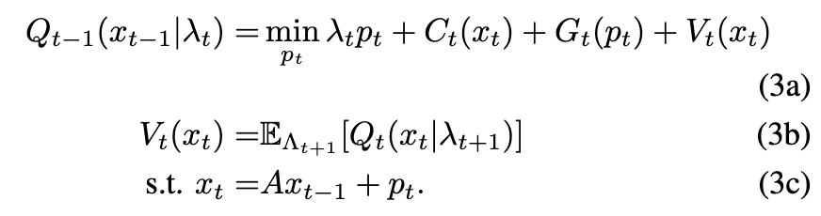
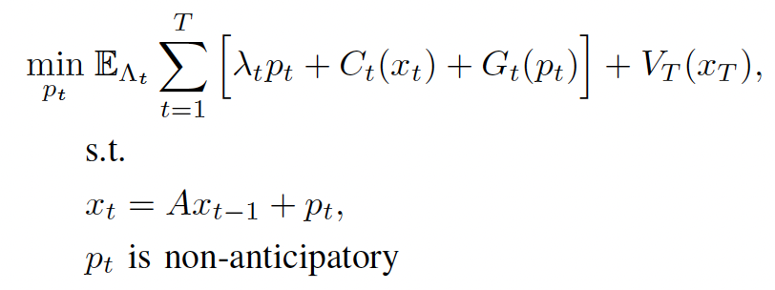
Problem Formulation
Demand model
Stochastic dynamic programming reformulation
Discrete time-varying system
Working backward and recursively solving a single-stage optimization for all time t
Linear system transition
Risk-neutral, cost-saving objective
State cost
Energy cost
Action cost
End value function: for value continuity, set to 0
Value function: rewards from the future about the current decision, it is a function of time-dependent state value.
λ – uncertain price
Soft
Hard
P – power consumption (battery charging/discharging)
X – state (battery SOC)
*Cost function modeling soft and hard constraints
11| Problem Formulation

Slide 12
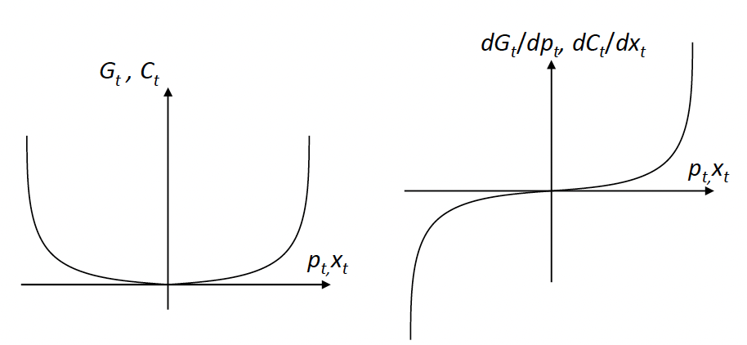
Problem Formulation
Definition - Normalized power and state cost
The system is in equilibrium at zero power and state;
Deviate from reference (0) increase discomfort (cost);
Highlight our focus on disturbances and variations.
HVAC system (air conditioning)
Temperature
x = 4
Discomfort reflected by cost function C(4)
29
Definition/assumption
Convex and continuous
Set point 25
x = 0
No discomfort
x = -5
Discomfort reflected by cost function C(5)
20
12| Problem Formulation

Slide 13
Background
Problem formulation
Main Results
Case Study and Conclusion
13|

Slide 14
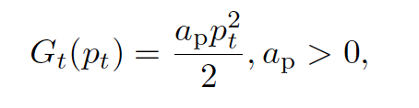


Main Results
Theorem 1 – Distribution-insensitive demand models
Same expectation
Quadratic action cost
Price distribution set L
Demand model:
Quadratic State cost
Set end value function to 0
Quadratic function:
Price
Price distribution
Demand model
Demand model
Theorem - The demand model at time t-1 is
distribution-insensitive to price distribution at time t
Time
Time domain
t
t+1
Value function with different uncertainty distribution
14| Main results

Slide 15
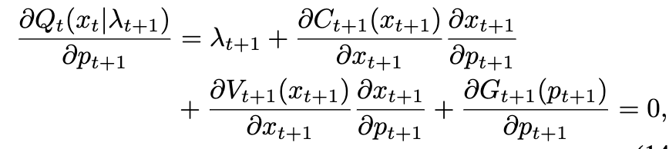
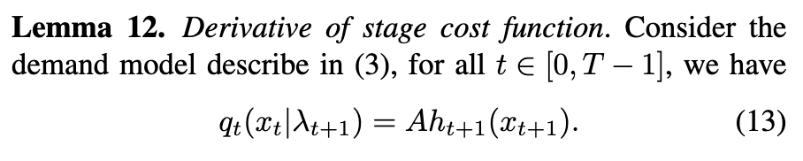
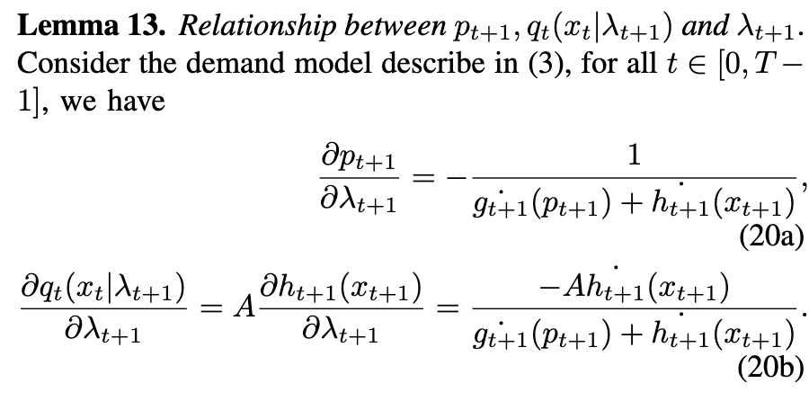
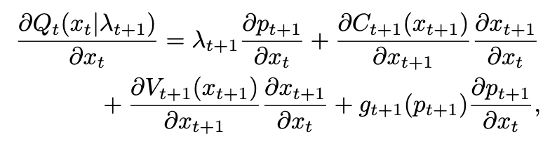
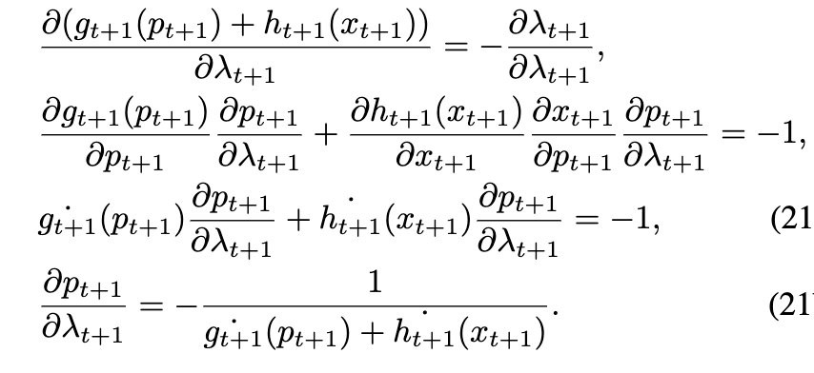

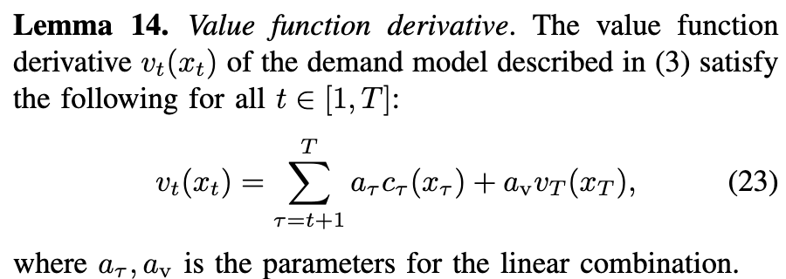
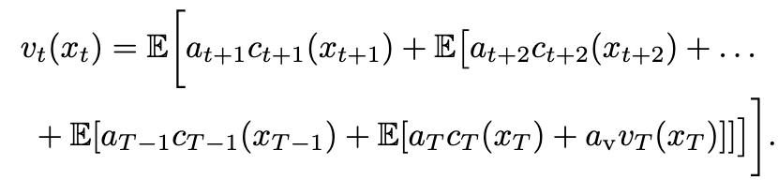

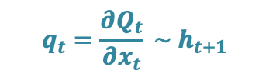








Show the price uncertainty doesn’t affect the value function
Main Results
Sketch of the proof:
KKT conditions/optimality condition
Demand model
State-related cost $h=c+v$
$$λ_{t+1}+g_{t+1}(p_{t+1})+h_{t+1}(x_{t+1})=0$$
Transformation
First-order derivative
Capital letter: function
Lowercase letter: function derivative
$$q_{t}=\frac{{∂Q}_{t}}{{∂x}_{t}} \sim h_{t+1}$$
$$λ_{t+1}\sim p_{t+1}$$
Lemma 13
Lemma 14
Lemma 12
Model definition
$$λ_{t+1}$$
$$p_{t+1}$$
$$h_{t+1}$$
$$q_{t}$$
$$v_{t}$$
$$p_{t+1}\sim x_{t+1}\sim c_{t+1}\sim h_{t+1}$$
Future price
Action
State cost
Stage cost
Value function
X
?
Price distribution
Demand model
15| Main results

Slide 16
Main Results
Corollary – time extrapolation
Price distribution
Same expectation
Theorem - The demand model at time t-1 is
distribution-insensitive to price distribution at time t
Demand model
Time
t-1
t
T
Distribution insensitive to all future time
Price
Key takeaway
Price uncertainty
Demand with quadratic cost function is independent of the future price distribution but only the expectation;
Demand change
Widely used quadratic models fail to capture real risk-aware decision behaviors, as they inherently ignore distributional effects and may thus lead to unintended demand pattern changes
Reference level
Time
16| Main results

Slide 17
Main Results
Corollary – distribution sensitive demand
Price distribution
Same expectation
Demand model:
Quadratic function:
Super quadratic function:
Price
Price uncertainty
???
Takeaway – problem
Demand change
Practical situations challenges distribution-insensitive conditions:
Devices show higher-order cost function performance (thermal comfort and hard constraints)
Reference level
Time
Practical price distribution – not symmetrical with zero-mean
Motivated super quadratic formulation – prudent demand
17| Main results

Slide 18





Main Results
Theorem 2 – Prudent demand models
Probability
Same expectation
Super Quadratic State cost
Price distribution set L
Quadratic State cost
Set to 0
Demand model:
Quadratic action cost
Demand model
$$γ$$
$$π$$
$$π′$$
Price
Theorem - The demand model before time t satisfies prudent and its sensitivity condition to price distribution at time t+1
Price
Price distribution
Time domain
Uncertainty
Demand model
$$γ,π′$$
$$γ,π$$
Value function with different uncertainty distribution
Time
Sensitivity
1
t
t+1
v(x)
Uncertainty
Sensitivity - More skewness
Prudent demand
Time
18| Main results

Slide 19
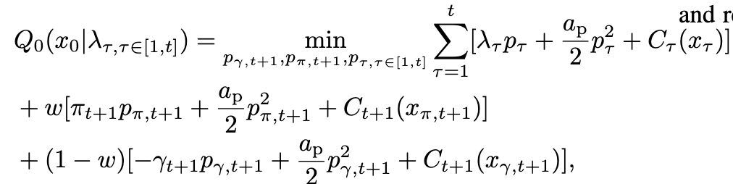
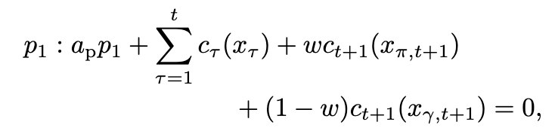
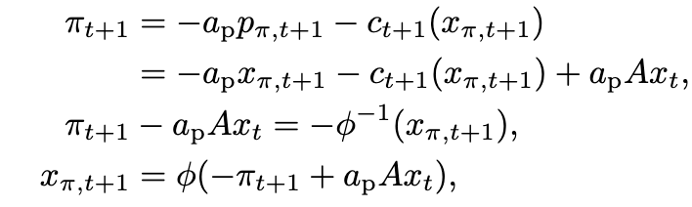
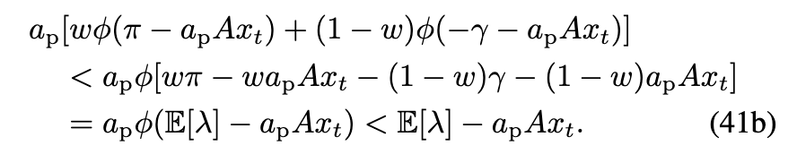
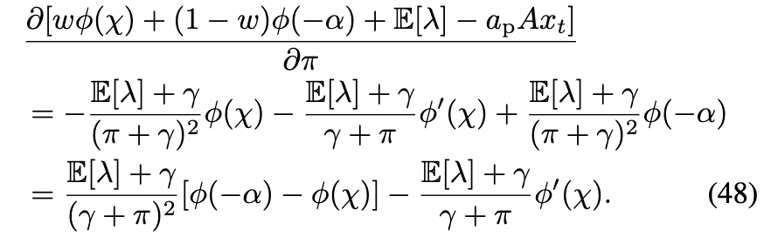

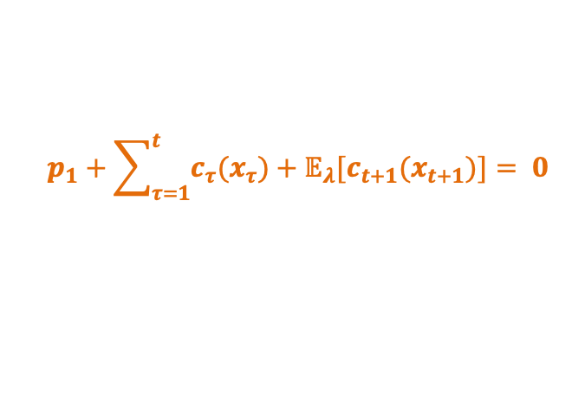








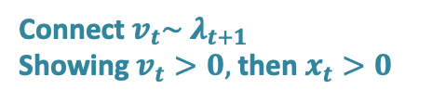
Show the price uncertainty doesn’t affect the value function
Main Results
Sketch of the proof:
State-related cost $h=c+v$
KKT conditions/optimality condition
Demand model
$$v_{t}$$
$$p_{1}+\sum_{τ=1}^{t}{c_{τ}(x_{τ})}+𝔼_{λ}[c_{t+1}(x_{t+1})]= 0$$
Function property
Probability
$$x_{t+1}\sim ∅(λ_{t+1})$$
Price
Connect$v_{t}\sim λ_{t+1}$
Showing $v_{t}>0,$ then $x_{t}>0$
Lemma 18
Lemma 16
Lemma 17
Lemma 15
$${λ′}_{t+1}$$
$$λ_{t+1}$$
$$x_{t+1}$$
$$v_{t}$$
$$p_{1→t}$$
More skewed
Future price
State
Value function
Action
More skewed uncertainty
$${∂v}_{t}/∂π>0$$
?
Price distribution
Demand model
19| Main results

Slide 20
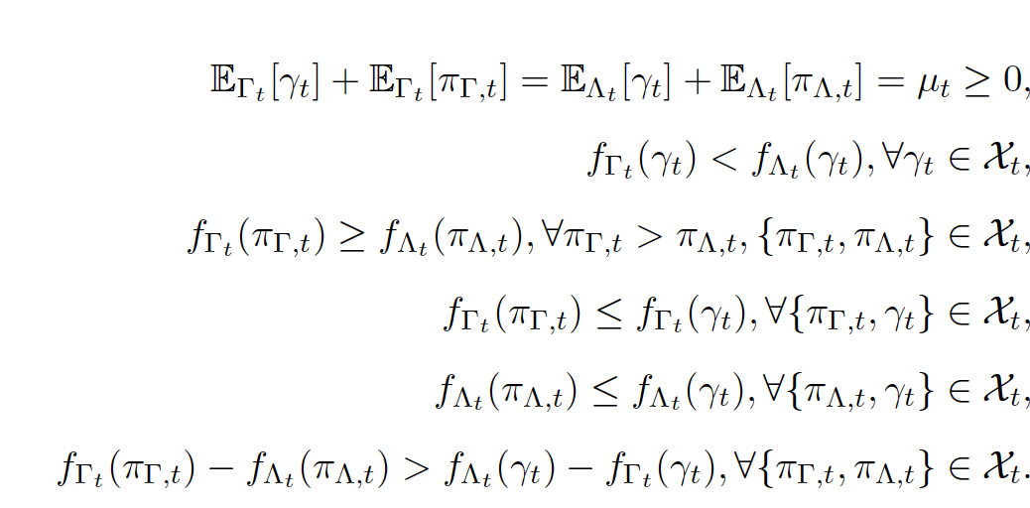

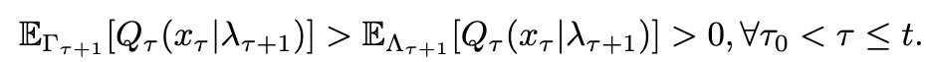





Main Results
Corollary – Distribution & sensitivity extrapolation
Corollary – Strict condition
Probability
Expectation
Prudent theorem
Demand model
$$γ$$
$$π$$
$$π′$$
Price
$$A<1$$
Expectation
$$→0$$
Strict condition
Price
20| Main results

Slide 21

Main Results
Key takeaway
Uncertainty
Prudent demand’s value function increases with the future price distributional factors, with the same expectation;
Demand change
This preparatory behavior reflects an inherent risk-averse response in the demand model; we suggest that the commonly used risk-averse formulations are approximations of a more realistic, higher-order structure.
Reference level
Sensitivity - The aversion degree increases with skewness
The demand level change due to prudence scales proportionally with the skewness of the price distribution, showing the skewness aversion behavior
Reference level
Our results align with the prudence definition from economics
Prudent demand – Change ahead of time
$$\frac{{∂^{3}V}_{t}}{∂x_{t}^{3}}>0$$
Skewness aversion
Outlier: Symmetrical distribution with the expectation of zero;
21| Main results
Notes:
Demand level strictly changes ahead of time to respond to risk;
Show skewness aversion

Slide 22
Background
Problem formulation
Main Results
Case Study and Conclusion
22|

Slide 23
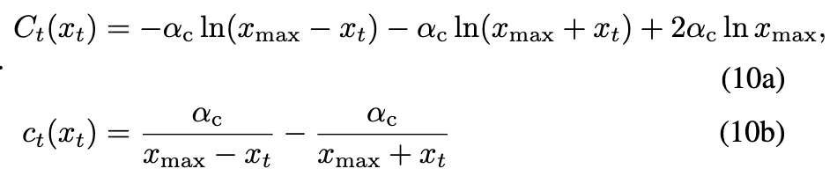




Case Study
Basic setting
Probability
Quadratic action cost function:
0 expectation
Log barrier state cost function:
$$γ=1$$
$$π=1$$
$$π′$$
Price
Parameter:
$$α_{c}=0.5, A=1,V_{T}=0,a_{p}=1,x_{max}=20$$
An illustration example
2-stage, 2-point price distribution with 0 expectation
$$x_{0}=0,γ=−1, π=1↗$$
Symmetrical uncertainty with 0 expectation and 0 initial state
23| Case Study

Slide 24
Case Study
Continuous prudent demand
24 stages
The event happens at the 10th stage
6 skewed price distributions with the same expectation and different variance (skewness)
State under 1st price distribution:
Prudent demand increases before event happen
Convergence under 1st price distribution:
Calculation time: 2s.
State before 10th with all distributions:
skewness aversion
24| Case Study

Slide 25
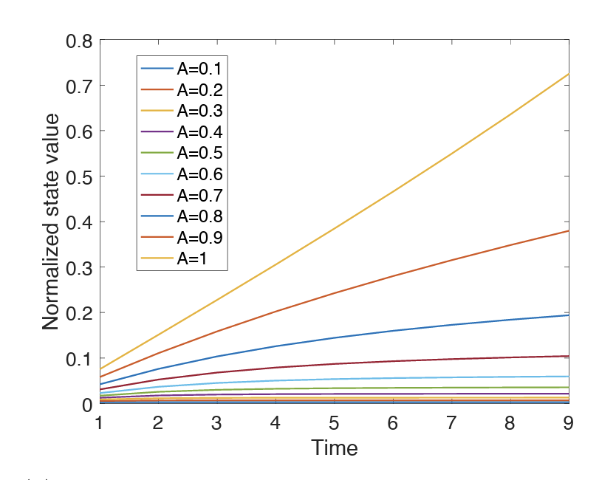
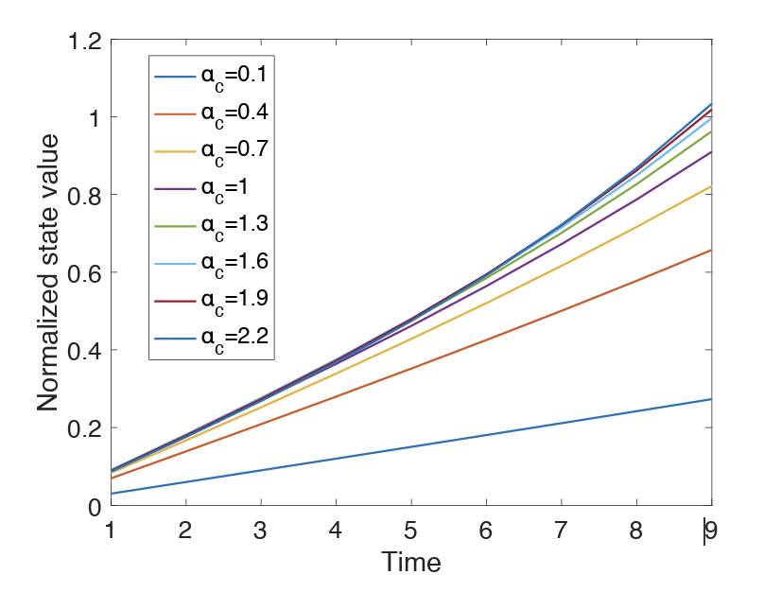
Case Study
Sensitivity of model parameters
24 stages
The event happens at the 10th stage
6 skewed price distributions with the same expectation and different variance (skewness)
Discount factors from 0.1 to 1 - A
State cost function parameters - \alpha
Precautionary saving behavior persists greater potential loss from uncertainty at the event time for the same state value, inducing stronger precautionary saving behavior. But, with a saturation effect. The cost of precautionary saving begins to outweigh the cost of expected risk at the event time.
State under 2nd price distribution:
Lower discount weaken the prudent influence
24| Case Study

Slide 26
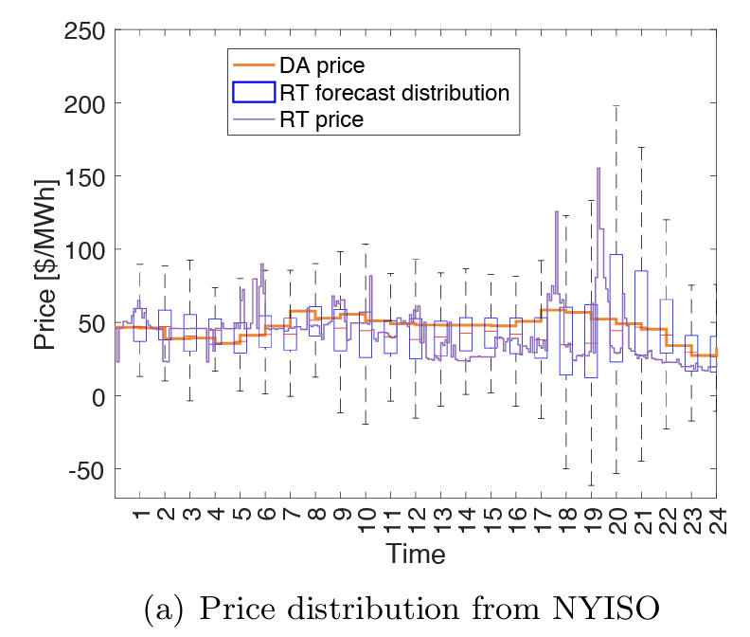
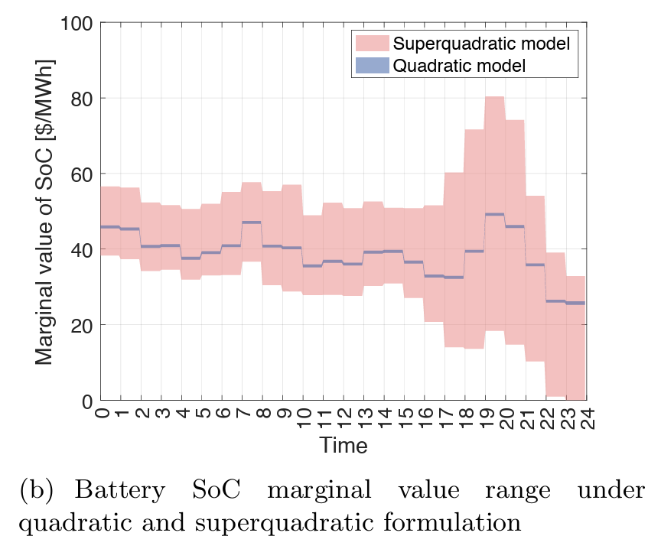
Case Study
Real-world case study
NYISO DA and RT price
Battery doing arbicharge under non-anticipatory price uncertainty
Superquadratic model with hard constraints
Quadratic model with quadratic penalty
Superquadratic model exhibits greater variability
Quadratic model captures the mean value of RT price uncertainty
Superquadratic formulation provides richer and more responsive decision behavior.
20-21
24| Case Study

Slide 27
Interpretation and Conclusion
Conclusion
We show that risk-aware behaviors in demand response originate from superquadratic state-dependent cost functions and price uncertainty with skewed distributions;
We obtain such results through developing a novel theoretical demand response framework that combines non-anticipatory multi-stage decision-making with superquadratic cost functions;
We introduce the concept of prudent demand, which is the first principle for risk-averse behavior despite a risk-neutral objective.
Future price uncertainty affects immediate consumption decisions, and the extent of this response scales proportionally with the skewness of the price distribution
26| Question

Slide 28
Interpretation and Conclusion
Practical implication
Practitioners and policymakers should adopt more sophisticated demand models, either through higher-order utility function formulations or the adoption of more accurate risk terms, especially considering physical and behavioral response limitations, thus, capturing real demand behavior and better accounting for demand pattern changes to efficiently design time-varying tariffs
Preparatory savings naturally provide additional backup capacity to the system ahead of emergencies. Thus, operators should not only focus on the event time itself, but also schedule additional generation or implement price incentives in advance to prevent unintended demand peaks.
Discounting factors and the sensitivity of demand to state value changes are important for accurately quantifying prudent behavior.
anticipating and preparing for tail-risk events and controlling the price ceiling exposed to customers, avoiding the direct exposure of retail consumers to highly volatile wholesale market prices.
26| Question

Slide 29
Selected Reference
Page 7&8
Jia, L., & Tong, L. (2012, October). Optimal pricing for residential demand response: A stochastic optimization approach. In 2012 50th Annual Allerton Conference on Communication, Control, and Computing (Allerton) (pp. 1879-1884). IEEE.
Morales-España, G., Martínez-Gordón, R., & Sijm, J. (2022). Classifying and modelling demand response in power systems. Energy, 242, 122544.
Deng, R., Yang, Z., Chow, M. Y., & Chen, J. (2015). A survey on demand response in smart grids: Mathematical models and approaches. IEEE Transactions on Industrial Informatics, 11(3), 570-582.
Li, N., Chen, L., & Low, S. H. (2011, July). Optimal demand response based on utility maximization in power networks. In 2011 IEEE power and energy society general meeting (pp. 1-8). IEEE.
Roald, L. A., Pozo, D., Papavasiliou, A., Molzahn, D. K., Kazempour, J., & Conejo, A. (2023). Power systems optimization under uncertainty: A review of methods and applications. Electric Power Systems Research, 214, 108725.
Page 2&9
Kimball, M. S. (1989). Precautionary Saving in the Small and in the Large.
Li, L., & Peter, R. (2021). Should we do more when we know less? The effect of technology risk on optimal effort. Journal of Risk and Insurance, 88(3), 695-725.
Ebert, S., & Wiesen, D. (2011). Testing for prudence and skewness seeking. Management Science, 57(7), 1334-1349
Peter, R. (2017). Optimal self-protection in two periods: On the role of endogenous saving. Journal of Economic Behavior & Organization, 137, 19-36.
Page 11
Shapiro, A., Dentcheva, D., & Ruszczynski, A. (2021). Lectures on stochastic programming: modeling and theory. Society for Industrial and Applied Mathematics
Others
Boyd, S. P., & Vandenberghe, L. (2004). Convex optimization. Cambridge university press
Zheng, N., Jaworski, J., & Xu, B. (2022). Arbitraging variable efficiency energy storage using analytical stochastic dynamic programming. IEEE Transactions on Power Systems, 37(6), 4785-4795
28| Reference

Slide 30
Thanks!
&
Q&A
For all details, please reference to - https://arxiv.org/abs/2405.16356

