Slide 1
Qualitative Spatial Relation Representation, Composition Reasoning and Similarity Matching
Shengsheng Wang
2015-7

Slide 2
Outline
Part I: Overview of QSR
Part II: Representation, reasoning and
similar matching for detailed
topological relations with DTString
Part III: Multi-granularity and Metric Spatial Reasoning
Part IV:Others and Future Works

Slide 3
Part I: Overview of QSR
定性时空关系表示
典型的定性空间关系模型
定性时空关系
定性时空推理
定性约束满足问题（QCSP）
半定性约束满足问题
多关系组合时空推理

Slide 4
大多数知识都与时间和空间相关，时空知识处理研究具有十分重要的理论意义，在地学、农业、交通、军事等领域具有广阔的应用前景。

Slide 5
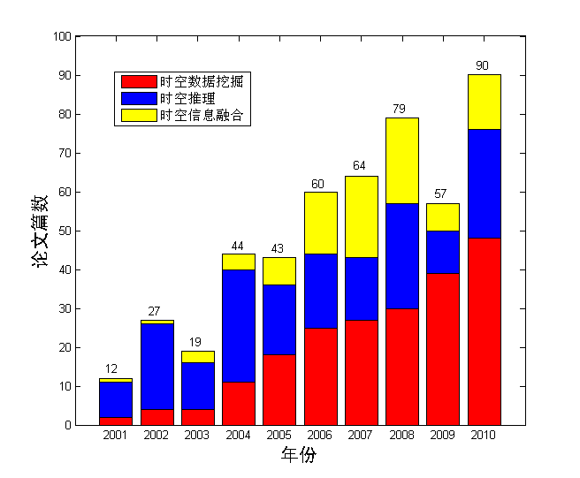
近十年来，围绕时空知识处理，在国际顶级会议和国际著名期刊上发表文章的数量呈逐年递增趋势 。
国际顶级会议:
IJCAI, AAAI,
ECAI, KR,
SIGKDD, ICDM,
VLDB, SIGMOD
国际著名期刊:
AI(IF:3.036 )
VLDB(IF:4.517 )
TKDE(IF:2.285)
DKE(IF:1.745)
Information Fusion(IF:2.212)

Slide 6
1.定性时空关系表示
定性时空关系
  对时变空间目标（或称对象）间的关系进行定性描述（或理解为分类）。
形式化表示方法
  较为严格的形式化语义（如，关系代数或模态逻辑，RCC）：推理可在逻辑(代数)框架下进行，完备可靠性有保障。
  较灵活的代数或几何描述语言定义（n交集）：丰富的语义，形式化程度低，推理工作难以展开，适用于空间查询等应用

Slide 7
2.典型的定性空间关系模型
模型名称 | 维度 | 目标类型 | 描述 | 基本关系
区间代数模型(IA) | 1 | 单向时间轴上的区间 | 描述两个时间区间的拓扑关系 | 13种
有向区间代数模型(DIA) | 1 | 时间轴上的有向区间 | 描述一维空间两个带有运动方向的线段间的拓扑关系 | 26种
矩形代数模型(RA) | 2 | 平面矩形 | 平面上矩形间的拓扑、方向关系 | 13*13种
体代数模型(BA) | 3 | 长方体 | 长方体间的拓扑、方向关系 | 13*13*13种
方向关系演算模型(CARDIR) | 2 | 点对象 | 描述两点之间的相对方位或绝对方位关系 | 9种

Slide 8
2.典型的定性空间关系模型（续）
模型名称 | 维度 | 目标类型 | 描述 | 基本关系
依赖关系模型(DEP) | 2 | 网络节点 | 描述一个网络中节点之间的次序 | 5种
偶极关系模型(DRA-24) | 2 | 平面上的偶极(有向线段) | 描述是两个偶极的起始点和结束点之间的关系 | 16种
双十字模型1(DCC) | 2 | 平面上的点 | 表示的是点C与两点A和B及过这两点与直线AB的垂线间的关系。 | 17种
触发器(FlipFlop)关系模型(FFC) | 2 | 平面上的点 | 平面上点C与有向线段AB之间的关系。 | 9种
几何方位模型(ORI) | 2 | 偶极 | 2个有向线段的排列关系 | 4种

Slide 9
2.典型的定性空间关系模型（续）
模型名称 | 维度 | 目标类型 | 描述 | 基本关系
粒度为m的有向点关系代数模型(OPRAm) | 2 | 有向2D点 | 关于粒度m的有向2D点a,b方向关系 | 4m − 1种
点代数关系集(PA) | 2 | 直线上的点 | 描述直线上的点的顺序关系（值） | 3种
区域连接关系模型(RCC-8) | 2 | 正则闭集区域 | 平面区域的拓扑关系(考虑边界) | 8种
区域连接关系模型(RCC-5) | 2 | 正则闭集区域 | 平面上区域的拓扑关系(不考虑边界) | 5种
圆盘代数 (DA) | 2 | 圆盘 | 描述平面上两个简单区域的拓扑关系(考虑边界) | 8种

Slide 10
2.典型的定性空间关系模型（续）
模型名称 | 维度 | 目标类型 | 描述 | 基本关系
单交关系集模型(SCC) | 2 | 2维点 | 描述点c与由线段ab和过b的垂线构成的坐标系间的关系 | 11种
4交集模型(4-IM) | 2 | 同胚于圆盘的简单区域 | 描述平面上两个区域的拓扑关系(考虑边界) | 8种
Li’s 9交集模型(9-IM) | 2 | 平面区域 | 描述平面上两个区域的拓扑关系(考虑边界) | 43种
扩展9交集模型(9+-IM) | 2 | 点、线和区域 | 描述平面上两个点、线和区域的间拓扑关系 | 23种

Slide 11
2.典型的定性空间关系模型
粗空间关系模型
  基本关系数目有限（RCC-8，8；IA，13），丢失细节
  实际应用中可能真正关心细节
细节空间关系模型
  拓展原有模型：更细致，形式化不严谨，缺少完备性讨论
  2010，Li，凸区域间的拓扑关系：完备，但无法直接推广
  2014，王生生等，细节拓扑关系模型。

Slide 12
3.定性时空关系
针对时空连续性的工作
基于概念邻域图等的工作
定性轨迹关系QTC(更接近实用化)
  表示两个运动的点目标，在一个时刻的速度和运动方向等关系
  一系列算子：最基本QTC_{B}模型（QTC_{B1D}、QTC_{B2D}）；采用双十字模型表示运动方向的QTC_{C}模型；将目标点限制在公路网内，得到QTC_{N}（交通领域）
  已提出了从轨迹数据中提取稳定QTC关系的算法
改进QTC

Slide 13
4.定性时空推理
功能：
  判定已知信息是否存在矛盾
  从已知信息推断未知信息
  发现哪些信息是冗余的
例如：由于视频底层处理的效果不稳定，在高层处理中应用定性空间推理是非常有必要的。

Slide 14
5.定性约束满足问题（QCSP）
定性时空关系约束网络
  在已获得对象之间的二元定性时空关系的前提下，时空场景可以用对象间的定性时空关系约束来表达。
最基本推理问题
  定性时空关系约束网络是否是可满足的？

Slide 15
5.定性约束满足问题（QCSP）：IA
基本结论
  基本IA的QCSP是路径一致算法可判定的(O(n³))
  全关系的QCSP是NP完全的
  其最大可处理子集为H₃
  已提出了较高效的推理算法
扩展
  两个维度上的IA正交组合，形成矩形代数RA（13×13种基本关系，表达矩形的方向+拓扑关系，2个独立IA的QCSP）
  粗粒度的IA由若干基本IA关系的析取构成，如IA₃和IA₇。分别对它们作二维正交，可以得到DIR9和DIR49，可以在RA已知结果上通过粒度运算获得它们的有关运算性质

Slide 16
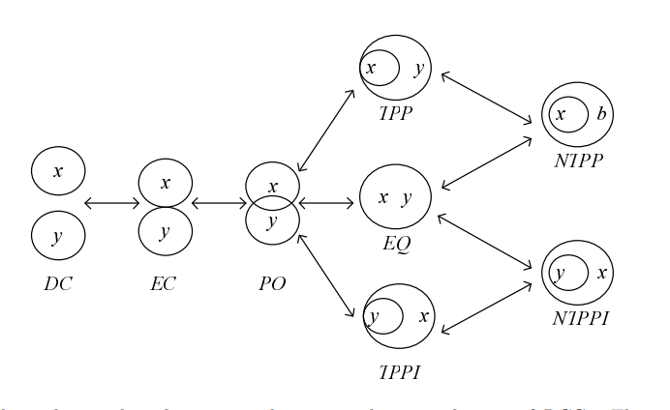
5.定性约束满足问题（QCSP）:RCC
从直觉逻辑导出RCC8基本关系的QCSP是路径一致(path-consistent)算法可判定的
RCC8的弱复合和关系代数的复合不等价，弱复合运算对RCC8不封闭，但路径一致可用代数封闭(algebraic closure)算法替代
RCC8全关系QCSP是NP完全问题（借助3SAT），可以构造较高效的推理算法（借助已知的3个RCC8最大可处理子集）

Slide 17
5.定性约束满足问题（QCSP）：RCC(续)
可处理子集
  可从形式化语义出发进行推导，如RCC8、区间代数可以从霍尔逻辑表示推导可处理子集
  也可采用问题独立的自动计算方法。
  在基本关系可处理前提下，可以从“基本关系在交、逆、弱复合下的闭包也可处理”这个性质出发，通过找到求精矩阵，扩充新关系得到更大的可处理子集。
RCC8等模型建立在逻辑、拓扑等抽象空间，在图像处理中应用需要建立到2维欧式空间的映射。
  Renz首先给出了RCC8的Kripke语义在1、2、3维欧氏空间的正则模型。
  Li等随后给了更简洁有效的正则模型。

Slide 18
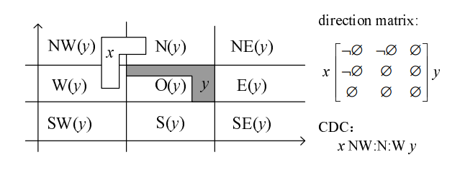
5.定性约束满足问题（QCSP）:CDC
CDC模型
  参考对象外接矩形的4条直线分割成的9个空间来描述平面上两个连通区域间的方向关系。

Slide 19
5.定性约束满足问题（QCSP）:CDC(续)
CDC关系的QCSP相当困难。
  基本关系218种
  不连通区域的CDCd有511种基本关系
CDCd基本关系的QCSP
  Skiadopoulos等给出了O(n5)算法判定。
考虑连通区域的CDC（刘未名等）
  Navarrete等从CDCd推广到CDC的工作存在错误
  基本关系QCSP的O(n3)判定算法
  CDC全关系QCSP是NP完全问题

Slide 20
6.半定性约束满足问题（路标问题）
半定性约束满足问题是QCSP的扩展，解决部分对象实例化(已知几何信息)情况下的定性约束满足问题
在GIS等领域有着实际意义。
同李三江老师等进行了共同研究，相关工作发表于IJCAI和AIJ上。

Slide 21
7.多关系组合时空推理
成果
  拓扑和尺寸的组合（Gerevini和Renz）
  拓扑、尺寸和时间三方面关系的组合（王生生等）
  方向和RCC拓扑关系的组合（Li等）
  距离和方向组合（Moratz等）
模型组合分类（Wölfl等）
  分松散组合
  紧密组合
同类别约束网络组合后是否一致（Li等）
  对基本RCC8关系，两个仅公共1条边的一致基本关系网络组合后仍然是一致的

Slide 22
7.多关系组合时空推理（续）
前述为同类空间对象多种空间关系模型组合
多类空间对象同时存在（异构空间对象）
  一幅遥感图像可能有绿地(区域)、小路(线)、水井(点)
异构对象空间关系的推理不容易实现，这超出了QCSP定义范围，尚无系统研究
异构对象多关系组合推理问题（更复杂、更有实际意义），未见相关报道
  包含点、线和面的异构对象的拓扑、方向和距离组合推理

Slide 23
Part II: Representation, reasoning and
similar matching for detailed
topological relations with DTString
Background
Motivation
DTString Representation
Atomic Topological Relation Model
Reasoning Algorithms on DTString
Similarity Matching with DTString
Experimental Result
Conclusion

Slide 24
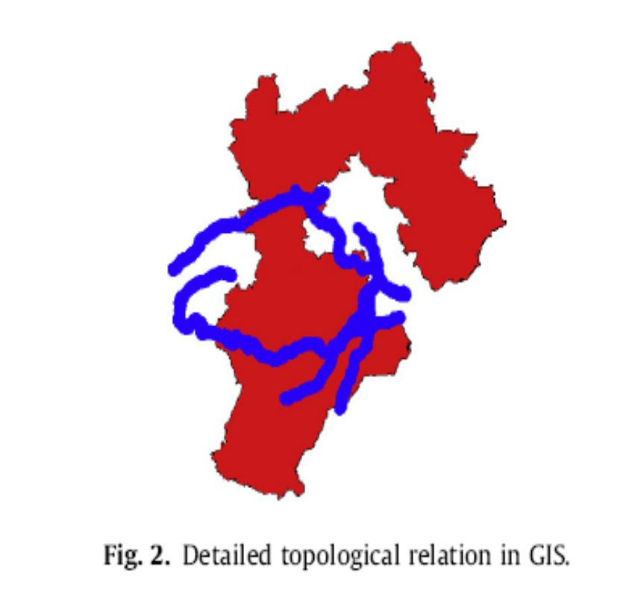
1. Background
Topological relationships have been widely studied by the geographic information systems (GIS) and spatial database. Topological relation of objects is regarded as a key element in image understanding and content-based image retrieval (CBIR). Tackling topological relations is also necessary for CAD, ontologies, Semantic Web, etc.

Slide 25
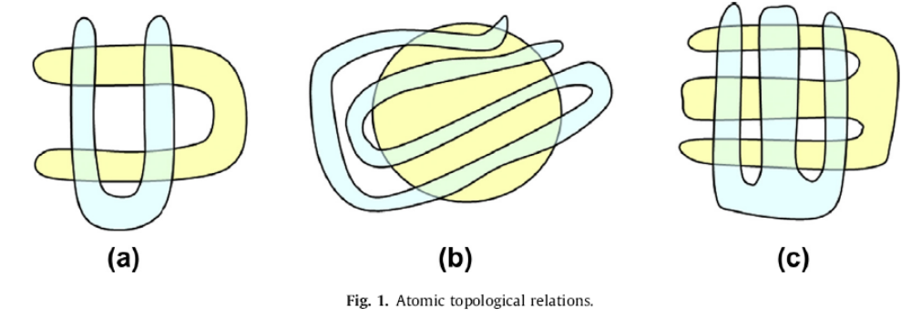
2. Motivation
pattern (a) and pattern (b) can continuously transform into each other, while pattern (c) cannot continuously transform into (a) or (b). Since they are all under the same RCC-8 relation (PO), RCC-8 is not atomic. Atomic relations can be considered undividable relations from the topological viewpoint.

Slide 26
3. DTString Representation
Some Preliminaries:
Simple region
  The boundary is single closed curve with no self-intersection.
  The area of the region is limited.
Geometrical structure GS(A,B)
  composed of two simple regions (A and B) in the same real plane

Slide 27
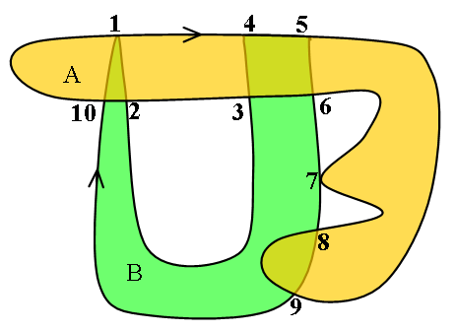
3. DTString Representation
Basic Elements of GS(A,B)
  Nodes
  Boundary Segment
  The boundary segment of ∂A starting from node i and ending at node j is denoted as bs(A,i,j)
  Subregion
  (A,B,AB,E)

Slide 28
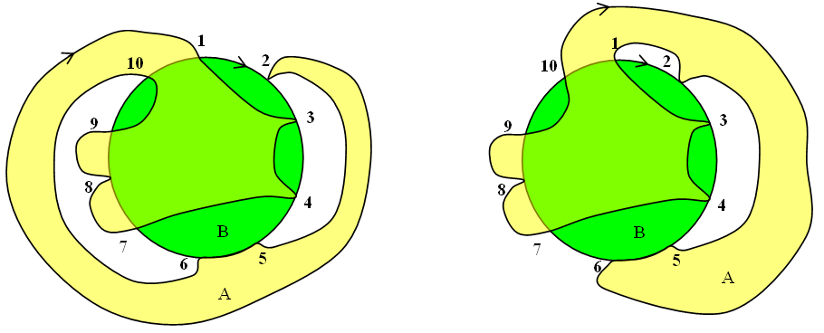
3. DTString Representation
(1) Number the Nodes
Mark the top node as node 1 and travel clockwise
(2) Determine the Direction of the Outside Boundary Segment
Is bs(A,i,j) ⊆ B^{e} positive or negative ?
In fact, cannot ignore the direction:
E.g. two GS with same node order same boundary segment type, except for directions of bs(A,2,1)

Slide 29
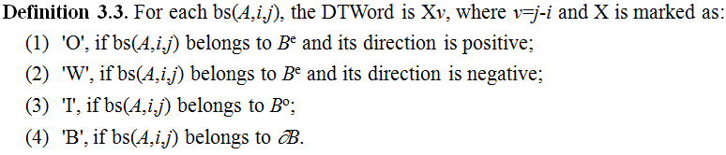
3. DTString Representation
(3) Build DTString with DTWord
(4) Merge all the DTWord in order
DTString(A,B)=(O3B1O4I-1W-1W-1 I-3W-1I8O-9)

Slide 30
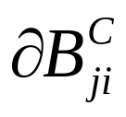
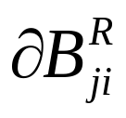
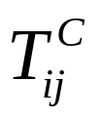

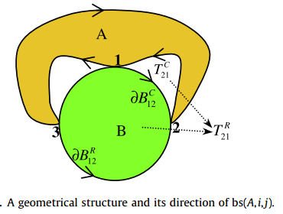
QA:How to determine the Direction of bs(A,i,j) ⊆ B^{e}
:the clockwise part of ∂B starting from node j ending at node i
: the clockwise part of ∂B starting from node j ending at node i
: positive area of bs(A,i,j), i.e. the region surrounded by bs(A,i,j) and
:negative area of bs(A,i,j), i.e. the region surrounded by bs(A,i,j) and

Slide 31

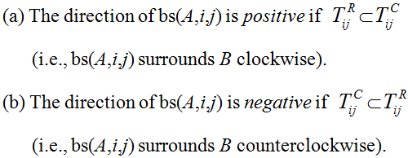
QA:How to determine the Direction of bs(A,i,j) ⊆ B^{e}
With the above definition, stands.
E.g, bs(A,2,1) is negative
bs(A,3,2) is positive

Slide 32
4.Atomic topological relation model
4.1 Circularly Equal DTStrings
  Definition 4.1. Given two DTWords X₁v₁ and X₂v₂ in two different DTStrings. Both of the two DTStrings have n DTWords. X₁v₁ and X₂v₂ are circularly equal iff X₁=X₂ and (v₁-v₂) mod n = 0.
  Given two DTStrings s and t, they are circularly equal iff
  s and t have the same number of DTWords, i.e., they have the same number of nodes n.
  (2) There exists a circular shift t' from t where every corresponding DTWord in s and t' is circularly equal. A one-step circular shift shifts the first DTWord to the last position. A circular shift consists of finite one-step circular shifts.
  e.g. s= (O3B1O4I-1W-1W-1I-3W-1I8O-9)
  t= (W9I-3W-1I-2O1O3B1O-6I-1W-1)

Slide 33

4.Atomic topological relation model
4.2 Isomorphic Geometrical Structures
Definition 4.2.Two geometrical structures G and H are isomorphic (denoted by ) iff G and H can continuously transform into each other. During the transformation, all basic elements (including nodes, boundary segments, and subregions) in G continuously map to the corresponding parts in H. Both elements and their neighbor structures keep the topological properties invariant during the transformation.
  G ≡_{I} G (Reflexivity)
  G ≡_{I} H ↔ H ≡_{I} G (Symmetry)
  A ≡_{I} B and B ≡_{I} C → A ≡_{I} C (Transitivity)

Slide 34
4.Atomic topological relation model
4.3 Regular Geometrical Structure
For a DTString and its circular equivalents, we define a regular geometrical structure (RGS).
  Draw a unit circle representing B and evenly distribute n nodes
  Draw boundary of A by checking every DTWord in DTString(A,B)
(1) For DTWord 'Bv', draw an arc from node a to a+v
  (2) For 'Iv', draw a line from a to a+v through the inside.
  (3) For 'Ov', draw a curve from a to a+v on the outside of B (clockwise with respect to the circle)
  (4) For 'Wv', draw a curve from node a to node a+v on the outside of B. (counterclockwise with respect to the circle)

Slide 35
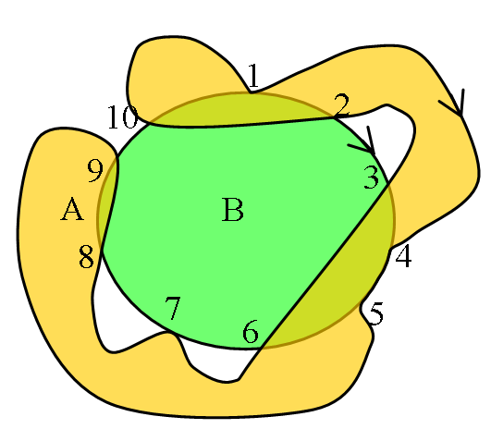
4.Atomic topological relation model
4.3 Regular Geometrical Structure
Example:
DTString(A,B)=(O3B1O4I-1W-1W-1 I-3W-1I8O-9) represents (a), the regular geometrical structure of (a) is shown as (b)
(a) (b)

Slide 36
4.Atomic topological relation model
4.4 Determining Isomorphism by DTString
Lemma 4.1. If DTString(a,b) is circularly equal to DTString(x,y), then:
RGS(DTString(a,b)) ≡_{I} RGS(DTString(x,y)).
Lemma 4.2. GS(x,y) ≡_{I} RGS(DTString(x,y)).
Theorem 4.1. Four simple regions a, b, x, y form two geometrical structures GS(a,b) and GS(x,y). GS(a,b) ≡_{I} GS(x,y) iff DTString(a,b) is circularly equal to DTString(x,y).

Slide 37
5. Reasoning Algorithms on DTString
5.1 Reverse DTString
Given DTString(A,B)=s , DTString(B,A) is also unique, called the reverse DTString of s.
Next we show that the reverse DTString can be computed directly from a given DTString by our algorithm,which is geometric-computation-free.

Slide 38
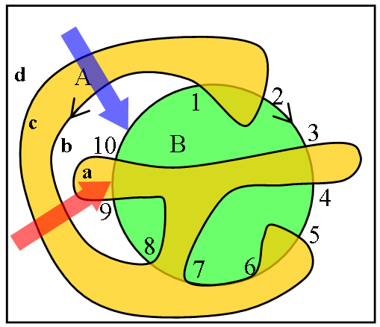
5. Reasoning Algorithms on DTString
Step 1. Determining Whether B’s Boundary Segments Are Internal or External of A
using the number of its surrounding lines: denoted by pass(bs(B,i,j))
e.g. pass(bs(B,10,1))=2
pass(bs(B,2,3))=0
pass(bs(B,9,10))=3

Slide 39
5. Reasoning Algorithms on DTString
5.1 Reverse DTString
Theorem 5.1. Given GS(A,B), let bs(B,i,j) satisfy bs(B,i,j) ⊆∂B and bs(B,i,j) ⊄∂A. Then the following conclusions hold:
(1) bs(B,i,j)⊆ A°, if pass(bs(B,i,j)) is an odd number;
(2) bs(B,i,j)⊆ A^{e}, if pass(bs(B,i,j)) is an even number.
e.g.
pass(bs(B,10,1))=2
pass(bs(B,9,10))=3
pass(bs(B,2,3))=0

Slide 40
5. Reasoning Algorithms on DTString
Step 2. Determining the Direction of B’s Outside Boundary Segment bs(B,i,j)
usingTC(bs(B,i,j)) ,TR(bs(B,i,j)) and Ombs(A,B).
if Ombs(A,B)⊂TC(bs(B,i,j)), bs(B,i,j) is positive.
if Ombs(A,B)⊂TR(bs(B,i,j)), bs(B,i,j) is negative.
e.g. Ombs(A,B)⊂ TR(bs(B,10,1)),
so the direction of bs(B,10,1)
is negative
Step 3. Renumber the nodes

Slide 41
6. Similarity Matching with DTString
6.1 Topological Similarity
Exact and Mirror Matching
Definition 6.1 Given two DTStrings s and t, they are exact matches iff they are circularly equal.
Definition 7.2. Given two DTStrings s and t, they are mirror matches iff
(1) s and t have the same number of DTWords, i.e., they all have n nodes.
(2) Let r be the reverse DTString of t; then there exists a circular shift t' from r, for every corresponding DTWord in s (i.e.Xv) and t' (i.e. X'v'), satisfying: X=X' and (|v-v'|%n=0 OR |v+v'|%n=0).

Slide 42
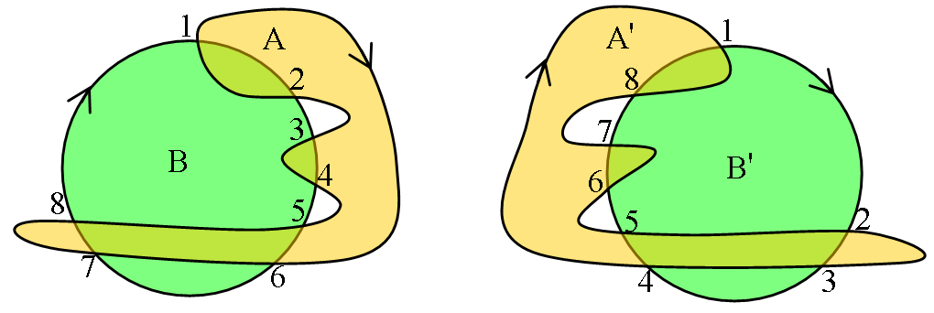
61. Similarity Matching with DTString
6.1 Topological Similarity
Exact and Mirror Matching
e.g. s=(O5I1O1I-3W-1I-1W-1I-1) represents GS(A,B),
t=(I7W-1I-1W-1I-3O1I1O-3) represents GS(A',B').
mirror match

Slide 43
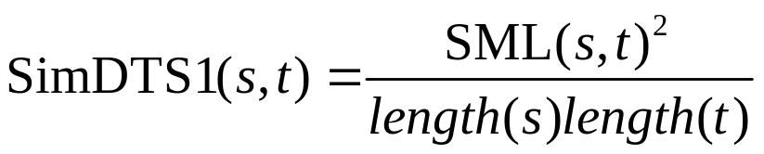
6.1 Topological Similarity
Similar Topology Matching
Longest Common Substring Length (LCSL).
The Longest Mirror Common Substring Length (LMCSL)
Given two DTStrings s and t, their similarity is defined as:
where SML(s,t)=Max{LCSL(s,t), εLMCSL(s,t)}
SimDTS(s,t) = max{SimDTS1(s,t),SimDTS1(ReverseDTString(s), t) }

Slide 44
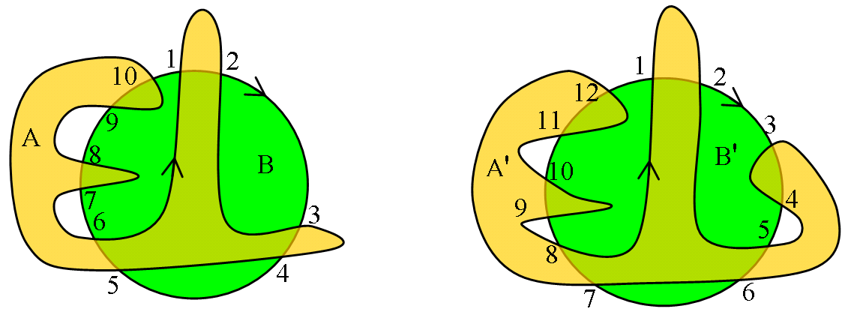
6.1 Topological Similarity
Similar Topology Matching
e.g. (a) s = (O1I1O1I1O5I-1W-1I-1W-1I-5) for GS(A,B);
(b) t = (O1I3W-1I-1O3I1O5I-1W-1I-1W-1I-7) for GS(A',B').
LCSL=10, LMCSL=5, SML=10, Then, SimDTS1(s,t)=0.8333 and SimDTS1(ReverseDTString(s),t) = 0.6667, hence SimDTS(s,t)=0.8333

Slide 45
6. Similarity Matching with DTString
6.2 Shape Similarity
Employ TAR method (N. Alajlan, 2008) to measure the similarity in shape of two geometrical structures
6.3 Distribution Similarity
use the AHDH method (P. Sidiropoulos, 2011) to measure the similarity of distribution of two geometrical structures.

Slide 46
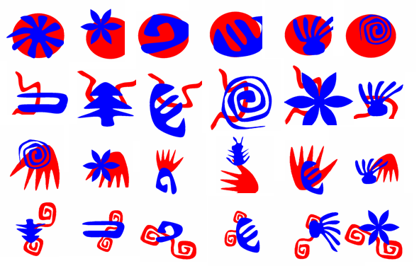
7. Experiments
7.1 test database
objects from:
MPEG7 CE Shape-1 Part-B database
Self-collected database
Each pair of objects constructed a GS

Slide 47
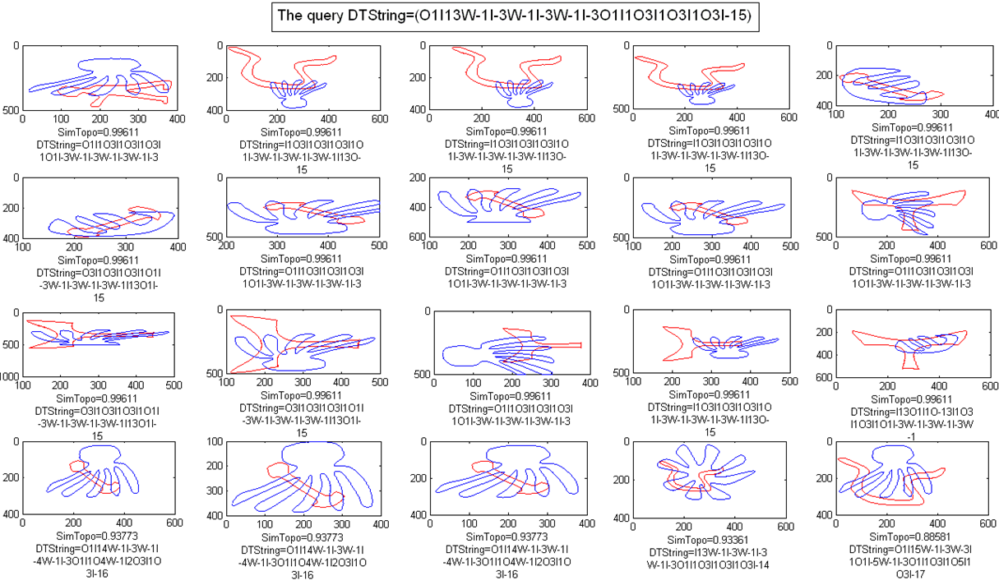
7.1 Retrieval by Description
Input a DTString:
d

Slide 48
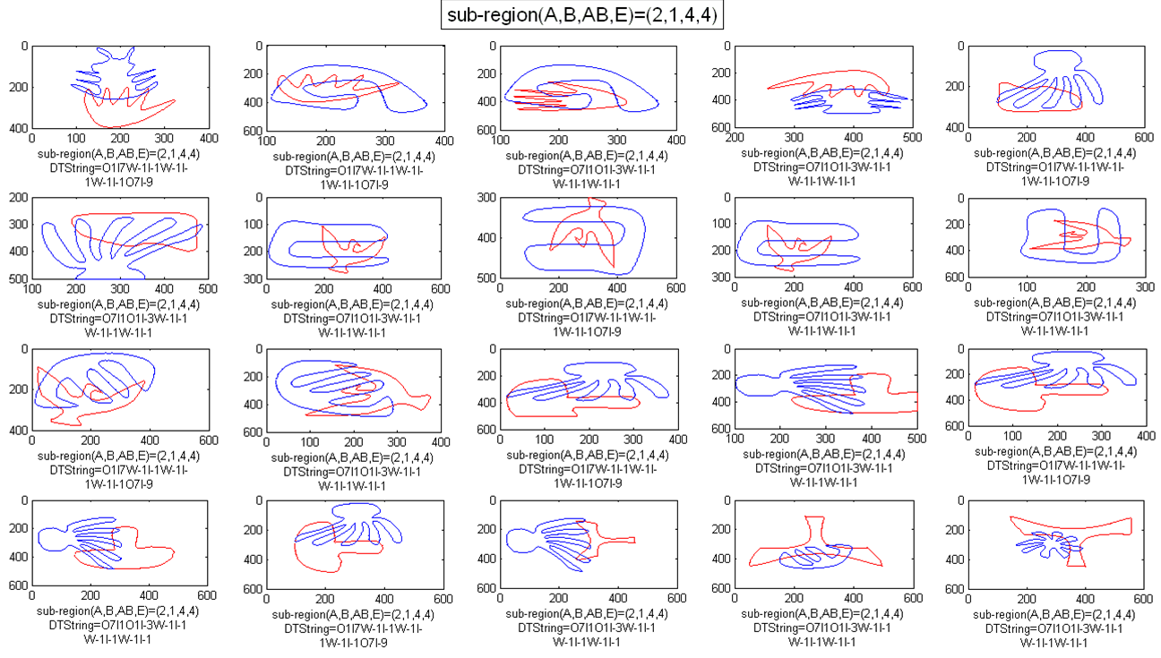
7.1 Retrieval by Description
Input subregions (A, B, AB, E)=(2,1,4,4)

Slide 49
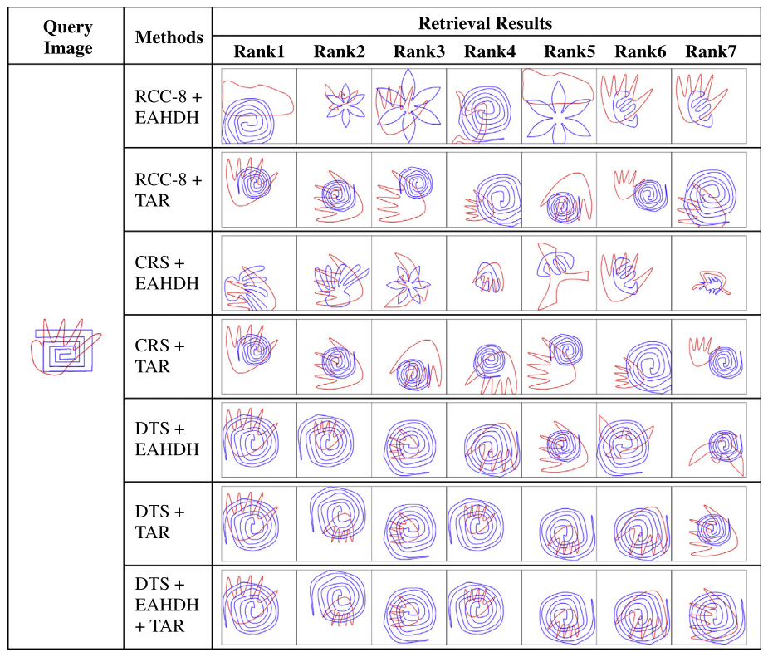
7.1 Retrieval by Image Query
Input a image query

Slide 50
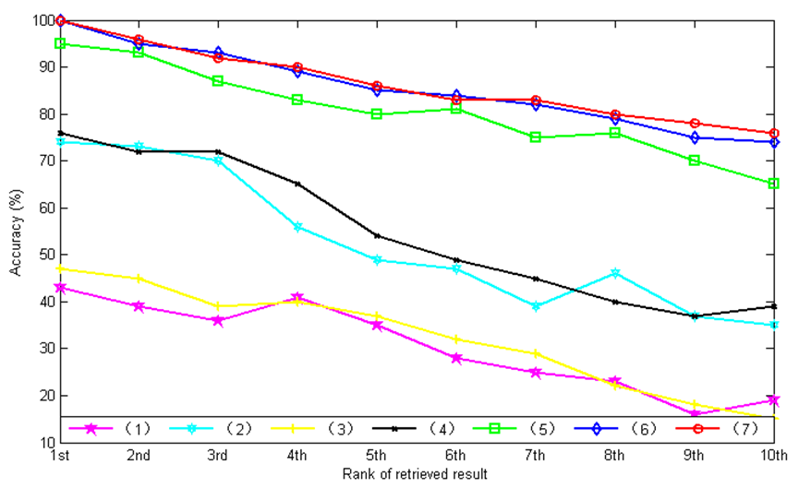
7.1 Retrieval by Image Query
Retrieval accuracy in the test database with last seven methods

Slide 51
7 Experiments
Conclusions:
DTString model consistently outperforms RCC-8 and CRString
Combined with the same topological model, TAR results in higher retrieval accuracy than EAHDH.
The TAR method has a very high computational complexity
The DTString + TAR + EAHDH method outperforms the rest of the approaches in retrieval accuracy. Meanwhile, the accuracy and execution time of [topological model] + TAR + EAHDH are very close to those of [topological model] + TAR.
DTString + TAR + EAHDH is the best if execution time is not a concern; otherwise, DTString + EAHDH is the best.

Slide 52
8. Comclusion
DTString is an atomic topological relation model
DTString applies to a larger object domain
with shorter encoding length,
and enables reasoning task
and similarity matching methods.

Slide 53
Part III: Multi-granularity and Metric Spatial Reasoning
Background and Motivation
Composition Reasoning Problems
Multi-granularity and Metric Spatial Relation
Experimental Result
Conclusion

Slide 54
1. Background and Motivation
Dozens of spatial relations models are developed with granularity parameters
  RCC8 and RCC5
  STAR_{m} , CDC_{m} , OPRA_{m}
In many applications, spatial relations models with different granularities exist in one scene, which caused by some aspects
  the accuracy of detection varies according to the distance
  the information acquisition technologies are diversified

Slide 55
1. Background and Motivation
Present situation
The previous works’ main purpose is to convert relations between different granularities
Most previous qualitative spatial reasoning works only use single granularity spatial relations models
Composition reasoning for multi-granularity spatial relation model has not been systematically studied before

Slide 56
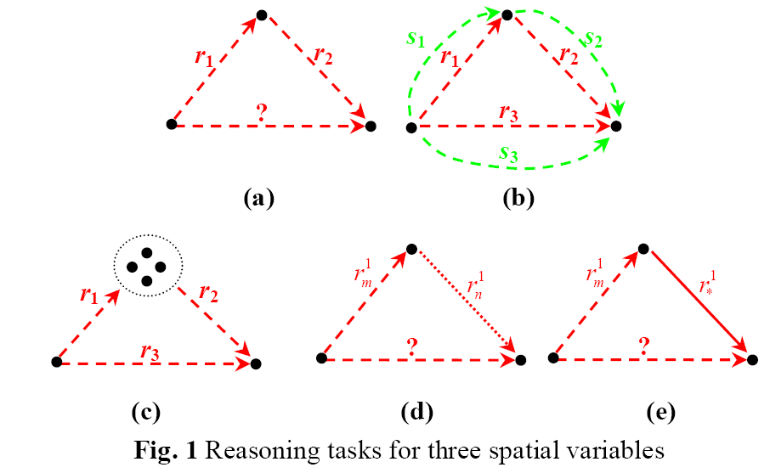
2. Composition Reasoning Problems

Slide 57




2. Composition Reasoning Problems
Multi-granularity spatial reasoning task
metric relation in the red circle
G1 granularity relation between the green and the red circles
G2 granularity between the blue and the green circles
Cannot detect objects outside the blue circle
C
?
A
B
G2
G1
Metric
D
?
robots have unified equipments
granularity of spatial relation is depending on the distance

Slide 58


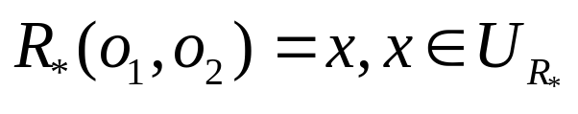
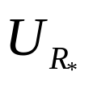
3. Multi-granularity and metric spatial relation
Single granularity
multi-granularity
  add a substript f
Metric spatial relation
  is a Metric Spatial Relation model iff
  x is a real number or a real number vector
  is infinite set

Slide 59

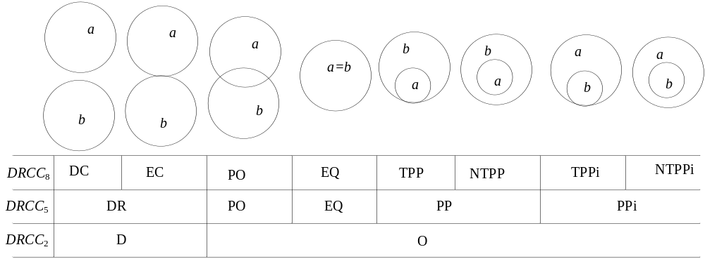
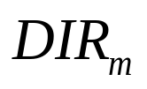
3. Multi-granularity and metric spatial relation (examples)
RCC → DRCC_{i} ,
DIS_{d} , DIS*
, DIR*

Slide 60
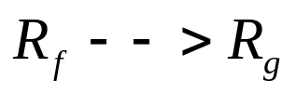
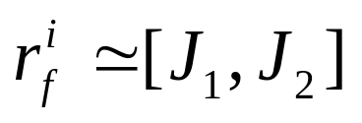
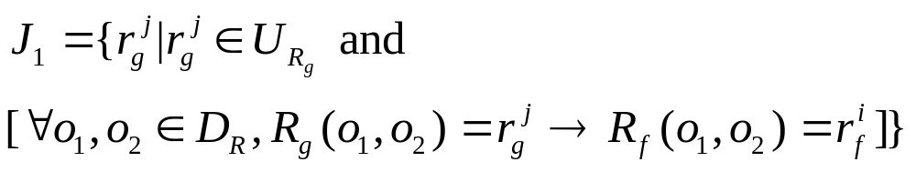
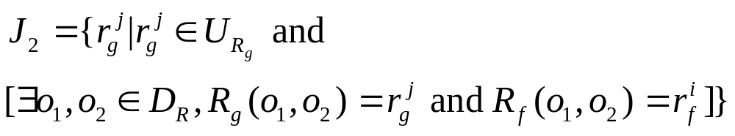
4. Granularity conversion and product
Conversion
lower bound:
upper bound :

Slide 61
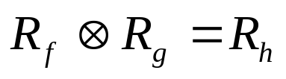
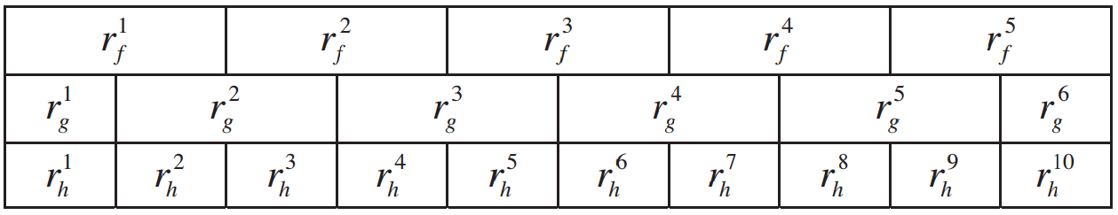
4. Granularity conversion and product
Product
  Finer granularity
Example:

Slide 62
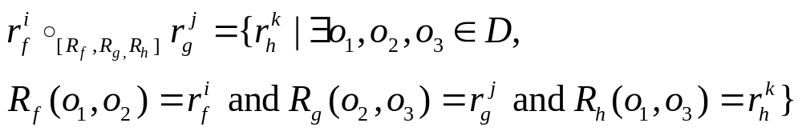

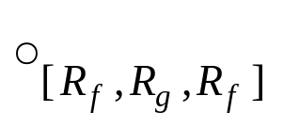
5. Multi-granularity weak composition
Multi-granularity weak composition
(m is a variable)
Not looking forward to produce any new granularity
Only consider

Slide 63
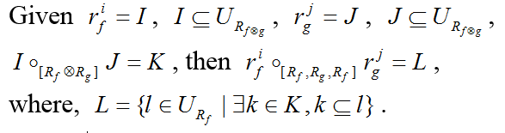
6. Multi-granularity and Metric Reasoning Framework
Theorem
Composition Reasoning with Metric Spatial Relation
  Type 1:
  Type 2:

Slide 64



7. Some Results
Type 1 Metric Reasoning of
is qualitatively solvable.
Type 2 Metric Reasoning of
is not qualitatively solvable.
Type 1 and type 2 Metric Reasoning of is not qualitatively solvable
Type 1 Metric Reasoning of is qualitatively solvable.
Type 2 Metric Reasoning of is not qualitatively solvable.

Slide 65
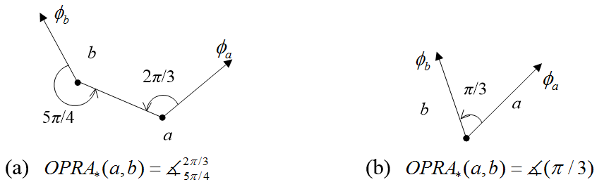
8. Multi-granularity and Metric Spatial Reasoning for OPRA_{m}
The OPRA model

Slide 66
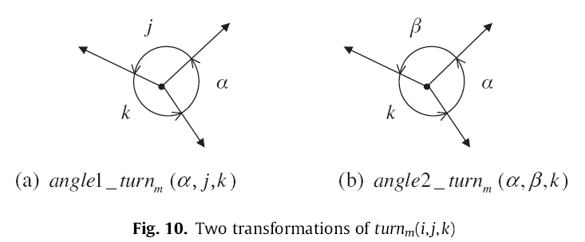
8. Multi-granularity and Metric Spatial Reasoning for OPRA_{m}

Slide 67
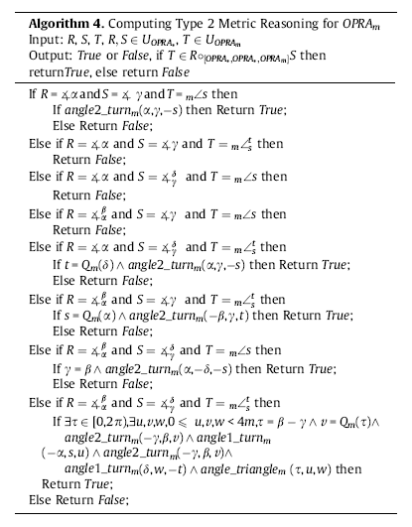
8. Multi-granularity and Metric Spatial Reasoning for OPRA_{m}

Slide 68
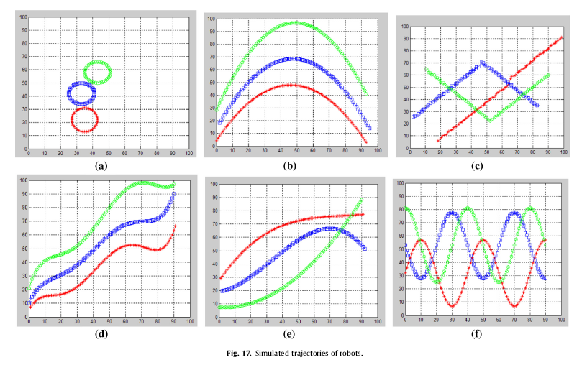
8. Multi-granularity and Metric Spatial Reasoning for OPRA_{m}

Slide 69
Part IV: IV:Others and Future Works
定性空间关系变化推理 2010年 KBS
基于轨迹的行为识别
基于改进QTC的定性轨迹描述
多层表示模型（个体视觉特征、交互轨迹、全局分布）
DBN学习模型
基于空间关系的图像检索
将空间关系结合其他视觉特征用于检索

Slide 70

Thank You!
And Any Question?

