Slide 1
Design and Analysis of Algorithms
3. Maximum Flow
Hongwei LI
School of Computer Science and Engineering
University of Electronic Science and Technology of China

Slide 2
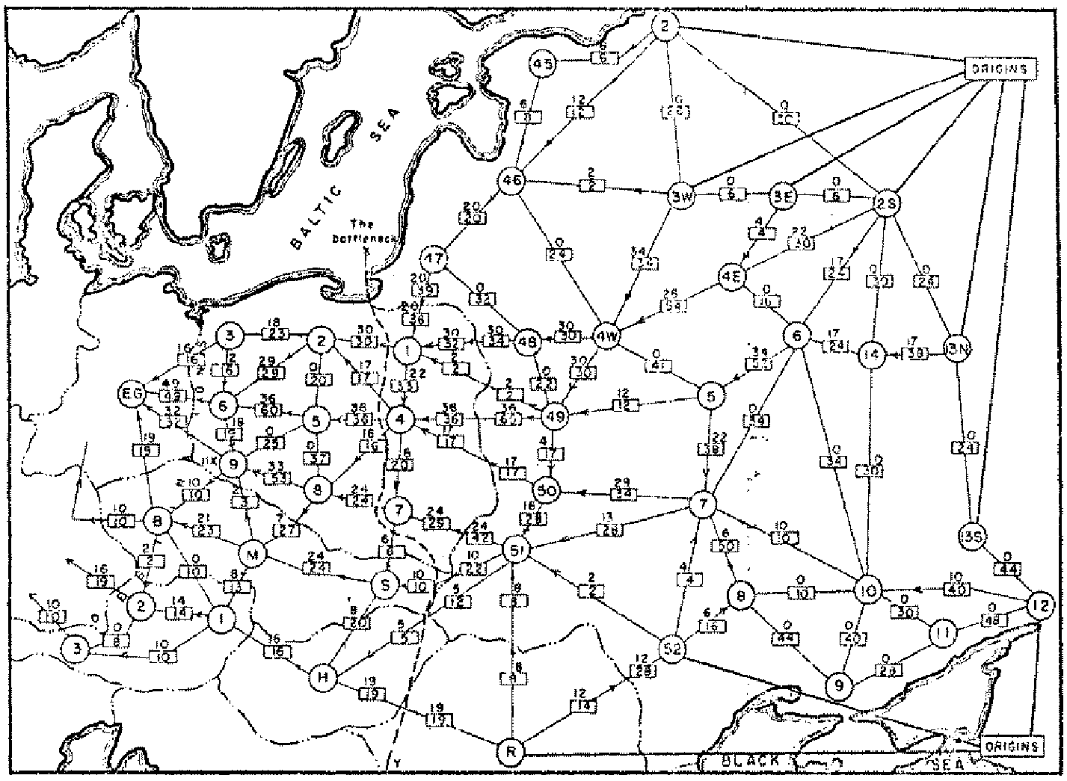
Soviet Rail Network, 1955
Reference: On the history of the transportation and maximum flow problems.
Alexander Schrijver in Math Programming, 91: 3, 2002.
Notes:
Russian scientist A. N. Tolstoi investigated soviet rail network. Wanted to optimize amount of cargo that could be shipped from origins in Soviet Union (right) to destination satellite counties (Poland, Czechoslovakia, Austria, Eastern Germany) (left). American scientists Harris and Ross were also interested in Soviet rail system but from a different perspective. In a secret report (declassified at Schrijver's request in 1999), Harris and Ross calculated a "minimum interdiction" of 163,000 tons.
after aggregation, 44 vertices, 105 edges

Slide 3
Maximum Flow and Minimum Cut
Max flow and min cut.
  Two very rich algorithmic problems.
  Cornerstone problems in combinatorial optimization.
  Beautiful mathematical duality.
Nontrivial applications / reductions.
  Data mining.
  Open-pit mining.
  Project selection.
  Airline scheduling.
  Bipartite matching.
  Baseball elimination.
  Image segmentation.
  Network connectivity.
  Network reliability.
  Distributed computing.
  Egalitarian stable matching.
  Security of statistical data.
  Network intrusion detection.
  Multi-camera scene reconstruction.
  Many many more …
Notes:
Network intrusion detection: http://www.ieee-infocom.org/2003/papers/46_02.PDF
Cornerstone: 基石
Combinatorial 组合
Nontrivial 非平凡的
open pit mining 露天矿
Egalitarian stable matching 平均主义稳定分配
Bipartite matching 偶匹配
Multi-camera scene reconstruction 多场景重建
Image segmentation 图像分割

Slide 4
Minimum Cut Problem
Flow network.
  Abstraction for material flowing through the edges.
  G = (V, E) = directed graph, no parallel edges.
  Two distinguished nodes: s = source, t = sink.
  c(e) = capacity of edge e.
2
9
5
10
4
15
15
10
source
s
5
3
8
6
10
t
sink
4
6
15
10
capacity
15
4
30
7
Notes:
source = where material originates, sink = where material goes.
We use cut to mean s-t cut.

Slide 5

Cuts
Def. An s-t cut is a partition (A, B) of V with s ∈ A and t ∈ B.
Def. The capacity of a cut (A, B) is:
2
9
5
10
4
15
15
10
s
5
3
8
6
10
t
A
4
6
15
10
15
Capacity = 10 + 5 + 15
= 30
4
30
7

Slide 6
Cuts
Def. An s-t cut is a partition (A, B) of V with s ∈ A and t ∈ B.
Def. The capacity of a cut (A, B) is:
2
9
5
10
4
15
15
10
s
5
3
8
6
10
t
A
4
15
15
6
10
Capacity = 9 + 15 + 8 + 30
= 62
4
30
7
Notes:
7->3 not counted

Slide 7
Minimum Cut Problem
Min s-t cut problem. Find an s-t cut of minimum capacity.
2
9
5
10
4
15
15
10
s
5
3
8
6
10
t
A
4
6
15
10
15
Capacity = 10 + 8 + 10
= 28
4
30
7

Slide 8



Flows
Def. An s-t flow is a function that satisfies:
  For each e ∈ E: [capacity]
  For each v ∈ V – {s, t}: [conservation]
Def. The value of a flow f is:
0
2
9
5
4
0
0
10
4
4
15
15
0
10
0
4
4
s
5
3
8
6
10
t
0
0
capacity
4
0
6
15
0
10
15
flow
0
0
Value = 4
4
30
7
Notes:
source = where material originates, sink = where material goes
flow conservation = otherwise warehouse overfills or oil pipe bursts
flow conservation is analogous to Kirchoff's law
* flow: abstract entity generated at source, transmitted across edges, absorbed at sink
* assume no arcs enter s or leave t (makes a little cleaner, no loss of generality)

Slide 9
Flows
Def. An s-t flow is a function that satisfies:
  For each e ∈ E: [capacity]
  For each v ∈ V – {s, t}: [conservation]
Def. The value of a flow f is:
6
2
9
5
10
0
6
10
4
4
15
15
0
10
3
8
8
s
5
3
8
6
10
t
1
10
capacity
4
0
6
15
0
10
15
flow
11
11
Value = 24
4
30
7

Slide 10
Maximum Flow Problem
Max flow problem. Find s-t flow of maximum value.
9
2
9
5
10
1
9
10
4
0
15
15
0
10
4
8
9
s
5
3
8
6
10
t
4
10
capacity
4
0
6
15
0
10
15
flow
14
14
Value = 28
4
30
7
Notes:
Equalize inflow and outflow at every intermediate node.
Maximize flow sent from s to t.

Slide 11

Flows and Cuts
Flow value lemma. Let f be any flow, and let (A, B) be any s-t cut. Then, the net flow sent across the cut is equal to the amount leaving s.
6
2
9
5
10
0
6
10
4
4
15
15
0
10
3
8
8
s
5
3
8
6
10
t
A
1
10
4
0
6
15
0
10
15
11
11
Value = 24
4
30
7

Slide 12
Flows and Cuts
Flow value lemma. Let f be any flow, and let (A, B) be any s-t cut. Then, the net flow sent across the cut is equal to the amount leaving s.
6
2
9
5
10
0
6
10
4
4
15
15
0
10
3
8
8
s
5
3
8
6
10
t
A
1
10
4
0
6
15
0
10
15
11
11
Value = 6 + 0 + 8 - 1 + 11
= 24
4
30
7
Notes:
total amount of flow that leaves S minus amount flow that "swirls" back

Slide 13
Flows and Cuts
Flow value lemma. Let f be any flow, and let (A, B) be any s-t cut. Then, the net flow sent across the cut is equal to the amount leaving s.
6
2
9
5
10
0
6
10
4
4
15
15
0
10
3
8
8
s
5
3
8
6
10
t
A
1
10
4
0
6
15
0
10
15
11
11
Value = 10 - 4 + 8 - 0 + 10
= 24
4
30
7

Slide 14

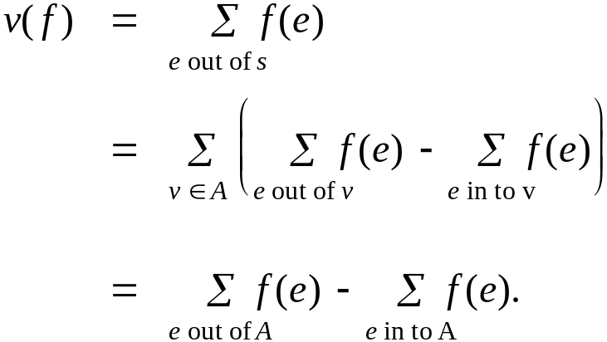
Flows and Cuts
Flow value lemma. Let f be any flow, and let (A, B) be any s-t cut. Then
Pf.
by flow conservation, all terms
except v = s are 0
Notes:
Proof? Edges inside A are offseted.
从第二到第三，将A中边分为与B相连的边及不与B相连的边。与B相连的边只出现1次，不与B相连的边出现两次，且抵消掉了。

Slide 15
Flows and Cuts
Weak duality. Let f be any flow, and let (A, B) be any s-t cut. Then the value of the flow is at most the capacity of the cut.
Cut capacity = 30 ⇒ Flow value ≤ 30
2
9
5
10
4
15
15
10
s
5
3
8
6
10
t
A
4
6
15
10
15
Capacity = 30
4
30
7
Notes:
Duality 二元性

Slide 16
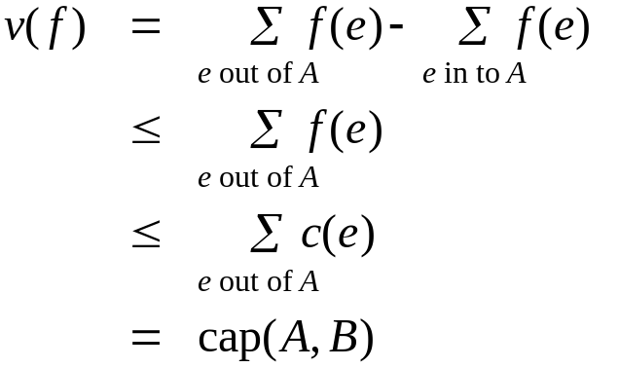
Flows and Cuts
Weak duality. Let f be any flow. Then, for any s-t cut (A, B) we have
v(f) ≤ cap(A, B).
Pf.
▪
A
B
4
8
t
s
7
6

Slide 17
Certificate of Optimality
Corollary. Let f be any flow, and let (A, B) be any cut.
If v(f) = cap(A, B), then f is a max flow and (A, B) is a min cut.
Value of flow = 28
Cut capacity = 28 ⇒ Flow value ≤ 28
9
2
9
5
10
1
9
10
4
0
15
15
0
10
4
8
9
s
5
3
8
6
10
t
4
10
A
4
0
6
15
0
10
15
14
14
4
30
7
Notes:
Corollary 推论

Slide 18
Towards a Max Flow Algorithm
Greedy algorithm.
  Start with f(e) = 0 for all edge e ∈ E.
  Find an s-t path P where each edge has f(e) < c(e).
  Augment flow along path P.
  Repeat until you get stuck.
1
0
0
20
10
s
30
0
t
10
20
0
0
Flow value = 0
2
Notes:
Augment: increase
Stuck: not move

Slide 19
Towards a Max Flow Algorithm
Greedy algorithm.
  Start with f(e) = 0 for all edge e ∈ E.
  Find an s-t path P where each edge has f(e) < c(e).
  Augment flow along path P.
  Repeat until you get stuck.
1
20
0
0
X
20
10
30
0
20
t
s
X
10
20
0
0
20
Flow value = 20
X
2
Notes:
Stuck:卡住了，动不了

Slide 20
Towards a Max Flow Algorithm
Greedy algorithm.
  Start with f(e) = 0 for all edge e ∈ E.
  Find an s-t path P where each edge has f(e) < c(e).
  Augment flow along path P.
  Repeat until you get stuck.
locally optimality ⇒ global optimality
1
1
20
0
20
10
20
10
20
10
s
30
20
t
s
30
10
t
10
20
10
20
0
20
10
20
greedy = 20
2
opt = 30
2

Slide 21
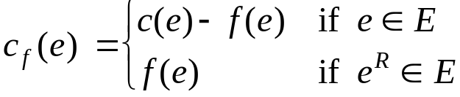
Residual Graph
Original edge: e = (u, v) ∈ E.
  Flow f(e), capacity c(e).
Residual edge.
  "Undo" flow sent.
  e = (u, v) and e^{R} = (v, u).
  Residual capacity:
Residual graph: G_{f} = (V, E_{f} ).
  Residual edges with positive residual capacity.
  E_{f} = {e : f(e) < c(e)} ∪ {e^{R} : f(e) > 0}.
capacity
u
17
v
6
flow
residual capacity
u
11
v
6
residual capacity

Slide 22
Ford-Fulkerson Algorithm(ex. 1)
2
4
4
capacity
G:
10
2
8
6
10
s
10
3
9
5
10
t

Slide 23
Ford-Fulkerson Algorithm（ex. 2）

Slide 24
Augmenting Path Algorithm
Augment(f, c, P) {
b ← bottleneck(P)
for each e ∈ P {
if (e ∈ E) f(e) ← f(e) + b
else f(e^{R})← f(e^{R}) - b
}
return f
}
forward edge
reverse edge
Ford-Fulkerson(G, s, t, c) {
for each e ∈ E f(e) ← 0
G_{f} ← residual graph
while (there exists augmenting path P) {
f ← Augment(f, c, P)
update G_{f}
}
return f
}
Notes:
f: flow. ,c:capacity, P:path.
G:graph. S:source, t:sink, c:capacity.

Slide 25
Max-Flow Min-Cut Theorem
Augmenting path theorem. Flow f is a max flow iff there are no augmenting paths.
Max-flow min-cut theorem. [Elias-Feinstein-Shannon 1956, Ford-Fulkerson 1956] The value of the max flow is equal to the value of the min cut.
Pf. We prove both simultaneously by showing:
  (i) There exists a cut (A, B) such that v(f) = cap(A, B).
  (ii) Flow f is a max flow.
  (iii) There is no augmenting path relative to f.
(i) ⇒ (ii) This was the corollary to weak duality lemma.
(ii) ⇒ (iii) We show contrapositive.
  Let f be a flow. If there exists an augmenting path, then we can improve f by sending flow along path.
Notes:
Contrapositive 对换句

Slide 26
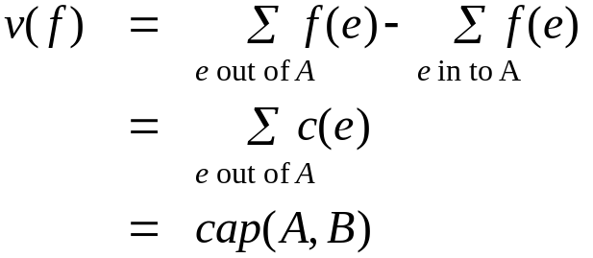
Proof of Max-Flow Min-Cut Theorem
(iii) ⇒ (i)
  Let f be a flow with no augmenting paths.
  Let A be set of vertices reachable from s in residual graph.
  By definition of A, s ∈ A.
  By definition of f, t ∉ A.
A
B
t
s
original network
Notes:
Let f be a flow with no augmenting paths: forward edge no residual, reverse edge 0;
可采用22页中的例子说明在剩余图中寻找增流路径的过程，当不能找到增流路径时，即满足等式

Slide 27
Running Time
Assumption. All capacities are integers between 1 and C.
Invariant. Every flow value f(e) and every residual capacity c_{f} (e) remains an integer throughout the algorithm.
Theorem. The algorithm terminates in at most v(f*) ≤ mC iterations.
Pf. Each augmentation increase value by at least 1. ▪
（m: number of edges）
Corollary. If C = 1, Ford-Fulkerson runs in O(m²) time.
Integrality theorem. If all capacities are integers, then there exists a max flow f for which every flow value f(e) is an integer.
Pf. Since algorithm terminates, theorem follows from invariant. ▪
Notes:
Invariant: constant
Integrality 完整性
n: number of vertexes. m: number of edges
Corollary. Where m is the number of edges in the graph and m is the maximum flow in the graph. This is because each augmenting path can be found in O(m) time and increases the flow by an integer amount which is at least 1 .

Slide 28
7.3 Choosing Good Augmenting Paths

Slide 29
Ford-Fulkerson: Exponential Number of Augmentations
Q. Is generic Ford-Fulkerson algorithm polynomial in input size?
A. No. If max capacity is C, then algorithm can take C iterations.
m, n, and log C
1
1
1
0
0
1
0
0
X
X
X
1
C
C
C
C
1
0
t
1
0
1
0
t
s
X
1
s
X
X
C
C
C
C
0
0
1
0
0
1
X
1
X
X
2
2

Slide 30
Choosing Good Augmenting Paths
Use care when selecting augmenting paths.
  Some choices lead to exponential algorithms.
  Clever choices lead to polynomial algorithms.
  If capacities are irrational, algorithm not guaranteed to terminate!
Goal: choose augmenting paths so that:
  Can find augmenting paths efficiently.
  Few iterations.
Choose augmenting paths with: [Edmonds-Karp 1972, Dinitz 1970]
  Max bottleneck capacity.
  Sufficiently large bottleneck capacity.
  Fewest number of edges.

Slide 31
Capacity Scaling
Intuition. Choosing path with highest bottleneck capacity increases flow by max possible amount.
  Don't worry about finding exact highest bottleneck path.
  Maintain scaling parameter Δ.
  Let G_{f} (Δ) be the subgraph of the residual graph consisting of only arcs with capacity at least Δ.
4
4
110
102
110
102
s
1
t
s
t
122
170
122
170
2
2
G_{f}
G_{f} (100)

Slide 32
Capacity Scaling
Scaling-Max-Flow(G, s, t, c) {
foreach e ∈ E f(e) ← 0
Δ ← smallest power of 2 greater than or equal to C
G_{f} ← residual graph
while (Δ ≥ 1) {
G_{f}(Δ) ← Δ-residual graph
while (there exists augmenting path P in G_{f}(Δ)) {
f ← augment(f, c, P)
update G_{f}(Δ)
}
Δ ← Δ / 2
}
return f
}

Slide 33
Capacity Scaling: Correctness
Assumption. All edge capacities are integers between 1 and C.
Integrality invariant. All flow and residual capacity values are integral.
Correctness. If the algorithm terminates, then f is a max flow.
Pf.
  By integrality invariant, when Δ = 1 ⇒ G_{f}(Δ) = G_{f}.
  Upon termination of Δ = 1 phase, there are no augmenting paths. ▪

Slide 34
Capacity Scaling: Running Time
Lemma 1. The outer while loop repeats 1 + ⎡log₂ C⎤ times.
Pf. Initially C ≤ Δ < 2C. Δ decreases by a factor of 2 each iteration. ▪
Lemma 2. The inner while loop repeats at most m times.
Theorem. The scaling max-flow algorithm finds a max flow in O(m log C) augmentations. It can be implemented to run in O(m² log C) time. ▪
Notes:
Lemma 2, Theorem. Why?

Slide 35
Multiflow and Multicut
Questions:
If there are more than two terminals in the graph, is value of the max flow equal to the value of the min cut?
How about the case that there are two pairs of terminals (s and t)?
How to decompose a flow?
Notes:
Why?

