Slide 1
Design and Analysis of Algorithms
4. NP and Computational Intractability
Hongwei LI
School of Computer Science and Engineering
University of Electronic Science and Technology of China

Slide 2
Algorithm Design Patterns and Anti-Patterns
Algorithm design patterns. Ex.
  Greedy. O(n log n) interval scheduling.
  Divide-and-conquer. O(n log n) FFT.
  Dynamic programming. O(n²) edit distance.
  Duality. O(n³) bipartite matching.
  Reductions.
  Local search.
  Randomization.
Algorithm design anti-patterns.
  NP-completeness. O(n^{c}) algorithm unlikely.
  PSPACE-completeness. O(n^{c}) certification algorithm unlikely.
  Undecidability. No algorithm possible.
Notes:
anti-patterns 反模式

Slide 3
4.1 Polynomial-Time Reductions

Slide 4
Classify Problems According to Computational Requirements
Q. Which problems will we be able to solve in practice?
A working definition. [von Neumann 1953, Godel 1956, Cobham 1964, Edmonds 1965, Rabin 1966]
Those with polynomial-time algorithms.
Yes
Probably no
Shortest path
Longest path
Matching
3D-matching
Min cut
Max cut
2-SAT
3-SAT
Planar 4-color
Planar 3-color
Bipartite vertex cover
Vertex cover
Notes:
Bipartite vertex cover：二部图的点覆盖

Slide 5
Classify Problems
Desiderata. Classify problems according to those that can be solved in polynomial-time and those that cannot.
Frustrating news. Huge number of fundamental problems have defied classification for decades.
This chapter. Show that these fundamental problems are "computationally equivalent" and appear to be different manifestations of one really hard problem.
Notes:
Desiderata（意大利语） 迫切需要物 Frustrating 令人沮丧的
Manifestations 表现形式

Slide 6
Polynomial-Time Reduction
Desiderata'. Suppose we could solve X in polynomial-time. What else could we solve in polynomial time?
Reduction. Problem X polynomial reduces to problem Y if arbitrary instances of problem X can be solved using:
  Polynomial number of standard computational steps, plus
  Polynomial number of calls to oracle that solves problem Y.
Notation. X ≤ _{P} Y.
don't confuse with reduces from
computational model supplemented by special piece
of hardware that solves instances of Y in a single step
Notes:
Cook reduction = polynomial time Turing reduction
Karp reduction = polynomial many-one reduction = polynomial transformation

Slide 7
Polynomial-Time Reduction
Purpose. Classify problems according to relative difficulty.
Design algorithms. If X ≤ _{P} Y and Y can be solved in polynomial-time, then X can also be solved in polynomial time.
Establish intractability. If X ≤ _{P} Y and X cannot be solved in polynomial-time, then Y cannot be solved in polynomial time.
Establish equivalence. If X ≤ _{P} Y and Y ≤ _{P} X, we use notation X ≡ _{P} Y.
up to cost of reduction
Notes:
Intractability: 棘手
Up to：取决于

Slide 8
Reduction By Simple Equivalence
Basic reduction strategies.
  Reduction by simple equivalence.
  Reduction from special case to general case.
  Reduction by encoding with gadgets.
Notes:
Gadget 小配件

Slide 9
Independent Set
INDEPENDENT SET: Given a graph G = (V, E) and an integer k, is there a subset of vertices S ⊆ V such that |S| ≥ k, and for each edge at most one of its endpoints is in S?
Ex. Is there an independent set of size ≥ 6? Yes.
Ex. Is there an independent set of size ≥ 7? No.
independent set
Notes:
Application: find set of mutually non-conflicting points

Slide 10
Vertex Cover
VERTEX COVER: Given a graph G = (V, E) and an integer k, is there a subset of vertices S ⊆ V such that |S| ≤ k, and for each edge, at least one of its endpoints is in S?
Ex. Is there a vertex cover of size ≤ 4? Yes.
Ex. Is there a vertex cover of size ≤ 3? No.
vertex cover
Notes:
TOY application = art gallery problem: place guards within an art gallery so that all corridors are visible at any time

Slide 11
Vertex Cover and Independent Set
Claim. VERTEX-COVER ≡_{P} INDEPENDENT-SET.
Pf. We show S is an independent set iff V − S is a vertex cover.
independent set
vertex cover

Slide 12
Vertex Cover and Independent Set
Claim. VERTEX-COVER ≡_{P} INDEPENDENT-SET.
Pf. We show S is an independent set iff V − S is a vertex cover.
⇒
  Let S be any independent set.
  Consider an arbitrary edge (u, v).
  S independent ⇒ u ∉ S or v ∉ S ⇒ u ∈ V − S or v ∈ V − S.
  Thus, V − S covers (u, v).
⇐
  Let V − S be any vertex cover.
  Consider two nodes u ∈ S and v ∈ S.
  Observe that (u, v) ∉ E since V − S is a vertex cover.
  Thus, no two nodes in S are joined by an edge ⇒ S independent set. ▪
Notes:
黑板推导1，学生推导2

Slide 13
Reduction from Special Case to General Case
Basic reduction strategies.
  Reduction by simple equivalence.
  Reduction from special case to general case.
  Reduction by encoding with gadgets.

Slide 14
Set Cover
SET COVER: Given a set U of elements, a collection S₁, S₂, . . . , S_{m} of subsets of U, and an integer k, does there exist a collection of ≤ k of these sets whose union is equal to U?
Sample application.
  m available pieces of software.
  Set U of n capabilities that we would like our system to have.
  The ith piece of software provides the set S_{i} ⊆ U of capabilities.
  Goal: achieve all n capabilities using fewest pieces of software.
Ex:
U = { 1, 2, 3, 4, 5, 6, 7 }
k = 2
S₁ = {3, 7} S₄ = {2, 4}
S₂ = {3, 4, 5, 6} S₅ = {5}
S₃ = {1} S₆ = {1, 2, 6, 7}

Slide 15
Vertex Cover Reduces to Set Cover
Claim. VERTEX-COVER ≤ _{P} SET-COVER.
Pf. Given a VERTEX-COVER instance G = (V, E), k, we construct a set cover instance whose size equals the size of the vertex cover instance.
Construction.
  Create SET-COVER instance:
    k = k, U = E, S_{v} = {e ∈ E : e incident to v }
  Set-cover of size ≤ k iff vertex cover of size ≤ k. ▪
VERTEX COVER
a
b
SET COVER
U = { 1, 2, 3, 4, 5, 6, 7 }
k = 2
S_{a} = {3, 7} S_{b} = {2, 4}
S_{c} = {3, 4, 5, 6} S_{d} = {5}
S_{e} = {1} S_{f}= {1, 2, 6, 7}
e₇
e₂
e₃
e₄
f
e₆
c
e₁
e₅
k = 2
e
d
Notes:
Set cover→vertex cover: intersection

Slide 16
Polynomial-Time Reduction
Basic strategies.
  Reduction by simple equivalence.
  Reduction from special case to general case.
  Reduction by encoding with gadgets.

Slide 17
4.2 Reductions via "Gadgets"
Basic reduction strategies.
  Reduction by simple equivalence.
  Reduction from special case to general case.
  Reduction via "gadgets."

Slide 18




Satisfiability
Literal: A Boolean variable or its negation.
Clause: A disjunction of literals.
Conjunctive normal form（CNF）: A propositional
formula Φ that is the conjunction of clauses.
SAT: Given CNF formula Φ, does it have a satisfying truth assignment?
3-SAT: SAT where each clause contains exactly 3 literals.
each corresponds to a different variable
Ex:
Yes: x₁ = true, x₂ = true x₃ = false.
Notes:
Clause: 条款 Negation:反面 Formula: 公式
Any logical formula can be expressed in CNF.
Conjunctive normal form：合取范式
A propositionalformula：一个命题式的公式

Slide 19






3 Satisfiability Reduces to Independent Set
Claim. 3-SAT ≤ _{P} INDEPENDENT-SET.
Pf. Given an instance Φ of 3-SAT, we construct an instance (G, k) of INDEPENDENT-SET that has an independent set of size k iff Φ is satisfiable.
Construction.
  G contains 3 vertices for each clause, one for each literal.
  Connect 3 literals in a clause in a triangle.
  Connect literal to each of its negations.
G
k = 3

Slide 20
3 Satisfiability Reduces to Independent Set
Claim. G contains independent set of size k = |Φ| iff Φ is satisfiable.
Pf. ⇒ Let S be independent set of size k.
  S must contain exactly one vertex in each triangle.
  Set these literals to true.
  Truth assignment is consistent and all clauses are satisfied.
Pf ⇐ Given satisfying assignment, select one true literal from each triangle. This is an independent set of size k. ▪
and any other variables in a consistent way
G
k = 3
Notes:
Claim 断言
如果不是K,则至少一个三角中的点都不在点覆盖中，该三角与其他三角的连线上的端点都是点覆盖中的点。

Slide 21
Review
Basic reduction strategies.
  Simple equivalence: INDEPENDENT-SET ≡ _{P} VERTEX-COVER.
  Special case to general case: VERTEX-COVER ≤ _{P} SET-COVER.
  Encoding with gadgets: 3-SAT ≤ _{P} INDEPENDENT-SET.
Transitivity. If X ≤ _{P} Y and Y ≤ _{P} Z, then X ≤ _{P} Z.
Pf idea. Compose the two algorithms.
Ex: 3-SAT ≤ _{P} INDEPENDENT-SET ≤ _{P} VERTEX-COVER ≤ _{P} SET-COVER.
Notes:
Proof idea for transitivity: compose the two algorithms.
Given an oracle for Z, can solve instance of X:
run the algorithm for X using a oracle for Y
each time oracle for Y is called, simulate it in a polynomial number of steps by using algorithm for Y, plus oracle calls to Z

Slide 22
Self-Reducibility
Decision problem. Does there exist a vertex cover of size ≤ k?
Search problem. Find vertex cover of minimum cardinality.
Self-reducibility. Search problem ≤ _{P} decision version.
  Applies to all (NP-complete) problems in this chapter.
  Justifies our focus on decision problems.
Ex: to find min cardinality vertex cover.
  (Binary) search for cardinality k* of min vertex cover.
  Find a vertex v such that G − { v } has a vertex cover of size ≤ k* - 1.
    any vertex in any min vertex cover will have this property
  Include v in the vertex cover.
  Recursively find a min vertex cover in G − { v }.
delete v and all incident edges
Notes:
not explicitly covered in book, but justifies our focus on decision problems instead of search problems
more generally, all np-complete problems are self-reducible

Slide 23
4.3 Definition of NP

Slide 24
Decision Problems
Decision problem.
  X is a set of strings.
  Instance: string s.
  Algorithm A solves problem X: A(s) = yes iff s ∈ X.
Polynomial time. Algorithm A runs in poly-time if for every string s, A(s) terminates in at most p(|s|) "steps", where p(⋅) is some polynomial.
PRIMES: X = { 2, 3, 5, 7, 11, 13, 17, 23, 29, 31, 37, …. }
length of s

Slide 25
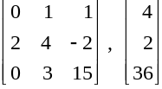
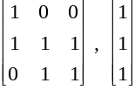
Definition of P
P. Decision problems for which there is a poly-time algorithm.
Problem | Description | Algorithm | Yes | No
MULTIPLE | Is x a multiple of y? | Grade school division | 51, 17 | 51, 16
RELPRIME | Are x and y relatively prime? | Euclid (300 BCE) | 34, 39 | 34, 51
PRIMES | Is x prime? | AKS (2002) | 53 | 51
EDIT-DISTANCE | Is the edit distance between x and y less than 5? | Dynamic programming | niether neither | acgggt ttttta
LSOLVE | Is there a vector x that satisfies Ax = b? | Gauss-Edmonds elimination
Notes:
Edit Distance ，又称Levenshtein距离，是指两个字串之间，由一个转成另一个所需的最少编辑操作次数。许可的编辑操作包括将一个字符替换成另一个字符，插入一个字符，删除一个字符。

Slide 26
NP
Certification algorithm intuition.
  Certifier views things from "managerial" viewpoint.
  Certifier doesn't determine whether s ∈ X on its own;
  rather, it checks a proposed proof t that s ∈ X.
Def. Algorithm C(s, t) is a certifier for problem X if for every string s, s ∈ X iff there exists a string t such that C(s, t) = yes.
NP. Decision problems for which there exists a poly-time certifier.
"certificate" or "witness"
C(s, t) is a poly-time algorithm and
|t| ≤ p(|s|) for some polynomial p(⋅).
Notes:
Certification:证明，鉴定，证书
Certifier:认证算法
Proof，certifcate:证据

Slide 27
Certifiers and Certificates: Composite
COMPOSITES. Given an integer s, is s composite?
Certificate. A nontrivial factor t of s. Note that such a certificate exists iff s is composite. Moreover |t| ≤ |s|.
Certifier.
Instance. s = 437,669.
Certificate. t = 541 or 809.
Conclusion. COMPOSITES is in NP.
boolean C(s, t) {
if (t ≤ 1 or t ≥ s)
return false
else if (s is a multiple of t)
return true
else
return false
}
437,669 = 541 × 809

Slide 28
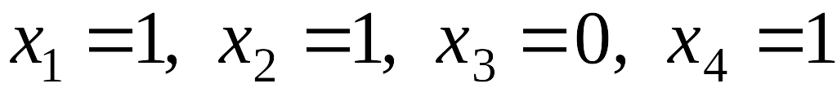
Certifiers and Certificates: 3-Satisfiability
SAT. Given a CNF formula Φ, is there a satisfying assignment?
Certificate. An assignment of truth values to the n boolean variables.
Certifier. Check that each clause in Φ has at least one true literal.
Ex.
Conclusion. SAT is in NP.
instance s
certificate t

Slide 29
Certifiers and Certificates: Hamiltonian Cycle
HAM-CYCLE. Given an undirected graph G = (V, E), does there exist a simple cycle C that visits every node?
Certificate. A permutation of the n nodes.
Certifier. Check that the permutation contains each node in V exactly once, and that there is an edge between each pair of adjacent nodes in the permutation.
Conclusion. HAM-CYCLE is in NP.
instance s
certificate t
Notes:
Permutation:排列

Slide 30
P, NP, EXP
P. Decision problems for which there is a poly-time algorithm.
EXP. Decision problems for which there is an exponential-time algorithm.
NP. Decision problems for which there is a poly-time certifier.
Claim. P ⊆ NP.
Pf. Consider any problem X in P.
  By definition, there exists a poly-time algorithm A(s) that solves X.
  Certificate: t = ε, certifier C(s, t) = A(s). ▪
Claim. NP ⊆ EXP.
Pf. Consider any problem X in NP.
  By definition, there exists a poly-time certifier C(s, t) for X.
  To solve input s, run C(s, t) on all strings t with |t| ≤ p(|s|).
  Return yes, if C(s, t) returns yes for any of these. ▪
Notes:
epsilon = empty string
run C(s, t) on all strings t t with |t| ≤ p(|s|):t的选择是指数级别的个数

Slide 31
The Main Question: P Versus NP
Does P = NP? [Cook 1971, Edmonds, Levin, Yablonski, Gödel]
  Is the decision problem as easy as the certification problem?
  Clay $1 million prize.
If yes: Efficient algorithms for 3-COLOR, TSP, FACTOR, SAT, …
If no: No efficient algorithms possible for 3-COLOR, TSP, SAT, …
Consensus opinion on P = NP? Probably no.
EXP
NP
EXP
P
P = NP
If P ≠ NP
If P = NP
would break RSA cryptography
(and potentially collapse economy)
Notes:
Consensus：共识
Cook formulated conjecture explicitly, others presented close approximations
“ The classes of problems which are respectively known and not known to have good algorithms are of great theoretical interest…. I conjecture that there is no good algorithm for the traveling salesman problem. My reasons are the same as for any mathematical conjecture: (i) It is a legitimate mathematical possibility and (ii) I do not know.” -- Jack Edmonds, 1966
If no, then computer scientists can say "I told you so"

Slide 32
4.4 NP-Completeness

Slide 33
Polynomial Transformation
Def. Problem X polynomial reduces (Cook) to problem Y if arbitrary instances of problem X can be solved using:
  Polynomial number of standard computational steps, plus
  Polynomial number of calls to oracle that solves problem Y.
Def. Problem X polynomial transforms (Karp) to problem Y if given any input x to X, we can construct an input y such that x is a yes instance of X iff y is a yes instance of Y.
Note. Polynomial transformation is polynomial reduction with just one call to oracle for Y, exactly at the end of the algorithm for X. Almost all previous reductions were of this form.
we require |y| to be of size polynomial in |x|
Notes:
If Cook reduction = Karp reduction then co-NP = NP.

Slide 34
NP-Complete
NP-complete. A problem Y in NP with the property that for every problem X in NP, X ≤ _{p} Y.
Theorem. Suppose Y is an NP-complete problem. Then Y is solvable in poly-time iff P = NP.
Pf. ⇐ If P = NP then Y can be solved in poly-time since Y is in NP.
Pf. ⇒ Suppose Y can be solved in poly-time.
  Let X be any problem in NP. Since X ≤ _{p} Y, we can solve X in
  poly-time. This implies NP ⊆ P.
  We already know P ⊆ NP. Thus P = NP. ▪
Fundamental question. Do there exist "natural" NP-complete problems?
Notes:
why couldn't there be incomparable problems such that neither X <= Y nor Y <= X ?

Slide 35
Circuit Satisfiability
CIRCUIT-SAT. Given a combinational circuit built out of AND, OR, and NOT gates, is there a way to set the circuit inputs so that the output is 1?
output
∧
¬
∧
yes: 1 0 1
∧
∨
∨
1
0
?
?
?
hard-coded inputs
inputs

Slide 36
The "First" NP-Complete Problem
Theorem. CIRCUIT-SAT is NP-complete. [Cook 1971, Levin 1973]
Pf. (sketch)
  Any algorithm that takes a fixed number of bits n as input and produces a yes/no answer can be represented by such a circuit.
  Moreover, if algorithm takes poly-time, then circuit is of poly-size.
  Consider some problem X in NP. It has a poly-time certifier C(s, t).
  To determine whether s is in X, need to know if there exists a certificate t of length p(|s|) such that C(s, t) = yes.
  View C(s, t) as an algorithm on |s| + p(|s|) bits (input s, certificate t) and convert it into a poly-size circuit K.
    first |s| bits are hard-coded with s
    remaining p(|s|) bits represent bits of t
  Circuit K is satisfiable iff C(s, t) = yes.
sketchy part of proof; fixing the number of bits is important,
and reflects basic distinction between algorithms and circuits
Notes:
intellectual milestone in CS
by Savage's theorem, P = languages with uniformly polynomial circuits

Slide 37
Establishing NP-Completeness
Remark. Once we establish the first "natural" NP-complete problem,
others fall like dominoes.
Recipe to establish NP-completeness of problem Y.
  Step 1. Show that Y is in NP.
  Step 2. Choose an NP-complete problem X.
  Step 3. Prove that X ≤ _{p} Y.
Justification. If X is an NP-complete problem, and Y is a problem in NP with the property that X ≤ _{P} Y then Y is NP-complete.
Pf. Let W be any problem in NP. Then W ≤ _{P} X ≤ _{P} Y.
  By transitivity, W ≤ _{P} Y.
  Hence Y is NP-complete. ▪
by definition of
NP-complete
by assumption

Slide 38
NP-Completeness
Observation. All problems below are NP-complete and polynomial reduce to one another!
by definition of NP-completeness
CIRCUIT-SAT
3-SAT
3-SAT reduces to INDEPENDENT SET
INDEPENDENT SET
DIR-HAM-CYCLE
GRAPH 3-COLOR
SUBSET-SUM
VERTEX COVER
HAM-CYCLE
PLANAR 3-COLOR
SCHEDULING
SET COVER
TSP
Notes:
Karp analyzed most juicy open problem in discrete math – showed most were NP-complete
x -> y means x reduces to y (if you can solve y, then you can solve x)
Then to join the NP complete club, you need a reduction from SAT (or any other current member) to you

Slide 39
Some NP-Complete Problems
Six basic genres of NP-complete problems and paradigmatic examples.
  Packing problems: SET-PACKING, INDEPENDENT SET.
  Covering problems: SET-COVER, VERTEX-COVER.
  Constraint satisfaction problems: SAT, 3-SAT.
  Sequencing problems: HAMILTONIAN-CYCLE, TSP.
  Partitioning problems: 3D-MATCHING 3-COLOR.
  Numerical problems: SUBSET-SUM, KNAPSACK.
Practice. Most NP problems are either known to be in P or NP-complete.
Notable exceptions. Factoring, graph isomorphism, Nash equilibrium.
Notes:
Packing :填充 Genres:类型 Nash equilibria in two-person non-zero-sum game always exist, but major open question to *find* such a solution in poly-time. [Is there a corresponding decision problem or is only the search problem interesting from a computational complexity viewpoint?]

Slide 40
Extent and Impact of NP-Completeness
Extent of NP-completeness. [Papadimitriou 1995]
  Prime intellectual export of CS to other disciplines.
  6,000 citations per year (title, abstract, keywords).
    more than "compiler", "operating system", "database"
  Broad applicability and classification power.
  "Captures vast domains of computational, scientific, mathematical endeavors, and seems to roughly delimit what mathematicians and scientists had been aspiring to compute feasibly."
Notes:
Ernst Ising proposed simple model for phase transitions that is of fundamental importance in physics.
One of most exiting periods in statistical mechanics when Norwegian chemist Lars Onsager (and Nobel laureate) discovered solution to Ising model of ferromagnetism on 2D lattice.
Result energized many of the most brilliant physicist and mathematicians for solution to more realistic 3D model.
Spin glass Ising model from statistical mechanics (2d version unrealistic, 3d is the one everyone wanted to sovle)

Slide 41
More Hard Computational Problems
Aerospace engineering: optimal mesh partitioning for finite elements.
Biology: protein folding.
Chemical engineering: heat exchanger network synthesis.
Civil engineering: equilibrium of urban traffic flow.
Economics: computation of arbitrage in financial markets with friction.
Electrical engineering: VLSI layout.
Environmental engineering: optimal placement of contaminant sensors.
Financial engineering: find minimum risk portfolio of given return.
Game theory: find Nash equilibrium that maximizes social welfare.
Genomics: phylogeny reconstruction.
Mechanical engineering: structure of turbulence in sheared flows.
Medicine: reconstructing 3-D shape from biplane angiocardiogram.
Operations research: optimal resource allocation.
Physics: partition function of 3-D Ising model in statistical mechanics.
Politics: Shapley-Shubik voting power.
Pop culture: Minesweeper consistency.
Statistics: optimal experimental design.

Slide 42
4.5 Sequencing Problems
Basic genres.
  Packing problems: SET-PACKING, INDEPENDENT SET.
  Covering problems: SET-COVER, VERTEX-COVER.
  Constraint satisfaction problems: SAT, 3-SAT.
  Sequencing problems: HAMILTONIAN-CYCLE, TSP.
  Partitioning problems: 3D-MATCHING, 3-COLOR.
  Numerical problems: SUBSET-SUM, KNAPSACK.

Slide 43
Hamiltonian Cycle
HAM-CYCLE: given an undirected graph G = (V, E), does there exist a simple cycle Γ that contains every node in V.
YES: vertices and faces of a dodecahedron.
Notes:
Dodecahedron:十二面体

Slide 44
Hamiltonian Cycle
HAM-CYCLE: given an undirected graph G = (V, E), does there exist a simple cycle Γ that contains every node in V.
1
1'
2
2'
3
3'
4
4'
5
NO: bipartite graph with odd number of nodes.

Slide 45
Directed Hamiltonian Cycle
DIR-HAM-CYCLE: given a digraph G = (V, E), does there exists a simple directed cycle Γ that contains every node in V?
Claim. DIR-HAM-CYCLE ≤ _{P} HAM-CYCLE.
Pf. Given a directed graph G = (V, E), construct an undirected graph G' with 3n nodes.
a_{out}
a
d_{in}
d
b
v
b_{out}
v_{in}
v
v_{out}
e
c
e_{in}
c_{out}
G
G'

Slide 46
Directed Hamiltonian Cycle
Claim. G has a Hamiltonian cycle iff G' does.
Pf. ⇒
  Suppose G has a directed Hamiltonian cycle Γ.
  Then G' has an undirected Hamiltonian cycle (same order).
Pf. ⇐
  Suppose G' has an undirected Hamiltonian cycle Γ'.
  Γ' must visit nodes in G' using one of following two orders:
    …, B, G, R, B, G, R, B, G, R, B, …
    …, B, R, G, B, R, G, B, R, G, B, …
  Blue nodes in Γ' make up directed Hamiltonian cycle Γ in G, or reverse of one. ▪
Notes:
Γ:gama

Slide 47
3-SAT Reduces to Directed Hamiltonian Cycle
Claim. 3-SAT ≤ _{P} DIR-HAM-CYCLE.
Pf. Given an instance Φ of 3-SAT, we construct an instance of DIR-HAM-CYCLE that has a Hamiltonian cycle iff Φ is satisfiable.
Construction. First, create graph that has 2^{n} Hamiltonian cycles which correspond in a natural way to 2^{n} possible truth assignments.

Slide 48
3-SAT Reduces to Directed Hamiltonian Cycle
Construction. Given 3-SAT instance Φ with n variables x_{i} and k clauses.
  Construct G to have 2^{n} Hamiltonian cycles.
  Intuition: traverse path i from left to right ⇔ set variable x_{i} = 1.
s
x₁
x₂
x₃
t
3k + 3
Notes:
the bi-directed edge represents two anti-parallel directed edges

Slide 49
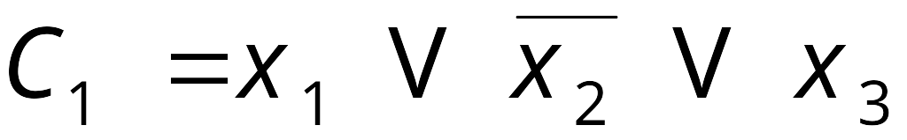
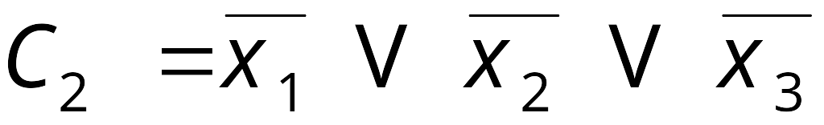
3-SAT Reduces to Directed Hamiltonian Cycle
Construction. Given 3-SAT instance Φ with n variables x_{i} and k clauses.
  For each clause: add a node and 6 edges.
clause node
clause node
s
x₁
x₂
x₃
t

Slide 50
3-SAT Reduces to Directed Hamiltonian Cycle
Claim. Φ is satisfiable iff G has a Hamiltonian cycle.
Pf. ⇒
  Suppose 3-SAT instance has satisfying assignment x*.
  Then, define Hamiltonian cycle in G as follows:
    if x*_{i} = 1, traverse row i from left to right
    if x*_{i} = 0, traverse row i from right to left
    for each clause C_{j} , there will be at least one row i in which we are going in "correct" direction to splice node C_{j} into tour

Slide 51
3-SAT Reduces to Directed Hamiltonian Cycle
Claim. Φ is satisfiable iff G has a Hamiltonian cycle.
Pf. ⇐
  Suppose G has a Hamiltonian cycle Γ.
  If Γ enters clause node C_{j} , it must depart on mate edge.
    thus, nodes immediately before and after C_{j} are connected by an edge e in G
    removing C_{j} from cycle, and replacing it with edge e yields Hamiltonian cycle on G - { C_{j} }
  Continuing in this way, we are left with Hamiltonian cycle Γ' in
  G - { C₁ , C₂ , . . . , C_{k} }.
  Set x*_{i} = 1 iff Γ' traverses row i left to right.
  Since Γ visits each clause node C_{j} , at least one of the paths is traversed in "correct" direction, and each clause is satisfied. ▪
Notes:
Mate:伴侣
clause node C_{j} 能够被访问必须方向正确，即有一个literal为1

Slide 52
Longest Path
SHORTEST-PATH. Given a digraph G = (V, E), does there exists a simple path of length at most k edges?
LONGEST-PATH. Given a digraph G = (V, E), does there exists a simple path of length at least k edges?
Claim. 3-SAT ≤ _{P} LONGEST-PATH.
Pf 1. Redo proof for DIR-HAM-CYCLE, ignoring back-edge from t to s.
Pf 2. Show HAM-CYCLE ≤ _{P} LONGEST-PATH.
Notes:
SHORTEST-PATH.从某顶点出发，沿图的边到达另一顶点所经过的路径中，各边上权值之和最小的一条路径——最短路径。解决最短路的问题有以下算法，Dijkstra算法，Bellman-Ford算法，Floyd算法和SPFA算法
LONGEST-PATH. 将原图的每条边的权值取反，然后利用spfa或者bellman-ford等最短路径算法求解。如果在原图中，起点和终点之间存在正权回路，则最长路径不存在。 这个方法有什么问题？

Slide 53

The Longest Path ^{t}
Lyrics. Copyright © 1988 by Daniel J. Barrett.
Music. Sung to the tune of The Longest Time by Billy Joel.
Woh-oh-oh-oh, find the longest path!
Woh-oh-oh-oh, find the longest path!
If you said P is NP tonight,
There would still be papers left to write,
I have a weakness,
I'm addicted to completeness,
And I keep searching for the longest path.
The algorithm I would like to see
Is of polynomial degree,
But it's elusive:
Nobody has found conclusive
Evidence that we can find a longest path.
I have been hard working for so long.
I swear it's right, and he marks it wrong.
Some how I'll feel sorry when it's done:
GPA 2.1
Is more than I hope for.
Garey, Johnson, Karp and other men (and women)
Tried to make it order N log N.
Am I a mad fool
If I spend my life in grad school,
Forever following the longest path?
Woh-oh-oh-oh, find the longest path!
Woh-oh-oh-oh, find the longest path!
Woh-oh-oh-oh, find the longest path.
t Recorded by Dan Barrett while a grad student at Johns Hopkins during a difficult algorithms final.
Notes:
http://www.cs.princeton.edu/~wayne/cs423/lectures/longest-path.mp3

Slide 54
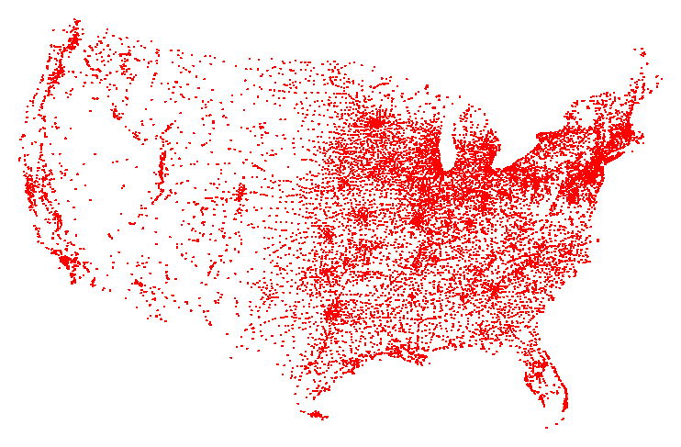
Traveling Salesperson Problem
TSP. Given a set of n cities and a pairwise distance function d(u, v), is there a tour of length ≤ D?
All 13,509 cities in US with a population of at least 500
Reference: http://www.tsp.gatech.edu
Notes:
旅行商问题，即TSP问题（Travelling Salesman Problem）又译为旅行推销员问题、货郎担问题，是数学领域中著名问题之一。假设有一个旅行商人要拜访n个城市，他必须选择所要走的路径，路径的限制是每个城市只能拜访一次，而且最后要回到原来出发的城市。路径的选择目标是要求得的路径路程为所有路径之中的最小值。

Slide 55
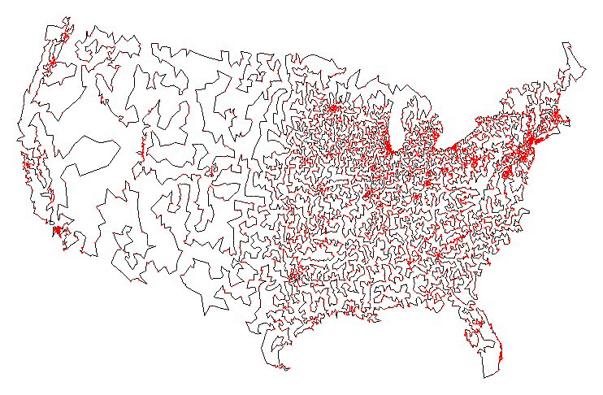
Traveling Salesperson Problem
TSP. Given a set of n cities and a pairwise distance function d(u, v), is there a tour of length ≤ D?
Optimal TSP tour
Reference: http://www.tsp.gatech.edu

Slide 56
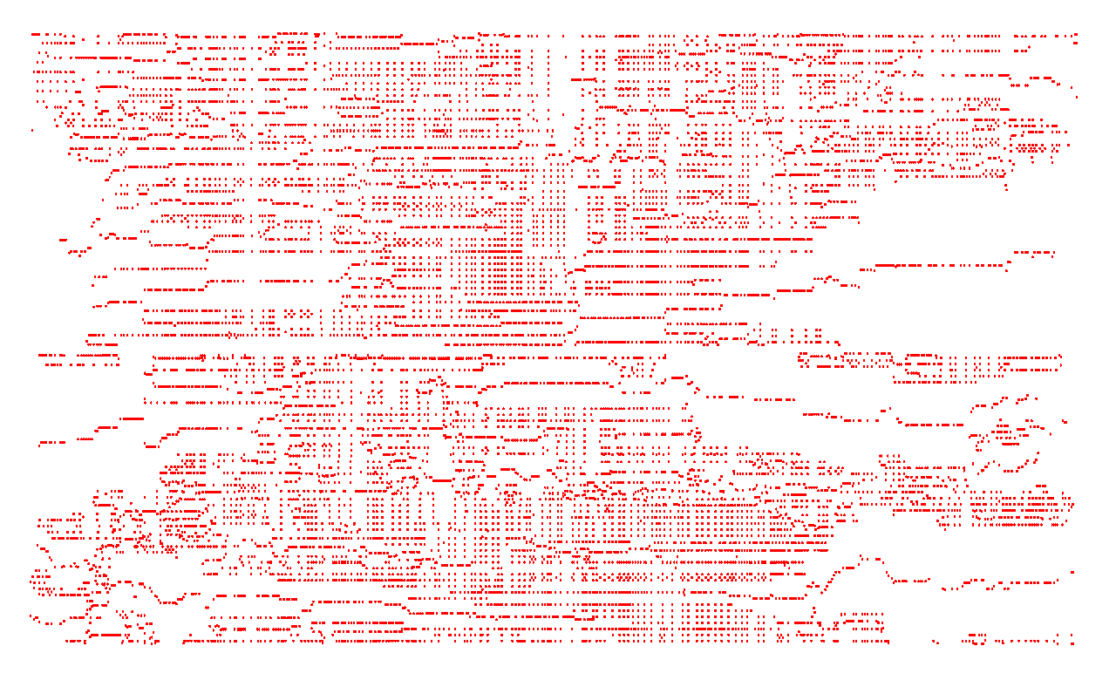
Traveling Salesperson Problem
TSP. Given a set of n cities and a pairwise distance function d(u, v), is there a tour of length ≤ D?
11,849 holes to drill in a programmed logic array
Reference: http://www.tsp.gatech.edu

Slide 57
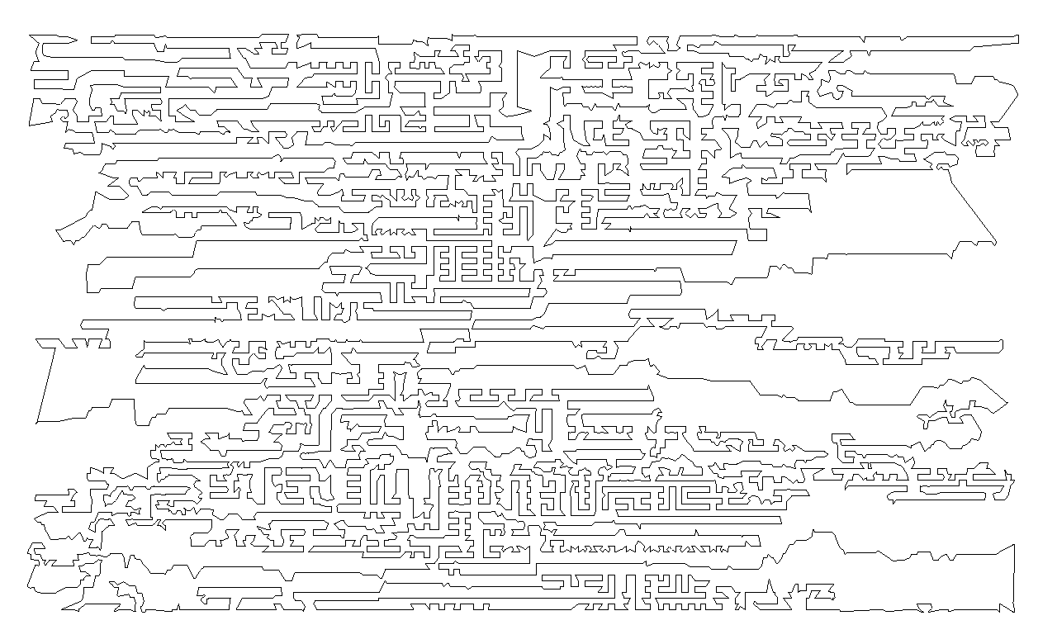
Traveling Salesperson Problem
TSP. Given a set of n cities and a pairwise distance function d(u, v), is there a tour of length ≤ D?
Optimal TSP tour
Reference: http://www.tsp.gatech.edu

Slide 58
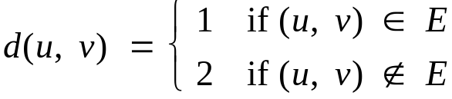
Traveling Salesperson Problem
TSP. Given a set of n cities and a pairwise distance function d(u, v), is there a tour of length ≤ D?
HAM-CYCLE: given a graph G = (V, E), does there exists a simple cycle that contains every node in V?
Claim. HAM-CYCLE ≤ _{P} TSP.
Pf.
  Given instance G = (V, E) of HAM-CYCLE, create n cities with distance function
  TSP instance has tour of length ≤ n iff G is Hamiltonian. ▪

Slide 59
4.6 Partitioning Problems
Basic genres.
  Packing problems: SET-PACKING, INDEPENDENT SET.
  Covering problems: SET-COVER, VERTEX-COVER.
  Constraint satisfaction problems: SAT, 3-SAT.
  Sequencing problems: HAMILTONIAN-CYCLE, TSP.
  Partitioning problems: 3D-MATCHING, 3-COLOR.
  Numerical problems: SUBSET-SUM, KNAPSACK.

Slide 60
3-Dimensional Matching
3D-MATCHING. Given n instructors, n courses, and n times, and a list of the possible courses and times each instructor is willing to teach, is it possible to make an assignment so that all courses are taught at different times?
Instructor
Course
Time
Wayne
COS 423
MW 11-12:20
Wayne
COS 423
TTh 11-12:20
Wayne
COS 226
TTh 11-12:20
Wayne
COS 126
TTh 11-12:20
Tardos
COS 523
TTh 3-4:20
Tardos
COS 423
TTh 11-12:20
Tardos
COS 423
TTh 3-4:20
Kleinberg
COS 226
TTh 3-4:20
Kleinberg
COS 226
MW 11-12:20
Kleinberg
COS 423
MW 11-12:20

Slide 61
3-Dimensional Matching
3D-MATCHING. Given disjoint sets X, Y, and Z, each of size n and a set T ⊆ X × Y × Z of triples, does there exist a set of n triples in T such that each element of X ∪ Y ∪ Z is in exactly one of these triples?
Claim. 3-SAT ≤ _{P} 3D-MATCHING.
Pf. Given an instance Φ of 3-SAT, we construct an instance of 3D-matching that has a perfect matching iff Φ is satisfiable.
Notes:
Note: x,y and z have the same size n.
注意T中的元素个数是n³ 个。

Slide 62
3-Dimensional Matching
number of clauses
Construction. (part 1)
  Create gadget for each variable x_{i} with 2k core and 2k tip elements.
  No other triples will use core elements.
  In gadget i, 3D-matching must use either both grey triples or both blue ones.
set x_{i} = true
set x_{i} = false
true
clause 1 tips
core
false
k = 2 clauses
n = 3 variables
x₁
x₂
x₃
Notes:
Note: the number of tips is 2k, not always 4.

Slide 63

3-Dimensional Matching
Construction. (part 2)
  For each clause C_{j} create two elements and three triples.
  Exactly one of these triples will be used in any 3D-matching.
  Ensures any 3D-matching uses either (i) grey（ture） core of x₁ or (ii) blue (false) core of x₂ or (iii) grey（ture） core of x₃.
clause 1 gadget
each clause assigned
its own 2 adjacent tips
true
clause 1 tips
core
false
x₁
x₂
x₃

Slide 64
3-Dimensional Matching
Construction. (part 3)
  For each tip, add a cleanup gadget.
clause 1 gadget
false
cleanup gadget
clause 1 tips
core
true
x₁
x₂
x₃

Slide 65
3-Dimensional Matching
Claim. Instance has a 3D-matching iff Φ is satisfiable.
Detail. What are X, Y, and Z? Does each triple contain one element from each of X, Y, Z?
clause 1 gadget
false
cleanup gadget
clause 1 tips
core
true
x₁
x₂
x₃
Notes:
由于是3D-matching每一个clause gadget中的2个点必须被选择。

Slide 66
3-Dimensional Matching
Claim. Instance has a 3D-matching iff Φ is satisfiable.
Detail. What are X, Y, and Z? Does each triple contain one element from each of X, Y, Z?
clause 1 gadget
cleanup gadget
clause 1 tips
core
x₁
x₂
x₃
Notes:
Note: Φ is satisfiable是在构造实例时强行规定的()。
即每一个clause只可能在构造的Gadget中选择组成tripe.

Slide 67
4.7 Graph Coloring
Basic genres.
  Packing problems: SET-PACKING, INDEPENDENT SET.
  Covering problems: SET-COVER, VERTEX-COVER.
  Constraint satisfaction problems: SAT, 3-SAT.
  Sequencing problems: HAMILTONIAN-CYCLE, TSP.
  Partitioning problems: 3D-MATCHING, 3-COLOR.
  Numerical problems: SUBSET-SUM, KNAPSACK.

Slide 68
3-Colorability
3-COLOR: Given an undirected graph G does there exists a way to color the nodes red, green, and blue so that no adjacent nodes have the same color?
yes instance

Slide 69
Register Allocation
Register allocation. Assign program variables to machine register so that no more than k registers are used and no two program variables that are needed at the same time are assigned to the same register.
Interference graph. Nodes are program variables names, edge
between u and v if there exists an operation where both u and
v are "live" at the same time.
Observation. [Chaitin 1982] Can solve register allocation problem iff interference graph is k-colorable.
Fact. 3-COLOR ≤ _{P} k-REGISTER-ALLOCATION for any constant k ≥ 3.

Slide 70
3-Colorability
Claim. 3-SAT ≤ _{P} 3-COLOR.
Pf. Given 3-SAT instance Φ, we construct an instance of 3-COLOR that is 3-colorable iff Φ is satisfiable.
Construction.
  For each literal, create a node.
  Create 3 new nodes T, F, B; connect them in a triangle, and connect each literal to B.
  Connect each literal to its negation.
  For each clause, add gadget of 6 nodes and 13 edges.
to be described next

Slide 71








3-Colorability
Claim. Graph is 3-colorable iff Φ is satisfiable.
Pf. ⇒ Suppose graph is 3-colorable.
  Consider assignment that sets all T literals to true.
  (ii) ensures each literal is T or F.
  (iii) ensures a literal and its negation are opposites.
true
false
T
F
B
base

Slide 72
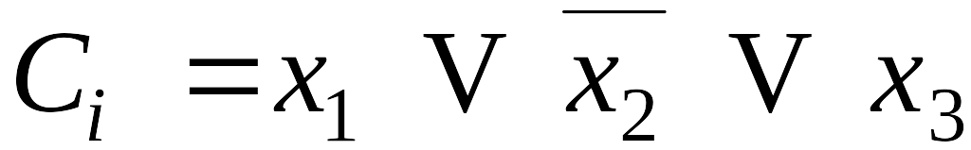
3-Colorability
Claim. Graph is 3-colorable iff Φ is satisfiable.
Pf. ⇒ Suppose graph is 3-colorable.
  Consider assignment that sets all T literals to true.
  (ii) ensures each literal is T or F.
  (iii) ensures a literal and its negation are opposites.
  (iv) ensures at least one literal in each clause is T.
B
6-node gadget
true
T
F
false

Slide 73
3-Colorability
Claim. Graph is 3-colorable iff Φ is satisfiable.
Pf. ⇒ Suppose graph is 3-colorable.
  Consider assignment that sets all T literals to true.
  (ii) ensures each literal is T or F.
  (iii) ensures a literal and its negation are opposites.
  (iv) ensures at least one literal in each clause is T.
B
not 3-colorable if all are red
contradiction
true
T
F
false
Notes:
反证法

Slide 74
3-Colorability
Claim. Graph is 3-colorable iff Φ is satisfiable.
Pf. ⇐ Suppose 3-SAT formula Φ is satisfiable.
  Color all true literals T.
  Color node below green node F, and node below that B.
  Color remaining middle row nodes B.
  Color remaining bottom nodes T or F as forced. ▪
B
a literal set to true in 3-SAT assignment
true
T
F
false
Notes:
Color node below green node F, and node below that B.（绿色节点下面的点着红色（F）,再下面的点为蓝色（B））
Color remaining middle row nodes B(中间行节点的颜色为蓝色（B）).

Slide 75
4.8 Numerical Problems
Basic genres.
  Packing problems: SET-PACKING, INDEPENDENT SET.
  Covering problems: SET-COVER, VERTEX-COVER.
  Constraint satisfaction problems: SAT, 3-SAT.
  Sequencing problems: HAMILTONIAN-CYCLE, TSP.
  Partitioning problems: 3-COLOR, 3D-MATCHING.
  Numerical problems: SUBSET-SUM, KNAPSACK.

Slide 76
Subset Sum
SUBSET-SUM. Given natural numbers w₁, …, w_{n} and an integer W, is there a subset that adds up to exactly W?
Ex: { 1, 4, 16, 64, 256, 1040, 1041, 1093, 1284, 1344 }, W = 3754.
Yes. 1 + 16 + 64 + 256 + 1040 + 1093 + 1284 = 3754.
Remark. With arithmetic problems, input integers are encoded in binary. Polynomial reduction must be polynomial in binary encoding.

Slide 77
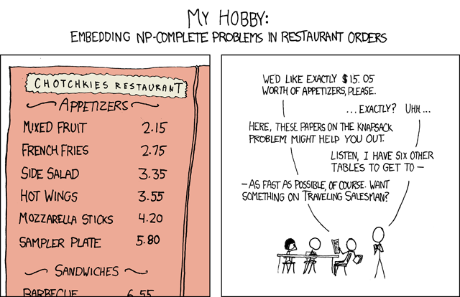
My Hobby
Randall Munro
http://xkcd.com/c287.html

Slide 78
Scheduling With Release Times
SCHEDULE-RELEASE-TIMES. Given a set of n jobs with processing time t_{i}, release time r_{i}, and deadline d_{i}, is it possible to schedule all jobs on a single machine such that job i is processed with a contiguous slot of t_{i} time units in the interval [r_{i}, d_{i} ] ?
Claim. SUBSET-SUM ≤ _{P} SCHEDULE-RELEASE-TIMES.
Pf. Given an instance of SUBSET-SUM w₁, …, w_{n}, and target W,
  Create n jobs with processing time t_{i} = w_{i}, release time r_{i} = 0, and no deadline (d_{i} = 1 + Σ_{j} w_{j}).
  Create job 0 with t₀ = 1, release time r₀ = W, and deadline d₀ = W+1.
Can schedule jobs 1 to n anywhere but [W, W+1]
job 0
0
W
W+1
S+1
Notes:
release time:最早开始时间；deadline：最晚结束时间,隐含条件t_{i} < r_{i}+d_{i}
S=Σ_{j} w_{j (j=1,…,n)}

Slide 79
4.10 A Partial Taxonomy of Hard Problems

Slide 80
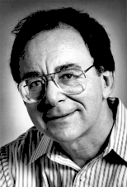
Polynomial-Time Reductions
constraint satisfaction
3-SAT
Dick Karp (1972)
1985 Turing Award
3-SAT reduces to INDEPENDENT SET
INDEPENDENT SET
DIR-HAM-CYCLE
GRAPH 3-COLOR
SUBSET-SUM
VERTEX COVER
HAM-CYCLE
PLANAR 3-COLOR
SCHEDULING
SET COVER
TSP
packing and covering
sequencing
partitioning
numerical
Notes:
Karp analyzed most juicy open problem in discrete math – showed most were NP-complete
x -> y means x reduces to y (if you can solve y, then you can solve x)
Then to join the NP complete club, you need a reduction from SAT (or any other current member) to you

Slide 81
Extra Slides

Slide 82
Subset Sum (proof from book)
Construction. Let X ∪ Y ∪ Z be an instance of 3D-MATCHING with triplet set T. Let n = |X| = |Y| = |Z| and m = |T|.
  Let X = { x₁, x₂, x₃ x₄ }, Y = { y₁, y₂, y₃, y₄ } , Z = { z₁, z₂, z₃, z₄ }
  For each triplet t= (x_{i}, y_{j}, z_{k} ) ∈ T, create an integer w_{t} with 3n digits that has a 1 in positions i, n+j, and 2n+k.
Claim. 3D-matching iff some subset sums to W = 111,…, 111.
use base m+1
Triplet t_{i}
x₁
x₂
x₃
x₄
y₁
y₂
y₃
y₄
z₁
z₂
z₃
z₄
w_{i}
x₁
y₂
z₃
1
0
0
0
0
1
0
0
0
0
1
0
100,001,000,010
x₂
y₄
z₂
0
1
0
0
0
0
0
1
0
1
0
0
10,000,010,100
x₁
y₁
z₁
1
0
0
0
1
0
0
0
1
0
0
0
100,010,001,000
x₂
y₂
z₄
0
1
0
0
0
1
0
0
0
0
0
1
10,001,000,001
x₄
y₃
z₄
0
0
0
1
0
0
1
0
0
0
0
1
100,100,001
x₃
y₁
z₂
0
0
1
0
1
0
0
0
0
1
0
0
1,010,000,100
x₃
y₁
z₃
0
0
1
0
1
0
0
0
0
0
1
0
1,010,000,010
x₃
y₁
z₁
0
0
1
0
1
0
0
0
1
0
0
0
1,010,001,000
x₄
y₄
z₄
0
0
0
1
0
0
0
1
0
0
0
1
100,010,001
111,111,111,111
Notes:
Note: subset的个数正好为n个。

Slide 83
Partition
SUBSET-SUM. Given natural numbers w₁, …, w_{n} and an integer W, is there a subset that adds up to exactly W?
PARTITION. Given natural numbers v₁, …, v_{m} , can they be partitioned into two subsets that add up to the same value?
Claim. SUBSET-SUM ≤ _{P} PARTITION.
Pf. Let W, w₁, …, w_{n} be an instance of SUBSET-SUM.
  Create instance of PARTITION with m = n+2 elements.
    v₁ = w₁, v₂ = w₂, …, v_{n} = w_{n}, v_{n+1} = 2 Σ_{i} w_{i} - W, v_{n+2} = Σ_{i} w_{i} + W
  There exists a subset that sums to W iff there exists a partition since two new elements cannot be in the same partition. ▪
½ Σ_{i} v_{i}
v_{n+1} = 2 Σ_{i} w_{i} - W
W
subset A
v_{n+2} = Σ_{i} w_{i} + W
Σ_{i} w_{i} - W
subset B
Notes:
v_{n+1} = 2 Σ_{i} w_{i} - W, v_{n+2} = Σ_{i} w_{i} + W不可能在同一个子集中

Slide 84
4 Color Theorem

Slide 85
Planar 3-Colorability
PLANAR-3-COLOR. Given a planar map, can it be colored using 3 colors so that no adjacent regions have the same color?
YES instance.
Notes:
applications to DNA
multi-million dollar industrial applications

Slide 86
Planar 3-Colorability
PLANAR-3-COLOR. Given a planar map, can it be colored using 3 colors so that no adjacent regions have the same color?
NO instance.

Slide 87
Planarity
Def. A graph is planar if it can be embedded in the plane in such a way that no two edges cross.
Applications: VLSI circuit design, computer graphics.
Kuratowski's Theorem. An undirected graph G is non-planar iff it contains a subgraph homeomorphic to K₅ or K_{3,3}.
planar
K₅: non-planar
K_{3,3}: non-planar
homeomorphic to K_{3,3}
Notes:
Planar:平面
Homeomorphic：同胚的

Slide 88
Planarity Testing
Planarity testing. [Hopcroft-Tarjan 1974] O(n).
Remark. Many intractable graph problems can be solved in poly-time if the graph is planar; many tractable graph problems can be solved faster if the graph is planar.
Notes:
Intractable：棘手的

Slide 89
Planar Graph 3-Colorability
Q. Is this planar graph 3-colorable?

Slide 90
Planar Graph 3-Colorability
Claim. W is a planar graph such that:
  In any 3-coloring of W, opposite corners have the same color.
  Any assignment of colors to the corners in which opposite corners have the same color extends to a 3-coloring of W.
Pf. Only 3-colorings of W are shown below (or by permuting colors).
Notes:
permuting colors：置换颜色

Slide 91
Planar Graph 3-Colorability
Claim. 3-COLOR ≤ _{P} PLANAR-GRAPH-3-COLOR.
Pf. Given instance of 3-COLOR, draw graph in plane, letting edges cross.
  Replace each edge crossing with planar gadget W.
  In any 3-coloring of W, a ≠ a' and b ≠ b'.
  If a ≠ a' and b ≠ b' then can extend to a 3-coloring of W.
b
b
a
a'
a
a'
b'
a crossing
gadget W
b'
Notes:
3-COLOR的图中有CROSS，我们只需要将CROSS转换成平面图

Slide 92
Planar Graph 3-Colorability
Claim. 3-COLOR ≤ _{P} PLANAR-GRAPH-3-COLOR.
Pf. Given instance of 3-COLOR, draw graph in plane, letting edges cross.
  Replace each edge crossing with planar gadget W.
  In any 3-coloring of W, a ≠ a' and b ≠ b'.
  If a ≠ a' and b ≠ b' then can extend to a 3-coloring of W.
a
a'
a
W
W
W
a'
multiple crossings
gadget W

Slide 93
Planar k-Colorability
PLANAR-2-COLOR. Solvable in linear time.
PLANAR-3-COLOR. NP-complete.
PLANAR-4-COLOR. Solvable in O(1) time.
Theorem. [Appel-Haken, 1976] Every planar map is 4-colorable.
  Resolved century-old open problem.
  Used 50 days of computer time to deal with many special cases.
  First major theorem to be proved using computer.
False intuition. If PLANAR-3-COLOR is hard, then so is PLANAR-4-COLOR and PLANAR-5-COLOR.
Notes:
4 color theorem
-------------------
* resolved 100+ year old open problem
* used 1200+ hours of computer time to deal with many
special cases and configurations
* first major theorem to be proved using computer

Slide 94
Polynomial-Time Detour
Graph minor theorem. [Robertson-Seymour 1980s]
Corollary. There exist an O(n³) algorithm to determine if a graph can be embedded in the torus in such a way that no two edges cross.
Pf of theorem. Tour de force.
Notes:
Juvan-Mohar 2005 = LEDA implementation
Juvan-Marincek-Mohar = linear time, but constant is still enormous
torus ：圆环面 Tour de force：绝技.

Slide 95
Polynomial-Time Detour
Graph minor theorem. [Robertson-Seymour 1980s]
Corollary. There exist an O(n³) algorithm to determine if a graph can be embedded in the torus in such a way that no two edges cross.
Mind boggling fact 1. The proof is highly non-constructive!
Mind boggling fact 2. The constant of proportionality is enormous!
Unfortunately, for any instance G = (V, E) that one could fit into the known universe, one would easily prefer n⁷⁰ to even constant time, if that constant had to be one of Robertson and Seymour's. - David Johnson
Notes:
Torus：环面
"The computation of the constant takes 9 steps, but most of the damage is concentrated in just three of them. Each is an application of some variant on the
"towers of 2s" generator t(k) where t(k) = 2^2^2^…2 [k times]. The first application computes a value θ₁ that is at least t(n/2). The second yields θ₂ which is
θ₁ tall. The third application yields a tower which is something like triply exponential in θ₂ . Still primitive recursive and slower than Ackermann's function."
Johnson, NP-Completeness Column #19

