Slide 1
Report: Fire Detection
Fangfu Liu Zerun Li
2022/6/8

Slide 2
Introduction
Method
Transfer learning
Based on ResNet & DenseNet
Based on ViT & MAE
Experiment
Discussion & Conclusion
Notes:
这个下游任务本身不难，可以用非深度学习方法解决，但是因为现在深度学习的热潮，所以出于好奇和探索，我们希望基于当下的一些较火的模型做一些调整来做这个任务的实现,

Slide 3
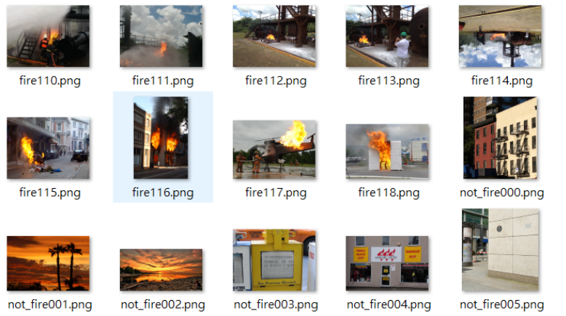
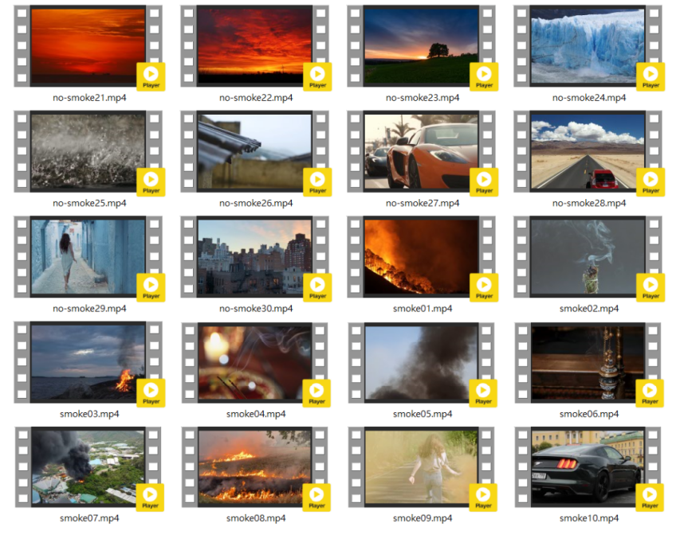
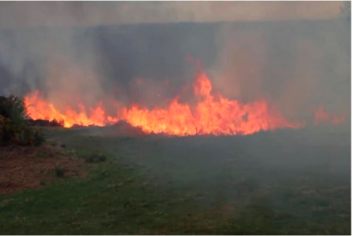
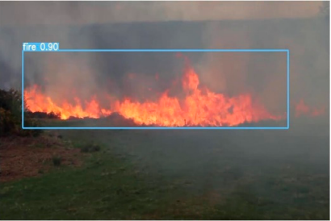
Introduction
Fire detection task
To classify or locate pyrotechnic images in surveillance images or videos
Unique significance in the field of fire safety
Our target: given an image and classify whether it is in fire or not
Fire or not
Notes:
因为我们在整个训练和验证的过程中都没有用到所提供的BoWFire数据集，我们只是用那个数据集做测试，所以自行在网上收集的数据量是非常少的，只有1000多张，但我们最后的准确率是非常的高，最高可以达到93，真阳率基本都在95以上

Slide 4
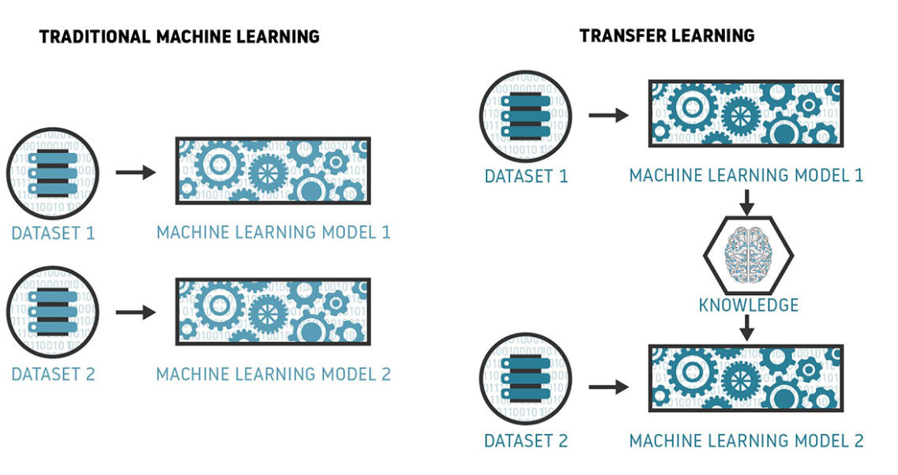
Transfer Learning
Why Transfer Learning
When tackling a completely new task, collecting a large amount of data is challenging
Instead of training a deep network from scratch for your task:
Pretraining + fine-tuning
Adapt it for your domain and your target task
Notes:
在NLP中近年非常火，有GPT（Generative Pre-training）, 但是在CV领域很早就有了应用，最早Yan LeCun 2012 提出的

Slide 5
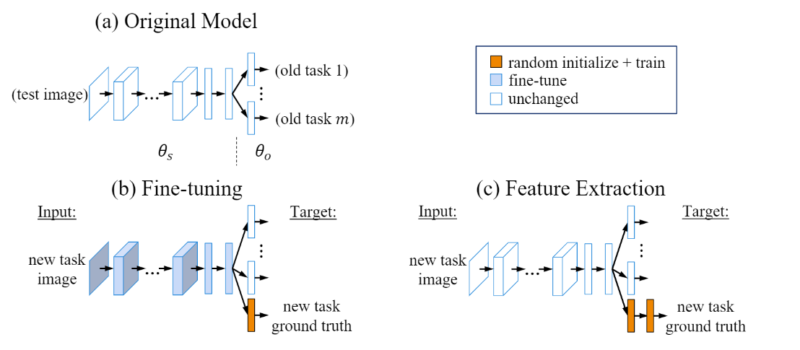
Transfer Learning
In action
Feature-based
Fine-tuning
Workflow:
Take layers from a pre-trained model
Freeze them to avoid altering any of the information they contain
Add some new, trainable layers on top of the frozen layers. They will learn to turn old features into predictions on a new dataset
Train the new layers on your dataset

Slide 6
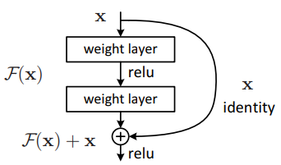
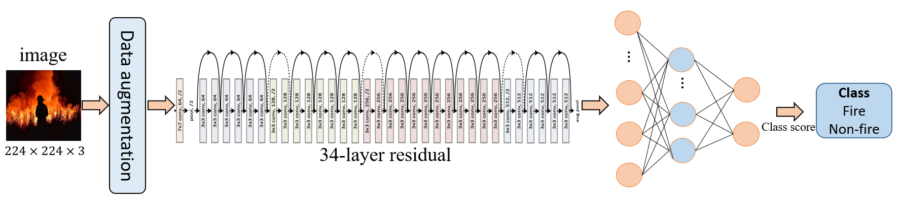
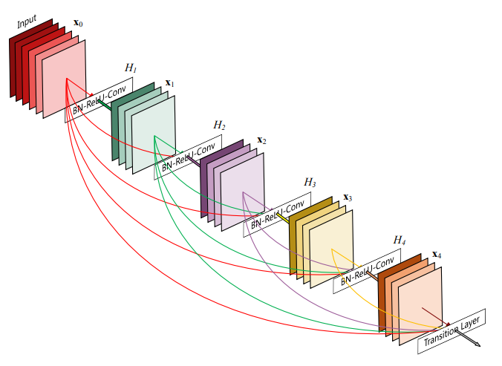
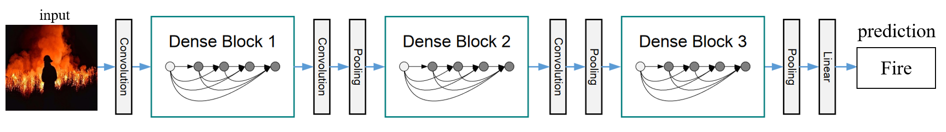
Based on ResNet & DenseNet
ResNet: solve the degradation problem via Short-cut Connection
DenseNet: connects each layer to every other layer in a feed-forward fashion
Our pipeline
He, Kaiming, et al. "Deep residual learning for image recognition." CVPR. 2016. Cited by 122132
Our pipeline
Huang, Gao, et al. "Convolutional networks with dense connectivity." CVPR. 2017. Cited by 25553
Notes:
我们多做了一步data augmentation
Dense net : they alleviate the vanishing-gradient problem, strengthen feature propagation, encourage feature reuse, and substantially reduce the number of parameters.

Slide 7
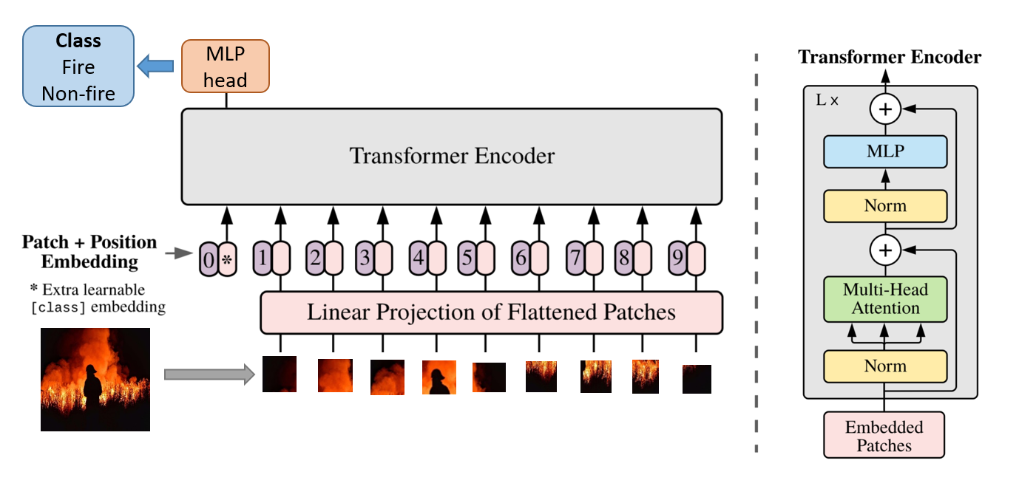
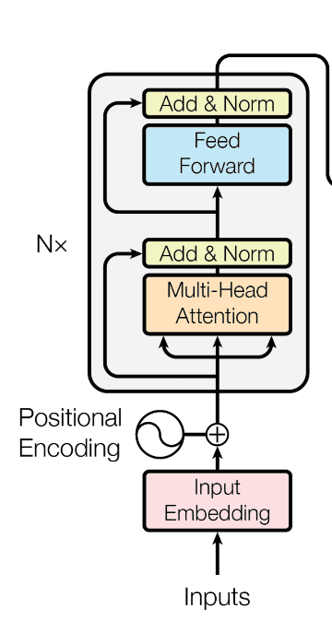
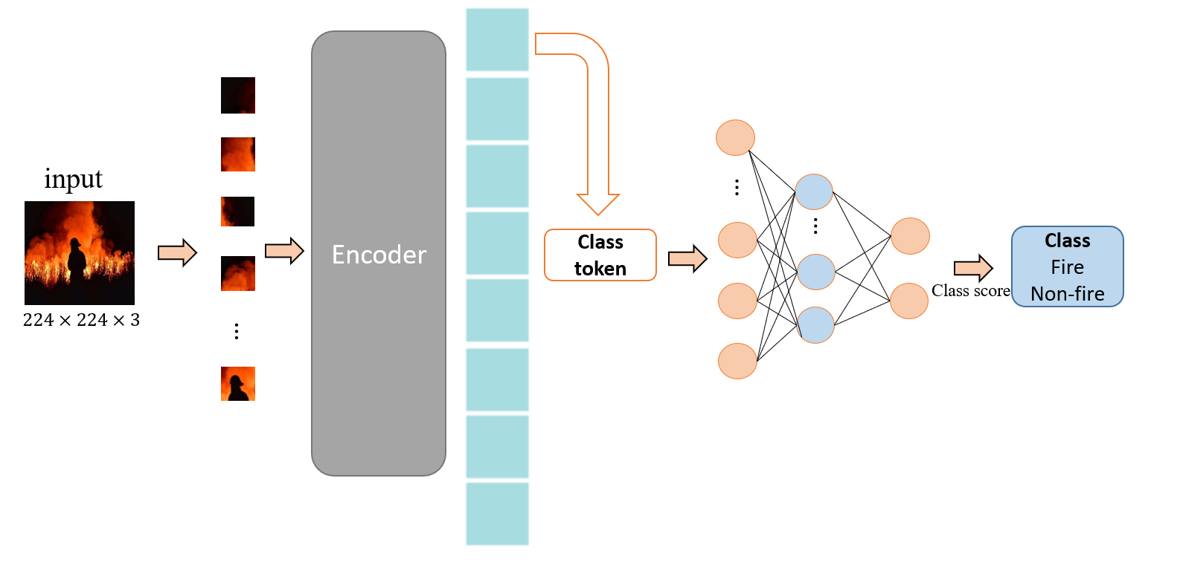
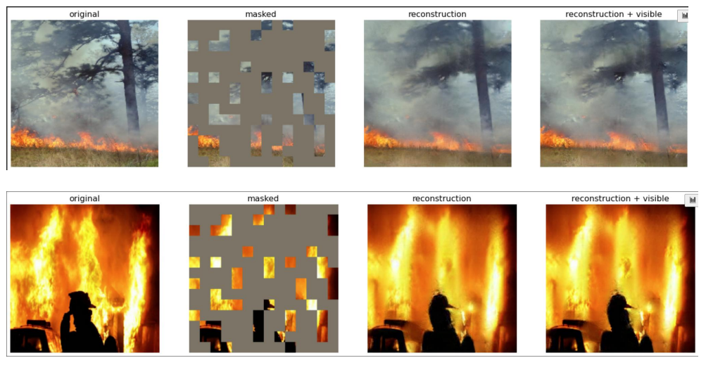

Based on ViT & MAE
Based on Vision Transformer
Based on MAE
Our pipeline
Standard transformer encoder
$$≠$$
Dosovitskiy, Alexey, et al. "An Image is Worth 16x16 Words: Transformers for Image Recognition at Scale." ICLR.2020
Our inference pipeline
Not fine-tune pipeline
He, Kaiming, et al. "Masked autoencoders are scalable vision learners." arXiv preprint arXiv:2111.06377 (2021).
Notes:
Vit是最近非常流行的网络，一开始就被挂到arxiv上，还没中的时候就引用了200多次，中了之后引用3000多了，和传统的transformer不同，这里把layer norm移到了前面，这个把最早的layer norm移到前面最早是GPT2 做的，只是一种recipe。最后输入到mlp head中的只是class token，为什么不是所有的patch embedding呢，实际上attention （multi-head那一部分）已经做了attention的聚合，是一个10*10的A矩阵，所以相当于已经对patch embedding的特征做了聚合。
注意，右边的是预测时候的网络，不是训练的网络, MAE效果不好可能是因为mis-match的一些原因，schedule sample的方式可以改善，而且可能是因为数据量domain的问题，编码器实际上就是ViT，将input image切分为不重叠的patches之后，执行linear projection，再加上positional embeddings (the sine-cosine version) ，然后送入transformer blocks

Slide 8
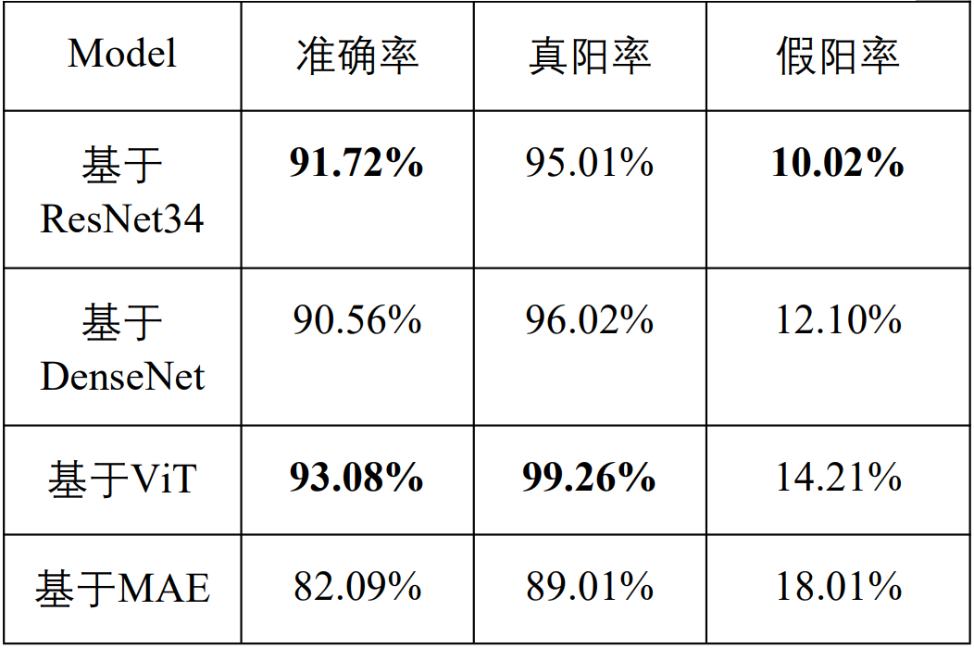
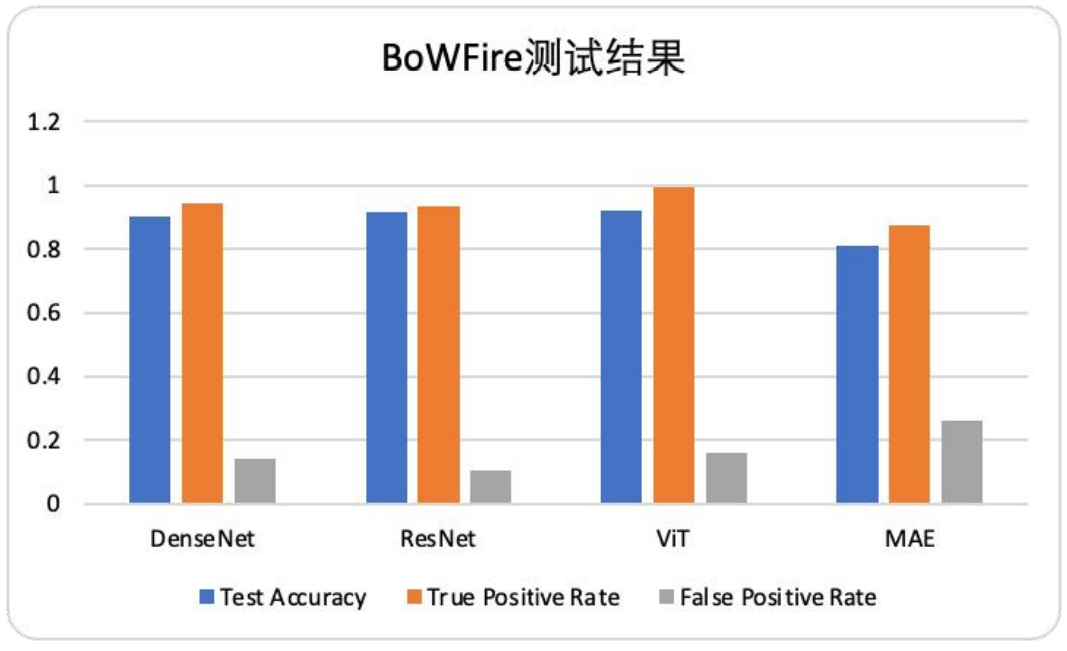
Experiment
Our small dataset: (collected from website)
845 positive
748 negative
Test dataset: BoWFire
https://cloud.tsinghua.edu.cn/d/d6f18f8f26d941cb9926/
Notes:
这里一些具体的训练细节就不展开了，确实recipe非常重要，包括data augmentation， 动态调整learning rate，多少个epoch比较合适，

Slide 9

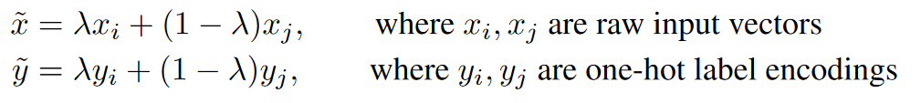
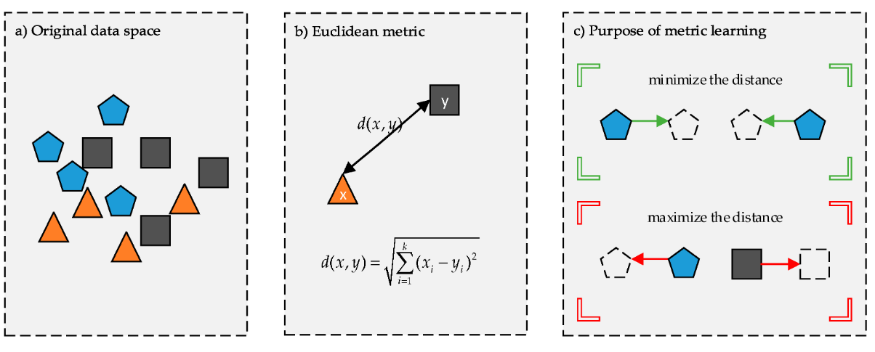
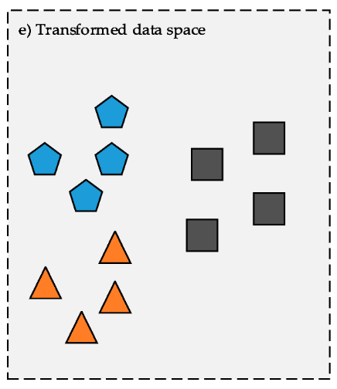
Discussion & Conclusion
Limitation
Sunset images (hard negative)
Different domain between train set and test set
Solutions
Traditional methods + Deep Learning
Mixup (intrinsically a method of data augmentation) (FAIR. ICLR.2018)
Metric Learning
Notes:
面向的问题不仅是fire detection的，很多task中存在的问题是相似的，比如现在说的对抗攻击样本，所以我们由于计算资源和时间原因，无法一一验证我们的猜想。传统方法（super pixel）+ 深度方法（因为火焰有明显的边缘信息，梯度算子优化）

Slide 10
Thanks for listening!

