Slide 1
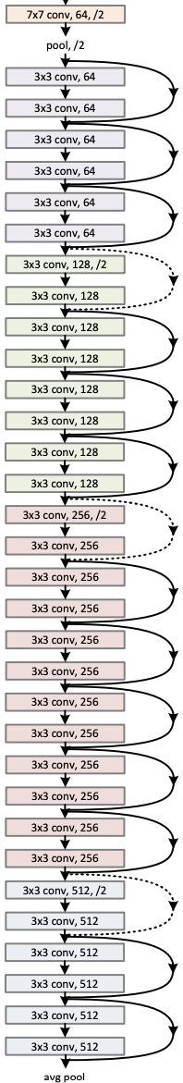
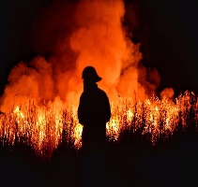

image
…
…
Class
Fire
Non-fire
Data augmentation
Class score
$$224×224×3$$
34-layer residual

Slide 2






Encoder
input
…
…
Class
Fire
Non-fire
Class
token
Class score
$$224×224×3$$
…

Slide 3
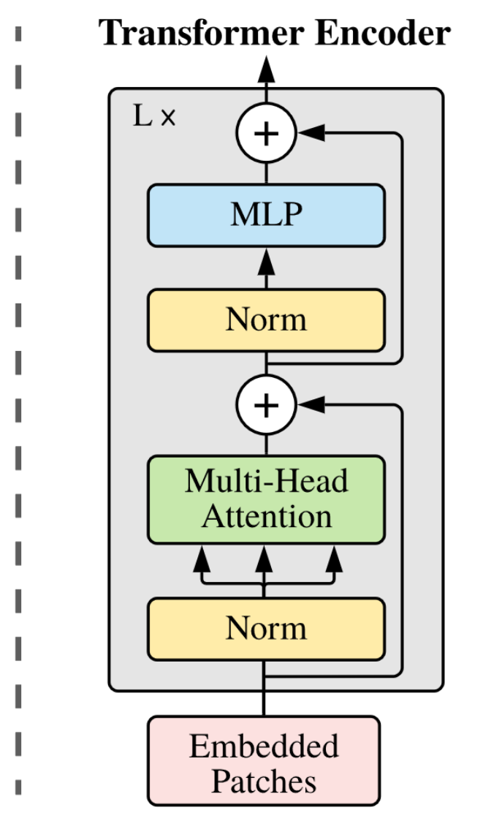
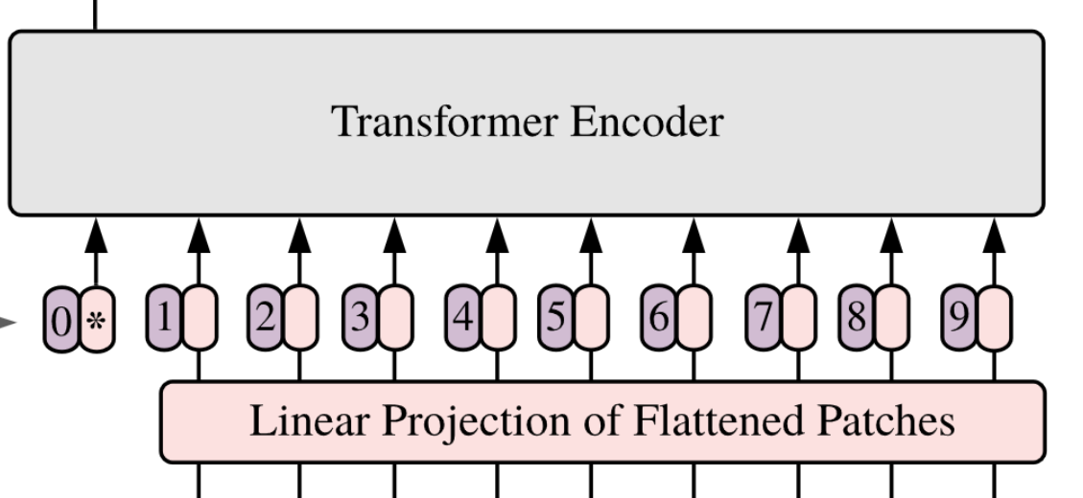
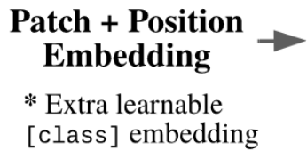



Class
Fire
Non-fire
MLP
head

Slide 4
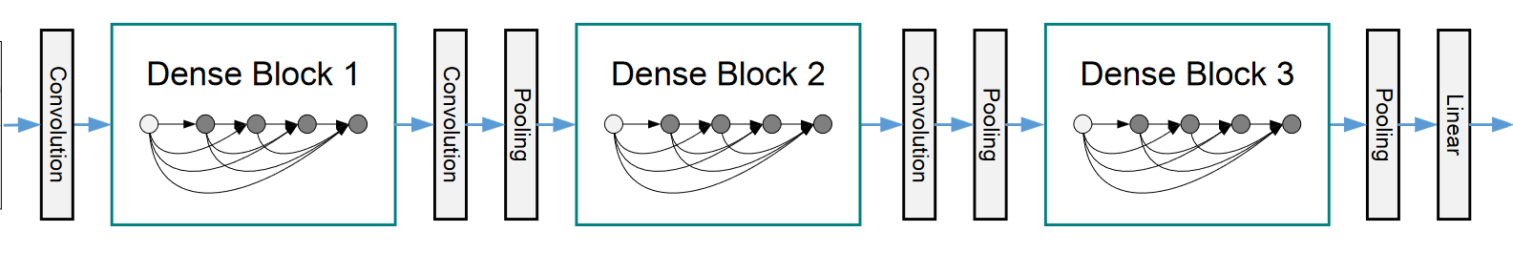
input
prediction
Fire

