Slide 1

Superfamilies of Evolved and Designed Networks
by Ron Milo, Shalev Itzkovitz, Nadav Kashtan, Reuven Levitt, Shai Shen-Orr, Inbal Ayzenshtat, Michal Sheffer, and Uri Alon
Science
Volume 303(5663):1538-1542
March 5, 2004
American Association for the Advancement of Science

Slide 2
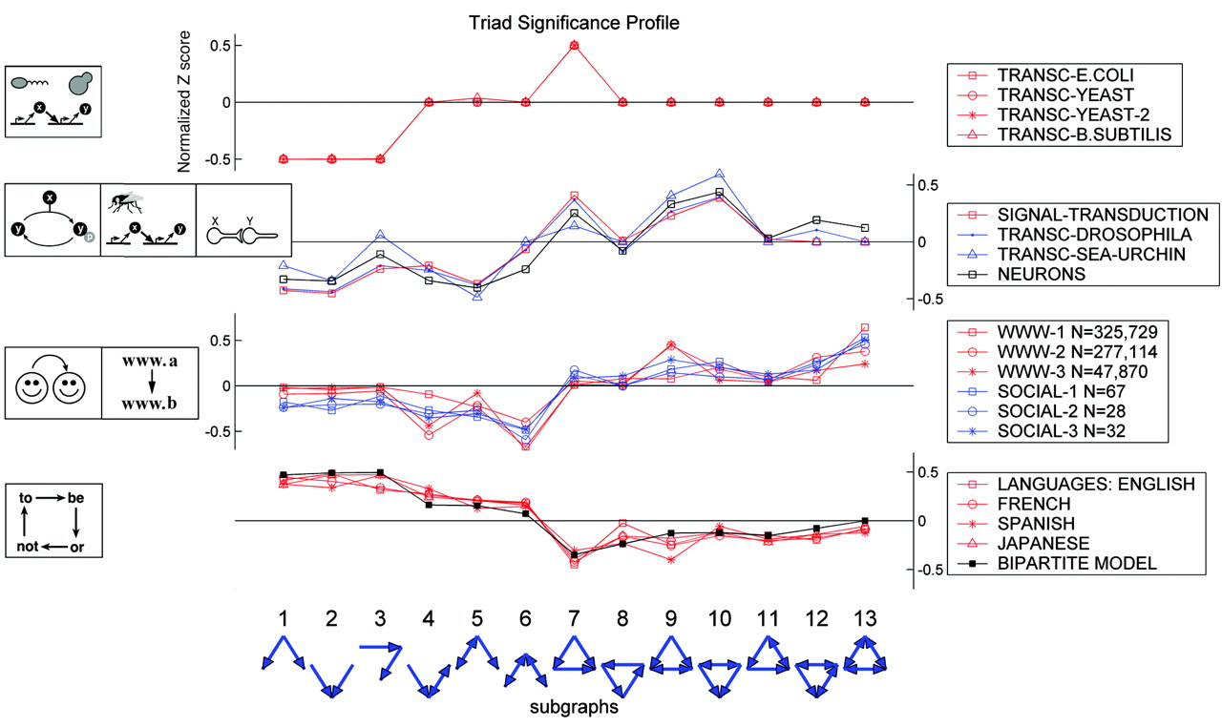
Fig. 1. The triad significance profile (TSP) of networks fromvarious disciplines.
Ron Milo et al. Science 2004;303:1538-1542
American Association for the Advancement of Science
Notes:
The triad significance profile (TSP) of networks fromvarious disciplines. The TSP shows the normalized significance level (Z score) for each of the 13 triads. Networks with similar characteristic profiles are grouped into superfamilies. The lines connecting the significance values serve as guides to the eye. The networks are as follows (where N and E are the number of nodes and edges, respectively) (12): (i) Direct transcription interactions in the bacteria E. coli (6) (TRANSC-E.COLI N = 424, E = 519) and B. subtilis (14) (TRANSC-B.SUBTILIS N = 516, E = 577) and in the yeast S. cerevisiae [TRANC-YEAST N = 685, E = 1052 (7) and TRANSC-YEAST-2 N = 2341, E=3969 (15)]. (ii) Signal-transduction interactions in mammalian cells based on the signal transduction knowledge environment (STKE, http://stke.sciencemag.org/) (SIGNAL-TRANSDUCTION N = 491, E = 989), transcription networks that guide development in fruit fly (from the GeNet literature database, www.csa.ru/Inst/gorb_dep/inbios/genet/genet.htm) (TRANSC-DROSOPHILA N = 110, E = 307), endomesoderm development in sea urchin (20) (TRANSC-SEAURCHIN N = 45, E = 83), and synaptic connections between neurons in C. elegans (NEURONS N = 280, E = 2170). (iii) WWW hyperlinks between Web pages in the www.nd.edu site (3) (WWW-1 N = 325729, E = 1469678), pages related to literary studies of Shakespeare (21) (WWW-2 N = 277114, E = 927400), and pages related to tango, specifically the music of Piazzolla (21) (WWW-3 N = 47870, E = 235441); and social networks, including inmates in prison (SOCIAL-1 N = 67, E = 182), sociology freshmen (22) (SOCIAL-2 N = 28, E = 110), and college students in a course about leadership (SOCIAL-3 N = 32, E = 96). (iv) Word-adjacency networks of a text in English (ENGLISH N = 7724, E = 46281), French (FRENCH N = 9424, E = 24295), Spanish (SPANISH N = 12642, E = 45129), and Japanese (JAPANESE N = 3177, E = 8300) and a bipartite model with two groups of nodes of sizes N₁ = 1000 and N₂ = 10 with probability of a directed or mutual edge between nodes of different groups being p = 0.06 and q = 0.003, respectively, and no edges between nodes within the same group (BIPARTITE N = 1010, E = 1261).

Slide 3
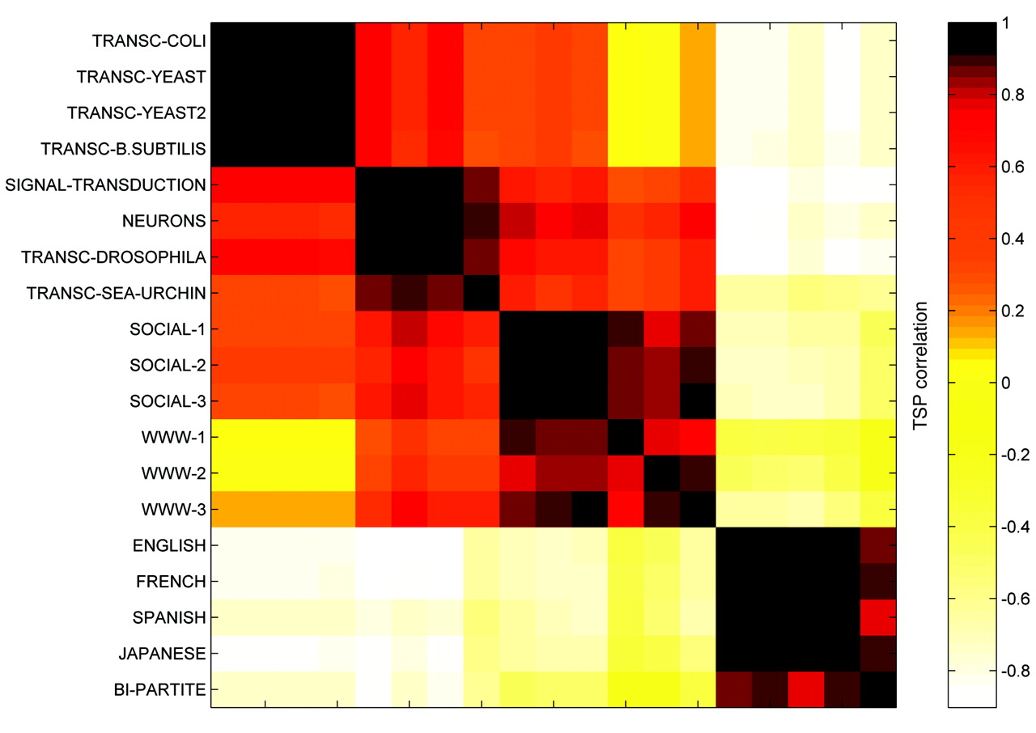
Fig. 2. The correlation coefficient matrix of the triad significance profiles for the directed networks in Fig. 1.
Ron Milo et al. Science 2004;303:1538-1542
American Association for the Advancement of Science
Notes:
The correlation coefficient matrix of the triad significance profiles for the directed networks in Fig. 1.

Slide 4
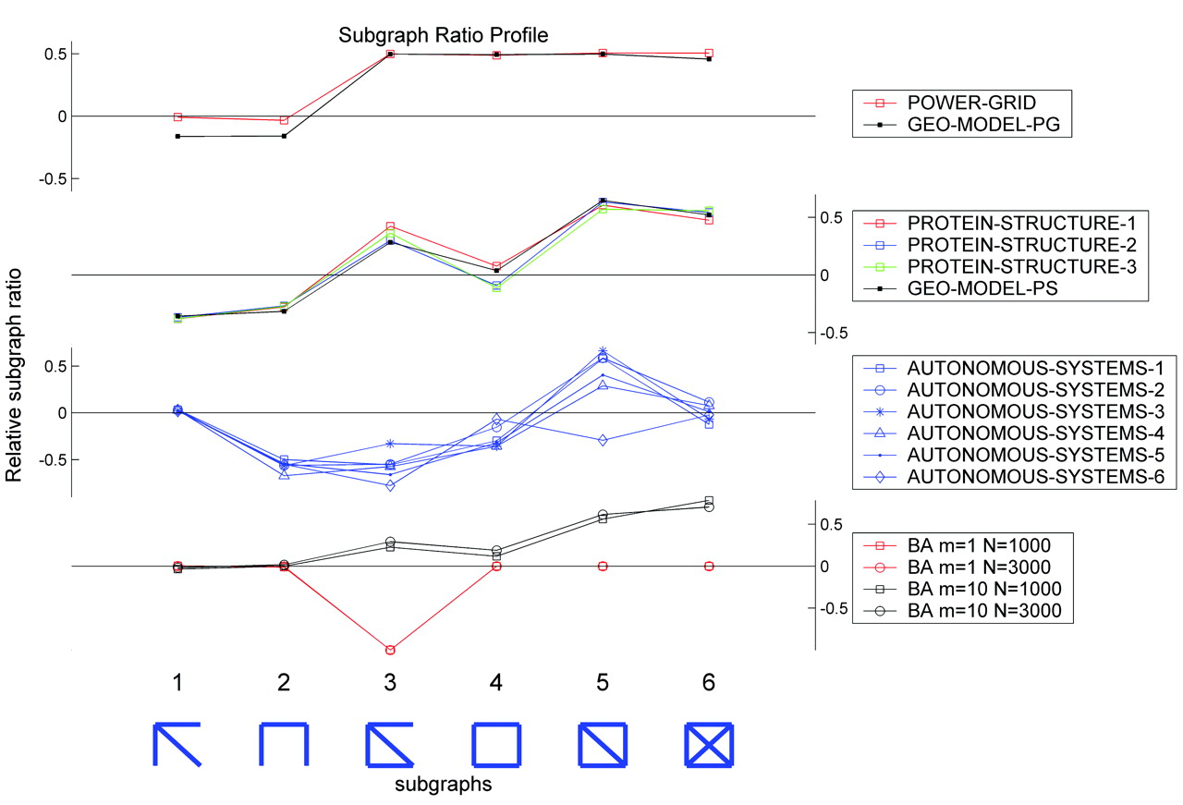
Fig. 3. The subgraph ratio profile (SRP) for various nondirected networks.
Ron Milo et al. Science 2004;303:1538-1542
American Association for the Advancement of Science
Notes:
The subgraph ratio profile (SRP) for various nondirected networks. The networks are as follows (12): (i) The electrical power grid of the western United States (4) (POWERGRID N = 4941, E = 6594) and a geometric model with similar clustering coefficient (GEO-MODEL-PG N = 5000, E = 7499). (ii) Networks of secondary-structure elements adjacency for several large proteins [structure based on the PDB database (www.rcsb.org/pdb/); the proteins (and their PDB ID) were 1A4J, an immunoglobulin (PROTEIN-STRUCTURE-1 N = 95, E = 213); 1EAW, a serine protease inhibitor (PROTEIN-STRUCTURE-2 N = 53, E = 123); and 1AOR, an oxidoreductase (PROTEIN-STRUCTURE-3 N = 99, E = 212)] and a geometric model with similar clustering coefficient (GEO-MODEL-PS N = 53, E = 136). (iii) The Internet at the autonomous system level (www.cosin.org) (AUTONOMOUS-SYSTEMS 1 to 6; N = 3015, 3522, 4517, 5357, 7956, 10515; E = 5156, 6324, 8376, 10328, 15943, 21455). (iv) Networks grown according to the preferential attachment BA model (3) with m = 1 or m = 10 edges per new node (BA m = 1, 10; N = 1000, 3000, 1000, 3000; E = 1000, 3000, 9901, 29901).

