Slide 1
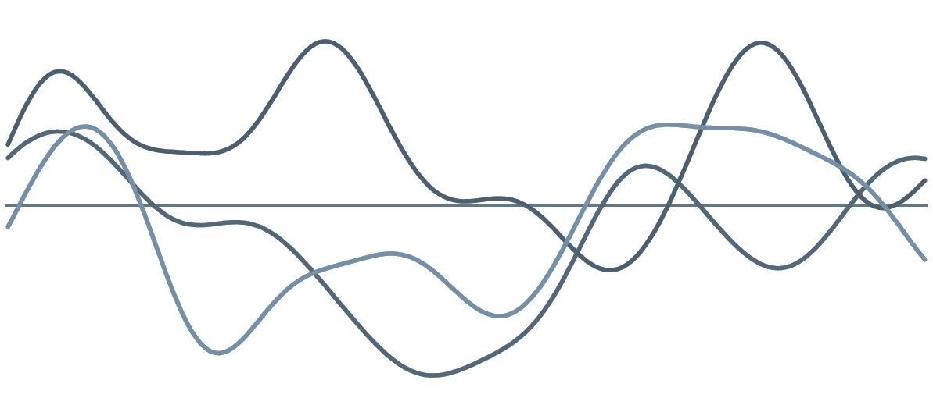
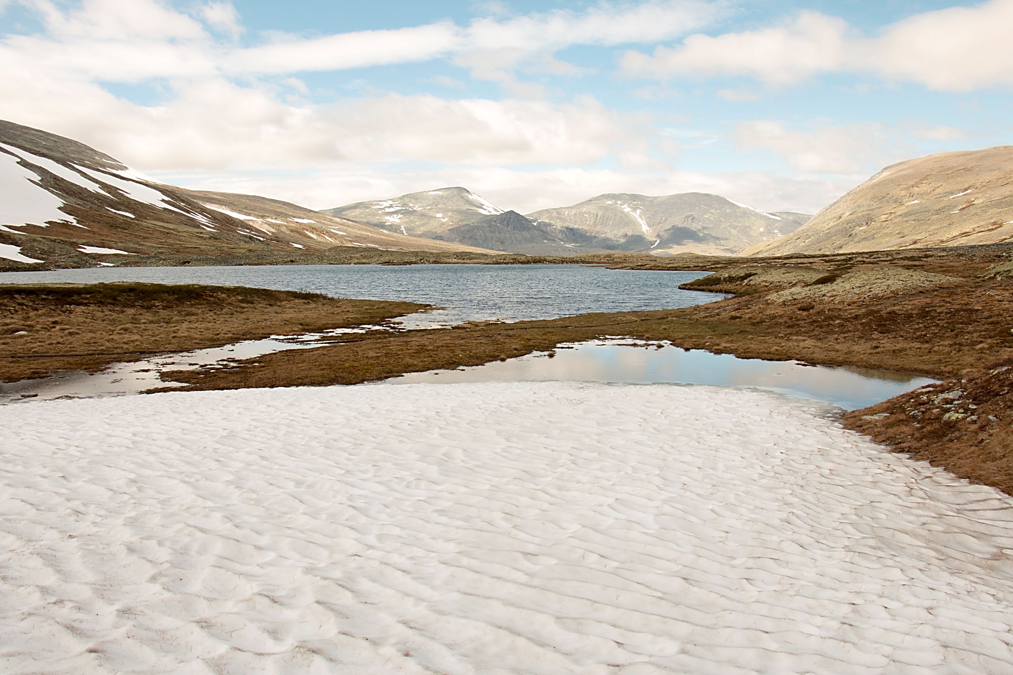
GEO4300 – Geophysical Data Science
Computer lab 0
Sigrid Bakke
Emiliano Gelati
Geologibygningen 319, 329b
s.j.bakke@geo.uio.no emiliano.gelati@geo.uio.no

Slide 2
- Who we are
- Have you used Python before?

Slide 3
Datalabs & Obligs
Data labs on Tuesdays 12:15-14:00
- IT-lab 209
Hands-on Geophysical Data Science
- That we use Python in Jupyter Notebook to solve
Submissions count
50% OF YOUR FINAL GRADE:
6 exercises (max 5p each)
+ 1 group project (max 15p)
= max 45p

Slide 4
Date | Time | Place | Topic | Due hand-in | Returned hand-in
Tue 30 Aug | 13:15–15:00 | GE IT-Lab 209 | 0 Introduction to Python and computational data analysis | - | -
Tue 6 Sep | 13:15–15:00 | GE IT-Lab 209 | 1 Probability distributions | 0 (not graded) | -
Tue 13 Sep | 13:15–15:00 | GE IT-Lab 209 | 2 Frequency analysis | 1 | -
Tue 20 Sep | 13:15–15:00 | GE IT-Lab 209 | 3 Confidence intervals | 2 | 1
Tue 27 Sep | 13:15–15:00 | GE IT-Lab 209 | 4 Hypothesis testing | 3 | 2
Tue 4 Oct | 13:15–15:00 | GE IT-Lab 209 | Group project help | 4 | 3
Tue 11 Oct | 13:15–15:00 | GE IT-Lab 209 | 5 Regression analysis | - | 4
Tue 18 Oct | 13:15–15:00 | GE IT-Lab 209 | Group project help | 5 | -
Tue 25 Oct | 13:15–15:00 | GE IT-Lab 209 | 6 Time series analysis | - | 5
Tue 1 Nov | 13:15–15:00 | GE IT-Lab 209 | Group project help | 6 | -
Tue 8 Nov | 13:15–15:00 | GE IT-Lab 209 | Questions and answers (if needed) | Group project | 6
Group projects will be graded by Tuesday 22 November

Slide 5
Submissions
You have until next datalab to solve each exercise.
Your solution to each exercise and project must be submitted as .ipynb and .html file in Canvas before the deadline.
Your .ipynb must be possible for me to run
  Make sure Kernel – Restart & Run All works
  If you use new input files, include them in your submission (make a zip)

Slide 6
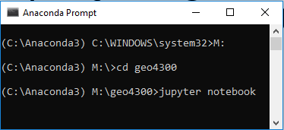
Let’s get started
Make a folder (e.g. in M-disc on a computer room machine) called «geo4300» or similar
Make Firefox or Chrome the default browser
(because Internet Explorer and Edge give some problems)
Open jupyter notebook
  Start Anaconda Prompt
  (Type «M:» and press Enter)
  Type «cd » followed by the path to your geo4300 folder and press Enter
  Type «jupyter notebook» and press Enter, it will open in your browser
We will first make a new notebook file to see what it looks like
- Press ”New” (top right) and then ”Python 3”
Get exercise
  Download exercise from Canvas to your geo4300 folder
  Right click on zipfile and press «Extract All…»
  Open it from the jupyter notebook interface
Link to getting jupyter notebook on your own computer

Slide 7
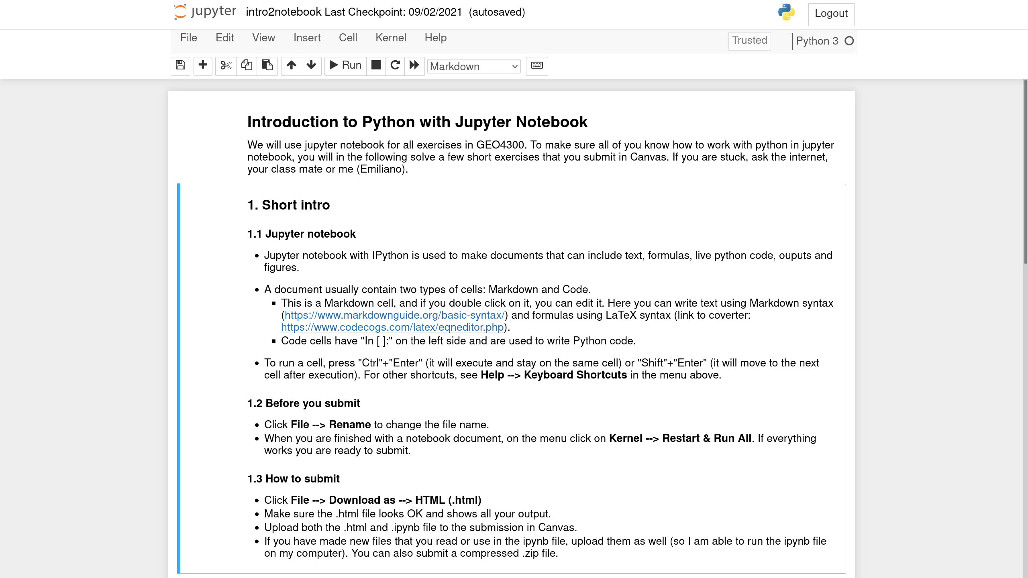
How to submit an exercise:

Slide 8
Submit tips
Procedure and understanding more important than correct numerical result (e.g. if you are not able to completely answer the question, explain what you did and/or what you could not do).
Figures should be understandable and have title, x and y labels, units, and legend if more than one plot.
Write an understandable code (meaningful variable names) and write formulas if needed.
Make sure your code runs again when re-opening the notebook from scratch.
When providing an answer, refer explicitly to the question number.

