Slide 1
Roadmap
Background: Decoupled Spatial Architectures
Decoupled-Spatial Architecture Programming
Compiling High-Level- Lang. to DSA
Advanced DSA Programming
Composing a Spatial Architecture
The Scala Embedded DSL

Slide 2
Hardware Stack: Composing Spatial Architecture
Overview of DSAGEN H/W Stack (3 mins)
Goal: Build Your Own Spatial Architecture (25 mins)
A Scala Embedded DSL – Build A Simple CGRA (10 mins)
Generate IR/RTL (3 mins)💻
Power/Area Estimation (2 mins)💻
Build your own CGRA (10 mins)💻
Advanced Hardware Features (5 mins)
A End-to-End Approach (5 mins)
Q & A

Slide 3
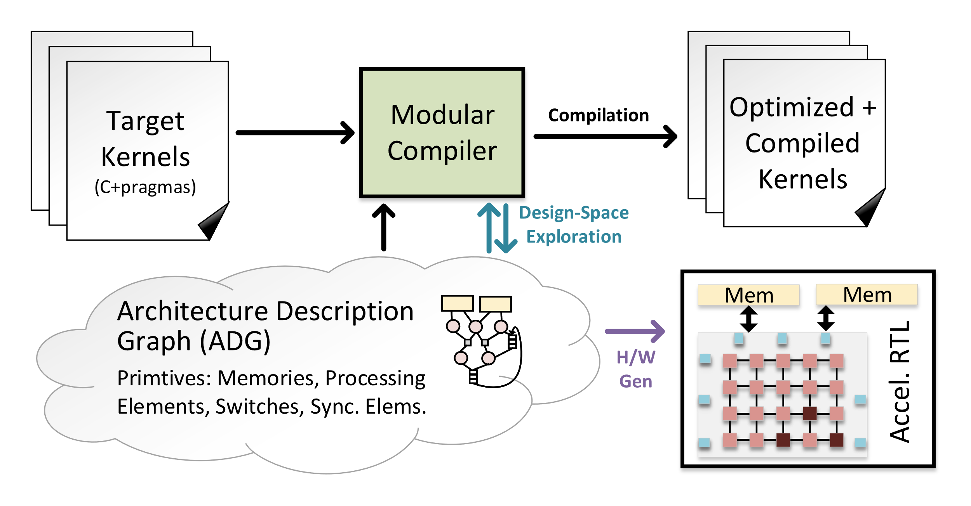
DSAGEN Hardware Stack
Define your own architecture.
Generate the IR for compiler
Generate the RTL for hardware research
Design-Space Exploration
ChipYard Integration
Run Stream-Dataflow Program Binary on DSAGEN
Integrate with other IPs
1
2
4
3
2
1
3
4*
*Design-Space Exploration will not be covered today

Slide 4
Hardware Stack: Composing Spatial Architecture
Overview of DSAGEN H/W Stack (3 mins)
Goal: Build Your Own Spatial Architecture (25 mins)
A Scala Embedded DSL – Build A Simple CGRA (10 mins)
Generate IR/RTL (3 mins)💻
Power/Area Estimation (2 mins)💻
Build your own CGRA (10 mins)💻
Advanced Hardware Features (5 mins)
A End-to-End Approach (5 mins)
Q & A

Slide 5
A Scala Embedded DSL – Build A Simple CGRA
RISCV CPU
Our Spatial Architecture:
CGRA
Processing Element
Switch
Vector Port
Memory System
RISC-V CPU (Rocket Core)
Memory
Mem. Controller
a[0:n]
b[0:n]
Recurrence
＋
c[0:n]

Slide 6
A Scala Embedded DSL – Build A Simple CGRA

Slide 7
A Scala Embedded DSL – Build A Simple CGRA
val vport_i1 = new ssnode("vector port")
val vport_i2 = new ssnode("vector port")
val vport_o1 = new ssnode("vector port")
vport_i1
vport_i2
sw1
sw2
val sw1 = new ssnode("switch")
val sw2 = new ssnode("switch")
val sw3 = new ssnode("switch")
val sw4 = new ssnode("switch")
pe
sw3
sw4
vport_o1
val pe = new ssnode("processing element")
pe("instructions", Seq("Add", "Mul"))

Slide 8
A Scala Embedded DSL – Build A Simple CGRA
// define the CGRA fabric val my_cgra = new ssfabric my_cgra("default_data_width", 64)
vport_i1
vport_i2
// define connection my_cgra( vport_i1 --> sw1)( vport_i2 --> sw2)( sw3 --> vport_o1)( sw1 <-> sw2)( sw1 <-> sw3)( sw2 <-> sw4)( sw3 <-> sw4)( sw1 --> pe)( sw2 --> pe)( sw3 --> pe)( sw4 <-> pe )
// define connection my_cgra( vport_i1 --> sw1)( vport_i2 --> sw2)( sw3 --> vport_o1)( sw1 <-> sw2)( sw1 <-> sw3)( sw2 <-> sw4)( sw3 <-> sw4)( sw1 --> pe)( sw2 --> pe)( sw3 --> pe)( sw4 <-> pe )
// define connection my_cgra( vport_i1 --> sw1)( vport_i2 --> sw2)( sw3 --> vport_o1)( sw1 <-> sw2)( sw1 <-> sw3)( sw2 <-> sw4)( sw3 <-> sw4)( sw1 --> pe)( sw2 --> pe)( sw3 --> pe)( sw4 <-> pe )
// define connection my_cgra( vport_i1 --> sw1)( vport_i2 --> sw2)( sw3 --> vport_o1)( sw1 <-> sw2)( sw1 <-> sw3)( sw2 <-> sw4)( sw3 <-> sw4)( sw1 --> pe)( sw2 --> pe)( sw3 --> pe)( sw4 <-> pe )
sw1
sw2
pe
sw3
sw4
vport_o1

Slide 9
A Scala Embedded DSL – Build A Simple CGRA
// dsa-cgra-gen/src/main/real/micro_demo
package real import dsl._ object micro_demo extends App{ // define vector port val vport_i1 = new ssnode("vector port") val vport_i2 = new ssnode("vector port") val vport_o1 = new ssnode("vector port") // define switch val sw1 = new ssnode("switch") val sw2 = new ssnode("switch") val sw3 = new ssnode("switch") val sw4 = new ssnode("switch") // define processing element that can do Add and Mul val pe = new ssnode("processing element") pe("instructions", Seq("Add", "Mul")) // define the CGRA fabric val my_cgra = new ssfabric my_gra("default_data_width", 64) // define connection my_cgra( vport_i1 --> sw1)(vport_i2 --> sw2)( sw3 --> vport_o1)( sw1 <-> sw2)(sw1 <-> sw3)(sw2 <-> sw4)(sw3 <-> sw4)( sw1 --> pe)(sw2 --> pe)(sw3 --> pe)(sw4 <-> pe ) }
vport_i1
vport_i2
sw1
sw2
pe
sw3
sw4
vport_o1

Slide 10
Hardware Stack: Composing Spatial Architecture
Overview of DSAGEN H/W Stack (3 mins)
Goal: Build Your Own Spatial Architecture (25 mins)
A Scala Embedded DSL – Build A Simple CGRA (10 mins)
Generate IR/RTL (3 mins)💻
Power/Area Estimation (2 mins)💻
Build your own CGRA (10 mins)💻
Advanced Hardware Features (5 mins)
A End-to-End Approach (5 mins)
Q & A

Slide 11
Before we start...
Tool(s) I will use: ss_sched (in dsa-release.zip)
Repositories: dsa-framework/dsa-cgra-gen, dsa-examples
dsa-framework/dsa-cgra-gen
$ cd <you workspace>
$ git clone https://github.com/PolyArch/dsa-framework.git
$ cd dsa-framework
$ git submodule update --init dsa-cgra-gen
dsa-examples
$ cd <you workspace>
$ git clone https://github.com/PolyArch/dsa-examples.git
Optional Tools:
Graphviz:
$ sudo apt-get install graphviz

Slide 12
Generate IR/RTL 💻
1. Add printIR to the end of CGRA description file
2. Generate IR through sbt
// dsa-cgra-gen/src/main/real/micro_demo
package real import dsl._ object micro_demo extends App{ // define vector port ………… // define switch ………… // define processing element that can do Add and Mul ………… // define the CGRA fabric ………… // define connection …………
// print IR my_cgra.printIR(filename = "my_cgra") }
$ cd dsa-framework/dsa-cgra-gen
$ sbt
$ sbt:dsa-cgra-gen> runMain real.micro_demo
3. Check the generated IR
// dsa-cgra-gen/my_cgra.json
{ "default_data_width" : 64, "identifier" : [ "id", "nodeType" ],
.........
"module_type" :"cgra.fabric.cgra_fabric" }
4. Generate RTL (Verilog)
$ cd dsa-framework/dsa-cgra-gen && sbt
$ sbt:dsa-cgra-gen>
cgra.driver.generator my_cgra.json

Slide 13
Hardware Stack: Composing Spatial Architecture
Overview of DSAGEN H/W Stack (3 mins)
Goal: Build Your Own Spatial Architecture (25 mins)
A Scala Embedded DSL – Build A Simple CGRA (10 mins)
Generate IR/RTL (3 mins)💻
Power/Area Estimation (2 mins)💻
Build your own CGRA (10 mins)💻
Advanced Hardware Features (5 mins)
A End-to-End Approach (5 mins)
Q & A

Slide 14
Power/Ares Estimation💻
1. Power and Area Estimation is done via spatial scheduler
$ cp dsa-framework/dsa-cgra-gen/my_cgra.json
dsa-examples/hw
$ cd dsa-examples/hw
$ ss_sched my_cgra.json
2. Power/Area Estimation Results via Spatial-Scheduler
--------- Sample Results like below ---------
FU: 422075um2 447.399mw
Network: 91593um2 22.8983mw
Sync: 139971um2 96.2mw
Memory: 39325um2 12.14mw
--------- What’s your result ? ---------

Slide 15
Hardware Stack: Composing Spatial Architecture
Overview of DSAGEN H/W Stack (3 mins)
Goal: Build Your Own Spatial Architecture (25 mins)
A Scala Embedded DSL – Build A Simple CGRA (10 mins)
Generate IR/RTL (3 mins)💻
Power/Area Estimation (2 mins)💻
Build your own CGRA (10 mins)💻
Advanced Hardware Features (5 mins)
A End-to-End Approach (5 mins)
Q & A (2 mins)

Slide 16
Build Your Own CGRA 💻
Can you build a CGRA like this?
Answer:
// dsa-cgra-gen/src/main/scala/real/micro_demo_answer
package real import dsl._ object micro_demo_sihao extends App{ .......
// put your code here
// Add a new vector port val vport_i3 = new ssnode("vector port") // Add a new switch val new_sw = new ssnode(“switch") // Add a new processing element val pe_div = new ssnode("processing element") pe_div("instructions", Seq(“UDiv")) // Add connections to fabric my_cgra(vport_i3 --> new_sw)( sw1 --> pe_div)( new_sw --> pe_div)( pe_div --> sw3)
// print IR my_cgra.printIR(filename = "my_cgra_div") }
vport_i3
vport_i1
vport_i2
sw5
sw1
sw2
Div
Add/
Mul
sw3
sw4
vport_o1

Slide 17
Visualize Your Own CGRA 💻
Perform spatial schedule
$ cd <your workspace>/dsa-examples/hw
$ ss_sched my_cgra_div.json add-div.dfg
Visualize the schedule result (graphviz required)
$ cd <your workspace>/dsa-examples/hw/viz
$ neato -Goverlap=false -Gstart=self -Gepsilon=.0000001 -Tpng -o \
add-div_my-cgra.png ./add-div.my_cgra_div.gv

Slide 18
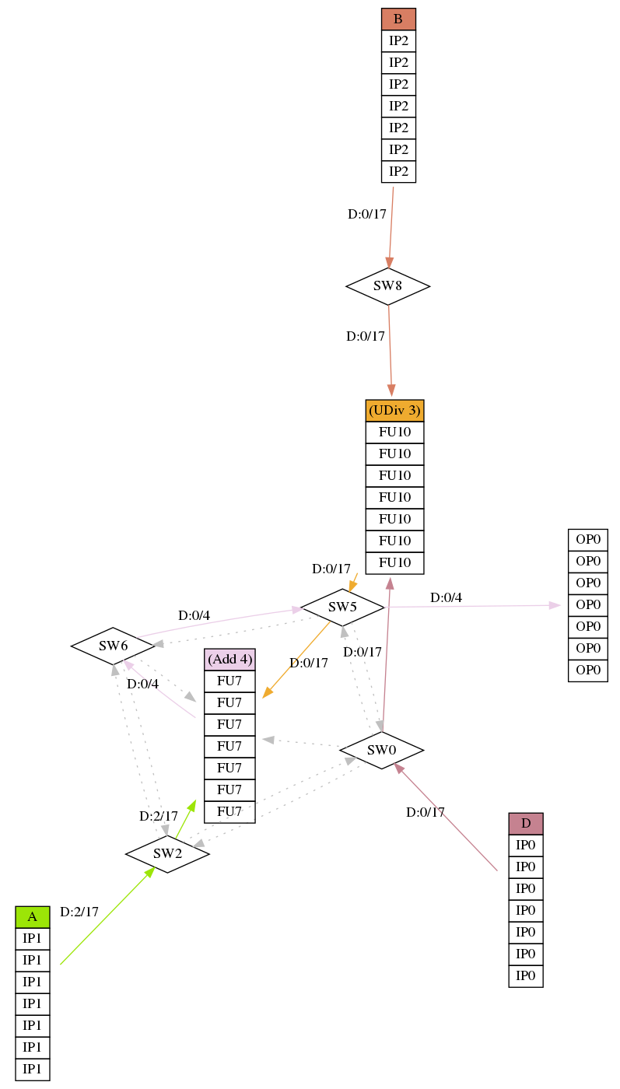
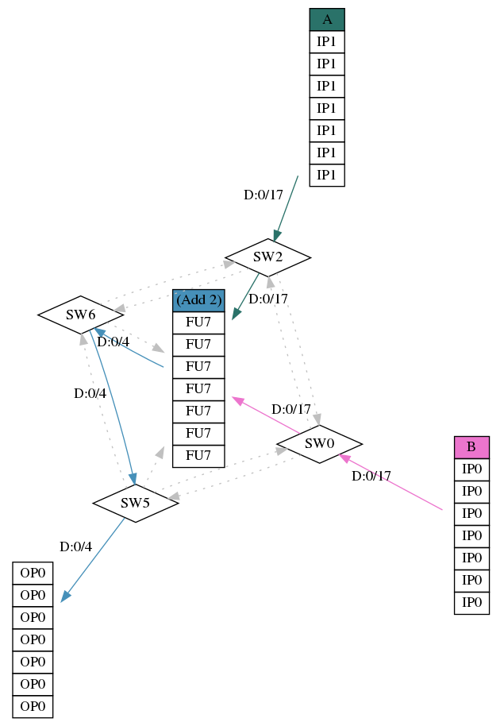
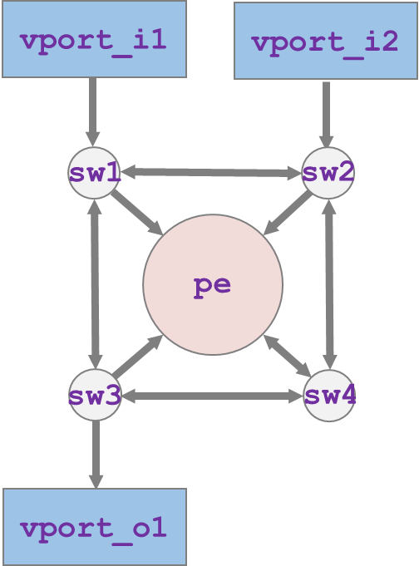
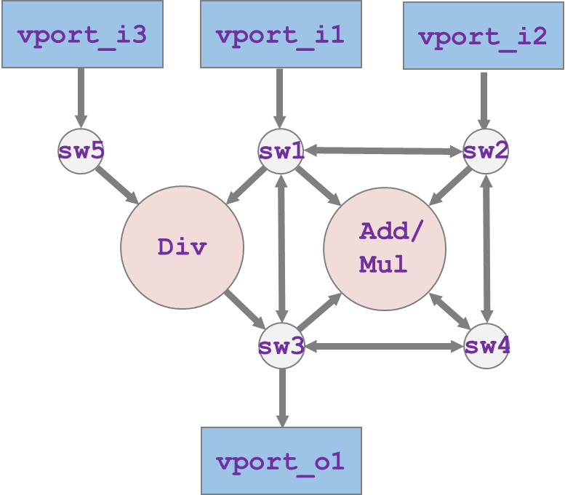
Visualize Your Own CGRA 💻

Slide 19
Hardware Stack: Composing Spatial Architecture
Overview of DSAGEN H/W Stack (3 mins)
Goal: Build Your Own Spatial Architecture (25 mins)
A Scala Embedded DSL – Build A Simple CGRA (10 mins)
Generate IR/RTL (3 mins)💻
Power/Area Estimation (2 mins)💻
Build your own CGRA (10 mins)💻
Advanced Hardware Features (5 mins)
A End-to-End Approach (5 mins)
Q & A (2 mins)

Slide 20
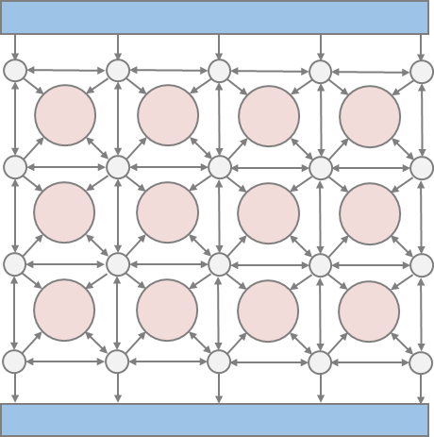
Basic Concept: Switch
Simplest Switch
Config.
// Define Switch val my_sw = new ssnode("switch")
MUX
Simplest Switch
4 Input Ports
3 Output Ports
1 9-bit Config. Register
For each output, we need 3 bit to specify 5 inputs (Input 1~4 + Ground) x 3 Outputs = 9-bit config
Decode config. information
MUX
MUX
A 4-Input 3-Output Switch

Slide 21
Basic Concept: Processing Element
// Define Your Processing Elements with Add / Sub / Mul val my_fu = new ssnode(“processing elements") my_fu( "instructions",Seq("Add", "Sub", "Mul"))( "data_width", 64)
MUX
MUX
Instruction Buffer
Function
Unit
Register
File
The number of operand is decided by ALU, which will affect the width of config. file
Hardware should be reused if some operations are subset of a bigger operation (like ADD16x4 and ADD64)
Instruction Scheduler

Slide 22
Basic Concept: Decomposability
invalid
invalid
valid
invalid
valid
invalid
invalid
invalid
invalid
16
16
invalid
Example DFG
invalid
16
invalid
invalid
16
16
valid
invalid
16
16
16
16
16
valid
16
PE
Mul 16
16
B
D
16
16
A
C
16
PE
Mul 16
16
16
16
16
16
Hardware Support
Mul16
Mul16
16
red means data is valid
16
16
16
16
16
Cat16
16
16
32
16
16
here:
we keep data at its original place
here:
we shift data by 16-bit
16
16
16
16
PE
Cat 16
16
16
16
16
16
32
16
32

Slide 23
Advanced Features: Decomposability in Switch
Define Decomposable Switch
// Define Decomposable Switch val my_switch = new ssnode("switch") my_switch( "data_width", 64)( "granularity",16)( "subnet_offset", Seq(0, 1, 2))
Config.
MUX
Sub-net Shifter Offset
MUX
0x1234__5678__9abc__de01
0x1234__5678__9abc__de01
subnet_offset = 1
subnet_offset = 2
0x5678__9abc__de01__1234
0x9abc__de01__1234__5678
In order to achieve decomposability, we add one subnet shifters for each output
The default offset is zero for each output
MUX
A 4-Input 3-Output Switch

Slide 24
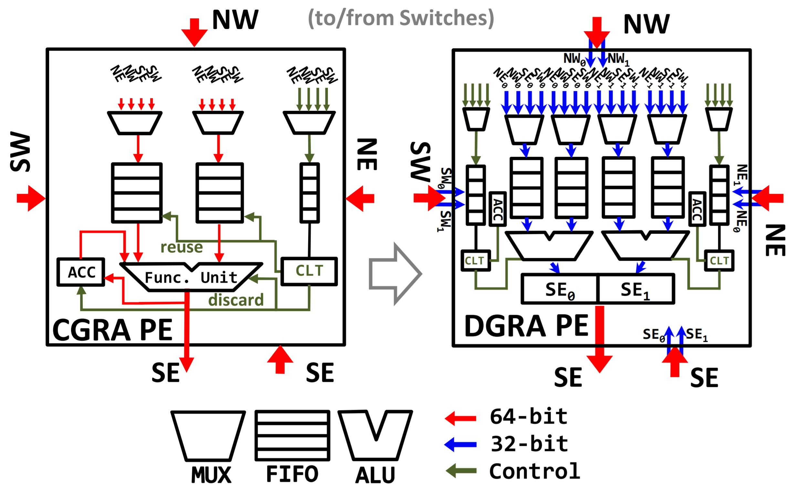
Advanced Features: Decomposability in PE
// Define Your own Data-dependent Controlled // Processing Elements with GE / LE and Add val my_fu = new ssnode(“processing element") my_fu( "instructions",Seq(“Add"))( "data_width", 64)(
// Here we decompose the processing elements "granularity", 32)
"granularity", 64
"granularity", 32
All you need to do is just changing the granularity from 64 to 32.

Slide 25
Advanced Features: Dynamic Flow Control
Define Decomposable Dynamic Switch
Conf.
Valid/Ready
// Define Decomposable Dynamic Switch val my_switch = new ssnode("switch") my_switch( "data_width", 64)( "granularity",16)( "flow_control", true )
Valid/Ready
MUX
Valid/Ready
Valid/Ready
MUX
Valid/Ready
In order to build dynamic switch, we need to add a Queue for every output.
For every IO port, two more wires (Valid/Ready) are added to implement backpressure.
Valid/Ready
Valid/Ready
MUX
A 4In-3Out Decomposable Dynamic Switch
Notes:
A better transition
The overview of the properties of the modules.
I need to convey the hardware feature -> software mapping. Different hardware feature has different cost, and hw and sw feature cost wil result into different overall performance
Tell the people the why to have the different modules, we don’t force each processing elements to have all features. Flow control:
1. we talk about the feature Vidushi talked about the backpressure, and what is the cost add the feature to different processing element and switch and make the switch to do that work

Slide 26
Advanced Features: Data-Controlled
NW
SW
NE
SE
NW
SW
NW
SW
NE
SE
NE
SE
Data-Flow
// Define Your own Data-dependent Controlled // Processing Elements with GE / LE and Add val my_fu = new ssnode(“processing elements") my_fu( "instructions",Seq("SelfCtrlGE", "SelfCtrlLE", "InputCtrlMin"))( "data_width", 64)
Flow-Ctrl
Stream-Join
FIFO₀
FIFO₁
FIFO₂
reuse
ACC
Func. Unit
CLT
reset
discard
A data-dependent controlled processing element is created based on its `instructions` field
Self-Control (`SelfCtrl`) instructions will use its own computed result to access CLT
Input-Control (`InputCtrl`) instruction will use the input from upstream to access CLT
SE
Data-dependent Control
Processing Element

Slide 27
Advanced Features: Mesh Topology
// Keys that differ nodes identifier("row_idx","col_idx")
PE
PE
PE
PE
PE
PE
PE
PE
PE
PE
// Building a 5 x 5 processing elements array val peArray = Array( Array(pe_spc, pe_add, pe_add, pe_add, pe_spc), Array(pe_spc, pe_add, pe_add, pe_add, pe_spc), Array(pe_add, pe_add, pe_add, another_pe, pe_add), Array(pe_add, pe_add, another_ pe, pe_add, pe_spc),
Array(pe_add, pe_add, pe_add, another_pe, pe_add), )
PE
PE
PE
PE
PE
PE
PE
PE
PE
PE
PE
PE
PE
PE
PE
ID is by default to identify a node, but you can add more identifier.
Like for mesh topology, natural identifiers will be the `column index` and `row index`.

Slide 28
Advanced Features: Hardware/Software Tradeoff
Compare the Hardware Tradeoff of different delay FIFO depth
-> % ss_sched my_cgra_delay_depth_4.json
-> % ss_sched my_cgra_delay_depth_16.json
// Input FIFO (depth = 4)
.........
FU: 4990.85um2 5.23123mw
Network: 1891.03um2 0.472758mw
Sync: 5238um2 3.6mw
Memory: 39325um2 12.14mw
// Input FIFO (depth = 16)
.........
FU: 4990.85um2 5.23123mw
Network: 1891.03um2 0.472758mw
Sync: 8730um2 6mw
Memory: 39325um2 12.14mw

Slide 29
Hardware Stack: Composing Spatial Architecture
Overview of DSAGEN H/W Stack (3 mins)
Goal: Build Your Own Spatial Architecture (25 mins)
A Scala Embedded DSL – Build A Simple CGRA (10 mins)
Generate IR/RTL (3 mins)💻
Power/Area Estimation (2 mins)💻
Build your own CGRA (10 mins)💻
Advanced Hardware Features (5 mins)
A End-to-End Approach (5 mins)
Q & A (2 mins)

Slide 30
A End-to-End Approach💻
Add DSAGEN Hardware Generator (dsa-cgra-gen) into ChipYard
class SSCgraConfig extends Config( new chipyard.iobinders.WithUARTAdapter ++ new chipyard.iobinders.WithTieOffInterrupts ++ new chipyard.iobinders.WithBlackBoxSimMem ++ new chipyard.iobinders.WithTiedOffDebug ++ new chipyard.iobinders.WithSimSerial ++ new testchipip.WithTSI ++ new chipyard.config.WithBootROM ++ new chipyard.config.WithUART ++ new chipyard.config.WithL2TLBs(1024) ++ new freechips.rocketchip.subsystem.WithNoMMIOPort ++ new freechips.rocketchip.subsystem.WithNoSlavePort ++ new freechips.rocketchip.subsystem.WithInclusiveCache ++ new ss_cgra_gen.WithSsCgra ++ // mixed with Stream-Dataflow CGRA
new freechips.rocketchip.subsystem.WithNExtTopInterrupts(0) ++ new freechips.rocketchip.subsystem.WithNBigCores(1) ++ new freechips.rocketchip.subsystem.WithCoherentBusTopology ++ new freechips.rocketchip.system.BaseConfig )
Notice: ss-chipyard (we have not released it in dsa-framework yet) has been integrated with dsa-cgra-gen

Slide 31
A End-to-End Approach💻
Generate the binary from C program with Stream-Dataflow Instruction
$ riscv64-unknown-elf-gcc -fno-common -fno-builtin-printf -specs=htif_nano.specs -o vec_add-ss.dsa-gnu.o -c vec_add-ss.cc
Link kernel via chipyard riscv-toolchain
$ riscv64-unknown-elf-gcc -static -specs=htif_nano.specs vec_add-ss.dsa-gnu.o -o vec_add-ss.cy-gnu.riscv
Run binary program on hardware simulator (verilator)
$ make run-binary-debug SUB_PROJECT=ss_cgra_gen BINARY=<dir to binary>/vec_add-ss.cy-gnu.riscv
Notice: ss-chipyard (we have not released it in dsa-framework yet) has been integrated with dsa-cgra-gen

Slide 32
Hardware Stack: Composing Spatial Architecture
Overview of DSAGEN H/W Stack (3 mins)
Goal: Build Your Own Spatial Architecture (25 mins)
A Scala Embedded DSL – Build A Simple CGRA (10 mins)
Generate IR/RTL (3 mins)💻
Power/Area Estimation (2 mins)💻
Build your own CGRA (10 mins)💻
Advanced Hardware Features (5 mins)
A End-to-End Approach (5 mins)
Q & A (2 mins) Any questions?

Slide 33
Advanced Features: Customized Connection
sw
sw
for(row_idx <- 0 until 5;col_idx <- 0 until 5){
// Pick out the processing elements from pe array val temp_node = peArray(row_idx)(col_idx).clone
// assign the identifier pe_node("row_idx",row_idx)("col_idx",col_idx) dev( dev(row_idx)(col_idx)("switch") --> pe_node )( dev(row_idx+1)(col_idx)("switch") --> pe_node )( dev(row_idx)(col_idx+1)("switch") --> pe_node )( dev(row_idx+1)(col_idx+1)("switch") <-> pe_node ) }
1
PE
3
2
4
1
sw
sw
2
Pick out a node from fabric
3
val net : ssfabric
val node : ssnode =
net(“key”, value)
4
Build Connection
val node1 : ssnode
val node2 : ssnode
val link1 : sslink = node1 --> node2 // connection from left to right
val link2 : sslink = node1 <-- node2 // connection from right to left
val link3 : sslink = node1 <-> node2 // dual-direction connection

