Slide 1

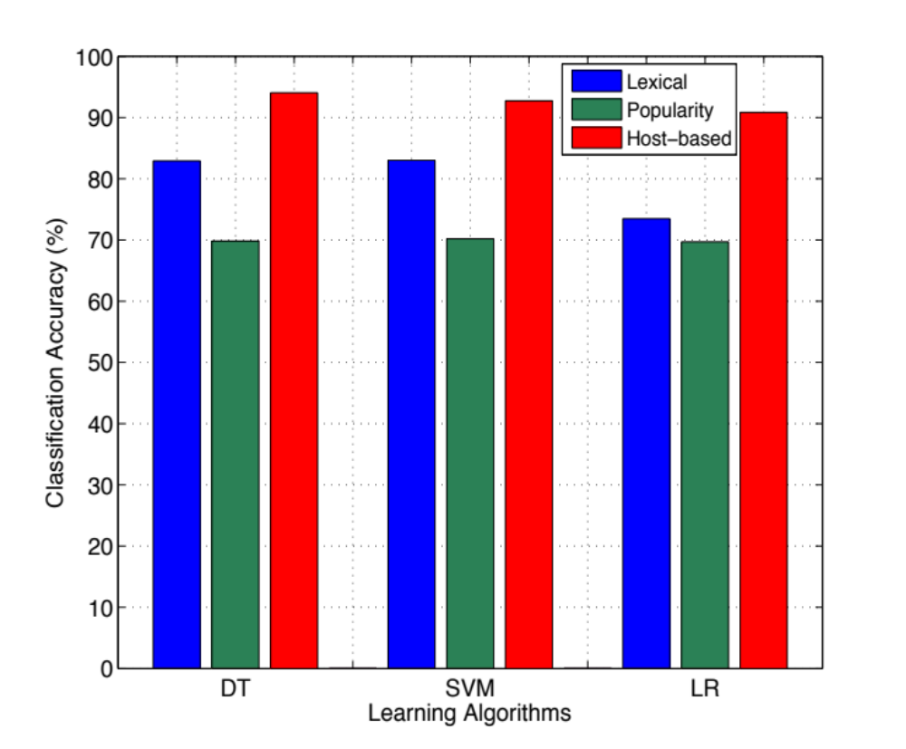
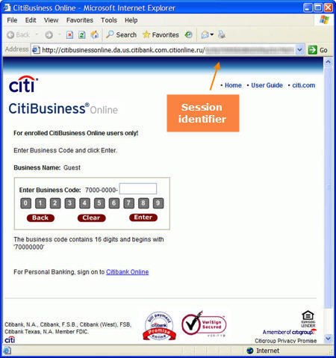
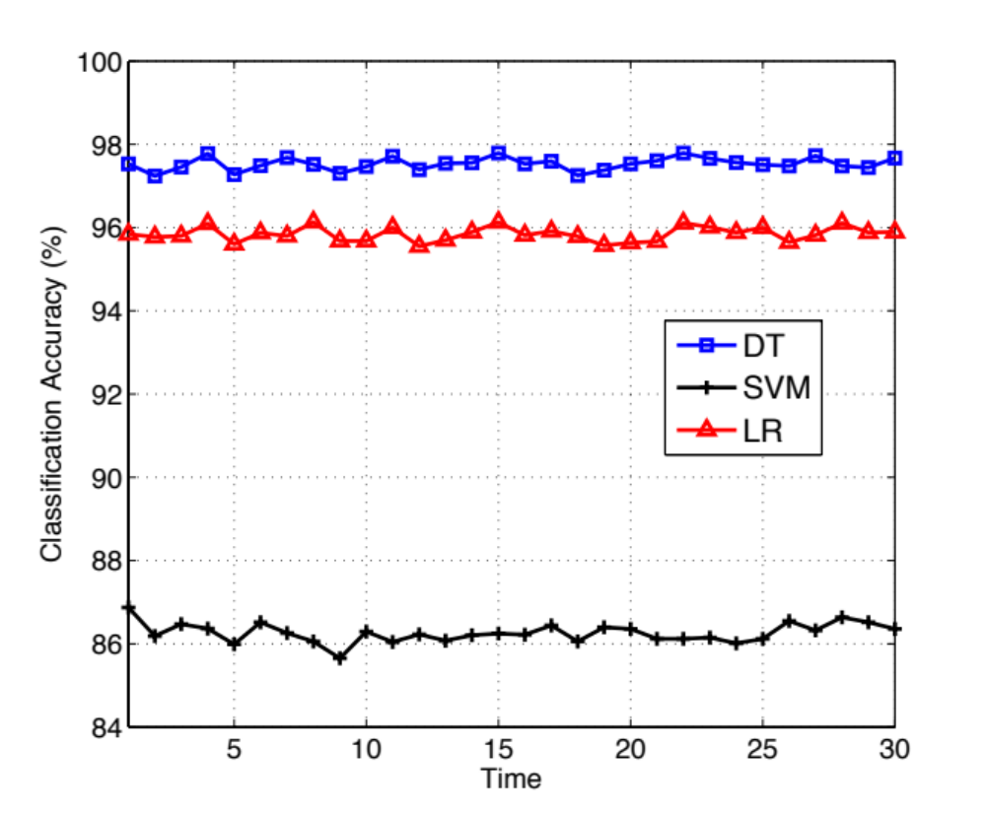
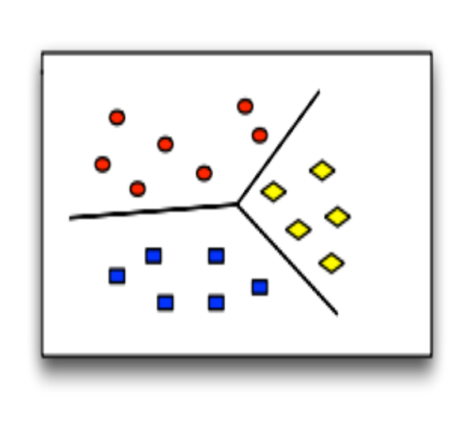
Learning based Malicious Web Sites Detection Using Suspicious URLs
Haotian Liu, Xiang Pan, Zhengyang Qu {haotianliu2011, xiangpan2011,zhengyangqu2017}@u.northwestern.edu
EECS 349: Machine Learning, Bryan Pardo(instructor), Northwestern University
Motivation
3. Approach
Feature Comparison
Problem statement
Web applications become popular and bring people convenience, while there is a rapid growth in the number of attacks from various criminal enterprises, such as financial fraud and spam-advertised commerce. The common thread among those attacks is the requirement that unsuspecting users visiting the sites, clicking the target Uniform Resource Locator (URL). If we can be informed of the properties of the target URL in advance, in other words, whether it is dangerous or not, such problems will be largely resolved.
Project Goal
This project is to present a learning based system that is capable of classifying URL intelligently without accessing the Web site, which removes the run-time latency and protects user from being exposed to browser-based vulnerabilities. Thus, our approach is complementary to existing blacklisting service and the systems based on evaluating site content and behavior. With the effective extraction of URL features and the resulting classification model, our system labels whether the Web site of the input URL is benign, phishing, or malware.
Feature Extraction & Selection
We separate the features of URL into 3 classes: Lexical Feature, Site popularity Feature, and Host-based Feature.
Evaluate how much each group of features increases/decreases the classification accuracy
Host-based features contribute the most to the performance.
The effect of lexical features on classification accuracy will be largely reduced when LR is utilized.
Lexical Feature
Host-based Feature
Feature | Type
Length of hostname | Integer
Length of entire URL | Integer
Number of dots | Integer
Top-level domain | Integer
Domain token count | Integer
Path token count | Integer
Average domain token length | Real
Average path token length | Real
Longest domain token length | Integer
Longest path token length | Integer
Brand name presence | Binary
IP address presence | Binary
Security sensitive word presence | Binary
Feature | Type
Autonomous system number | Integer
IP country | Integer
Number of registration information | Integer
Number of resolved IPs | Integer
Domain contains valid PTR record | Binary
Redirect to new site | Binary
All IPs are consistent | Binary
Site Popularity Feature
Feature | Type
Number of External Links | Integer
Real traffic rank | Integer
Domain in a reputable sites list | Binary
Classifier Comparison
We evaluate each algorithm in classification accuracy, runtime latency and true positive rate (TPR) and false positive rate (FPR).
2. System
Baseline Method
Classifier | Accuracy (%) | Runtime (s)
DT | 97.53 | 1.9
SVM | 86.26 | 579.4
LR | 95.84 | 5.7
DT
Given the input URL, our system first extracts the features in 3 groups and performs transformation on the features with String type by referring to a Map constructed by us. With the sample and classification model, our approach can classify the URL and output the classification result.
 | Benign | Malware | Phishing
TPR (%) | 98.3 | 99.9 | 90.7
FPR (%) | 3.6 | 0.2 | 1.1
Lexical Feature Extraction
Lexical Features
Feature Selection & Combination
30 times test (5 fold validation each time)
Host-based Features
SVM
URL
Preprocessing
Host-based Feature Extraction
Site Popularity Features
Learning Algorithm
 | Benign | Malware | Phishing
TPR (%) | 98.9 | 84.8 | 44.0
FPR (%) | 30.6 | 0.7 | 0.3
Site Popularity Feature Extraction
Decision Tree (DT)
Target Web Site
Result
Support Vector Machine(SVM)
LR
Classifier
Logistic Regression (LR)
 | Benign | Malware | Phishing
TPR (%) | 97.5 | 100 | 83.2
FPR (%) | 6.4 | 0 | 1.8
Gathering The Data
We randomly collect 22,190 benign URLs from DMOZ Open Directory Project. DMOZ is one of the largest human-edited directory of the world. It classifies URLs into different categories. As for phishing URLs, we collect 5,703 samples from PhishTank, a collaborative site where people can submit and verify phishing URLs. Besides, we select 9,220 URLs from DNS-BH project, a site creating and maintaining a list of domains known to be used to propagate malware and spyware.
4. Evaluation
Baseline
5. Conclusions
We adopt ZeroR algorithm as baseline method. ZeroR is a simple rule-based classifier and it assigns every value to the most common class. In our dataset, we have 37113 instances, including 5703 phishing URLs, 22190 benign URLs and 9220 malware URLs. Therefore, ZeroR will simply classify all the instances as benign URLs and in our case, the accuracy of ZeroR can be calculated by using the number of benign URLs divided by the size of dataset, which is 59.79%. The baseline if 59.79%.
We propose a learning based approach to separating Web sites into 3 classes: benign, phishing, and malware. The analysis is only based on URL itself without accessing the target website, which removes the run-time latency and protects user from being exposed to browser-based vulnerabilities. We argue that this approach is complementary to both blacklisting and the systems based on evaluating site content and behavior. By carefully selecting features and learning algorithms, our system achieves 97.53% accuracy on detecting malicious Web sites.
Training
URLs in the dataset are labeled. We use 5-fold method to train our systems. Before training, we preprocess the features not consistent with others. For example, the range of traffic is much larger than that of other features. We map the feature into a much smaller range and it turns out to significantly increase the accuracy. We also use Chi-Square test and virtualization tool in Weka to select most informative features. Then, we use three learning algorithms-J48 Decision Tree, SVM and Logistic Regression to train set.
6. Web Site
http://users.eecs.northwestern.edu/~hlc720/349/index.html
Additional thanks to Zhiyao Duan, Mark Cartwright, and Prof. Yan Chen
Notes:
the
eect of lexical features on classication accuracy will be
largely reduced when LR is utilized

