Slide 1
A Framework for Financial Accounting
1

Slide 2
PART A
ACCOUNTING AS A MEASUREMENT/COMMUNICATION PROCESS
Notes:
Welcome to accounting. A common misconception about this course is that it is a math class, much like college algebra, calculus, or business statistics. You will soon see that this is not a math class. Don’t say to yourself, “I’m not good at math so I probably won’t be good at accounting.” Though it’s true that we use numbers heavily throughout each chapter, accounting is far more than adding, subtracting, and solving for unknown variables. So, what exactly is accounting? We’ll take a close look at this next.

Slide 3
Learning Objective 1
LO1-1 Describe the two primary functions of financial accounting.

Slide 4
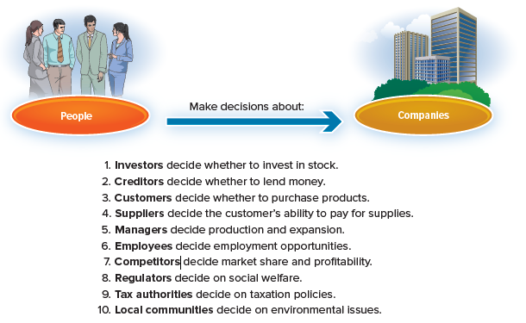
Decisions People Make About Companies
Illustration 1-1
Notes:
Accounting is “the language of business.” It's the language companies use to tell their financial story. More precisely, accounting is a system of maintaining records of a company’s operations and communicating that information to decision makers.
Millions of people every day must make informed decisions about companies. Illustration 1-1 identifies some of those people and examples of decisions they make about the companies.

Slide 5
Financial Accounting
Accounting information provided to external users is referred to as financial accounting, which is the focus of this book.
The two functions of financial accounting are
to measure business activities of a company, and
to communicate those measurements to external parties for decision-making purposes.
Notes:
As you study the business activities discussed in this book, it is important for you to keep in mind this “framework” for financial accounting. For each activity, ask yourself:
How is the business activity being measured?
How is the business activity being communicated?
These are the two functions of financial accounting. You’ll better understand why this process exists by thinking about how the measurements being communicated help people make better decisions.
Accounting information that is provided for internal users (managers) is referred to as managerial accounting, and is covered in another course.

Slide 6
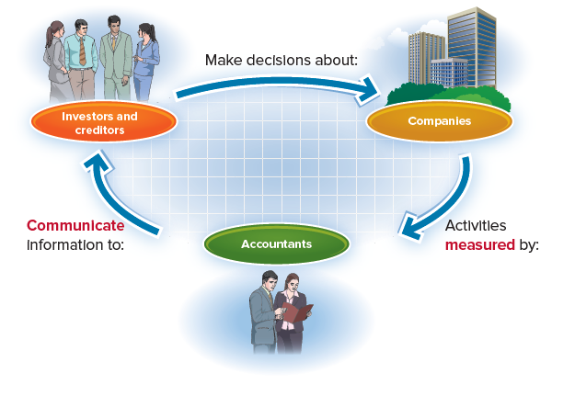
Framework for Financial Accounting
Illustration 1-2
Notes:
To make the decisions outlined in Illustration 1-1, these people need information. This is where accounting plays a key role. As Illustration 1-2 shows, accountants measure the activities of the company and communicate those measurements to others.

Slide 7
Key Point
The functions of financial accounting are to measure business activities of a company and to communicate information about those activities to investors and creditors and other outside users for decision-making purposes.

Slide 8
Learning Objective 2
LO1-2 Understand the business activities that financial accounting measures.

Slide 9
Business Activities
Financing activities: transactions the company has with investors and creditors
Investing activities: transactions involving the purchase and sale of resources that are expected to benefit the company for several years
Operating activities: transactions that relate to the primary operations of the company
Notes:
A business engages in three fundamental activities – financing activities, investing activities, and operating activities.
Financing activities include transactions the company has with investors and creditors, such as issuing stock and borrowing money from a local bank.
Investing activities include transactions involving the purchase and sale of resources that are expected to benefit the company for several years, such as the purchase of equipment. With the necessary resources in place, the company is ready to begin operations.
Operating activities will include transactions that relate to the primary operations of the company, such as providing products and services to customers and the associated costs of doing so, like rent, salaries, utilities, taxes, and advertising.

Slide 10
Types of Business Organizations
A corporation is a company that is legally separate from its owners.
The advantage of being legally separate is that the stockholders have limited liability.
A sole proprietorship is a business owned by one person.
A partnership is a business owned by two or more persons.
Neither sole proprietorships nor partnerships offer limited liability.
Notes:
Limited liability prevents stockholders from being held personally responsible for the financial obligations of the corporation.
A disadvantage of selecting the sole proprietorship or partnership form of business is that owners must have sufficient personal funds to finance the business in addition to the ability to borrow money. Another disadvantage of being a sole proprietorship or partnership is that neither offers limited liability.
A potential disadvantage of a corporation is double taxation: (1) the company first pays corporate income taxes on income it earns and (2) stockholders then pay personal income taxes when the company distributes that income as dividends to them.
Because most of the largest companies in the United States are corporations, in this book we will focus primarily on accounting from a corporation’s perspective. Focusing on corporations also highlights the importance of financial accounting—to measure and communicate activities of a company for investors (stockholders) and creditors (lenders, such as a local bank).

Slide 11
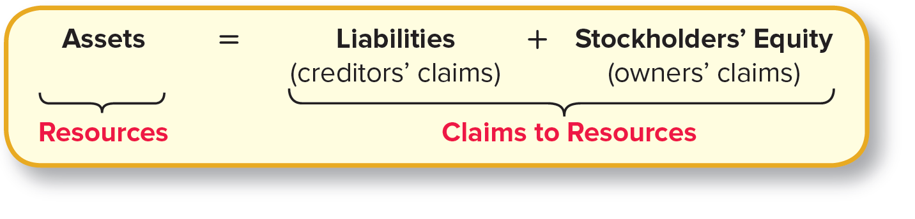
Assets, Liabilities, and Stockholders’ Equity
Illustration 1-3 – The Accounting Equation
Assets = total resources of the company.
Liabilities = amounts owed to creditors.
Stockholders’ equity = owners’ claims to resources
The accounting equation illustrates a fundamental model of business valuation.
Notes:
What information would investors and creditors be interested in knowing to determine whether their investment in a company was a good decision? Ultimately, investors and creditors want to know about the company’s resources and their claims to those resources. Accounting uses some conventional names to describe such resources and claims.
Assets are the total resources of a company.
Examples: cash, equipment, supplies, inventory for sale to customers, buildings, land, and investments.
Liabilities are amounts owed to creditors.
Examples: amounts owed to suppliers, employees, utility companies, and the government (in the form of taxes).
Liabilities typically include claims that must be paid by a specified date.
Stockholders’ equity represents the owners' claims to resources.
These claims arise from two primary sources: (1) contributions by the owners themselves and (2) net resources generated by company operations.
You can also think of stockholders' equity as total assets minus total liabilities.
The relationship among the three measurement categories is called the accounting equation. It shows that a company’s assets equal its liabilities plus stockholders’ equity. Alternatively, a company’s resources equal creditors’ and owners’ claims to those resources.

Slide 12
Revenues, Expenses, and Dividends
Revenues are the amounts recognized when the company sells products or provides services to customers.
Expenses are the costs of providing products and services and other business activities during the current period.
Net income is the difference between revenues and expenses. Other common names for net income include earnings or profit.
Dividends are cash payments to stockholders.
Dividends are not expenses.
Notes:
All businesses want revenues to be greater than expenses, producing a positive net income and adding to stockholders’ equity in the business.
However, if expenses exceed revenues, as happens from time to time, the difference between them is a negative amount—a net loss.
What should a company do with the net income, or the resources generated during the month? The company can make a cash payment to stockholders (dividends) and retain the remaining resources in the company to help grow future operations.

Slide 13
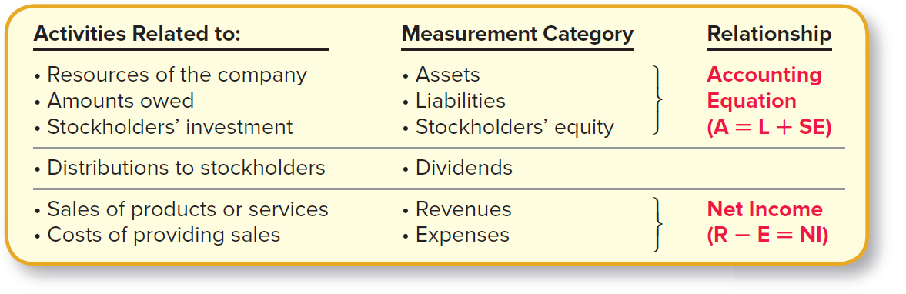
Business Activities and Their Measurement
Illustration 1-4
Notes:
The measurement role of accounting is to create a record of the activities of a company. To make this possible, a company must maintain an accurate record of its assets, liabilities, stockholders’ equity, revenues, expenses, and dividends.
Be sure you understand the meaning of these items. We will refer to them throughout this book. Illustration 1-4 summarizes the business activities and the categories that measure them.

Slide 14
Key Point
The measurement role of accounting is to create a record of the activities of a company.
To make this possible, a company must maintain an accurate record of its assets, liabilities, stockholders’ equity, revenues, expenses, and dividends.

Slide 15
Concept Check 1-1
The total resources of a company are referred to as:
a. Liabilities
b. Revenues
c. Assets
d. Expenses
Assets are the resources of the company that will benefit future operations. They include items such as cash, supplies, inventory for sale to customers, buildings, land, and investments.

Slide 16
Concept Check 1-2
The amounts recorded when the company sells products or provides services to customers are referred to as:
a. Liabilities
b. Revenues
c. Assets
d. Expenses
Revenues are recorded when the company sells products or provides services to customers.

Slide 17
Learning Objective 3
LO1-3 Determine how financial accounting information is communicated through financial statements.

Slide 18
Communicating through Financial Statements
Financial statements are periodic reports published by the company for the purpose of providing information to external users.
Primary financial statements
Income statement
Statement of stockholders’ equity
Balance sheet
Statement of cash flows
Notes:
The first important role of financial accounting is to measure the relevant transactions of a company.
Its second vital role is to communicate these business activities to those outside the company.
The primary means of communicating business activities is through financial statements.
These financial statements give investors and creditors the key information they need when making decisions about a company: Should I buy the company’s stock? Should I lend money to the company? Is management efficiently operating the company?
Without these financial statements, it would be difficult for those outside the company to see what’s going on inside.

Slide 19
Income Statement
Reports the company’s revenues and expenses over an interval of time
If revenues > expenses, then net income
If revenues < expenses, then net loss
Key Point: The income statement compares revenues and expenses for the current period to assess the company’s ability to earn a profit from running its operations.
Notes:
The income statement is a financial statement that reports the company’s revenues and expenses over an interval of time.
It shows whether the company was able to generate enough revenue to cover the expenses of running the business.
If revenues exceed expenses, then the company reports net income:
Revenues − Expenses = Net Income
If expenses exceed revenues, then the company reports a net loss.

Slide 20
Income Statement for Eagle Soccer Academy
Illustration 1-5
EAGLE SOCCER ACADEMY
Income Statement
For the month ended December 31, 2021
EAGLE SOCCER ACADEMY
Income Statement
For the month ended December 31, 2024
Revenues
Service revenue $72,000
Expenses
Rent expense 5,000
Supplies expense 10,000
Salaries expense 31,000
Utilities expense 9,000
Interest expense 1,000
Other expenses 2,000
Total expenses 58,000
Net income $14,000
Copyright ©2022 McGraw-Hill. All rights reserved. No reproduction or distribution without the prior written consent of McGraw-Hill.
Copyright ©2022 McGraw-Hill. All rights reserved. No reproduction or distribution without the prior written consent of McGraw-Hill.
Notes:
On December 1, 2024, Eagle Soccer Academy began operations by offering lessons to junior players. At the end of the first month of operations, Eagle Soccer Academy reports its income statement as shown in Illustration 1-5.
Here are some specifics about Eagle’s income statement:
Heading--The heading includes the company’s name, the title of the financial statement, and the time period covered by the financial statement. Because Eagle began operations on December 1, this income statement shows activity occurring from December 1 to December 31, 2024.
Revenues--Eagle provides soccer training and bills customers for a total of $72,000 during the month of December.
Expenses--Eagle has costs for business activities of $58,000 during the month of December. These are typical costs that we might expect of any company, such as rent, supplies, salaries, utilities, interest, and other items. Each of these costs is reported in a separate account.
An account maintains a record of the business activities related to a particular item.
Net income--Revenues exceed expenses ($72,000 is greater than $58,000), and thus the company has generated a profit for its owners of $14,000.
Underlines--In a financial statement, a single underline generally represents a subtotal (in this case, total revenues or total expenses), while a double underline indicates a final total (in this case, net income).

Slide 21
Statement of Stockholders’ Equity
Stockholders’ Equity
= Common Stock + Retained Earnings
Summarizes the changes in stockholders’ equity over an interval of time
External
Source
Company
Value
Internal
Source
Notes:
The statement of stockholders’ equity is a financial statement that summarizes the changes in stockholders’ equity over an interval of time. Stockholders’ equity has two primary components—common stock and retained earnings.
Common stock represents amounts invested by stockholders (the owners of the corporation) when they purchase shares of stock. Common stock is an external source of stockholders’ equity.
Retained earnings, on the other hand, is an internal source of stockholders’ equity. Its balance represents all net income minus all dividends over the life of the company.
Think of retained earnings this way. A company that has net income has generated resources through its operations. Those resources can either be returned to owners for their personal use (dividend payments) or retained in the business for future use. From the company’s perspective, we need to account for the total net income retained in the business. That’s the balance of retained earnings.

Slide 22
Statement of Stockholders’ Equity for Eagle Soccer Academy
Illustration 1-6
EAGLE SOCCER ACADEMY
Statement of Stockholders’ Equity
For the month ended December 31, 2024
Total
Stockholders’
Equity
Common
Stock
Retained Earnings
Beginning balance (Dec. 1)
Issuance of common stock
Add: Net income for the period
Less: Dividends
Ending balance (Dec. 31)
$ -0-
200,000
$200,000
$ -0-
14,000
(4,000)
$ 10,000
$ -0-
200,000
14,000
(4,000)
$210,000
*Beginning balances are zero only because this is the first month of operations for Eagle. Normally, beginning balances for Common Stock and Retained Earnings equal ending balances from the previous period.
Notes:
Accounting convention uses parentheses to signify an amount to be subtracted (such as dividends here).
Here are some specifics about Eagle’s statement of stockholders’ equity:
Heading —The statement of stockholders’ equity reports the activity for common stock and retained earnings over an interval of time. Similar to the income statement, the period of time in this example is December 1 to December 31, 2024.
Common stock —When Eagle begins operations on December 1, the balance of common stock is $0. This would be true of any company beginning operations. During December, Eagle issues 10,000 shares of common stock for $20 per share, so the balance of common stock increases by $200,000.
Retained Earnings —Retained Earnings also begins the first month of operations with a balance of $0. For the month of December, retained earnings increase by net income of $14,000 and decrease by $4,000 for dividends paid to stockholders. We show the amount of net income in blue here to emphasize that it came from the income statement. The ending balance of $10,000 represents all net income minus all dividends over the life of the company, which is only one month to this point in our example.
Total Stockholders' Equity —The third column shows that the two components—common stock and retained earnings—add to equal total stockholders’ equity of $210,000.
Statement of Retained Earnings. Notice the middle column of the statement of stockholders’ equity. This column sometimes is referred to as the statement of retained earnings. In practice, companies don’t report retained earnings in a separate statement from common stock, so that’s why we demonstrate the statement of stockholders’ equity. Nevertheless, it’s useful to see that this column highlights how net income (revenues minus expenses) from the income statement links to total stockholders’ equity by adding to the balance of retained earnings.

Slide 23
Common Mistake
Dividends represent the payment of cash but are not considered an expense in running the business.
Students sometimes mistakenly include the amount of dividends as an expense in the income statement, rather than as a distribution of net income in the statement of stockholders’ equity.

Slide 24
Key Point
The statement of stockholders’ equity reports information related to changes in common stock and retained earnings each period.
The change in retained earnings equals net income less dividends for the period.

Slide 25
Balance Sheet
Financial position:
Resources = Claims to Resources
Presents the financial position of the company on a particular date
Assets
Liabilities +
Stockholders’ Equity
=
Notes:
The balance sheet is a financial statement that presents the financial position of the company on a particular date. The financial position of a company is summarized by the accounting equation (see Illustration 1-3):
Assets = Liabilities + Stockholders’ Equity
As discussed earlier, this equation provides a fundamental model of business valuation.
Assets are the resources of the company, and liabilities are amounts owed to creditors. Stockholders have equity in the company to the extent that assets exceed liabilities. Creditors also need to understand the balance sheet; it’s the company’s assets that will be used to pay liabilities as they become due. Illustration 1-7 shows the balance sheet of Eagle Soccer Academy.

Slide 26
Balance Sheet for Eagle Soccer Academy
Illustration 1-7
EAGLE SOCCER ACADEMY
Balance Sheet
December 31, 2024
Assets
Liabilities
Cash
Accounts receivable
Supplies
Equipment, net
Other assets
$137,000
27,000
13,000
118,000
55,000
Accounts payable
Salaries payable
Utilities payable
Interest payable
Notes payable
Other liabilities
Total liabilities
$ 23,000
3,000
9,000
1,000
100,000
4,000
140,000
Stockholders’ Equity
Common stock
Retained earnings
Total stockholders’ equity
Total liabilities and stockholders’ equity
200,000
10,000
210,000
Total assets
$350,000
$350,000
Notes:
Another name for the balance sheet is the statement of financial position.
Here are some specifics about Eagle’s balance sheet:
Heading —The balance sheet reports assets, liabilities, and stockholders’ equity at a point in time, in contrast to the income statement which shows revenue and expense activities over an interval of time. For example, Eagle’s income statement shows revenue and expense activity occurring from December 1 to December 31, 2024; its balance sheet shows assets, liabilities, and stockholders’ equity of the company on December 31, 2024.
Assets —These are the resources of a company. Eagle has total assets of $350,000. Cash is a resource because it can be used to make purchases. Accounts receivable is a resource because they represent the right to receive cash from customers that have already been provided products or services. Supplies include resources used to run the soccer academy, such as paper, cleaning supplies, and soccer balls. Equipment is a resource that can be used to provide services to customers.
Liabilities —These are the amounts owed by a company. Eagle has total liabilities of $140,000. These include amounts owed to regular vendors (accounts payable), as well as amounts owed for other items such as employee salaries, utilities, interest, and bank borrowing (notes payable). Many liabilities are referred to as “payables,” to signify amounts the company will “pay” in the future.
Stockholders’ equity —The difference between total assets and total liabilities of $210,000 represents stockholders’ equity. Total stockholders’ equity includes the amount of common stock plus the amount of retained earnings from the statement of stockholders’ equity. We show the stockholders’ equity items in purple here, to indicate they came from the statement of stockholders’ equity.
Accounting Equation —Notice that the amounts listed in the “balance sheet” show that the accounting equation “balances.”
Assets = Liabilities + Stockholders’ Equity; $350,000 (resources) = $140,000 (creditors' claims) + $210,000 (owners' claims)“
The income statement is like a video (shows events over time), whereas a balance sheet is like a photograph (shows events at a point in time).

Slide 27
Concept Check 1-3
Which of the following accounts would appear in a company’s income statement?
a. Accounts Payable
b. Cash
c. Dividends
d. Rent Expense
The income statement is a financial statement that reports the company’s revenues and expenses over an interval of time. Accounts Payable (liability) and Cash (asset) would appear in the balance sheet, and Dividends would appear in the statement of stockholders’ equity.

Slide 28
Concept Check 1-4
Which relationship is reflected in the balance sheet?
a. Revenues − Expenses = Net income
b. Assets = Liabilities + Stockholders’ Equity
c. Assets − Liabilities = Net Income
d. Assets = Revenues + Dividends
The balance sheet reflects the financial position of a company on a particular date. The company’s financial position is summarized by showing that resources (Assets) equal claims to resources (Liabilities + Stockholders’ Equity).

Slide 29
Statement of Cash Flows
Measures activities involving cash receipts and cash payments over an interval of time
Operating
cash flows
Investing
cash flows
Financing
cash flows
cash transactions
involving revenue and expense activities
cash transactions
for the purchase
and sale of investments
and long-term assets
cash transactions
with lenders
and stockholders
Notes:
The statement of cash flows is a financial statement that measures activities involving cash receipts and cash payments over an interval of time. We can classify all cash transactions into three categories that correspond to the three fundamental business activities—operating, investing, and financing.
Operating cash flows include cash receipts and cash payments for transactions involving revenue and expense activities during the period. In other words, operating activities include the cash effects of the same activities that are reported in the income statement to calculate net income.
Investing cash flows generally include cash transactions for the purchase and sale of investments and long-term assets. Long-term assets are resources owned by a company that are thought to provide benefits for more than one year.
Financing cash flows include cash transactions with lenders, such as borrowing money and repaying debt, and with stockholders, such as issuing stock and paying dividends.

Slide 30
Statement of Cash Flows for Eagle Soccer Academy
Illustration 1-8
EAGLE SOCCER ACADEMY
Statement of Cash Flows
For the month ended December 31, 2024
Cash Flows from Operating Activities
Cash inflows:
From customers
Cash outflows:
For salaries
For rent
Net cash flows from operating activities
$ 49,000
(28,000)
(60,000)
$(39,000)
Cash Flows from Investing Activities
Purchase equipment
Net cash flows from investing activities
(120,000)
(120,000)
Cash Flows from Financing Activities
Issue common stock
Borrow from bank
Pay dividends
Net cash flows from financing activities
Net increase in cash
Cash at the beginning of the period
Cash at the end of the period
200,000
100,000
(4,000)
296,000
137,000
-0-
$137,000
Notes:
Illustration 1-8 provides the statement of cash flows for Eagle Soccer Academy. Notice that the three sections in the statement of cash flows show the types of inflows and outflows of cash during the period. Inflows are shown as positive amounts; outflows are shown in parentheses to indicate negative cash flows. The final line in each section shows, in the right-most column, the difference between inflows and outflows as net cash flow for that type of activity.
The total of the net cash flows from operating, investing, and financing activities equals the net change in cash during the period.
Change in cash = Operating cash flows + Investing cash flows + Financing cash flows
For Eagle, that net change in cash for December was an increase of $137,000. That amount equals the sum of its operating cash flows of −$39,000, investing cash flows of −$120,000, and financing cash flows of $296,000. We next add the beginning balance of cash. Because this is the first month of operations for Eagle, cash at the beginning of the period is zero. The ending balance of cash is the same as that reported in the balance sheet in Illustration 1-7.
This reconciliation of the beginning and ending cash balances emphasizes that the statement of cash flows explains why the cash reported in the balance sheet changed from one period to the next.

Slide 31
Concept Check 1-5
The cash collected from a customer would be recorded as which type of activity in the statement of cash flows?
Operating Activity
Business Activity
Investing Activity
Financing Activity
Operating activities include revenue and expense transactions. Collecting cash from customers represents activity related to revenues.

Slide 32
Links among Financial Statements
Illustration 1-9
EAGLE SOCCER ACADEMY
Income Statement
EAGLE SOCCER ACADEMY
Statement of Stockholders’ Equity
Revenues
Expenses
Net Income
$72,000
58,000
$14,000
Total
Stockholders’
Equity
[1]
Common
Stock
Retained Earnings
[1] Notice that the amount of net income in the income statement appears in the statement of stockholders’ equity.
Beginning balance (Dec. 1)
Issuances
Add: Net income
Less: Dividends
Ending balance (Dec. 31)
$ -0-
200,000
$200,000
$ -0-
14,000
(4,000)
$10,000
$ -0-
200,000
14,000
(4,000)
$210,000
[2] Notice that the ending balance in the statement of stockholders’ equity reappears in the balance sheet.
[2]
EAGLE SOCCER ACADEMY
Balance Sheet
EAGLE SOCCER ACADEMY
Statement of Cash Flows
Cash flows from operating activities
Cash flows from investing activities
Cash flows from financing activities
Net increase in cash
Cash at the beginning of the year
Cash at the end of the year
$137,000
213,000
[3]
$140,000
210,000
$ (39,000)
(120,000)
296,000
137,000
-0-
$137,000
Cash
Other assets
Total assets $350,000
Liabilities
Stockholders’ equity
Total liabilities and
stockholders’ equity $350,000
[3] Notice that the amount of cash in the balance sheet reappears as the ending cash balance in the statement of cash flows.
Notes:
Link (1) shows that net income from the income statement is reported in the statement of stockholders’ equity as part of the calculation of retained earnings. Link (2) shows that after we calculate the balance of retained earnings, the amount of total stockholders’ equity can be reported in the balance sheet. Finally, link (3) demonstrates that the balance of cash in the balance sheet equals the amount of cash reported in the statement of cash flows.
The four financial statements are linked, because events that are reported in one financial statement often affect amounts reported in another. Many times, a single business transaction, such as receiving cash from a customer when providing services, will affect more than one of the financial statements.
Providing services to a customer, for example, results in revenues recorded in the income statement, which are used to calculate net income. Net income, in turn, is reported in the calculation of retained earnings in the statement of stockholders’ equity. Then, the ending balance of retained earnings is reported in the balance sheet.
Thus, any transaction that affects the income statement ultimately affects the balance sheet through the balance of retained earnings.
The cash received from customers will be reported as part of the ending cash balance in the balance sheet and as part of operating cash flows in the statement of cash flows.

Slide 33
Key Point All transactions that affect revenues or expenses reported in the income statement ultimately affect the balance sheet through the balance in retained earnings.

Slide 34
Other Information Reported to Outsiders
The financial statements are a key component of a company’s annual report.
Two other important components of the annual report are (1) management’s discussion and analysis and (2) note disclosures to the financial statements.
The management discussion and analysis (MD&A) section typically includes management’s views on significant events, trends, and uncertainties pertaining to the company’s operations and resources.
Note disclosures offer additional information either to explain the information presented in the financial statements or to provide information not included in the financial statements.
Notes:
OTHER INFORMATION REPORTED TO OUTSIDERS
The financial statements are a key component of a company’s annual report, the term most often used to describe the formal document detailing a company’s activities and financial performance. As the name suggests, annual reports are provided by companies each year.
Two other important components of the annual report are (1) management’s discussion and analysis and (2) note disclosures to the financial statements.
The management discussion and analysis (MD&A) section typically includes management’s views on significant events, trends, and uncertainties pertaining to the company’s operations and resources.
Note disclosures offer additional information either to explain the information presented in the financial statements or to provide information not included in the financial statements. For example, companies are required to report total revenues in the income statement, but they also often report revenues itemized by geographic region in a note disclosure. We’ll discuss these items throughout this book.
For now, if you’d like to see an abbreviated version of an actual company’s annual report with financial statements, see Appendix A (American Eagle Outfitters) or Appendix B (Buckle) near the end of this book.

Slide 35
Learning Objective 4
LO1-4 Describe the role that financial accounting plays in the decision-making process.

Slide 36
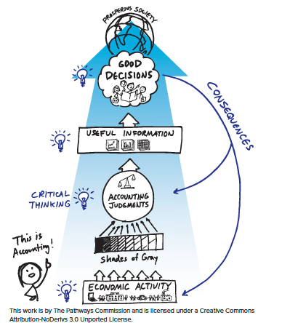
Pathways Commission Visualization: "THIS is Accounting!"
Illustration 1-10
Accounting serves an important role in a prosperous society by measuring economic activity and communicating useful information to help investors and creditors make good decisions.
The practice of accounting requires judgment and critical thinking skills.
Reprinted with permission from the American Accounting Association.
Notes:
Does the use of financial accounting information result in better business decisions?
One of the rewarding things about studying financial accounting is that it does matter! The concepts in this course have an impact on everyday business decisions as well as wide-ranging economic consequences.
Most prospering economies in the world today are structured around free markets. In free markets, firms are allowed to compete and customers are free to choose from a variety of products and services. From which company do you prefer to buy a laptop computer—Dell, Hewlett-Packard, or Apple?
Can these companies offer you the laptop computer you want for a price above their costs? If they can, they’ll earn a profit and stay in business. If they cannot, they’ll eventually go out of business.
Successful companies use their resources efficiently to sell products and services for a profit. When a company is able to make a profit, investors and creditors are willing to transfer their resources to it, and the company will expand its profitable operations even further.
But how do investors and creditors know the successful companies from the unsuccessful companies? How do they get the information necessary to make good investment decisions that help develop a prosperous society? Investors and creditors rely heavily on financial accounting information in making investment and lending decisions. Accounting serves an important role in a prosperous society by measuring economic activity and communicating useful information to help investors and creditors make good decisions.

Slide 37
Key Point Financial accounting serves an important role by providing information useful in investment and lending decisions.

Slide 38
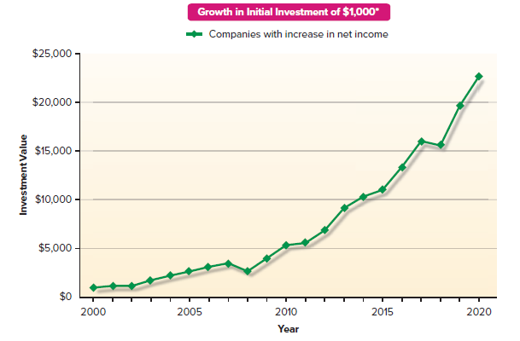
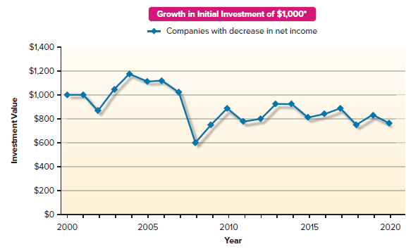
Relationship between Changes in Stock Prices and Changes in Net Income over a 20-Year Period
Illustration 1-11
*Amounts in this chart represent the investment growth based on the median stock return of each group each year. Companies included in this analysis are all U.S. companies with listed stocks, which averages about 6,000 companies per year.
Notes:
To demonstrate the importance of financial accounting information to investment decisions, we can look at the relationship between changes in stock prices and changes in net income over 20 years. As an investor, you will make money from an increase in the stock price of a company in which you invest (you can sell the stock for more than you bought it).
So as an investor, you are looking for companies whose stock price is likely to increase. Is there a way to find such companies? Interestingly, there is: No other single piece of company information better explains companies’ stock price performance than does financial accounting net income, the bottom line in the income statement.
What if you were able to accurately predict the direction of companies’ changes in net income over the next year—that is, whether it would increase or decrease—and then you invested $1,000 in companies that were going to have an increase? In contrast, what if instead you invested in companies that would have a decrease in net income? Illustration 1-11 shows what would happen to your $1,000 investment over 20 years for each scenario.
Investors and creditors also use information reported in the balance sheet. Consider a company’s total liabilities, often referred to as total debt. Expanding debt levels limit management’s ability to respond quickly and effectively to business situations. The “overhanging” debt, which involves legal obligation of repayment, restricts management’s ability to engage in new profit-generating activities.

Slide 39
Key Point No single piece of company information better explains companies’ stock price performance than does financial accounting net income. A company’s debt level is an important indicator of management’s ability to respond to business situations and the possibility of bankruptcy.

Slide 40
PART B
FINANCIAL ACCOUNTING INFORMATION
Notes:
Recall that accounting serves two main functions:
It (1) measures business activities and
(2) communicates those measurements to investors and creditors so they can make decisions.
Although this process might seem straightforward, some issues have been heavily debated, and the answers have changed over time.
How do we measure assets? When do we record revenues? What do we classify as an expense? How should we present financial statements?
Next, we’ll take a look at factors that shape the measurement and communication processes of financial accounting.

Slide 41
Learning Objective 5
LO1-5 Explain the term generally accepted accounting principles (GAAP) and describe the role of GAAP in financial accounting.
Notes:
-

Slide 42
Financial Accounting Standards
Make their decisions based on
Financial Accounting Information
Investors & Creditors
Should be based on formal standards
Generally Accepted Accounting Principles
(GAAP)
Notes:
Because financial accounting information is so vital to investors and creditors, formal standards have been established.
The rules of financial accounting are called Generally Accepted Accounting Principles, often abbreviated as GAAP (pronounced gap).
The fact that all companies use these same rules is critical to financial statement users. It helps investors to accurately compare financial information among companies when they are making decisions about where to invest or lend their resources.

Slide 43
Standard Setting Today
United States
Global
Financial Accounting
Standards Board (FASB)
International Accounting
Standards Board (IASB)
Governed by the
Securities and Exchange Commission (SEC)
Notes:
Financial accounting and reporting standards in the United States are established primarily by the Financial Accounting Standards Board (FASB) (pronounced either by the letters themselves or as faz-be). The FASB is an independent, private-sector body with full-time voting members and a very large support staff. Members include representatives from the accounting profession, large corporations, financial analysts, accounting educators, and government agencies.
The global counterpart to the FASB is the International Accounting Standards Board (IASB). In many ways, this organization functions like the FASB. (Not all countries follow the same accounting and reporting standards.)
The Securities and Exchange Commission (SEC), a government agency created in 1934, has both the power and the responsibility for setting accounting and reporting standards for companies whose securities are publicly traded. The SEC has delegated the primary responsibility for setting accounting standards to FASB.
Note that the SEC delegated only the responsibility, not the authority, to set these standards. The power still lies with the SEC. If the SEC does not agree with a particular standard issued by the FASB, it can force a change in the standard. In fact, it has done so in the past.

Slide 44
Key Point
The rules of financial accounting are called Generally Accepted Accounting Principles (GAAP).
The Financial Accounting Standards Board (FASB) is an independent, private body that has primary responsibility for the establishment of GAAP in the United States.

Slide 45
Importance of Auditors
Trained individuals hired by a company as an independent party to express a professional opinion of the extent to which financial statements are prepared in compliance with GAAP and are free of material misstatement.
Role of auditors
Help ensure that management has in fact appropriately applied GAAP in preparing the company’s financial statements.
Play a major role in investors’ and creditors’ decisions by adding credibility to the financial statements.
Notes:
For many businesses, there is a natural separation between those who run the business (managers) and those who own the business or finance operations (investors and creditors). This separation creates the need to ensure honest financial reporting. While it is the responsibility of management to apply GAAP when communicating with investors and creditors through financial statements, sometimes those in charge of preparing financial statements do not always follow the rules.
To help ensure that management has in fact appropriately applied GAAP, the SEC requires independent outside verification of the financial statements of publicly traded companies. Such independent examination is done by auditors, who are not employees of the company, but who are hired by the company as an independent party to express a professional opinion of the extent to which financial statements are prepared in compliance with GAAP and are free of material misstatement.
If auditors find mistakes or fraudulent reporting behavior, they require the company to correct all significant information before issuing financial statements. Auditors play a major role in investors’ and creditors’ decisions by adding credibility to a company’s financial statements.

Slide 46
Excerpts from the Independent Auditor’s Report of Dick’s Sporting Goods, Inc.
Illustration 1-12
DICK’S SPORTING GOODS, INC.
Report of Independent Auditors
To the Board of Directors and Stockholders of
Dick’s Sporting Goods, Inc.
Pittsburgh, Pennsylvania
We have audited the accompanying consolidated balance sheets of Dick's Sporting Goods, Inc., and subsidiaries (the "Company") as of February 1, 2020, and February 2,
2019, and the related consolidated statements of income, comprehensive income, changes in stockholders' equity, and cash flows for each of the three years in the period ended February 1, 2020and the related notes (collectively referred to as the
“financial statements”).
In our opinion, such consolidated financial statements present fairly, in all material respects, the financial position of the Company as of February 1, 2020, and February 2,
2019, and the results of their operations and their cash flows for each of the three years in the period ended February 1, 2020, in conformity with accounting principles generally accepted in the United States of America.
Notes:
Illustration 1-12 presents an excerpt from the auditor’s report for Dick’s Sporting Goods, Inc. The auditor’s report indicates that the financial statements for the period mentioned have been prepared in conformity with GAAP.
To further enhance the credibility of financial reporting, Congress established in 2002 the Public Company Accounting Oversight Board (PCAOB). The role of the PCAOB is to ensure that auditors follow a strict set of guidelines when conducting their audits of public companies’ financial statements. The PCAOB is a government entity that, simply stated, “audits the auditors.”

Slide 47
Illustration 1-13 Objectives of Financial Accounting
Financial accounting should provide information that:
1. Is useful to investors and creditors in making decisions.
2. Helps to predict cash flows.
3. Tells about economic resources, claims to resources, and changes in resources
and claims.
Notes:
The first objective is specific to investors and creditors. In addition to those users, though, financial accounting information is likely to have general usefulness to other groups of external users, who are interested in essentially the same financial aspects of a business as are investors and creditors. Some of these other groups were discussed in Illustration 1-1.
The second objective refers to the specific cash flow information needs of investors and creditors.
The third objective emphasizes the need for information about economic resources (assets) and claims to those resources (liabilities and stockholders’ equity) and their changes over time.

Slide 48
Key Point
The primary objective of financial accounting is to provide useful information to investors and creditors in making decisions.

Slide 49
Concept Check 1-6
Auditors are independent parties that help:
To establish accounting rules in the U.S.
To ensure management has appropriately prepared the company’s financial statements
Investors and creditors in their decisions by adding credibility to the financial statements
Both b. and c. are correct
Auditors are hired by a company as an independent party to express a professional opinion of the extent to which financial statements are prepared in compliance with GAAP.

Slide 50
PART C
CAREERS IN ACCOUNTING
Notes:
Whether you plan to major in accounting or not, this section is important for you. Accounting majors need to realize the many different options available upon graduation. Those who do not plan to major in accounting need a solid understanding of the many different business decisions involving accounting information.
One of the greatest benefits of an accounting degree is the wide variety of job opportunities it opens to you. With an accounting degree you can apply for almost any position available to finance majors. However, it doesn’t work the other way: Finance majors often lack the accounting background necessary to apply for accounting positions.

Slide 51
Learning Objective 6
LO1-6 Identify career opportunities in accounting.

Slide 52
Some of the Career Options in Accounting
Illustration 1-14
 | Public Accounting (Big 4 and Non-Big 4) | Private Accounting
Who are the clients? | Corporations Governments Nonprofit organizations Individuals | Your particular employer
What are the traditional career opportunities? | Auditors Tax preparers/planners Business consultants | Financial accountants Managerial accountants Internal auditors Tax preparers Payroll managers
What other career opportunities are available? | Financial planners Information technology developers Financial analysts Forensic accountants Information risk managers Investment bankers Environmental accountants Financial advisors Tax lawyers | Information managers Management advisors Tax planners Acquisition specialists FBI agents Sports agents
Notes:
Public accounting firms are professional service firms that traditionally have focused on three areas: auditing, tax preparation/planning, and business consulting. We already have discussed the role of auditors in attesting to the conformity of companies’ financial statements with GAAP. Tax preparation/planning is an increasingly important activity in the United States, as the complexity of tax laws related to personal and corporate taxes continues to increase. Business consulting is perhaps the most lucrative activity of accountants.
If you choose a career in public accounting, the next big decision is whether to work for one of the “Big 4” public accounting firms (Deloitte, Ernst & Young, PricewaterhouseCoopers, and KPMG) or one of the thousands of medium or smaller-sized firms. The Big 4 firms are huge, each having annual revenues in the billions. They audit almost all the Fortune 500 companies in the United States and most of the largest companies around the world, and they hire thousands of accounting majors each year. The thousands of smaller international, regional, and local accounting firms also hire thousands of accounting majors right out of college.
Most public accountants become Certified Public Accountants (CPAs). You become a CPA by passing the four parts of the CPA exam and meeting minimum work experience requirements (in some states). Most states require that you have 150 semester hours (225 quarter hours) of college credit to take the exam. Becoming a CPA can provide a big boost in salary and long-term job opportunities.
A career in private accounting means providing accounting services to the company that employs you. Every major company in the world needs employees with training and experience in financial accounting, management accounting, taxation, internal auditing, and accounting information systems. Whereas working as a public accountant provides the advantage of experience working with a number of different clients, private accountants sometimes earn higher starting salaries. In fact, many accounting students begin their careers in public accounting, gaining experience across a wide array of companies and industries, and then eventually switch over to one of their favorite clients as private accountants. Other students take positions directly in private accounting right out of college.

Slide 53
Learning Objective 7
LO1-7 Explain the nature of the conceptual framework used to develop generally accepted accounting principles.

Slide 54
APPENDIX
CONCEPTUAL FRAMEWORK
Notes:
Welcome to accounting. A common misconception about this course is that it is a math class, much like college algebra, calculus, or business statistics. You will soon see that this is not a math class. Don’t say to yourself, “I’m not good at math so I probably won’t be good at accounting.” Though it’s true that we use numbers heavily throughout each chapter, accounting is far more than adding, subtracting, and solving for unknown variables. So, what exactly is accounting? We’ll take a close look at this next.

Slide 55
Conceptual Framework
The conceptual framework:
Is established by the FASB.
Provides standard setters with a benchmark for creating a consistent set of financial reporting rules now and in the future.
Provides others with a written framework so that everyone understands the underlying concepts that accountants are to consider in preparing and interpreting financial accounting information.
Notes:
In much the same way that our nation’s Constitution provides the underlying principles that guide the “correctness” of all laws, the FASB’s conceptual framework prescribes the correctness of financial accounting rules.

Slide 56
Key Point
The conceptual framework provides an underlying foundation for the development of
accounting standards and interpretation of accounting information.

Slide 57
Qualitative Characteristics of Useful Financial Information
Illustration 1-15
QUALITATIVE CHARACTERISTICS
Decision Usefulness
Overriding
objective
Relevance
Faithful representation
Fundamental
characteristics
Confirmatory value
Predictive value
Materiality
Completeness
Neutrality
Freedom from error
Components/
Aspects
Comparability
(Consistency)
Verifiability
Timeliness
Understandability
Enhancing
characteristics
Cost effectiveness
(Benefits exceed costs)
Constraint
Notes:
Notice that at the top of the figure is decision usefulness—the ability of the information to be useful in decision making. Accounting information should help investors, lenders, and other creditors make important decisions about providing funds to a company.
The two fundamental decision-specific qualitative characteristics that make accounting information useful are relevance and faithful representation. Both are critical. No matter how representative, if information is not relevant to the decision at hand, it is useless. Conversely, relevant information is of little value if it does not faithfully represent the underlying activity.
To have relevance, accounting information should possess confirmatory value and/or predictive value. Generally, useful information will possess both of these components.
For example, the ability of a company to report a positive net income confirms that its management is effectively and efficiently using the company’s resources to sell quality products. In this case, net income has confirmatory value. At the same time, reporting a positive and growing net income for several consecutive years should provide information that has predictive value for the company’s future cash-generating ability.
Materiality reflects the impact of financial accounting information on investors’ and creditors’ decisions. Unless an item is material in amount or nature—that is, sufficient in amount or nature to affect a decision—it need not be reported in accordance with GAAP. (Recording a $6 wastebasket as a current expense instead of a long-term asset for a multibillion-dollar company has no impact on investors’ decisions.)
To be a faithful representation of business activities, accounting information should be complete, neutral, and free from error. Completeness means including all information necessary for faithful representation of the business activity the firm is reporting. Neutrality means to be unbiased. Freedom from error indicates that reported amounts reflect the best available information.
Four enhancing qualitative characteristics are comparability, verifiability, timeliness, and understandability. Comparability refers to the ability of users to see similarities and differences between two different business activities. Comparability also refers to the ability of users to see similarities and differences in the same company over time. Closely related to the notion of comparability is consistency. Consistency refers to the use of similar accounting procedures either over time for the same company, or across companies at the same point in time. Comparability of financial information is the overriding goal, while consistency of accounting procedures is a means of achieving that goal.
Verifiability implies a consensus among different measurers. Timeliness refers to information being available to users early enough to allow them to use it in the decision process. Understandability means that users must be able to understand the information within the context of the decision they are making. The cost constraint suggests that financial accounting information is provided only when the benefits of doing so exceed the costs.

Slide 58
Key Point (Fundamental Characteristics)
To be useful for decision making, accounting information should have relevance and faithful representation.

Slide 59
Key Point (Enhancing Characteristics)
Four characteristics of financial reporting enhance its usefulness.
These characteristics include comparability, verifiability, timeliness, and understandability.

Slide 60
Assumptions That Underlie GAAP
Illustration 1-16
GAAP
Underlying assumptions
Economic
entity
Monetary
unit
Periodicity
Going
concern
Notes:
For the qualitative characteristics to be applied to accounting information, four basic assumptions must be made to support the existence of GAAP. As pictured in Illustration 1-16, they are (1) the economic entity assumption, (2) the monetary unit assumption, (3) the periodicity assumption, and (4) the going concern assumption.
The economic entity assumption states that we can identify all economic events with a particular economic entity. In other words, only business transactions involving Nike should be reported as part of Nike’s financial accounting information. Another key aspect of this assumption is the distinction between the economic activities of owners and those of the company. For example, Nike co-founder and chairman Phil Knight’s personal residence is not an asset of Nike, Inc.
Information would be difficult to use if, for example, we listed assets as “three machines, two trucks, and a building.” According to the monetary unit assumption, in order to measure financial statement elements, we need a unit or scale of measurement. The dollar in the United States is the most appropriate common denominator to express information about financial statement elements and changes in those elements. In Europe, the common denominator is the euro. Nike has operations throughout the world, so it must translate all its financial information to U.S. dollars under the monetary unit assumption.
The periodicity assumption relates to the qualitative characteristic of timeliness. External users need periodic information to make decisions. The periodicity assumption divides the economic life of an enterprise (presumed to be indefinite) into artificial time periods for periodic financial reporting. Corporations like Nike, whose securities are publicly traded, are required to provide financial information to the SEC on a quarterly and an annual basis. Quarterly reports are more timely, while annual reports allow the full application of GAAP.
The going concern assumption states that in the absence of information to the contrary, a business entity will continue to operate indefinitely. This assumption is critical to many broad and specific accounting principles. It provides justification for measuring many assets based on their original costs (a practice known as the historical cost principle). If we knew an enterprise was going to cease operations in the near future, we would measure assets and liabilities not at their original costs but at their current liquidation values.

Slide 61
Concept Check 1-7
Which of the following assumptions indicates that the life of a company can be divided into artificial time periods for periodic reporting?
Economic Entity
Periodicity
Going Concern
Monetary Unit
The periodicity assumption states that the economic life of an enterprise (presumed to be indefinite) can be divided into artificial time periods for periodic financial reporting.

Slide 62
End of Chapter 1

