Slide 1
The Accounting Cycle: During the Period
2

Slide 2
Functions of Financial Accounting
(1) Measure business activities of the company.
• Record transactions
(2) Communicate measurements to external parties for decision making.
• Prepare financial statements
Notes:
Recall from Chapter 1 that the two functions of financial accounting are to:
Measure business activities of the company, and
(2) Communicate those measurements to external parties for decision-making purposes.
The full set of procedures used to accomplish this two-step measurement/communication process is referred to as the accounting cycle.

Slide 3
PART A
MEASURING BUSINESS ACTIVITIES
Notes:
In this chapter, we’ll focus on the procedures related to measuring business activities during the accounting period.
In Chapter 3, we’ll complete the accounting cycle by examining the remaining procedures that occur at the end of the accounting period.
Although nearly every company accomplishes the accounting cycle using a computerized accounting system, this chapter shows a manual system to help you better understand the basic model underlying computerized programs.

Slide 4
Learning Objective 1
LO2-1 Identify the basic steps in measuring external transactions.

Slide 5
Key Point
External transactions are transactions between the company and a separate company or individual.
Internal transactions do not include an exchange with a separate economic entity.
Notes:
A company has business transactions with many different individuals and other companies. Examples are selling products to a customer, purchasing supplies from a vendor, paying salaries to an employee, and borrowing money from a bank. These transactions are often referred to as external transactions because they are conducted between the company and a separate economic entity. In this chapter, we focus on the measurement of external transactions occurring during the period.
In Chapter 3, we’ll discuss internal transactions measured at the end of the period. These include events that affect the financial position of the company, but do not include an exchange with a separate company or individual.

Slide 6
Illustration 2-1 Six Steps in Measuring External Transactions
Step 1 • Use source documents to identify accounts affected by an external transaction.
Step 2 • Analyze the impact of the transaction on the accounting equation.
Step 3 • Assess whether the transaction results in a debit or credit to account balances.
Step 4 • Record the transaction in a journal using debits and credits.
Step 5 • Post the transaction to the general ledger.
Step 6 • Prepare a trial balance.
Copyright ©2022 McGraw-Hill . All rights reserved. No reproduction or distribution without the prior written consent of McGraw-Hill .
Notes:
Measuring external transactions is a six-step process, as outlined as outlined in Illustration 2-1. These steps are the foundation for the remaining chapters in this book. Make sure you understand them before you proceed.
A company has business transactions with many different individuals and other companies. Examples are selling products to a customer, purchasing supplies from a vendor, paying salaries to an employee, and borrowing money from a bank. These transactions are often referred to as external transactions because they are conducted between the company and a separate economic entity. We need to measure these business transactions, so they can be communicated to investors, creditors, and other financial statement users. In this chapter, we focus on the measurement of external transactions occurring during the period. In Chapter 3, we'll discuss internal transactions measured at the end of the period. These include events that affect the financial position of the company but do not include an exchange with a separate company or individual.
The first step in the measurement process involves gathering information about a transaction. Source documents such as sales invoices, bills from suppliers, and signed contracts provide information related to external transactions. These source documents usually identify the date and nature of each transaction, the participating parties, and the monetary terms. For example, a sales invoice might identify the date of sale, the customer, the specific items sold, the dollar amount of the sale, and the payment terms.
Steps 2–6 involve conventions used by accountants to capture the effects of transactions in accounts. An account provides a record of the business activities related to a particular item.
To review:
Step 1: Gathering information about a transaction. Source documents such as sales invoices, bills from suppliers, and signed contracts provide information related to external transactions. These source documents are used to determine the accounts that will be affected.
Step 2: Next, the effect of the transaction on elements of the accounting equation must be analyzed. After each transaction, assets must always equal liabilities plus stockholders’ equity.
Step 3: In the basic accounting equation (Assets = Liabilities + Stockholders’ Equity), accounts on the left side are increased with debits. Accounts on the right side are increased with credits. The opposite is true to decrease any of these accounts. After identifying the accounts affected, we must determine if it must be debited or credited.
Step 4: Recording the transaction in a journal with debits and credits.
Step 5: Posting is the process of transferring the debit and credit information from transactions recorded in the journal to the T-accounts in the general ledger.
Step 6: Preparing a trial balance. A trial balance is a list of all accounts and their balances at a particular date.

Slide 7
Capturing Transactions in Accounts
Account: Record of all transactions related to a particular item over a period of time.
Asset accounts:
Examples: Cash, Supplies, and Equipment
Liability accounts:
Examples: Accounts Payable, Salaries Payable, Utilities Payable, and Taxes Payable
Stockholders’ equity accounts:
Examples: Common Stock and Retained Earnings
Chart of accounts: A list of all account names used to record transactions
Notes:
An account provides a record of the business activities related to a particular item.
For instance, asset accounts include Cash, Supplies, and Equipment. All transactions affecting cash are recorded in the Cash account. When a company receives cash, an increase is recorded in the Cash account. When the company pays cash, a decrease is recorded in the Cash account. The balance of the account equals all increases minus all decreases. This is the way that all accounts work.
Examples of liability accounts include Accounts Payable, Salaries Payable, Utilities Payable, and Taxes Payable. Each of these accounts keeps a record of amounts owed as a result of the related transactions.
Stockholders’ equity accounts include Common Stock and Retained Earnings.
A list of all account names used to record transactions of a company is referred to as the chart of accounts.

Slide 8
Key Point
The six-step measurement process (Illustration 2–1) is the foundation of financial accounting.
To understand this process, it is important to realize in Step 2 that we analyze the effects of business transactions on the accounting equation (Part A of this chapter).
Then, in Step 3 we begin the process of translating those effects into the accounting records (Part B of this chapter).

Slide 9
Learning Objective 2
LO2-2 Analyze the impact of external transactions on the accounting equation.

Slide 10
Effects of Transactions on the Basic Accounting Equation
Each transaction will have a dual effect on the basic accounting equation
Assets = Liabilities + Stockholders’ Equity
(creditors’ claims) (owners’ claims)
Resources Claims to Resources
If total assets increase, then liabilities or stockholders’ equity increases by the same amount.
If total assets decrease, then liabilities or stockholders’ equity decreases by the same amount.
Notes:
The activities we want to record are those that affect the financial position of the company. That means they affect the accounting equation.
When a company borrows cash from a bank, its financial position is affected because assets (cash) increase and liabilities (the loan payable to the bank) increase. The company records that event in its accounting records.
On the other hand, when the company hires Ralph as a front-door greeter, that action doesn’t change the company’s assets, liabilities, or stockholders’ equity; the company’s financial position is unaffected the day Ralph is hired, and until he begins work.
The basic accounting equation must always remain in balance: The left side (assets) equals the right side (liabilities plus stockholders’ equity). Each transaction will have a dual effect. If one side of the equation increases, then the other side of the equation increases by the same amount.

Slide 11
Understanding Effects of Transaction
For each transaction, ask these three questions:
1. What is one account affected by the transaction?
Does this account increase or decrease?
2. What is a second account affected by the transaction?
Does this account increase or decrease?
3. Do assets equal liabilities plus stockholders’ equity?
THEY MUST!! EVERY TIME!!
Notes:
To see the effect of each transaction, ask yourself these questions:
“What is one account in the accounting equation affected by the transaction? Does that account increase or decrease?”
“What is a second account in the accounting equation affected by the transaction? Does that account increase or decrease?”
After noting the effects of the transaction on the accounting equation, ask yourself this:
“Do assets equal liabilities plus stockholders’ equity?”
The answer to the third question must be “yes.”

Slide 12
Illustration 2-2 External Transactions of Eagle Soccer Academy
Transaction Date Description
(1) Dec. 1 Sell shares of common stock for $200,000 to obtain the funds necessary to start the business.
(2) Dec. 1 Borrow $100,000 from the local bank and sign a note promising to repay the full amount of the debt in three years.
(3) Dec. 1 Purchase equipment necessary for giving soccer training. $120,000 cash.
(4) Dec. 1 Pay one year of rent in advance, $60,000 ($5,000 per month).
(5) Dec. 6 Purchase supplies on account, $23,000.
(6) Dec. 12 Provide soccer training to customers for cash, $43,000.
(7) Dec. 17 Provide soccer training to customers on account, $20,000.
(8) Dec. 23 Receive cash in advance for 12 soccer training sessions to be given in the future, $6,000.
(9) Dec. 28 Pay salaries to employees, $28,000.
(10) Dec. 30 Pay cash dividends of $4,000 to shareholders.
Copyright ©2022 McGraw-Hill . All rights reserved. No reproduction or distribution without the prior written consent of McGraw-Hill .
Notes:
The best way to understand the impact of a transaction on the accounting equation is to see it demonstrated by a few examples. Let’s return to the Eagle Soccer Academy from Chapter 1.
The illustration in this slide summarizes ten external transactions for Eagle in December, the first month of its operations.

Slide 13

Transaction (1): Issue Common Stock (1 of 3)
Sell shares of common stock for $200,000 to obtain the funds necessary to start the business.
What is one account affected by the transaction?
Cash
Does that account increase or decrease?
Increase by $200,000
Notes:
To begin operations, Eagle Soccer Academy needs cash. To generate cash from external sources, Eagle sells shares of common stock for $200,000.
It’s time to ask the three questions we asked earlier:
What is one account in the accounting equation affected by the transaction? Does that account increase or decrease?
Answer: Cash. Cash is a resource owned by the company, which makes it an asset. The company receives cash from investors, so cash and total assets increase by $200,000.

Slide 14
Transaction (1): Issue Common Stock (2 of 3)
Sell shares of common stock for $200,000 to obtain the funds necessary to start the business.
What is a second account affected by the transaction?
Common Stock
Does that account increase or decrease?
Increase by $200,000
Notes:
2. What is a second account in the accounting equation affected by the transaction? Does that account increase or decrease?
Answer: Common stock. Common stock is a stockholders’ equity account. Issuing common stock in exchange for $200,000 increases the amount of common stock owned by the company’s stockholders, so common stock and total stockholders’ equity both increase.

Slide 15
Transaction (1): Issue Common Stock (3 of 3)
Sell shares of common stock for $200,000 to obtain the funds necessary to start the business.
Assets = Liabilities + Stockholders’ Equity
Cash Common Stock
(1) +$200,000 = +$200,000
Do assets equal liabilities plus stockholders’ equity?
Yes, assets increase by $200,000 and stockholders’ equity increases by $200,000
Notes:
3. Do assets equal liabilities plus stockholders’ equity?
Answer: Yes.
Note: The accounting equation balances. If one side of the equation increases, so does the other side. We can use this same series of questions to understand the effect of any business transaction.

Slide 16
Common Mistake
It’s sometimes tempting to decrease cash as a way of recording an investor’s initial investment.
However, remember we account for the transactions from the company’s perspective, and the company received cash from the stockholder—an increase in cash.

Slide 17
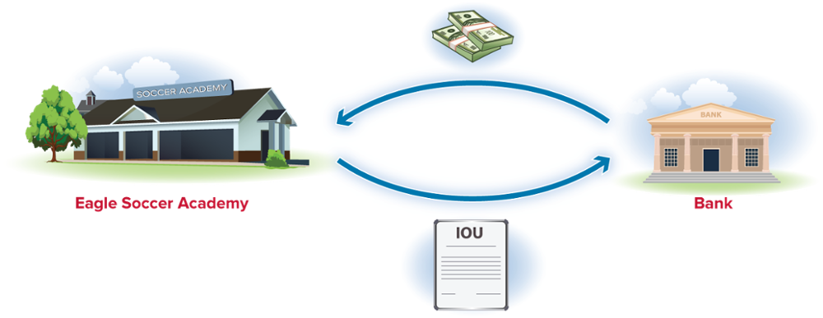
Transaction (2): Borrow Cash from the Bank
Borrow $100,000 from the local bank and sign a note promising to repay the full amount of the debt in three years.
Assets = Liabilities + Stockholders’ Equity
Cash Notes Payable Common Stock
Bal. $200,000 $200,000
Bal. $300,000 $100,000 $200,000
(2) +$100,000 +$100,000
$300,000 = $300,000
Notes:
In our next transaction, Eagle borrows $100,000 from the bank and signs a note for it. Consider the same questions:
1. What is one account in the accounting equation affected by the transaction? Does that account increase or decrease?
Answer: Cash. Cash is a resource owned by the company, which makes it an asset. The company receives cash, so cash and total assets increase.
2. What is a second account in the accounting equation affected by the transaction? Does that account increase or decrease?
Answer: Notes payable. Notes payable represents amounts owed to creditors (the bank in this case), which makes them a liability. The company incurs debt when signing the note, so notes payable and total liabilities increase.
3. Do assets equal liabilities plus stockholders’ equity?
Answer: Yes.
After two transactions, the accounting equation remains in balance. The total resources of the company equal $300,000. Creditors’ claims to those resources total $100,000 and the remaining resources of $200,000 were provided by stockholders.
Regardless of the number of transactions occurring during the period, the accounting equation always must remain in balance. For brevity, we do not address the three-question process for the remaining transactions, but you should ask yourself those questions until you feel comfortable with the process.

Slide 18
Key Point
After each transaction, the accounting equation must always remain in balance.
In other words, assets must always equal liabilities plus stockholders’ equity.

Slide 19

Transaction (3): Purchase Equipment
Purchase equipment necessary for giving soccer training, $120,000 cash.
Assets = Liabilities + Stockholders’ Equity
Cash Equipment Notes Payable Common Stock
Bal. $300,000 $100,000 $200,000
Bal. $180,000 $120,000 $100,000 $200,000
(3) –$120,000 +$120,000
$300,000 = $300,000
Notes:
Let’s go on to another transaction. Once Eagle obtains financing by issuing common stock and borrowing from the bank, the company can invest in long-term assets necessary to operate the business.
Buying equipment from a supplier for cash causes one asset to increase and another asset to decrease.
Notice that purchasing one asset (equipment) with another asset (cash) has no effect on the category totals in the accounting equation.
Once we add Transaction (3) to the accounting equation, we can see in the slide the accounting equation remains in balance.

Slide 20
Concept Check 2-1
What would be the effect on total assets if a company purchased land for $200,000 cash?
a. Total assets would go up by $200,000.
b. Total assets would go down by $200,000.
There would be zero effect on total assets.
d. None of the above
One asset (land) would go up and another asset (cash) would go down. There would be zero effect on total assets.

Slide 21
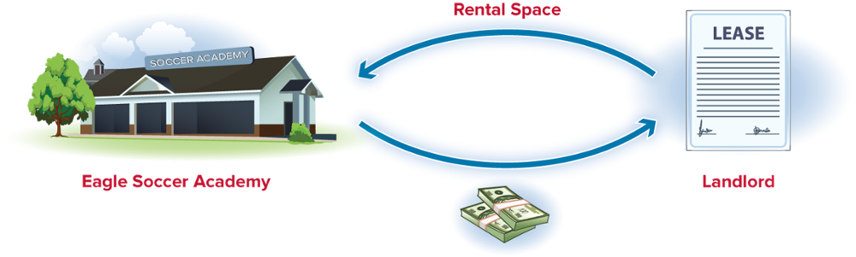
Transaction (4): Pay for Rent in Advance
Pay one year of rent in advance, $60,000 ($5,000 per month).
Assets = Liabilities + Stockholders’ Equity
Prepaid
Rent
Notes
Payable
Cash Equipment Common Stock
Bal. $180,000 $120,000 $100,000 $200,000
(4) –$ 60,000 +$60,000
Bal. $120,000 $60,000 $120,000 $100,000 $200,000
$300,000 = $300,000
Notes:
Let’s demonstrate another transaction. Eagle pays one year of rent in advance, $60,000.
On December 1, Eagle signs an agreement with a local soccer club to rent a field to provide soccer training to its customers. At the time the agreement is signed, Eagle pays one year of rent in advance, $60,000. Because the rent paid is for occupying space in the future, we record it as an asset representing a resource of the company. We call the asset prepaid rent. Other common examples of prepaid assets include prepaid insurance, prepaid advertising, and other prepaid services. These items often are purchased prior to their use.

Slide 22
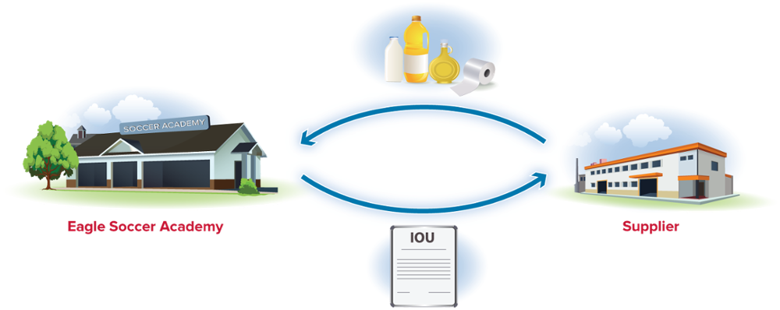
Transaction (5): Purchase Supplies on Account
Purchase supplies on account, $23,000.
Assets = Liabilities + Stockholders’ Equity
Prepaid
Rent
Accounts
Payable
Notes
Payable
Cash Supplies Equipment Common Stock
Bal. $120,000 $60,000 $120,000 $100,000 $200,000
(5) +$23,000 +$23,000
Bal. $120,000 $23,000 $60,000 $120,000 $23,000 $100,000 $200,000
$323,000 = $323,000
Notes:
Let’s move on to another transaction. On December 6, Eagle purchases supplies on account, $23,000. The phrase on account indicates that the company does not pay cash immediately but promises to pay cash in the future.
While supplies represent a resource of the company (an asset), the promise to pay the supplier (vendor) later is an obligation. We refer to a liability of this type, in which we purchase something on account, as an account payable. The term payable means “to be paid in the future.” Thus, the Accounts Payable account is a record of specific people and companies to whom we expect to pay cash in the future.
Purchasing supplies with the promise to pay cash in the future causes an asset (supplies) to increase and also causes a liability (accounts payable) to increase.
Later, when the company pays cash to those suppliers, an asset decreases (cash) and a liability decreases (accounts payable). Accounts payable decrease because those amounts are no longer owed to suppliers once the cash has been paid.

Slide 23
Illustration 2-3 Expanded Accounting Equation
Basic
Accounting
Equation
Assets = Liabilities + Stockholders’ Equity
Common
Stock
+
Retained Earnings
Expanded
Accounting
Equation
Revenues
−
Expenses
−
Dividends
Copyright ©2022 McGraw-Hill . All rights reserved. No reproduction or distribution without the prior written consent of McGraw-Hill .
Notes:
We can divide stockholders’ equity into its two components—common stock and retained earnings.
Common stock represents investments by stockholders. Retained earnings represents net income reported over the life of the company that has not been distributed to stockholders as dividends. Both common stock and retained earnings represent stockholders’ claims to the company’s resources.
Next, we can split retained earnings into its three components—revenues, expenses, and dividends—where revenues and expenses will ultimately be represented as net income. This illustration presents the expanded accounting equation, which shows these components.
Be sure to notice the effects of revenues, expenses, and dividends on retained earnings (and therefore on total stockholders’ equity) in the expanded accounting equation.
We add revenues to calculate retained earnings. That’s because revenues increase net income, and net income increases stockholders’ claims to resources. Therefore, an increase in revenues has the effect of increasing stockholders’ equity in the basic accounting equation.
We subtract expenses and dividends to calculate retained earnings. Expenses reduce net income, and dividends represent a distribution of net income to stockholders. Both expenses and dividends reduce stockholders’ claims to the company’s resources. Therefore, an increase in expenses or dividends has the effect of decreasing stockholders’ equity in the basic accounting equation.

Slide 24
Key Point
The expanded accounting equation demonstrates that revenues increase retained earnings while expenses and dividends decrease retained earnings.
Retained earnings is a component of stockholders’ equity.

Slide 25

Transaction (6): Provide Services for Cash
Provide soccer training to customers for cash, $43,000.
Assets = Liabilities + Stockholders’ Equity
Prepaid
Rent
Accounts
Payable
Notes
Payable
Common
Stock
Retained
Earnings
Cash Supplies Equipment
Bal. $120,000 $23,000 $60,000 $120,000 $23,000 $100,000 $200,000
(6) +$43,000 +$43,000
Bal. $163,000 $23,000 $60,000 $120,000 $23,000 $100,000 $200,000 $43,000
Service
Revenue
$366,000 = $366,000
Notes:
To see an example of how revenue affects the expanded accounting equation, let’s first consider the revenue recognition principle, which states that companies recognize revenue at the time they provide goods and services to customers.
The amount of revenue to recognize equals the amount the company is entitled to receive from customers. In transaction 6, Eagle provides soccer training to customers who pay cash at the time of the service, $43,000. Because Eagle has provided services, it is entitled to the cash of $43,000 and has revenues for that amount.
Providing services to customers for cash causes an asset (cash) and stockholders’ equity (service revenue) to increase.
Notice that an increase in Service Revenue increases stockholders’ equity by increasing the Retained Earnings account (+$43,000). Therefore, the basic accounting equation remains in balance (Assets = Liabilities + Stockholders’ Equity).
Revenues are a component of retained earnings. When a company recognizes revenue, the amount of retained earnings (or net income) in the business increases. Stated another way, an increase in revenues increases net income, which increases retained earnings, which increases total stockholders’ equity:

Slide 26
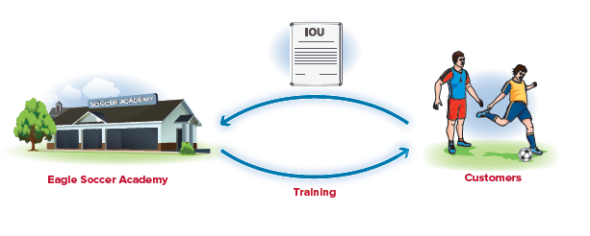
Transaction (7): Provide Services on Account
Provide soccer training to customers on account, $20,000.
Assets = Liabilities + Stockholders’ Equity
Accounts Receivable
Prepaid
Rent
Accounts
Payable
Notes
Payable
Common
Stock
Retained
Earnings
Cash Supplies Equipment
Bal. $163,000 $23,000 $60,000 $120,000 $23,000 $100,000 $200,000 $43,000
(7) +$20,000 +$20,000
Bal. $163,000 $20,000 $23,000 $60,000 $120,000 $23,000 $100,000 $200,000 $63000
Service
Revenue
$386,000 = $386,000
Notes:
In this transaction, other customers receive soccer training but do not pay cash at the time of the service. Instead, these customers promise to pay $20,000 cash at some time in the future.
Does failure to receive cash at the time of the service prevent Eagle from recognizing revenue? No. According to the revenue recognition principle, Eagle has provided those services to customers and therefore has revenue for the amount it is entitled to receive.
In addition, the right to receive cash from a customer is something of value the company owns, and therefore represents an asset. When a customer does not immediately pay for services with cash, we traditionally say the services are performed “on account,” and we recognize an asset called accounts receivable. The term receivable means “to be received in the future.” Thus, the Accounts Receivable account is a record of specific people and companies from whom we expect to receive cash in the future.
Providing services to customers on account causes an asset (accounts receivable) and stockholders’ equity (service revenue) to increase.
Later, when the company receives cash from those customers, one asset increases (cash) and another asset decreases (accounts receivable). Accounts receivable decrease because those amounts are no longer receivable from customers once the cash has been collected.

Slide 27
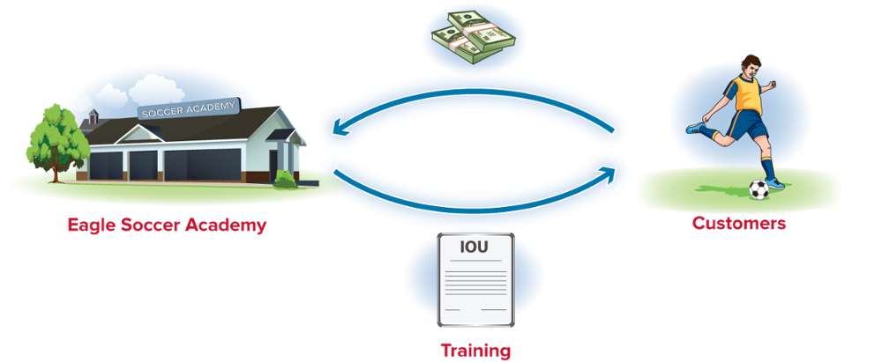
Transaction (8): Receive Cash in Advance from Customers
Receive cash in advance for 12 soccer training sessions to be given in the future, $6,000.
Assets = Liabilities + Stockholders’ Equity
Accounts Receivable
Prepaid
Rent
Accounts
Payable
Deferred
Revenue
Notes
Payable
Common
Stock
Retained
Earnings
Cash Supplies Equipment
Bal. $163,000 $20,000 $23,000 $60,000 $120,000 $23,000 $100,000 $200,000 $63,000
(8) +$ 6,000 $6,000
Bal. $169,000 $20,000 $23,000 $60,000 $120,000 $23,000 $6,000 $100,000 $200,000 $63,000
$392,000 = $392,000
Notes:
Rather than providing services before receiving cash, companies sometimes receive cash in advance from customers. Here, Eagle receives $6,000 from customers for soccer training to be provided later. In this case, Eagle cannot report revenue from training at the time it receives this cash because it has yet to provide services to those customers.
Recall that the revenue recognition principle states that revenue is recognized when goods and services are provided to customers. Receiving cash in advance from customers creates an obligation for the company to perform services in the future. This future obligation is a liability (or debt), most commonly referred to as deferred revenue.
Receiving cash in advance causes an asset (cash) and a liability (deferred revenue) to increase.

Slide 28
Common Mistake
Don’t let the account name fool you.
Even though the term revenue appears in the account title for deferred revenue, this is NOT a revenue account.
Deferred indicates that the company has yet to provide services even though it has collected the customer’s cash.
The company owes the customer a service, which creates a liability.

Slide 29

Transaction (9): Pay Salaries to Employees
Pay salaries to employees, $28,000.
Assets = Liabilities + Stockholders’ Equity
Accounts
Payable
Notes
Payable
Common
Stock
Retained
Earnings
Accounts Receivable
Prepaid
Rent
Deferred
Revenue
Retained
Earnings
Cash Supplies Equipment
Bal. $169,000 $20,000 $23,000 $60,000 $120,000 $23,000 $6,000 $100,000 $200,000 $63,000
(9) –$28,000 –$28,000
Bal. $141,000 $20,000 $23,000 $60,000 $120,000 $23,000 $6,000 $100,000 $200,000 $35,000
Salaries
Expense
$364,00 = $364,000
Notes:
Companies incur a variety of costs in running the business. Eagle pays salaries to employees for work in the current month. Because these salaries represent a cost of operations during the current period, Eagle records them in the current month as salaries expense of $28,000.
Paying salaries for the current period causes an asset (cash) to decrease and stockholders’ equity to decrease (and salaries expense to increase).
Notice that an increase in Salaries Expense results in a decrease in Retained Earnings (−$28,000). As a result, the accounting equation remains in balance, with both sides decreasing by $28,000.
Expenses reduce net income and therefore reduce the amount of retained earnings, a stockholders’ equity account. Stated another way, an increase in expenses decreases net income, which decreases retained earnings, which decreases total stockholders’ equity:
Beyond salaries expense, companies have a number of other expenses. Most expense accounts are labeled with the word expense in the title. For instance, common expense accounts include Supplies Expense, Utilities Expense, Rent Expense, Advertising Expense, Interest Expense, and Insurance Expense.
When a company has a cost that benefits future periods, then we typically record an asset rather than an expense. For example, in previous transactions we had the cost of equipment, the cost of rent, and the cost of supplies. In each of these transactions, the cost represented the purchase of a resource that will provide a benefit to the company beyond the date of the transaction, so we recorded each of these as assets.

Slide 30

Transaction (10): Pay Cash Dividends
Pay cash dividends of $4,000 to stockholders.
Assets = Liabilities + Stockholders’ Equity
Accounts Receivable
Prepaid
Rent
Accounts
Payable
Deferred
Revenue
Notes
Payable
Common
Stock
Retained
Earnings
Cash Supplies Equipment
Bal. $141,000 $20,000 $23,000 $60,000 $120,000 $23,000 $6,000 $100,000 $200,000 $35,000
(10)–$ 4,000 –$ 4,000
Bal. $137,000 $20,000 $23,000 $60,000 $120,000 $23,000 $6,000 $100,000 $200,000 $31,000
Dividends
$360,000 = $360,000
Notes:
The final transaction of Eagle Soccer Academy for the month is the payment of a $4,000 cash dividend to stockholders. Recall from the previous chapter that a dividend represents a distribution to the owners (stockholders) of the company.
Normally a company wouldn’t pay dividends after only a month in business, but we make this assumption here for purposes of illustration.
Paying dividends causes an asset (cash) to decrease and stockholders’ equity to decrease (and dividends to increase):
Like expenses, dividends reduce retained earnings, but dividends are not expenses.
Instead, dividends are distributions of part of the company’s net income to the owners, reducing the amount of earnings that have been retained in the business. Therefore, an increase in Dividends results in a decrease in Retained Earnings (−$4,000).
The accounting equation remains in balance, with both sides decreasing by $4,000. Because Retained Earnings is a stockholders’ equity account, when retained earnings decreases, so does stockholders’ equity.

Slide 31
Common Mistake
Students often believe a payment of dividends to owners increases stockholders’ equity.
Remember, you are accounting for the resources of the company.
While stockholders have more personal cash after dividends have been paid, the company in which they own stock has fewer resources (less cash).

Slide 32
Illustration 2-4 Summary of All 10 External Transactions of Eagle Soccer Academy
 | Assets |  |  |  |  | = | Liabilities |  |  | + | Stockholders' Equity | Stockholders' Equity
 |  | Accounts Receivables |  | Prepaid Rent |  |  | Accounts Payable | Deferred Revenue | Notes Payable |  | Common Stock | Retained Earnings
 | Cash |  | Supplies |  | Equipment
Dec. 1 | $0 | $0 | $0 | $0 | $0 |  | $0 | $0 | $0 |  | $0 | $0
(1) | +200,000 |  |  |  |  |  |  |  |  |  | +200,000
(2) | +100,000 |  |  |  |  |  |  |  | +100,000
(3) | -120,000 |  |  |  | +120,000
(4) | -60,000 |  |  | +60,000
(5) |  |  | +23,000 |  |  |  | +23,000
(6) | +43,000 |  |  |  |  |  |  |  |  |  |  | +43,000 | Service Revenue
(7) |  | +20,000 |  |  |  |  |  |  |  |  |  | +20,000 | Service Revenue
(8) | +6,000 |  |  |  |  |  |  | +6,000
(9) | -28,000 |  |  |  |  |  |  |  |  |  |  | -28,000 | Salaries Expense
(10) | -4,000 |  |  |  |  |  |  |  |  |  |  | -4,000 | Dividends
Dec. 31 | $137,000 | $20,000 | $23,000 | $60,000 | $120,000 |  | $23,000 | $6,000 | $100,000 |  | $200,000 | $31,000
 |  | $360,000 |  |  |  | = | $360,000
Copyright ©2022 McGraw-Hill . All rights reserved. No reproduction or distribution without the prior written consent of McGraw-Hill .
Notes:
Here is a summary of all ten transactions – and the resulting totals of all accounts.
Take a moment to go back and review each one. It is imperative that you understand how the accounting equation works before we move on to the next section which will use the accounting terms of debits and credits.

Slide 33
Concept Check 2-2
What effect does the payment of dividends have on the accounting equation?
a. Assets decrease and equity increases
b. Assets decrease and equity decreases
c. Assets decrease and liabilities increase
Assets increase and equity increases
Payment of dividends causes the cash account (which is an asset) to decrease and also causes retained earnings (which is an equity account) to decrease. So the correct answer is the payment of dividends decreases both assets and equity.

Slide 34
PART B
DEBITS AND CREDITS
Notes:
As we saw in the previous section, transactions have the effect of increasing or decreasing account balances. While the terms increase and decrease are well understood, accountants more often use the terms debit and credit to indicate whether an account balance has increased or decreased.
Here, we introduce those terms, discuss their effect on account balances, and show how we record transactions using debits and credits.

Slide 35
Learning Objective 3
LO2-3 Assess whether the impact of external transactions results in a debit or credit to an account balance.

Slide 36
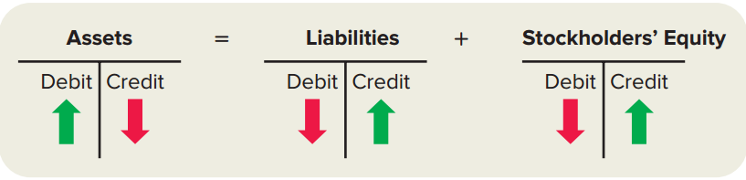
Debit and Credit Effects on Accounts in the Basic Accounting Equation
Illustration 2-5
1. Left side—Assets increase with debits.
2. Right side—Liabilities and stockholders’ equity increase with credits.
The opposite is true to decrease the balance of any of these accounts.
Notes:
You will need to learn how to increase and decrease account balances using the terms debit and credit because that’s the language of accounting.
Debit simply means “left” and credit means “right.”
Look at the accounting equation in Illustration 2-5. Like every equation, there is a left-hand side and a right-hand side. Assets are on the left-hand side of the equal sign, while liabilities and stockholders’ equity are on the right-hand side.
In accounting terminology, we refer to increases in assets (left-hand side accounts) as debits, and we refer to decreases in assets as credits. For example, if a company receives cash (an asset), the balance of the Cash account increases, so we refer to the increase as a “debit to cash.” We would refer to a decrease in cash as a “credit to cash.”
Just the opposite is true for liabilities and stockholders' equity. These accounts are on the right-hand side of the accounting equation. We refer to increases in liabilities and stockholders’ equity (right-hand side accounts) as credits, and decreases in those accounts as debits.

Slide 37
Common Mistake
Some students think the term “debit” always means increase, and “credit” always means decrease.
While this is true for assets, it is not true for liabilities and stockholders’ equity.
Liabilities and stockholders’ equity increase with a credit and decrease with a debit.

Slide 38
Key Point
For the basic accounting equation:
(Assets = Liabilities + Stockholders’ Equity), assets (left side) increase with debits.
Liabilities and stockholders’ equity (right side) increase with credits.
The opposite is true to decrease any of these accounts.

Slide 39
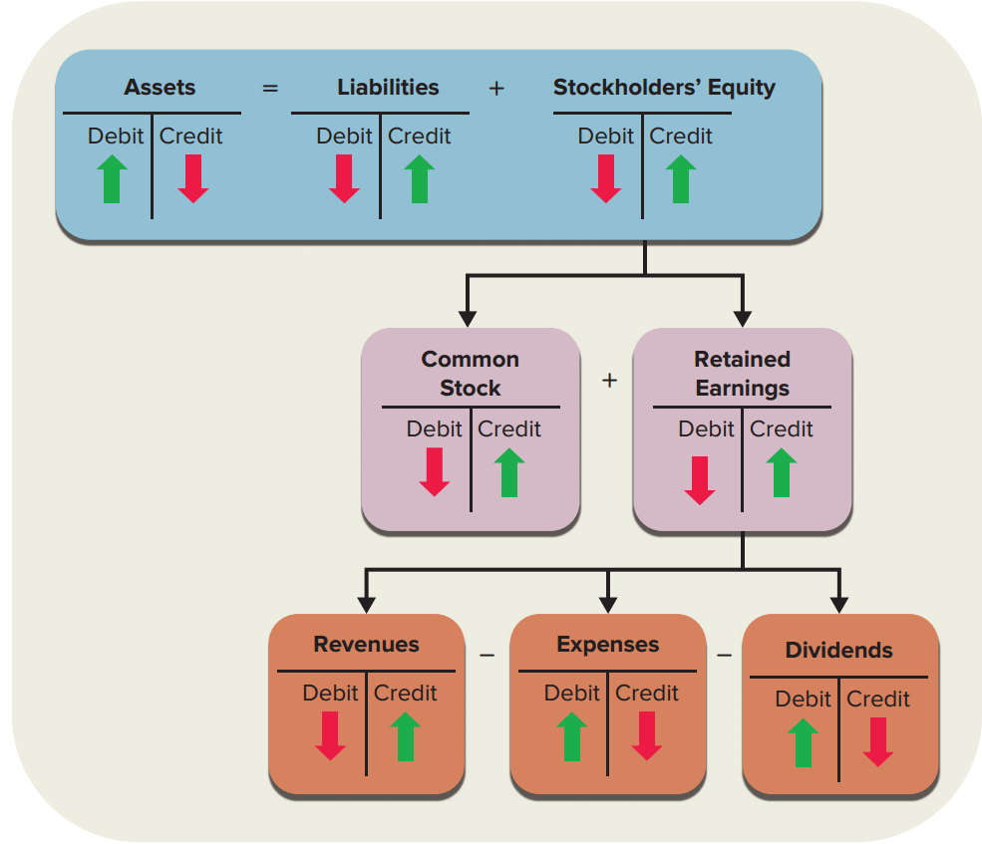
Debit and Credit Effects on Accounts in the Expanded Accounting Equation
Illustration 2-6
Notes:
As we discussed previously, we can expand the basic accounting equation to include the components of stockholders’ equity (common stock and retained earnings) and the components of retained earnings (revenues, expenses, and dividends).
Because common stock and retained earnings are part of stockholders’ equity (right-hand side), it follows directly that we increase both with a credit, and decrease both with a debit.
For the components of Retained Earnings:
Revenues increase retained earnings (“there’s more to keep”). Retained Earnings is a credit account, so we increase revenues with a credit.
Expenses, on the other hand, decrease retained earnings (“there’s less to keep”). Thus, we do the opposite of what we do with revenues; we increase expenses with a debit.
Dividends, similar to expenses, decrease retained earnings, so we increase dividends with a debit.
For each of these components, we do the opposite to decrease the balance.

Slide 40
Key Point
The Retained Earnings account is a stockholders’ equity account that normally has a credit balance.
The Retained Earnings account has three components—revenues, expenses, and dividends.
The difference between revenues (increased by credits) and expenses (increased by debits) equals net income.
Net income increases the balance of Retained Earnings.
Dividends (increased by debits) decrease the balance of Retained Earnings.

Slide 41
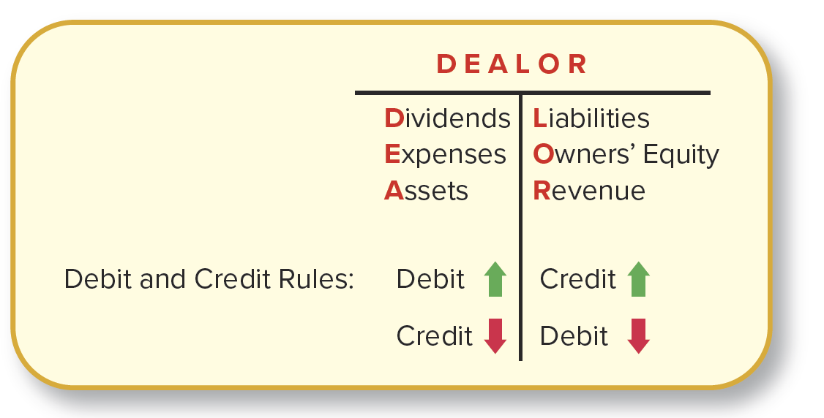
Debit and Credit Effects on Each Account Type
Illustration 2-7
A simple memory aid
Notes:
Here’s a simple way to remember which accounts increase with debits and which with credits.
The three accounts on the left, or debit, side of DEALOR—Dividends, Expenses, and Assets—increase with a debit and decrease with a credit. The three accounts on the right, or credit, side—Liabilities, Owners’ (stockholders’) equity, and Revenues—increase with a credit and decrease with a debit.

Slide 42
Concept Check 2-3
What does the word debit mean?
a. Left side
b. Right side
c. Increase
d. Decrease
The word debit means left side and the word credit means right side. The effects of debits and credits on account balances are different depending on the type of account being used. Sometimes a debit increases an account balance and sometimes it decreases an account balance.

Slide 43
Learning Objective 4
LO2-4 Record transactions in a journal using debits and credits.

Slide 44
Format for Recording a Business Transaction, or Journal Entry
Illustration 2-8
Date Debit Credit
Account Name ....................................... Amount
Account Name.................................. Amount
(Description of transaction)
Prior to the widespread use of computers, companies recorded their transactions in paper-based journals. Thus, the term journal entry.
Notes:
The journal entry that records a transaction has a place for the date of the transaction, the relevant account names, debit amounts, credit amounts, and a description of the transaction. A journal provides a chronological record of all transactions affecting a firm.
We first list the account to be debited; below that, and indented to the right, we list the account to be credited. The entry has two amount columns—one for debits, one for credits. Because the amounts always represent dollar amounts (not number of units, for example), the dollar sign ($) is not used.
As you might expect, the left-hand column is for debits, and the right-hand column is for credits. A brief description of the transaction is customarily included at the bottom to leave an information trail for later reference if necessary.
If you wanted to know all the company’s transactions for March 2, you would access the journal.
If you wanted to know all the company’s transactions for cash, you would access the cash account.

Slide 45
Common Mistake
Many students forget to indent the credit account names.
For the account credited, be sure to indent both the account name and the amount.

Slide 46
Recording Transactions—Example
On December 1, Eagle Soccer Academy sells shares of common stock to investors for cash of $200,000.
Debit to Cash for $200,000
Credit to Common Stock for $200,000
December 1 Debit Credit
Cash (+A).................................................. 200,000
Common Stock (+SE).......................... 200,000
(Issue common stock for cash)
Notes:
To record the transaction between Eagle and its investors in the books of Eagle, Cash is debited and Common Stock is credited for $200,000.
For each transaction, total debits must equal total credits.

Slide 47
Key Point
For each transaction, total debits must equal total credits.

Slide 48
Common Mistake
Students sometimes hear the phrase “assets are the debit accounts” and believe it indicates that assets can only be debited. This is incorrect! Assets, or any account, can be either debited or credited. Rather, this phrase indicates that debiting the asset account will increase the balance and that an asset account normally will have a debit balance.
Similarly, the phrase “liabilities and stockholders’ equity are the credit accounts” does not mean that these accounts cannot be debited. They will be debited when their balances decrease. Rather, the phrase means that crediting the liabilities and stockholders’ equity accounts increases their balances, and they normally will have a credit balance.

Slide 49
Learning Objective 5
LO2-5 Post transactions to the general ledger.

Slide 50
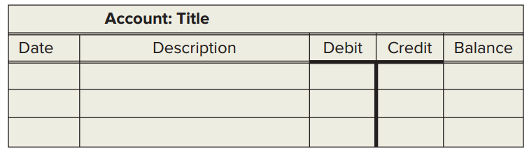
General Ledger Account
Illustration 2-10
Posting is the process of transferring the debit and credit information from the journal to individual general ledger accounts.
The general ledger provides, in a single collection, each account with its individual transactions and resulting account balance.
Notes:
A general ledger account includes an account title, transaction date, transaction description, and columns for debits, credits, and the cumulative account balance.
After all individual transactions for the period are posted to a general ledger account, we aggregate these individual amounts to compute a single ending account balance. It is this process of measuring each transaction and then aggregating those measurements that allows efficient communication of accounting information to financial statements users.
Of course, computerized systems automatically and instantly post information from the journal to the general ledger accounts and calculate account balances.

Slide 51
Posting Transaction to Accounts (1 of 10)
On December 1, Eagle Soccer Academy sells shares of common stock to investors for cash of $200,000.
(1) December 1 Debit Credit
Cash (+A)................................................................. 200,000
Common Stock (+SE)....................................... 200,000
(Issue common stock for cash)
Account: Cash
Date
Descriptions
Debit
Credit
Balance
Dec. 1
Beginning Balance
0
Dec. 1
Issue common stock for cash
200,000
200,000
Account: Common Stock
Date
Descriptions
Debit
Credit
Balance
Dec. 1
Beginning Balance
0
Dec. 1
Issue common stock for cash
200,000
200,000
Notes:
Posting involves simply moving the debit to Cash from the journal entry to a debit (or left side) in the Cash general ledger account, increasing its balance by $200,000. The credit to Common Stock from the journal entry becomes a credit (or right side) in the Common Stock general ledger account, increasing its balance by $200,000.

Slide 52
Posting Transaction to Accounts (2 of 10)
On December 1, Eagle borrows cash from a bank, $100,000.
(2) December 1 Debit Credit
Cash (+A)................................................................. 100,000
Notes Payable (+L)…........................................ 100,000
(Borrow cash by signing three-year note)
Account: Cash
Date
Descriptions
Debit
Credit
Balance
Dec. 1
Beginning balance
0
Dec. 1
Issue common stock for cash
200,000
200,000
Dec. 1
Borrow cash by signing note
100,000
300,000
Account: Notes Payable
Date
Descriptions
Debit
Credit
Balance
Dec. 1
Beginning balance
0
Dec. 1
Borrow cash by signing note
100,000
100,000
Notes:
We see that the balance in both accounts increases by $100,000. The balance of the Cash account is now $300,000, which includes $200,000 cash received from stockholders plus $100,000 cash received from the bank. The balance of the Notes Payable account increases from $0 to $100,000.

Slide 53
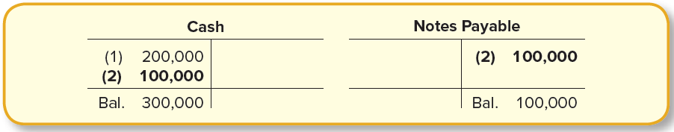
T-account
A T-account includes the account title at the top, one side for recording debits, and one side for recording credits.
The left side of the T-account is the debit column.
The right side is the credit column.
Here are the T-accounts for Cash and Notes Payable after posting transaction (2).
Notes:
From this point forward we’ll use a simplified version of the general ledger account, commonly referred to as a T-account.
You can see that the name T-account comes from the natural T shape formed in the general ledger by the debit and credit columns.

Slide 54
Posting Transaction to Accounts (3 of 10)
On December 1, Eagle purchases equipment with cash, $120,000.
(3) December 1 Debit Credit
Equipment (+A)....................................................... 120,000
Cash (−A)…………………....................................... 120,000
(Purchase equipment with cash)
Post to
accounts
T-account: Simplified version of general ledger account
Includes the account title at the top, left side for recording debits, and right side for recording credits
Equipment
Cash
(3) 120,000
Bal. 120,000
(3) 120,000
(1) 200,000
(2) 100,000
Bal. 180,000
Notes:
When Eagle purchases equipment with cash, we debit Equipment and post the debit to the Equipment account to show the balance of equipment has increased. We also credit Cash and post the credit to the Cash account to show that the balance of cash has decreased.
As we go through the remaining transactions, notice how each individual transaction is recorded in the journal but then adds to or subtracts from the account’s total balance in the general ledger.

Slide 55
Posting Transaction to Accounts (4 of 10)
On December 1, Eagle pays one year of rent in advance, $60,000 ($5,000 per month).
(4) December 1 Debit Credit
Prepaid Rent (+A) ….……………………………………………… 60,000
Cash (−A) ……………………………….……………………… 60,000
(Prepay one year of rent with cash)
Prepaid Rent
Cash
(4) 60,000
Bal. 60,000
(1) 200,000 (3) 120,000
(2) 100,000 (4) 60,000
Bal. 120,000
Notes:
When Eagle pays one year of rent in advance, we debit Prepaid Rent and post the debit to the Prepaid Rent account to show the balance of prepaid rent has increased. We also credit Cash and post the credit to the Cash account to show that the balance of cash has decreased.

Slide 56
Posting Transaction to Accounts (5 of 10)
On December 6, Eagle purchases supplies on account, $23,000.
(5) December 6 Debit Credit
Supplies (+A) .……………………………………………….………. 23,000
Accounts Payable (+L) .…………………………………. 23,000
(Purchase supplies on account)
Supplies
Accounts Payable
(5) 23,000
Bal. 23,000
(5) 23,000
Bal. 23,000
Notes:
When Eagle purchases supplies on account, we debit Supplies and post the debit to the Supplies account to show the balance of supplies has increased. We also credit Accounts Payable and post the credit to the Accounts Payable account to show that the balance of accounts payable has increased.

Slide 57
Posting Transaction to Accounts (6 of 10)
On December 12, Eagle provides soccer training to customers for cash, $43,000.
(6) December 12 Debit Credit
Cash (+A)……..……………………………………………….……….. 43,000
Service Revenue (+R, +SE) …………………………….. 43,000
(Provide training to customers for cash)
Cash
Service Revenue
(1) 200,000 (3) 120,000
(2) 100,000 (4) 60,000
(6) 43,000
Bal. 163,000
(6) 43,000
Bal. 43,000
Notes:
When Eagle provides soccer training to customers for cash, we debit Cash and post the debit to the Cash account to show the balance of cash has increased. We also credit Service Revenue and post the credit to the Service Revenue account to show that the balance of service revenue has increased.

Slide 58
Posting Transaction to Accounts (7 of 10)
On December 17, Eagle provides soccer training to customers on account, $20,000.
(7) December 17 Debit Credit
Accounts Receivable (+A) …………………………….……….. 20,000
Service Revenue (+R, +SE) …………………………….. 20,000
(Provide training to customers on account)
Accounts Receivable
Service Revenue
(7) 20,000
Bal. 20,000
(6) 43,000
(7) 20,000
Bal. 63,000
Notes:
When Eagle provides soccer training to customers on account, we debit Accounts Receivable and post the debit to the Accounts Receivable account to show the balance of accounts receivable has increased. We also credit Service Revenue and post the credit to the Service Revenue account to show that the balance of service revenue has increased.

Slide 59
Posting Transaction to Accounts (8 of 10)
On December 23, Eagle receives cash in advance for 12 soccer training sessions to be given in the future, $6,000.
(8) December 23 Debit Credit
Cash (+A) ………………………………………………….…….… …… 6,000
Deferred Revenue (+L) ………..………………………… 6,000
(Receive cash in advance from customers)
Cash
Deferred Revenue
(1) 200,000 (3) 120,000
(2) 100,000 (4) 60,000
(6) 43,000
(8) 6,000
Bal. 169,000
(8) 6,000
Bal. 6,000
Notes:
When Eagle receives cash in advance from customers, we debit Cash and post the debit to the Cash account to show the balance of cash has increased. We also credit Deferred Revenue and post the credit to the Deferred Revenue account to show that the balance of deferred revenue has increased.

Slide 60
Posting Transaction to Accounts (9 of 10)
On December 28, Eagle pays salaries to employees, $28,000.
(9) December 28 Debit Credit
Salaries Expense (+E, −SE) ……………………………………… 28,000
Cash (−A) ……………………………………………………….. 28,000
(Pay salaries to employees)
Salaries Expense
Cash
(9) 28,000
Bal. 28,000
(1) 200,000 (3) 120,000
(2) 100,000 (4) 60,000
(6) 43,000 (9) 28,000
(8) 6,000
Bal. 141,000
Notes:
When Eagle pays salaries to employees, we debit Salaries Expense and post the debit to the Salaries Expense account to show the balance of salaries expense has increased. We also credit Cash and post the credit to the Cash account to show that the balance of cash has decreased.

Slide 61
Posting Transaction to Accounts (10 of 10)
On December 30, Eagle pays cash dividends to shareholders, $4,000.
(10) December 30 Debit Credit
Dividends (+D, −SE) ………..…………………………..……..… 4,000
Cash (−A) ………………………………………………………. 4,000
(Pay cash dividends)
Dividends
Cash
(10) 4,000
Bal. 4,000
(1) 200,000 (3) 120,000
(2) 100,000 (4) 60,000
(6) 43,000 (9) 28,000
(8) 6,000 (10) 4,000
Bal. 137,000
Notes:
When Eagle pays cash dividends to shareholders, we debit Dividends and post the debit to the Dividends account to show the balance of dividends has increased. We also credit Cash and post the credit to the Cash account to show that the balance of cash has decreased.

Slide 62
Key Point
Posting is the process of transferring the debit and credit information from transactions recorded in the journal to individual accounts in the general ledger.

Slide 63
Illustration 2-11 (1 of 3) Summary of Journal Entries Recorded for Transactions of Eagle Soccer Academy
(1) December 1 Debit Credit
Cash (+A) ……..……………………………………………………….. 200,000
Common Stock (+SE) ……………………………………. 200,000
(Issue common stock for cash)
(2) December 1 Debit Credit
Cash (+A) ……..……………………………………………………….. 100,000
Notes Payable (+L) ………………………………………… 100,000
(Borrow cash by signing three-year note)
(3) December 1 Debit Credit
Equipment (+A) ..…..………………………………………………. 120,000
Cash (−A) ……………………………….……………………… 120,000
(Purchase equipment with cash)
(4) December 1 Debit Credit
Prepaid Rent (+A) ….…………………………………….…………. 60,000
Cash (−A) ……………………………….……………………….. 60,000
(Prepay rent with cash)
Continued
Copyright ©2019 McGraw-Hill Education. All rights reserved. No reproduction or distribution without the prior written consent of McGraw-Hill Education.
Notes:
A summary of the first four external transactions recorded for Eagle Soccer Academy in the month of December are provided in this slide.

Slide 64
Illustration 2-11 (2 of 3) Summary of Journal Entries Recorded for Transactions of Eagle Soccer Academy
(5) December 6 Debit Credit
Supplies (+A) .……………………………………………….……… 23,000
Accounts Payable (+L) .………………………………… 23,000
(Purchase supplies on account)
(6) December 12 Debit Credit
Cash (+A)……..……………………………………………….……… 43,000
Service Revenue (+R, +SE) …………………………… 43,000
(Provide training to customers for cash)
(7) December 17 Debit Credit
Accounts Receivable (+A)……..………….……….….………. 20,000
Service Revenue (+R, +SE) ………………………….… 20,000
(Provide training to customers on account)
(8) December 23 Debit Credit
Cash (+A) ……………………………..………….……….….………. 6,000
Deferred Revenue (+L) …………………..……………. 6,000
(Receive cash in advance from customers)
Continued
Copyright ©2019 McGraw-Hill Education. All rights reserved. No reproduction or distribution without the prior written consent of McGraw-Hill Education.
Notes:
A summary of the second four external transactions recorded for Eagle Soccer Academy in the month of December are provided in this slide.

Slide 65
Illustration 2-11 (3 of 3) Summary of Journal Entries Recorded for Transactions of Eagle Soccer Academy
(9) December 28 Debit Credit
Salaries Expense (+E, −SE) ..…..……………………….… …… 28,000
Cash (−A) …..…………………………..……………………… 28,000
(Pay salaries to employees)
(10) December 30 Debit Credit
Dividends (+D, −SE) ……………..………….……….….……...... 4,000
Cash (−A) …..…………………………..…………………….... 4,000
(Pay cash dividends)
Copyright ©2019 McGraw-Hill Education. All rights reserved. No reproduction or distribution without the prior written consent of McGraw-Hill Education.
Notes:
A summary of the final two external transactions recorded for Eagle Soccer Academy in the month of December are provided in this slide.

Slide 66
Illustration 2-12 Posting of External Transactions of Eagle Soccer Academy from Journal Entries to General Ledger Accounts
z
Assets = Liabilities + Stockholders’ Equity
Accounts
Receivable
Accounts
Payable
Common
Stock
Retained
Earnings
Cash
200,000
100,000
120,000
60,000
(7) 20,000
(5) 23,000
(1) 200,000
0
43,000
(8) 6,000
(9) 28,000
(10) 4,000
Bal. 20,000
Bal. 23,000
Bal. 200,000
0
Bal. 137,000
Prepaid
Rent
Deferred Revenue
Service Revenue
Salaries Expense
Supplies
(5) 23,000
(4) 60,000
(8) 6,000
43,000
20,000
(9) 28,000
Bal. 23,000
Bal. 60,000
Bal. 6,000
Bal. 63,000
Bal. 28,000
Notes
Payable
Equipment
Dividends
(3) 120,000
(2) 100,000
(10) 4,000
Bal. 120,000
Bal. 100,000
Bal. 4,000
Transaction numbers are shown in parentheses. Account balances are in bold.
Copyright ©2019 McGraw-Hill Education. All rights reserved. No reproduction or distribution without the prior written consent of McGraw-Hill Education.
Notes:
The general ledger shows the balances of all accounts.

Slide 67
Concept Check 2-4
Which of the following is used to provide a chronological record of all transactions affecting a firm?
a. The general ledger
b. The journal
c. The trial balance
The income statement
The journal is a chronological record of the economic events that have taken place. (The general ledger is used to accumulate the balances of the accounts, and the trial balance is a summarized listing of all the debit and credit accounts. The income statement is a financial statement used to determine whether the business was profitable.)

Slide 68
Concept Check 2-5
Which of the following accounts would be debited when a company pays $12,000 in advance for one year of rent?
a. Cash
b. Rent Expense
c. Prepaid Rent
Rental Income
This transaction creates a prepaid account—specifically prepaid rent. Prepaid rent is an asset account. In order to increase an asset account you would debit it. The correct answer is the prepaid rent account would be debited for $12,000 when the rent was paid in advance. (Cash would be credited.)

Slide 69
Learning Objective 6
LO2-6 Prepare a trial balance.

Slide 70
Trial Balance
A trial balance is a list of all accounts and their balances at a particular date, showing that total debits equal total credits.
Another purpose of the trial balance is to assist us in preparing adjusting entries for internal transactions (Chapter 3).
Used for internal purposes only
Not published to external parties
Not required to follow an order of listing
Notes:
After we’ve posted journal entries to the general ledger accounts, the sum of the accounts with debit balances should equal the sum of the accounts with credit balances. This is expected because debits were equal to credits for every journal entry posted to those ledger accounts.
To prove this and to check for any errors in posting, we prepare a trial balance. A trial balance is a list of all accounts and their balances at a particular date, showing that total debits equal total credits. Another purpose of the trial balance is to assist us in preparing adjusting entries (for internal transactions). We discuss adjusting entries in Chapter 3.

Slide 71
Common Mistake
Just because the debits and credits are equal in a trial balance does not necessarily mean that all balances are correct.
A trial balance could contain offsetting errors.
For example, if we overstate cash and revenue each by $1,000:
Both accounts will be in error.
But the trial balance will still balance, since the overstatement to cash increases debits by $1,000 and the overstatement to revenue increases credits by $1,000.

Slide 72
Illustration 2-13 Trial Balance of Eagle Soccer Academy
EAGLE SOCCER ACADEMY
Trial Balance
December 31, 2024
Accounts Debit Credit
Cash
Accounts Receivable
Supplies
Prepaid Rent
Equipment
Accounts Payable
Deferred Revenue
Notes Payable
Common Stock
Retained Earnings
Dividends
Service Revenue
Salaries Expense
Totals
$ 137,000
20,000
23,000
60,000
120,000
4,000
28,000
$392,000
$ 23,000
6,000
100,000
200,000
0
63,000
$392,000
Must
Equal
Copyright ©2019 McGraw-Hill Education. All rights reserved. No reproduction or distribution without the prior written consent of McGraw-Hill Education.
Notes:
Using the account balances we can now prepare the trial balance of Eagle Soccer Academy. Notice that accounts are listed with the debit balances in one column and the credit balances in another column. Asset, expense, and dividend accounts normally have debit balances. Liability, stockholders’ equity, and revenue accounts normally have credit balances. As expected, total debits ($392,000) equal total credits ($392,000).

Slide 73
Concept Check 2-6
Which of the following accounts would appear in the credit column of a trial balance?
a. Prepaid Rent
b. Dividends
c. Common Stock
Salaries Expense
The trial balance is a listing of all accounts and their balances at a given date. The only account listed above that would have a credit balance and therefore appear in the credit column of the trial balance is the common stock account. This is an equity account and equity accounts are increased by credits. (All other accounts listed have debit balances and therefore appear in the debit column.)

Slide 74
Order of Accounts
The trial balance is used for internal purposes only and provides a check on the equality of the debits and credits.
The trial balance simplifies preparation of the published financial statements.
Notes:
Because the trial balance is not a published financial statement to be used by external parties, there is no required order for listing accounts in the trial balance. However, most companies list accounts in the following order: assets, liabilities, stockholders’ equity, dividends, revenues, and expenses.
Having the accounts listed in order of those classifications in the trial balance makes it easier to prepare the financial statements.
Asset, liability, and stockholders’ equity accounts are reported in the balance sheet.
Dividends are reported in the statement of stockholders’ equity.
Revenue and expense accounts are reported in the income statement.

Slide 75
End of Chapter 2

