Slide 1
CS2115 Computer Organization 2023/2024 Sem A
Chapter 2: Number Systems
Dr. Nan Guan
Department of Computer Science
City University of Hong Kong

Slide 2
Outline
Decimal, Binary, Octal, Hexadecimal Systems
Conversion between different systems
Arithmetic
Signed Number Representation
Sign Magnitude Number
Two’s Complement
Floating-point Number
BCD, ASCII, Gray …
Notes:
We will talk about

Slide 3
Outline
Decimal, Binary, Octal, Hexadecimal Systems
Conversion between different systems
Arithmetic
Signed Number Representation
Sign Magnitude Number
Two’s Complement
Floating-point Number
BCD, ASCII, Gray

Slide 4
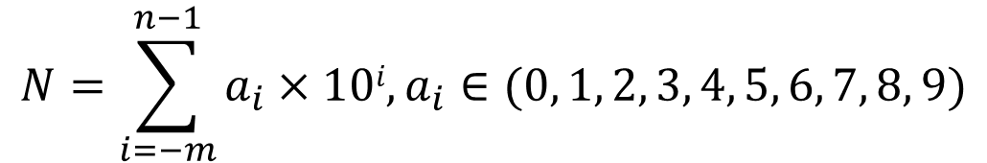
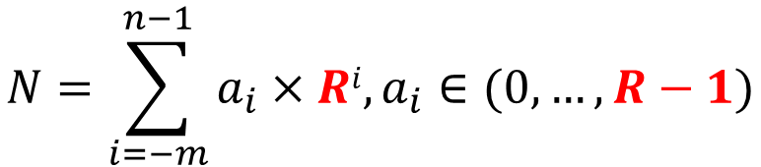
Decimal System
972.5 = 9×10² + 7×10¹ + 2×10⁰ + 5×10⁻¹
radix
$N=(a_{n−1}a_{n−2}…a_{1}a_{0} .a_{−1}a_{−2}…a_{−m})$₁₀
$$N=\sum_{i=−m}^{n−1}{a_{i}×10i{, a}_{i}}∈(0, 1, 2, 3, 4, 5, 6, 7, 8, 9)$$
Radix-10 System
generalize
$N=(a_{n−1}a_{n−2}…a_{1}a_{0} .a_{−1}a_{−2}…a_{−m})$_{R}
$$N=\sum_{i=−m}^{n−1}{a_{i}×Ri{, a}_{i}}∈(0, …, R−1)$$
Radix-R System

Slide 5
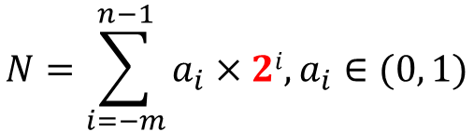
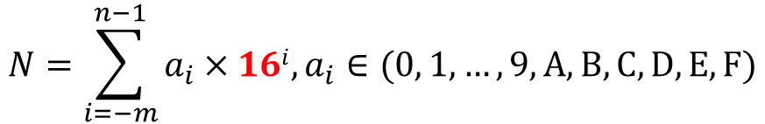

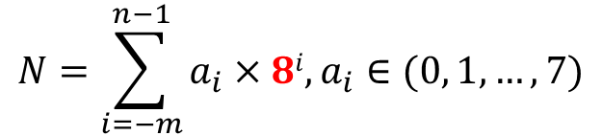

Binary, Octal and Hexadecimal
$N=(a_{n−1}a_{n−2}…a_{1}a_{0} .a_{−1}a_{−2}…a_{−m})$₂
Binary system (Radix-2)
Octal system (Radix-8)
Hexadecimal system (Radix-16)
$$N=\sum_{i=−m}^{n−1}{a_{i}×2i{,a}_{i}}∈(0, 1)$$
12.125 = (1100.001)₂
12.125 = 1×2³+1×2²+0×2¹+0×2⁰+0×2⁻¹+0×2⁻²+1×2⁻³
$N=(a_{n−1}a_{n−2}…a_{1}a_{0} .a_{−1}a_{−2}…a_{−m})$₈
$$N=\sum_{i=−m}^{n−1}{a_{i}×8i{,a}_{i}}∈(0, 1,…,7)$$
12.125 = (14.1)₈
12.125 = 1×8¹+4×8⁰+1×8⁻¹
$N=(a_{n−1}a_{n−2}…a_{1}a_{0} .a_{−1}a_{−2}…a_{−m})$₁₆
$$N=\sum_{i=−m}^{n−1}{a_{i}×16i{,a}_{i}}∈(0, 1,…,9,A,B,C,D,E, F)$$
12.125 = (C.2)₁₆
12.125 = C×16⁰+2×16⁻¹
$$10, 11, 12, 13, 14, 15$$

Slide 6
Binary ←→ Octal ←→ Hexadecimal

Slide 7
Binary ←→ Octal ←→ Hexadecimal
2 6 3 5 . 5 4 4
Hexadecimal
5 9 D . B 2
Octal
10110011101.1011001
00
0
10110011101.1011001
Binary
0
0
Binary

Slide 8
Conversion to Decimal
(10101)₂ = (1×2⁴+ 0×2³+1×2²+ 0×2¹+1×2⁰)₁₀ = (21)₁₀
(1276)₈ = (1×8³+2×8²+7×8¹+6×8⁰)₁₀ = (702)₁₀
(9DF8)₁₆ = (9×16³+D×16²+F×16¹+8×16⁰)₁₀ = (40440)₁₀
(101.11)₂ = (1×2²+1×2⁰+1×2⁻¹+1×2⁻²)₁₀ = (4+1+0.5+0.25)₁₀ =(5.75)₁₀
(8A.E2)₁₆ = (8×16¹+A×16⁰+E×16⁻¹+8×16⁻²)₁₀
= (128 + 10 + 14/16 + 8/256)₁₀
= (138.90625)₁₀

Slide 9
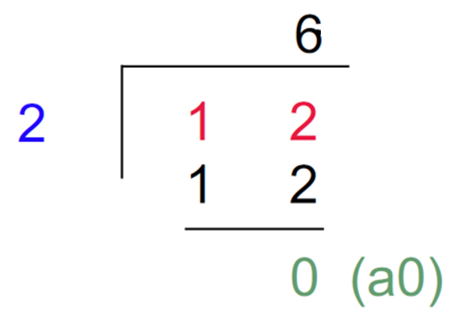
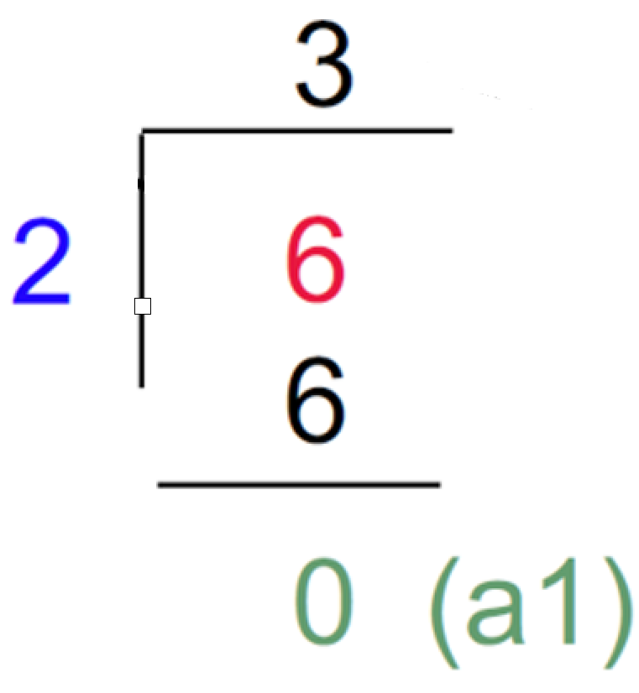
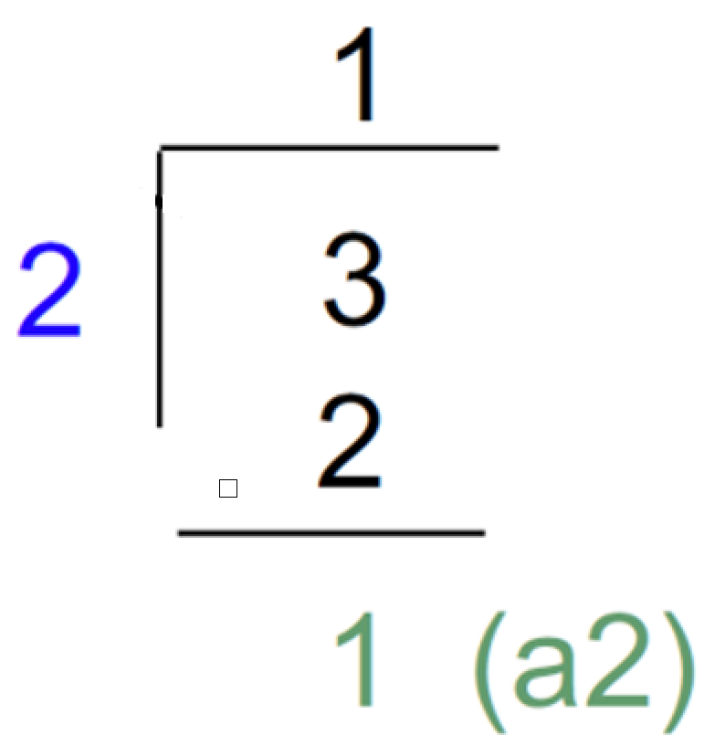
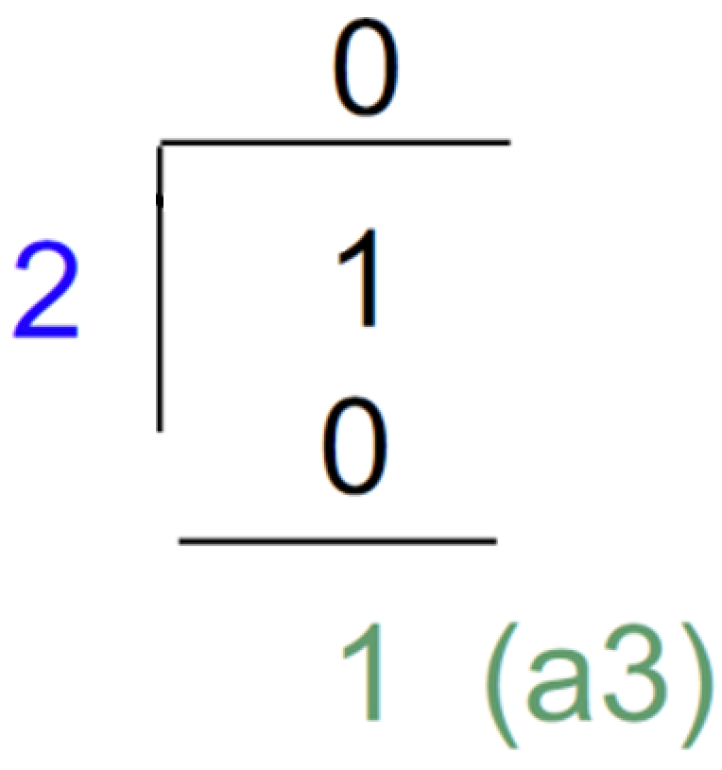
Conversion from Decimal
For integers: Radix divide method
(12)₁₀ = ( ? )₂
(12)₁₀ = ( 1100 )₂
(1582)₁₀ = ( ? )₁₆
(1582)₁₀ = ( 62E )₁₆

Slide 10
Conversion from Decimal
For the fractional part: Radix multiply method
(0.72)₁₀ = ( ? )₂
(0.65)₁₀ = ( ? )₁₆
0.72×2 = 1.44
0.65×16 = 10.4
0.44×2 = 0.88
0.4×16 = 6.4
0.88×2 = 1.76
0.4×16 = 6.4
0.76×2 = 1.52
…
0.52×2 = 1.04
(0.65)₁₀ = ( 0.A666 … )₁₆
…
(0.72)₁₀ = ( 0.10111 … )₂

Slide 11
Arithmetic
Direct computation:
Following essentially the same rule as in decimal, with a different radix
(1001)₂+ (1101)₂
1001
1001
1001
1001
+
1101
+
1101
+
1101
+
1101
1
1
10110
0
10
110
8B
8B
(8B)₁₆ × (3)₁₆
×
3
×
3
2
2
1
1A1
Notes:
We can also do

Slide 12
Arithmetic
Indirect computation
First convert everything to decimal, then compute, finally convert back
(1001)₂+ (1101)₂
(9)₁₀+ (13)₁₀
(22)₁₀
(11010)₂
(8B)₁₆ × (3)₁₆
(139)₁₀ × (3)₁₆
(417)₁₀
(1A1)₁₆

Slide 13
Outline
Decimal, Binary, Octal, Hexadecimal Systems
Conversion between different systems
Arithmetic
Signed Number Representation
Sign Magnitude Number
Two’s Complement
Floating-point Number
BCD, ASCII, Gray

Slide 14
Sign Magnitude Numbers
Naïve representation: the leftmost digit represents sign (sign digit), the remailing represents the absolute value
sign digit =0 → positive; sign digit = 1 → negative
Drawbacks
Addition/subtraction need to consider different cases of different signs
Complicate circuit and more computation effort
Rarely used in practice
sign
magnitude

Slide 15
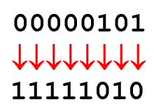
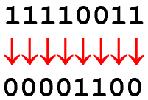
2’s Complement
Rules:
Positive numbers are represented in the same way as in sign magnitude numbers
Negative numbers are represented as the complement of positive numbers
Complement: change 1 to 0, change 0 to 1

Slide 16
2’s Complement
+127
01111111
Consider a 8-bit binary system
Cut the number system in half
Use 00000001 – 01111111 to indicate positive numbers
Use 10000000 – 11111111 to indicate negative numbers
pos(+)
+126
01111110
+125
01111101
+1
00000001
0
00000000
-1
11111111
-2
11111110
-127
10000001
neg(-)
-128
10000000

Slide 17
Sign Bit
+127
01111111
The most significant bit (MSB) of the binary numbers is the signed bit
The MSB is (0) for all positive numbers
Except 00000000
The MSB is (1) for all negative numbers
Similar to sign magnitude numbers, this allows you to instantly determine whether a number is positive or negative
pos(+)
+126
01111110
+125
01111101
+1
00000001
0
00000000
-1
11111111
-2
11111110
-127
10000001
neg(-)
-128
10000000

Slide 18
2’s Complement Process
To calculate the representation of a negative number – using 2’s Complement Process
First, complement all of the digits in a number.
Second, add 1.

Slide 19
2’s Complement Process
Example #1
5 = 00000101
↓↓↓↓↓↓↓↓
Complement Digits
11111010
+1
Add 1
-5 = 11111011
Example #2
-13 = 11110011
↓↓↓↓↓↓↓↓
Complement Digits
00001100
+1
Add 1
13 = 00001101

Slide 20
2’s Complement Arithmetic
Use the 2’s complement process to add the following numbers
POS
+ POS
POS
9
+ 5
14
NEG
+ POS
NEG
(-9)
+ 5
- 4
⇒
⇒
POS
+ NEG
POS
9
+ (-5)
4
NEG
+ NEG
NEG
(-9)
+ (-5)
- 14
⇒
⇒

Slide 21
POS + POS → POS Answer
If no 2’s complement is needed, use regular binary addition.
9
+ 5
14
⎯→
00001001
00000101
⎯→
+
←⎯
00001110

Slide 22
POS + NEG → POS Answer
Take the 2’s complement of the negative number and use regular binary addition.
9
+ (-5)
4
⎯→
00001001
11111011
+
←⎯
1]00000100
8th Bit = 0: Answer is Positive
Disregard 9th Bit
00000101
↓↓↓↓↓↓↓↓
11111010
+1
11111011
2’s
Complement
Process

Slide 23
POS + NEG → NEG Answer
Take the 2’s complement of the negative number and use regular binary addition.
(-9)
+ 5
-4
11110111
00000101
⎯→
+
←⎯
11111100
8th Bit = 1: Answer is Negative
11111100
↓↓↓↓↓↓↓↓
00000011
+1
00000100
00001001
↓↓↓↓↓↓↓↓
11110110
+1
11110111
To Check:
Perform 2’s
Complement
On Answer
2’s
Complement
Process

Slide 24
NEG + NEG → NEG Answer
Take the 2’s complement of both negative numbers and use regular binary addition.
(-9)
+ (-5)
-14
⎯→
11110111
2’s Complement
Numbers, See
Conversion Process
In Previous Slides
11111011
⎯→
+
←⎯
1]11110010
8th Bit = 1: Answer is Negative
Disregard 9th Bit
11110010
↓↓↓↓↓↓↓↓
00001101
+1
00001110
To Check:
Perform 2’s
Complement
On Answer

Slide 25
Outline
Decimal, Binary, Octal, Hexadecimal Systems
Conversion between different systems
Arithmetic
Signed Number Representation
Sign Magnitude Number
Two’s Complement
Floating-point Number
BCD, ASCII, Gray

Slide 26
Binary with Fractional Part
Recall that in binary number system
(1001.1010)₂ = 2³ + 2⁰ +2⁻¹ + 2⁻³ =9.625
If we fix the position of the point
We are not able to represent small numbers with high precision
We are not able to represent large numbers
Point is here
0 | 0 | 0 | 0 | 0 | 0 | 0 | 1 | 0 | 1 | 1 | 0 | 1 | 0 | 1 | 1
Point is here
1 | 0 | 0 | 0 | 0 | 1 | 0 | 1 | 0 | 0 | 0 | 0 | 0 | 0 | 0 | 0

Slide 27
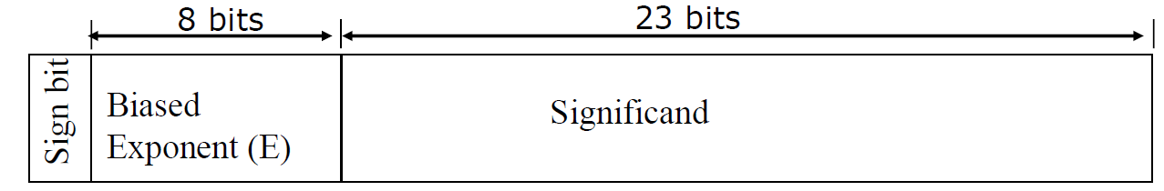
Floating-Point Numbers
32-bit Binary Floating-Point Numbers
value = (+/- Significand × 2^{E’})
Sign bit: 0→positive; 1→negative
Biased Exponent (E)
Biased exponent E = real exponent value E’ + bias
bias=2^{K-1} - 1, K=8 (8-bits of exponent), bias = 127
Significand
Normalized number: represent 1.xxx
The most significant digit is always 1, so we do not need to store this information
Thus, 23-bit is used to store 24-bit significand

Slide 28
Floating-Point Numbers
32-bit Binary Floating-Point Numbers
value = (+/- Significand × 2^{E’})
Sign bit: 0→positive; 1→negative
Biased Exponent (E)
Biased exponent E = real exponent value E’ + bias
bias=2^{K-1} - 1, K=8 (8-bits of exponent), bias = 127
Significand
Normalized number: represent 1.xxx
The most significant digit is always 1, so we do not need to store this information.
Thus, 23-bit is used to store 24-bit significand
1
10000100
10100000000000000000000
negative
Biased exponent E = 132
Real exponent value E’ = 132 – 127 = 5
Significand = 1 + 0.101000... (binary)
= 1 + 0. 625 (decimal)
So the value of the number is
-1.625 × 2⁵

Slide 29
Outline
Decimal, Binary, Octal, Hexadecimal Systems
Conversion between different systems
Arithmetic
Signed Number Representation
Sign Magnitude Number
Two’s Complement
Floating-point Number
BCD, ASCII, Gray

Slide 30
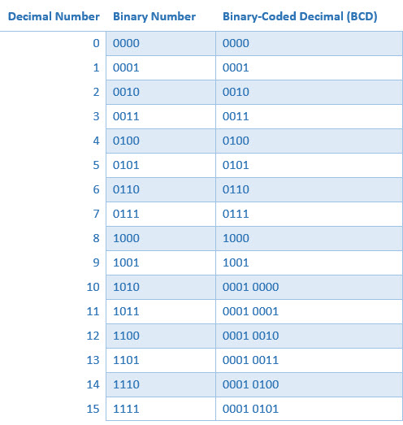
BCD: Binary-Coded Decimal
4-bit binary form to encode ten numbers from 0 to 9

Slide 31
BCD: Binary-Coded Decimal
4-bit binary form to encode ten numbers from 0 to 9

Slide 32
BCD: Binary-Coded Decimal
4-bit binary form to encode ten numbers from 0 to 9

Slide 33
BCD: Binary-Coded Decimal
4-bit binary form to encode ten numbers from 0 to 9
137
10001001
0001 0011 0111

Slide 34
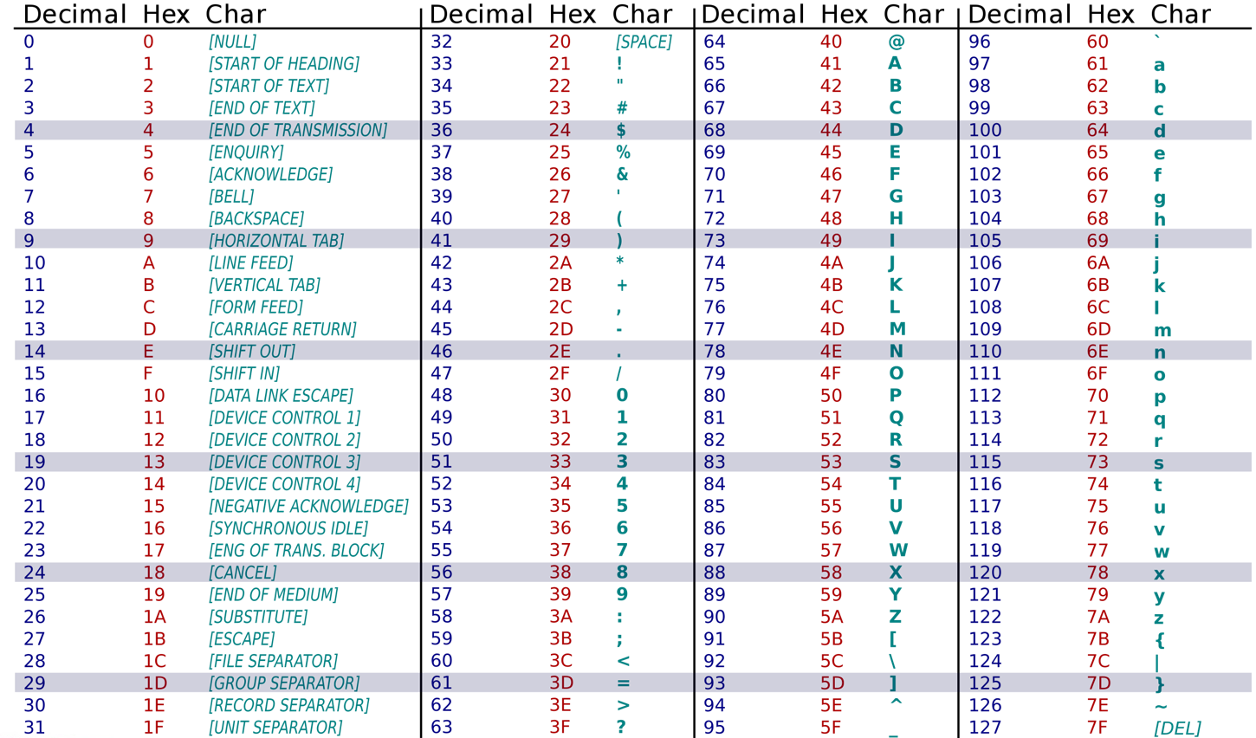
ASCII Code
ASCII: American Standard Code for Information Interchange
ASCII encodes 128 specified characters into 7-bit integers

Slide 35
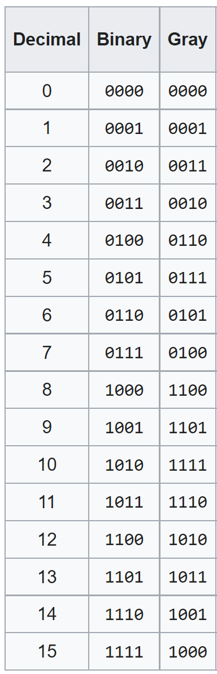
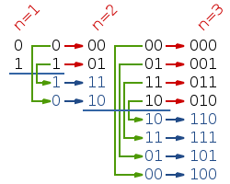
Gray Code
An encoding of numbers so that adjacent numbers have a single digit differing by 1

