Slide 1
CS2115 Computer Organization 2023/2024 Sem A
Chapter 3: Circuits
Dr. Nan Guan
Department of Computer Science
City University of Hong Kong

Slide 2
Outline
Combinational logic circuits
Sequential logic circuits

Slide 3
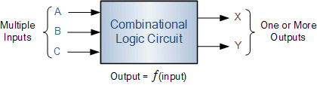

Logic Circuits
Operate on binary variables
have inputs and outputs
to implement functions of logic variables

Slide 4
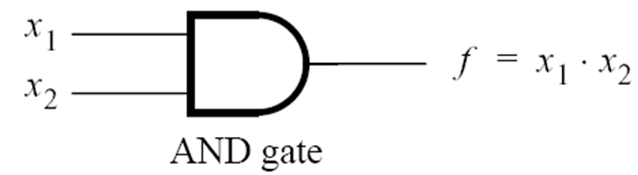
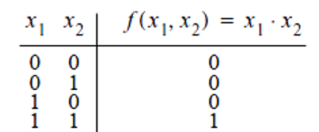
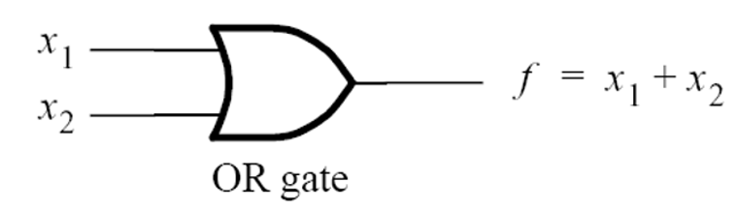
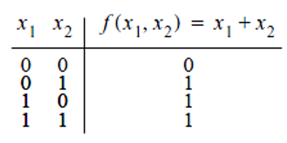
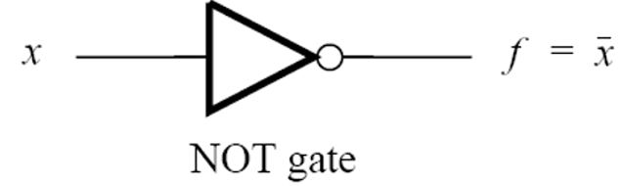
Logic Gates
Logical circuits are implemented using electronic logic gates
Standard logic gates
AND is also called “product”
Truth Table: sets out the functional values of logical expressions on each combination of values of inputs
OR is also called “add”

Slide 5
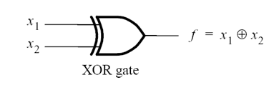
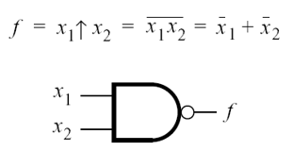
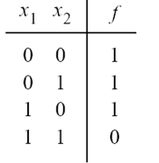
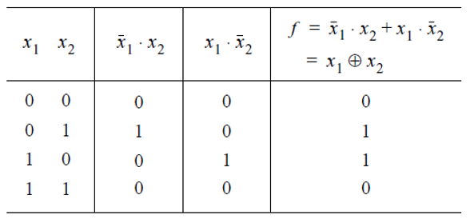
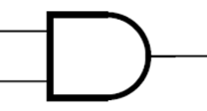
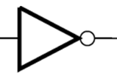
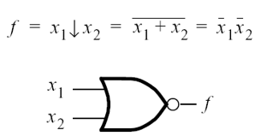
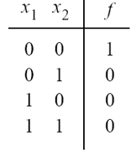
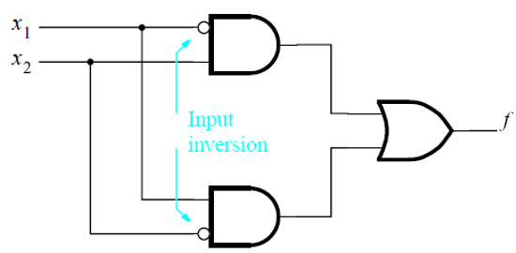
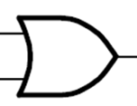
Logic Gates
More gates
NAND gate
inversion
inversion
NOR gate

Slide 6
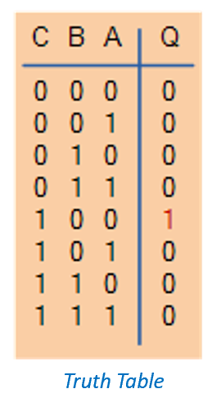
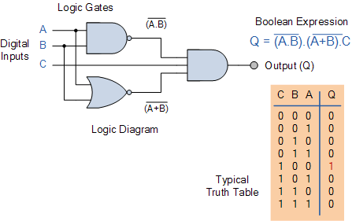
Logic Gates
Combinational logic circuits
made up of basic logic gates that are “combined” or connected together to produce more complicated “functions”
Truth Table

Slide 7
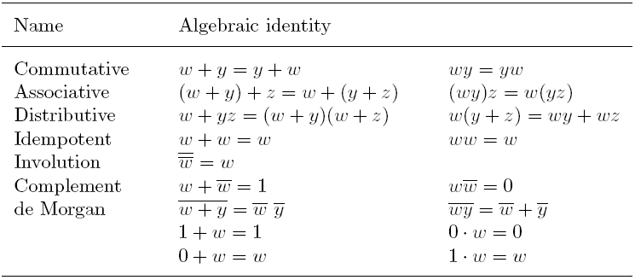
Rules of Binary Logic
Recall: OR → “add”, AND → “product”

Slide 8
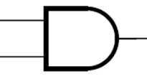
Rules of Binary Logic
w
y
z
=
y
w
z
Recall: OR → “add”, AND → “product”

Slide 9
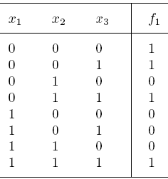

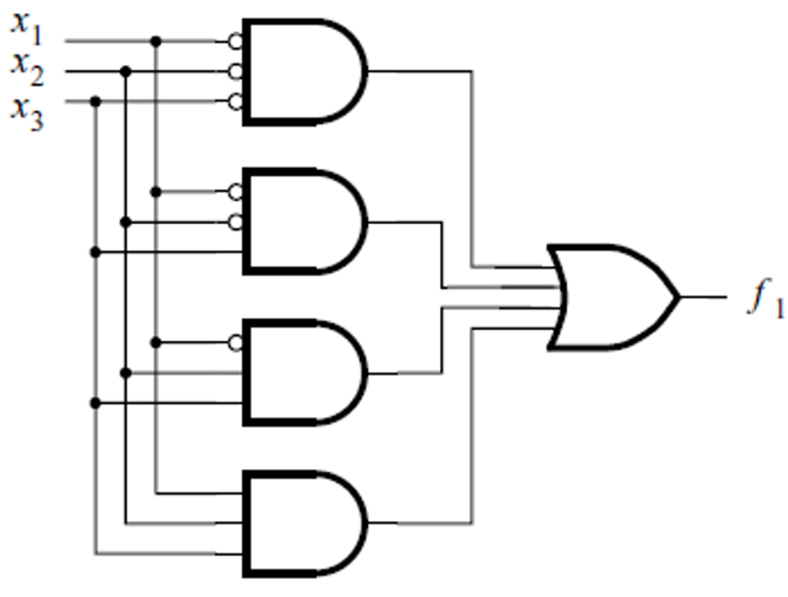
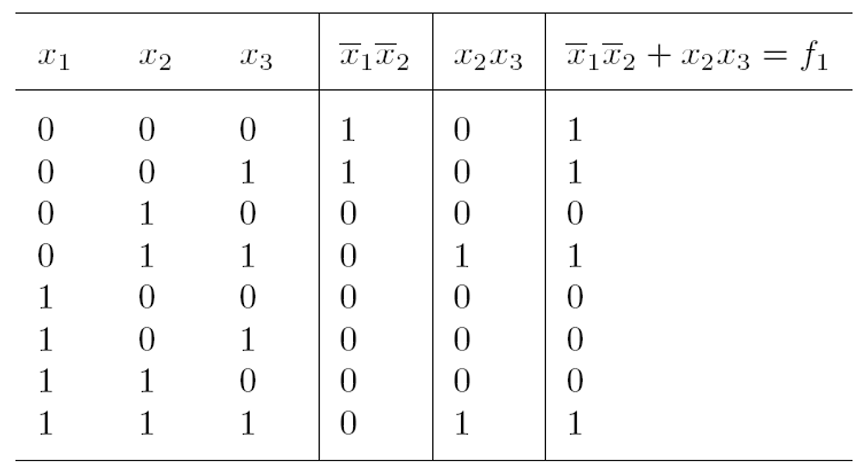
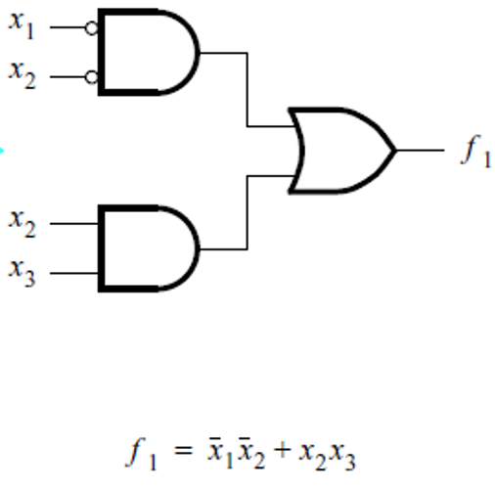
Synthesis of Circuit
Designing a logic circuit according to truth table
Use the sum-of-products form
Product term: includes all inputs, applying NOT to those of value 0
Sum of all the product terms having output 1
but this much simpler one also works!
Notes:
As illustrated in this example, a logic function can be implemented with circuits of different complexities.
It is useful to minimize a logic expression to reduce the cost of the synthesized circuit.

Slide 10
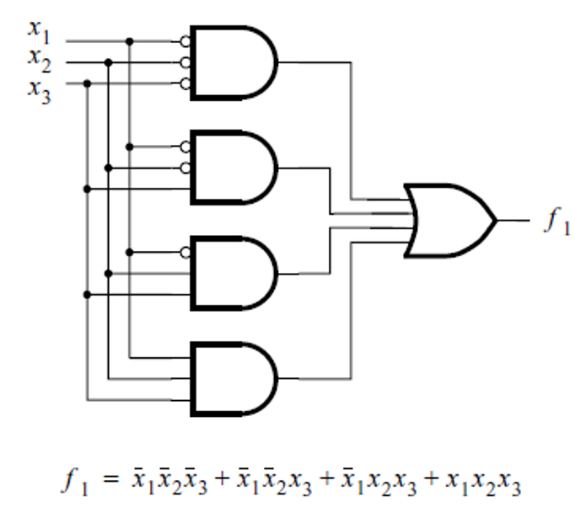
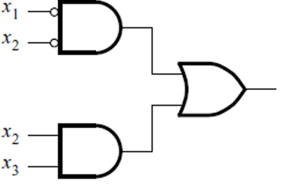




Simplification of Logic Expression
Use binary logic rules to simplify
$$f1= \overline{x1}\overline{x2}\overline{x3}+\overline{x1}\overline{x2}x3+\overline{x1}x2x3+x1x2x3$$
$=$ $\overline{x1}\left(\overline{x2}\overline{x3}+\overline{x2}x3\right)+(\overline{x1}+x1)x2x3$
$=$ $\overline{x1}\left(\overline{x2}(\overline{x3}+x3)\right)+x2x3$
$$=\overline{x1}\overline{x2}+x2x3$$

Slide 11
Simplification of Logic Expression
Karnaugh Maps
Different form of a truth table which enables easier pattern recognition.
Pictorial method of simplifying Boolean expressions.
Good for circuit designs with up to 4 variables.

Slide 12
Karnaugh Maps
Truth Table
Karnaugh Map
A | B | F
0 | 0 | 0
0 | 1 | 1
1 | 0 | 1
1 | 1 | 1
A
0
0
0
0
1
B
0
1
0
0
0
1
0
1
1
0
1
1
1
1
1
1
1
0
1
1
1
1
1
F

Slide 13
Deriving Expressions from a Karnaugh Map

Slide 14
A
Karnaugh Map
A | B | F
0 | 0 | 0
0 | 1 | 0
1 | 0 | 1
1 | 1 | 1
A
1
B
0
1
1
0
0 | 1
0 | 1
0
1
1
1
F

Slide 15

A
$$∨$$
B
Karnaugh Map
A | B | F
0 | 0 | 0
0 | 1 | 1
1 | 0 | 1
1 | 1 | 1
A
1
B
0
1
1
0
0 | 1
1 | 1
1
1
1
1
F

Slide 16
1
Karnaugh Map
A | B | F
0 | 0 | 1
0 | 1 | 1
1 | 0 | 1
1 | 1 | 1
A
B
0
1
1
1 | 1
1 | 1
0
1
1
1
1
F

Slide 17



$¬$A
$$∨$$
$¬$B
Karnaugh Map
A | B | F
0 | 0 | 1
0 | 1 | 1
1 | 0 | 1
1 | 1 | 0
A
0
1
B
0
1 | 1
1 | 0
0
1
1
0
1
1
F

Slide 18
Karnaugh Maps with 3 Variables

Slide 19
A
A | B | C | F
0 | 0 | 0 | 0
0 | 0 | 1 | 0
0 | 1 | 0 | 1
0 | 1 | 1 | 1
1 | 0 | 0 | 1
1 | 0 | 1 | 1
1 | 1 | 0 | 1
1 | 1 | 1 | 1
A
0
1
BC
0
1
0
0
0
0
BC
0
0
1
0
00
1
00
0
1
0
0
1
0
1
1
01
0
1
00
01
0
1
1
1
01
0
1
0
0
1
11
01
1
1
11
1
1
11
1
0
1
1
1
1
0
1
10
1
11
1
10
10
1
1
1
1
1
1

Slide 20

A
$$∨$$
B
A | B | C | F
0 | 0 | 0 | 0
0 | 0 | 1 | 0
0 | 1 | 0 | 1
0 | 1 | 1 | 1
1 | 0 | 0 | 1
1 | 0 | 1 | 1
1 | 1 | 0 | 1
1 | 1 | 1 | 1
A
1
BC
0
1
00
0
1
1
1
01
0
1
11
11
1
1
1
1
10
1
1
1
10
1

Slide 21
A
$$∨$$
B
A
BC
0
1
AB
00
0
1
C
00
01
11
10
0 | 1 | 1 | 1
0 | 1 | 1 | 1
0
01
0
1
1
11
1
1
10
1
1

Slide 22
B
$$∨$$
A
AB
01
11
01
11
00
11
10
C
10
0 | 1 | 1 | 1
0 | 1 | 1 | 1
0
1
1
1
1
1
1
1
CORRECT!
WRONG!

Slide 23
A | B | C | F
0 | 0 | 0 | 1
0 | 0 | 1 | 0
0 | 1 | 0 | 1
0 | 1 | 1 | 0
1 | 0 | 0 | 1
1 | 0 | 1 | 1
1 | 1 | 0 | 1
1 | 1 | 1 | 1
AB
C
00
01
11
10
1 | 1 | 1 | 1
0 | 0 | 1 | 1
0
1

Slide 24


$¬$C
$$∨$$
A
AB
C
00
01
11
10
1 | 1 | 1 | 1
0 | 0 | 1 | 1
0
0
1
1
1
1
1
1
1

Slide 25

A
$$∧$$
B
AB
01
11
11
C
00
11
10
0 | 0 | 1 | 0
0 | 0 | 1 | 0
0
1

Slide 26
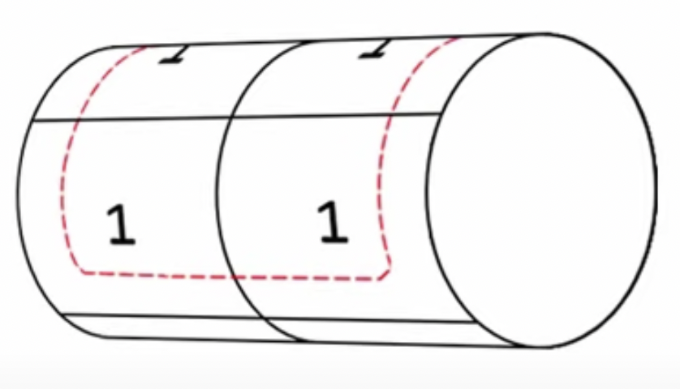
$¬$C
A
0
1
BC
0
1
00
1
1
00
1
1
00
01
0
0
11
0
0
10
10
10
1
1
1
1

Slide 27


A
$$∧$$
$¬$C
A
1
BC
0
1
00
1
00
0
1
01
0
0
11
0
0
10
10
0
1
1

Slide 28
Summary of Grouping Rules
A group must only contain 1s, no 0s
A group can only be horizontal or vertical, not diagonal
A group must contain 2^{n} 1s (1, 2, 4, 8, etc.)
Each group should be as large as possible
Groups may overlap
Groups may wrap around a table
Every 1 must be in at least one group
There should be as few groups as possible

Slide 29
Karnaugh Maps with 4 Variables

Slide 30
A | B | C | D | F
0 | 0 | 0 | 0 | 0
0 | 0 | 0 | 1 | 1
0 | 0 | 1 | 0 | 0
0 | 0 | 1 | 1 | 0
0 | 1 | 0 | 0 | 0
0 | 1 | 0 | 1 | 1
0 | 1 | 1 | 0 | 0
0 | 1 | 1 | 1 | 0
1 | 0 | 0 | 0 | 0
1 | 0 | 0 | 1 | 1
1 | 0 | 1 | 0 | 0
1 | 0 | 1 | 1 | 0
1 | 1 | 0 | 0 | 1
1 | 1 | 0 | 1 | 1
1 | 1 | 1 | 0 | 1
1 | 1 | 1 | 1 | 1
A | B | C | D | F
0 | 0 | 0 | 0 | 0
0 | 0 | 0 | 1 | 1
0 | 0 | 1 | 0 | 0
0 | 0 | 1 | 1 | 0
0 | 1 | 0 | 0 | 0
0 | 1 | 0 | 1 | 1
0 | 1 | 1 | 0 | 0
0 | 1 | 1 | 1 | 0
1 | 0 | 0 | 0 | 0
1 | 0 | 0 | 1 | 1
1 | 0 | 1 | 0 | 0
1 | 0 | 1 | 1 | 0
1 | 1 | 0 | 0 | 1
1 | 1 | 0 | 1 | 1
1 | 1 | 1 | 0 | 1
1 | 1 | 1 | 1 | 1
AB
01
01
11
00
11
00
10
CD
10
0 | 0 | 1 | 0
1 | 1 | 1 | 1
0 | 0 | 1 | 0
0 | 0 | 1 | 0
00
00
1
01
01
1
1
1
1
11
11
1
10
10
1

Slide 31

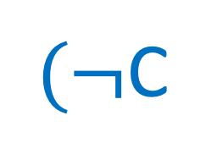

(A
$$∧$$
B
$(¬$C
$$∧$$
A
B)
$¬$C
D)
$$∨$$
D
AB
01
11
11
CD
00
11
10
0 | 0 | 1 | 0
1 | 1 | 1 | 1
0 | 0 | 1 | 0
0 | 0 | 1 | 0
00
1
01
01
01
1
1
1
1
11
1
10
1

Slide 32
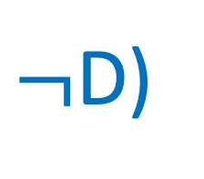




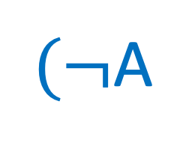

$¬$A
$¬$C
D
$$∨$$
$$∧$$
$(¬$A
$$∧$$
D)
A
$¬$D)
$$∧$$
(A
$¬$D
AB
01
01
11
00
11
00
10
CD
10
0 | 0 | 1 | 1
1 | 1 | 0 | 0
0 | 0 | 0 | 0
0 | 0 | 1 | 1
00
00
1
1
01
01
01
1
1
11
10
10
1
1

Slide 33
AB
CD
00
01
11
10
1 | 1 | 1 | 1
1 | 1 | 1 | 0
1 | 1 | 1 | 0
1 | 1 | 1 | 1
00
1
1
1
1
01
1
1
1
11
1
1
1
10
1
1
1
1

Slide 34




$¬$D
$$∨$$
$¬$A
$$∨$$
B
AB
01
01
11
00
01
11
CD
00
10
1 | 1 | 1 | 1
1 | 1 | 1 | 0
1 | 1 | 1 | 0
1 | 1 | 1 | 1
00
00
1
1
1
1
01
1
1
1
11
1
1
1
10
10
1
1
1
1

Slide 35
Half Adder
1-bit half adder
Input |  | Output
A | B | S | C
0 | 0 | 0 | 0
0 | 1 | 1 | 0
1 | 0 | 1 | 0
1 | 1 | 0 | 1
A
A
S
+
B
∑
C
S
B
C

Slide 36
Half Adder
A
S
A
S
∑
∑
B
C
B
C
Half Adder1
Half Adder2
half adder is not able to add carry-out from the previous addition to the next bits
Notes:
One of the main drawback of

Slide 37
Full Adder
1-bit full adder
Input |  |  | Output
A | B | CI | S | CO
0 | 0 | 0 | 0 | 0
0 | 0 | 1 | 1 | 0
0 | 1 | 0 | 1 | 0
0 | 1 | 1 | 0 | 1
1 | 0 | 0 | 1 | 0
1 | 0 | 1 | 0 | 1
1 | 1 | 0 | 0 | 1
1 | 1 | 1 | 1 | 1
A
S
B
∑
CI
CO
S = A⊕B⊕CI
CO = A·B+ B·CI+A·CI
Notes:
This is taken care using the full adder circuit. The full adder circuit consists of three input bits and two output bits. The three inputs to the full adder are A,B and Ci, where A and B are the bits to be added and Ci is the previous carry bit. The outputs are S and Co, where S is the sum bit and Co is the carry bit generated for this sum.
The truth table for the full adder is also shown here. We can see that the output of sum is high whenever there are odd number of high inputs. And Co bit is high if at least 2 or more than 2 inputs are high.

Slide 38
Full Adder
1-bit full adder circuit
CI
A
S
B
S = A⊕B⊕CI
CO = AB+ BCI+ACI
CO
Notes:
Now since we have the Boolean expressions, we can build the adder circuit using Ex-or, OR and AND gates.

Slide 39
Ripple Carry Adder
The sum of position 2 cannot complete until it receives C1 from position 1.
The sum of position 3 cannot complete until it receives C2 from position 2
…
In this way, the carry “ripples” through the circuit from right to left.
4-bit ripple carry adder (RCA)
A4
A3
A2
A1
+
B4
B3
B2
B1
C3
C2
C1
C4
S4
S3
S2
S1
C4
S4
S3
S2
S1
CO
CO
CO
CO
∑
∑
∑
∑
CI
CI
CI
CI
A4
B4
C3
A3
B3
C2
A2
B2
C1
A1
B1
C0
Notes:
With the full adder, it is very easy to construct the adder. Assuming A4A3A2A1 and B4B3B2B1, the circuit diagram of A4A3A2A1 + B4B3B2B1 serial carry adder using the full adder can be constructed by this.
This series method only completes the basic function, but it is completely infeasible in efficiency.

Slide 40
Carry Look Ahead Adder
A carry look ahead adder contains circuits that determine whether the previous adder stage produce a carry
Produces the “carry” for each stage without having to wait for the carry to ripple through the prior stage
C4
S4
S3
S2
S1
CO
CO
CO
CO
∑
∑
∑
∑
CI
CI
CI
CI
C4
C3
C2
C1
C0
A4
B4
A3
B3
A2
B2
A1
B1
Notes:
To eliminate the ripple delay, we want to create look ahead circuits that are only dependent on the system inputs as opposed to the intermediate carry out signals.

Slide 41
Carry Look Ahead Adder
Input |  |  | Output
A_{i} | B_{i} | C_{i} | C_{i+1}
0 | 0 | 0 | 0
0 | 0 | 1 | 0
0 | 1 | 0 | 0
0 | 1 | 1 | 1
1 | 0 | 0 | 0
1 | 0 | 1 | 1
1 | 1 | 0 | 1
1 | 1 | 1 | 1
C_{i+1} = G_{i}+ P_{i}·C_{i}
√
A_{i}⊕B_{i}=1 & C_{i}=1
P
G
√
C_{i+1} = A_{i}·B_{i}+ (A_{i} ⊕ B_{i})·C_{i}
√
A_{i}·B_{i}=1
Carry generator
Carry propagator
√
Notes:
So what we are going to do actually in the Carry Look Ahead adder is to predict the carry.
We will start from this table truth table, the sum is not mentioned because I have already told you that we are going to focus on the carry output so what we are going to do in this truth table is to see when the carry output is 1 or high and do some analysis.
There are the four cases in which carry output is high. So let's consider the last two cases. In this, you can see that whenever both A and B are high, the carry output is high. It doesn't depend upon your carry input whether it is 0 or 1. So, this is A and B.
The next cases, you can see that CI is always high and one of A and B is high. So, we can say that when A XOR B is equal to 1 and also CI(C input) is equal to 1.
We can write CO(C output) as A and B or A XOR B and CI(C input).
This is we just evaluated from our truth table. Now there are some terminologies involved with this expression. Let me explain you that. This part we call as carry generator and this part we call as carry propagator. Why we call it as carry generator and why we call it as carry propagator? It is because there is no dependency on CI in this first case. The carry is generated depending upon A and B, only in this case the carry is generated. When the carry from the CI is propagated as one so we call it as carry propagator. This part we call it G and this part we call it P depending upon generator and propagator.

Slide 42
Carry Look Ahead Adder
C_{i+1} = G_{i}+ P_{i}·C_{i}
For multi-bits adder
G_{i} = A_{i} · B_{i}
P_{i} = A_{i} ⊕ B_{i}
C₁ = G₀ + P₀C₀
C₂ = G₁ + P₁C₁
= G₁ + P₁G₀ + P₁P₀C₀
C₃ = G₂ + P₂C₂
= G₂ + P₂G₁ + P₂P₁G₀ + P₂P₁P₀C₀
… …
C_{i} = G_{i} + P_{i}C_{i} = G_{i-1} + P_{i-1}G_{i-2} + … + P_{i-1}P_{i-2}…P₁G₀ + P_{i-1}P_{i-2} … P₀C₀
C₄
Carry look ahead logic
C₀
G3
P3
G2
P2
G1
P1
G0
P0
C₃
C₂
C₁
C₀
∑
∑
∑
∑
A3
B3
S₃
A2
B2
S₂
A1
B1
S₁
A0
B0
S₀

Slide 43
Carry Look Ahead Adder
Fan-in constraint: In practice, the number of inputs of a gate is limited
Cannot directly build carry look ahead adders with a large number of bits
Do it in a hierarchical way!
C_{i} = G_{i} + P_{i}C_{i} = G_{i-1} + P_{i-1}G_{i-2} + … + P_{i-1}P_{i-2}…P₁G₀ + P_{i-1}P_{i-2} … P₀C₀
C₄
Carry look ahead logic
C₀
G3
P3
G2
P2
G1
P1
G0
P0
C₃
C₂
C₁
C₀
∑
∑
∑
∑
A3
B3
S₃
A2
B2
S₂
A1
B1
S₁
A0
B0
S₀

Slide 44
Carry Look Ahead Adder
G^{I}
P^{I}
C₄
Carry look ahead logic
C₀
C_{out}
C₀
G₃
P₃
G₂
P₂
G₁
P₁
G₀
P₀
4-bit adder
C₃
C₂
C₁
C₀
∑
∑
∑
∑
A₃₋₀
B₃₋₀
S₃₋₀
A₃
B₃
S₃
A₂
B₂
S₂
A₁
B₁
S₁
A₀
B₀
S₀
G^{I} = G₃+P₃G₂+P₃P₂G₁+P₃P₂P₁G₀
P^{I} = P₃P₂P₁P₀

Slide 45
Carry Look Ahead Adder
Carry look ahead logic
G^{I}₃
P^{I}₃
G^{I}₂
P^{I}₂
G^{I}₁
P^{I}₁
G^{I}₀
P^{I}₀
C_{out}
C₁₂
C_{out}
C₈
C_{out}
C₄
C_{out}
C₀
4-bit adder
4-bit adder
4-bit adder
4-bit adder
A₁₅₋₁₂
B₁₅₋₁₂
S₁₅₋₁₂
A₁₁₋₈
B₁₁₋₈
S₁₁₋₈
A₇₋₄
B₇₋₄
S₇₋₄
A₃₋₀
B₃₋₀
S₃₋₀
C₄ = G^{I}₀ + P^{I}₀C^{I}₀
C₈ = G^{I}₁ + P^{I}₁C^{I}₁ = G^{I}₁ + P^{I}₁G^{I}₀ + P^{I}₁P^{I}₀C^{I}₀
C₁₂ = G^{I}₂ + P^{I}₂C^{I}₂ = G^{I}₂ + P^{I}₂G^{I}₁ + P^{I}₂P^{I}₁G^{I}₀ + P^{I}₂P^{I}₁P^{I}₀C^{I}₀

Slide 46










Multiplexers
Selects binary information from one of many input lines and directs it to the output line
$$I_{0}$$
$$I_{0}$$
$$I_{1}$$
$$I_{1}$$
$$I_{2}$$
$$Y=I_{0}$$
$$I_{2}$$
$$Y=I_{1}$$
$$I_{3}$$
$$I_{3}$$
Notes:
Multiplexer is a combinational circuit that selects binary information from one of many input lines and directs it to the output line. Here you can see this thing in which there are four inputs and one output and a dialer. It means you can select any input I0 I1 I2 I3 by moving this dialer. At this position the position you can see the output Y is going to be I0 if I move it here at this point then the Y is going to be I2. So you already know that this input lines are having the data the information of some activity and by moving this dialer we can have a particular line carrying a particular information selected has the output Y. We call it simply a data selector because it is selecting our data.

Slide 47





Multiplexers
$$I_{0}$$
S1 | S0 | Y
0 | 0 | I0
0 | 1 | I1
1 | 0 | I2
1 | 1 | I3
$$I_{1}$$
$$I_{2}$$
4:1 MUX
$$Y=I_{0}$$
$$I_{3}$$
S1
S0
Select Line/selector variables
Notes:
How this dialer is moving and how out of these four inputs one of the input is being selected? it is done by a select line or we also call it a selector variable.
When the value of s0 and s1 are 0 0, then the input I0 will be selected an output Y will be I0. Similarly when s1 and s0 are 1 1, the input I 3 is being selected as the output Y.

Slide 48

Multiplexers
Types
2:1 MUX 4:1 MUX 8:1 MUX 16:1 MUX 32:1 MUX
Type | Number of select lines
2:1 MUX | 1
4:1 MUX | 2
8:1 MUX | 3
16:1 MUX | 4
32:1 MUX | 5
$$n=\log_{2}m$$
m
n

Slide 49






Multiplexers
Build a 2:1 multiplexer
$$I_{0}$$
E | S | Y
0 | X | 0
1 | 0 | I0
1 | 1 | I1
2:1 MUX
$$Y=I_{0}$$
$$I_{1}$$
$$E∙\overline{S}∙I_{0}$$
$$E∙S∙I_{1}$$
E
S
$$Y=E∙\overline{S}∙I_{0}+E∙S∙I_{1}$$
(Enable)
Notes:
Let's try to study something more about 2 raise to 1 MUX. The one more thing is there in this multiplexer is we call E, which is the enable. Let’s see the truth table for the 2 cross 1 MUX.
When the value of E is equal to zero, this circuit will not work and when the circuit is not working, the output is equal to zero. So whatever the value of select line we don't care it is always going to be zero when the enable is zero.
When the enable is one and S is equal to zero, Y is connected to I0, so Y will be I0 and when S is equal to one, Y is connected to I1 and it is equal to i1.
Let's try to find out the logical expression for this. We will see for this two cases.

Slide 50



Multiplexers
Build a 2:1 multiplexer
$$Y=E∙\overline{S}∙I_{0}+E∙S∙I_{1}$$
S
$$I_{0}$$
Y
$$I_{1}$$
E
Notes:
So the next thing is the implementation of this circuit. You can easily implement it by using the two and gates.
There are so many uses of these multiplexers. It is a medium scale integrated circuit. And it is available in the form of ICs(integrated circuit). There are different ICs for different types of multiplexers available in the market and by using a single IC you can implement various number of what combinational circuits, like you want to implement a half adder a full adder or subtractor or any other combinational circuit, you can just simply implement it by using a MUX a single IC, you don’t require much gates in that. So there may be great advantages of doing this thing.
So let's see what are the advantages of using the multiplexer. The first advantage is, it reduces the number of wires, I just told you that we don't require number of gates, you are just going to implement your logic your combinational logic by using a single IC. For example if you have to connect ten gates, you require so many wires and if you don't have to connect ten gates you just have to connect one or two gates, then you are going to require lesser number of wires.
The another thing is it reduces the circuit complexity and cost. Let's see how, I just told you that the wires are reduced and wires are reduced because the gates are reduced. When both wires and gates are reduced definitely the complexity is going to reduce and at the same time caused because gates and wires have definitely some cost.
The third point is, implementation of various circuit using the MUX.

Slide 51
Outline
Combinational logic circuits
Sequential logic circuits

Slide 52
Sequential Logic Circuits
Combinational logic circuits: output only depends on current inputs
Sequential logic circuits: output depends on both current inputs and history inputs
Sequential logic has state (memory) while combinational logic does not

Slide 53
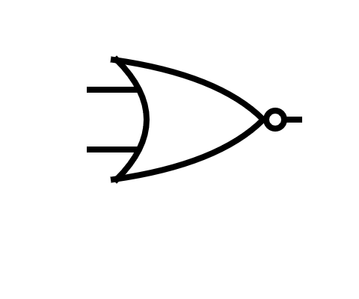
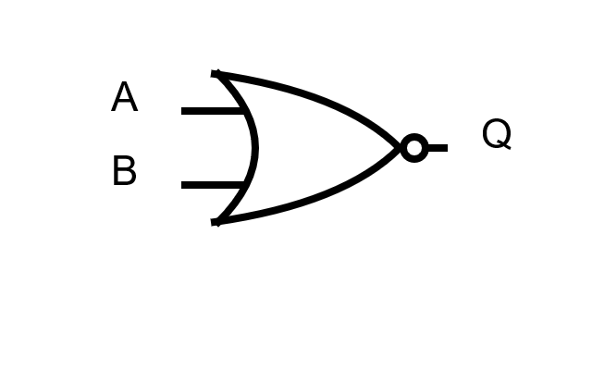
SR Latch
SR (set-reset) Latch
The simplest bistable (stable in set or reset state) device
NOR
R
Q
A | B | Q
0 | 0 | 1
0 | 1 | 0
1 | 0 | 0
1 | 1 | 0
Suppose to be always
opposite to each other
-
Q
S

Slide 54
SR Latch
Assume the current state is as follows
Q=1
0
R
1
Q
-
0
0
Q
S
Notes:
The starting state here is that s and R are both low, that is both inputs are 0.
Q is high, that is the output is warm and not Q the inverse of this is 0.
Both of the inputs of the top nor gate are 0. So the output of the top gate is 1. This is exactly what you would expect from an or gate.
The inputs of the lower nor gate are 1 and 0, so the output of the lower gate is 0. Because Q is 1 the latch is currently storing 1.

Slide 55
SR Latch
Change the input R to 1
Q becomes 0 → “reset” the SR Latch
Change R back to 0, keep this state
1
0
R
1
0
1
Q
A pulse to R resets SR Latch
0
-
0
1
0
Q
S
Notes:
(click)Now we apply a pulse to input R to reset the latch.
This changes the output of the top gate and then this is fed back into the lower gate.
The lower gates output also changes and this is fed back into the top gate.
(click)The pulse that was applied to reset the SR latch is then removed and re zero again.
But the output at Q is now zero so the latch is now storing a zero.

Slide 56


SR Latch
Q
R
press/release
buttons
Change the input S to 1
Q becomes to 1 → “set” the SR Latch
Change S back to 0, keep this state
S
0
R
1
0
1
Q
0
A pulse to S sets SR Latch
1
0
-
0
1
0
Q
1
S
Notes:
In order to store a 1 again, a pulse must be applied to input S which will set the latch.
(click)again notice how the various changes are propagated around the circuit.
(click) the set pulse is then removed and the circuit is now latched into a set state it's storing a 1 again.
Notice that if another set pulse is applied, it has no effect. Applying a set pulse at S will always force the latch into a set state regardless of the previous state of the latch.
Similarly, applying a reset pulse will always force the latch into a reset state. It should be noted that S and R are never left high, that is neither is ever set continuously to the value 1. The latch is controlled by pulses only.

Slide 57
SR Latch
Truth table of SR Latch
When both R and S are 0,
0
R
1
S | R | Q | Q
0 | 0 | 1 0 | 0 1
0 | 1 | 0 | 1
1 | 0 | 1 | 0
1 | 1 | 0 | 0
0
Q
1
-
0
0
Q
S

Slide 58
SR Latch
Truth table of SR Latch
When both R and S are 0,
Q is either 1 or 0, depending on the past state
0
R
0
S | R | Q | Q
0 | 0 | 1 0 | 0 1
0 | 1 | 0 | 1
1 | 0 | 1 | 0
1 | 1 | 0 | 0
1
Q
0
-
1
0
Q
S

Slide 59
SR Latch
Truth table of SR Latch
When R=1 and S=0, Q=0 (reset)
1
R
0
S | R | Q | Q
0 | 0 | 1 0 | 0 1
0 | 1 | 0 | 1
1 | 0 | 1 | 0
1 | 1 | 0 | 0
1
Q
0
-
1
0
Q
S
Notes:
Let's examine the truth table as this SR latch is reset again.
The reset pulse is applied. S is 0 R is 1. output Q is 0 and its inverse not Q is 1.The SR latch is storing a 0.

Slide 60
SR Latch
Truth table of SR Latch
When the reset signal to R is removed, Q still remains 0
0
R
0
S | R | Q | Q
0 | 0 | 1 0 | 0 1
0 | 1 | 0 | 1
1 | 0 | 1 | 0
1 | 1 | 0 | 0
1
Q
0
-
1
0
Q
S
Notes:
The reset pulse is removed. Both S and R are 0 again. Output Q remains at 0 and its inverse remains at 1. The SR latch is still storing a 0.

Slide 61
SR Latch
Truth table of SR Latch
When R=0 and S=1, Q=1 (set)
0
R
1
S | R | Q | Q
0 | 0 | 1 0 | 0 1
0 | 1 | 0 | 1
1 | 0 | 1 | 0
1 | 1 | 0 | 0
0
Q
1
-
0
1
Q
S
Notes:
A set pulse is applied. S is 1 and R is 0. The output Q becomes 1 and its inverse becomes 0.

Slide 62
SR Latch
Truth table of SR Latch
When the set signal to R is removed, Q still remains 1
0
R
1
S | R | Q | Q
0 | 0 | 1 0 | 0 1
0 | 1 | 0 | 1
1 | 0 | 1 | 0
1 | 1 | 0 | 0
0
Q
1
-
0
0
Q
S
Notes:
The set pulse is removed. S is 0 and R is 0. Output Q is still 1 and not Q is of course 0.

Slide 63
SR Latch
Truth table of SR Latch
When R=1 and S=1, both Q and not Q are 0
Invalid state
1
R
0
S | R | Q | Q
0 | 0 | 1 0 | 0 1
0 | 1 | 0 | 1
1 | 0 | 1 | 0
1 | 1 | 0 | 0
0
Q
0
-
0
1
Q
S
Notes:
Now the only circumstance we haven't considered is when both inputs S and R are set to 1 at the same time.
If this were to occur, we'd be telling the SR latch to set the value of Q to both 1 and 0 simultaneously.
In reality Q would become 0 and not Q would also become 0.
This would sort itself out if one of the inputs fell to 0 before the other.
For example, if our fell to 0 first, with S still at 1, then Q would become 1 again. If however both inputs are at 1 and both fell to 0 at the same time we have what's known as a race condition between the two gates. They be racing each other to feedback their new output and it’s impossible to know which one would win. Hence if both inputs are high the next state of the latch can't be determined.

Slide 64
SR Latch
Truth table of SR Latch
When R=1 and S=1, both Q and not Q are 0
Invalid state
1
R
0
S | R | Q | Q
0 | 0 | 1 0 | 0 1
0 | 1 | 0 | 1
1 | 0 | 1 | 0
1 | 1 | 0 | 0
0
Q
invalid
0
-
0
1
Q
S
Notes:
Now the only circumstance we haven't considered is when both inputs S and R are set to 1 at the same time.
If this were to occur, we'd be telling the SR latch to set the value of Q to both 1 and 0 simultaneously.
In reality Q would become 0 and not Q would also become 0.
This would sort itself out if one of the inputs fell to 0 before the other.
For example, if our fell to 0 first, with S still at 1, then Q would become 1 again. If however both inputs are at 1 and both fell to 0 at the same time we have what's known as a race condition between the two gates. They be racing each other to feedback their new output and it’s impossible to know which one would win. Hence if both inputs are high the next state of the latch can't be determined.

Slide 65
SR Latch
This is an Active High SR latch
In most of time, both inputs are 0, a momentarily 1 (high voltage) sets/resets the SR latch
0
R
1
S | R | Q | Q
0 | 0 | 1 0 | 0 1
0 | 1 | 0 | 1
1 | 0 | 1 | 0
1 | 1 | 0 | 0
0
Q
1
-
0
1
Q
S
Notes:
A set pulse is applied. S is 1 and R is 0. The output Q becomes 1 and its inverse becomes 0.

Slide 66
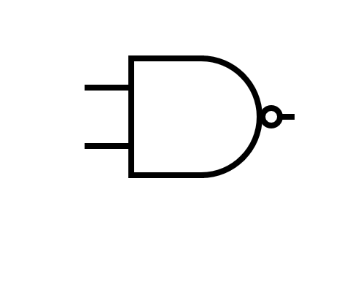
SR Latch
Active high SR latch
Active low SR latch
0
1
R
1
S
1
0
Q
0
Q
1
1
-
-
0
0
0
Q
1
Q
S
R
S | R | Q | Q
0 | 0 | 1 0 | 0 1
0 | 1 | 0 | 1
1 | 0 | 1 | 0
1 | 1 | 0 | 0
S | R | Q | Q
0 | 0 | 1 | 1
0 | 1 | 1 | 0
1 | 0 | 0 | 1
1 | 1 | 0 1 | 1 0
Invalid
Invalid
Notes:
To summarize them, an SR latch can be built from nor gates or from manned gates.
Both types of latch do the same job but they just controlled in a slightly different way.
The NOR gate based SR latch is set or reset with high logic. That is, it is an active high SR latch.
the NAND gate SR latch on the other hand is set or reset with low logic. That is, it's an active low SR latch.

Slide 67
SR Latch
Active low SR latch using NAND gates
S
S | R | Q | Q
0 | 0 | 1 | 1
0 | 1 | 1 | 0
1 | 0 | 0 | 1
1 | 1 | 0 1 | 1 0
Q
-
Q
R
Notes:
The wiring of this SR latch is the same but notice that input S is at the top now and R is at the bottom.
(click)Here’s a truth table for this variation of the SR latch. it's a little different from the truth table we've just seen because this latch behaves differently.

Slide 68
SR Latch
Active low SR latch using NAND gates
1
S
0
S | R | Q | Q
0 | 0 | 1 | 1
0 | 1 | 1 | 0
1 | 0 | 0 | 1
1 | 1 | 0 1 | 1 0
Q
-
1
1
Q
R
Notes:
The difference is that R and S are kept high most of the time.
Here we can see that output Q is zero so the latch is storing a zero.

Slide 69
SR Latch
Active low SR latch using NAND gates
0
S
1
S | R | Q | Q
0 | 0 | 1 | 1
0 | 1 | 1 | 0
1 | 0 | 0 | 1
1 | 1 | 0 1 | 1 0
0
Q
1
-
0
1
Q
R
Notes:
When input s is made low momentarily, that is when s becomes 0 and R is still 1.
The output at Q becomes warm.

Slide 70
SR Latch
Active low SR latch using NAND gates
1
S
1
S | R | Q | Q
0 | 0 | 1 | 1
0 | 1 | 1 | 0
1 | 0 | 0 | 1
1 | 1 | 0 1 | 1 0
0
Q
1
-
0
1
Q
R
A low-voltage pulse to S sets SR Latch
Notes:
The latch is now storing a 1 and S can be returned to its normal high state.

Slide 71
SR Latch
Active low SR latch using NAND gates
1
S
0
S | R | Q | Q
0 | 0 | 1 | 1
0 | 1 | 1 | 0
1 | 0 | 0 | 1
1 | 1 | 0 1 | 1 0
1
Q
0
-
1
0
Q
R
Notes:
When R is set low momentarily, the output at Q is changed to zero.

Slide 72
SR Latch
Active low SR latch using NAND gates
1
S
0
S | R | Q | Q
0 | 0 | 1 | 1
0 | 1 | 1 | 0
1 | 0 | 0 | 1
1 | 1 | 0 1 | 1 0
1
Q
0
-
1
1
Q
R
A low-voltage pulse to R resets SR Latch
Notes:
R can then return to its normal high value and the latch is now storing a zero again.
An SR latch built from NAND gates like this is more explicitly known as an active low SR latch.

Slide 73
SR Latch
Active low SR latch using NAND gates
0
S
1
S | R | Q | Q
0 | 0 | 1 | 1
0 | 1 | 1 | 0
1 | 0 | 0 | 1
1 | 1 | 0 1 | 1 0
1
Q
Invalid
1
-
1
0
Q
R
Notes:
An SR latch based on NAND gates also has a forbidden state that is when both S and R are simultaneously 0.
This would result in an illegal state in which both Q and its complement are 1.

Slide 74
Gated SR Latch
Can only change state while it’s enabled
“enabled”: input to the E is 1
0
S
Q
1
1
E
0
R
Q
0
Notes:
A gated set/reset latch is an SR latch that can only change state while it’s enabled.
For example, imagine an air conditioning system in the building, each room could have its own cooling unit controlled independently by its own SR latch, the set and reset signals might come from a temperature sensor or a humidity sensor in the room. If these were gated SR latches then a central control panel could be used to enable or disable the switching on and off of these units on a room-by-room basis.

Slide 75
Gated SR Latch
Can only change state while it’s enabled
“enabled”: input to the E is 1
R
Q
-
Q
S
Notes:
Here's an uncoated SR latch.
Remember an SR latch built from nor gates like this one is an active high SR latch.
This means it requires a high pulse that’s a 1 to be applied at input S in order to get a high output at Q, in other words to set the latch.
Alternatively, to reset the latch and make the output at Q 0, it requires a high pulse to be applied to input R.
It's invalid for both S and R to be made high at the same time.
An SR latch is said to be level sensitive, this means it will respond to a valid change in either S or R regardless of the duration of the input pulse.
It's the level high or low that matters not how long it's applied for.

Slide 76
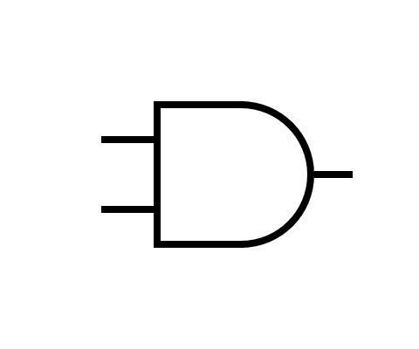
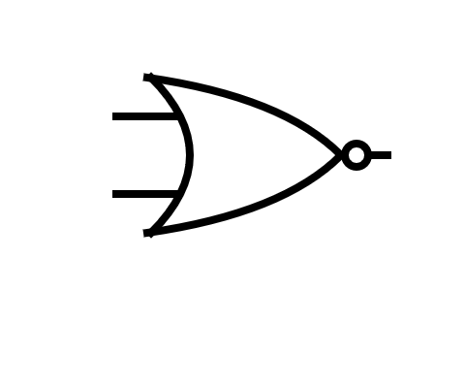
Gated SR Latch
Can only change state while it’s enabled
“enabled”: input to the E is 1
R
Q
E
-
Q
S
Notes:
To build a gated SR latch, we can make some simple enhancements to an SR latch by connecting a pair of AND gates in series with the inputs of an OR based SR latch.
We've created a third input E which can be used to enable or disable the latching effect.
A regular AND gate will only have a high output if both inputs are high.
So only when E is set to 1 with a 1 from S or a 1 from R get through to our cross connected NOR gates.

Slide 77
0
1
0
0
0
1
0
0
1
1
0
0
1
1
1
0
0
0
0
0
0
1
0
0
1
0
0
0
0
1
0
0
0
S
Q
1
S
Q
S
Q
S
Q
S
Q
S
Q
S
Q
S
Q
S
Q
S
Q
S
Q
Q
S
Q
S
Q
S
Q
S
Q
S
Q
S
0
0
0
0
1
0
1
0
1
1
1
0
1
1
0
0
1
E
E
E
E
E
E
E
E
E
E
E
E
E
E
E
E
E
0
0
0
1
0
0
0
1
0
0
0
1
0
0
0
1
0
1
0
1
0
0
1
0
0
1
1
0
1
0
1
0
1
R
Q
0
R
Q
R
Q
R
Q
R
Q
R
Q
R
Q
R
Q
R
Q
R
Q
R
Q
Q
R
Q
R
Q
R
Q
R
Q
R
Q
R
Timing diagram
S
R
E
Q
time
Notes:
Now let’s examine what happens when E varies.
(click)You can see that some of the time E is high and some of the time E is low.
(click)We begin with an output of 0 but Q, and because E is low the latch is disabled. (click)
(click)S goes high but it has no effect on the output of the latch. (click)
(click)Now E is high the latch is enabled.
(click)So when S goes high so does Q.
(click)And when the S drops to low again the latch stays high,
(click)until such time as R goes high and then Q drops to 0 again. (click)
(click)Now E is zero the latch is no longer enabled.
(click)So if S goes high, it has no effect on queue. (click)
(click)E is high again the latch is enabled.
(click)And so it responds when S goes high, the latch is set again. (click)
(click)E goes to zero, the latch is disabled.
(click)R goes high but Q doesn't drop, it remains in its high state. (click)

Slide 78
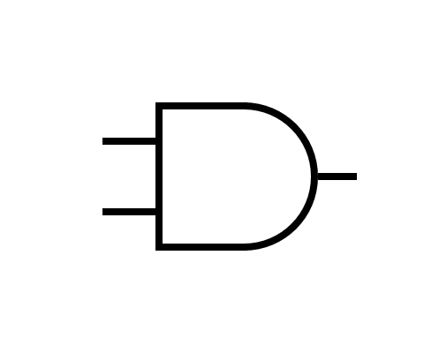
Gated SR Latch
Gated SR Latch can be built by
Adding two AND gates to active high SR Latch, or
Adding two NAND gates to active low SR Latch
R
S
Q
Q
E
E
-
-
Q
Q
S
R
In both cases, gated SR Latch is active high

Slide 79
Gated SR Latch
Gated SR Latch can be built by
Adding two AND gates to active high SR Latch, or
Adding two NAND gates to active low SR Latch
We usually use this symbol to represent a gated SR Latch
S
Q
E
R
Q

Slide 80
Gated D Latch
We can build a gated D Latch based on a gated SR Latch
Also called a data latch or simply a D latch
D stands for “data”
1
D
Q
1
1
E
Q
0
Notes:
A gated D-latch is a 1-bit memory device. The D stands for data. A gated D-latch is also referred to as a data latch or simply a D latch. We're going to look at how a D latch can be built from a gated SR latch and examine its behavior with a timing diagram.

Slide 81
Gated D Latch
Based on Gated SR Latch, negating S for R
0
S
1
Q
1
E
0
-
0
Q
R

Slide 82
Gated D Latch
Based on Gated SR Latch, negating S for R
D
S
Q
E
-
Q
R

Slide 83
Gated D Latch
A simpler implementation
D
D
Q
Q
E
-
E
-
Q
Q

Slide 84
0
0
1
1
0
0
1
1
0
0
0
1
1
1
1
0
0
0
1
1
0
D
Q
0
D
Q
D
Q
D
Q
D
Q
D
Q
D
Q
D
Q
D
Q
D
Q
D
Q
1
1
1
1
0
0
1
0
1
0
1
E
E
E
E
E
E
E
E
E
E
E
1
0
1
0
1
0
0
1
1
0
Q
1
Q
Q
Q
Q
Q
Q
Q
Q
Q
Q
D
E
Q
Notes:
we‘re interested in the relationship between D E and Q, so here they are on a shared time axis. Not Q is always the inverse of Q, so we haven't included it on this diagram.
(click)At our starting point, E is high, in other words the D latch is enabled, D is low and therefore so is Q.
(click)
(click)When D goes high so does Q.
(click)When D goes low so does Q. You can see that while E is high Q is following D.
(click) (click) (click)
(click) when E goes low, Q is latched. (click)it can’t change so we can see here changes in D and not being reflected in Q.
D at the moment is low, Q is high, but when E goes high again(click), Q reflects D and once again Q is following D.
(click) (click)
(click) On this diagram, we see E go in low again, so Q is no longer following D (click) until of course E goes high again.(click)

Slide 85
Clocked D Latch
Edge detector
Notes:
Consider this combination of logic gates for a moment, and NOT gate with a AND gate. One input of the AND gate is always the inverse of the other.

Slide 86
Clocked D Latch
Edge detector
1
1
0
0
Notes:
This is how you might expect it to behave when we input a 1 into the circuit the inputs of the and gate1 & 0 so the output is 0.

Slide 87
Clocked D Latch
Edge detector
0
0
0
0
1
Notes:
When we input a0 into the circuit the inputs of the and gate are 0 & 1so the output is 0.

Slide 88
Clocked D Latch
Edge detector
1
1
1
1
Notes:
The fact is however that the not gate doesn't invert its input instantly.
When the input transitions from low to high, there’s a very very brief period when the output from the NOT gate is the same as its input. This means that for the same very brief period both inputs of the AND gate high and therefore so is its output.

Slide 89
Clocked D Latch
Edge detector
1
1
1
0
0
Notes:
When the NOT gate catches up everything is once again as we'd expect.

Slide 90
Clocked D Latch
Edge detector
0
0
0
0
0
Notes:
Similarly, when the input transitions from high to low, there's another very brief period in which the NOT gate must catch up but notice that this doesn’t affect the output of the and gate.

Slide 91
Clocked D Latch
Edge detector
0
0
0
0
1
Notes:
What we have here then is a device that can detect the very brief instant at which an input rises from low to high.

Slide 92
Clocked D Latch
Edge detector
1
1
0
0
1
1
1
0
0
0
1
1
0
0
0
0
1
0
0
1
1
0
Raising edge detector
C
Output
Notes:
Let’s examine the operation of this edge detecting circuit on a timing diagram. The top chart shows a clock signal being applied to the input, the lower chart shows the corresponding output. The output of this circuit is low most of the time.
(click)
(click) but you can see that when the input changes from low to high there’s a very brief moment in which the output of the NOT gate lags behind its input. So, momentarily the output of this circuities also high.
We've isolated just the rising edge of the clock cycle what we have here then is a positive edge detection device.

Slide 93
Clocked D Latch
Connecting the raising edge detector to a Gated D Latch
1
D
1
Q
0
-
C
1
Q
E
Notes:
Here is our D latch again.
(click)when we install our edge detection device at E, we can rename the enabling input to C. (click)
see for clock our D latch has been changed from a level triggered device into an edge triggered device. Some people would now call this a flip-flop and by many definitions they'd be correct. A flip-flop being a clock edge triggered by stable which can be in one state or another. Purists however would argue that this is actually a pulse latch but it does now behave something like a flip-flop albeit with some limitations.

Slide 94
Clocked D Latch
D
Q
C
Q
D
C
Q
Notes:
The clocked d-latch has its own symbol notice the addition of a triangle next to input C indicating the dynamic nature of the clock input. So let's analyze its behavior on a timing diagram.
(click)D is sampled whenever there's a rising edge in the clock cycle.
(click)For the rest of the time, the device is latched. Q can’t change so this is what we would expect from an edge triggered D latch some what different from its level triggered counterpart.

Slide 95
Clocked D Latch
The output pulse of the raising edge detector is instantaneous
If we worry the generated pulse is too short, we can add more delays to generate wider output pulse
0
C
0
0
0
1
Output
1
1
C
0
0
Output

Slide 96
Clocked D Latch
Falling edge detector
1
0
D
Q
0
1
C
0
Q
0
0
1

Slide 97
Clocked D Latch
Connecting the edge detector to a gated D Latch
The value of D is sampled at the corresponding edge
1
D
1
Q
0
-
C
0
Q
Notes:
Another enhancement we can make is to add an extra pair of inputs called preset and clear.

Slide 98
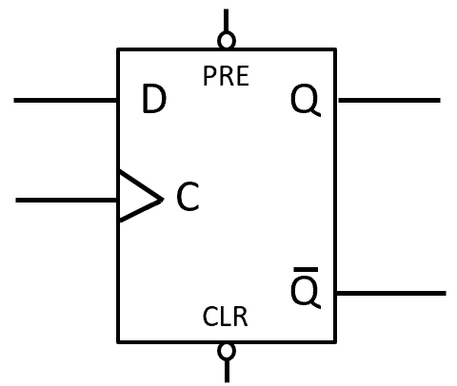
Clocked D Latch
Adding preset (PRE) and clear (CLR)
PRE
1
D
1
Q
-
0
0
Q
C
CLR
Notes:
The only thing that's changed here is we're using three input NAND gates now. And as with any NAND gate only when all of the inputs are high is the output low. So when preset and clear are both kept high, they make no difference to the latching behavior.

Slide 99
Clocked D Latch
Adding preset (PRE) and clear (CLR)
PRE
1
D
0
Q
If CLR is 0 (PRE is 1), Q will fall to 0; (don’t need to wait for the clock edge)
-
0
1
Q
C
CLR

Slide 100
Clocked D Latch
Adding preset (PRE) and clear (CLR)
PRE
1
D
1
Q
If PRE is 0 (CLR 1), Q will raise to 1 (don’t need to wait for the clock edge)
-
0
0
Q
C
CLR

Slide 101
Clocked D Latch
Adding preset (PRE) and clear (CLR)
PRE
1
D
1
Q
-
0
0
Q
C
CLR

Slide 102
D Flip-Flop
Gated D Latch
Gated SR Latch
Notes:
let's put the two together

Slide 103
D Flip-Flop
D
Q
-
Q
CLK
Notes:
so that the outputs of the D latch become the inputs of the SR latch.

Slide 104
D Flip-Flop
D
Q
-
Q
CLK
Notes:
now let's connect the inverse of the clock signal to the enabling input of the SR latch. This device is known as a master slave D type flip-flop. With this type of memory device, we can precisely control the moment at which a group of them will change state.
The latch on the left is called the master and the latch on the right is known as the slave.

Slide 105
D Flip-Flop
D
Q
-
Q
CLK
Notes:
The master latch reads the input value at D when the clock signal is high and latches onto it. In fact, this begins to happen at the rising edge of the clock cycle. Meanwhilethe slave is disabled so the new output from the flip-flop as a whole is not available just yet.

Slide 106
D Flip-Flop
D
Q
-
Q
CLK
Notes:
Then when the clock signal falls to low again, the slave is enabled. Data is passed from the master to the slave and is therefore available at the output. A D type flip-flop can be compared to an airlock consisting of two doors which are never open at the same time. The flip-flop as a whole is never fully open, so an input signal can't pass straight through as it does with a simple deal.
The output of the flip-flop occurs during the next phase of the same clock cycle as that in which the input occurred. That is ever so slightly later. The D type flip-flop is therefore sometimes referred to as a delay type flip-flop.

Slide 107
D Flip-Flop
Qm
Qs
D
D
Q
D
Q
Q
Master
Slave
CLK
C
Q
C
Q
Q
Notes:
Let's simplify our diagram and analyze the behavior of a D type flip-flop on a timing diagram.

Slide 108
Qm
Qs
D
D
Q
D
Q
Q
Master
Slave
CLK
C
Q
C
Q
Q
D
C
Qm
Qs

Slide 109
Qm
Qs
D
D
Q
D
Q
Q
Master
Slave
CLK
C
Q
C
Q
Q
D
C
Qm
Qs
Notes:
Now let’s take a look at Q s the output of the slave and therefore the output of the flip-flop as a whole. Qs follows Qm because the Masters output is the slaves input but more importantly Qs only follows Qm while C is low because the slave is being fed the inverse of the clock signal.

Slide 110
Qm
Qs
D
D
Q
D
Q
Q
Master
Slave
CLK
C
Q
C
Q
Q
D
C
Qm
Qs
Notes:
Consider this point in time Qm is changing from low to high but Qs remains low because C is high.
While the flip-flop is responding to a change in its input. Its output remains unchanged. At this point in time however Qs becomes high to follow Qm at the falling edge of the clock cycle. Notice that Qm the Masters output cannot be changed now because C is low. This means that changes to the input of the flip-flop cannot impact on the output at this point.
Also notice that the output of the flip-flop has been delayed by half a clock cycle.

Slide 111
Qm
Qs
D
D
Q
D
Q
Q
Master
Slave
CLK
C
Q
C
Q
Q
D
C
Qm
Qs
Notes:
Consider this point in time Qm is changing from low to high but Qs remains low because C is high.
While the flip-flop is responding to a change in its input. Its output remains unchanged. At this point in time however Qs becomes high to follow Qm at the falling edge of the clock cycle. Notice that Qm the Masters output cannot be changed now because C is low. This means that changes to the input of the flip-flop cannot impact on the output at this point.
Also notice that the output of the flip-flop has been delayed by half a clock cycle.

Slide 112
Qm
Qs
D
D
Q
D
Q
Q
Master
Slave
CLK
C
Q
C
Q
Q
D
C
Qm
Qs
Notes:
Here the input at D has changed to low as if in readiness for another change to the state of the flip-flop.

Slide 113
Qm
Qs
D
D
Q
D
Q
Q
Master
Slave
CLK
C
Q
C
Q
Q
D
C
Qm
Qs
Notes:
When C goes high the output of the master changes but this has no impact on Qs, that is no impact on the output of the flip-flop as a whole the slave isn't listening.

Slide 114
Qm
Qs
D
D
Q
D
Q
Q
Master
Slave
CLK
C
Q
C
Q
Q
D
C
Qm
Qs
Notes:
And soon after we see D going high again during the high phase of the clock cycle, but this glitch has no effect on the output of the flop.

Slide 115
Qm
Qs
D
D
Q
D
Q
Q
Master
Slave
CLK
C
Q
C
Q
Q
D
C
Qm
Qs
Notes:
At this point we do seek us changing again to follow D while the clock signal is low, but of course the master will ignore any changes in the input while the flip flops in your output is being made available.

Slide 116
Qm
Qs
D
D
Q
D
Q
Q
Master
Slave
CLK
C
Q
C
Q
Q
D
C
Qm
Qs
Notes:
Here we see that D has gone high as if to set the state of the flip-flop to high on the next high pulse of the clock. And when the clock goes high, the Masters output Qm follows D.

Slide 117
Qm
Qs
D
D
Q
D
Q
Q
Master
Slave
CLK
C
Q
C
Q
Q
D
C
Qm
Qs
Notes:
But now the input falls to low while the clock is high and so does Qm.

Slide 118
Qm
Qs
D
D
Q
D
Q
Q
Master
Slave
CLK
C
Q
C
Q
Q
D
C
Qm
Qs
Notes:
So by the time the clock signal forced to low again and the slave is once again responding to changes in its input the flip-flop has ignored yet another glitch.

Slide 119
Qm
Qs
D
D
Q
D
Q
Q
Master
Slave
CLK
C
Q
C
Q
Q
D
C
Qm
Qs
Notes:
What we’ve seen then is that the D type flip-flop effectively ignores any input fluctuations because the master and the slave are enabled on opposite phases of the same clock cycle. The flip-flop accepts input when the clock signal goes high but only gives up the corresponding output when the clock signal falls to low.
To summarize then a D type flip-flop is a 1 bit memory device. Several flip-flops can be combined to build a register or a bank of memory. A D type flip-flop is built by combining two level triggered latches which act as a master and a slave. The output of the master is the input of the slave. A d type flip-flop is safe because it allows sufficient time for propagation delays and therefore time for the inputs to change and settle down without affecting the output. A D type flip-flop does however involve a lot of components compared to say a pulse latch which makes it relatively slow and power-hungry.

Slide 120
D Flip-Flop
Master and slave enabled on opposite phases of one clock cycle
More reliable
Effectively edge-triggered sampling
Several flip-flops combined to build registers or memory bank

