Slide 1
CS2115 Computer Organization 2023/2024 Sem A
Chapter 5: CPU
Dr. Nan Guan
Department of Computer Science
City University of Hong Kong

Slide 2
Overview
Explain the principles and techniques to build a processor
Consider a simple MIPS-like processor example including the following instructions
Data transfer: lw, sw
Data operation: add, sub, and, or, slt
As well as their immediate versions
Control: beq
The implementation of other instructions follows the same principle

Slide 3
Overview
For all types of instructions, the first two steps are identical
Use PC (program counter) to address the memory that contains the code and fetch the instruction from the memory
Read one or two registers
Using fields of the instruction to select registers
For some instruction (e.g., lw), need to only read one register, but most other instructions read two registers
After these two steps, different instructions do different actions

Slide 4
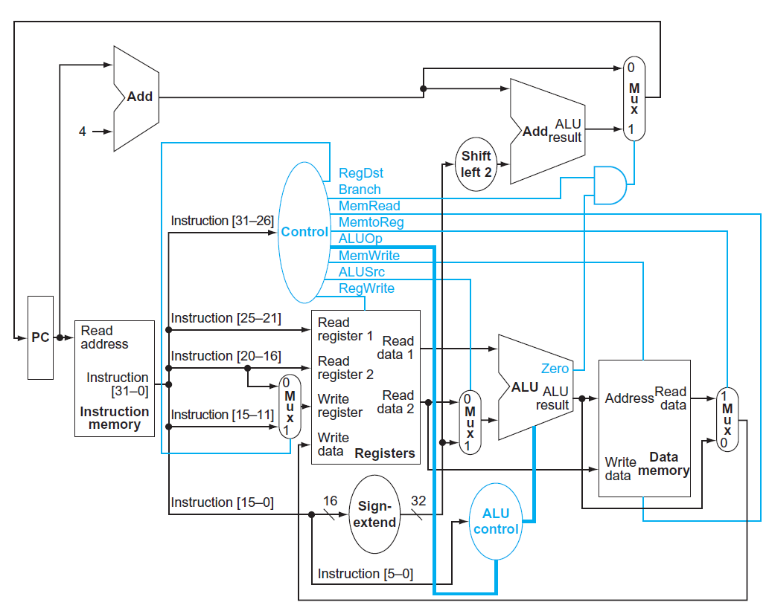
Structure of the MIPS Processor
Blue lines: control information
Black lines: data path

Slide 5
ALU and Auxiliary Computation Logics
auxiliary computation logics
ALU

Slide 6
Multiplexer
Multiplexer

Slide 7






Multiplexers
Build a 2:1 multiplexer
$$I_{0}$$
E | S | Y
0 | X | 0
1 | 0 | I0
1 | 1 | I1
2:1 MUX
$$Y=I_{0}$$
$$I_{1}$$
$$E∙\overline{S}∙I_{0}$$
$$E∙S∙I_{1}$$
E
S
$$Y=E∙\overline{S}∙I_{0}+E∙S∙I_{1}$$
(Enable)

Slide 8
Signed Bit Extender
Sign-extend
0100110011001100
00000000000000000100110011001100
1100110011001100
11111111111111111100110011001100

Slide 9
State Elements
State elements
PC
Register
Memory
Store certain information
Edge-triggered
All of them have clock inputs
Emitted here for simplicity
Note: in reality, the CPU does not directly connect to instruction and data memory, but to caches instead

Slide 10
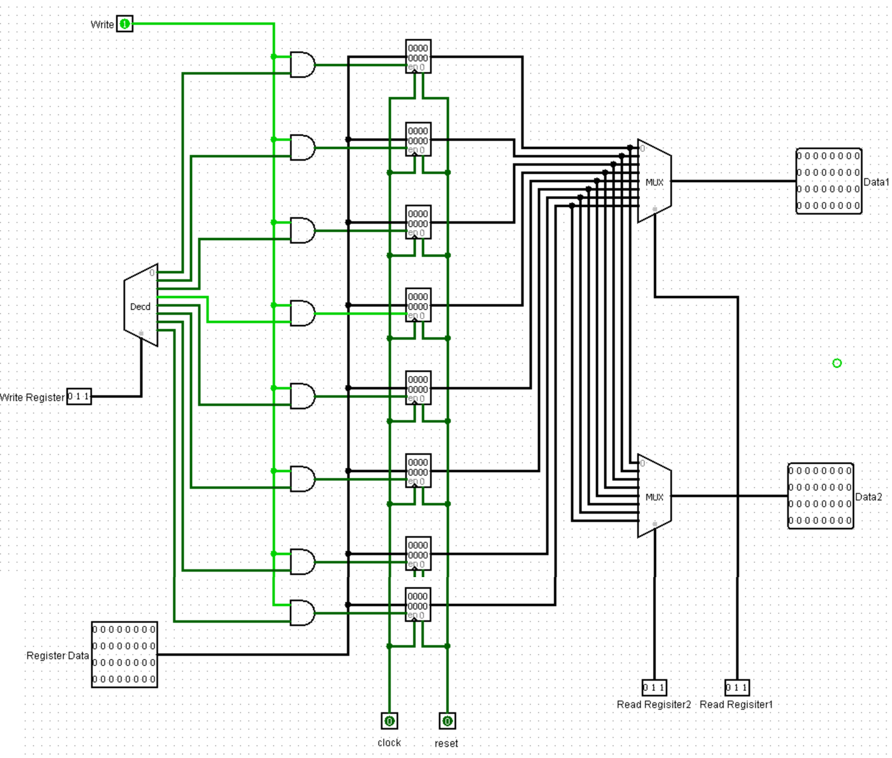
Register File
1st operand
Example: a register file with 8 registers
add $s0, $s1, $s2
destination
2nd operand
read data 1
Whether read or write
Which registrer to read (as the 1st operand)
The data read from register 1
Which registrer to read (as the 2nd operand)
Which registrer to write (as the destination)
The data read from register 2
What data to write into the destination
read data 2
Write data

Slide 11
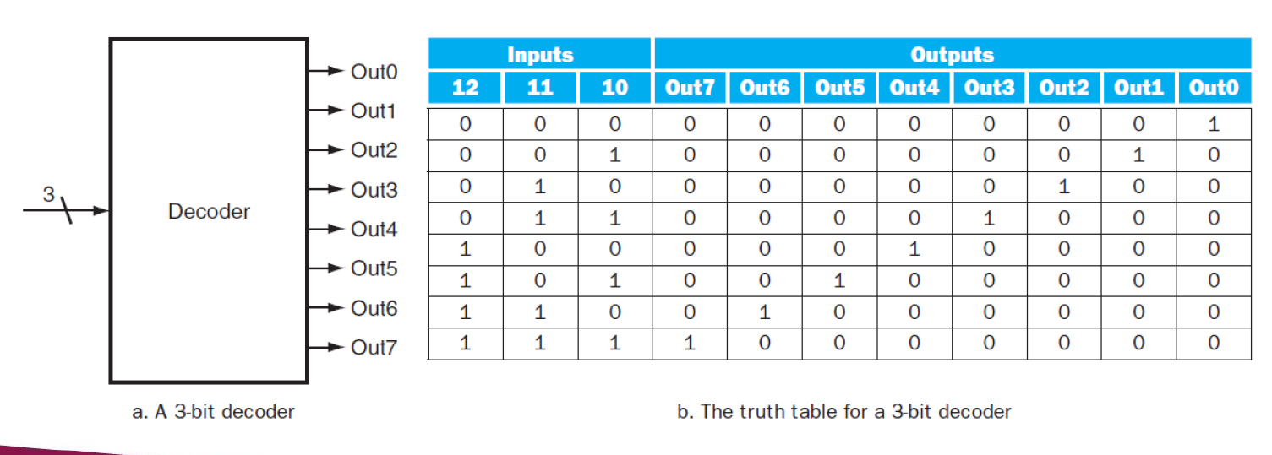
Decoder
Has an n-bit input and 2^{n} outputs
Only one output is set to 1 for each input combination
others outputs are 0
Decoder translates the n-bit input into a signal that corresponds to the binary value of the n-bit input

Slide 12
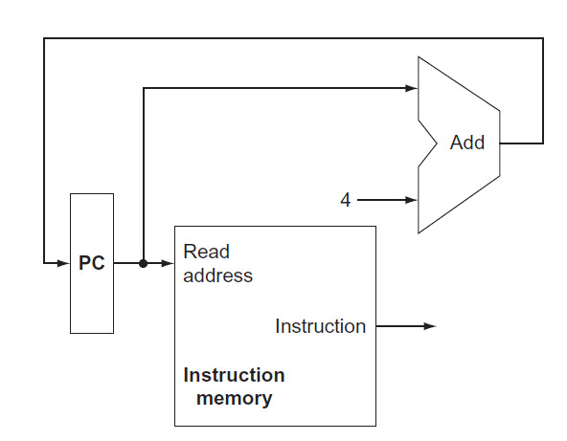
Fetching Instructions
Simplified view of the part fetching
instruction and incrementing PC
PC is edge triggered
Clock

Slide 13
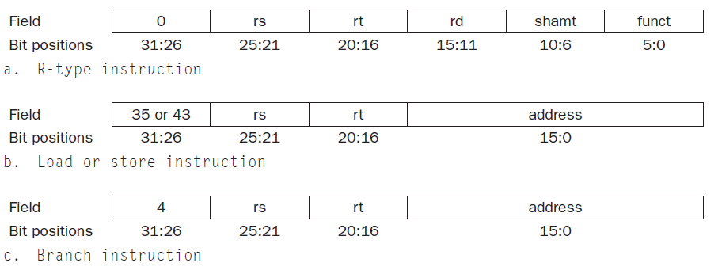
Decoding Instructions
opcode
R-type instruction
opcode
add $t3, $t1, $t2
opcode

Slide 14
Decoding Instructions
opcode
R-type instruction
opcode
add $t3, $t1, $t2
opcode

Slide 15
Decoding Instructions
opcode
R-type instruction
opcode
add $t3, $t1, $t2
opcode

Slide 16
Decoding Instructions
opcode
R-type instruction
opcode
add $t3, $t1, $t2
opcode

Slide 17
Decoding Instructions
opcode
R-type instruction
opcode
add $t3, $t1, $t2
opcode

Slide 18
Control Logic
opcode
R-type instruction
opcode
add $t3, $t1, $t2
opcode

Slide 19
Control Logic
Input (of some bits)
Combinational logic
Output (of some bits)

Slide 20
Control Logic
Input (of some bits)
Combinational logic
Output (of some bits)

Slide 21
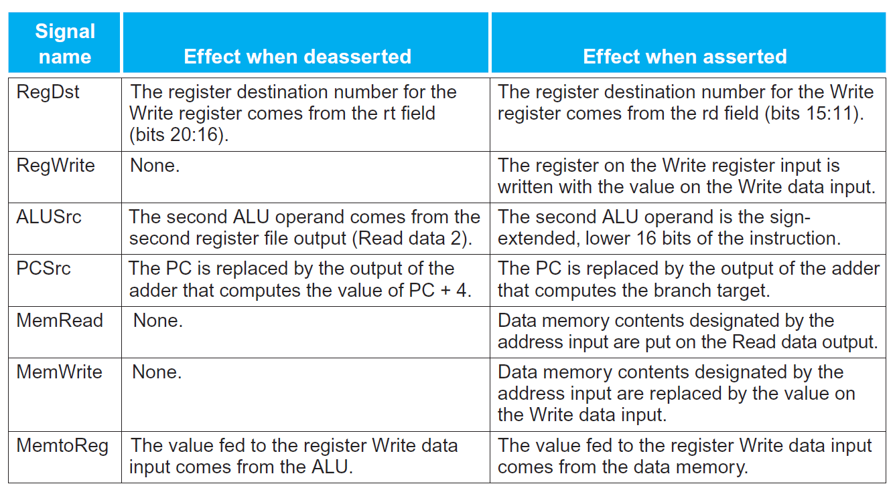
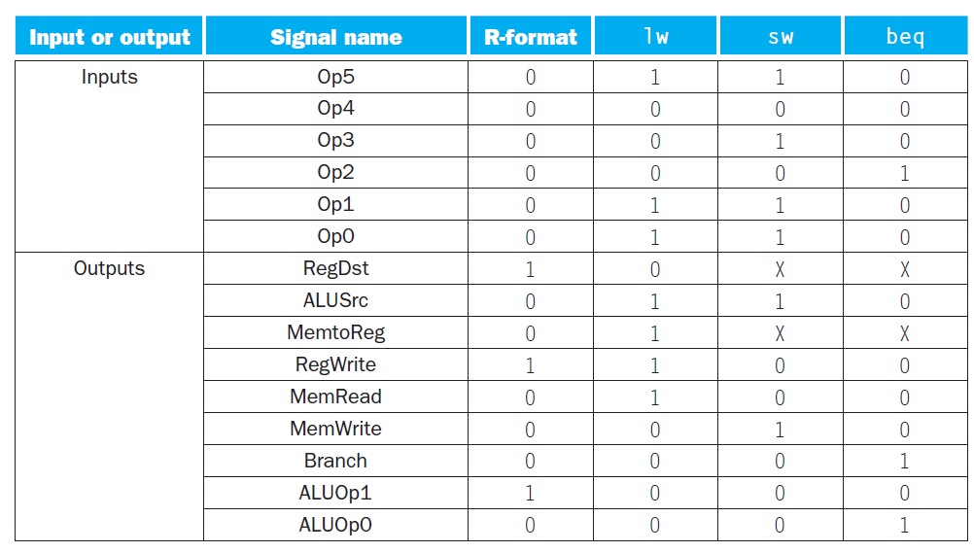
Control Logic
deasserted: 0
asserted: 1

Slide 22
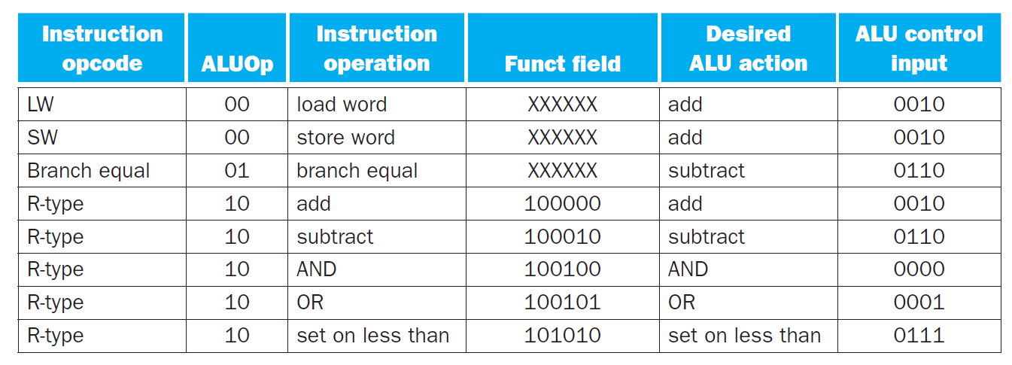
Control Logic
Used only for shift operations (ignore here)
opcode
R-type instruction
opcode
add $t3, $t1, $t2
opcode
ALU control code

Slide 23
Execution
opcode
R-type instruction
opcode
add $t3, $t1, $t2
opcode

Slide 24
add vs. addi
add $t3, $t1, $t2
opcode
R-type instruction
opcode
immediate
I-type instruction
addi $t3, $t2, 100
opcode

Slide 25
add vs. addi
add $t3, $t1, $t2
opcode
R-type instruction
opcode
immediate
I-type instruction
addi $t3, $t2, 100
opcode

Slide 26
Load Word
opcode
R-type instruction
opcode
immediate
I-type instruction
opcode
lw $t1, 100($t2)

Slide 27
Load Word
opcode
R-type instruction
opcode
immediate
I-type instruction
opcode
lw $t1, 100($t2)

Slide 28
Load Word
opcode
R-type instruction
opcode
immediate
I-type instruction
opcode
lw $t1, 100($t2)

Slide 29
Load Word
opcode
R-type instruction
opcode
immediate
I-type instruction
opcode
lw $t1, 100($t2)

Slide 30
Load Word
opcode
R-type instruction
opcode
immediate
I-type instruction
opcode
lw $t1, 100($t2)
The address of memory content to
be loaded is computed by 100 + $t2

Slide 31
Load Word
opcode
R-type instruction
opcode
immediate
I-type instruction
opcode
lw $t1, 100($t2)
The address of memory content to
be loaded is computed by 100 + $t2

Slide 32
Store Word
opcode
R-type instruction
opcode
immediate
I-type instruction
opcode
sw $t1, 100($t2)
The address of memory content to
be loaded is computed by 100 + $t2

Slide 33
Branch If Equal
opcode
R-type instruction
opcode
immediate
I-type instruction
opcode
beq $t1, $t2, 100
if $t1=$t2, jump to PC+4+100*4

Slide 34
Clock
All the state elements are edge-triggered
State elements: PC, register, memory
Either rising or falling edge-triggered
What if we do not use clocks?
May cause oscillation: the change at output may change the input, then change the output again, and repeat forever and never be stable
So far an instruction is finished in one cycle
Change triggered at an edge, and all updates finished before the next edge arrives

Slide 35
Problem of Single-Cycle Processor
In single-cycle processor
The signal has to pass through many gates in one cycle
Each gate incurs some delay
If clock cycle is too short, some updates cannot finish before next edge
Problem 1: even some instructions has very “short” path, it still uses the same clock cycle as those with “long” path
Problem 2: while the signal is propagating through some circuits, other circuits are unused
Single-cycle processor is not used in modern computers
Clock

Slide 36
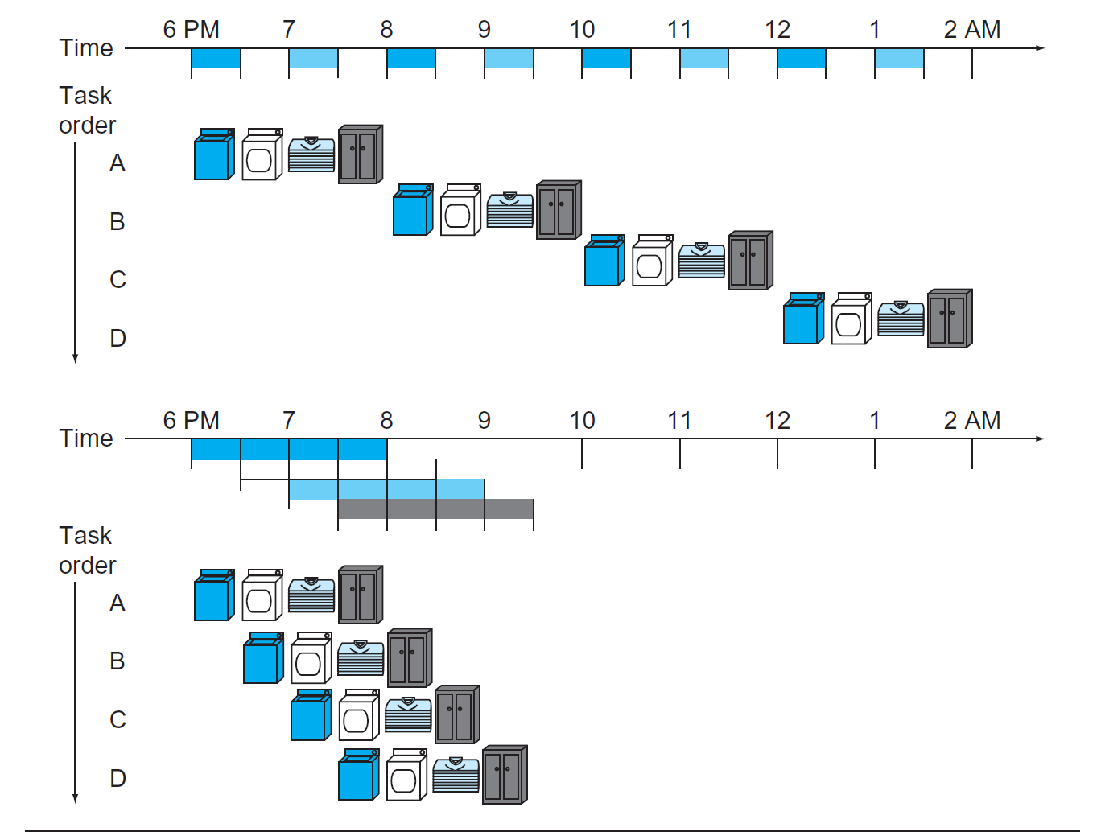
Pipeline
Divide instructions into sequential steps (aka "pipeline")
Performed by different processor units with different parts of instructions processed in parallel
Keep every part of the processor busy as much as possible

Slide 37
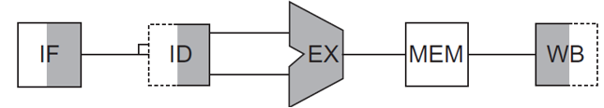
Pipeline
In MIPS, instructions are executed in five stages
IF: instruction fetch stage
ID: instruction decode & register file read stage
EX: execution stage
MEM: memory access stage
WB: write-back stage
add $s0, $t1, $t2
add $s1, $t3, $t4
add $s2, $t5, $t6

Slide 38
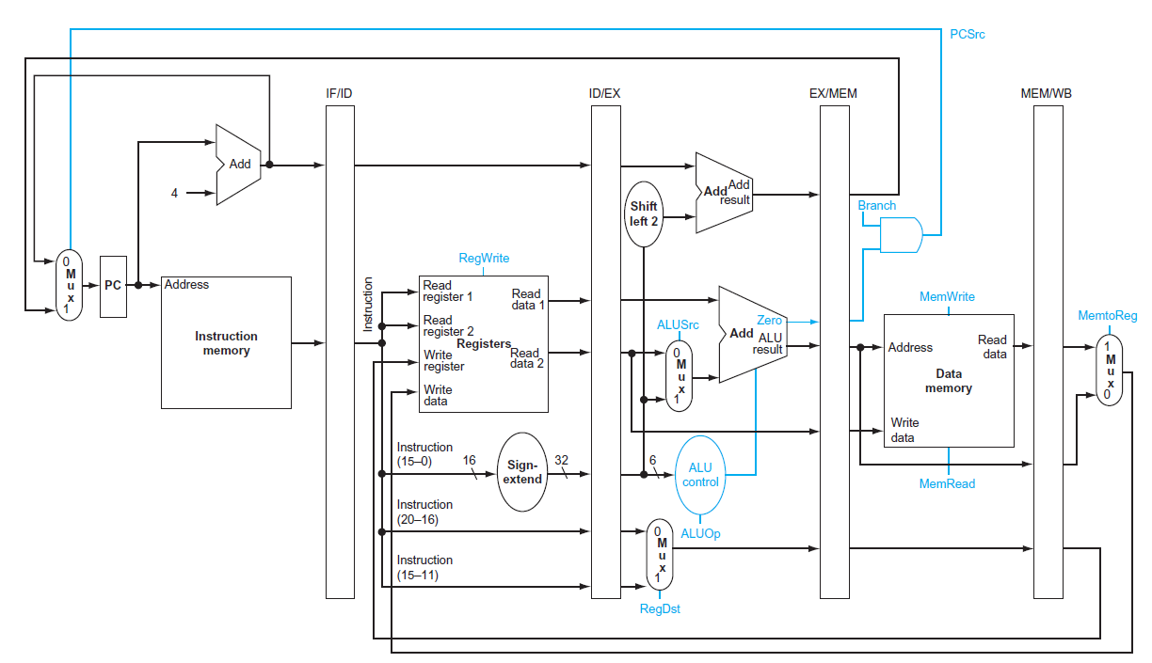
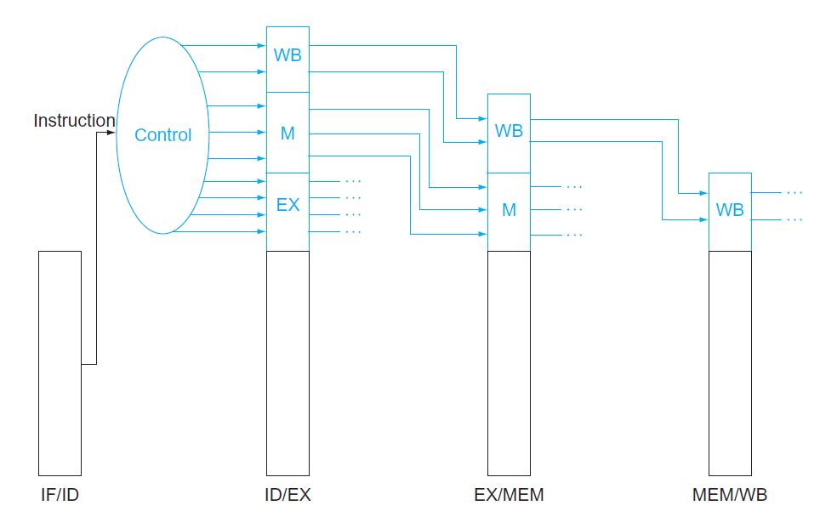
Pipeline
Implemented by adding pipeline registers between two steps

Slide 39
Pipeline Hazard
There are situations in pipelining when the next instruction cannot execute in the following clock cycle
Different types of hazard
Structural hazard
Data hazard
Control hazard

Slide 40
Structural Hazard
Occurs when hardware does not support the desired combination of instructions execute in the same clock cycle
Solution: change the hardware
lw $1, 100($0)
If the memory does not allow to access two different pieces of information (data and instruction) in the same clock cycle, it is a structural hazard
lw $2, 200($0)
lw $3, 300($0)
lw $4, 400($0)

Slide 41
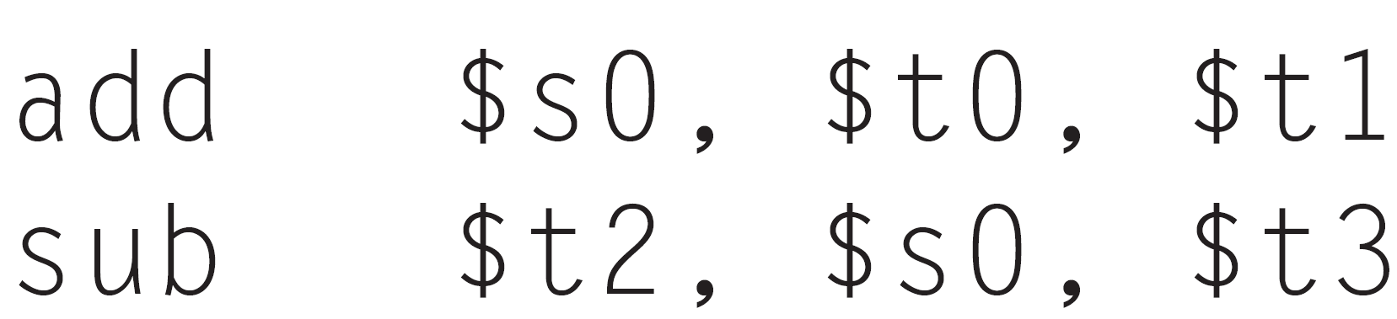
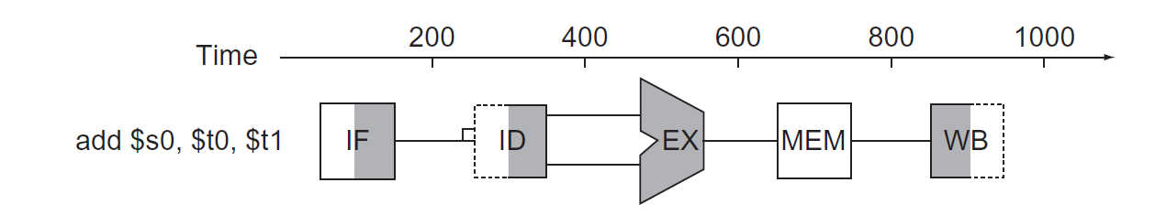
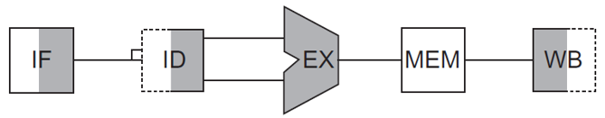
Data Hazard
Occurs when the pipeline must be stalled because one step must wait for another to complete
For example, we have an add instruction followed immediately by a subtract instruction that uses the sum ($s0)
add $s0, $t0, $t1
sub $t2, #s0, $t3

Slide 42
Data Hazard
Occurs when the pipeline must be stalled because one step must wait for another to complete
For example, we have an add instruction followed immediately by a subtract instruction that uses the sum ($s0)
The add instruction doesn’t write its result until the fifth stage, so we have to waste three clock cycles in the pipeline – pipline stall
add $s0, $t0, $t1
sub $t2, #s0, $t3

Slide 43
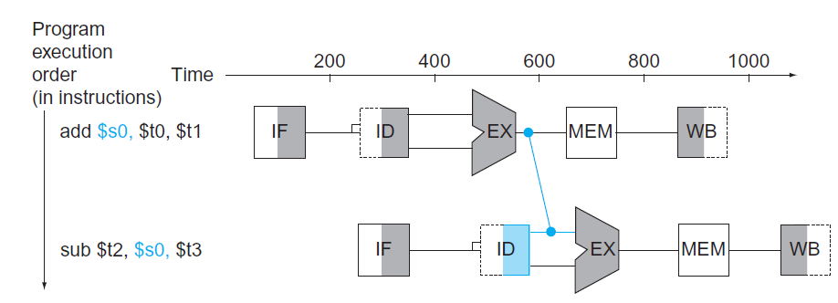
Forwarding
Solution: Forwarding
Add extra hardware to retrieve missing information early from the internal resources

Slide 44
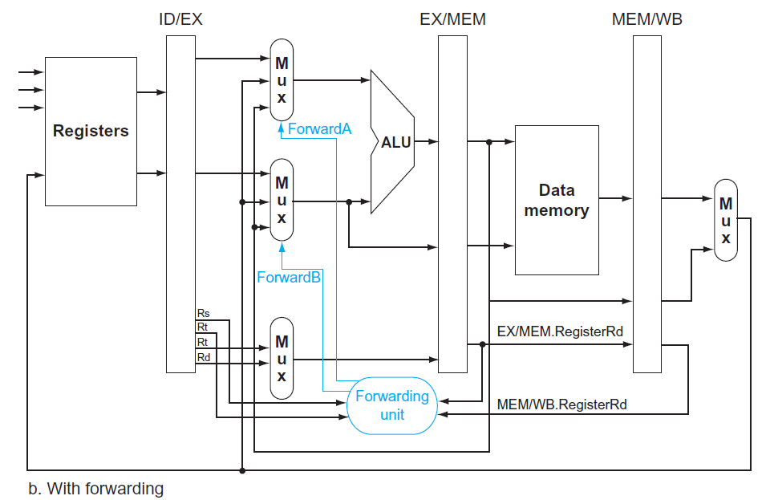
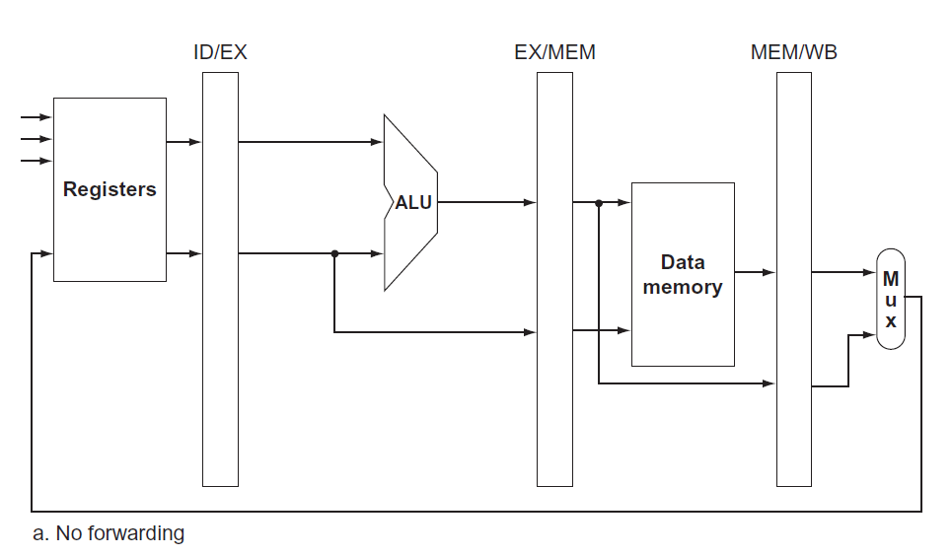
Forwarding

Slide 45
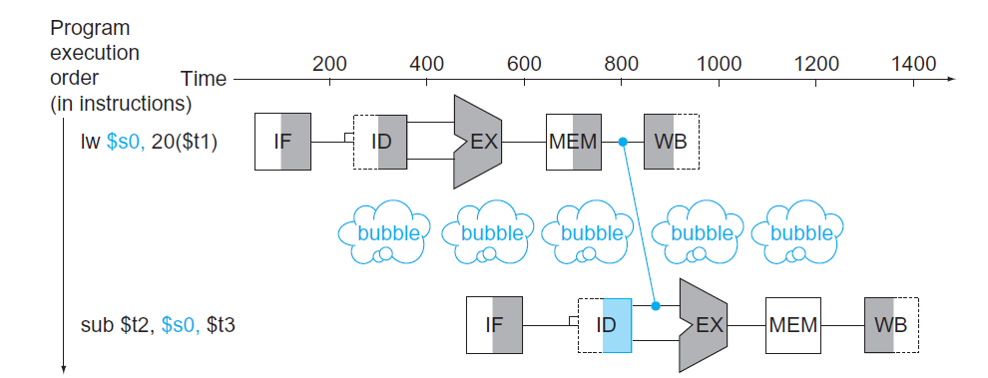
Data Hazard
Forwarding cannot avoid all pipeline stall

Slide 46
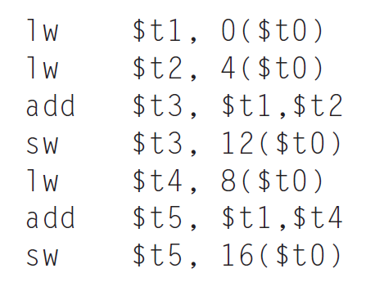


Data Hazard
We may reorder the code to avoid pipeline stalls

Slide 47
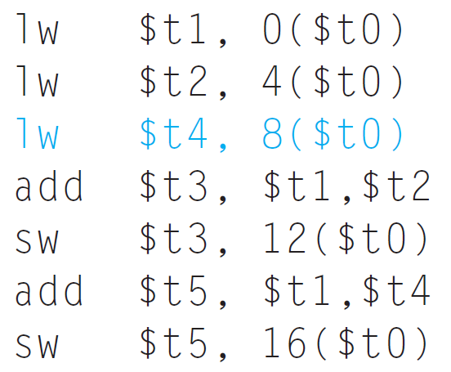
Data Hazard
We may reorder the code to avoid pipeline stalls

Slide 48
Control Hazards
Arising from the need to make a decision based on the results of one instruction while others are executing
We must begin fetching the instruction following the branch on the next clock cycle
Nevertheless, the pipeline cannot possibly know what the next instruction should be
We can simply stall at each conditional branch, until it becomes clear which is the next instruction
But it wastes cycles

Slide 49
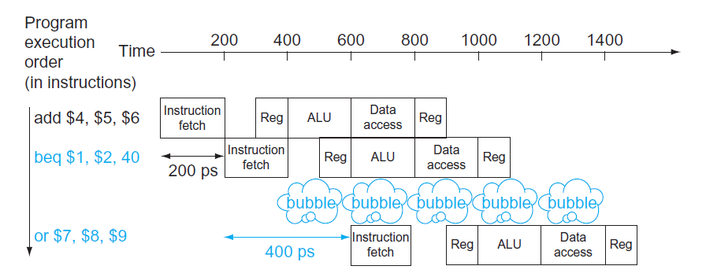
Control Hazards
Can add extra circuits to shorten the stall
E.g., to add hardware to test registers, calculate the branch address, and update the PC during the second stage of the pipeline
So the next instruction is clear after the second stage
But the pipeline stall would still exist

Slide 50
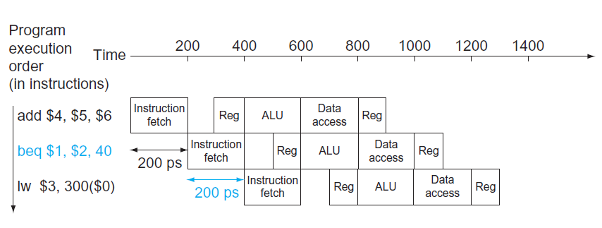

Branch Prediction
Computers usually use branch prediction for better performance
A simple approach is to assume branches to be always untaken
When you’re right, the pipeline proceeds at full speed
Only when branches are taken does the pipeline stall

Slide 51
Branch Prediction
Computers usually use branch prediction for better performance
A simple approach is to assume branches to be always untaken
When you’re right, the pipeline proceeds at full speed
Only when branches are taken does the pipeline stall

Slide 52
Branch Prediction
Computers usually use branch prediction for better performance
A simple approach is to assume branches to be always untaken
When you’re right, the pipeline proceeds at full speed
Only when branches are taken does the pipeline stall

Slide 53
Branch Prediction
Computers usually use branch prediction for better performance
A simple approach is to assume branches to be always untaken
When you’re right, the pipeline proceeds at full speed
Only when branches are taken does the pipeline stall
It turns out the branch is taken

Slide 54

Branch Prediction
Computers usually use branch prediction for better performance
A simple approach is to assume branches to be always untaken
When you’re right, the pipeline proceeds at full speed
Only when branches are taken does the pipeline stall

Slide 55
Branch Prediction
Computers usually use branch prediction for better performance
A simple approach is to assume branches to be always untaken
When you’re right, the pipeline proceeds at full speed
Only when branches are taken does the pipeline stall

Slide 56
Branch Prediction
Computers usually use branch prediction for better performance
A simple approach is to assume branches to be always untaken
When you’re right, the pipeline proceeds at full speed
Only when branches are taken does the pipeline stall

Slide 57
Branch Prediction
Computers usually use branch prediction for better performance
A simple approach is to assume branches to be always untaken
When you’re right, the pipeline proceeds at full speed
Only when branches are taken does the pipeline stall

Slide 58
Branch Prediction
Computers usually use branch prediction for better performance
A simple approach is to assume branches to be always untaken
When you’re right, the pipeline proceeds at full speed
Only when branches are taken does the pipeline stall

Slide 59
Branch Prediction Policy
The simplest policy: always assuming a branch is not taken
Dynamic branch prediction: to look up the address of the instruction to see if a branch was taken this instruction was executed in recent past, and, if so, to begin fetching new instructions from the same place as the last time
Using branch prediction buffer: small memory indexed by the lower portion of the address of the branch instruction
E.g., using a bit that says whether the branch by this instruction was recently taken or not

Slide 60
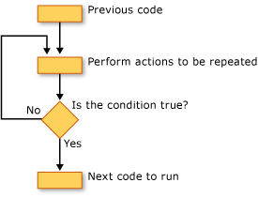
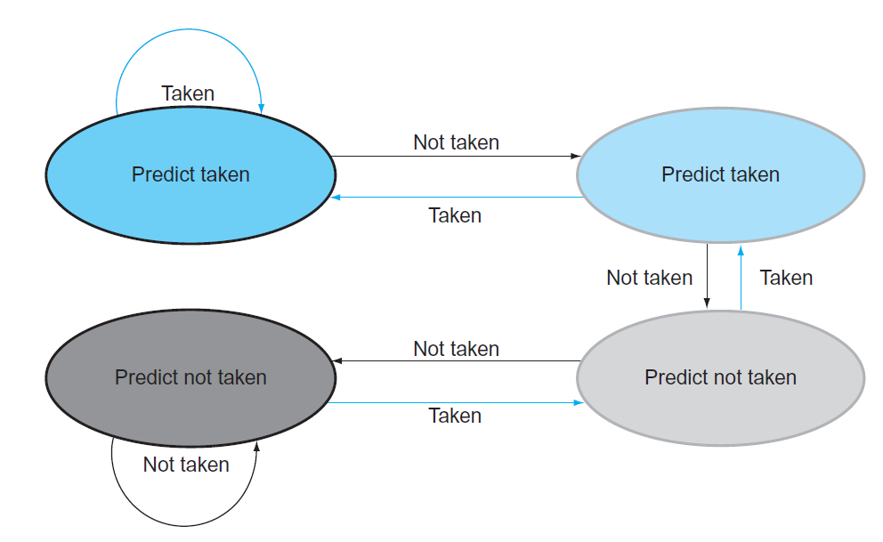
Branch Prediction Policy
1-bit prediction buffer for one instruction -- weakness
Example: a loop iterates for N times
Prediction incorrect twice:
1st iteration: last time some other loop terminates
Last iteration: inevitable
To remedy this weakness, 2-bit prediction schemes are often used
a prediction must be wrong twice before it is changed.

