Slide 1
CS2115 Computer Organization 2023/2024 Sem A
Chapter 7: I/O System
Dr. Nan Guan
Department of Computer Science
City University of Hong Kong

Slide 2
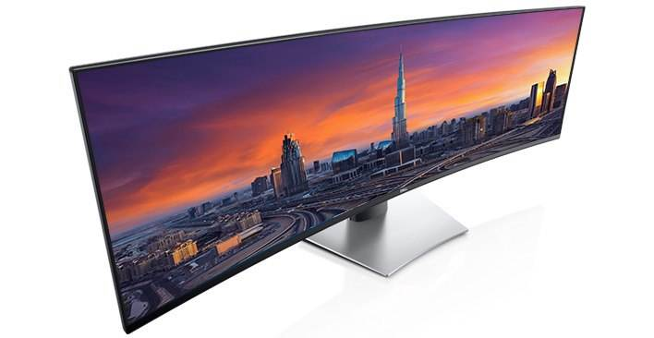
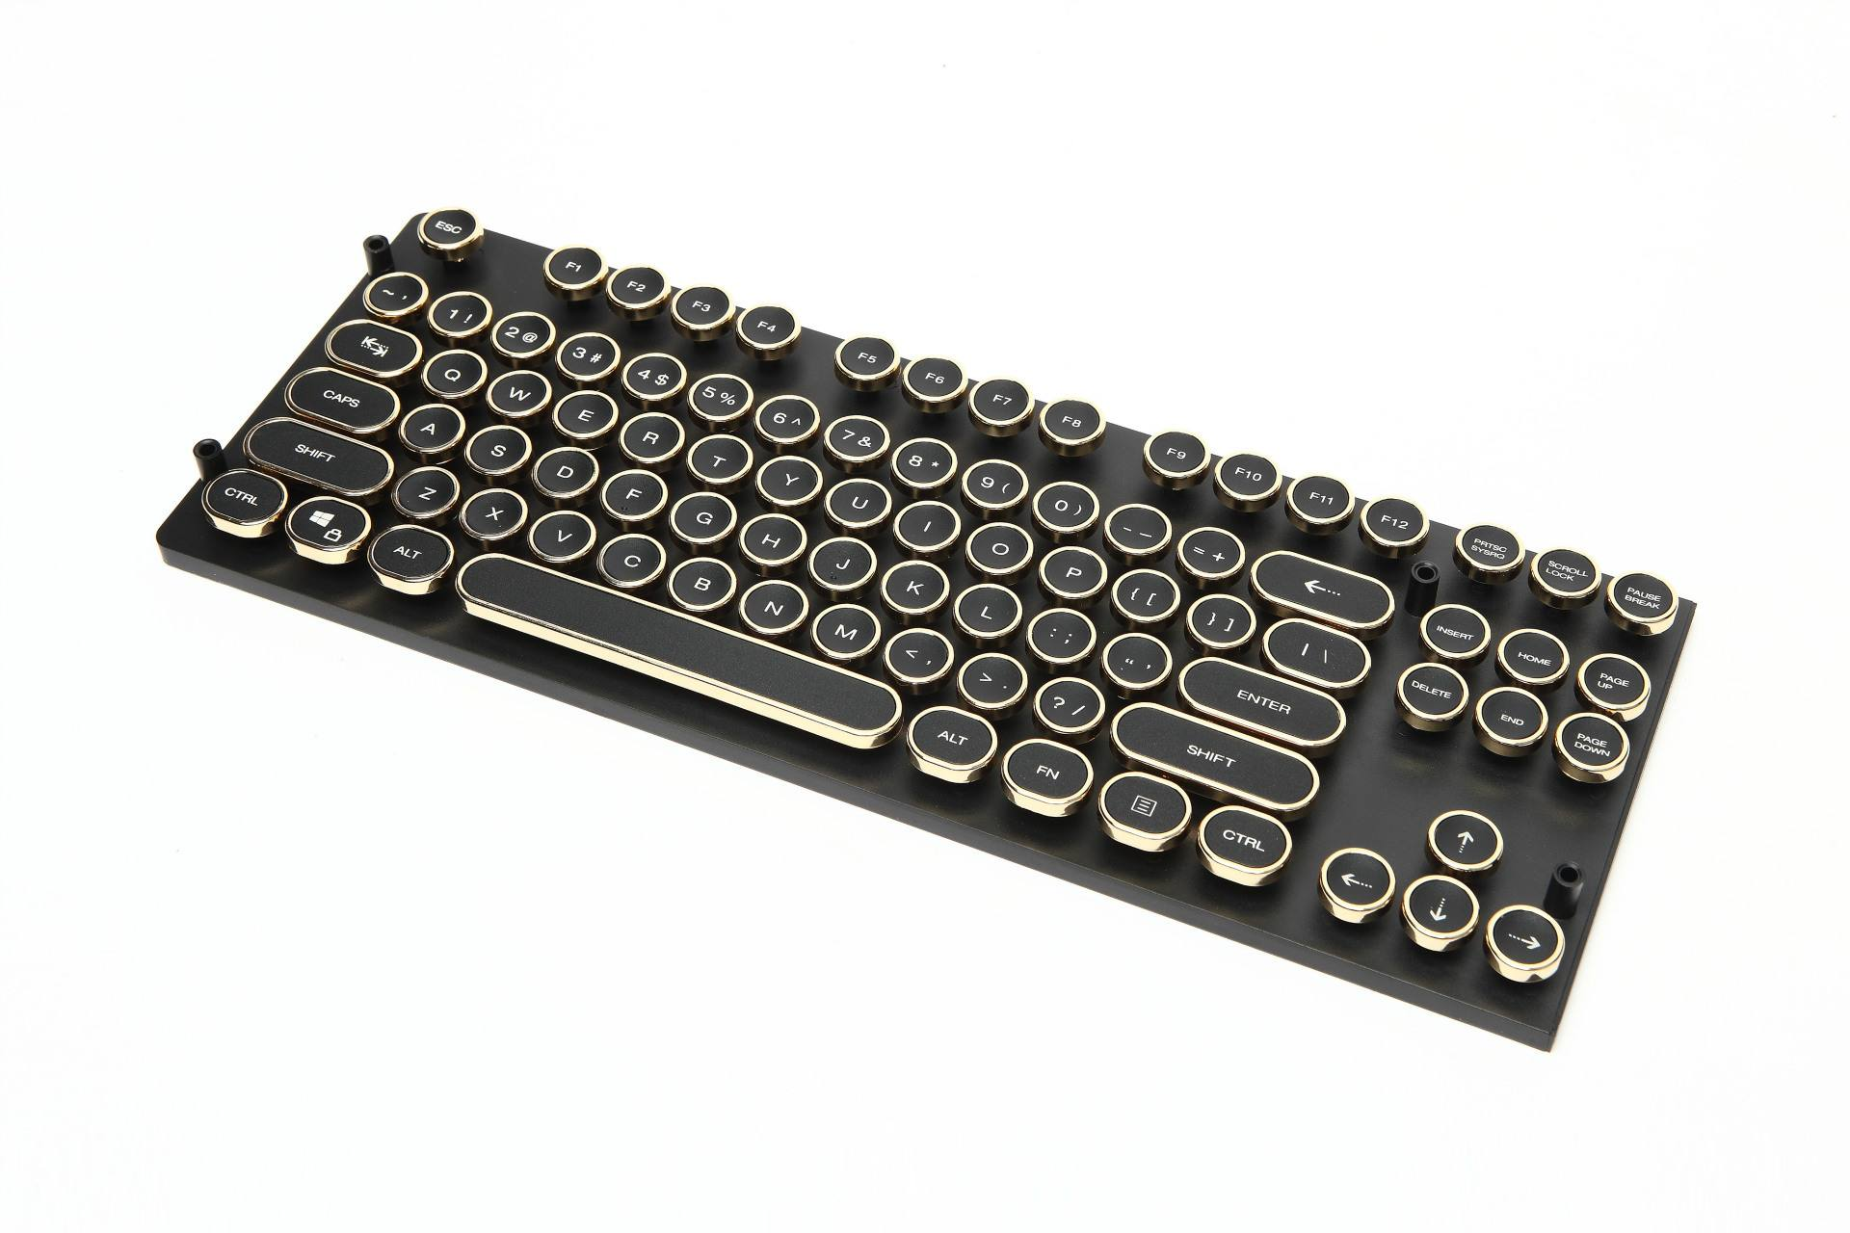
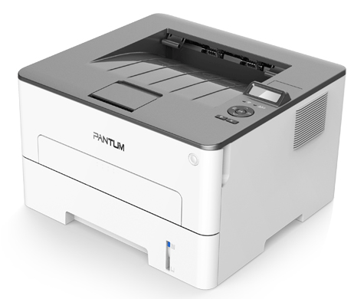
Peripheral Devices (I/O Devices)
Peripheral devices include :
Display peripherals - Video Display (Monitor)
Input peripherals - Keyboard, Mouse, Tracker ball, Joystick
Hardcopy peripherals – Dot Matrix and Laser Printers
…

Slide 3
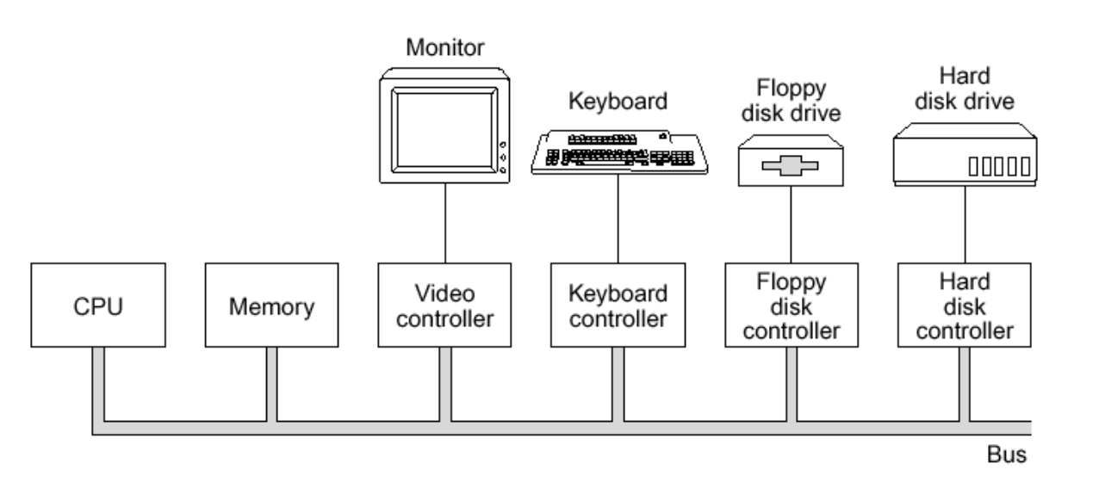
Peripheral Devices (I/O Devices)
The structure of a personal computer is to utilize a single bus to connect the CPU, memory, and I/O devices
Each I/O device requires a device controller:

Slide 4
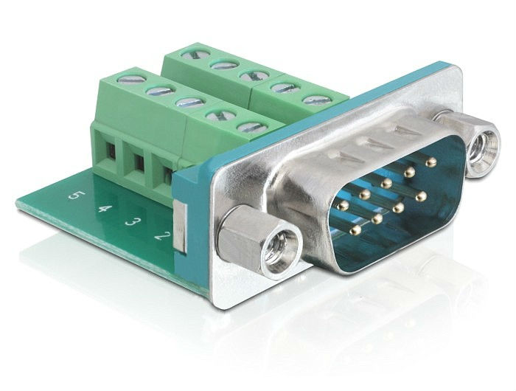
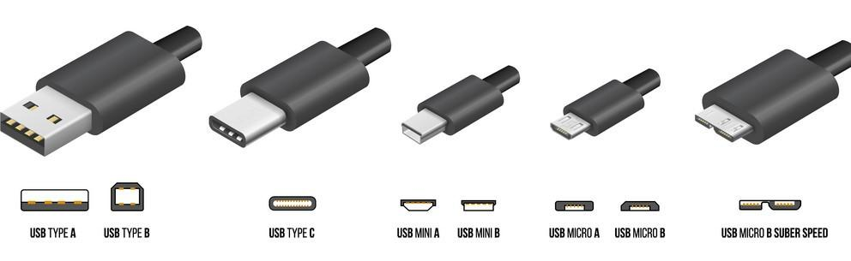
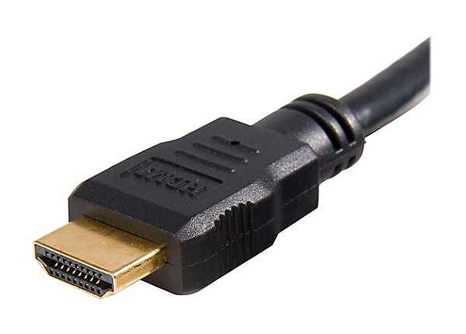
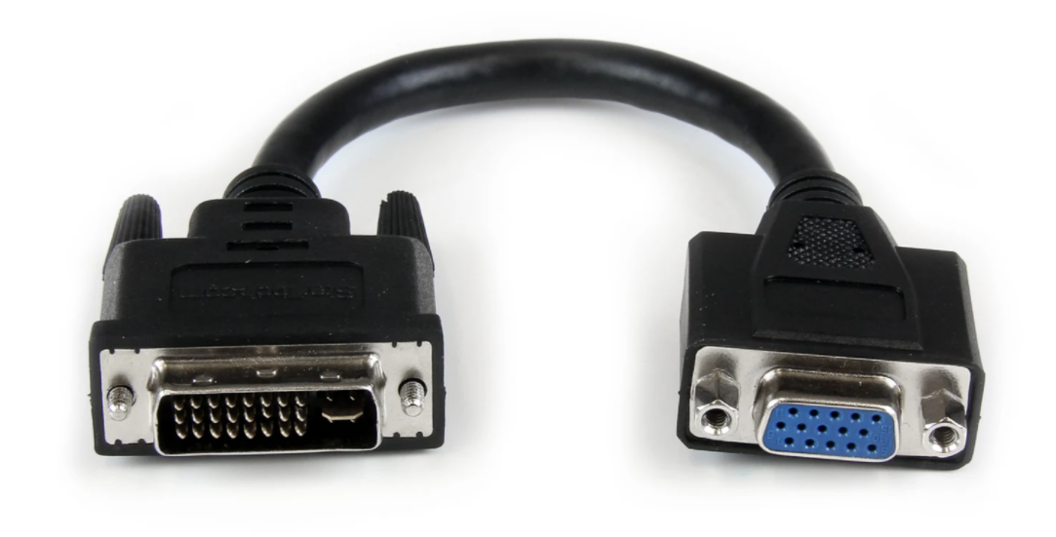
Communication Interface
Communication interface between two digital systems that transmits data as a series of voltage pulses down a wire.
Examples
RS-232 serial cable connection
The Universal Serial Bus (USB)
a simple, low-cost, and easy to use interconnection system
HDMI, VGA: video data interface

Slide 5
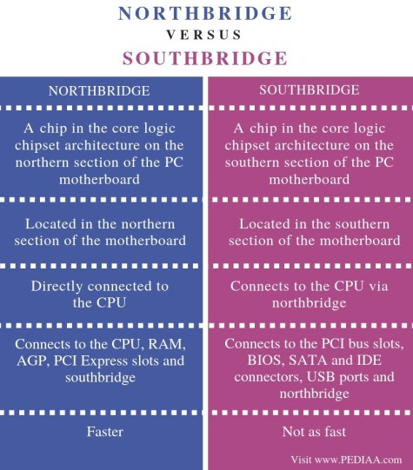
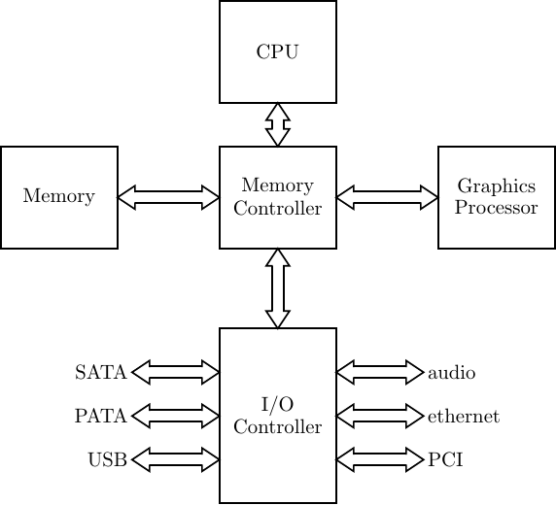
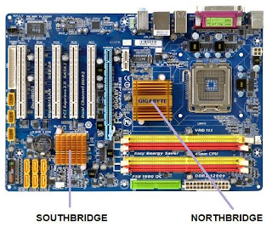
Northbridge and Southbridge
Northbridge: memory controller
Southbridge: I/O controller

Slide 6
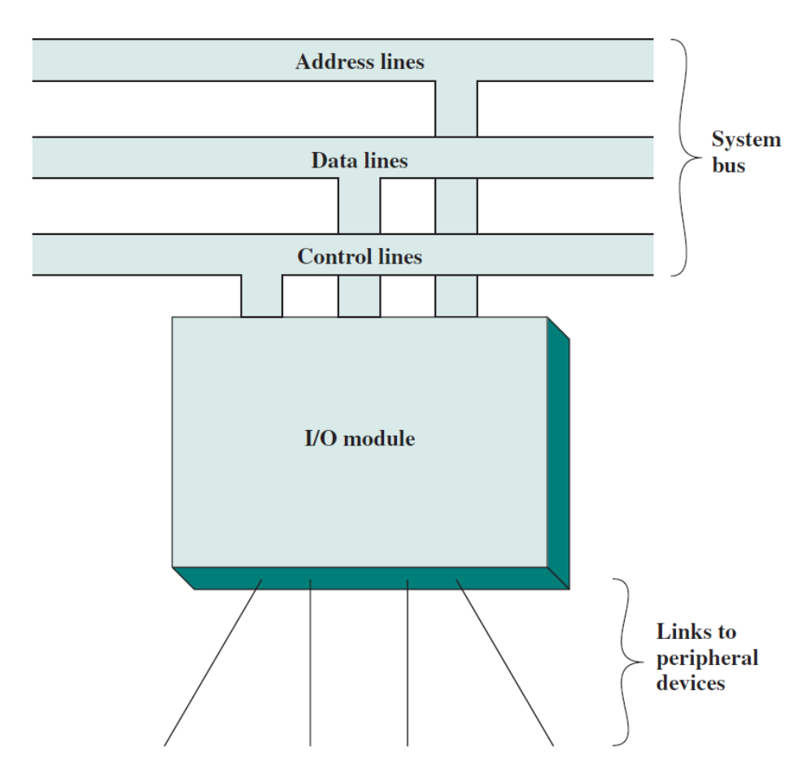
I/O Controller (I/O Module)
Major Functions:
Provide a standard interface for I/O operations.
Tailored to specific I/O devices and its interface requirements

Slide 7
I/O Controller Diagram
Interface to System Bus or I/O Controller
Interface to External Device
Data Registers
External
Device
Interface
Logic
Data
Data
Linea
Status
Status/Control Registers
Control
. . .
Address Lines
I/O
Logic
External
Device
Interface
Logic
Data
Control
Lines
Status
Control

Slide 8
External Interface
The external interface, must be tailored to the nature and operation of the peripheral
Parallel vs. serial data transfers
Data format conversions
Transfer rates
Number of devices supported

Slide 9
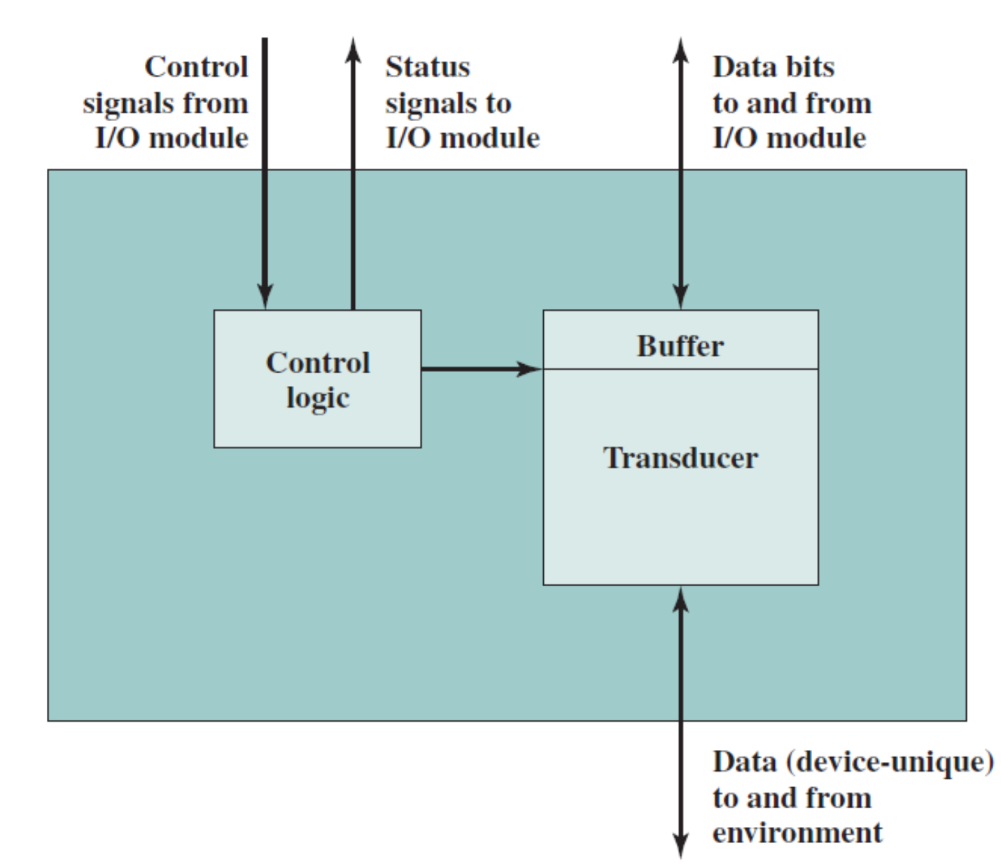
External Device
Three types of signals
Control Signals
Status Signals
Data

Slide 10
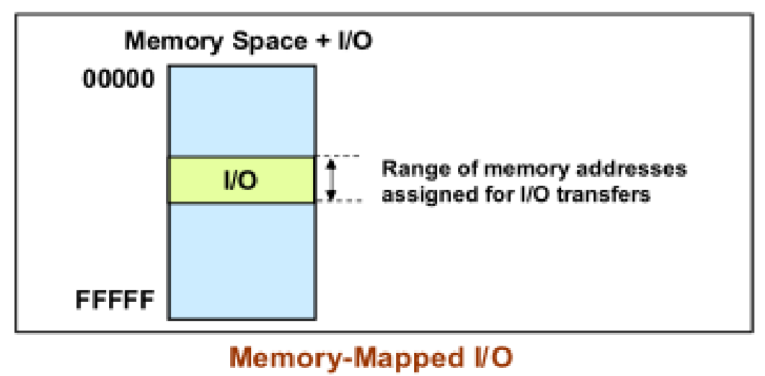
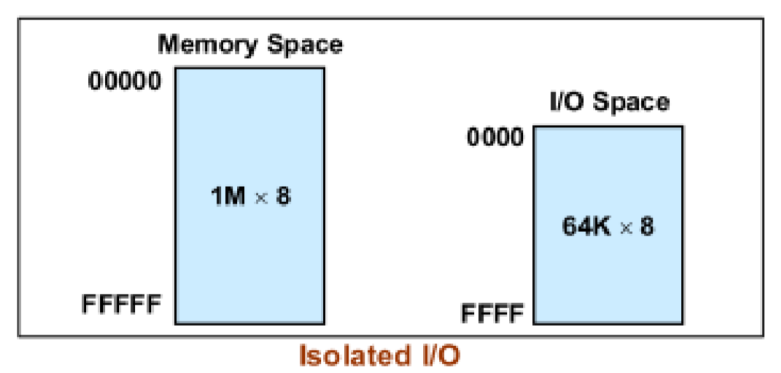
I/O Addressing
Memory mapped I/O
Devices and memory share same address space
I/O looks just like memory read/write
No special commands for I/O
Isolated I/O
Separate address spaces
Need I/O or memory select lines
Special commands for I/O

Slide 11
I/O Techniques
Three techniques for I/O Operations
Programmed I/O
Interrupt driven I/O
Direct Memory Access (DMA)

Slide 12
Programmed I/O
CPU issues I/O commands to I/O modules and directly controls I/O
Sensing status
Read/write commands
Transferring data
Periodically poll I/O modules to check their status
Disadvantages:
CPU waits for I/O module to complete operation
Waste CPU time – CPU is slowed down to the speed of peripherals
Advantages:
Simple
No extra hardware support required

Slide 13
Interrupt-Driven I/O
Interrupt-driven I/O:
To reduce the time CPU spends on I/O operations
CPU issues I/O commands to I/O module
CPU continues for its other tasks while the module
performs I/O operations
The module signals the CPU when I/O operations are finished (Interrupt)
CPU responds to the interrupt by executing an interrupt service routine
CPU recognizes and responds to interrupts at the end of an instruction execution cycle

Slide 14
Interrupt-Driven I/O
How to identify which device issues the interrupt?
How to decide which one to proceed if multiple interrupts occurs?
Separate Interrupt Lines
Different device trigger different interrupt lines
Pooling
Use software to check the status of different devices
Priority control
Assign priorities to different devices; automatically arbitrated

Slide 15
Direct Memory Access (DMA)
Interrupt driven and programmed I/O require CPU involvement for I/O operations
DMA (Direct Memory Access) does not need CPU except for initialization of I/O operations
Large amounts of data can be transferred between memory and the peripheral without severely impacting CPU performance
Data
count
Data lines
Data
register
Address
register
Address lines
Request to DMA
Acknowledge from DMA
Interrupt
Read
Write
Control
logic

Slide 16
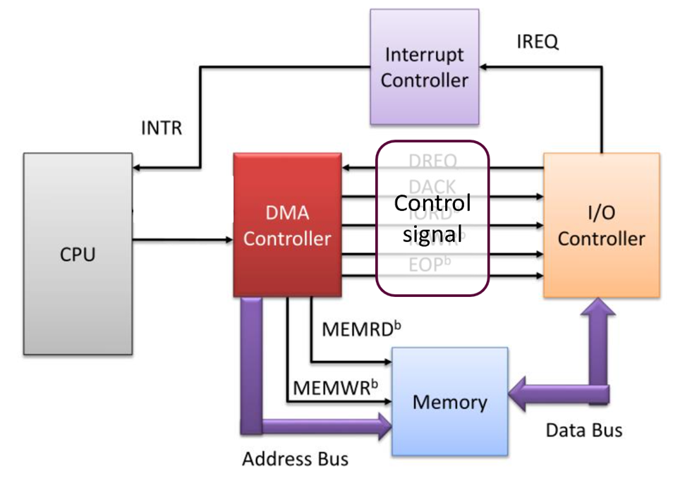
Direct Memory Access (DMA)
Interrupt-driven and programmed I/O require CPU involvement for I/O operations
DMA (Direct Memory Access) does not need CPU except for initialization of I/O operations
Large amounts of data can be transferred between memory and the peripheral without severely impacting CPU performance

