Slide 1
Introduction to Computational Probability Modeling CS 2402

Slide 2
Course General Info
Teaching Team
Lecturers: Prof. Shuaicheng Li/Prof. Kede Ma
Email: sc.li/kede.ma
Office: AC1-G6520 (Li)/AC1-Y6424 (Ma)
TAs: 12 PhD students
Canvas-based Course Site
It is your own responsibility to check Canvas and University e-mail account regularly for announcements and updates

Slide 3
Teaching Activities
Lecture/In-class Exercise (3 hours/week)
Lecturers will present selected material
Students will do two or more in-class questions in each lecture
Tutorial (one hour)
8 tutorials in total for practicing learned concepts
Week TBD, and will be announced days prior to lectures

Slide 4
Assessment
Coursework (50%)
Assignments (20%)
In Class Exercises/Tutorials (10%)
Midterm (20%)
Examination (50%)
For a student to pass the course, at least 30% of the maximum mark for the exam must be obtained

Slide 5
Resources
Lecture Notes
Books (Optional)
Probability & Statistics for Engineers & Scientists, 9/E Ronald E. Walpole Raymond H. Myers
Think Stats: Probability and Statistics for Programmers. Allen B. Downey. O’Reilly. 2011
Introduction to Scientific Computing in Python. Robert Johansson
Online

Slide 6
Course Intended Learning Outcomes (CILOs)
Understand and explain how computational probability models are used in computer science, information technology, and data science
Develop critical thinking skills to use computational probability models to explain random phenomenon through independent investigation
Write computer programs to simulate random phenomenon, and analyze data with computational probability models

Slide 7
Probability
Probability Theory: the study of uncertainty
Probability quantifies how uncertain we are about future / random events
Statistics: the study of how to make inference and decisions in face of uncertainty

Slide 8
Uncertainty Events
Coin toss
Traffic
The lifespan
Lotteries
Notes:
LED 40,000-50,000 hours

Slide 9
Early Beginnings
The viewpoint that randomness was unknowable was held for a long time during the Roman empire and throughout the middle ages…
Until 1400s when mathematicians started to study games of chance (dice and cards)
Improved their chances of winning at the gaming table
For themselves or for some wealthy noblemen
First, looked at which combinations of dice are more common to gain advantages when betting
Then started to study harder problems…

Slide 10

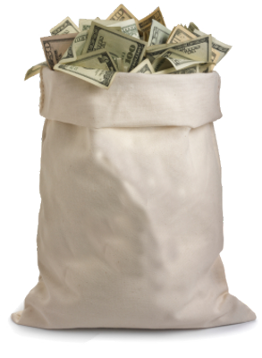




The Unfinished Game
There are two players, Alice and Bob
They place equal bets ($50 each)
The pot ($100) goes to the winner of the best of 5 tosses of a fair coin (i.e., 3 out of 5)
They stop in the middle of the game….
How should they divide the pot?
$???
$100
$???
Notes:
Head and tail

Slide 11
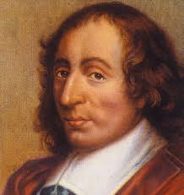
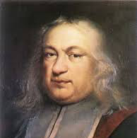
The Unfinished Game
Many mathematicians looked at this problem but could not solve it correctly until in 1654…
One famous French mathematician, Blaise Pascal, wrote a letter to another equally famous French mathematician, Pierre de Fermat
After several letters they solved the problem
Developed a method to predict the future by calculating the numerical likelihood (probability) of an event
Notes:
Andrew Wiles
a^n + b^n =c^n

Slide 12
Birth of Probability Theory
The solution of the “Unfinished Game” marked the birth of probability theory
Impacts us in many ways:
Allows us to plan our lives around uncertain events with great precision
Insurance
Life expectancy and annuities, maritime insurance
Engineering and science
Likelihood of failure (e.g., the likelihood of a major disaster of the space shuttle), analysis of data
Business and government
Managing and quantifying risk, decision making, casinos, lotteries
Notes:
Marine insurance covers the physical loss or damage of ships, cargo, terminals, and any transport by which the property is transferred, acquired, or held between the points of origin and the final destination.

Slide 13

Frequentist Probability
Probability: the relative frequency that an event will occur over many trials or over a large population
Example: the probability of being struck by lightning in HK is 1/3,200,000
Empirical or experimental probability – based on direct observation and data collection

Slide 14
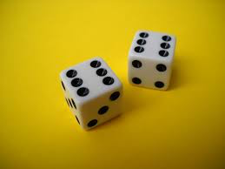
Frequentist Probability
Probability: the relative frequency that an event will occur over many trials or over a large population
Example: the probability of rolling two 6’s when you throw two dice is 1/36
Theoretical probability – calculated via theoretical mathematical arguments, such as symmetry of dice

Slide 15
Conditional Probability
Conditional probability: the probability of one event given that another event has occurred
A revision of probability based on knowledge or evidence
Example:
The probability you will cough today is 5%
The probability that you will cough today given that you have a cold is 75%
Here the evidence is “you have a cold,” so it is much more likely that you will cough

Slide 16





Monty Hall Problem
You are on a TV game show
There are 3 closed doors, and you can pick one
A car is randomly placed behind one door
Goats are behind the two other doors
You pick door number 1
1
2
3
Notes:
http://marilynvossavant.com/game-show-problem/
http://xkcd.com/1282/
21 movie: https://www.youtube.com/watch?v=cXqDIFUB7YU&feature=kp
and various solutions
mythbusters: https://www.youtube.com/watch?v=-XWLynrvTzE#t=772

Slide 17
Monty Hall Problem
The host will open one of the other doors (2 or 3) to reveal a goat
If both doors have goats, the host will randomly pick a door to open
Suppose the host opens Door 3, revealing a goat
1
2
3
3
Notes:
http://marilynvossavant.com/game-show-problem/
http://xkcd.com/1282/
21 movie: https://www.youtube.com/watch?v=cXqDIFUB7YU&feature=kp
and various solutions
mythbusters: https://www.youtube.com/watch?v=-XWLynrvTzE#t=772

Slide 18
Monty Hall Problem
Now the host offers you a choice:
Stick with your current Door 1 or switch to Door 2?
What is the probability that the car is behind Door 2?
1
2
3
Notes:
http://marilynvossavant.com/game-show-problem/
http://xkcd.com/1282/
21 movie: https://www.youtube.com/watch?v=cXqDIFUB7YU&feature=kp
and various solutions
mythbusters: https://www.youtube.com/watch?v=-XWLynrvTzE#t=772

Slide 19
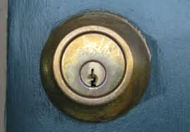
Subjective Probability
“I’m 95% sure that I locked the door today”
What does it mean?
You either locked the door or not
How can there be a probability of this event?
Subjective probability: represents an individual’s subjective belief that an event occurred
“A numerical estimate of the certainty of our knowledge”
“Quantification of our ignorance”

Slide 20
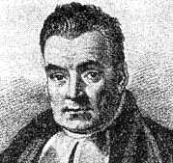
Revising Beliefs and Bayes’ Rule
Subjective probability is often combined with concrete data to obtain refined subjective probabilities
“By updating our initial belief about something with objective new information, we get a new and improved belief”
Allows us to reason about cause and effect
1701-1761
Notes:
applications [B Ch1, preface]

Slide 21


Bayes’ Original Experiment
Imagine I turn my back on a table
I throw the cue ball onto the table, and it has equal chance to stop anywhere on the table
I want to guess where the cue ball is…

Slide 22

Bayes’ Original Experiment
I throw the 8-ball onto the table, and you tell me whether it stopped to the left or right of the cue ball
If you say left, then the cue ball is more likely to be on the right side of the table, and vice versa
Keep repeating, and I can update the likely positions of the cue ball

Slide 23

Bayes’ Guessing Game Demo
Replace the table with the number line between 1 and 100
Cue ball is the mystery number
Black ball is a random number between 1 and 100

Slide 24
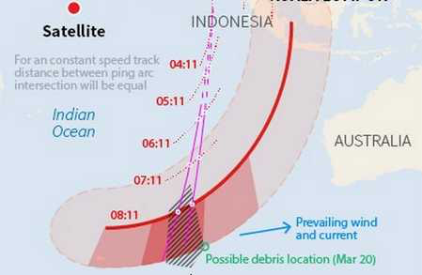
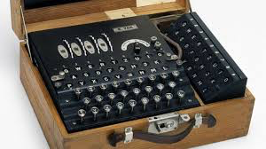
Revising Beliefs and Bayes
Subjective probability has many practical applications for making decisions under uncertainty
Accumulating evidence for decision making
Breaking secret codes (Enigma), directing artillery fire
Searching for missing things (nukes, U-boats, airplanes)
Artificial intelligence
Notes:
applications [B Ch1, preface]

Slide 25
Permutations and Combinations
Twelve people belong to the club, how many ways can they pick a president, vice president, secretary and treasurer?
12 people can be the president
11 people for vice president
10 for the secretary
9 for treasurer
12 x 11 x 10 x 9
Notes:
P(n,r), nPr, p^n_r = n!/(n-r)!

Slide 26
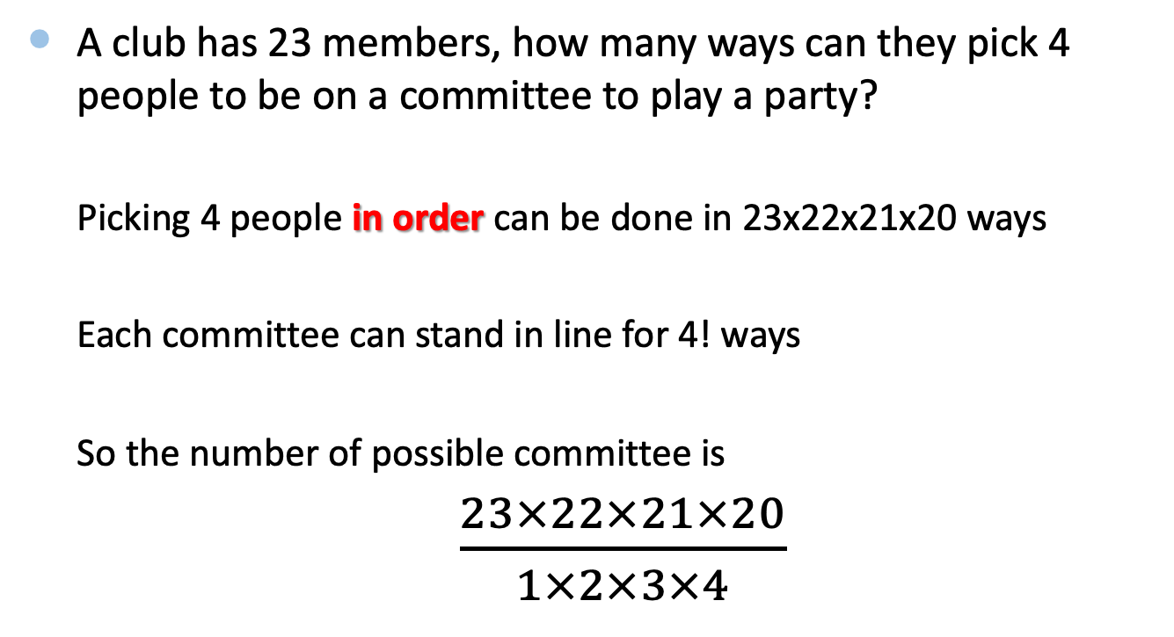
Permutations and Combinations
A club has 23 members, how many ways can they pick 4 people to be on a committee to play a party?
Picking 4 people in order can be done in 23x22x21x20 ways
Each committee can stand in line for 4! ways
So the number of possible committee is
$\frac{23×22×21×20}{1×2×3×4}$
Notes:
P(n,k): k-permutations of n items, nPk, P^n_k

Slide 27
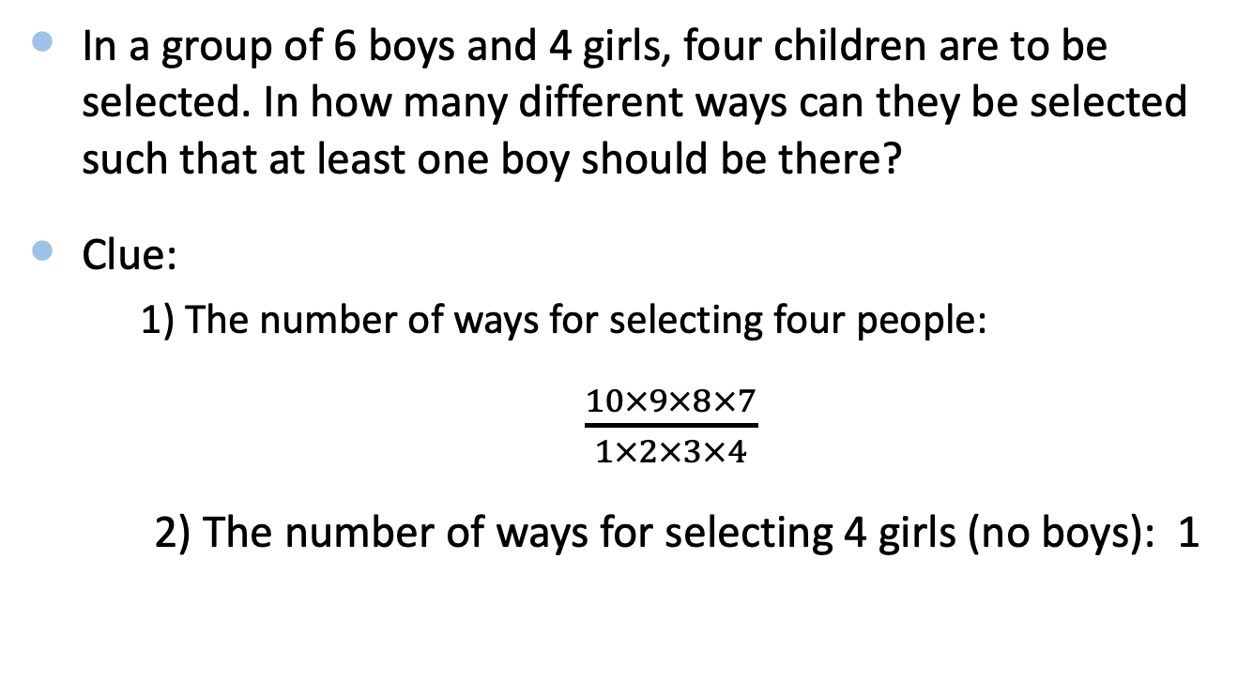
Permutations and Combinations
In a group of 6 boys and 4 girls, four children are to be selected. In how many different ways can they be selected such that at least one boy should be there?
Clue:
1) The number of ways for selecting four people:
$\frac{10×9×8×7}{1×2×3×4}$
2) The number of ways for selecting 4 girls (no boys): 1

Slide 28
Permutations and Combinations
In a birthday party, every person shakes hand with every other person. If there was a total of 28 handshakes in the party, how many persons were present in the party?

Slide 29
Example: World Series
In the basketball event, the first team to win four games wins the series. The series may last 4,5,6,7 games. However, a fan who wants to buy a ticket would like to know what are the probabilities of each of these outcomes
Here, we assume that the two teams are equally matched
At most, we can have 7 games

Slide 30
World Series
Four games
Two possible ways:
A wins all four games: AAAA
B wins all four games: BBBB
2x2x2x2=16 possible outcomes for the first four games
P(4) = 2/16 = 1/8

Slide 31
World Series
Five games
Ways that A wins the series:
BAAAA, ABAAA, AABAA, AAABA
AAAAB/AAAAA are not included, as they have been already included in the four-game case
Ways that B wins the series:
P(5)=2*4/(2^5)=1/4

Slide 32
World Series
Six games
Enumerating all the ways that the series ends in 6 games and A wins
BBAAAA ABBAAA AABBAA AAABBA
BABAAA ABABAA AABABA BAABAA
ABAABA BAAABA
We need to exclude the cases that lead to early termination (the series ends in 4 or 5 games)
P(6)=2*10/2^6=5/16
Notes:
asterisk

Slide 33

World Series
Seven games
1$−$P(4) $−$P(5) $−$P(6)
Games | 4 | 5 | 6 | 7
Probabilities | 0.125 | 0.25 | 0.3125 | 0.3125
Are there any other ways to compute P(7), expect for enumerating all the possibilities?

Slide 34

World Series
Seven games
3 A for the first 6 games
3 B for the first 6 games
The number that ends in a 3-3 tie is
In total, there are 64 combinations, and this gives us the probability of
P(7)=20/64=5/16
$\frac{6∗5∗4}{1∗2∗3}=20$

Slide 35
Frequency Distributions
The data is grouped into different intervals, and then the number of observations that belong to each interval is determined
Data that is presented in this manner are known as grouped data

Slide 36
Data
15.8 26.4 17.3 11.2 23.9 24.8 18.7 13.9 9.0 13.2 22.7 9.8 6.2 14.7 17.5 26.1 12.8 28.6 17.6 23.7 26.8 22.7 18.0 20.5 11.0 20.9 15.5 19.4 16.7 10.7 19.1 15.2 22.9 26.6 20.4 21.4 19.2 21.6 16.9 19.0 18.5 23.0 24.6 20.1 16.2 18.0 7.7 13.5 23.5 14.5 14.4 29.6 19.4 17.0 20.8 24.3 22.5 24.6 18.4 18.1 8.3 21.9 12.3 22.3 13.3 11.8 19.3 20.0 25.7 31.8 25.9 10.5 15.9 27.5 18.1 17.9 9.4 24.1 20.1 28.5

Slide 37
Class Limits & Frequency
Limits | Frequency
5.0 – 8.9 9.0 – 12.9 13.0 – 16.9 17.0 – 20.9 21.0 – 24.9 25.0 – 28.9 29.0 – 32.9 | 3 10 14 25 17 9 2
Total | 80

Slide 38
Summary
The solution of the “Unfinished Game” by Pascal and Fermat marked the birth of probability theory
Further developments have enabled us to plan our lives and make decisions under uncertainty in the real world
Frequentist probability – relative frequency of an event
Subjective probability – measure of certainty about a belief
Conditional probability and Bayes’ rule

Slide 39
The Exercise
Q1. There are 7 women and 5 men in a class. The instructor must select 5 to be on a committee. How many ways can the instructor select
a group of 3 women and 2 men?
a group of 2 women and 3 men?
a group of all women?
a group of all men?

Slide 40
The Exercise
Q2. Suppose we have a basket of 7 good apples and 5 bad apples. If we randomly select 4 apples, what is the probability of getting
exactly 3 good apples?
exactly 4 good apples?
no good apples?
at least 3 good apples?

Slide 41
The Exercise (Optional)
Q3. How many ways to partition a set that has exactly n elements?
Hint: https://en.wikipedia.org/wiki/Bell_number
Notes:
Bell number

