Slide 1
Basic Bayesian Method
CS2402 Lecture 10

Slide 2
Topics
Problem and Bayes’ original experiment
From effect to cause, more examples:
Disease problem
Prosecutor's fallacy
Email spam filtering
Two children problem
Summary
Bayesian inference in estimation (optional)

Slide 3
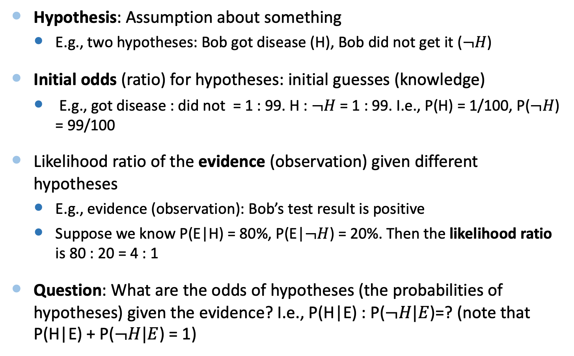
Problem
Hypothesis: Assumption about something
E.g., two hypotheses: Bob got disease (H), Bob did not get it ($¬H$)
Initial odds (ratio) for hypotheses: initial guesses (knowledge)
E.g., got disease : did not = 1 : 99. H : $¬H$ = 1 : 99. I.e., P(H) = 1/100, P($¬H$) = 99/100
Likelihood ratio of the evidence (observation) given different hypotheses
E.g., evidence (observation): Bob’s test result is positive
Suppose we know P(E|H) = 80%, P(E|$¬H$) = 20%. Then the likelihood ratio is 80 : 20 = 4 : 1
Question: What are the odds of hypotheses (the probabilities of hypotheses) given the evidence? I.e., P(H|E) : P($¬H|E$)=? (note that P(H|E) + P($¬H|E$) = 1)

Slide 4
Bayesian Method for Revising Beliefs
Rather than directly calculating the probability of the hypotheses, Bayes developed a way to revise the probability (or certainty) using new information
Method:
updated odds = likelihood ratio X initial odds
revised odds of the hypotheses
ratio of the probability observing the new information given the various hypotheses are true
multiplied by
the initial odds of the various hypotheses
equal to

Slide 5
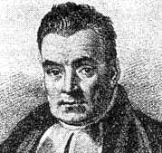

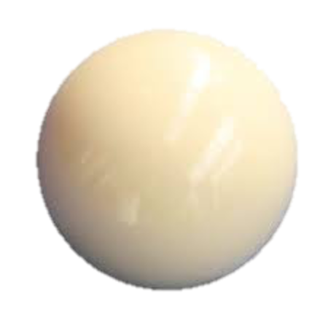
Bayes’ Original Experiment
Imagine I turn my back on a game table
I throw the cue ball onto the table, and it has equal chance (i.e., probability) to stop anywhere on the table
I want to guess where the cue ball is…

Slide 6
Initial Guess
For simplicity, consider 5 equally-spaced lines that are the possible positions of the cue ball
Each line is a hypothesis about the position of the cue ball
Equal chance for the cue ball to land on each line
Initial odds of each hypothesis should be the same
Odds for each line are 1:1:1:1:1 (probability for each line = 1/5)
: : : :

Slide 7

Evidence
I throw the 8-ball onto the table, and you tell me whether it stopped to the left or right of the cue ball
Suppose you say “left”…
Then the cue ball is more likely to be on the right side of the table

Slide 8
Evidence
For each hypothesis, calculate likelihood of “left”
I.e., the conditional probability that the black ball will be left of the hypothesized position of the cue ball
Hypothesis
P(“left”|Hypothesis)
Likelihood Ratio
1/6
1
2/6
2
3/6
3
4/6
4
5/6
5

Slide 9
Likelihood for “right” under different Hypotheses
Hypothesis
P(“Right”|Hypothesis)
Likelihood Ratio
5/6
5
4/6
4
3/6
3
2/6
2
1/6
1

Slide 10
Revising Beliefs
Revised odds = likelihood ✕ prior odds
: : : :
✕
: : : :
more likely to be on the right
=
: : : :

Slide 11
Getting More Observations
Repeat getting observations and updating odds
update with “left”
update again with “right”
✕
✕
=
=

Slide 12
Calculating Probabilities
Calculate probabilities from odds by normalizing to sum to 1:
Sum up the values
Divide each value by the sum
We use odds because it makes calculations simpler
Don’t need to normalize after each update
Odds | 5 | 16 | 27 | 32 | 25
Probability | 4.8% | 15.2% | 25.7% | 30.5% | 23.8%

Slide 13

Bayes’ Guessing Game Demo
Replace the table with the number line between 1 and 100
Cue ball is the mystery number
Black ball is a random number between 1 and 100

Slide 14
Topics
Problem and Bayes’ original experiment
From effect to cause, more examples:
Disease problem
Prosecutor's fallacy
Email spam filtering
Two children problem
Summary
Bayesian inference in estimation (optional)

Slide 15
Effect to Cause
Bayes mainly used intuition and geometry to show how to update the odds with new info
By revising the probabilities, we can reason from the effect (observation) to the cause (hypothesis)
Cause
Effect

Slide 16
Setup
Hypothesis H – what we are interested in knowing (i.e., the cause)
Prior probability P(H), P(¬H)
The original belief of the hypothesis being true
Evidence E – observations about the hypothesis (i.e., the effect)
Likelihood P(E|H), P(E|¬H)
The probability of seeing the evidence when the hypothesis is true, and when the hypothesis is false

Slide 17
Disease Example
Hypothesis (cause)
H = “you have disease”
Prior probability
P(H) = 2%
P(¬H) = 98%
Evidence (effect)
E = “tested positive for disease”
Likelihood (given hypothesis)
P(E|H) = 100%
P(E|¬H) = 8.2%
incidence rate
not H: “you don’t have disease”
sensitivity (true positive rate)
false positive rate
Notes:
Specificity: True negative rate

Slide 18
From Effect to Cause
Model how the effect is generated from the cause:
Hypothesis: P(H)
Prior probability of H
Likelihood: P(E|H), P(E|¬H)
P(EH) = P(E|H)P(H)
Given the evidence (effect) E, we can reason about the cause from the effect, i.e., computing:
P(H|E)
It is called the posterior probability of hypothesis H

Slide 19
Bayes’ Formula (Bayes’ rule)
Probability of the hypothesis given the evidence:
P(H|E) =[P(H)*P(E|H)]/P(E)
Note that P(HE)=P(H)P(E|H)
The denominator is for normalizing the posterior probability to sum to 1
P(E) = P(E|H)P(H) + P(E|¬H)P(¬H)
Pf: P(E|H)P(H) + P(E|¬H)P(¬H) = P(EH) + P(E¬H) = P(E)
Posterior is proportional to likelihood multiplied by prior
P(H|E) = P(E|H)*P(H) / P(E) ∝ P(E|H)*P(H)
P(¬H|E) = P(E|¬H)*P(¬H) / P(E) ∝ P(E|¬H)*P(¬H)
P(H|E) : P(¬H|E) = P(E|H)*P(H) : P(E|¬H)*P(¬H)

Slide 20
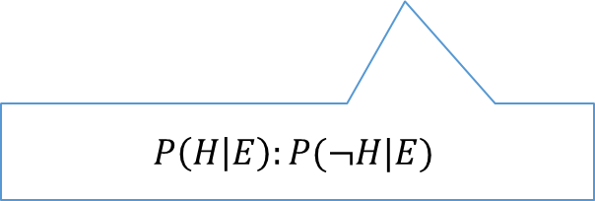
Bayes Odds
Equivalently, we can look at the odds between the hypothesis being true or false
This is the form used in Bayes’ cue ball experiment
Prior odds P(H):P(¬H)
Likelihood ratio P(E|H):P(E|¬H)
Posterior odds = likelihood ratio X prior odds
P(E|H)P(H) : P(E|¬H)P(¬H)
“the odds that the hypothesis is true to begin with”
“ratio of observing E when the hypothesis is true vs. when false”
$$P\left(H | E\right):P(¬H|E)$$
“the odds that the hypothesis is true after observing E”

Slide 21
Disease Problem
What is the probability that you have disease, given that you tested positive?
Hypothesis: H = “you have disease”
Prior odds P(H):P(¬H) = 2:98 = 1:49
Evidence: E = “tested positive for disease”
Likelihood ratio P(E|H):P(E|¬H) = 100:8.2
Posterior odds of H
(100X1) : (8.2X49) = 1:4
Posterior Probability of H
P(H|E) = 20%
P(¬H|E) = 80%
“odds to have disease”
“ratio to test positive when you have disease vs when not”
“odds to have disease given tested positive”

Slide 22
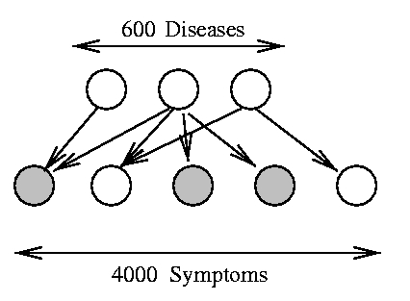
Medical Diagnosis
Diagnose diseases from observed symptoms
Hypotheses: presence/absence of various diseases
Evidence: symptoms observed
Real example:
QMR (Quick Medical Reference)
Medical knowledge base built by medical experts
600 diseases, 4000 symptoms
Served as a diagnostic consultant for doctors/interns

Slide 23


Prosecutor’s Fallacy
The probabilities P(E|H) and P(H|E) are often confused with each other
Example:
DNA was found at the crime scene, and it matched Alice in a DNA database
The chance of an accidental match is 1 in a million
The prosecutor suggests that there is a 1 in a million chance that Alice is innocent
Why is this wrong?

Slide 24
Prosecutor’s Fallacy
The chance of an accidental match is 1 in a million:
P(Found DNA matches Alice|Alice is innocent)
= 1/10^6
Prosecutor uses the above probability. It is wrong.
He should use:
P(Guilty|Found DNA matches Alice) = P(G|M) or
P(Innocent|Found DNA matches Alice) = P(I|M)

Slide 25
Prosecutor’s Fallacy
Posterior Odds:
P(G|M):P(I|M) = P(G)*P(M|G) : P(I) * P(M|I)
P(M|G) = 100%, P(M|I) = 1/10^6. If P(G) is very small, e.g., P(G) = 1/10^8, P(G|M):P(I|M) = 1:100→ P(G|M) = 1/101
The DNA evidence is not strong enough to suggest guilty
The Prosecutor’s Fallacy is to use P(Evidence|Innocent) instead of P(Innocent|Evidence) when making arguments about innocence
We should use P(H|E) instead of P(E|H) when arguing about H

Slide 26

Email Spam Filtering
Bayes’ rule can be used for email spam filtering
Hypothesis: “this email is spam”
Prior odds P(spam):P(¬spam) = 4:1
Evidence: occurrence of various words in the email
Probability of word occurring in spam and normal email
If no prior beliefs, could also use 1:1
Word | P(word|spam) | P(word|¬spam)
$$$ | 90% | 50%
Nigeria | 50% | 10%
group | 10% | 25%
CS2402 | 1% | 40%
50% of spam emails contain word “Nigeria”
10% of normal emails contain word “Nigeria”

Slide 27

Probability of Spam
Calculate posterior odds that email is spam given the observed words
Example: “Attention sir, I need help to transfer $$$ out of Nigeria…”
P(spam|Evidence):P(¬spam|Evidence) = 0.36:0.01
P(spam | “Nigeria”, “$$$”) = 0.36 / (0.36+0.01) = 97.3%
Hypothesis
spam
¬spam
Prior odds
0.80
0.20
Likelihood ratio
P(“$$$”|spam) P(“Nigeria”|spam) = 0.90 ✕ 0.50 = 0.45
P(“$$$”|¬spam) P(“Nigeria”|¬spam) = 0.50 ✕ 0.10 = 0.05
Posterior odds
0.36
0.01

Slide 28
Probability of Spam
Example: “CS2402 Announcement, projects are due today, except for the Nigeria group!”
P(spam | “CS2402”, “Nigeria”, “group”):P(¬spam | “CS2402”, “Nigeria”, “group”) =0.0004:0.002 = 4:20 = 1:5
P(spam | “CS2402”, “Nigeria”, “group”) = 1/6
Hypothesis
spam
¬spam
Prior odds
0.80
0.20
Likelihood ratio
P(“CS2402”|spam) P(“Nigeria”|spam) P(“group”|spam) = 0.01 ✕ 0.50 ✕ 0.10 = 0.0005
P(“CS2402”|¬spam) P(“Nigeria”|¬spam) P(“group”|¬spam) = 0.40 ✕ 0.10 ✕ 0.25 = 0.01
Posterior odds
0.0004
0.002

Slide 29
Email Spam Filtering
This is called Naïve Bayes spam filtering
“Naïve” means that we assume that all words are (conditionally) independent from each other
Convenient for calculations, but obviously not true
Used by many email clients and servers (e.g., Gmail)
Better than other methods using fixed word lists
Able to weight all information appropriately
E.g., “Nigeria” itself is highly likely to be spam, but other non-spam words like “CS2402” can override it
Easy to personalize and adapt to each user

Slide 30
Two Children Problem
My next-door neighbor has just moved in. We know that this family has two children. On the first day, I saw one boy come out from their apartment. The next day, my wife told me that she also saw a boy come out. Given these two evidences, can you compute the probabilities that this family has two boys, one boy and one girl, and two girls?
Hypotheses: H1: two boys, H2: one boy and one girl, H3: two girls
Initial odds: H1:H2:H3 = 1:2:1 /* (b,b), (b,g), (g,b), (g,g) have the same chance
My observation E1: P(E1|H1) = 1, P(E1|H2) = 1/2, P(E1|H3) = 0
Likelihood ratio of evidence under different hypotheses:
P(E1|H1):P(E1|H2):P(E1|H3) = 2:1:0
Updated odds of different hypotheses by E1: H1:H2:H3 = 2:2:0
My Wife’s observation E2: P(E2|H1) = 1, P(E2|H2) = 1/2, P(E2|H3) = 0
Likelihood ratio of evidence under different hypotheses:
P(E2|H1):P(E2|H2):P(E2|H3) = 2:1:0
Updated odds of different hypotheses by E2: H1:H2:H3 = 4:2:0 = 2:1:0
P(H1|E1, E2) = 2/3, P(H2|E1, E2) = 1/3, P(H3|E1,E2) = 0

Slide 31
Summary
Bayesian Method
1. Initial odds (prior probabilities) of hypotheses
2. Evidence (observation)
Likelihood ratio of evidence under different hypotheses
3. Posterior odds (probabilities) of hypotheses
= initial ratio X likelihood ratio

Slide 32
Topics
Problem and Bayes’ original experiment
From effect to cause, more examples:
Disease problem
Prosecutor's fallacy
Email spam filtering
Two children problem
Summary
Bayesian inference in estimation (optional)

Slide 33

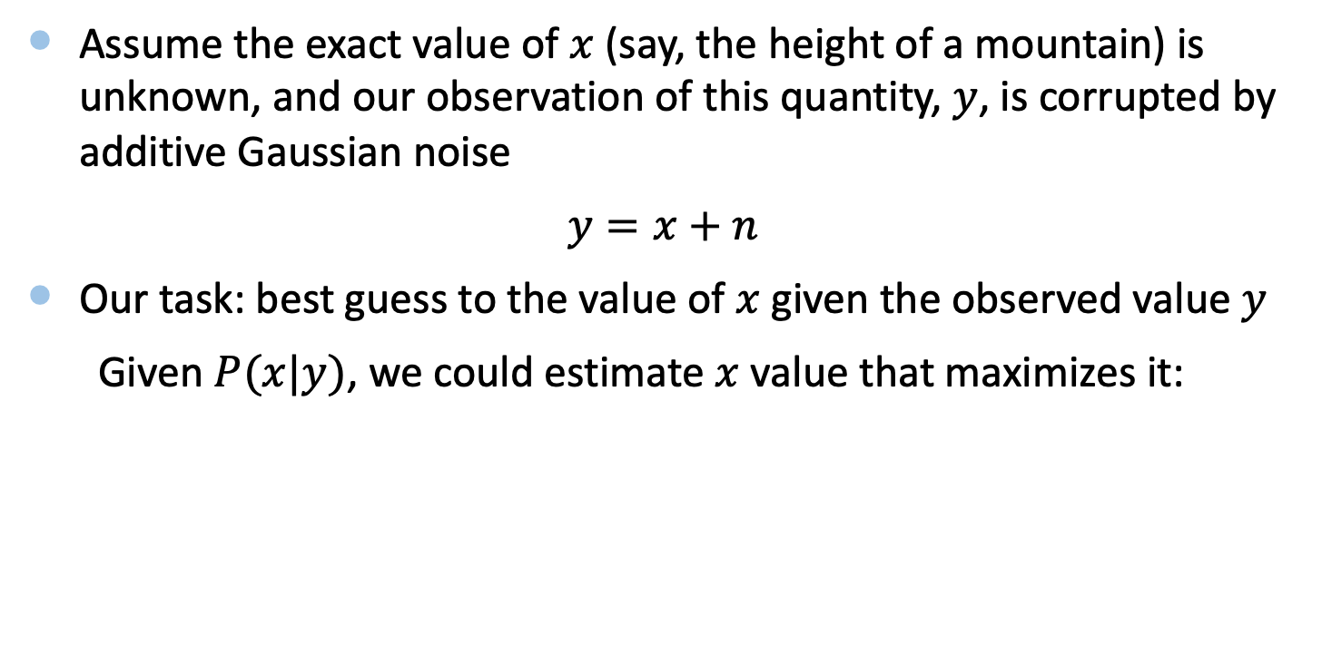
Bayesian Inference
Assume the exact value of $x$ (say, the height of a mountain) is unknown, and our observation of this quantity, $y$, is corrupted by additive Gaussian noise
$y=x+n$
Our task: best guess to the value of $x$ given the observed value $y$
Given $P(x|y)$, we could estimate $x$ value that maximizes it:
$$\hat{x}=arg max P(x|y)$$

Slide 34

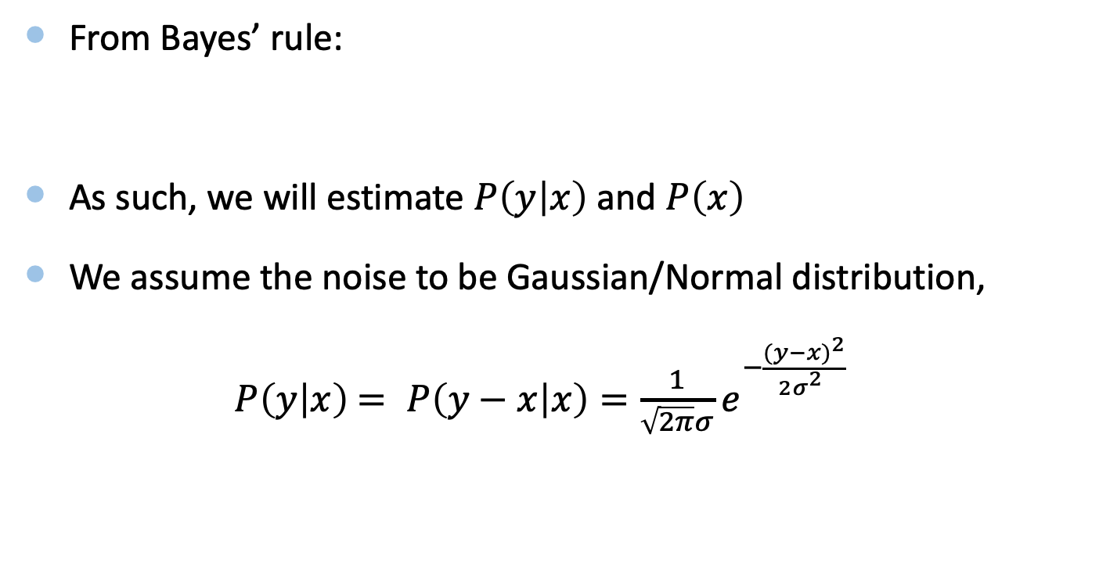
Bayesian Inference
From Bayes’ rule:
As such, we will estimate $P\left(y | x\right)$ and $P\left(x\right)$
We assume the noise to be Gaussian/Normal distribution,
$P\left(y | x\right)$ $= P\left(y−x | x\right)=\frac{1}{\sqrt{2π}σ}e^{−\frac{{(y−x)}^{2}}{2σ_{}^{2}}}$
$P\left(x | y\right)=$ $\frac{P\left(y | x\right)P(x) }{P(y)}$

Slide 35

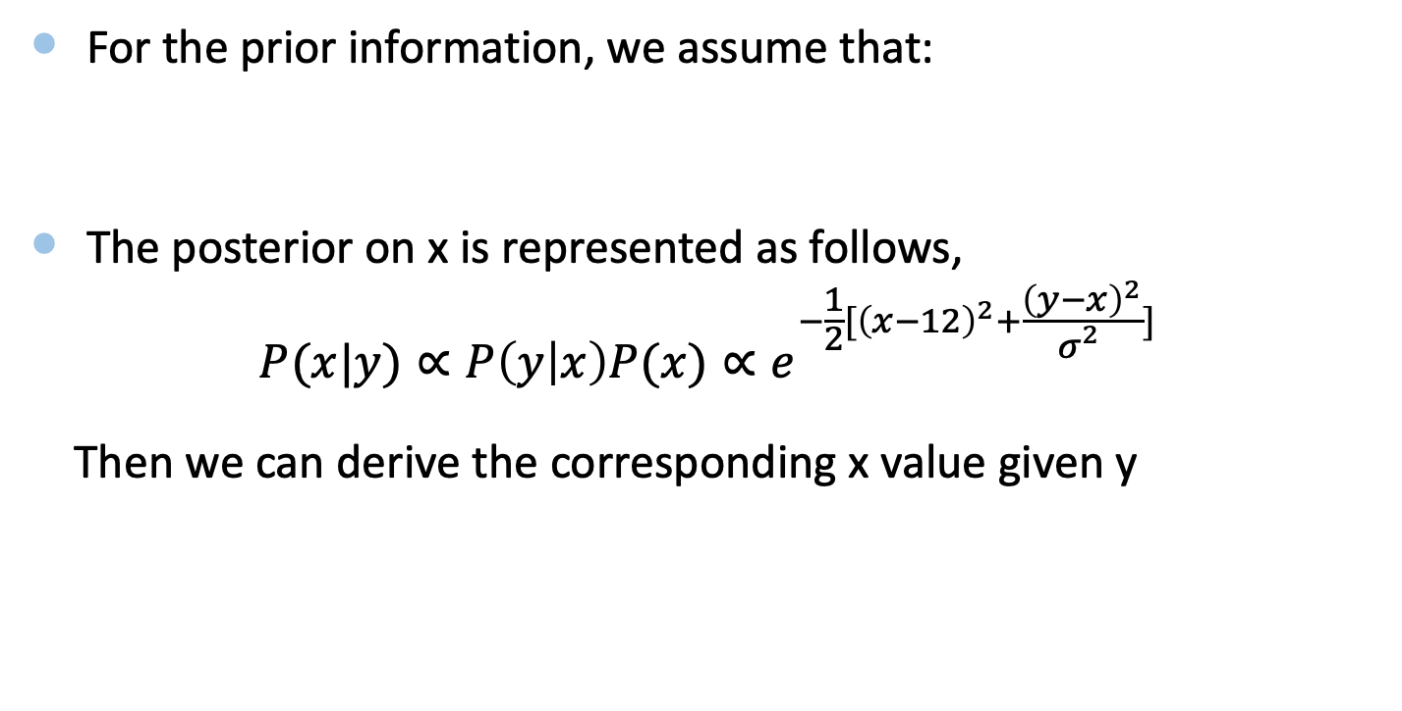
Bayesian Inference
For the prior information, we assume that:
The posterior on x is represented as follows,
$$P(x|y)∝P\left(y | x\right)P(x)∝e^{−\frac{1}{2}[{\left(x−12\right)}^{2}+\frac{{\left(y−x\right)}^{2}}{σ_{}^{2}}]}$$
Then we can derive the corresponding x value given y
$P(x)$ $=\frac{1}{\sqrt{2π}}e^{−\frac{{(x−12)}^{2}}{2}}$

