Slide 1
Independence, False Positive Probability and Random Variable
CS 2402 Lecture 4

Slide 2
Revision on Lecture 3

Slide 3
Probability
The probability of an event is the relative frequency of occurrence in the experiment
Probability of event E is
P(E) =
The value of P is between 0 and 1, inclusive
Assume that each outcome has the same relative frequency
The sample space
number of outcomes in E
total number of possible outcomes
event E
Notes:
area

Slide 4

Lightning
What is the probability of being struck by lightning in Hong Kong?
44 people struck in past 20 years
2.2 people per year (HK observatory)
HK population: 7.5 million
In one year:
P(struck by lightning) = 2.2/7,500,000 = 1/3,409,090
1 in 3.4 million chance

Slide 5

Random Sneeze Call
If you call a random phone number and say “God bless you,” what are the chances that the person who answers just sneezed?
Answer: 1 in 40,000
http://what-if.xkcd.com/55/

Slide 6
Random Sneeze Call
One study estimates that a person sneezes 400 times a year
Each sneeze is around 2 seconds long (“a-choo”)
In one year:
365 days x 24 hours/day x 60 minutes/hour x 30 sneezes/minute
= 15,768,000 possible sneezes in one year
In each 2-second period, the chance to sneeze is:
P = 400 / 15,768,000 = ~1 / 40,000

Slide 7
Math Definition of Probability
Probability is a way to assign numbers to events, which satisfies:
For any event A
If S is the sample space, P(S) = 1
For a finite or infinite sequences of disjoint events

Slide 8
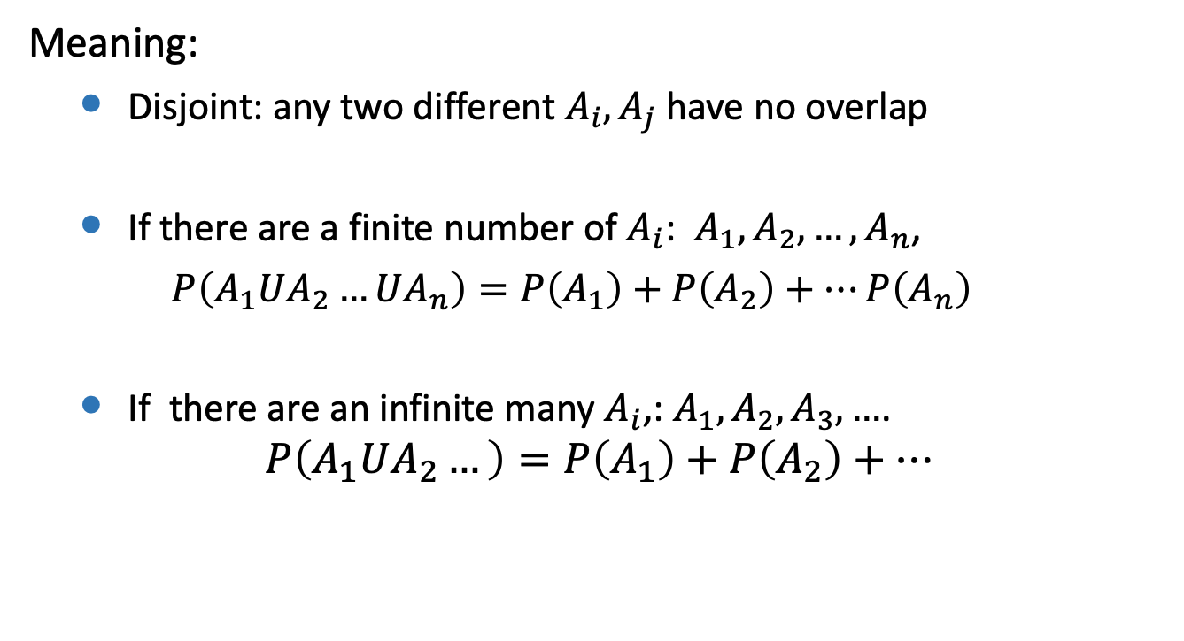
Math Definition of Probability
Meaning:
Disjoint: any two different $A_{i}, A_{j}$have no overlap
If there are a finite number of $A_{i}$: $A_{1},A_{2},…, A_{n}$,
$P\left(A_{1}UA_{2}…UA_{n}\right)=P\left(A_{1}\right)+P\left(A_{2}\right)+…P\left(A_{n}\right)$
If there are an infinite many $A_{i}$,: $A_{1},A_{2},A_{3},…$.
$$P\left(A_{1}UA_{2}…\right)=P\left(A_{1}\right)+P\left(A_{2}\right)+…$$

Slide 9

Summary
Techniques for computing probabilities:
$P\left(AUB\right)=P\left(A\right)+P\left(B\right)$ if AB = $∅$
P(AB) = P(A)P(B) if A and B are independent of each other
P(AUB) = P(A) + P(B) - P(AB)
P(A$)=1−P(\overline{A} )$

Slide 10
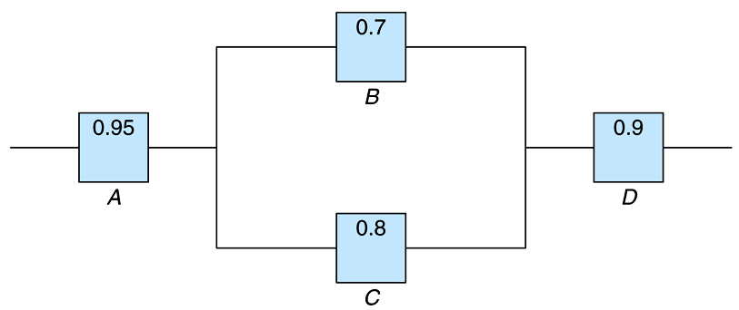
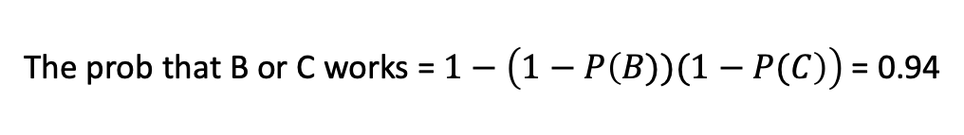
Electronic System
An electronic system consists of several components, and the reliability is shown. Find the probability that the entire system works
The prob that B or C works = $1−\left(1−P\left(B))(1−P(C\right)\right)$= 0.94
The prob that the entire system works = $0.95$*0.94*0.9 = 0.8037

Slide 11
Contents
Independent event
False positive probability and its examples in the real world
Early work in population statistics and its impact
Random variable

Slide 12
Math Definition of Independent Events
Two events A and B are called independent if their joint probability equals the product of their probabilities:
P(AB) = P(A)P(B)
Meaning: A and B do not influence each other

Slide 13
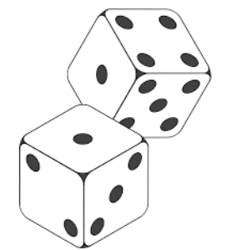
Example 1: Roll Two Dice
A = “The sum of the two dice is 9”
B = “The first dice is 2”
Are A and B independent of each other?
A = {(6,3),(5,4),(4,5),(3,6)}
P(A) = 4/36
P(B) = 1/6

Slide 14
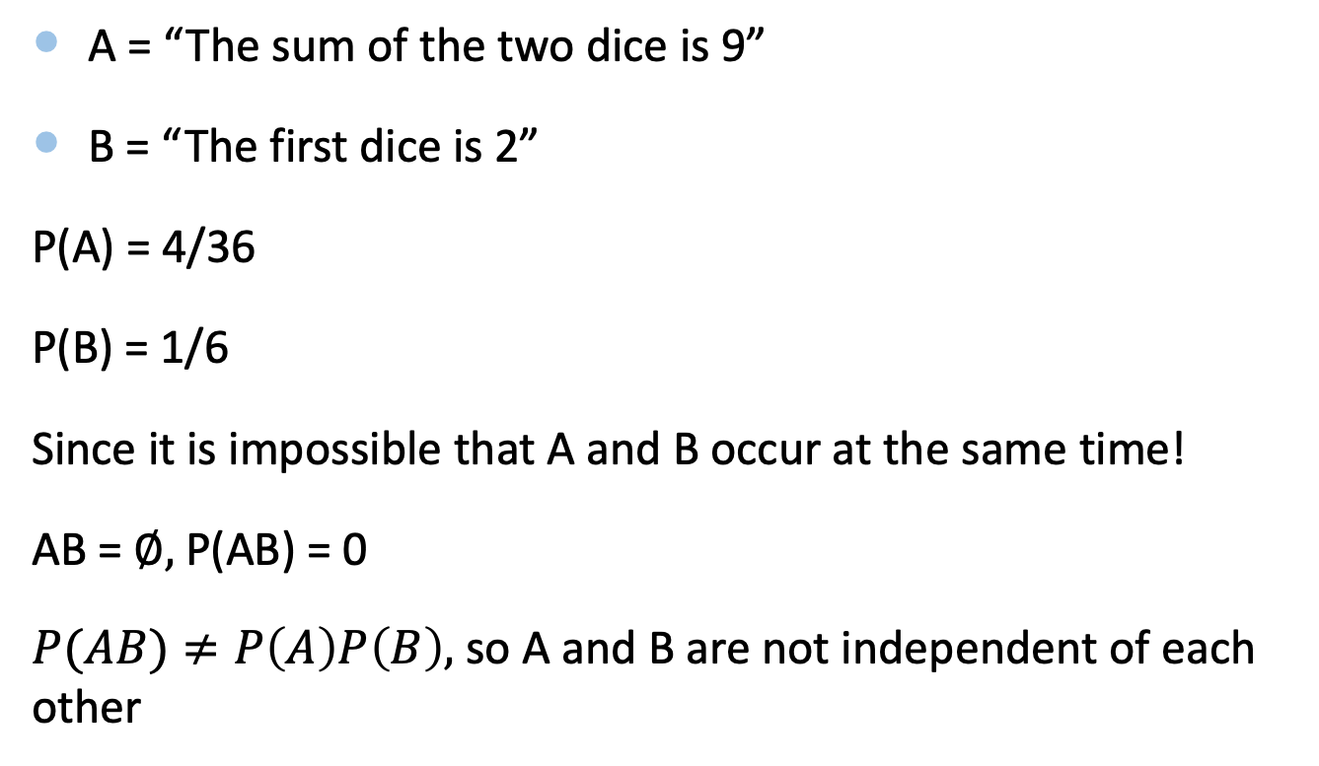
Example 1: Roll Two Dice
A = “The sum of the two dice is 9”
B = “The first dice is 2”
P(A) = 4/36
P(B) = 1/6
Since it is impossible that A and B occur at the same time!
AB = $∅,$P(AB) = 0
$P(AB)≠P\left(A\right)P\left(B\right),$ so A and B are not independent of each other

Slide 15
Example 2
Suppose that we toss 2 dice
Let E denote the event that the sum of the dice is 6 and
F denote the event that the first dice equals 4
Q: are events E and F independent?

Slide 16
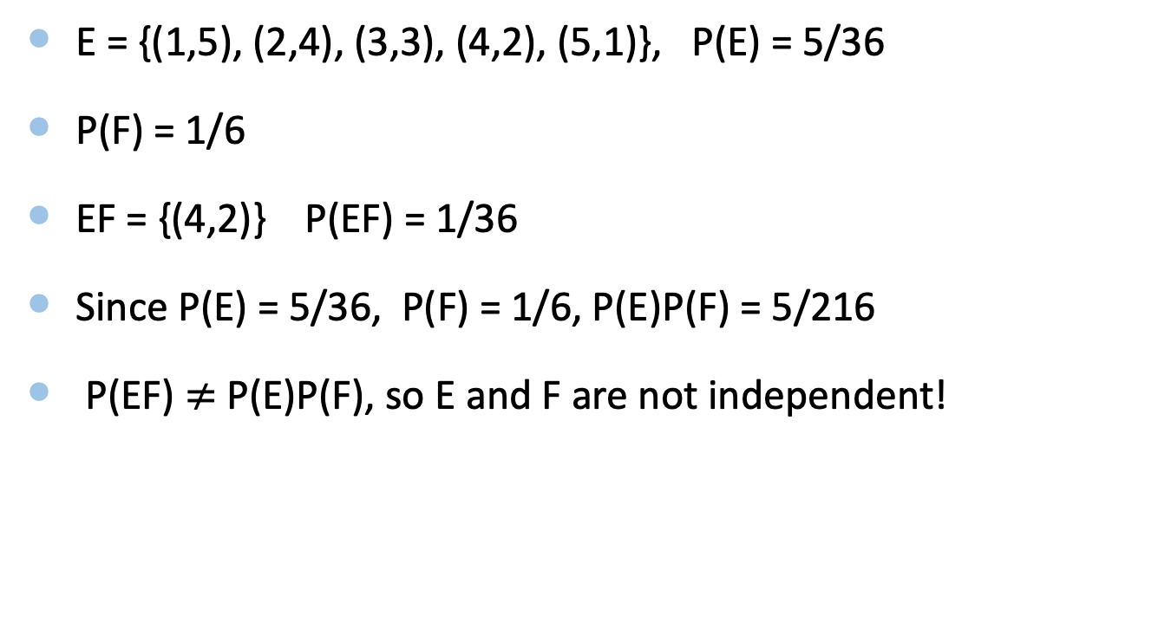
Solution
E = {(1,5), (2,4), (3,3), (4,2), (5,1)}, P(E) = 5/36
P(F) = 1/6
EF = {(4,2)} P(EF) = 1/36
Since P(E) = 5/36, P(F) = 1/6, P(E)P(F) = 5/216
P(EF) $≠$P(E)P(F), so E and F are not independent!

Slide 17
Example 3
A = “The first dice is 4”
B = “The sum of two dice is 7”
Are A and B independent?

Slide 18
Solution
A = “The first dice is 4”
B = “The sum of two dice is 7”
P(A) = 1/6
P(B) = P({(1,6), (2,5), (3,4), (4,3), (5,2), (6,1)}) = 6/36 = 1/6
P(AB) = P({(4,3)}) = 1/36 = P(A)P(B)
So, A and B are independent of each other

Slide 19
Draw a Card
Event A: First draw: I draw a card from a bag. Then I put it back in the bag (with replacement)
Event B: Second draw: I draw a card from a bag
Result of the first draw does not affect the second draw

Slide 20
Draw a Card
Event A: First draw: I draw a card from a bag. Then I don’t replace it (i.e., without replacement)
Event B: Second draw: I draw a card from a bag
Events A and B are dependent

Slide 21
Contents
Independent event
False positive probability and its examples in the real world
Early work in population statistics and its impact
Random variable

Slide 22

False Positive
2% of people in this class have a disease
Fortunately, we have a test to detect this disease
The test is 92% reliable…
It always tests positive when the disease is present
But 8% of the time it gives a positive result when no disease is present. This is called a “false positive”
Q: If you test positive for the disease, what is the probability that you actually have it?

Slide 23

Open Your Test Result…
If you tested negative, you don’t have it!
How many tested positive?
If you tested positive, there are two possibilities:
1) your result is a false positive, and you don’t have it
2) your result is a true positive, and you have it
How many actually had the disease
P(you have it | you test positive) =
(8%*98%+2%)*N
2%*N
(2%*N) / [(8%*98%+2%)$∗N]≈$20%

Slide 24
False Positive
In this example, the incidence rate (2%) is less than the false positive rate (8%)
Hence, the test will detect more false positives than true positives
When interpreting the test results, need to consider the rareness of the disease
Notes:
false positive on test for rare disease
http://en.wikipedia.org/wiki/False_positive_paradox

Slide 25

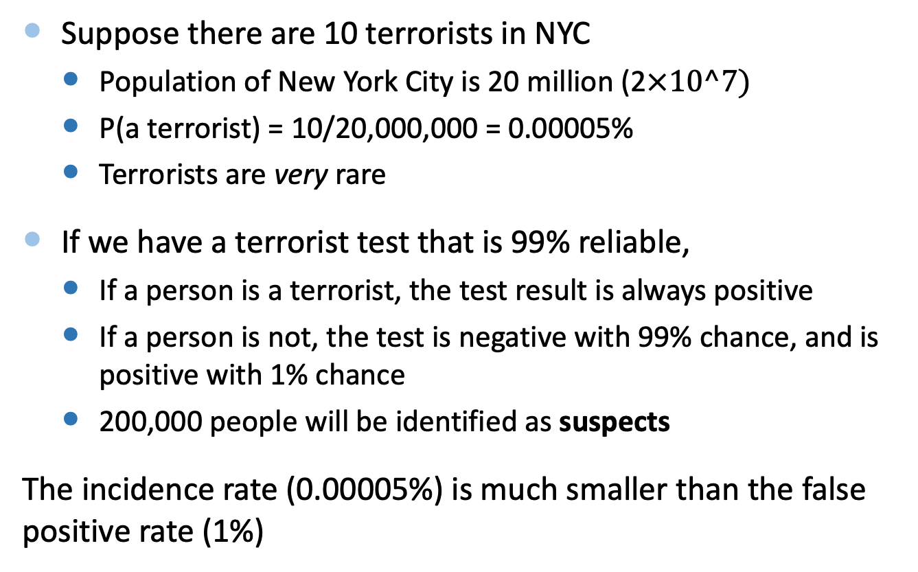
Catching Terrorists in New York City
Suppose there are 10 terrorists in NYC
Population of New York City is 20 million (2$×10^7)$
P(a terrorist) = 10/20,000,000 = 0.00005%
Terrorists are very rare
If we have a terrorist test that is 99% reliable,
If a person is a terrorist, the test result is always positive
If a person is not, the test is negative with 99% chance, and is positive with 1% chance
200,000 people will be identified as suspects
The incidence rate (0.00005%) is much smaller than the false positive rate (1%)
“Little Brother”, Cory Doctorow.

Slide 26
Contents
Independent event
False positive probability and its examples in the real world
Early work in population statistics and its impact
Random variable

Slide 27

Mortality Rates
The King (17th century) was interested in the number of men in London of fighting age (16 to 56)
Graunt calculated age-related mortality rates
Introduced life-expectancy tables
For example,
36% of deaths were children between 0-6
Deaths between 0-6, divided by the total deaths
Notes:
John Graunt (24 April 1620 – 18 April 1674) has been regarded as the founder of demography.[1] Graunt was one of the first demographers, and perhaps the first epidemiologist

Slide 28
Graunt’s Table (1600s London)
Calculated percentage of deaths in each age interval
I.e., the probability that a person will die in a given age interval
This is called a probability distribution (total sum is 100%)
Notes:
population statistics: mortality rates, life-expectancy tables (beginning of statistics)

Slide 29
Summing Up Intervals
P(died before reaching 7) =
4% + 32% = 36%
Repeat for all intervals starting at Born
P(died before reaching 17) = 36%+24% = 60%
Notes:
population statistics: mortality rates, life-expectancy tables (beginning of statistics)

Slide 30
Graunt’s Table (1600s London)
This is called a cumulative distribution
Probabilities are always increasing, and does not sum to 100%
Notes:
population statistics: mortality rates, life-expectancy tables (beginning of statistics)

Slide 31
Graunt’s Table (1600s London)
The complement event of “someone died before a given age” is “someone survived to a given age”
So, calculating 1 - P
Notes:
population statistics: mortality rates, life-expectancy tables (beginning of statistics)

Slide 32

Solving Legal Problems
How much time should elapse after an individual has become missing before a court can legally declare the person dead?
Common problem in cases of inheritance
Nikolaus Bernoulli proposed a solution using Graunt’s life tables
Starting from when the person becomes absent, Bernoulli calculated the age when the probability of being dead is twice that of being alive
Notes:
for courts to declare missing people dead

Slide 33
Solving Legal Problems
For example, suppose a 46-year-old person went missing, look at probability of death
Doing this for all ages gives the following table:
Age Interval | 0-6 | 7-16 | 17-26 | 27-36 | 37-46 | 47-56 | 57-66 | 67-76 | 77-86
Probability died within age interval | 36% | 24% | 15% | 9% | 6% | 4% | 3% | 2% | 1%
2.33 times more likely to be dead when 66 → wait 20 years
7%
3%
Age when last seen | 0 | 6 | 16 | 26 | 36 | 46 | 56 | 66 | 76
Time to wait (years) | 21 | 24 | 25 | 25 | 23 | 20 | 15 | 10 | 7
Notes:
for courts to declare missing people dead

Slide 34
Contents
Independent event
False positive probability and its examples in the real world
Early work in population statistics and its impact
Random variable

Slide 35
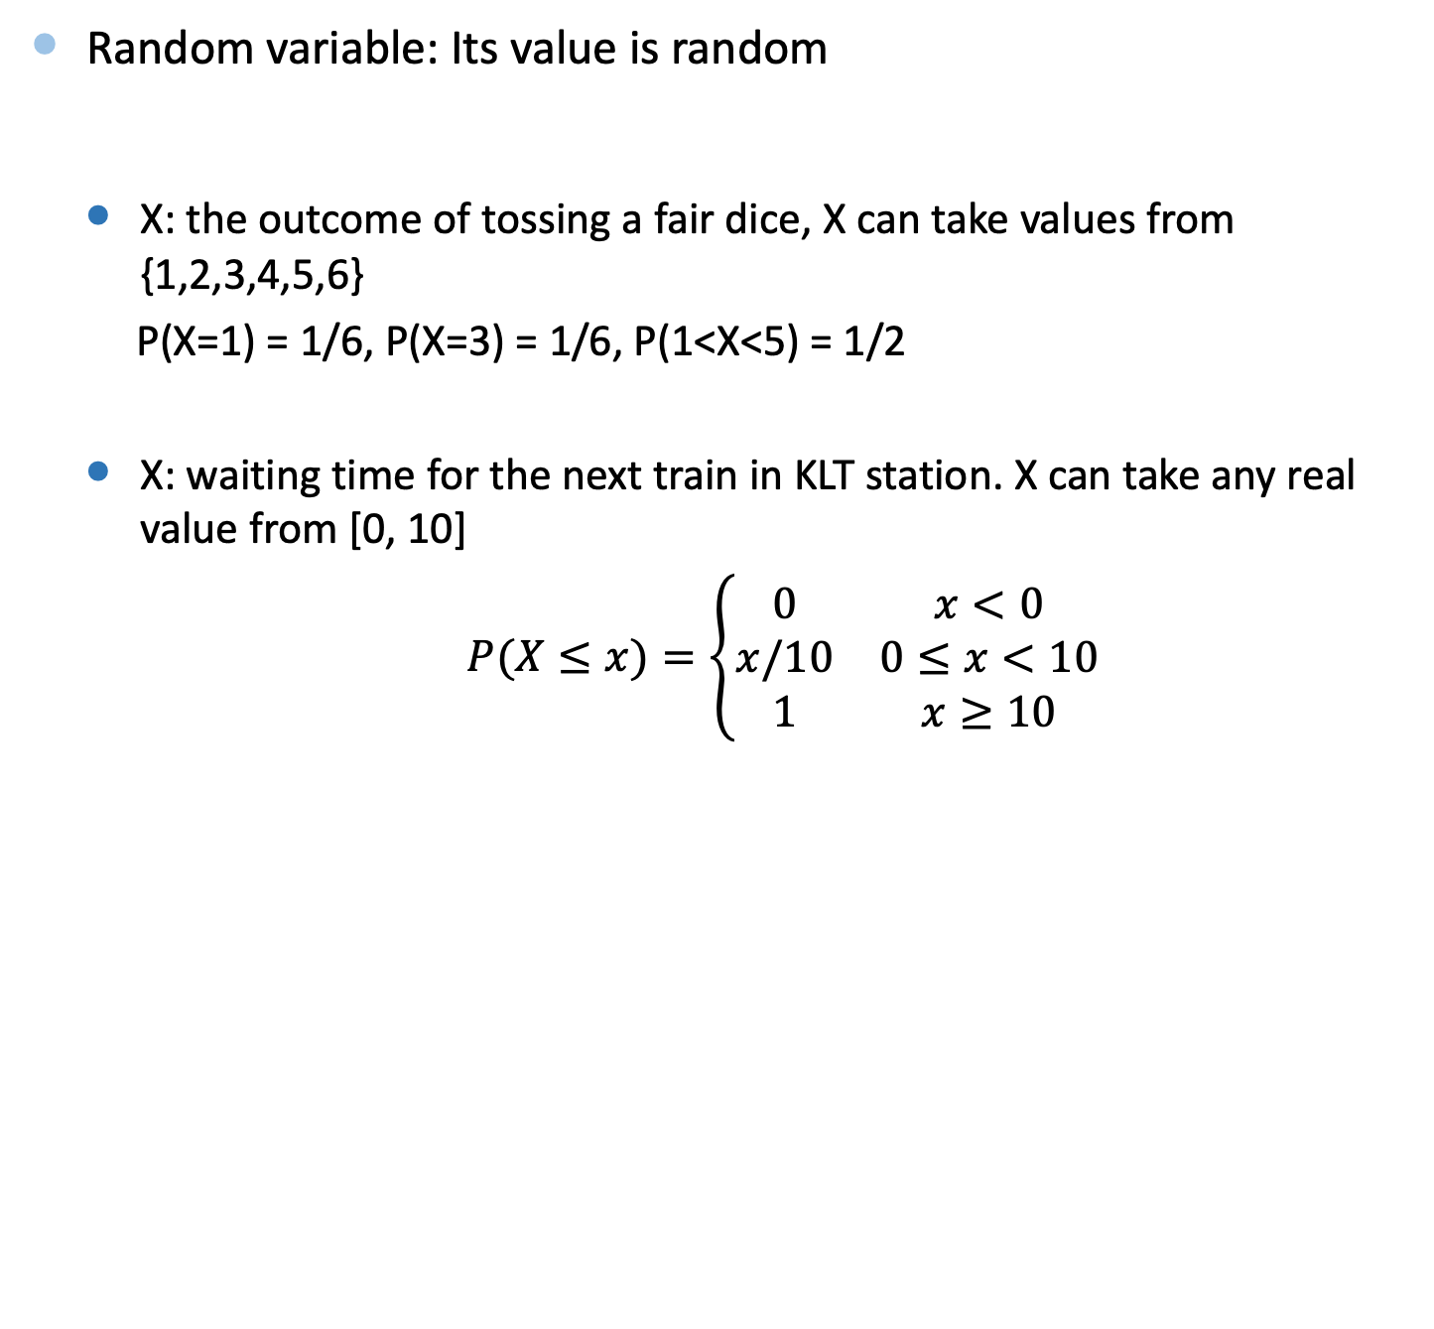
Random Variable
Random variable: Its value is random
X: the outcome of tossing a fair dice, X can take values from {1,2,3,4,5,6}
P(X=1) = 1/6, P(X=3) = 1/6, P(1<X<5) = 1/2
X: waiting time for the next train in KLT station. X can take any real value from [0, 10]
$P(X≤x)=\left\{\begin{matrix}0 & x<0 \\ x/10 & 0≤x<10 \\ 1 & x≥10\end{matrix}\right.$

Slide 36
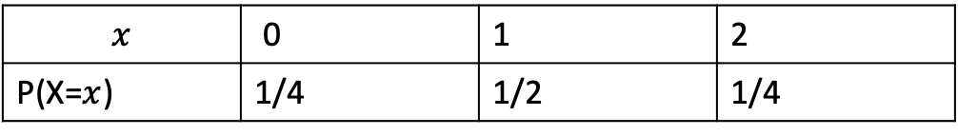
Random Variable
X: the number of heads in two tosses of a fair coin:
$$x$$ | 0 | 1 | 2
P(X=$x$) | 1/4 | 1/2 | 1/4

Slide 37
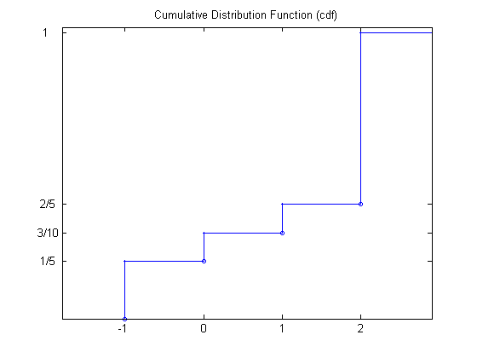

The cumulative distribution function (CDF) of random variable is defined as:
$F\left(x\right)=P(X≤x)$
P(X=-1)=1/5
P(X=0)=1/10
P(X=1)=1/10
P(X=2)=3/5

Slide 38
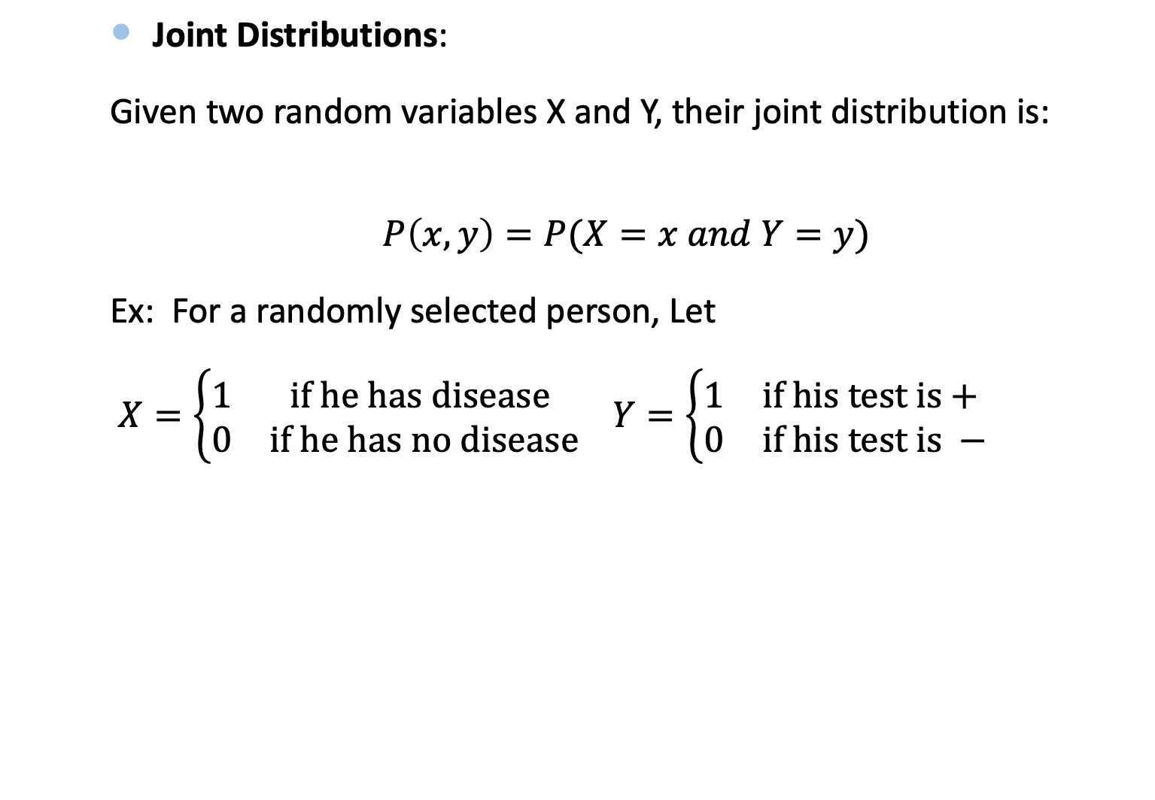
Joint Distributions
Joint Distributions:
Given two random variables X and Y, their joint distribution is:
$$P\left(x,y\right)=P(X=x and Y=y)$$
Ex: For a randomly selected person, Let
$X=\left\{\begin{matrix}1 & if he has disease \\ 0 & if he has no disease\end{matrix}\right.$ $Y=\left\{\begin{matrix}1 & if his test is+ \\ 0 & if his test is −\end{matrix}\right.$
P(x,y)
 | X=0 | X=1
Y=0 | 98%*92% | 0
Y=1 | 98%*8% | 2%

Slide 39
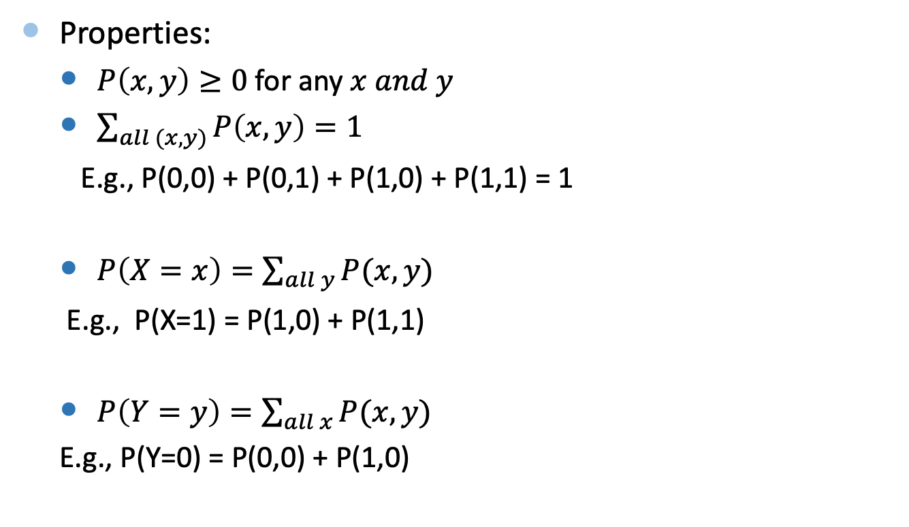
Joint Distributions
Properties:
$P\left(x,y\right)≥0$ for any $x and y$
$\sum_{all (x,y)}{P\left(x,y\right)=1}$
E.g., P(0,0) + P(0,1) + P(1,0) + P(1,1) = 1
$P\left(X=x\right)=\sum_{all y}{P(x,y)}$
E.g., P(X=1) = P(1,0) + P(1,1)
$P\left(Y=y\right)=\sum_{all x}{P(x,y)}$
E.g., P(Y=0) = P(0,0) + P(1,0)

Slide 40
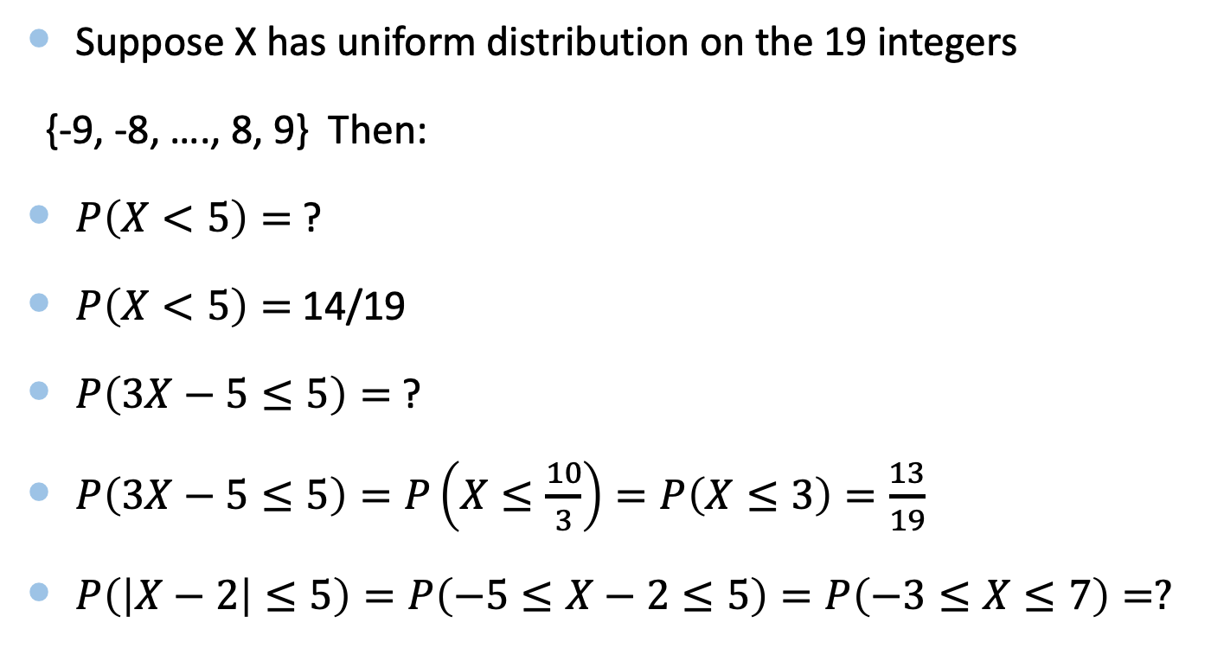
Example
Suppose X has uniform distribution on the 19 integers
{-9, -8, …., 8, 9} Then:
$P\left(X<5\right)=$ ?
$P\left(X<5\right)=$ 14/19
$P\left(3X−5≤5\right)=$?
$P\left(3X−5≤5\right)=P\left(X≤\frac{10}{3}\right)=P\left(X≤3\right)=\frac{13}{19}$
$P\left(\left|X−2\right|≤5\right)=P\left(−5≤X−2≤5\right)=P\left(−3≤X≤7\right)=?$

Slide 41
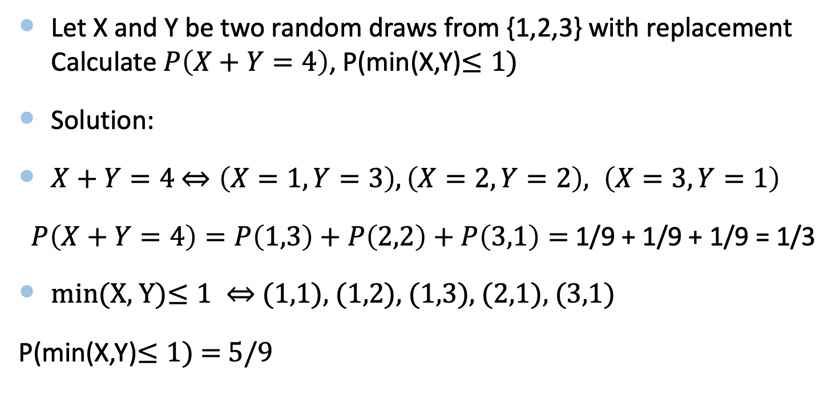
Example
Let X and Y be two random draws from {1,2,3} with replacement Calculate $P\left(X+Y=4\right)$, P(min(X,Y)$≤1)$
Solution:
$X+Y=4$ $⇔\left(X=1, Y=3\right), \left(X=2, Y=2\right), \left(X=3, Y=1\right)$
$P\left(X+Y=4\right)=P\left(1,3\right)+P\left(2,2\right)+P\left(3,1\right)=$1/9 + 1/9 + 1/9 = 1/3
min(X, Y)$≤1 ⇔$ (1,1), (1,2), (1,3), (2,1), (3,1)
P(min(X,Y)$≤1)$ = 5/9

Slide 42
Bernoulli (Binomial) Distribution
Bernoulli trial: A random experiment with only two outcomes: 0 (failure), 1 (success)
p: the probability of outcome being 1
1-p: the probability of outcome being 0
Ex: randomly select a person from HK
Outcome = 1 if the person is a CityU student, outcome = 0 if she/he is not
p = 1/700 (assume HK population = 7m, and the CityU student population = 10,000)

Slide 43
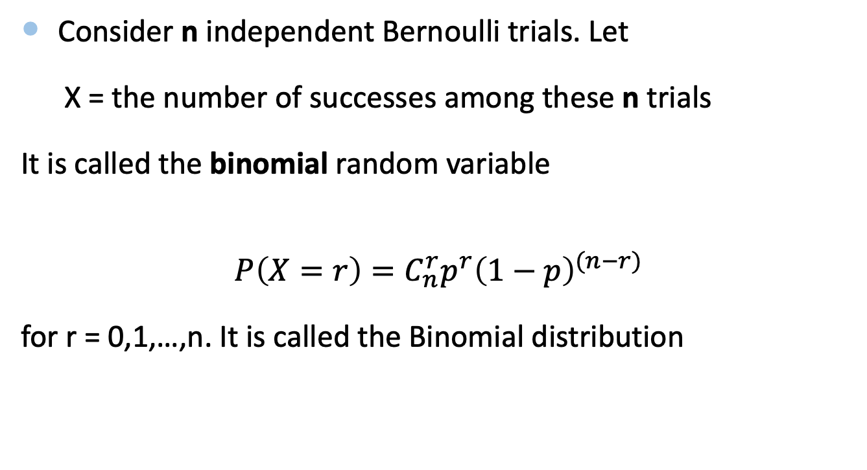
Bernoulli (Binomial) Distribution
Consider n independent Bernoulli trials. Let
X = the number of successes among these n trials
It is called the binomial random variable
$$P\left(X=r\right)=C_{n}^{r}p^{r}{\left(1−p\right)}^{(n−r)}$$
for r = 0,1,…,n. It is called the Binomial distribution

Slide 44
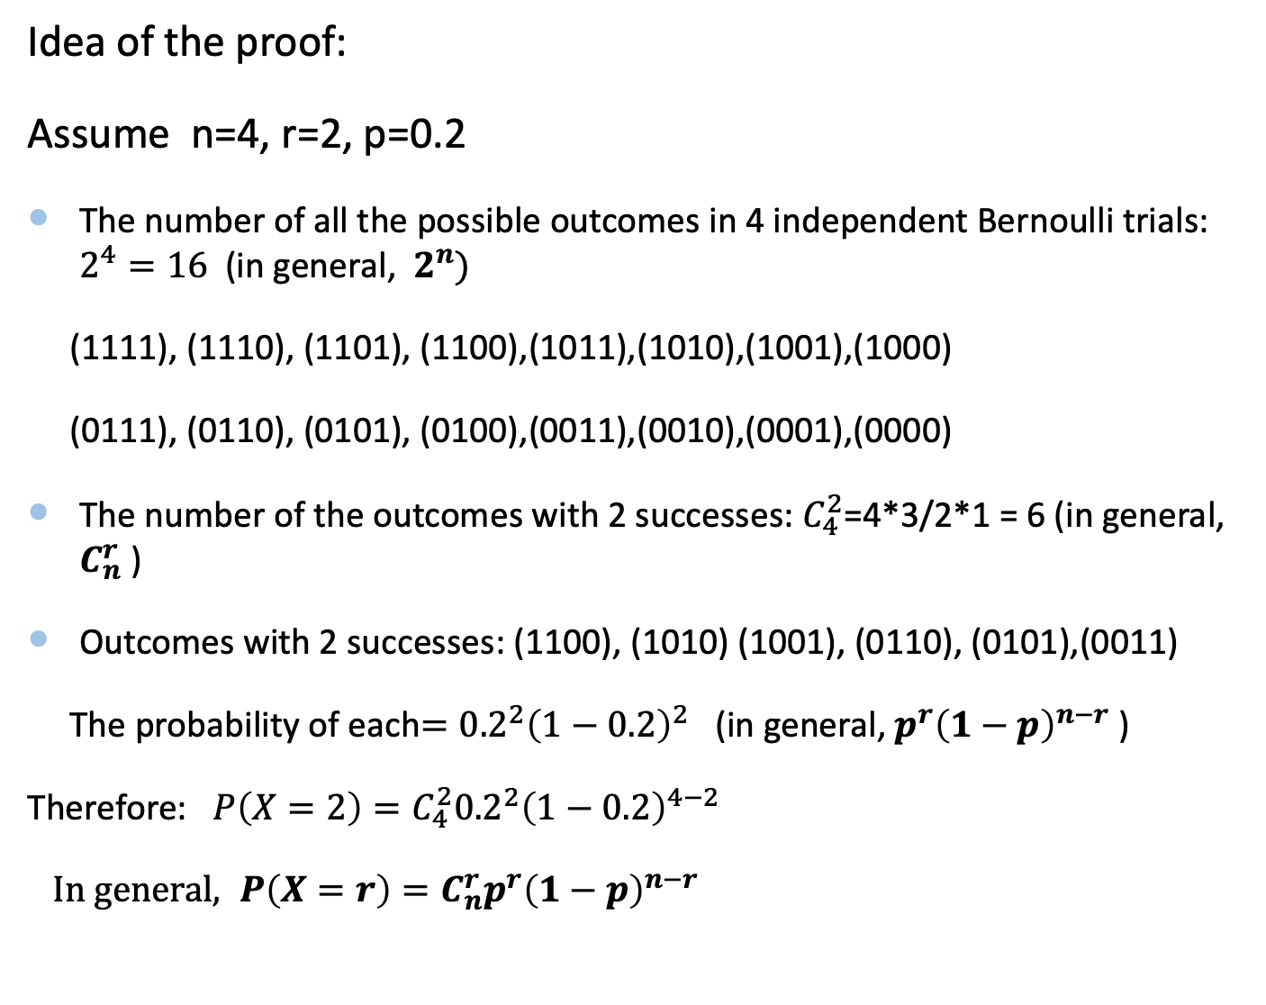
Idea of the proof:
Assume n=4, r=2, p=0.2
The number of all the possible outcomes in 4 independent Bernoulli trials: $2^{4}=16$ (in general, $2^{n})$
(1111), (1110), (1101), (1100),(1011),(1010),(1001),(1000)
(0111), (0110), (0101), (0100),(0011),(0010),(0001),(0000)
The number of the outcomes with 2 successes: $C_{4}^{2}$=4*3/2*1 = 6 (in general, $C_{n}^{r}$ )
Outcomes with 2 successes: (1100), (1010) (1001), (0110), (0101),(0011)
The probability of each$={0.2}^{2}{\left(1−0.2\right)}^{2}$ (in general, $p^{r}{\left(1−p\right)}^{n−r}$ )
Therefore: ${P\left(X=2\right)=C}_{4}^{2}{0.2}^{2}{\left(1−0.2\right)}^{4−2}$
${ In general, P\left(X=r\right)=C}_{n}^{r}p^{r}{\left(1−p\right)}^{n−r}$

Slide 45
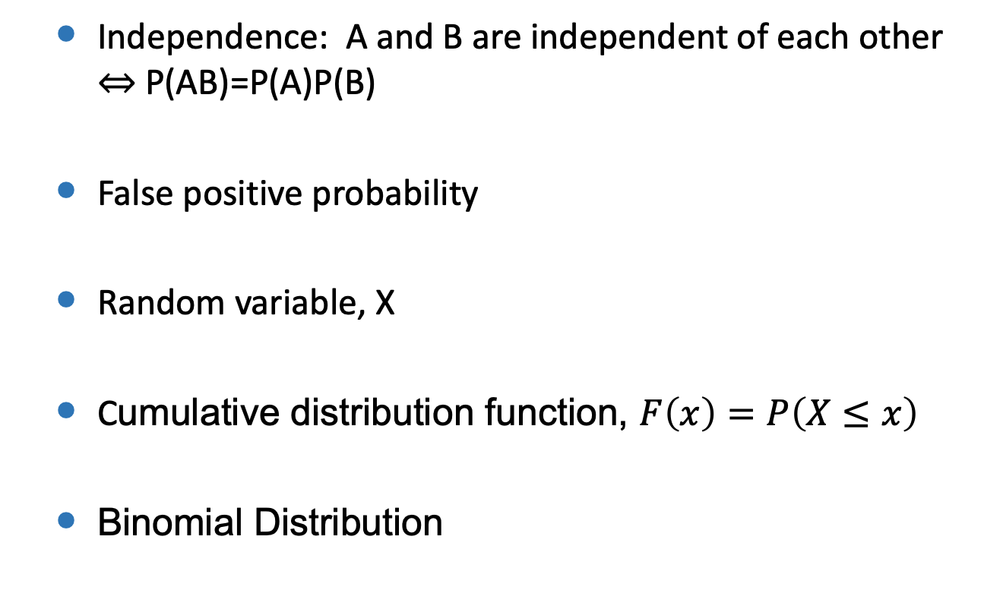
Summary
Independence: A and B are independent of each other $⇔$ P(AB)=P(A)P(B)
False positive probability
Random variable, X
Cumulative distribution function, $F\left(x\right)=P\left(X≤x\right)$
Binomial Distribution

