Slide 1
Mean and Utility
CS 2402 Lecture 5

Slide 2
Objectives
Independence of Random Variables
Expectation (Mean)
Pascal’s Wager
Expected Utility and the St. Petersburg Paradox
Notes:
It posits that human beings wager with their lives that God either exists or does not.

Slide 3
Revision
Events A and B are independent of each other if
P(AB) = P(A)P(B)
AB: intersection of A and B, meaning that the event that makes both A and B occur

Slide 4
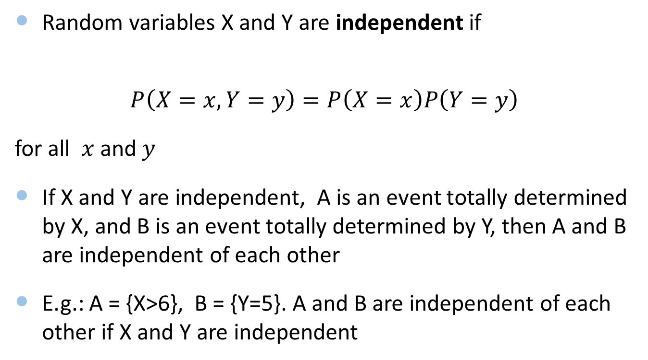
Independence of Random Variables
Random variables X and Y are independent if
$$P\left(X=x, Y=y\right)=P\left(X=x\right)P\left(Y=y\right)$$
for all $x$ and $y$
If X and Y are independent, A is an event totally determined by X, and B is an event totally determined by Y, then A and B are independent of each other
E.g.: A = {X>6}, B = {Y=5}. A and B are independent of each other if X and Y are independent

Slide 5
Independence of Random Variables
E.g.: Let X and Y be independent of each other, each uniformly distributed on {0, 1, 2, …, 9}. Find P(X=Y) and P(X<Y)
P(X=Y) = P(X=0, Y=0) + P(X=1, Y=1) + … + P(X=9, Y=9)
= P(X=0)P(Y=0) + P(X=1)(Y=1) + … + P(X=9)P(Y=9)=10*(1/10)*(1/10)=1/10
P(X<Y) = P(X=0,Y>0) + P(X=1,Y>1) + … + P(X=9,Y>9)
= P(X=0)P(Y>0) + P(X=1)P(Y>1) + … + P(X=9)P(Y>9)
= (1/10)*9/10+1/10*8/10+….+(1/10)*0/10=(1/10)(9+8+7+.._1)/10=0.45
Another solution: note that P(X=Y)+P(X>Y)+P(Y>X) = 1 and P(X>Y) = P(Y>X)
P(X>Y) = P(Y>X) = 0.45

Slide 6
Objectives
Independence of Random Variables
Expectation (Mean)
Pascal’s Wager
Expected Utility and the St. Petersburg Paradox

Slide 7
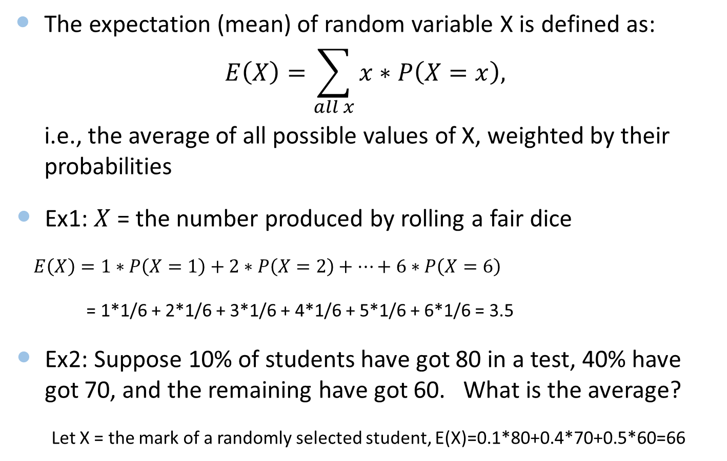
Expectation (Mean)
The expectation (mean) of random variable X is defined as:
$$E\left(X\right)=\sum_{all x}{x∗P\left(X=x\right),}$$
i.e., the average of all possible values of X, weighted by their probabilities
Ex1: $X$ = the number produced by rolling a fair dice
$E\left(X\right)=1∗P\left(X=1\right)+2∗P\left(X=2\right)+…+6∗P\left(X=6\right)$
= 1*1/6 + 2*1/6 + 3*1/6 + 4*1/6 + 5*1/6 + 6*1/6 = 3.5
Ex2: Suppose 10% of students have got 80 in a test, 40% have got 70, and the remaining have got 60. What is the average?
Let X = the mark of a randomly selected student, E(X)=0.1*80+0.4*70+0.5*60=66

Slide 8
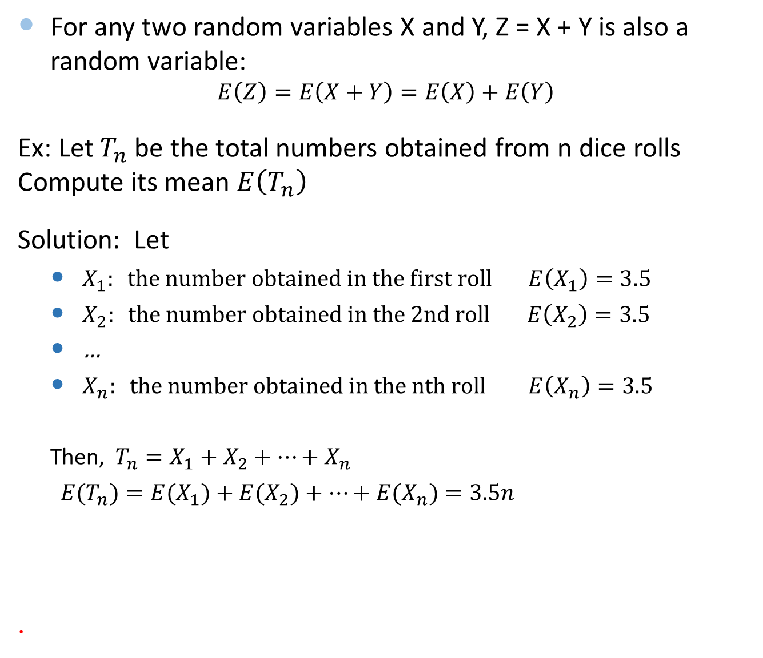
Addition Rule
For any two random variables X and Y, Z = X + Y is also a random variable:
$$E\left(Z\right)=E\left(X+Y\right)=E\left(X\right)+E\left(Y\right)$$
Ex: Let $T_{n}$ be the total numbers obtained from n dice rolls Compute its mean $E\left(T_{n}\right)$
Solution: Let
$X_{1}: the number obtained in the first roll E\left(X_{1}\right)=3.5$
$X_{2}: the number obtained in the 2nd roll E\left(X_{2}\right)=3.5$
…
$X_{n}: the number obtained in the nth roll E\left(X_{n}\right)=3.5$
Then, $T_{n}=X_{1}+X_{2}+…+X_{n}$
$E(T_{n})={E(X}_{1})+{E(X}_{2})+…+E(X_{n})=3.5n$
.

Slide 9
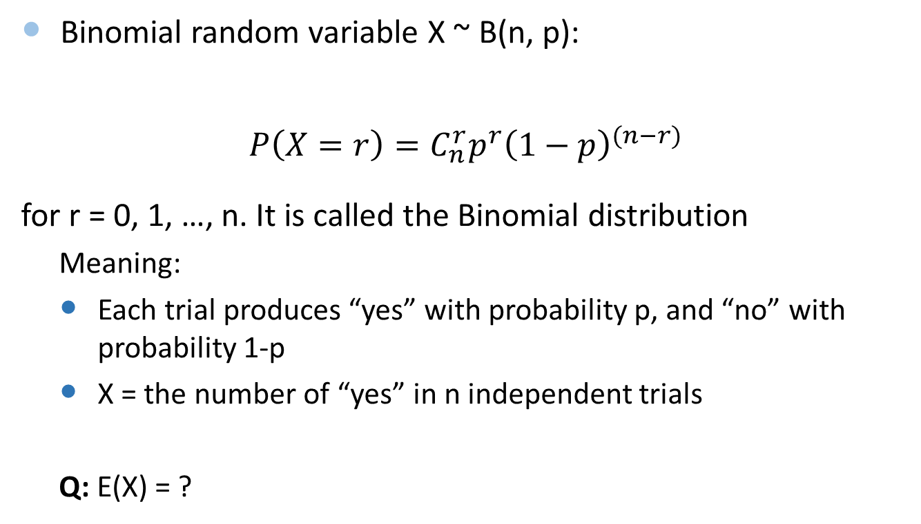
Mean of Binomial Random Variable
Binomial random variable X ~ B(n, p):
$$P\left(X=r\right)=C_{n}^{r}p^{r}{\left(1−p\right)}^{(n−r)}$$
for r = 0, 1, …, n. It is called the Binomial distribution
Meaning:
Each trial produces “yes” with probability p, and “no” with probability 1-p
X = the number of “yes” in n independent trials
Q: E(X) = ?

Slide 10
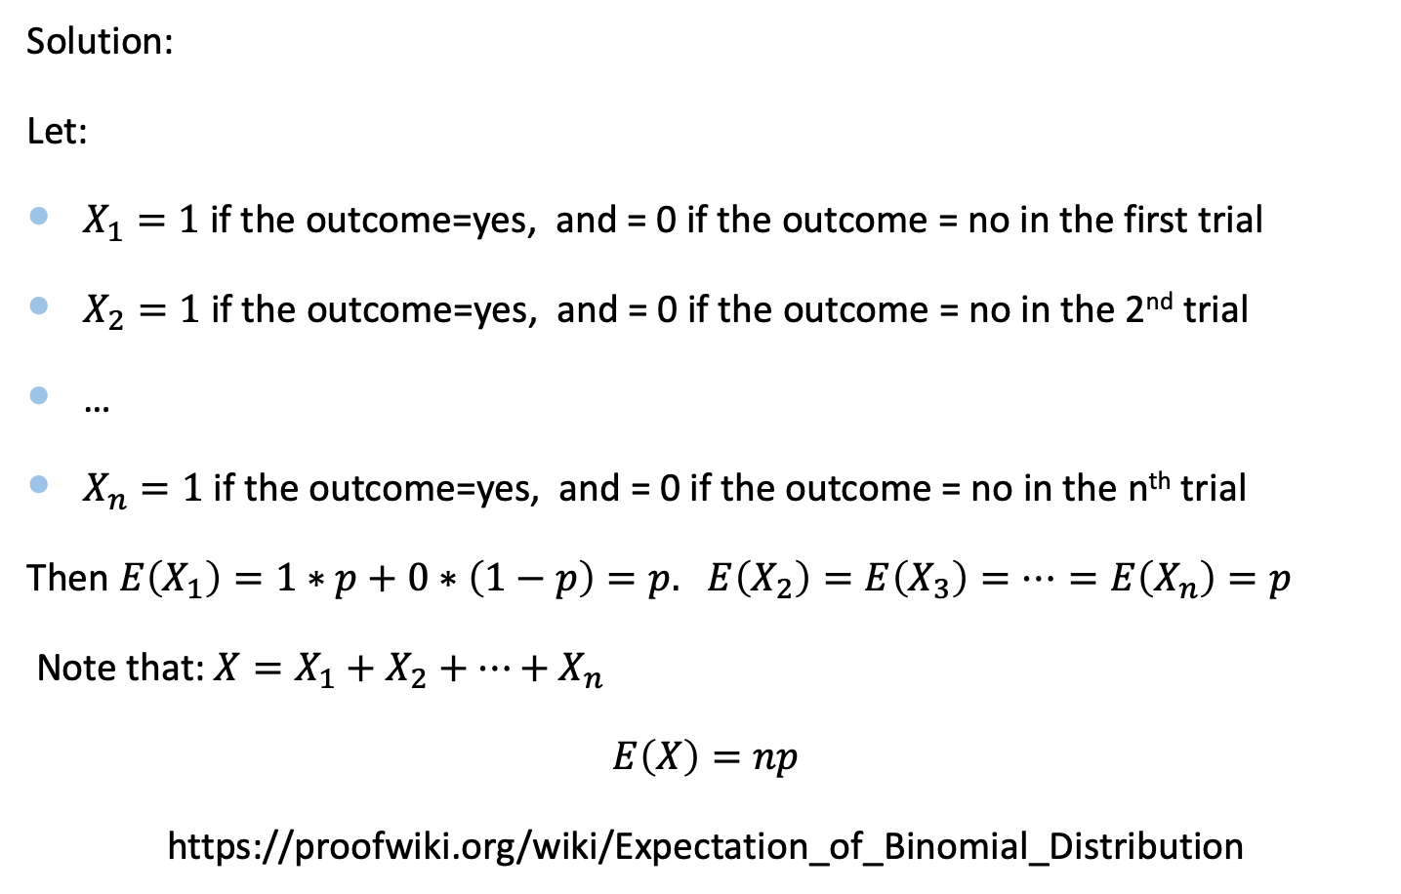
Mean of Binomial Random Variable
Solution:
Let:
$X_{1}=1$if the outcome=yes, and = 0 if the outcome = no in the first trial
$X_{2}=1$if the outcome=yes, and = 0 if the outcome = no in the 2nd trial
…
$X_{n}=1$if the outcome=yes, and = 0 if the outcome = no in the n^{th} trial
Then $E\left(X_{1}\right)=1∗p+0∗\left(1−p\right)=p.$ $E\left(X_{2}\right)=E\left(X_{3}\right)=…=E\left(X_{n}\right)=p$
Note that: $X=X_{1}+X_{2}+…+X_{n}$
$E\left(X\right)=np$
https://proofwiki.org/wiki/Expectation_of_Binomial_Distribution

Slide 11

Mean of Binomial Random Variable
X ~ B(10, ½):
$P\left(X=r\right)=C_{10}^{r}({\frac{1}{2})}^{r}{\left(1−\frac{1}{2}\right)}^{(10−r)}$=$C_{10}^{r}({\frac{1}{2})}^{10}$
for r = 0, 1, 2, …, 10
Note that $C_{10}^{r}=C_{10}^{10−r}$
E(X) = n*p = 10*0.5 = 5

Slide 12
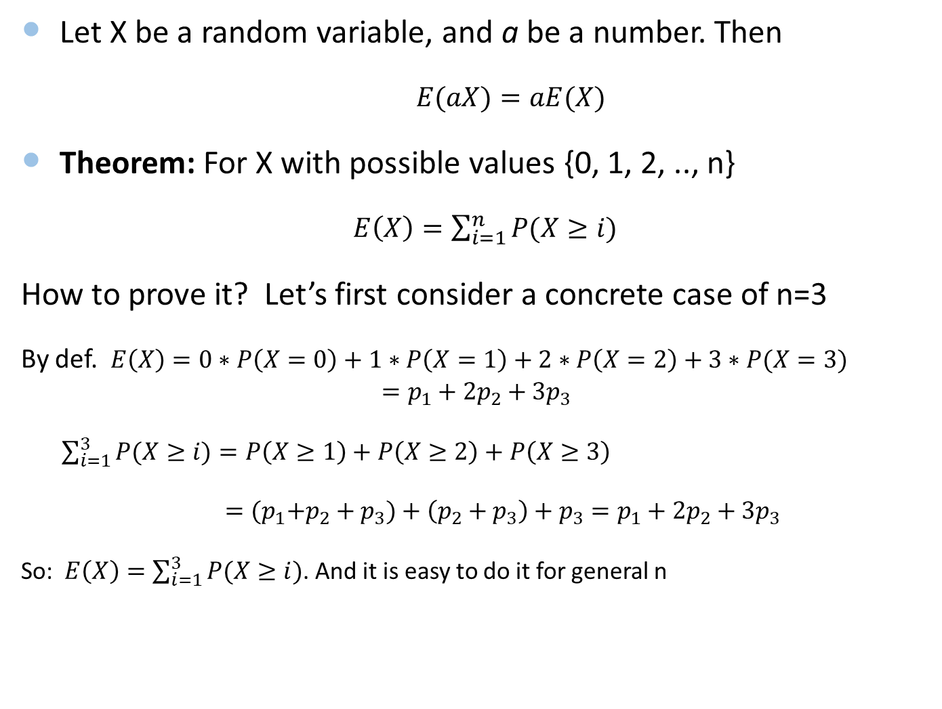
More on Expectation
Let X be a random variable, and a be a number. Then
$E(aX)=aE(X)$
Theorem: For X with possible values {0, 1, 2, .., n}
$E\left(X\right)=\sum_{i=1}^{n}{P(X≥i)}$
How to prove it? Let’s first consider a concrete case of n=3
By def. $E\left(X\right)=0∗P\left(X=0\right)+1∗P\left(X=1\right)+2∗P\left(X=2\right)+3∗P(X=3)$
$$=p_{1}+2p_{2}+3p_{3}$$
$\sum_{i=1}^{3}{P(X≥i)}=P\left(X≥1\right)+P\left(X≥2\right)+P\left(X≥3\right)$
$={(p}_{1}+p_{2}+p_{3})+\left(p_{2}+p_{3}\right)+p_{3}=p_{1}+2p_{2}+3p_{3}$
So: $E\left(X\right)=\sum_{i=1}^{3}{P(X≥i)}$. And it is easy to do it for general n

Slide 13
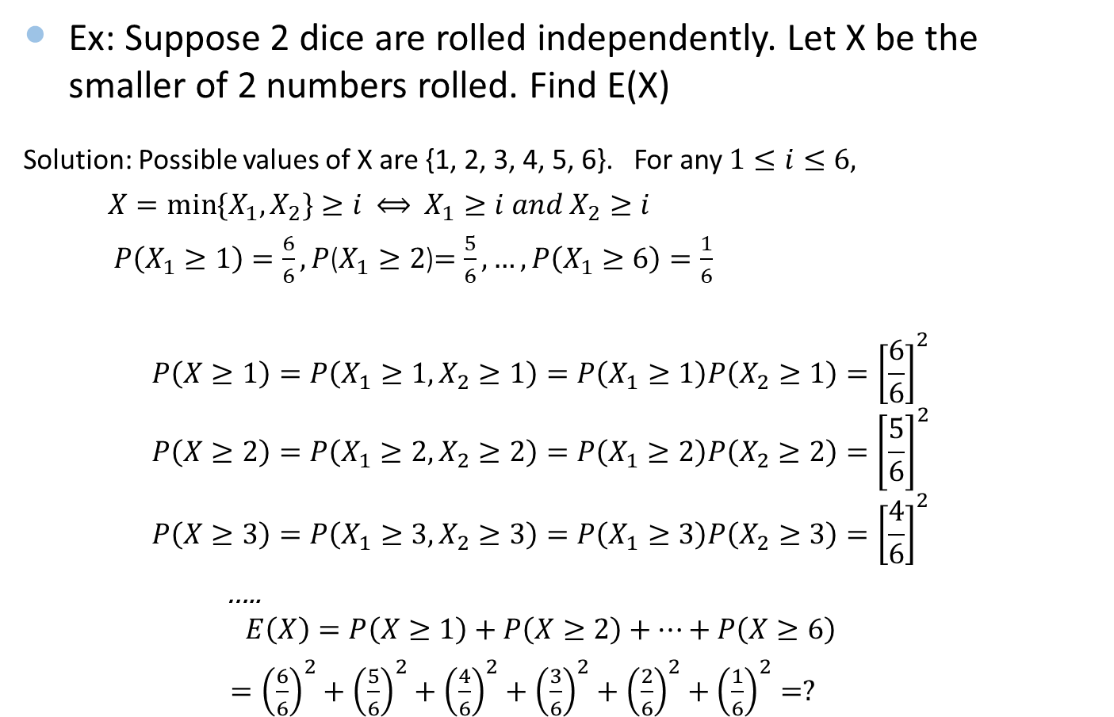
Example
Ex: Suppose 2 dice are rolled independently. Let X be the smaller of 2 numbers rolled. Find E(X)
Solution: Possible values of X are {1, 2, 3, 4, 5, 6}. For any $1≤i≤6,$
$X=min⁡\{X_{1}, X_{2}\}≥i$ $⟺$ $X_{1}≥i and X_{2}≥i$
$P\left(X_{1}≥1\right)=\frac{6}{6}, P$($X_{1}≥2$)$=\frac{5}{6}, …,P\left(X_{1}≥6\right)=\frac{1}{6}$
$$P\left(X≥1\right)=P\left(X_{1}≥1, X_{2}≥1\right)=P\left(X_{1}≥1\right)P\left(X_{2}≥1\right)={\left[\frac{6}{6}\right]}^{2}$$
$$P\left(X≥2\right)=P\left(X_{1}≥2, X_{2}≥2\right)=P\left(X_{1}≥2\right)P\left(X_{2}≥2\right)={\left[\frac{5}{6}\right]}^{2}$$
$$P\left(X≥3\right)=P\left(X_{1}≥3, X_{2}≥3\right)=P\left(X_{1}≥3\right)P\left(X_{2}≥3\right)={\left[\frac{4}{6}\right]}^{2}$$
…..
$$E\left(X\right)=P\left(X≥1\right)+P\left(X≥2\right)+…+P\left(X≥6\right)$$
$={\left(\frac{6}{6}\right)}^{2}+{\left(\frac{5}{6}\right)}^{2}+{\left(\frac{4}{6}\right)}^{2}+{\left(\frac{3}{6}\right)}^{2}+{\left(\frac{2}{6}\right)}^{2}+{\left(\frac{1}{6}\right)}^{2}=?$

Slide 14
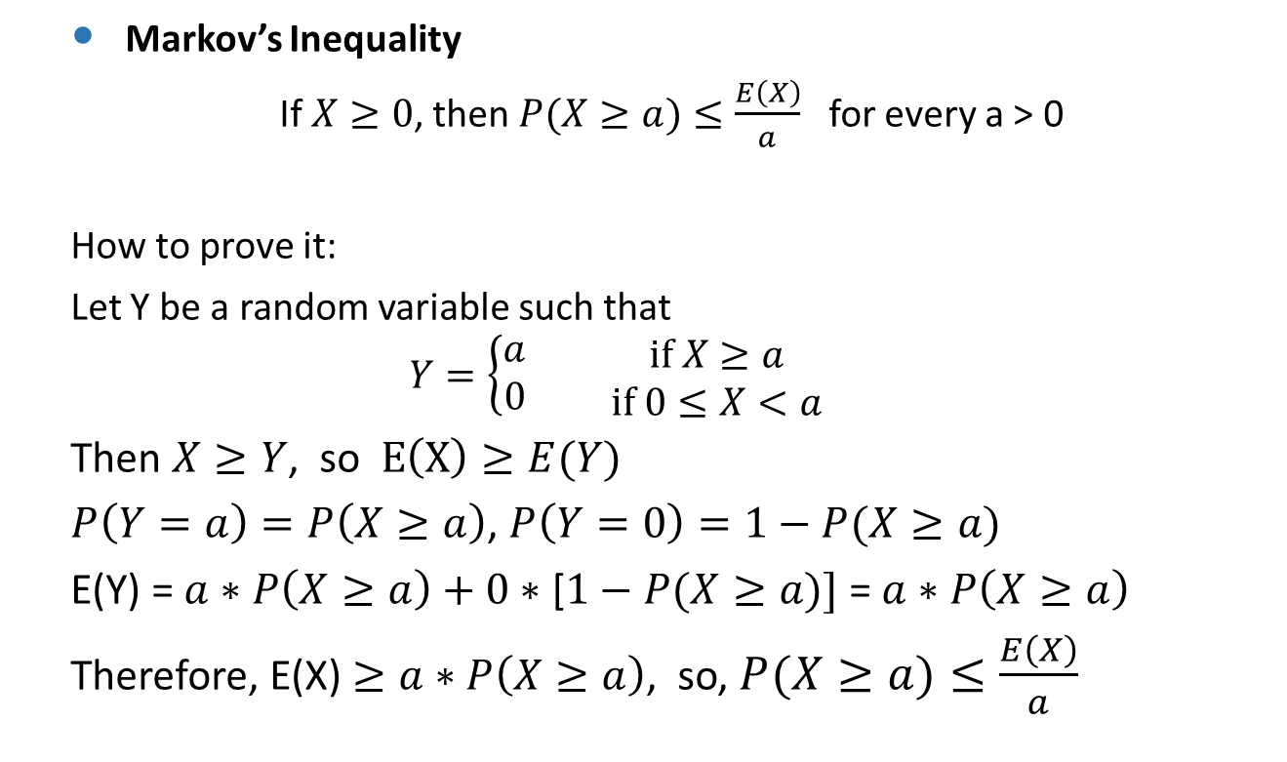
Markov’s Inequality
Markov’s Inequality
If $X≥0$, then $P(X≥a)≤\frac{E\left(X\right)}{a}$ for every a > 0
How to prove it:
Let Y be a random variable such that
$$Y=\left\{\begin{aligned}a \\ 0\end{aligned}\right.\begin{matrix} & if X≥a \\ & if 0≤X<a\end{matrix}$$
Then $X≥Y$, so $E\left(X\right)≥E(Y)$
$P\left(Y=a\right)=P\left(X≥a\right)$, $P\left(Y=0\right)=1−P(X≥a)$
E(Y) = $a∗P\left(X≥a\right)+0∗$ [$1−P(X≥a)]$ = $a∗P\left(X≥a\right)$
Therefore, E(X) $≥a∗P\left(X≥a\right)$, so, $P(X≥a)≤\frac{E\left(X\right)}{a}$

Slide 15
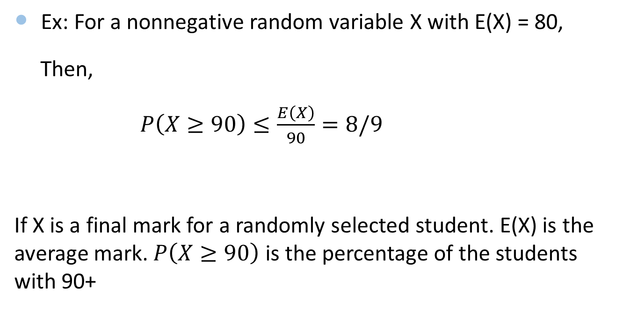
Markov’s Inequality
Ex: For a nonnegative random variable X with E(X) = 80,
Then,
$P\left(X≥90\right)≤\frac{E\left(X\right)}{90}=8/9$
If X is a final mark for a randomly selected student. E(X) is the average mark. $P\left(X≥90\right)$ is the percentage of the students with 90+

Slide 16

Expectation Summary
Summary
Definition of expectation (mean)
E(X+Y) = E(X) + E(Y)
E(aX) = aE(X)
For X with possible values {0,1,2,..,n}, $E\left(X\right)=\sum_{i=1}^{n}{P(X≥i)}$
Markov’s inequality

Slide 17
Objectives
Independence of Random Variables
Expectation (Mean)
Pascal’s Wager
Expected Utility and the St. Petersburg Paradox

Slide 18
Pascal’s Wager (1658)
Pascal (French mathematician, 17th century) argued that we should lead a pious life
Used expectation to calculate the reward of different actions
We do not know if God exists
Let p be the probability that God exists
So, 1-p is the probability that God doesn’t exist
There are two possible actions
Live a pious (religious or spiritual) life full of self-sacrifice
Live a material life

Slide 19
Pascal’s Wager: Expected Gain (Expectation)
Consider the expected gain for each action
Since the expected gain for pious life is infinite, the rational thing is to lead a pious life
Worldly life is better if p = 0, but “no one is in a position to know that”
Pascal’s conclusion: “we are compelled to gamble”
 | God exists | God doesn’t exist | Expected Gain (mean)
Probability | p | 1–p
Gain for pious life | ∞ (eternal life in heaven) | A (self-sacrifice, possibly negative) | p ×∞ + (1-p)×A = ∞
Gain for worldly life | B (Lesser reward, possibly negative) | C (material life) | p × B +(1-p)×C

Slide 20
Objectives
Independence of Random Variables
Expectation (Mean)
Pascal’s Wager
Expected Utility and the St. Petersburg Paradox

Slide 21

St. Petersburg Paradox
Consider a game of repeated coin tosses
Throw a heads on the first toss (H), then win $2
Throw a tails then a heads (TH), then win $4
Throw 2 tails then a heads (TTH), then win $8
Throw 3 tails then a heads (TTTH), then win $16
…Every time tails is thrown, the game continues, and the reward is doubled
Now suppose you have been offered to play, and your friend offers to pay you to take your place? How much is the game worth to you?
a) $2, b) $10, c) $20, d) $50, e) $100, f)$10,000

Slide 22
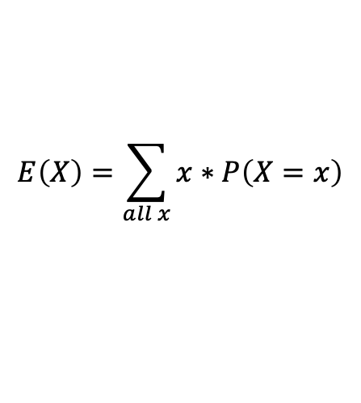
Let’s compute the expected gain of this offer:
Recall:
The game can go on indefinitely (tails keeps being thrown), so the expected gain is infinite
Oddly, 99% of games will end within 7 throws
In theory, the value of this offer is infinity. You should not give up your place!
But most people will give up their game for $10-$20
$$E\left(X\right)=\sum_{all x}{x∗P\left(X=x\right)}$$
Game Outcome | H | TH | TTH | TTTH | TTTTH | TTTTTH | TTTTTTH | …
Probability | 1/2 | 1/4 | 1/8 | 1/16 | 1/32 | 1/64 | 1/128 | …
Gain | $2 | $4 | $8 | $16 | $32 | $64 | $128 | …
Prob. x Gain | $1 | $1 | $1 | $1 | $1 | $1 | $1 | …
Mean | $1+1+1+1+… = ∞

Slide 23
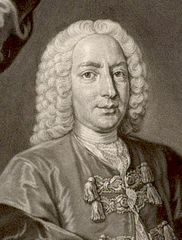
Utility
How to resolve this paradox?
Bernoulli introduced the concept of “utility”
Utility measures the significance of an event to a specific individual
Bernoulli’s observation
Utility is different for each person and is based on their current wealth

Slide 24
Example: Bet on a Coin
Suppose you have $100,000, and you are offered a bet on flipping a coin:
Heads, you win $50,000
Tails, you lose $50,000
Would you take the bet?
No!
Yes!

Slide 25
Example: Bet on a Coin
Game Outcome | H | T
Probability | 1/2 | 1/2
Gain | $50,000 | –$50,000
Prob. x Gain | $25,000 | –$25,000
Expected Gain | $0
The expected gain is $0, so there is no preference to play or not
You probably wouldn’t play because the risk is unacceptable
The ½ probability of losing $50,000 (half of your wealth) outweighs the ½ probability of winning $50,000 (50% gain)

Slide 26
Bernoulli’s Utility
Bernoulli introduced a utility function that is based on the player’s wealth
utility = log( wealth )
Diminishing utility: change in utility decreases as wealth increases – concave function

Slide 27
Risk Averse
For the same amount of money, the decrease in utility for a loss is larger than the increase in utility for a gain
I.e., the player is risk averse

Slide 28
Expected Utility Change
Rather than look at expected gain, Bernoulli suggested to look at expected change in utility
Change in Utility = log( wealth + gain ) – log( wealth )
Represents the significance of the bet to player
For a large amount (relative to the player’s wealth), a loss has more negative utility than a profit
I.e., the player is risk averse if they might lose a large portion of their wealth
A small gain (relative to the player’s wealth) will give change of utility close to 0

Slide 29
Example: Expected Utility Change
Game Outcome | H | T
Probability | 1/2 | 1/2
Gain | $50,000 | –$50,000
Change in Utility | 0.176 log(100k+50k)-log(100k) | –0.301 log(100k-50k)-log(100k)
Prob. x Change in Utility | 0.176*(1/2)= 0.088 | -0.301*(1/2)= -0.151
Expected Utility Change | 0.088+(-0.151)=–0.063
wealth=$100,000
For different wealth
Wealth | Expected Utility Change
$50,000 | –∞
$55,000 | –0.38028
$100,000 | –0.06247
$1,000,000 | –0.00054

Slide 30
Summary
Summary:
Utility measures the significance of an outcome of an event to a specific individual
Adds a personal aspect to probability calculations
For example, Bernoulli’s utility is based on the person’s current wealth
Bernoulli’s idea of utility eventually made its way into various fields
Economics, risk management, decision making

