Slide 1
Variance and Standard Deviation
CS 2402 Lecture 6

Slide 2
Logistics
Assignment 1 is will be out by tonight, and will be due on Mar. 10, 11:59 pm
Mid-term exam will be (tentatively) held on Mar. 9 (Sat.), 10:00 – 11:30 am
Official announcement will be made later

Slide 3
Revision on Lecture 5

Slide 4
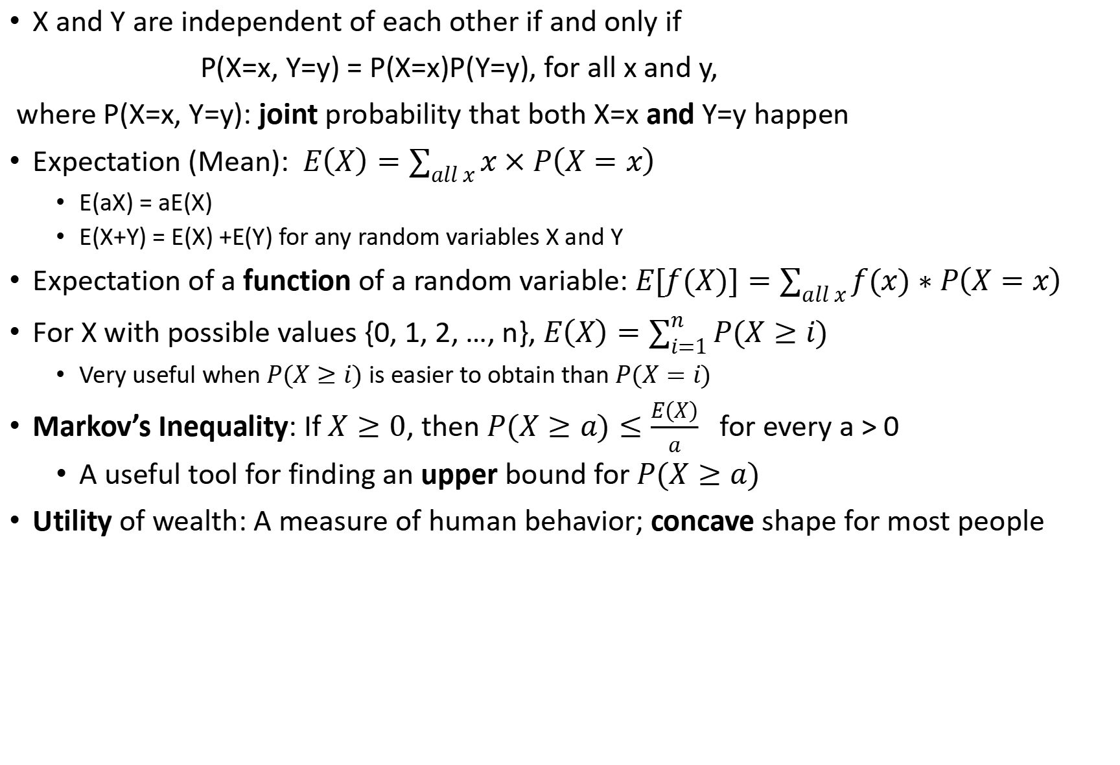
Independence and Expectation
X and Y are independent of each other if and only if
P(X=x, Y=y) = P(X=x)P(Y=y), for all x and y,
where P(X=x, Y=y): joint probability that both X=x and Y=y happen
Expectation (Mean): $E\left(X\right)=\sum_{all x}{x×P\left(X=x\right)}$
E(aX) = aE(X)
E(X+Y) = E(X) +E(Y) for any random variables X and Y
Expectation of a function of a random variable: $E[f(X)]=\sum_{all x}{f(x)∗P\left(X=x\right)}$
For X with possible values {0, 1, 2, …, n}, $E\left(X\right)=\sum_{i=1}^{n}{P(X≥i)}$
Very useful when$P(X≥i)$ is easier to obtain than $P(X=i)$
Markov’s Inequality: If $X≥0$, then $P(X≥a)≤\frac{E\left(X\right)}{a}$ for every a > 0
A useful tool for finding an upper bound for $P(X≥a)$
Utility of wealth: A measure of human behavior; concave shape for most people

Slide 5
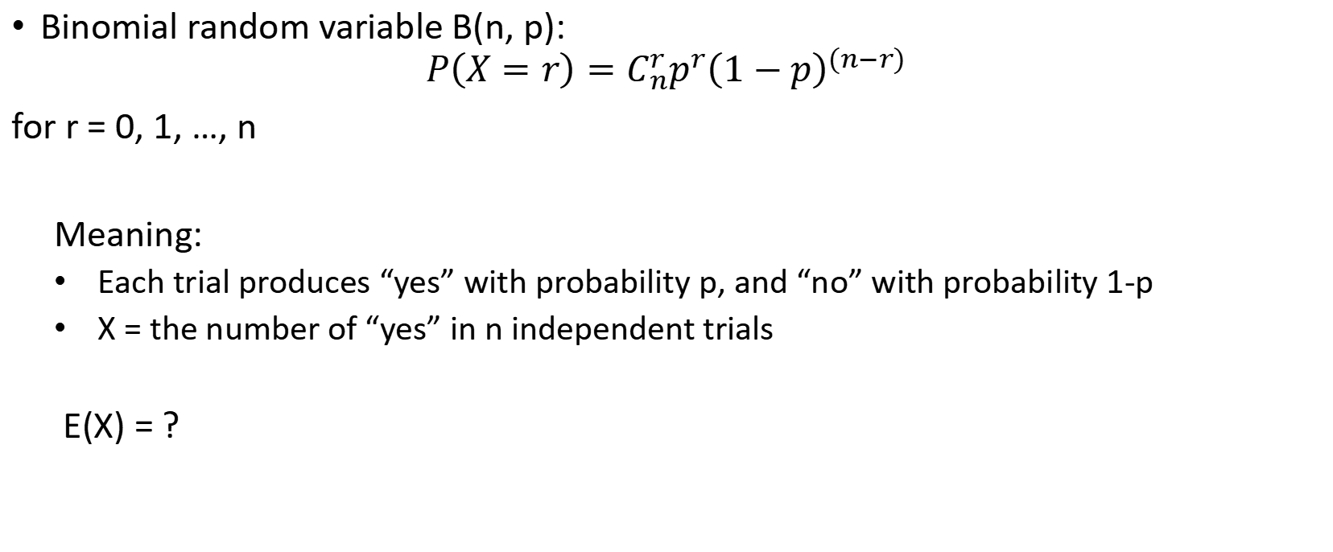
Expectation of Binomial Random Variable
Binomial random variable B(n, p):
$$P\left(X=r\right)=C_{n}^{r}p^{r}{\left(1−p\right)}^{(n−r)}$$
for r = 0, 1, …, n
Meaning:
Each trial produces “yes” with probability p, and “no” with probability 1-p
X = the number of “yes” in n independent trials
E(X) = ?

Slide 6
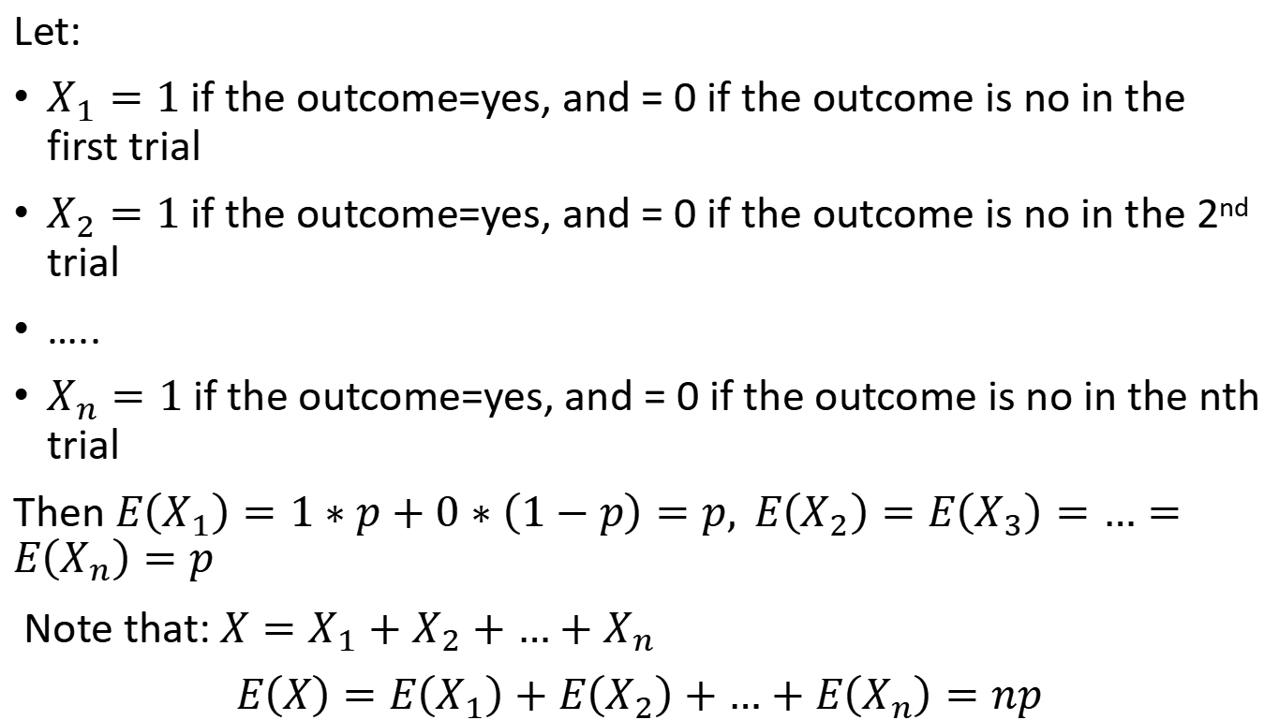
Solution
Let:
$X_{1}=1$if the outcome=yes, and = 0 if the outcome is no in the first trial
$X_{2}=1$if the outcome=yes, and = 0 if the outcome is no in the 2nd trial
…..
$X_{n}=1$if the outcome=yes, and = 0 if the outcome is no in the nth trial
Then $E\left(X_{1}\right)=1∗p+0∗\left(1−p\right)=p, E\left(X_{2}\right)=E\left(X_{3}\right)=…=E\left(X_{n}\right)=p$
Note that: $X=X_{1}+X_{2}+…+X_{n}$
$E\left(X\right)=E\left(X_{1}\right)+E\left(X_{2}\right)+…+E\left(X_{n}\right)=np$

Slide 7
Bernoulli’s Utility
Bernoulli introduced a utility function that is based on the player’s wealth
utility = log( wealth )
Diminishing utility: change in utility decreases as wealth increases – concave function

Slide 8
Risk Averse
For the same amount of money, the decrease in utility for a loss is larger than the increase in utility for a gain
I.e., the player is risk averse

Slide 9
Example: Expected Utility Change
Game Outcome | H | T
Probability | 1/2 | 1/2
Gain | $50,000 | –$50,000
Change in Utility | 0.176 log(100k+50k)-log(100k) | –0.301 log(100k-50k)-log(100k)
Prob. x Change in Utility | 0.176*(1/2)= 0.088 | -0.301*(1/2)= -0.151
Expected Utility Change | 0.088+(-0.151)=–0.063
Wealth = $100,000
If he is neutral to risk, the value of the game is 0 to him
However, the expected utility change of the game is negative to him, meaning that he doesn’t like risk. That is, he is risk averse

Slide 10
Variance and Standard Deviation

Slide 11
1. When X and Y are independent of each other, E(XY) = ?

Slide 12
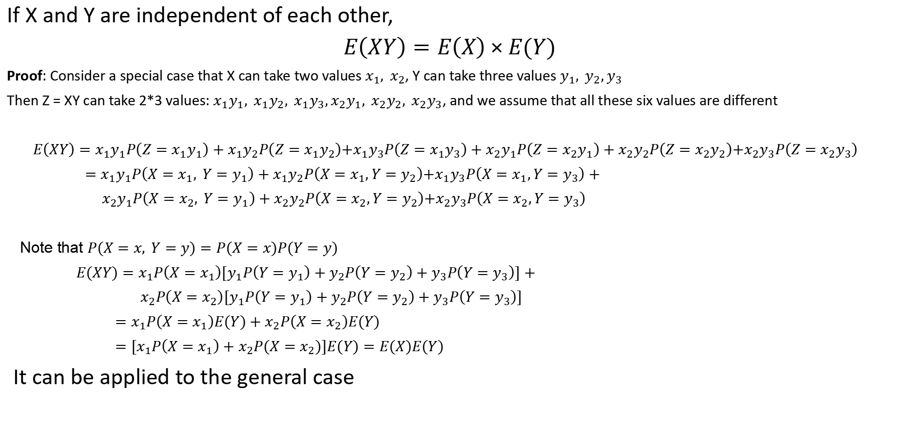
Theorem
If X and Y are independent of each other,
$E\left(XY\right)=E\left(X\right)×E(Y)$
Proof: Consider a special case that X can take two values $x_{1}, x_{2}$, Y can take three values $y_{1}, y_{2},y_{3}$
Then Z = XY can take 2*3 values: $x_{1}y_{1}, x_{1}y_{2}, x_{1}y_{3},x_{2}y_{1}, x_{2}y_{2}, x_{2}y_{3}$, and we assume that all these six values are different
$E\left(XY\right)=$ $x_{1}y_{1}P\left(Z=x_{1}y_{1}\right)+x_{1}y_{2}P\left(Z=x_{1}y_{2}\right){+x}_{1}y_{3}P\left(Z=x_{1}y_{3}\right)+x_{2}y_{1}P\left(Z=x_{2}y_{1}\right)+x_{2}y_{2}P\left(Z=x_{2}y_{2}\right){+x}_{2}y_{3}P\left(Z=x_{2}y_{3}\right)$
$=x_{1}y_{1}P\left(X=x_{1}, Y=y_{1}\right)+x_{1}y_{2}P\left(X=x_{1},Y=y_{2}\right){+x}_{1}y_{3}P\left(X=x_{1},Y=y_{3}\right)+$
${ x}_{2}y_{1}P\left(X=x_{2}, Y=y_{1}\right)+x_{2}y_{2}P\left(X=x_{2},Y=y_{2}\right){+x}_{2}y_{3}P\left(X=x_{2},Y=y_{3}\right)$
Note that $P(X=x, Y=y)=P(X=x)P(Y=y)$
$E(XY)=x_{1}P\left(X=x_{1}\right){[y}_{1}P\left(Y=y_{1}\right)+y_{2}P\left(Y=y_{2}\right)+y_{3}P\left(Y=y_{3}\right)]+$
${ x}_{2}P\left(X=x_{2}\right){[y}_{1}P\left(Y=y_{1}\right)+y_{2}P\left(Y=y_{2}\right)+y_{3}P\left(Y=y_{3}\right)]$
${=x}_{1}P\left(X=x_{1}\right)E(Y)+x_{2}P\left(X=x_{2}\right)E(Y)$
$={[x}_{1}P\left(X=x_{1}\right)+x_{2}P(X=x_{2})]E(Y)=E(X)E(Y)$
It can be applied to the general case

Slide 13

Example
Ex: Let X and Y be independent, E(X) = 2, E(Y) = 1, E($X^{2})=$ 5, E${(Y}^{2})=2,$ $E{\left(X−Y\right)}^{2}=?$
Solution: $E{\left(X−Y\right)}^{2}=E\left(X^{2}+Y^{2}−2XY\right)$
$=E\left(X^{2}\right)+E\left(Y^{2}\right)−2E\left(XY\right)$
= 5 + 2 – 2 * 2 * 1 = 3

Slide 14
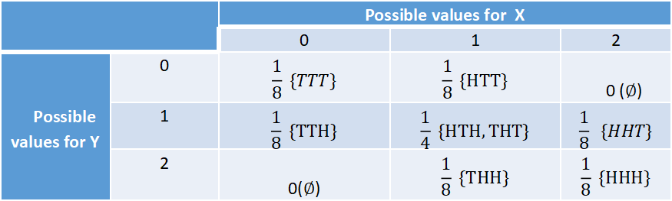
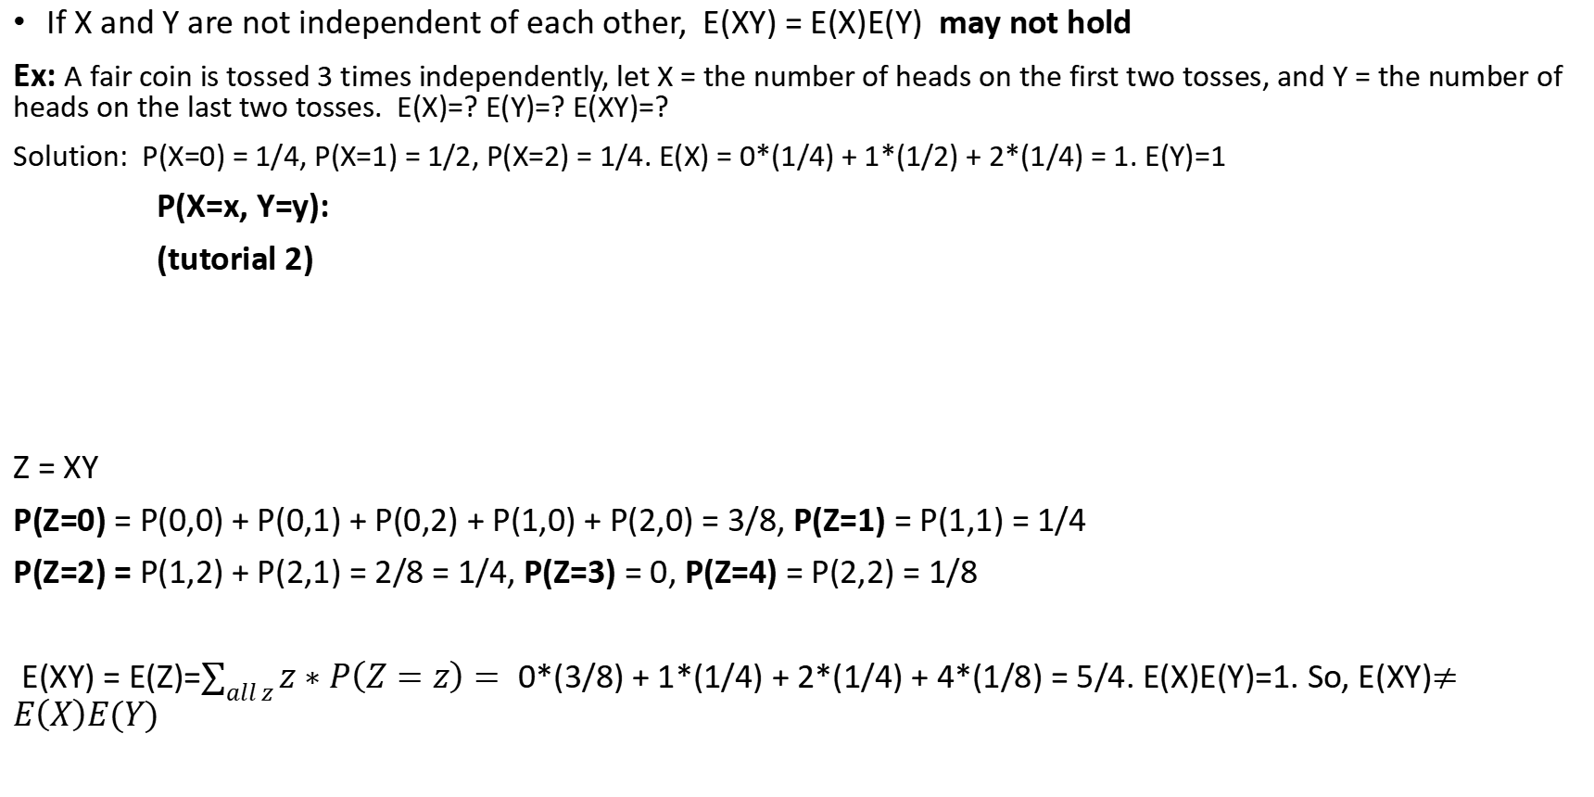
Example
If X and Y are not independent of each other, E(XY) = E(X)E(Y) may not hold
Ex: A fair coin is tossed 3 times independently, let X = the number of heads on the first two tosses, and Y = the number of heads on the last two tosses. E(X)=? E(Y)=? E(XY)=?
Solution: P(X=0) = 1/4, P(X=1) = 1/2, P(X=2) = 1/4. E(X) = 0*(1/4) + 1*(1/2) + 2*(1/4) = 1. E(Y)=1
P(X=x, Y=y):
(tutorial 2)
Z = XY
P(Z=0) = P(0,0) + P(0,1) + P(0,2) + P(1,0) + P(2,0) = 3/8, P(Z=1) = P(1,1) = 1/4
P(Z=2) = P(1,2) + P(2,1) = 2/8 = 1/4, P(Z=3) = 0, P(Z=4) = P(2,2) = 1/8
E(XY) = E(Z)=$\sum_{all z}{z∗P\left(Z=z\right)= }$0*(3/8) + 1*(1/4) + 2*(1/4) + 4*(1/8) = 5/4. E(X)E(Y)=1. So, E(XY)$≠E\left(X\right)E(Y)$
 |  | Possible values for X
 |  | 0 | 1 | 2
Possible values for Y | 0 | $$\frac{1}{8} \{TTT\}$$ | $$\frac{1}{8} \{HTT\}$$ | 0 ($∅$)
 | 1 | $$\frac{1}{8} \{TTH\}$$ | $$\frac{1}{4} \{HTH,THT\}$$ | $$\frac{1}{8} \{HHT\}$$
 | 2 | 0($∅$) | $$\frac{1}{8} \{THH\}$$ | $$\frac{1}{8} \{HHH\}$$

Slide 15
2. Variance and Standard Deviation

Slide 16
Question
Plots of two probability functions P(X=x)
Q: Is there a good parameter that well distinguishes between the two distributions?
Notes:
a measure of dispersion, meaning it is a measure of how far a set of numbers is spread out from their average value

Slide 17
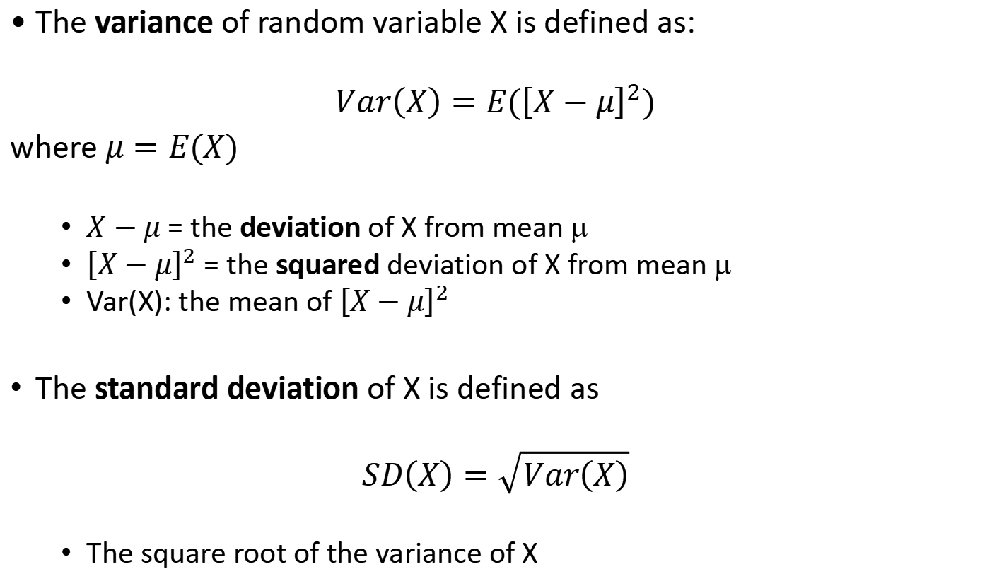
Variance and Standard Deviation
The variance of random variable X is defined as:
$$Var\left(X\right)=E({\left[X−μ\right]}^{2})$$
where $μ=E(X)$
$X−μ$ = the deviation of X from mean μ
${\left[X−μ\right]}^{2}$ = the squared deviation of X from mean μ
Var(X): the mean of ${\left[X−μ\right]}^{2}$
The standard deviation of X is defined as
$$SD\left(X\right)=\sqrt{Var\left(X\right)}$$
The square root of the variance of X

Slide 18
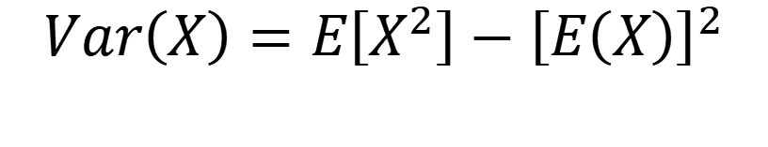
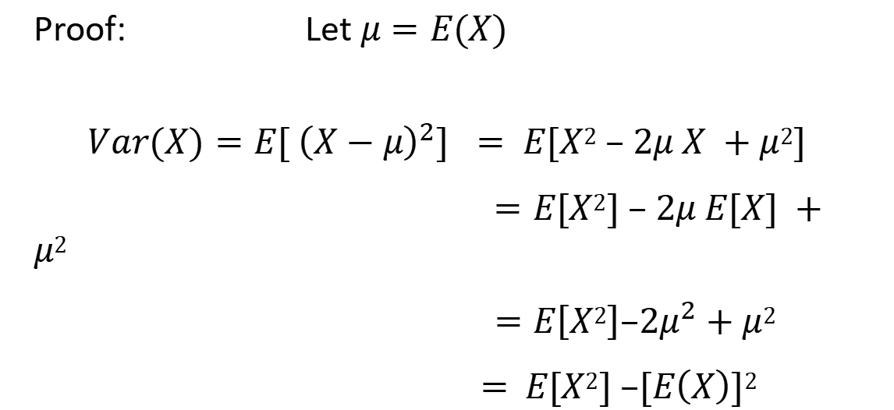
Computational Formula for Variance
Theorem
$$Var\left(X\right)=E\left[X^{2}\right]−{\left[E\left(X\right)\right]}^{2}$$
Proof: Let $μ=E(X)$
$$Var(X)=E[ {\left(X−μ\right)}^{2}] = E[X2 – 2μ X +μ2]$$
$=E[X2] – 2μ E[X] +μ2$
$=E\left[X2\right]–2μ^{2}+μ2$
= $E[X2] –[E\left(X\right)]2$

Slide 19

Properties of Variance
Claim 1: For any random variable X, $Var\left(X\right)≥0$
Proof: ${\left[X−E\left(X\right)\right]}^{2}≥0→Var\left(X\right)=E{\left[X−E\left(X\right)\right]}^{2}≥0$
Claim 2: Var(X) = 0 if and only if P(X = E(X)) = 1

Slide 20

Example
Ex: Let P(X=1) = p and P(X=0) = 1-p. Find Var(X) and SD(X)?
Solution: E(X) = 1*p + 0*(1-p) = p
${E\left(X^{2}\right)=1^{2}∗p+0^{2}∗\left(1−p\right)=p }^{}$
Var(X) = $E\left(X^{2}\right)−{\left(E(X)\right)}^{2}=p−p^{2}$
SD(X) = $\sqrt{p−p^{2}}$

Slide 21

Example
Ex: Let X = the number on a fair die. Find Var(X) and SD(X)
Solution: $Var\left(X\right)=E\left(X^{2}\right)−{\left(E(X)\right)}^{2}$
=$\left(1^{2}∗\frac{1}{6}+2^{2}∗\frac{1}{6}+3^{2}∗\frac{1}{6}+4^{2}∗\frac{1}{6}+5^{2}∗\frac{1}{6}+6^{2}∗\frac{1}{6}\right)−{\left(3.5\right)}^{2}=\frac{35}{12}$
SD(X) =$\sqrt{\frac{35}{12}}$

Slide 22
3. Chebyshev's Inequality

Slide 23
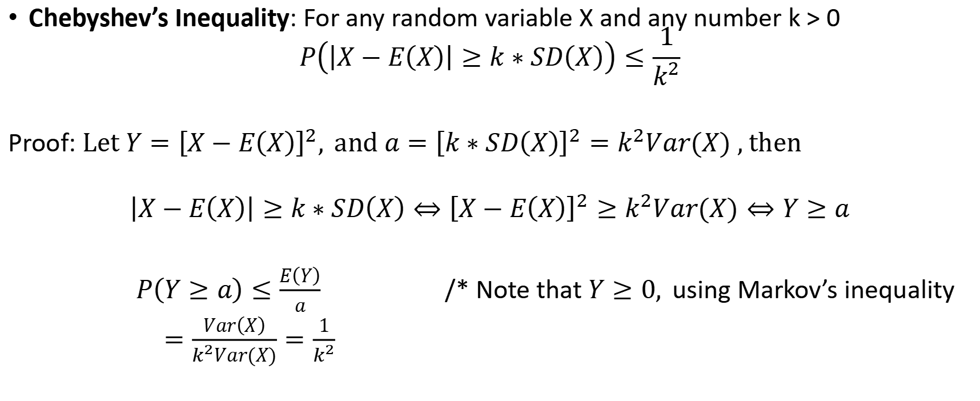
Chebyshev’s Inequality
Chebyshev’s Inequality: For any random variable X and any number k > 0
$$P\left(\left|X−E\left(X\right)\right|≥k∗SD\left(X\right)\right)≤\frac{1}{k^{2}}$$
Proof: $Let Y={\left[X−E\left(X\right)\right]}^{2},$and $a={\left[k∗SD\left(X\right)\right]}^{2}=k^{2}Var(X)$, then
$$\left|X−E\left(X\right)\right|≥k∗SD\left(X\right)⇔{\left[X−E\left(X\right)\right]}^{2}≥k^{2}Var(X)⇔Y≥a$$
$P\left(Y≥a\right)≤\frac{E\left(Y\right)}{a}$ /* Note that $Y≥0,$using Markov’s inequality
$=\frac{Var\left(X\right)}{k^{2}Var(X)}=\frac{1}{k^{2}}$

Slide 24
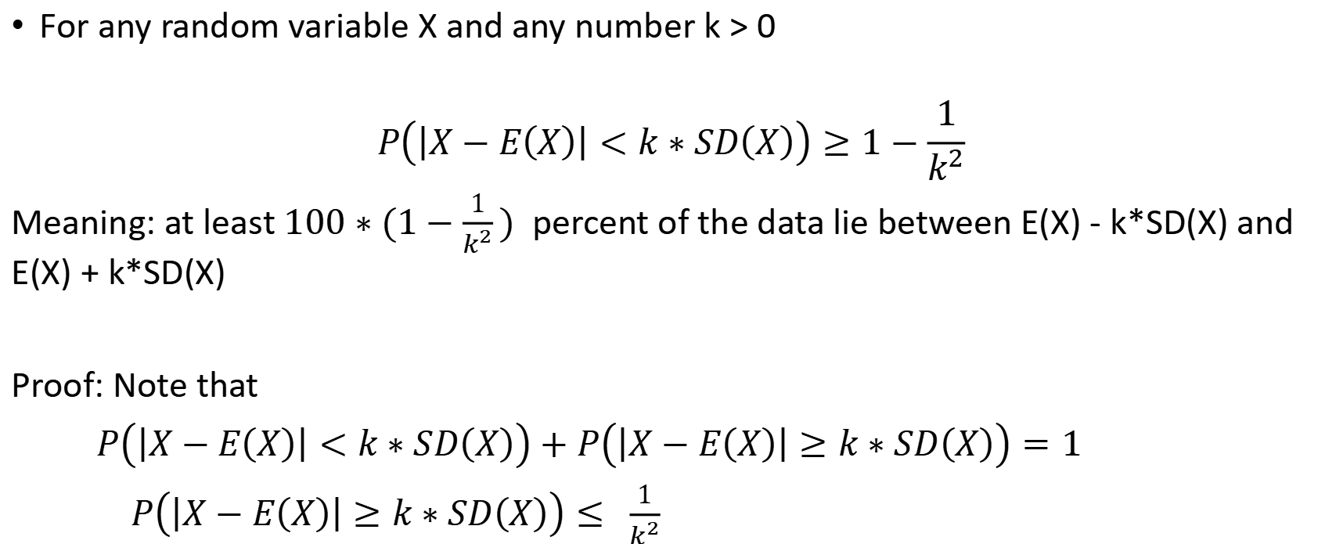
Variant of Chebyshev’s Inequality
For any random variable X and any number k > 0
$$P\left(\left|X−E\left(X\right)\right|<k∗SD\left(X\right)\right)≥1−\frac{1}{k^{2}}$$
Meaning: at least$100∗(1−\frac{1}{k^{2}})$ percent of the data lie between E(X) - k*SD(X) and E(X) + k*SD(X)
Proof: Note that
$P\left(\left|X−E\left(X\right)\right|<k∗SD\left(X\right)\right)+$ $P\left(\left|X−E\left(X\right)\right|≥k∗SD\left(X\right)\right)=1$
$P\left(\left|X−E\left(X\right)\right|≥k∗SD\left(X\right)\right)≤ \frac{1}{k^{2}}$

Slide 25
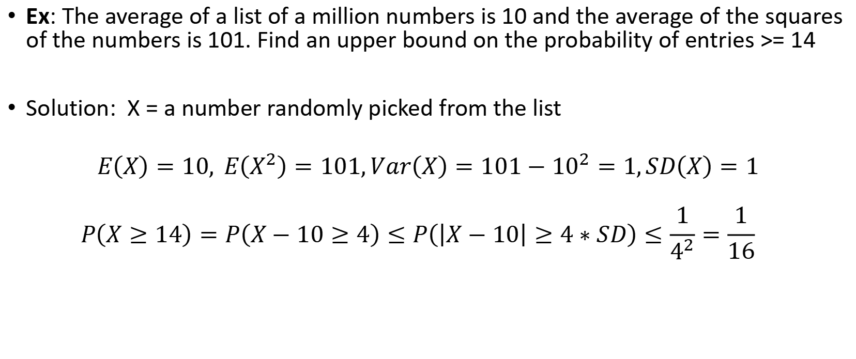
Example
Ex: The average of a list of a million numbers is 10 and the average of the squares of the numbers is 101. Find an upper bound on the probability of entries >= 14
Solution: X = a number randomly picked from the list
$$E\left(X\right)=10, E\left(X^{2}\right)=101,Var\left(X\right)=101−{10}^{2}=1,SD\left(X\right)=1$$
$$P\left(X≥14\right)=P\left(X−10≥4\right)≤P\left(\left|X−10\right|≥4∗SD\right)≤\frac{1}{4^{2}}=\frac{1}{16}$$

Slide 26
Example
Ex: Suppose that the average of a list of numbers is 100. The standard derivation is 10. Find a lower upper bound of the percentage that the numbers in the list is between 80 and 120
Solution: X = a random number from the list, E(X) = 100, SD(X) = 10
P(|X-100|<20)=P(|X-E(X)|<2*SD(X))>=1-(1/2)^2 = 75%
That is, at least 75% of the numbers in the list is between 80 and 120

Slide 27
4. Variance of a Sum of Independent Random Variables

Slide 28
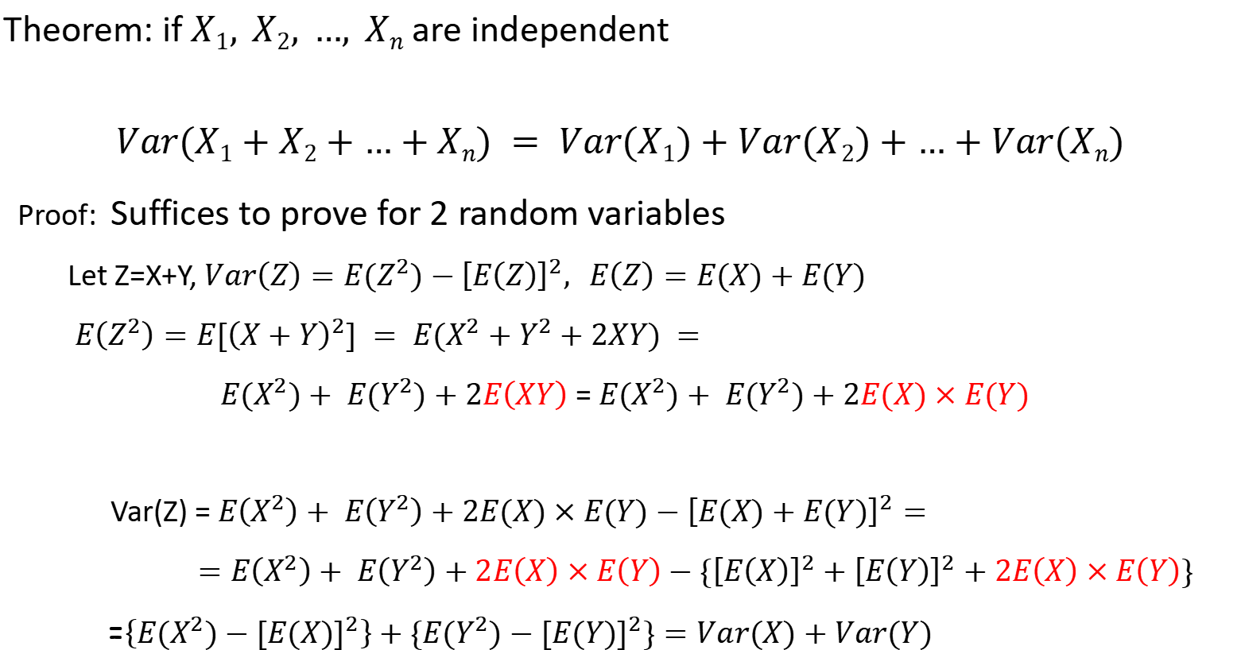
Theorem
Theorem: if $X1, X2, …, Xn$are independent
$$Var(X1+X2+…+Xn) = Var(X1)+Var(X2)+…+Var(Xn)$$
Proof: Suffices to prove for 2 random variables
Let Z=X+Y, $Var\left(Z\right)=E{(Z}^{2})−{\left[E\left(Z\right)\right]}^{2},$ $E\left(Z\right)=E(X)+E(Y)$
$E\left(Z^{2}\right)=E[{\left(X+Y\right)}^{2}] = E(X^{2}+Y^{2}+2XY) =$
$E(X^{2})+ E(Y^{2})+2E\left(XY\right)$ = $E(X^{2})+ E(Y^{2})+2E(X)×E(Y)$
Var(Z) = $E\left(X^{2}\right)+ E\left(Y^{2}\right)+2E(X)×E(Y)−{\left[E(X)+E(Y)\right]}^{2}=$
$=E\left(X^{2}\right)+ E\left(Y^{2}\right)+2E\left(X\right)×E\left(Y\right)−\{{\left[E\left(X\right)\right]}^{2}+{\left[E\left(Y\right)\right]}^{2}+2E\left(X\right)×E\left(Y\right)\}$
=$\left\{E(X^{2})−{[E(X)]}^{2}\right\}+\{E(Y^{2})−{[E(Y)]}^{2}\}=Var(X)+Var(Y)$

Slide 29
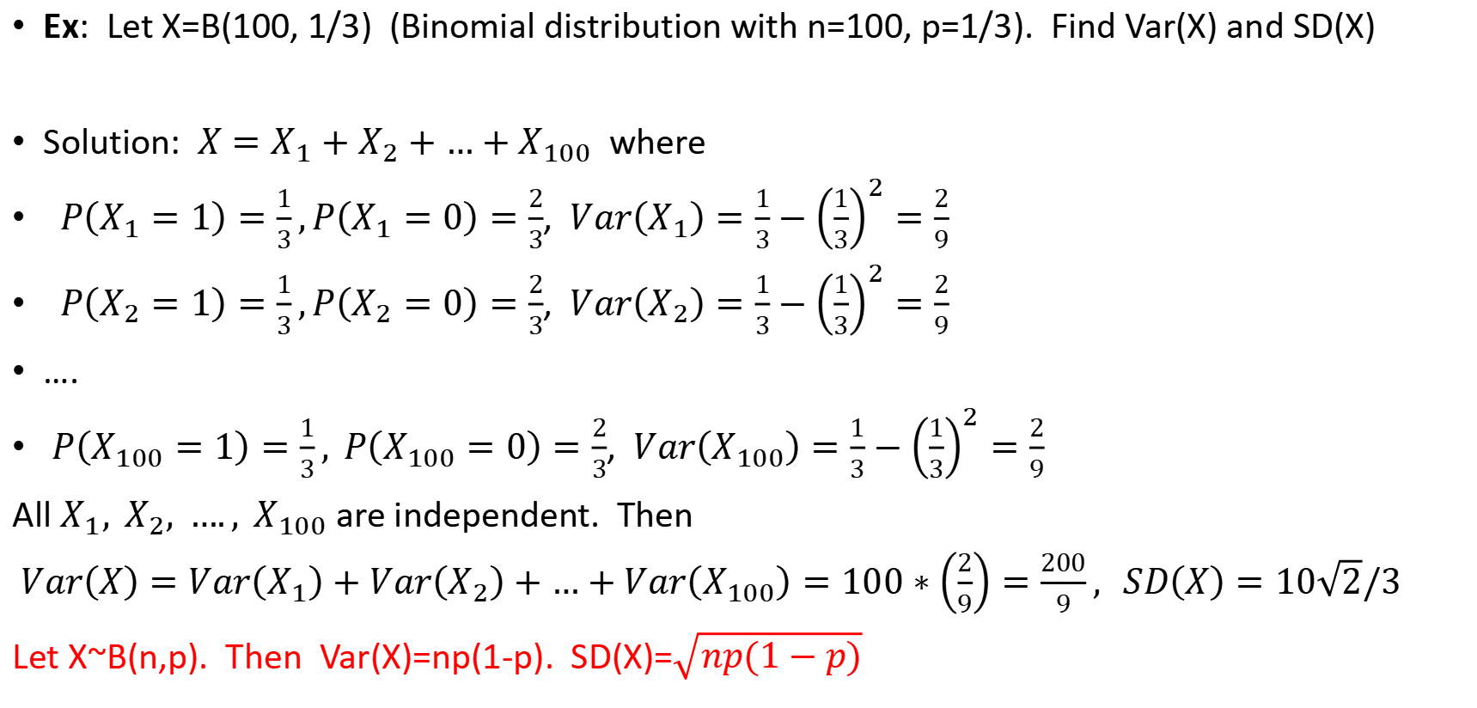
Example
Ex: Let X=B(100, 1/3) (Binomial distribution with n=100, p=1/3). Find Var(X) and SD(X)
Solution: $X=X_{1}+X_{2}+…+X_{100}$ where
$P\left(X_{1}=1\right)=\frac{1}{3},P\left(X_{1}=0\right)=\frac{2}{3}$, $Var\left(X_{1}\right)=\frac{1}{3}−{\left(\frac{1}{3}\right)}^{2}=\frac{2}{9}$
$P\left(X_{2}=1\right)=\frac{1}{3},P\left(X_{2}=0\right)=\frac{2}{3}$, $Var\left(X_{2}\right)=\frac{1}{3}−{\left(\frac{1}{3}\right)}^{2}=\frac{2}{9}$
….
$P\left(X_{100}=1\right)=\frac{1}{3}, P\left(X_{100}=0\right)=\frac{2}{3}$, $Var\left(X_{100}\right)=\frac{1}{3}−{\left(\frac{1}{3}\right)}^{2}=\frac{2}{9}$
All $X_{1}, X_{2}, …., X_{100}$ are independent. Then
$Var\left(X\right)=Var\left(X_{1}\right)+Var\left(X_{2}\right)+…+Var\left(X_{100}\right)=100∗\left(\frac{2}{9}\right)=\frac{200}{9}, SD\left(X\right)=10\sqrt{2}/3$
Let X~B(n,p). Then Var(X)=np(1-p). SD(X)=$\sqrt{np(1−p)}$

Slide 30
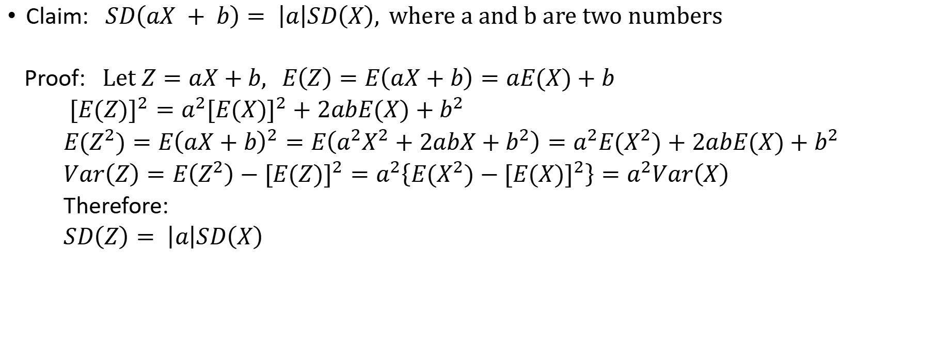
Claim
Claim: $SD\left(aX + b\right)= \left|a\right|SD\left(X\right), where a and b are two numbers$
Proof: $Let Z=aX+b, E\left(Z\right)=E\left(aX+b\right)=aE(X)+b$
${[E(Z)]}^{2}=a^{2}{[E(X)]}^{2}+2abE(X)+b^{2}$
${E(Z}^{2})=E{\left(aX+b\right)}^{2}=E\left(a^{2}X^{2}+2abX+b^{2}\right)=a^{2}E(X^{2})+2abE(X)+b^{2}$
$Var\left(Z\right)=E\left(Z^{2}\right)−{[E(Z)]}^{2}=a^{2}\left\{E{(X}^{2})−{[E(X)]}^{2}\right\}=a^{2}Var\left(X\right)$
Therefore:
$SD\left(Z\right)= \left|a\right|SD\left(X\right)$

Slide 31
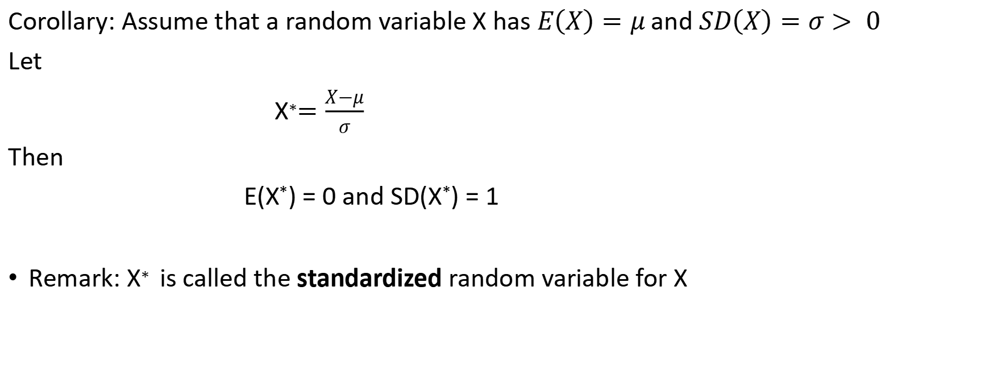
Corollary
Corollary: Assume that a random variable X has $E\left(X\right)=μ$and $SD\left(X\right)=σ> 0$
Let
X$∗=\frac{X−μ}{σ}$
Then
E(X*) = 0 and SD(X*) = 1
Remark: X$∗$is called the standardized random variable for X

Slide 32
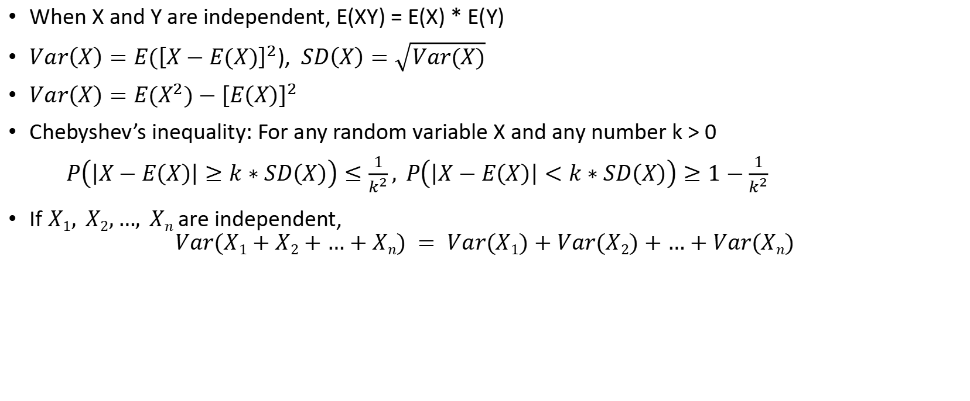
Summary
When X and Y are independent, E(XY) = E(X) * E(Y)
$Var\left(X\right)=E({\left[X−E(X)\right]}^{2}$), $SD\left(X\right)=\sqrt{Var(X)}$
$Var\left(X\right)=E(X^{2})−{\left[E\left(X\right)\right]}^{2}$
Chebyshev’s inequality: For any random variable X and any number k > 0
$P\left(\left|X−E\left(X\right)\right|≥k∗SD\left(X\right)\right)≤\frac{1}{k^{2}}, P\left(\left|X−E\left(X\right)\right|<k∗SD\left(X\right)\right)≥1−\frac{1}{k^{2}}$
If $X1, X2,…, Xn$are independent,
$$Var(X1+X2+…+Xn) = Var(X1)+Var(X2)+…+Var(Xn)$$

