Slide 1
Tutorial 1: Getting Started with Linux
CS3103
Operating Systems
Some slides are adapted from tutorial slides of Augustine Abaris at Boston University: Introduction to Linux (Available at here).

Slide 2





What is Linux?
Linux (/ˈlɪnəks/ LIN-əks) is a family of open source Unix-like operating systems based on the Linux kernel, an operating system kernel first released on September 17, 1991, by Linus Torvalds.
Linux is typically packaged in a Linux distribution. Distributions include the Linux kernel and supporting system software and libraries.
Popular Linux distributions include Debian, Red Hat, SUSE, Fedora, and Ubuntu.
Base distributions
Derived distributions

Slide 3
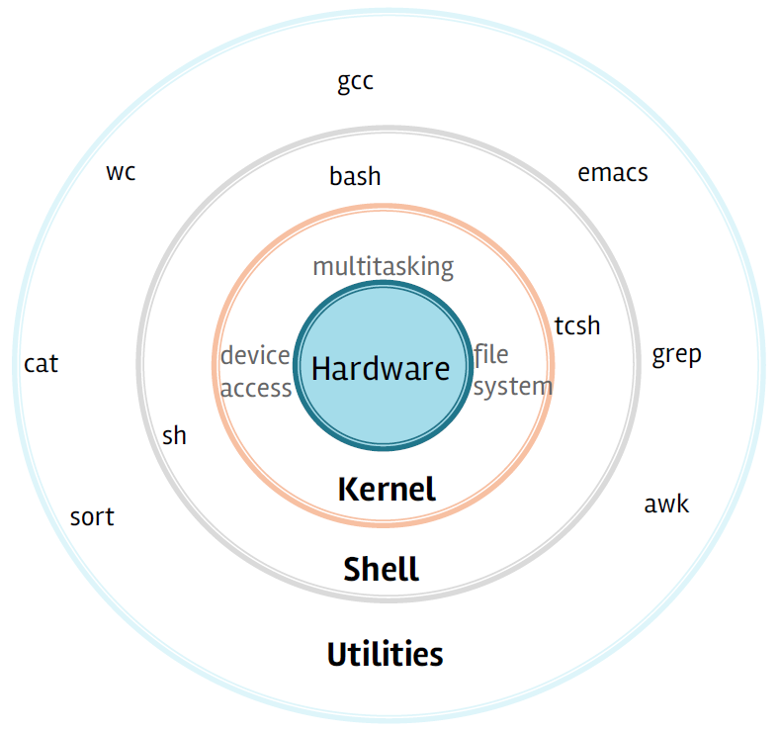

What is Linux? (cont’d) Where is Linux
Bird’s eye view
World Wide Web
67% of the world’s web-servers run Linux (2016)
Research/High-Performance Compute
Google, Amazon, NSA, 100% of TOP500 Super-computers ^{[1]}
Modern Smartphones and devices
Android phones
Amazon Kindle
Smart TVs/Devices
The most common OS used by CityU researchers when working on a server or computer cluster.
Linux Runs on All of the Top 500 Supercomputers, Again! https://itsfoss.com/linux-runs-top-supercomputers/

Slide 4
Why Linux
Free and open-source.
Powerful for research datacenters
Personal for desktops and phones
Universal
Community (and business) driven
We’ll do labs and projects on CSLab servers, using Linux machines.

Slide 5





Connecting
Let’s use Linux

Slide 6
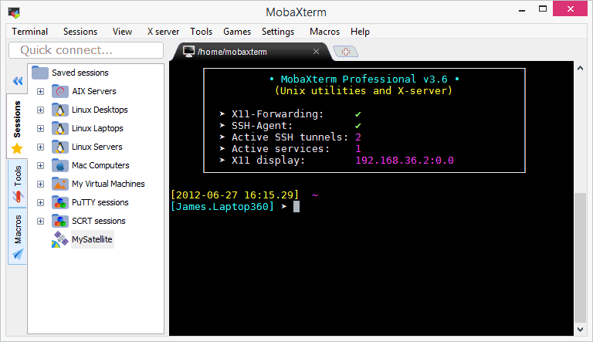
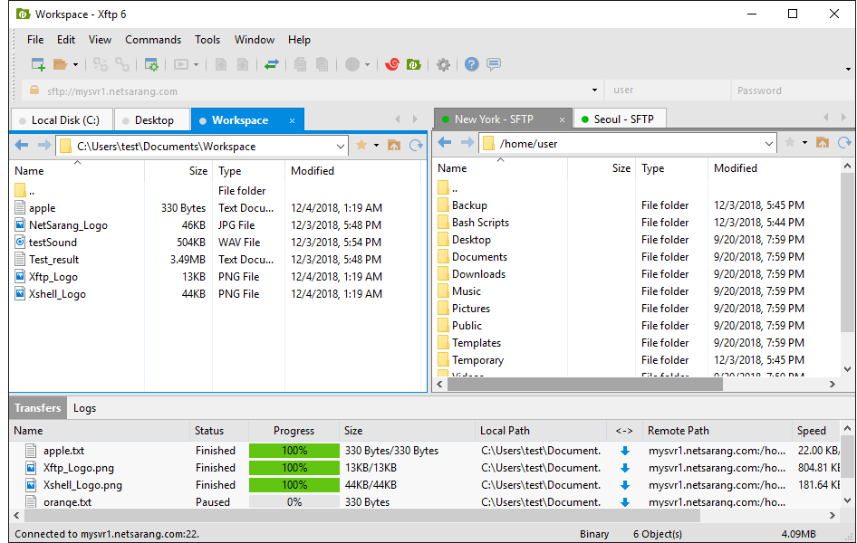
Connection Protocols and Software
Remote Connections: Secure Shell (SSH)
Data Transfer: Secure File Transfer Protocol (SFTP)

Slide 7
Connecting from Different Platforms
 | SSH | SFTP
Microsoft Windows | MobaXterm, Xshell, PuTTY | MobaXterm, Xftp, FileZilla, Cyberduck
Apple macOS | Terminal (Built in), iTerm2 | Cyberduck, ForkLift3, FileZilla
Linux | Terminal (Built in) | Various (Built in)
Note:
[1] MobaXterm is available on all CSLab Windows machines. You can launch MobaXterm from CSLab Menu, which is on the Windows desktop. All softwares listed above provide free license for home and school users.

Slide 8
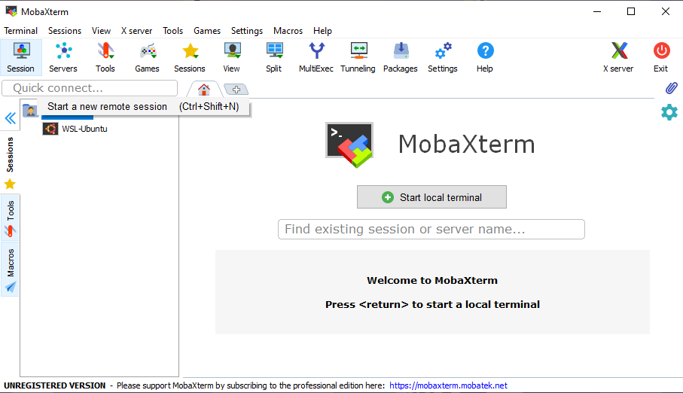
Microsoft Windows (MobaXterm)
Launch MobaXterm from CSLab Menu, which is on the Windows desktop and start a “New Session”:

Slide 9
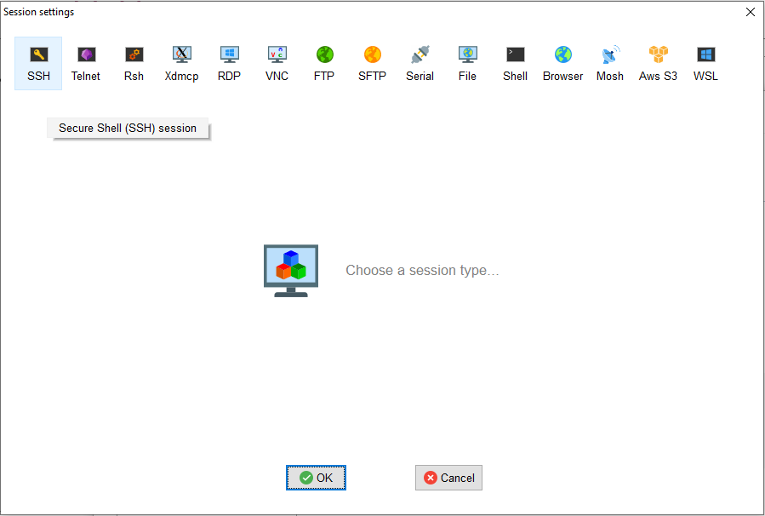
Microsoft Windows (MobaXterm)
Select “SSH” as the session type:

Slide 10
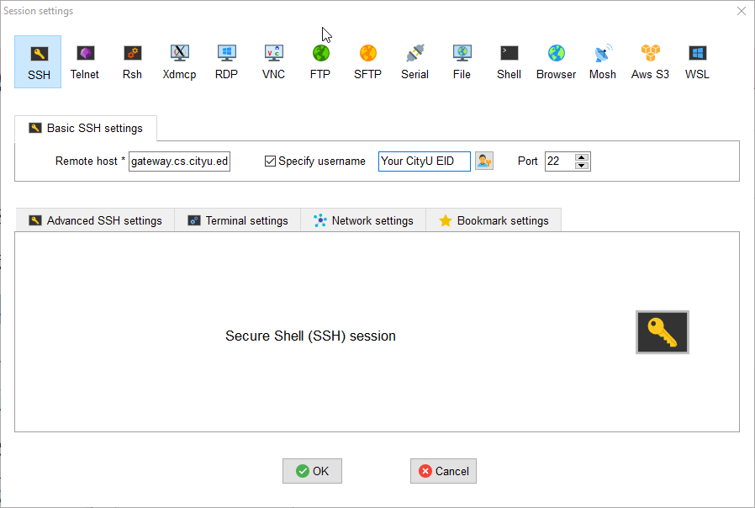
Microsoft Windows (MobaXterm)
Specify “gateway.cs.cityu.edu.hk” as the remote host, your EID (e.g., cctom2) as the username, and click “OK”

Slide 11
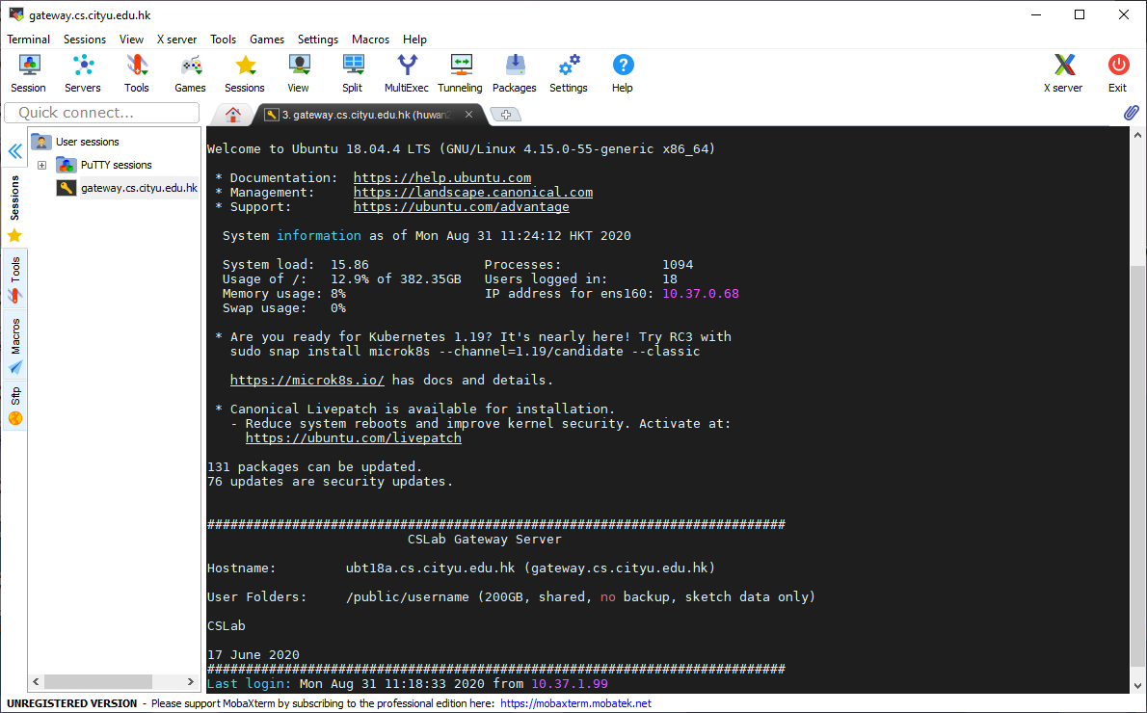
Microsoft Windows (MobaXterm)
In the terminal window you will get a prompt to enter your password (Note that the characters in your password will not be displayed when you type them as a security precaution).
Your connection will be saved on the left sidebar, so the next time you can start your session by clicking the “gateway.cs.cityu.edu.hk (yourEID)” link.
You can edit, delete, and move
sessions by right clicking on them
in the left MobaXterm sidebar.

Slide 12
Microsoft Windows (MobaXterm)
Exit an SSH session (logout)
The session terminates when you exit the command-line shell on the server (typically by typing exit) to the command line.
Alternatively, you can terminate the session by clicking Exit button or closing the terminal window.

Slide 13
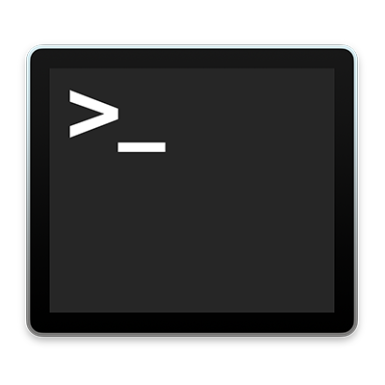
Other Platforms
Apple macOS
Built in Terminal: Applications > Utilities > Terminal
Linux
Built in Terminal: Applications > System > Terminal
Connect:
The tool on Linux for connecting to a remote system using SSH is called, unsurprisingly, ssh.
The most basic form of the command is: ssh username@remote_host. Username is your EID, and the remote_host in this lab is gateway.cs.cityu.edu.hk.
Once you have connected to the server, you will probably be asked to verify your identity by providing a password.
When you first connect you will receive a notification text, and it is necessary to specify the option of yes to continue the connection.

Slide 14

Other Platforms (cont’d)
Enter your password. Note that your password will not be shown on the screen as you type it, not even as a row of stars (******).
$ ssh cctom2@gateway.cs.cityu.edu.hk
cctom2@gateway.cs.cityu.edu.hk's password:
The authenticity of host 'gateway.cs.cityu.edu.hk (144.214.37.68)' can't be established.
RSA key fingerprint is f3:cf:58:ae:71:0b:c8:04:6f:34:a3:b2:e4:1e:0c:8b.
Are you sure you want to continue connecting (yes/no)? yes
cctom2@ubt18a:~$
Type “yes”.

Slide 15
Linux Interaction
The Shell
Program that interprets commands and sends them to the OS. It provides built-in commands.
Linux supports multiple shells. The default on CSLab gateway server is Bash or csh.
The “prompt”
After successfully logging in, the shell will always give you a prompt if it is ready to accept commands. A shell prompt normally ends in a $ sign like this. Some shell prompts use % or > instead.
Your Username
Current Directory
cctom2@ubt18a:~$
“Bash” = “Bourne-again Shell”
(GNU version of ~1977 shell written by Stephen Bourne)
The System Name
( In Linux “ ~ ” is a shorthand for your home directory. )

Slide 16
Linux: Command Basics
cctom2@ubt18a:~$ command --option argument
Commands have three parts; command, options and arguments/parameters.
Command: Command/program that does one thing
Options: Change the way a command does that one thing
Short form: Single-dash and one letter e.g. ls -a
Long form: Double-dash and a word e.g. ls --all
Argument: Provides the input/output that the command interacts with
Example: cal -j 9 2020. “cal” is the command, “-j” is an option, “9” and “2020” are arguments/parameters.
cctom2@ubt18a:~$ cal
September 2020
Su Mo Tu We Th Fr Sa
1 2 3 4 5
6 7 8 9 10 11 12
13 14 15 16 17 18 19
20 21 22 23 24 25 26
27 28 29 30
cctom2@ubt18a:~$ cal 09 2020
September 2020
Su Mo Tu We Th Fr Sa
1 2 3 4 5
6 7 8 9 10 11 12
13 14 15 16 17 18 19
20 21 22 23 24 25 26
27 28 29 30
cctom2@ubt18a:~$ cal -j 9 2020
September 2020
Su Mo Tu We Th Fr Sa
245 246 247 248 249
250 251 252 253 254 255 256
257 258 259 260 261 262 263
264 265 266 267 268 269 270
271 272 273 274
Note: -j option: Display Julian days (days one-based, numbered from January 1).

Slide 17
Try it out
After you connect, type the following commands:
whoami # my login
hostname # name of this computer
echo “Hello, world” # print characters to screen
date # print current time/date
cal # print this month’s calendar
Help with Commands
For more information about any command, use man or info, --help option.
date --help
man date
info date
Yes, you can always Google it.
Note: press q to quit when using man or info.

Slide 18
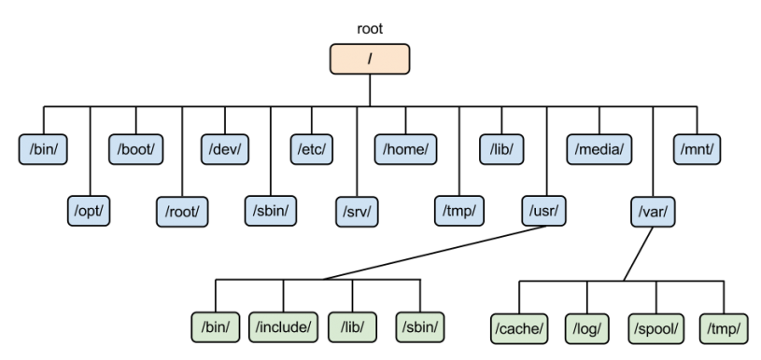
Linux The Filesystem
The structure resembles an upside-down tree
Directories (a.k.a. folders) are collections of files and other directories.
Every directory has a parent except for the root directory.
Many directories have subdirectories.
Source: https://www.rs-online.com/designspark/an-intro-to-linux-file-system-management

Slide 19
Navigating the File System
Essential navigation commands:
pwd print current directory
ls list files
cd change directory
We use pathnames to refer to files and directories in the Linux file system. There are two types of pathnames:
Absolute – The full path to a directory or file; begins with /
Relative – A partial path that is relative to the current working directory; does not begin with /

Slide 20
Navigating the File System (cont’d)
Special characters interpreted by the shell for filename expansion:
~ your home directory (e.g., /usr1/tutorial/tuta1)
. current directory
.. parent directory
* wildcard matching any filename
? wildcard matching any character
TAB try to complete (partially typed) filename
Examples:
cd /usr/local Change directory to /usr/local/lib
cd ~ Change to home directory (could just type ‘cd’)
pwd Print working (current) directory
cd .. Change directory to the “parent” directory
cd / Change directory to the “root”
ls –d pro* Listing of only the directories starting with “pro”

Slide 21
The ls command
Useful options for the “ls” command:
ls -a List all files, including hidden files beginning with a “.”
ls -ld * List details about a directory and not its contents
ls -F Put an indicator character at the end of each name
ls –l Simple long listing
ls –lR Recursive long listing
ls –lh Give human readable file sizes
ls –lS Sort files by file size
ls –lt Sort files by modification time (very useful!)

Slide 22
Some Useful File Commands
cp [file1] [file2] copy file
mkdir [name] make directory
rmdir [name] remove (empty) directory
mv [file] [destination] move/rename file
rm [file] remove (-r for recursive)
file [file] identify file type
less [file] page through file
head -n N [file] display first N lines
tail -n N [file] display last N lines
ln –s [file] [new] create symbolic link
cat [file] [file2…] display file(s)
touch [file] update modification time
od [file] display file contents, esp. binary

Slide 23
Manipulating files and directories
Examples:
cd # The same as cd ~
mkdir test
cd test
echo ‘Hello everyone’ > myfile.txt
echo ‘Goodbye all’ >> myfile.txt
less myfile.txt
mkdir subdir1/subdir2 # Fails. Why?
mkdir -p subdir1/subdir2 # Succeeds
mv myfile.txt subdir1/subdir2
cd ..
rmdir test # Fails. Why?
rm –rf test # Succeeds

Slide 24
File Editors
nano
Lightweight editor.
vim (recommended)
A better version of ‘vi’ (an early full-screen editor). Very fast, efficient.
Steep learning curve.
Popular among systems programmers.
emacs
Swiss-army knife, has modes for all major languages, and can be customized.
Formerly steep learning curve has been reduced with introduction of menu and tool bars.
Resources:
[1] Interactive Vim tutorial https://www.openvim.com
[2] Vim Cheat Sheet https://vim.rtorr.com/
[3] How To Learn Vim: A Four Week Plan, https://medium.com/actualize-network/how-to-learn-vim-a-four-week-plan-cd8b376a9b85

Slide 25
More topics
I/O Redirection
stdin (0) / stdout (1) / stderr (2)
I/O redirection with pipes (|)
Processes & Job Control
Use the “ps” command to see a listing of processes
Use “top” command to see active processes
Use the “kill” command to terminate a job
Foreground/background processes

