Slide 1
CS3103 Operating System 2023/2024 Sem B
Chapter 10: Storage
Dr. Nan Guan
Department of Computer Science
City University of Hong Kong

Slide 2
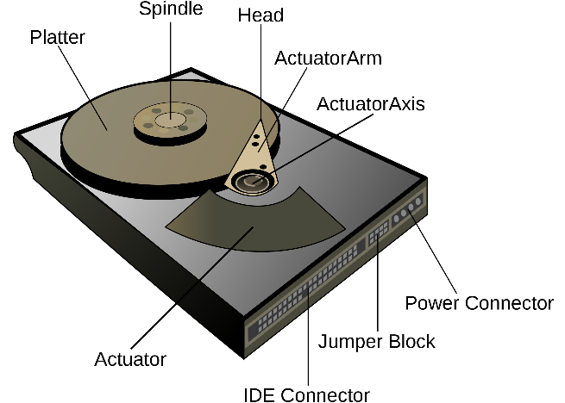
Magnetic disks
Magnetic disk (Hard disk)
electro-mechanical data storage device using magnetic storage and one or more rigid rapidly rotating platters coated with magnetic material
a type of non-volatile memory (NVM), retaining stored data even when powered off
Used to store mass data

Slide 3
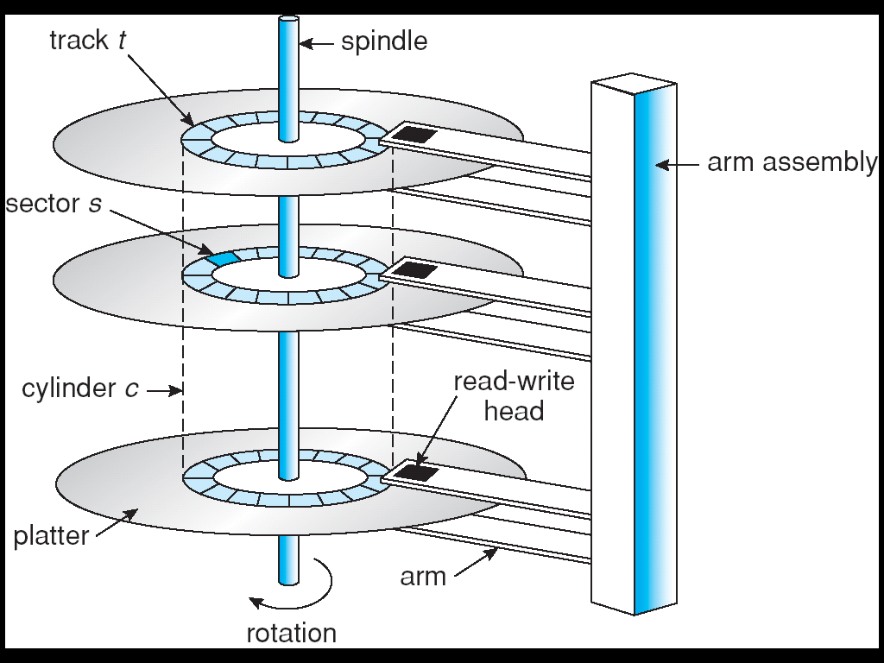
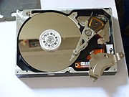
Magnetic disks
Magnetic disks as secondary storage of modern computers

Slide 4
Magnetic disks
Magnetic disks as secondary storage of modern computers
Drives rotate at 60 to 200 times per second
Transfer rate: rate of data flow between drive and computer
Positioning time: time to move disk arm to desired cylinder (seek time) and time for desired sector to rotate under the disk head (rotational latency)
Typically several ms
Head crash: a failure that occurs when a head makes contact with its rotating platter, slashing its surface and cause permanent damage

Slide 5
Disk Structure
Disk addressed as a large array of logical blocks (smallest unit to transfer)
Logical blocks mapped into the sectors of the disk sequentially
Sector 0 is the first sector of the first track on the outermost cylinder
Mapping proceeds in order through that track, then the rest of the tracks in that cylinder, and then through the rest of the cylinders from outermost to innermost

Slide 6
Disk Attachment
Storage accessed through I/O ports talking to I/O busses
SCSI (Small Computer System Interface): standard interfaces that allow PCs to communicate with peripherals, e.g., disk drives
5 MB/s, 10MB/s, …, 640 MB/s
SAS (Serial Attached SCSI), a beefed-up version of a SCSI drive
3 Gbit/s, 6Gbit/s, …, 45Gbit/s
SATA (Serial Advanced Technology Attachment): the interface used by most desktop and laptops on the market today
Transfer rate similar to SAS, but larger storage size

Slide 7
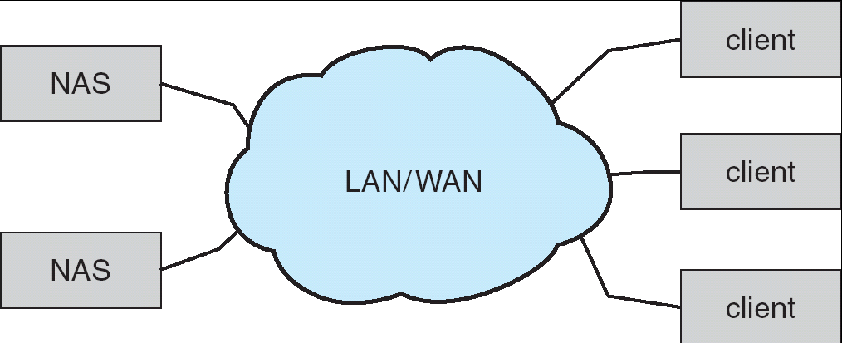
Network-Attached Storage
Network-attached storage (NAS) is storage made available over a network rather than over a local connection (such as a bus)
NFS (Linux) and CIFS (Windows) are common protocols
New iSCSI protocol uses IP network to carry the SCSI protocol

Slide 8
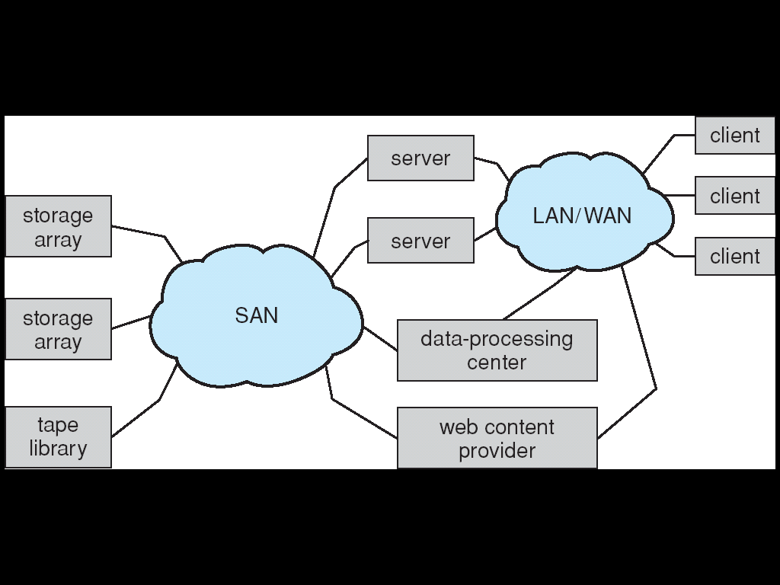
Storage Area Network
Storage Area Network (SAN): a specialized, high-speed network that provides block-level network access to storage
Common in large storage environments (becoming more common)
Multiple hosts attached to multiple storage arrays - flexible

Slide 9
Disk Scheduling
OS responsible for using hardware efficiently — for the disk drives, this means having a fast access time and disk bandwidth
Disk bandwidth: the total number of bytes transferred, divided by the total time between the first request for service and the completion of the last transfer
Access time has two components: Seek time + Rotational latency
Minimize seek time
Seek time ≈ seek distance
Notes:
Seek time is the time for the disk to move the heads to the cylinder containing the desired sector.
Rotational latency is the additional time waiting for the disk to rotate the desired sector to the disk head.

Slide 10
Disk Scheduling
Different algorithms to schedule the service of disk I/O requests
We illustrate them with a request queue (cylinder #):
98, 183, 37, 122, 14, 124, 65, 67
Head pointer 53

Slide 11
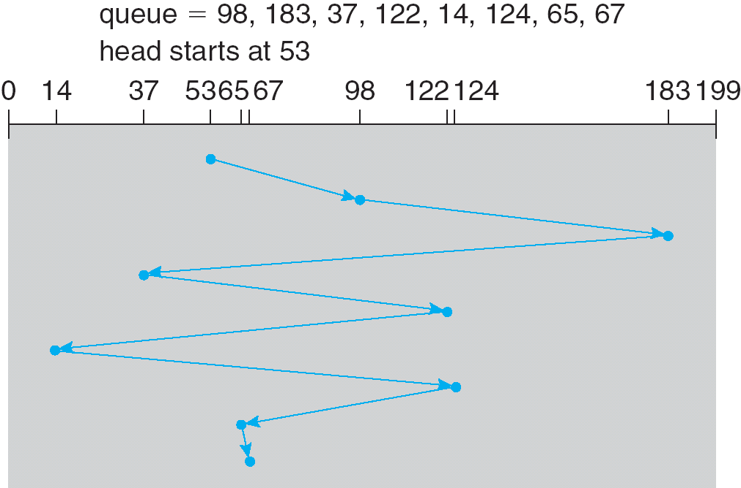
FCFS
First Come First Service (FCFS)
|98-53| = 45
|183-98| = 85
|37-183| = 146
|122-37| = 85
|14-122| = 108
|124-14| = 110
|65-124| = 59
|67-65| = 2
total head movement of 640 cylinders

Slide 12
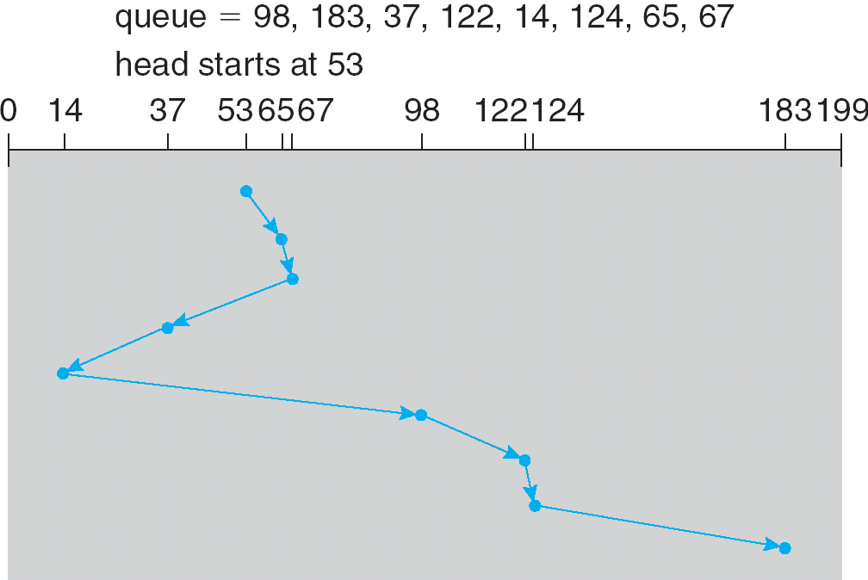
SSTF
Shortest Seek Time First (SSTF)
Selects the request with minimum seek time from current head position
May cause starvation of some requests
total head movement of 236 cylinders

Slide 13
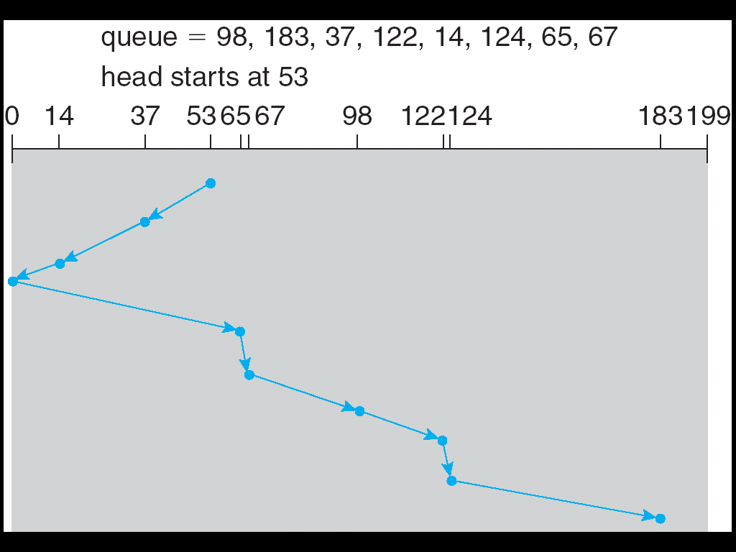
SCAN
Also called the elevator algorithm
Arm starts at one end, and moves toward the other end, servicing requests until it gets to the other end, then moves back and servicing continues.
total head movement of 236 cylinders.

Slide 14
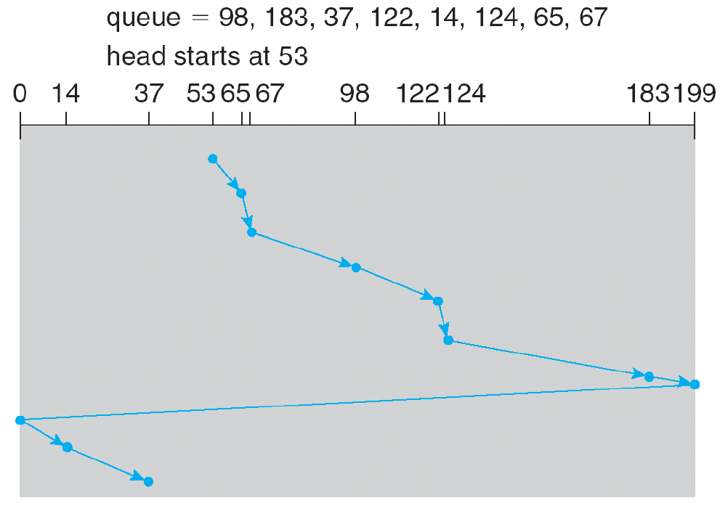
C-SCAN
The head moves from one end of the disk to the other. servicing requests as it goes. When it reaches the other end, however, it immediately returns to the beginning of the disk,
Notes:
Treats the cylinders as a circular list that wraps around from the last cylinder to the first one.

Slide 15
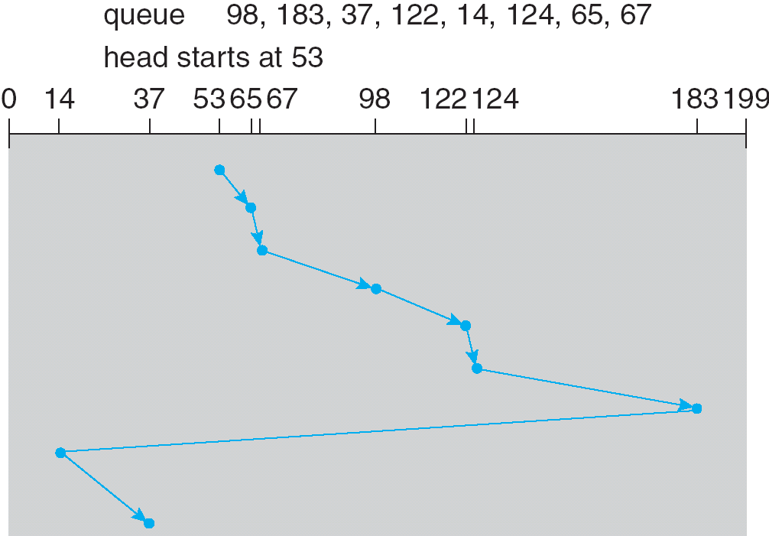
C-LOOK
Variant of C-SCAN
Arm only goes as far as the last request in each direction, then reverses direction immediately, without first going all the way to the end of the disk.

Slide 16
Selecting a Disk-Scheduling Algorithm
SSTF is common and has a natural appeal
But may cause starvation
SSTF or C-LOOK is a reasonable choice for default algorithm
SCAN and C-SCAN perform better for systems that place a heavy load on the disk
Performance depends on the number and types of requests
Requests for disk service influenced by the file-allocation method
Disk-scheduling should be a separate module of OS, allowing it to be replaced with a different algorithm if necessary

Slide 17
Disk Formatting
Low-level formatting (physical formatting): Dividing a disk into sectors that the disk controller can read and write
To use a disk to hold files, the OS still needs to record its own data structures on the disk
Partition the disk into one or more groups of cylinders
Logical formatting or “making a file system”
Methods such as sector sparing used to handle bad blocks
Maintaining a spare sector per track
After detecting a bad write, the data are written into the spare sector and marks the bad sector as unusable

Slide 18
Solid State Disk
SSD: Solid State Disk
uses integrated circuit assemblies to store data persistently, typically using flash memory
Compared with HDD, SSDs are typically more resistant to physical shock, run silently, and have quicker access time and lower latency

Slide 19
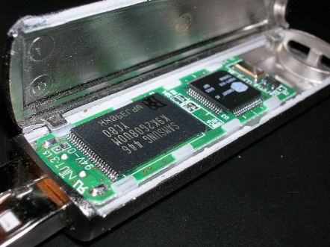
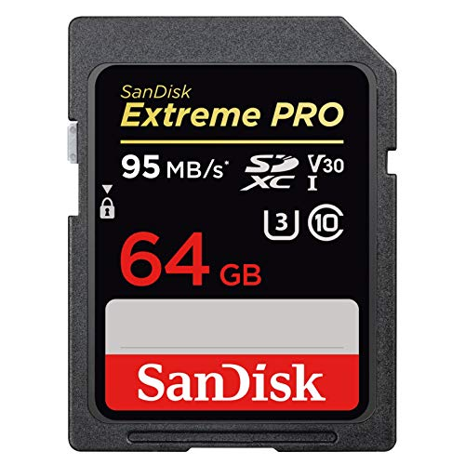


Flash Memory
Toshiba developed flash memory in the 1980s
Two main types of flash memory: NAND (for data) and NOR (for code)
Started to be heavily used because of digital cameras
Exponential growth with smartphones/tablets

Slide 20
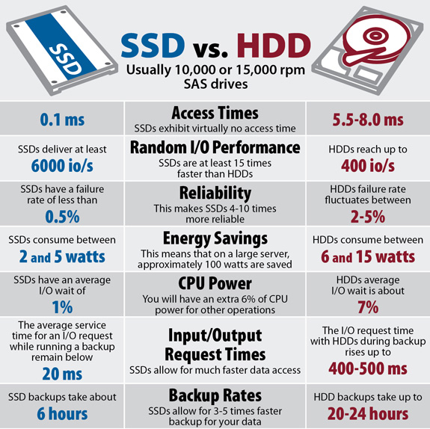
Comparison of SSD and HDD

Slide 21
Flash Cell Organization
BL
BL
BL
BL
BL
BL
Control Gate
Source Gate Line
Gate Oxide
WL 3
Page: 4 K to 32 KB
For read and write
21
One page
e
e
e
e
WL 2
Floating Gate
WL 1
Tunnel Oxide
WL 0
S
D
Substrate
Source Gate Line
Source Line
Floating-Gate Cell
Block: 64 to 1024 pages
For erase

Slide 22
Garbage Collection
Three basic operations: read, write (page) and erase (block)
Out-of-place update
Garbage collection to reclaim space
To get continuous space
Example:
Write page 0 and 1
Update page 0
Write page 2 and 3
Update page 2
Garbage collection on block 1
Block 1
Block 2
clean
Page 0
Page 1
Page 1
Page 0
valid
Page 0
Page 3
Page 2
Page 2
invalid
Page 3
Page 2

Slide 23
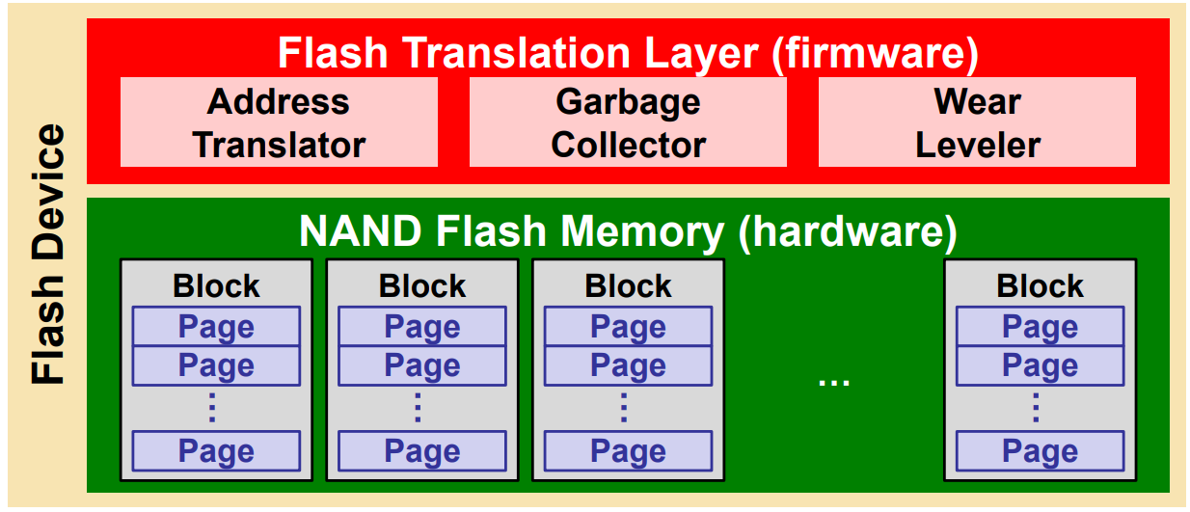
Flash Translation Layer (FTL)
Flash Memory
Erase-before-write
Random writes inside a block is less efficient
Limited program/erase (P/E) cycle
Flash Translation Layer (FTL) is a firmware inside the flash device to make the NAND flash memory to “appear as” a block device
Address translator
Garbage collector
Wear leveler

Slide 24
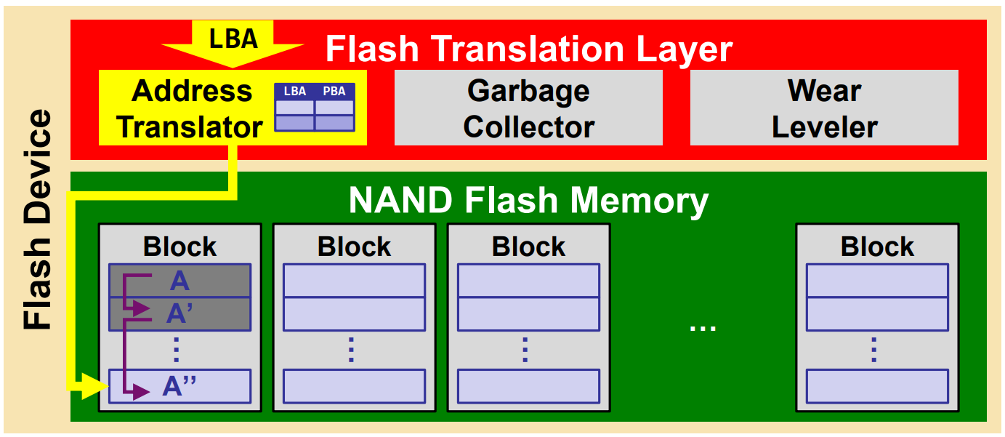
Address Translator
Address translator maps logical block addresses (LBAs) from the host to physical page addresses (PPAs) in flash
The mapping table is kept in the memory space of the flash device
Out-place update is adopted to write the updated data to free pages

Slide 25
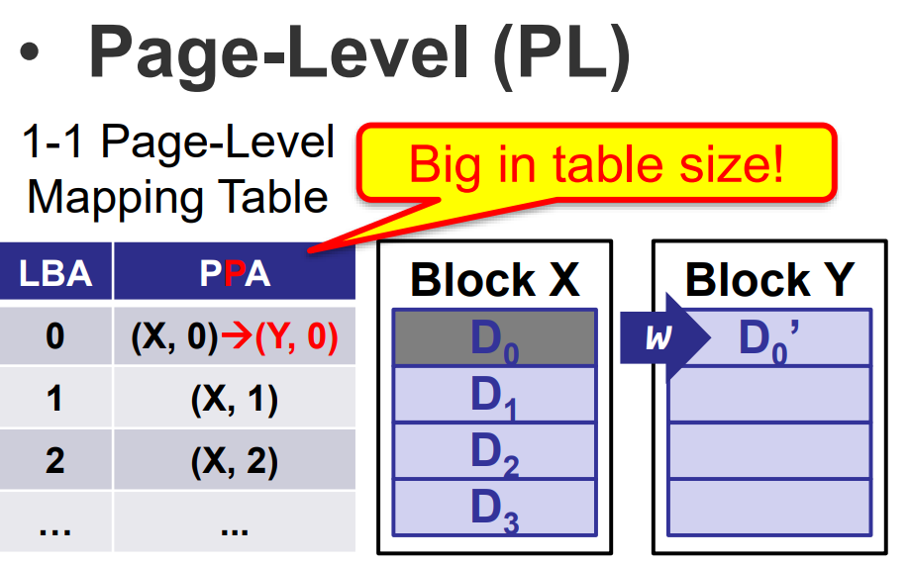
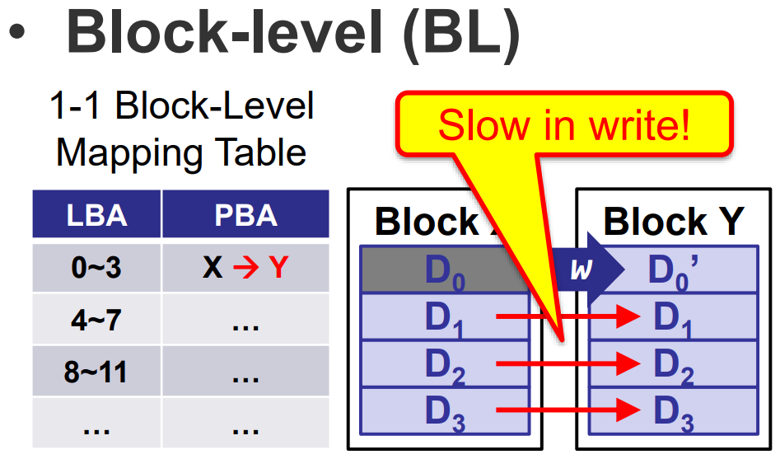
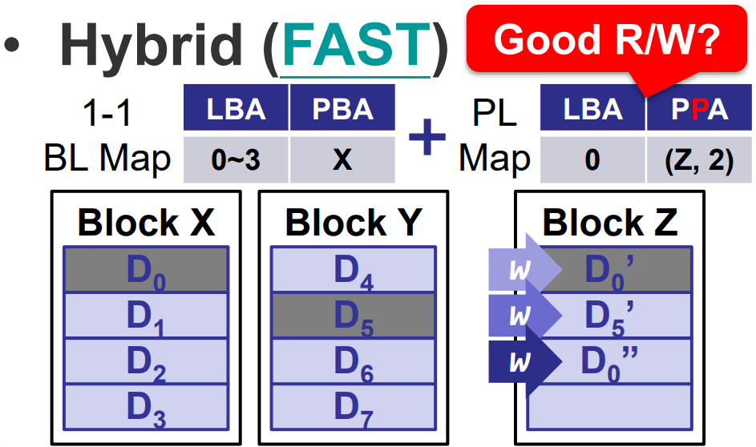
Page-Level, Block-Level, and Hybrid

Slide 26
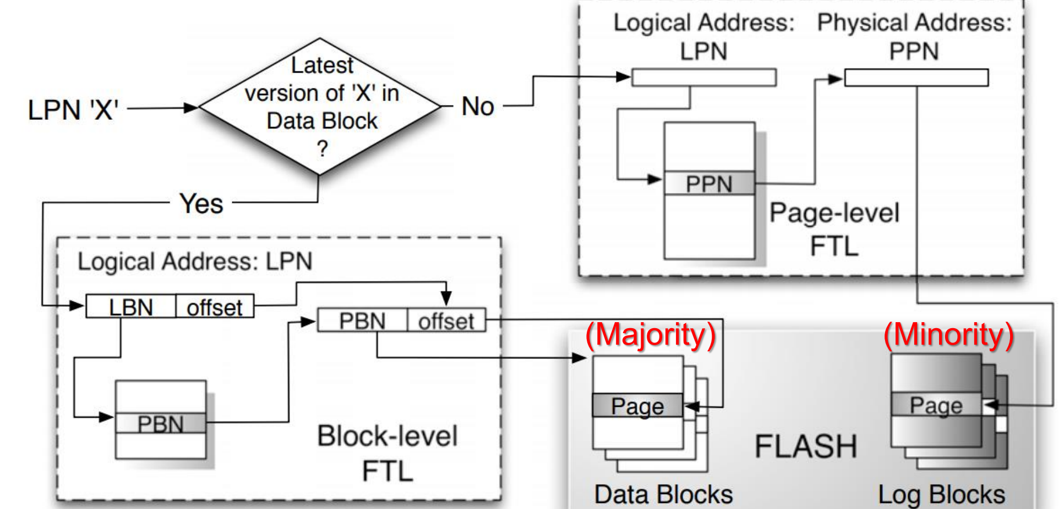
The Hybrid Approach
Hybrid FTLs logically partition blocks into two groups
Data Blocks are mapped via block-level mapping
Log/Update Blocks are mapped via page-level mapping
Any update on data blocks are performed by writes to the log blocks

Slide 27
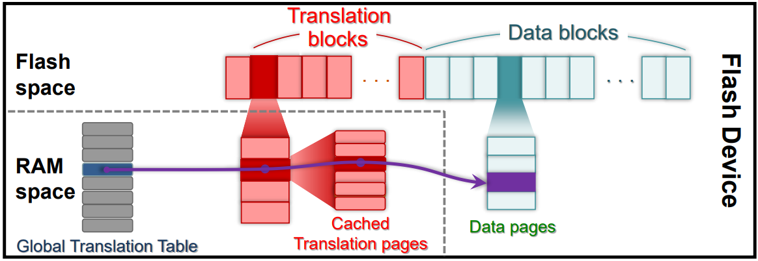
Demand-based Address Translation
Keeping all mapping tables in RAM is ineffective
Page-level translation for all data with limited RAM
Map of data pages are stored in translation pages on flash
Translation pages are cached in RAM on demand
Map of translation pages (i.e., global translation table) are kept in RAM for efficient lookup

Slide 28
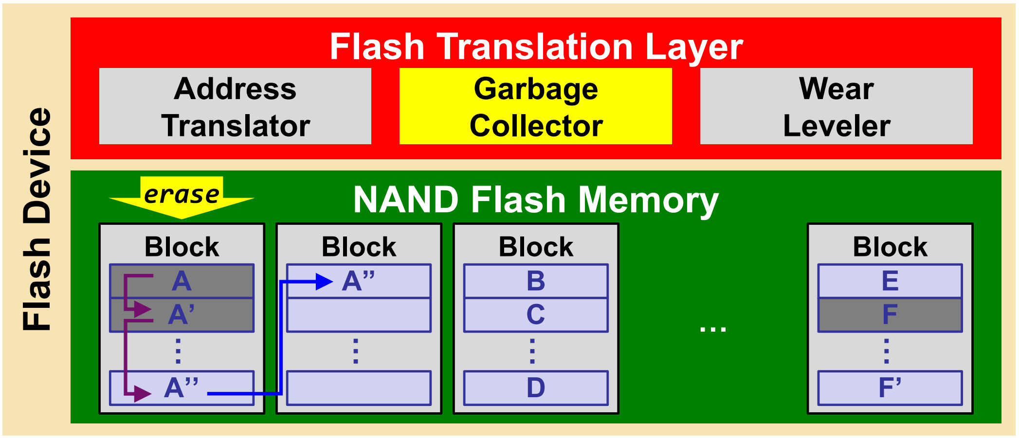
Garbage Collector
Since the out-place update leaves multiple versions of data, the garbage collector is to reclaim pages occupied by stale data by erasing its residing blocks
The live-page copying is needed to migrate pages of the latest versions of data before the erase operation

Slide 29
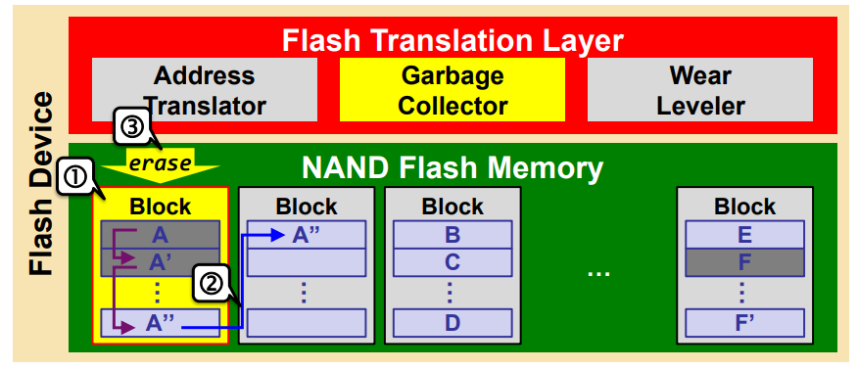
Typical GC Procedure
Victim Block Selection: Pick one (or more) block that is “most worthy” to be reclaimed
Live-Page Copying: Migrate all live pages out
Victim Block Erasing: Reclaim the space occupied by dead pages

Slide 30
Typical Victim Block Selection Policies
Random selects the victim block in a uniformly random manner to yield a long-term average use
Round-Robin cleans blocks in a round-robin manner for minimized P/E cycle difference
Greedy cleans the block with the largest number of dead pages for minimized live-page copying
Cost-Benefit (CB) (and its variants) cleans the block with the largest benefit-cost for wear leveling
Balance between live-paging copy cost and wear leveling

Slide 31
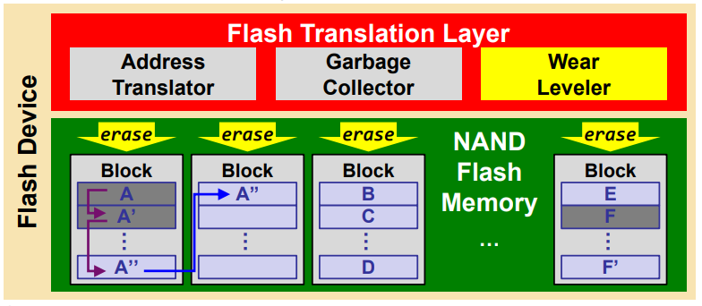
Wear Leveling
Each block can only endure a limited number of P/E cycles, wear leveling is to prolong the overall lifetime by evenly distributing erases
The main objective is to prevent any flash block from being worn out “prematurely” too much earlier than others

Slide 32
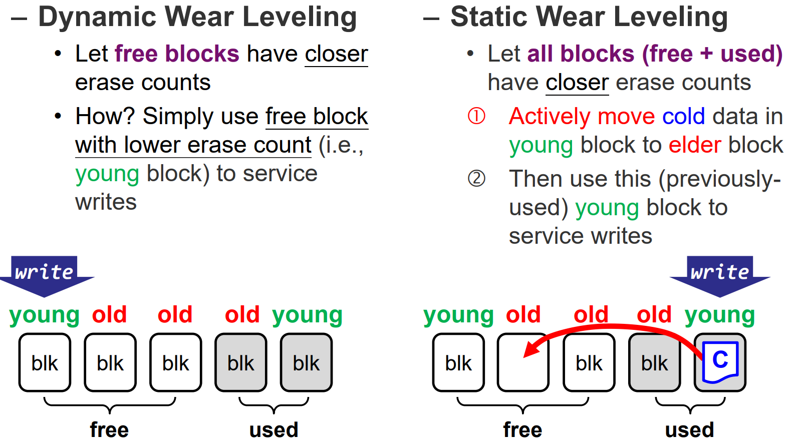
Dynamic vs. Static Wear Leveling
Wear leveling is classified into static or dynamic based on the type of blocks involved

Slide 33
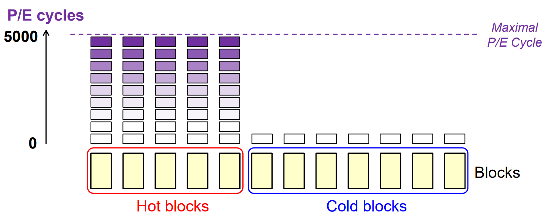
Dynamic Wear Leveling (DWL)
DWL achieves wear leveling only for hot blocks
Hot Block: a block mainly containing hot data
Cold Block: a block mainly containing cold data
Hot blocks will be worn out earlier than cold blocks

Slide 34
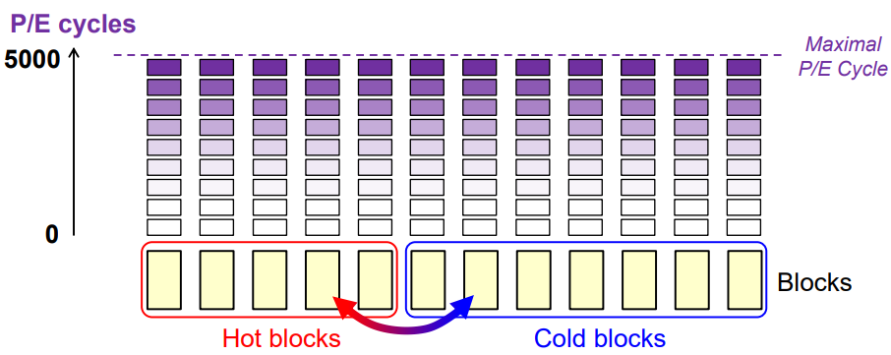
Static Wear Leveling (SWL)
SWL achieves wear leveling for all blocks by proactively moving cold data to young blocks
Extra data migrations are introduced
Performance is traded for lifetime/endurance

Slide 35
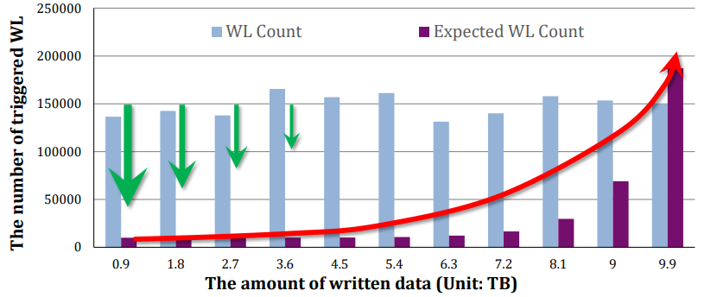
Progressive Wear Leveling (PWL)
When, and how often WL should be performed?
WL should be performed in a progressive way
Prevent WL in the early stages for better performance
Progressively trigger WL to prolong lifetime
More and more WLs are performed over time

Slide 36
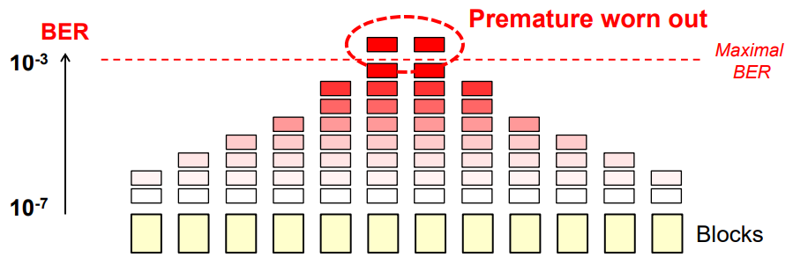
Error-Rate-Aware Wear Leveling
Key Observations: Flash is not perfect!
P/E cycles might inaccurately reflect the reliability of flash
Blocks might have different bit-error rates (BERs) when enduring the same P/E cycles due to process variation
BER could be a better metric to WL designs. – The error correction hardware can report BER to FTL

Slide 37
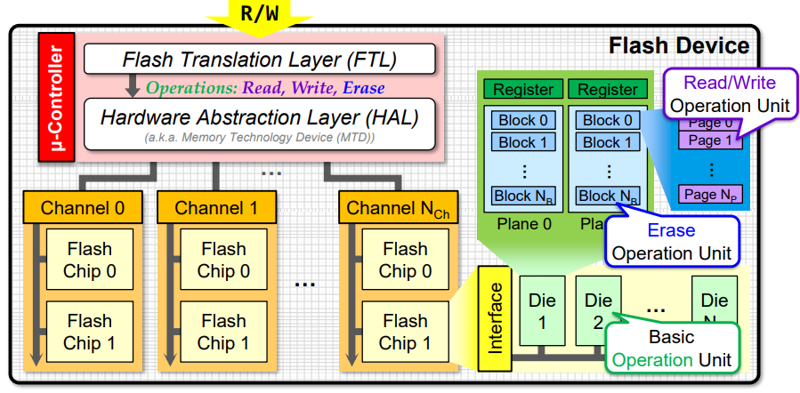
Multilevel I/O Parallelism
The internal of flash devices is highly hierarchical
Channel → Chip → Die → Plane → Block → Page
Multiple I/O operations can be performed concurrently

Slide 38
Flash-aware File System
Random writes are bad to flash devices
Free space fragmentation
Degraded performance (due to GC)
Reduced lifetime (due to GC)
Writes must be reshaped into sequential writes
Most flash-aware file systems are derived from LFS (Log-structured file system)
Journaling Flash File System (JFFS)
Yet Another Flash File System (YAFFS)
Flash-Friendly File System (F2FS): since Linux 3.8

Slide 39
Update Propagation
Inode
Map
Dir Inode
Directory data
File Inode
File data
…
File data
Indirect
Pointer block
Direct
Pointer block

Slide 40
Flash-aware Index Structure
Restrained update propagation
NAT
Node Address Table
Dir Inode
Directory data
File Inode
File data
…
File data
Referenced via NAT
Referenced via NAT
Indirect
Pointer block
Direct
Pointer block

Slide 41
Final Exam
Final exam:
2023 May. 6, 14:00-16:00
Similar form to midterm
Closed-book, paper-based
Calculator allowed
No computer/software
Scope: all lectures and tutorials

