Slide 1
CS3103 Operating System 2023/2024 Sem B
Chapter 2: Process
Dr. Nan Guan
Department of Computer Science
City University of Hong Kong

Slide 2
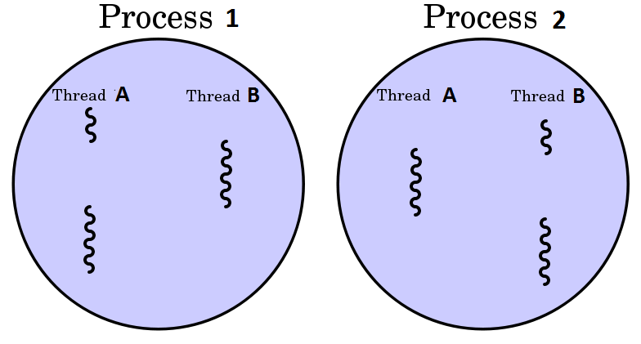
Process and Thread
Process:
a program in execution
Thread:
A thread is the unit of execution within a process

Slide 3
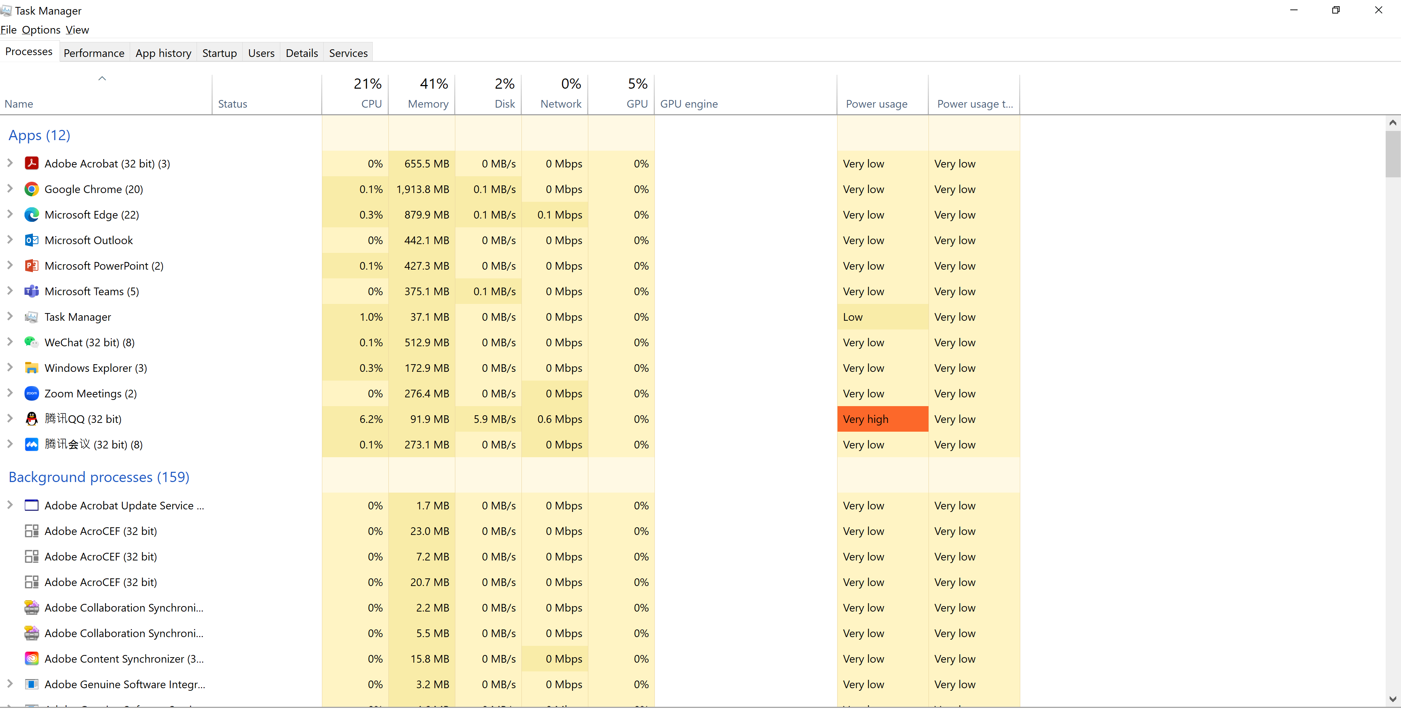
Process

Slide 4
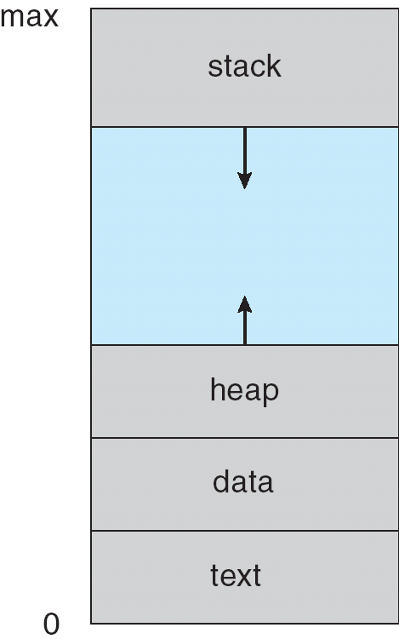
Process
Process – a program in execution
A process includes
program counter
stack
data section
…
Memory layout of a process

Slide 5
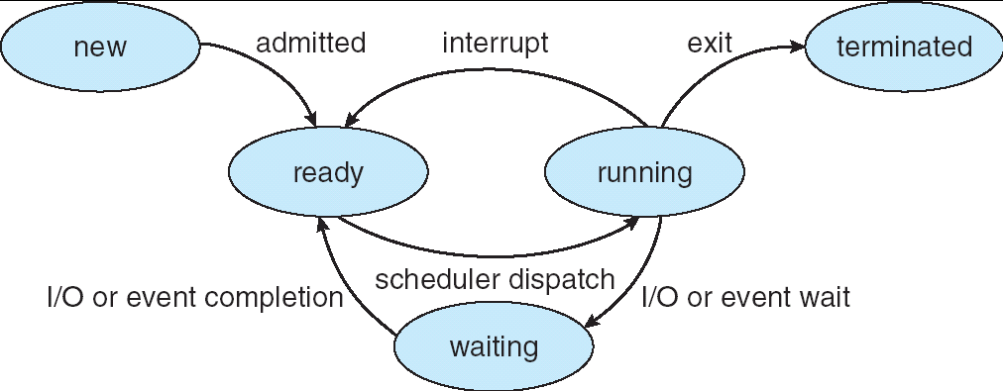
Process State
As a process executes, it changes state
new: The process is being created
ready: The process is waiting to be assigned to CPU
running: Instructions are being executed
waiting: The process is waiting for some event to occur
terminated: The process has finished execution

Slide 6
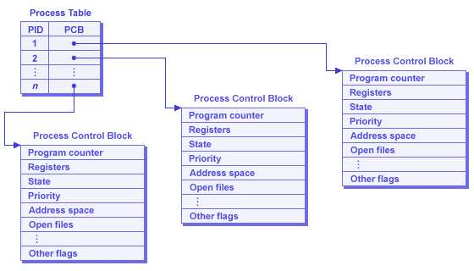
Process Control Block (PCB)
Each process is represented in OS by a Process Control Block (PCB)
Also called a task control block
Information recorded in OS for each process
Process ID (PID)
Process state
Program counter
Register values
CPU scheduling information (e.g., priority)
List of open files
I/O status information
… …

Slide 7
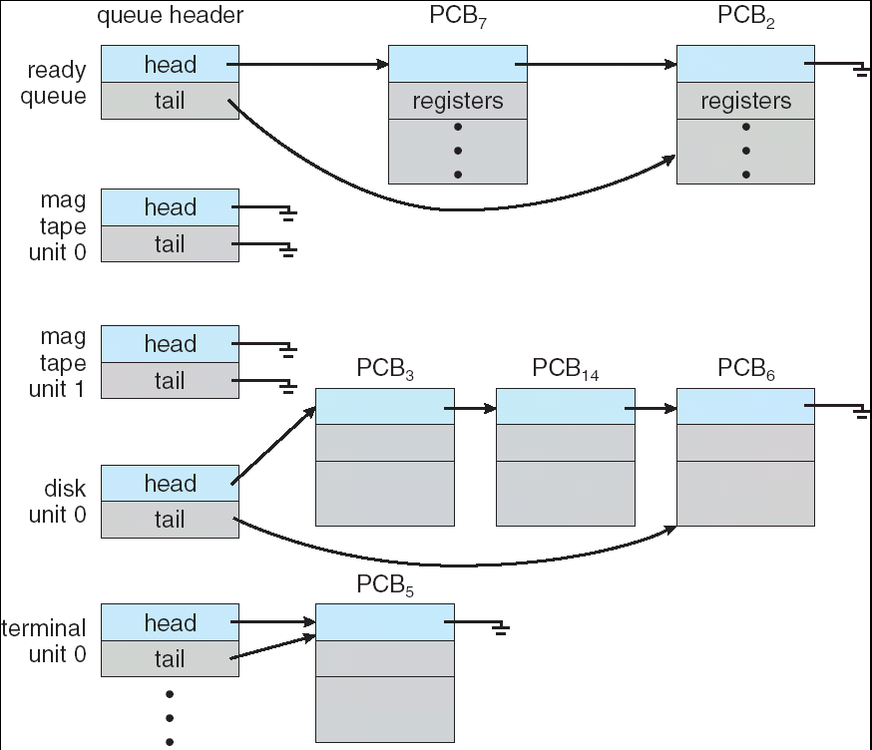
Process Scheduling
Several queues are involved in the scheduling of processes
Job queue – set of all processes in the system
Ready queue – set of all processes residing in main memory, ready and waiting to execute
Device queues – set of processes waiting for an I/O device
Processes migrate among these queues
Notes:
Different possibilities to implement these queues

Slide 8
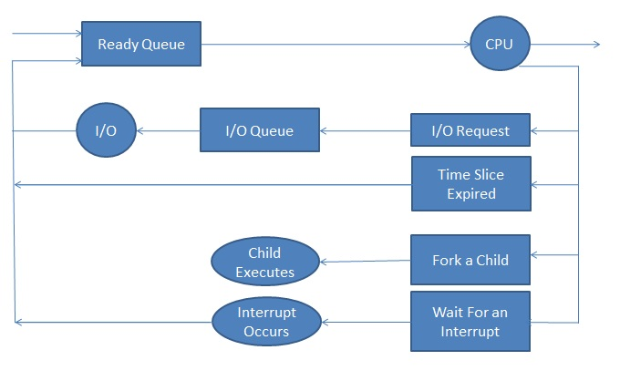
Process Scheduling

Slide 9
Scheduler
Long-term scheduler (or job scheduler) – selects which processes should be brought into the ready queue
Invoked infrequently (seconds, minutes)
To arrange the execution of some job at some time
Controls the degree of multiprogramming
Short-term scheduler (or CPU scheduler) – selects which process should be executed next and allocates CPU
Invoked frequently (milliseconds)
To create concurrency; switching must be sufficiently fast

Slide 10
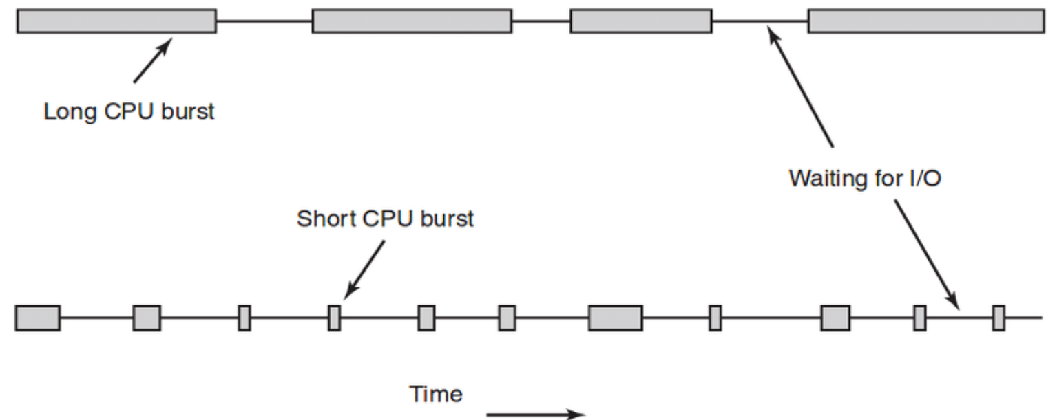
CPU-bound vs I/O-bound
Processes can be classified into
CPU-bound process: spends more time doing computations
Few long CPU bursts
I/O-bound process: spends more time doing I/O than computations
Many short CPU bursts
CPU-bound process
I/O-bound process

Slide 11
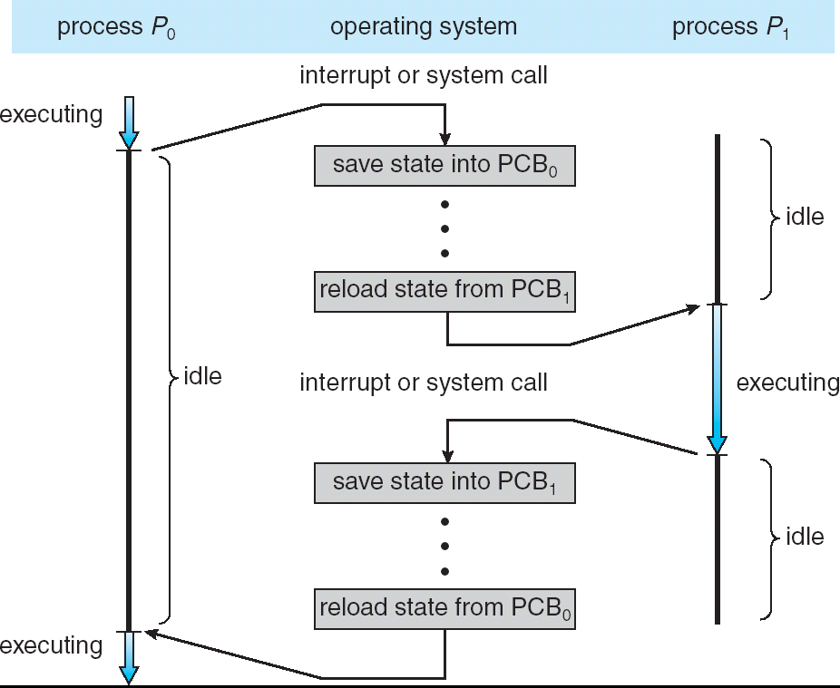
Context Switch
When CPU switches to another process, the system must save the state of the old process and load the saved state for the new process
Context-switch time is overhead; does no useful work while switching
Time dependent on hardware support

Slide 12
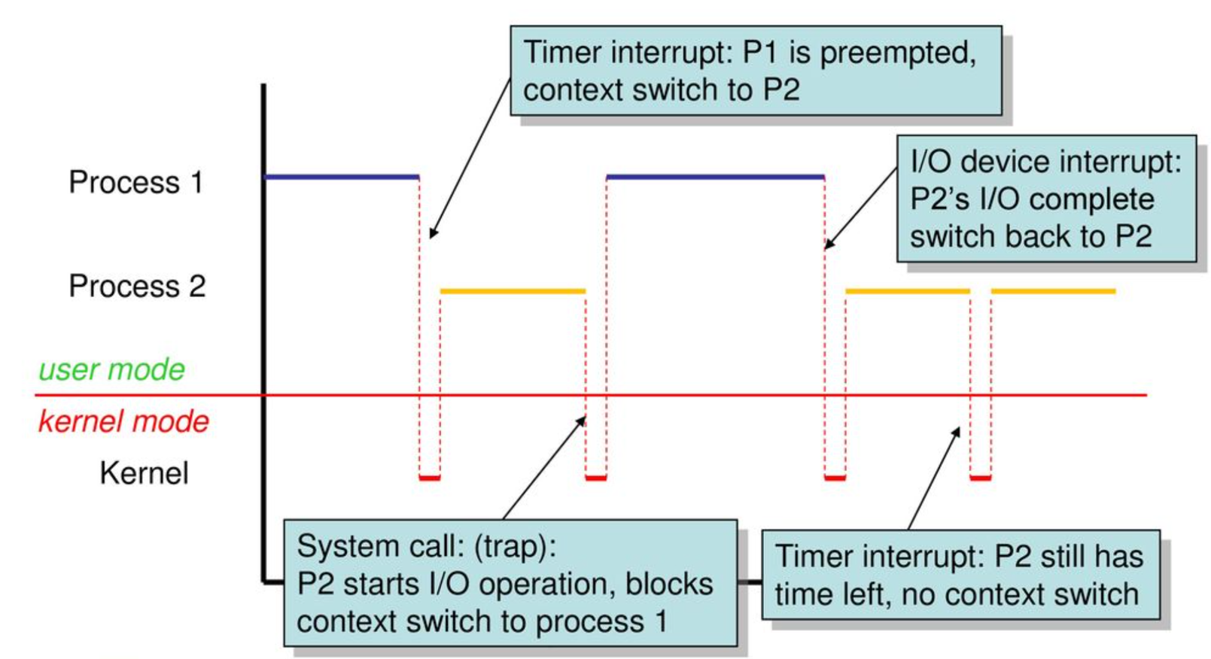
Context Switch
A context switch scenario example

Slide 13
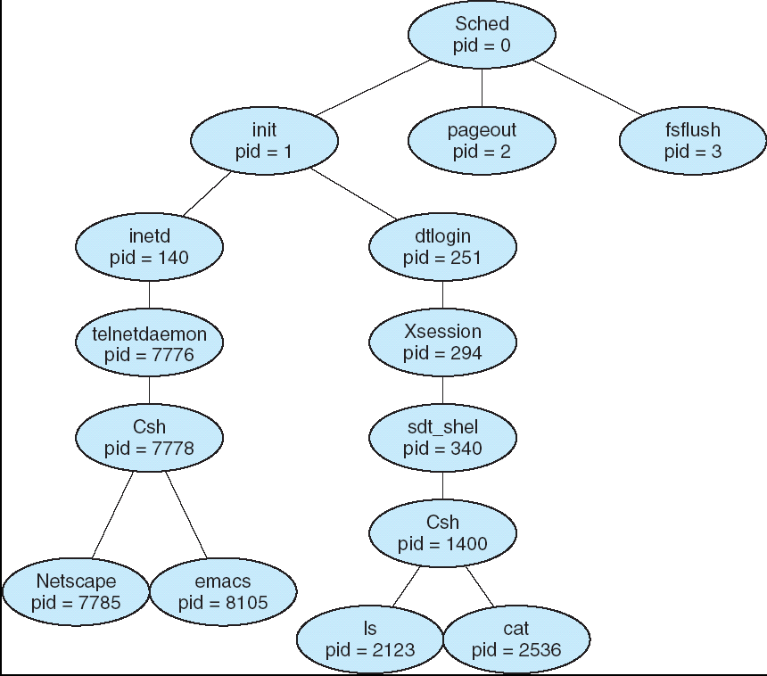
Process Tree
Unix Example:

Slide 14
Process Creation
Child may duplicate parent’s memory space, or load new memory contents (in particularly, load a new program)
UNIX examples
fork system calls creates new process
The return value of fork():
In the parent process: the process ID (PID) of the newly created child process
In the child process: 0
exec system calls used after a fork to replace the process’ memory space with a new program and execute
int main()
{
Pid_t pid;
/* fork another process */
pid = fork();
if (pid < 0) { /* error occurred */
fprintf(stderr, "Fork Failed");
exit(-1);
}
else if (pid == 0) { /* child process */
execlp("/bin/ls", "ls", NULL);
}
else { /* parent process */
/* parent wait for the child to complete */
wait (NULL);
printf ("Child Complete");
exit(0);
}
}

Slide 15
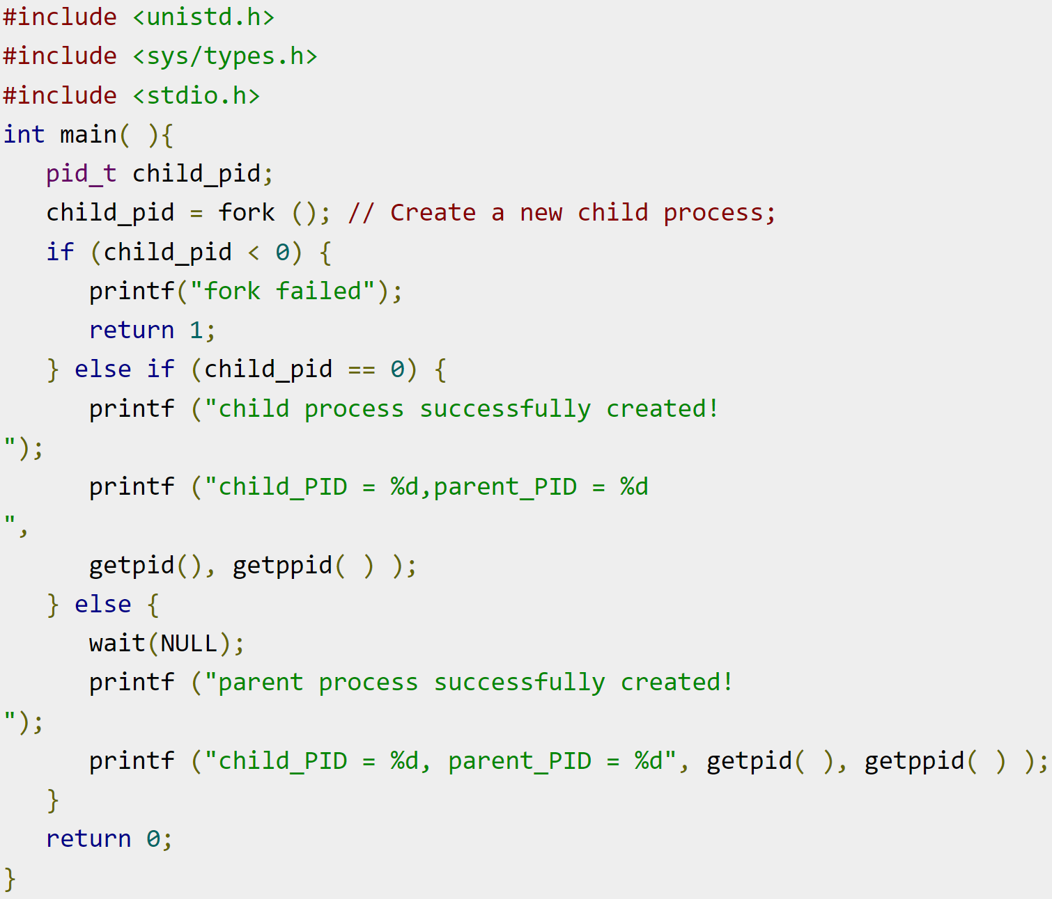
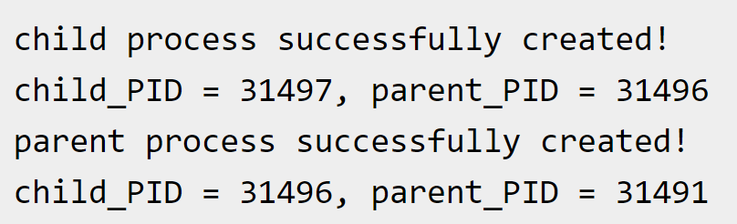
Process Creation
Parent process creates children processes
Result

Slide 16
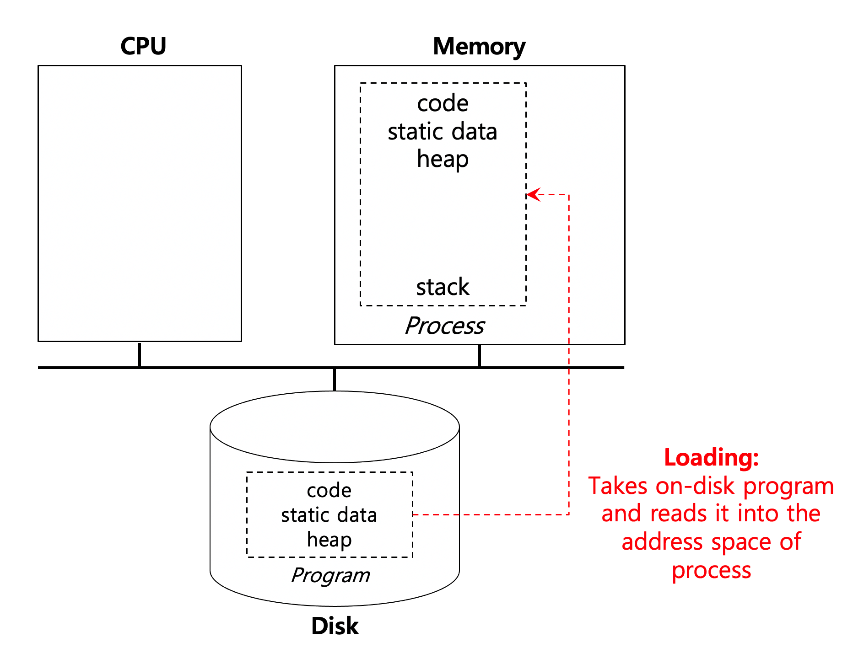
Process Creation
Steps:
Load a program code into memory.
Programs initially reside on disk in executable format.
OS perform the loading process lazily.
Loading pieces of code or data only as they are needed during program execution.
The program’s run-time stack is allocated.
Use the stack for local variables, function parameters, and return address.
Initialize the stack with arguments → argc and the argv array of main() function

Slide 17
Process Creation
The program’s heap is created.
For explicitly requested dynamically allocated data.
Program request such space by calling malloc() and free it by calling free().
The OS does some other initialization tasks.
E.g., input/output (I/O) setup
Each process by default has three open file descriptors.
Standard input, output and error
Start the program running at the entry point, namely main().
The OS may transfer control of the CPU to the newly-created process.

Slide 18
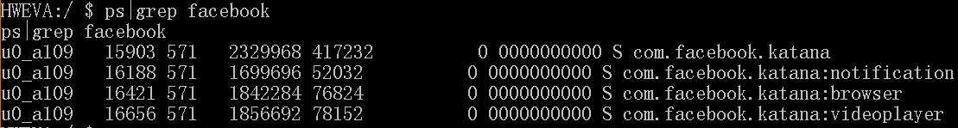
Example: Process on Android
By default, every app runs in its own Linux process
When launching Twitter, there is one process
When playing AngryBird, there is one process
Some application may use several processes
When using Facebook, there are four processes

Slide 19
Process Termination
Process executes last statement and asks the OS to delete it (exit)
Output data from child to parent (wait)
Process’ resources are de-allocated by OS
Parent may terminate execution of children processes (abort)
Happens when
Child has exceeded allocated resources
Task assigned to child is no longer required
If parent is exiting
Some OS does not allow child to continue if its parent terminates
All children terminated - cascading termination

Slide 20
Processes Cooperation
Independent process cannot affect or be affected by the execution of another process
Cooperating process can affect or be affected by the execution of another process
Advantages of process cooperation
Information sharing
Computation speed-up
Modularity
…

Slide 21
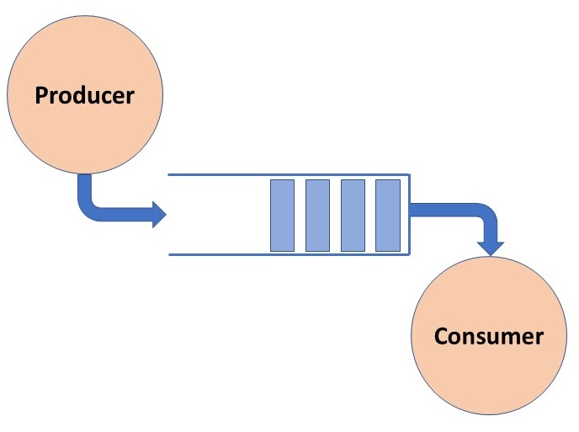
Producer-Consumer Problem
Producer produces information that is consumed by Consumer
unbounded-buffer places no practical limit on the size of the buffer
bounded-buffer assumes that there is a fixed buffer size

Slide 22
Interprocess Communication (IPC)
Mechanism for processes to communicate and synchronize
Message system – processes communicate with each other without resorting to shared variables
IPC facilities provide two operations
send(message)
receive(message)
If P and Q wish to communicate, they need to
establish a communication link between them
exchange messages via send/receive
message size fixed or variable

Slide 23
Implementation Issues
How are links established?
Can a link be associated with more than two processes?
How many links can there be between every pair of communicating processes?
What is the capacity of a link?
Is the size of a message that the link can accommodate fixed or variable?
Is a link unidirectional or bi-directional?
…

Slide 24
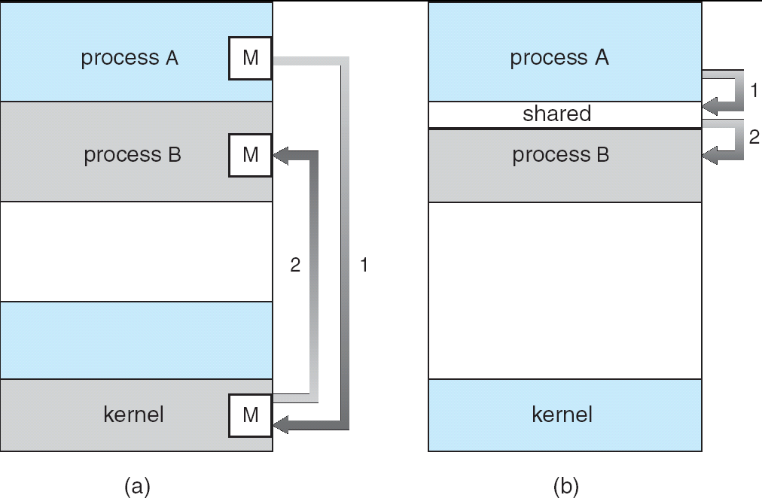
Communication Models
(a) Message passing (b) Shared memory

Slide 25
Communication Models
Message Passing Model | Shared Memory Model
Message passing facility is used for communication. | Shared memory region is used for communication.
It can be used in a distributed environment where communicating processes reside on remote machines connected through a network. | It is used for communication between processes on a single processor or multiprocessor systems where the communicating processes reside on the same machine.
OS provides mechanism for communication and synchronization of actions performed by the communicating processes. | Need the programmer to write programs to explicitly coordinate the access of data by different processes.
It is time consuming as message passing is implemented through kernel intervention (system calls). | It provides maximum speed of computation as communication is done through shared memory so system calls are made only to establish the shared memory.

Slide 26
Direct Communication
Processes must name each other explicitly:
send(P, message) – send a message to process P
receive(Q, message) – receive a message from process Q
Properties of communication link
Links are established automatically
A link is associated with exactly one pair of communicating processes
Between each pair there exists exactly one link
The link may be unidirectional, but is usually bi-directional

Slide 27
Indirect Communication
Messages are directed and received from mailboxes (also referred to as ports)
Each mailbox has a unique id
Processes can communicate only if they share a mailbox
Properties of communication link
Link established only if processes share a common mailbox
A link may be associated with many processes
Each pair of processes may share several communication links
Link may be unidirectional or bi-directional

Slide 28
Indirect Communication
Mailbox operations
create a new mailbox
send and receive messages through mailbox
destroy a mailbox
Primitives are defined as:
send(A, message) – send a message to mailbox A
receive(A, message) – receive a message from mailbox A

Slide 29
Indirect Communication
Mailbox sharing
P₁, P₂, and P₃ share mailbox A
P₁, sends; P₂ and P₃ receive
Who gets the message?
Possible choices:
Allow a link to be associated with at most two processes
Allow only one process at a time to execute a receive operation
Allow the system to select arbitrarily the receiver. The sender is notified of who the receiver was

Slide 30
Synchronization
Message passing may be either blocking or non-blocking
Blocking is considered synchronous
Blocking send has the sender block until the message is received
Blocking receive has the receiver block until a message is available
Non-blocking is considered asynchronous
Non-blocking send has the sender send the message and continue
Non-blocking receive has the receiver receive a valid message or null

Slide 31
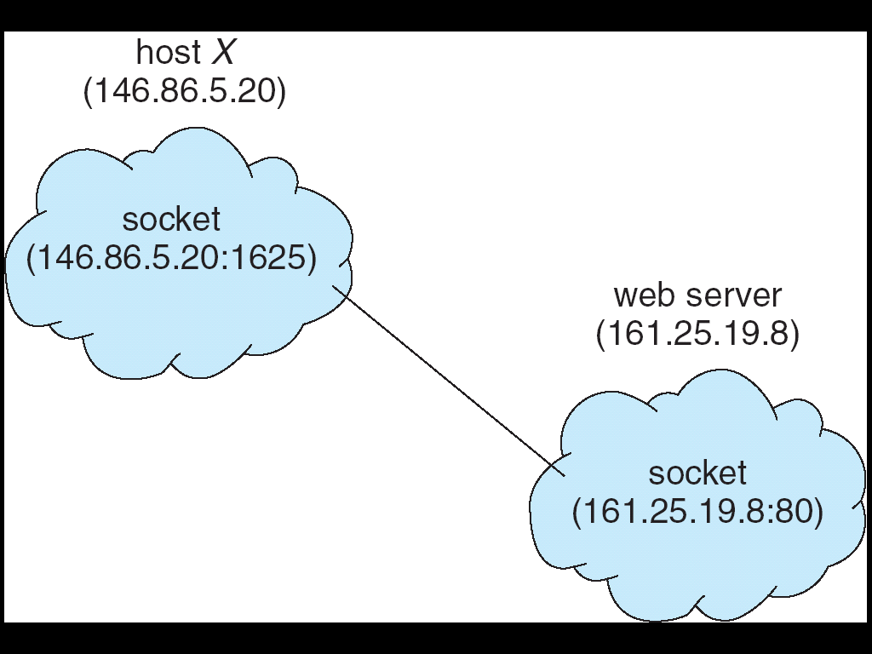
Client-Server Communication
Internet sockets
A socket is defined as an endpoint for communication
Concatenation of IP address and port
The socket 161.25.19.8:1625 refers to port 1625 on host 161.25.19.8
Unix sockets
Use essentially the same function calls as Internet sockets
all communication occurs entirely within the OS kernel, instead of using an underlying network protocol
two-way FIFO queues

Slide 32
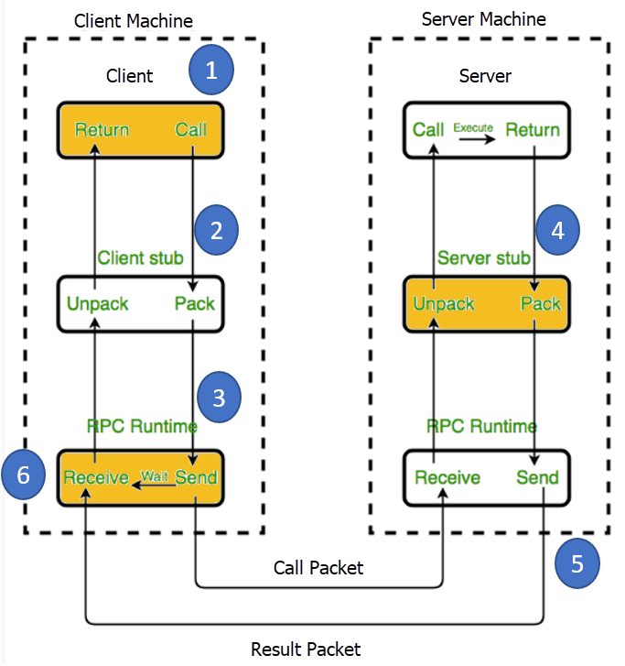
Remote Procedure Calls (RPC)
RPC abstracts procedure calls between processes on networked systems
The client-side stub locates the server and marshalls the parameters
The server-side stub receives this message, unpacks the marshalled parameters, and performs the procedure on the server

